Slide 1
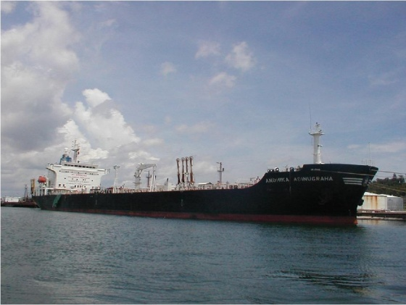
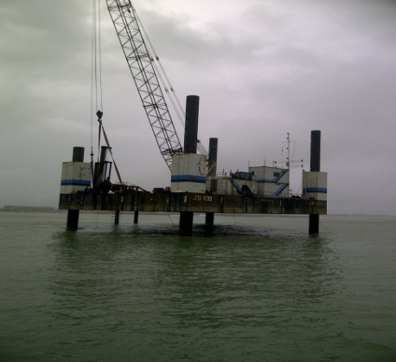
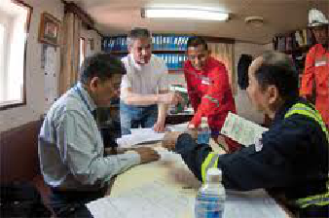

SHIP AGENCY DIVISION
PLANNING 2014
Function : Ship Agency Division
PIC : Toto Sugeng Suharto
18 October 2013

Slide 2
STRATEGIC THEME 2014
Enhance Customer
& Employee Satisfaction,
Cost Efficiency,

Slide 3
KPI PERFORMANCE PLAN 2014
NO
PERSPECTIVE
KPI
WEIGHT (%)
TARGET
UNIT
1.
Finance
1. Revenue
10%
16.8 M
Rupiah
2. Gross margin
10%
50
%
3. Return on Capital Employment
5%
1000 Jt
Rupiah / Employee
4. Employee Contribution to Revenue
5%
459 Milion
Rupiah / Employee
2.
Customer
5. Customer satisfaction
10%
80
%
6. Customer Complain
10%
ZERO
Complain
7. Increase New Customer
5%
4
Customer / Year

Slide 4
KPI PERFORMANCE PLAN 2014
NO
PERSPECTIVE
KPI
WEIGHT (%)
TARGET
UNIT
3.
Internal Process
8. Coordination Meeting & Safety Talk
5%
2
Major NC
9. Customer Response
5%
2
Incident
10. Incident
10%
ZERO
Incident
11. Environmental incident
10%
ZERO
Incident
4.
Learning & Growth
12. Training
5%
3
Days / Employee
13. Employee Satisfaction Index
10%
75
%
TOTAL
100%
Keterangan :
Jika KPI Customer Satisfaction ≤ 60%, maka KPI Score dinyatakan gagal.
Jika terdapat Major Customer Complaint (berupa surat tertulis, delayed service, dan
Keluhan langsung dari Direktur Customer), maka KPI Score tersebut dinyatakan gagal.

Slide 5
KPI ACTION PLAN 2014
NO | PERSPECTIVE | KPI | TARGET | ACTIVITY / ACTION PLAN | DUE DATE | PIC
1. | Finance | 1. Revenue | Rp. 17 Billion | Increase New Customer : Bidding Tender / Introduce our services / Searching New Customer / Customer Recommendation Increase Vessel Call : Visit to Customer / Entertainment / Improve our services | Dec 2014 | Ship Agency Division
 |  | 2. Gross margin | 50% | Cost Efficiency : Control Operation Cost / Negotiate with 3rd party (Local Agent) / Minimize other cost | Dec 2014 | Ship Agency Division
 |  | 3. AR Turn Over | 10 Times | Monitoring account receivable and improve process | Dec 2014 | Ship Agency Division
 |  | 4. Return on Capital Employment | Rp. 459 M/Emp | Targeted over achievement of budget 2014 | Dec 2014 | Ship Agency Division

Slide 6
KPI ACTION PLAN 2014
NO | PERSPECTIVE | KPI | TARGET | ACTIVITY / ACTION PLAN | DUE DATE | PIC
1. | Finance | 1. Revenue | Rp. 17 Billion | Increase New Customer : Bidding Tender / Introduce our services / Searching New Customer / Customer Recommendation Increase Vessel Call : Visit to Customer / Entertainment / Improve our services | Dec 2014 | Ship Agency Division
 |  | 2. Gross margin | 50% | Cost Efficiency : Control Operation Cost / Negotiate with 3rd party (Local Agent) / Minimize other cost | Dec 2014 | Ship Agency Division
 |  | 3. AR Turn Over | 10 Times | Monitoring account receivable and improve process | Dec 2014 | Ship Agency Division
 |  | 4. Return on Capital Employment | Rp. 459 M/Emp | Targeted over achievement of budget 2014 | Dec 2014 | Ship Agency Division

Slide 7
KPI ACTION PLAN 2014
NO | PERSPECTIVE | KPI | TARGET | ACTIVITY / ACTION PLAN | DUE DATE | PIC
2. | Customer | 5. Customer Satisfaction | 80% | Apply questionnaire customer satisfaction to each vessel | Dec 2014 | Ship Agency Division
 |  | 6. Customer Complain | Zero | Pro-active to all customer inquiries, response email less than 2 hours, keep communication 24 hours | Dec 2014 | Ship Agency Division
 |  | 7. Increase New Customer | 4 | Bidding Tender / Introduce our services / Searching New Customer / Customer Recommendation | Dec 2014 | Ship Agency Division

Slide 8
KPI ACTION PLAN 2014
NO | PERSPECTIVE | KPI | TARGET | ACTIVITY / ACTION PLAN | DUE DATE | PIC
3. | Internal Process | 8. Coordination meeting & safety talk | 2 Times/Mth | Consistent implementing to SOP | Dec 2014 | Ship Agency Division
 |  | 9. Customer Response | 2 hour | All Customer's email addressed to agency@andhika.com should be replay less than 2 hours in formal office hour | Dec 2014 | Ship Agency Division
 |  | 10 Incident | ZERO | Safety briefing before every single activities, safety first as priority | Dec 2014 | Ship Agency Division
 |  | 11. Environmental incident | ZERO | Follow the instructions safety awareness and comply with environmental awareness | Dec 2014 | Ship Agency Division
4. | Learning & Growth | 10. Training | 3 days/Emp | Attending external training program or internal sharing knowledge | Dec 2014 | Ship Agency Division
 |  | 11. Index | 75% | Increase gross revenue and profit margin | Dec 2014 | Ship Agency Division

Slide 9
YOUR TRUST IS OUR COMMITMENT

Slide 10
THANK YOU

