Slide 1
Airline Passenger Satisfaction pre-Processing and machine learning model prediction
Filippo Chiauzzi

Slide 2
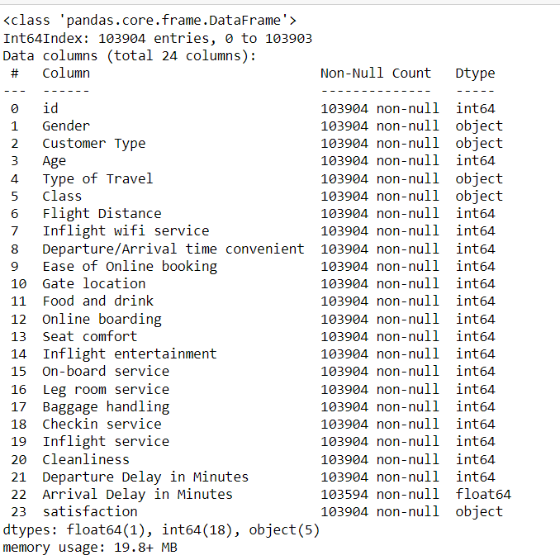
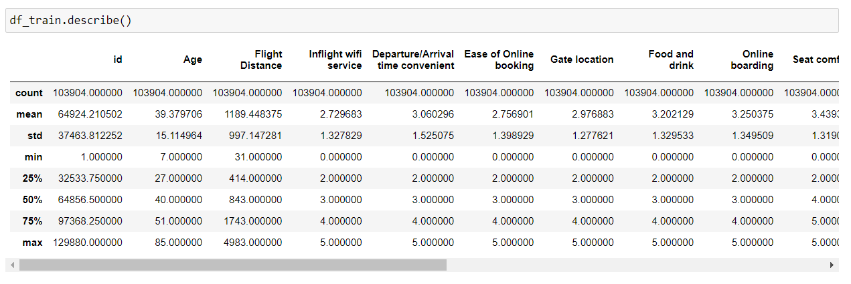
Train Data
103904 rows;
24 columns ;
1 index numerical colum ;
5 categorical columns ;
14 numericals discrete columns (range 1 to 5) ;
3 numericals continue columns ;
1 binary target column (0 neutral/dissatisfied, 1 satisfied).
Check missing values
Check outliers
First Summary Statistic approach as min, mean, and max value of each column as well as standar deviation end quantile

Slide 3
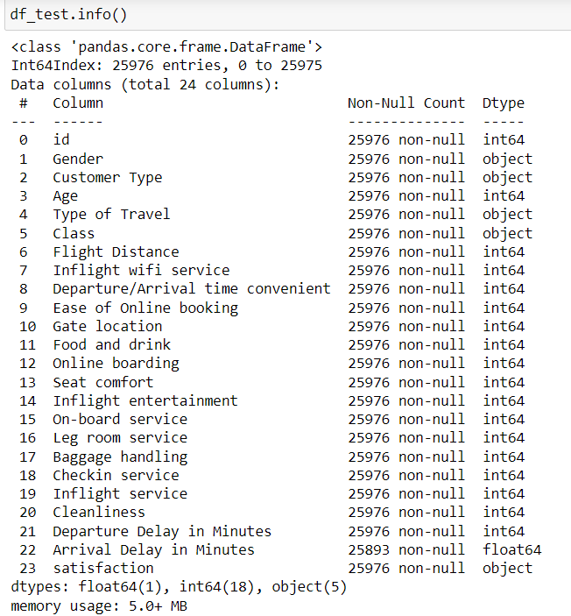
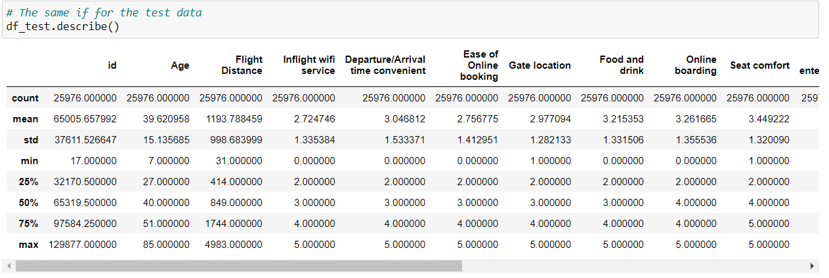
Test Data
25976 rows;
24 columns ;
1 index numerical colum ;
5 categorical columns ;
14 numericals discrete columns (range 1 to 5) ;
3 numericals continue columns ;
1 binary target column (0 neutral/dissatisfied, 1 satisfied).
Percentage of missingness
train dataframe:
"Arrival Delay in Minutes" column: 0.29%
Test dataframe:
"Arrival Delay in Minutes" column: 0.32 %

Slide 4
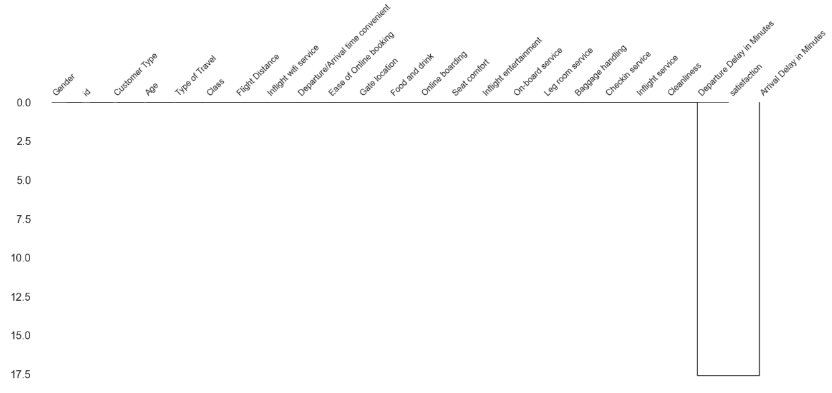
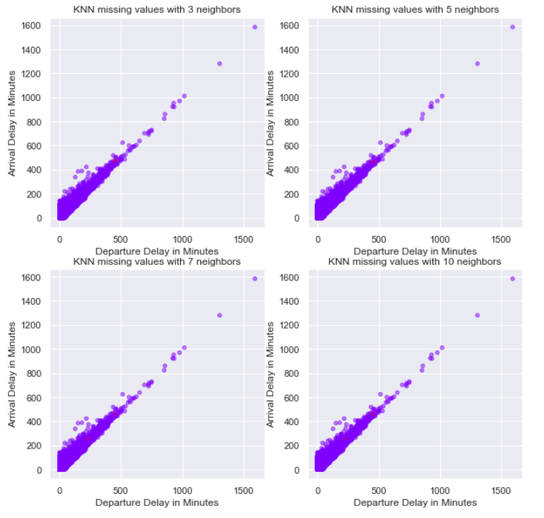
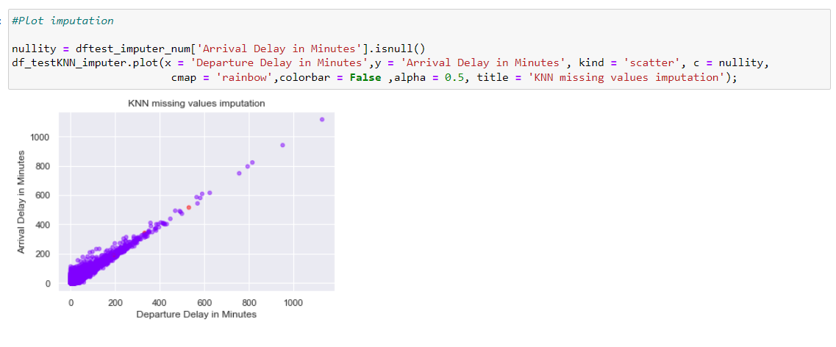
Missing values
Detection with missingo package:
Dengrogram function to plot missingness correlations
2. Imputation wiht Knn imputer:
After hyper parameter tuning, imputation wiht
K = 3 neighboors, In red the new values.
Test dataframe imputation

Slide 5
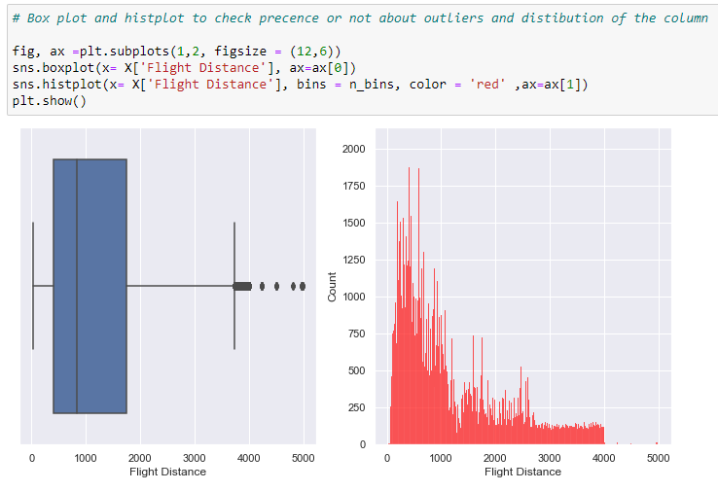
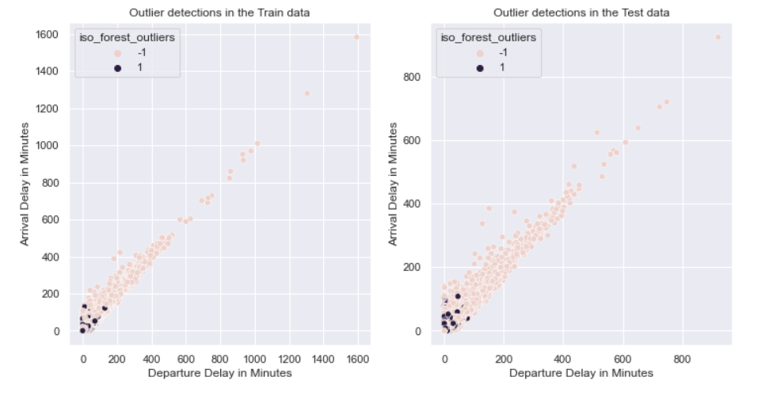
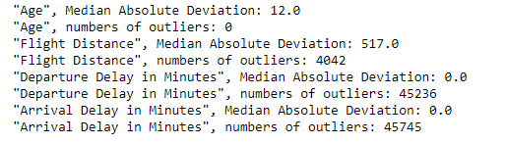
Outliers detection
Univariate analysis
example with « flight distance » column
2. Multivariate analysis
Example with Departure Delay in Minutes and Arrival Delay in Minutes columns with Isolatio Forest unsupervised classification.
1 = inliers
-1 = outliers
Median Absolute Deviation to detect outliers since is robust about them

Slide 6
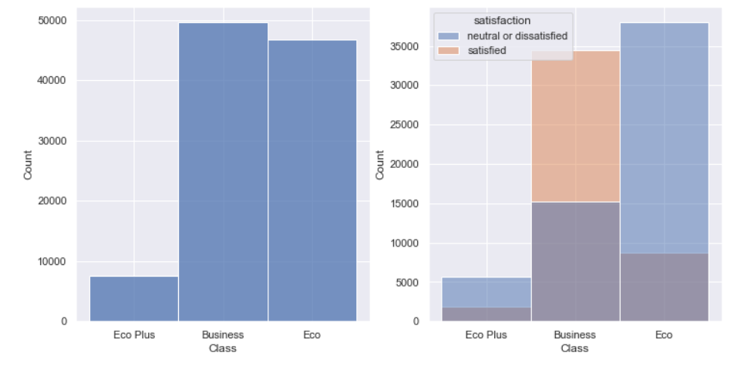
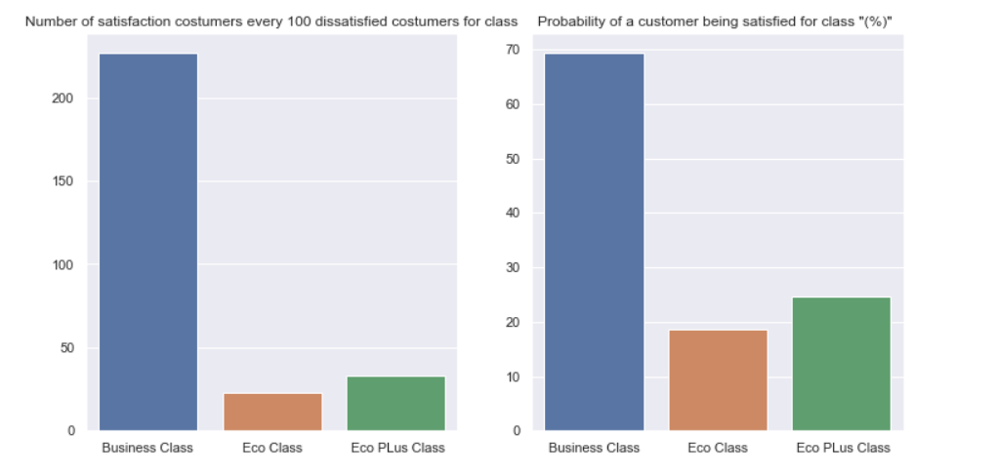
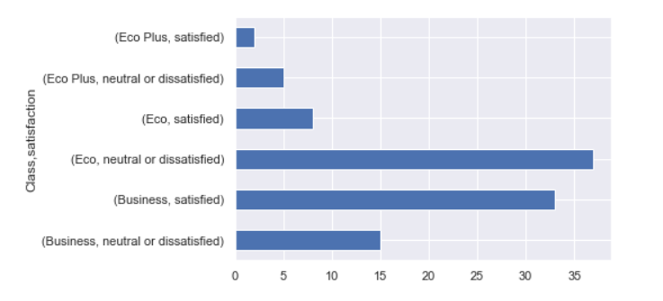
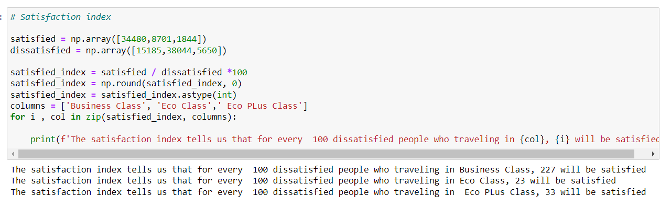
Exploraroty Data Analysis and Feature Engineering
2. Creation Satisfaction index for type of class
Example of EDA about Class column with the response variable
The probability of having a satisfied customer for Business Class is: 69.43%
The probability of having a satisfied customer for Eco Class is: 18.61%
The probability of having a satisfied customer for Eco PLus Class is: 24.61%
Ratio satisfaction for class

Slide 7
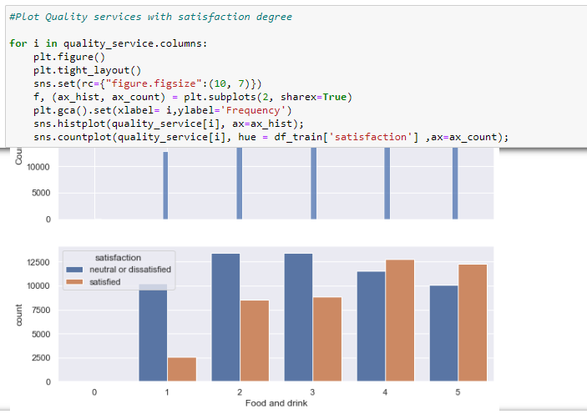
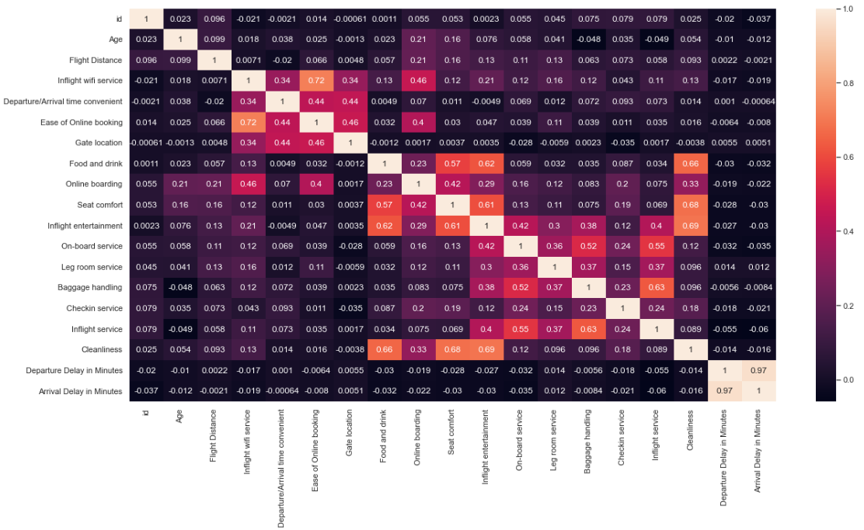
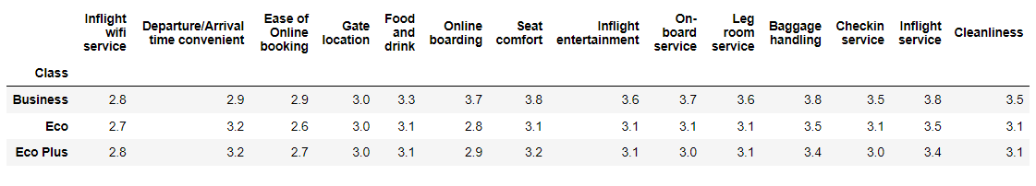
Pearson correlation matrix to show relations between columns (bright colors = positive correlation)
Quality services univariate and multivariate analysis
Mean of the quality service airplane vote about costumers for class

Slide 8
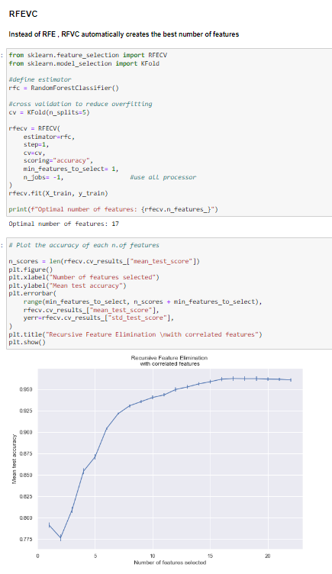
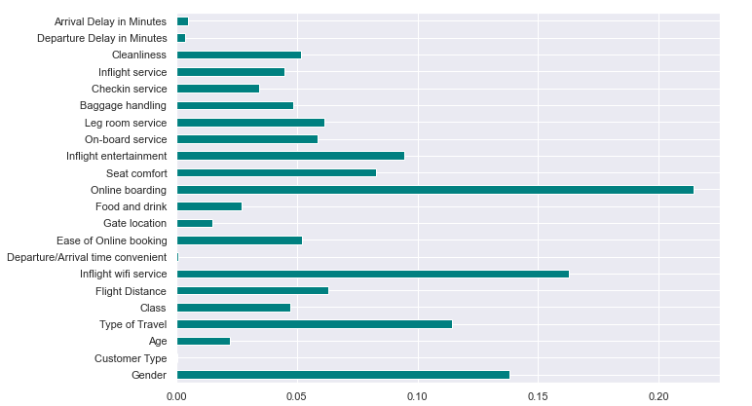
Feature Selection
RRECV to avoid overfitting and random forest classifier as estimator to evaluate the performance
Information Gain since as it is a very good approach to compare numerical and categorical variables with the target because the entropy calculation under the condition of the target variable allows to discover how many variables are impure, clean under the dependece to the response variable.

Slide 9
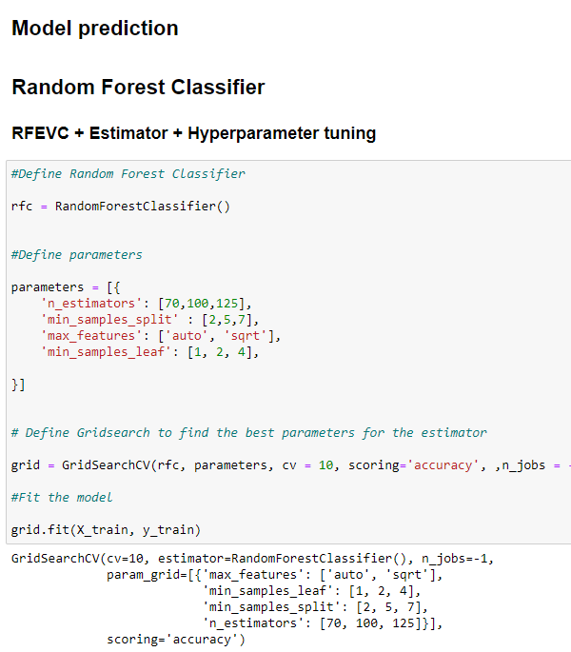
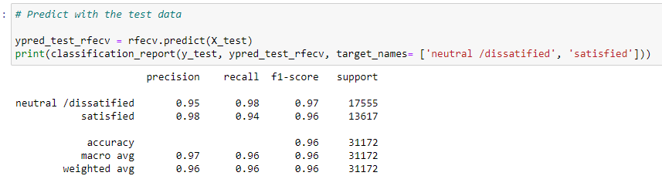
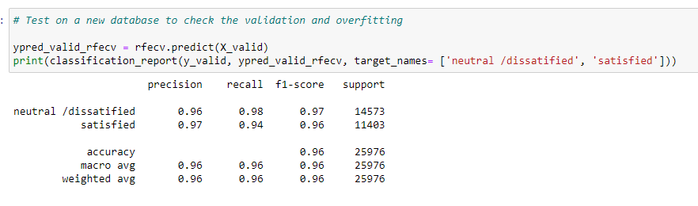
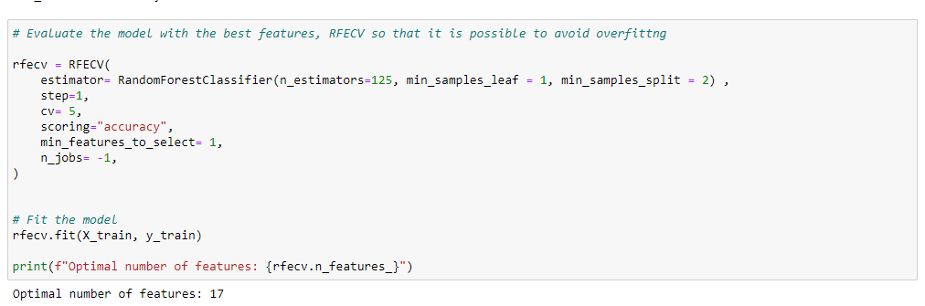
Model prediction
RFE with Random forest Classifier Hyperparameter tuned
Evaluation model with test df
Evaluation model with a new and external dataframe called Validation df to check whether the model generalizes well

Slide 10
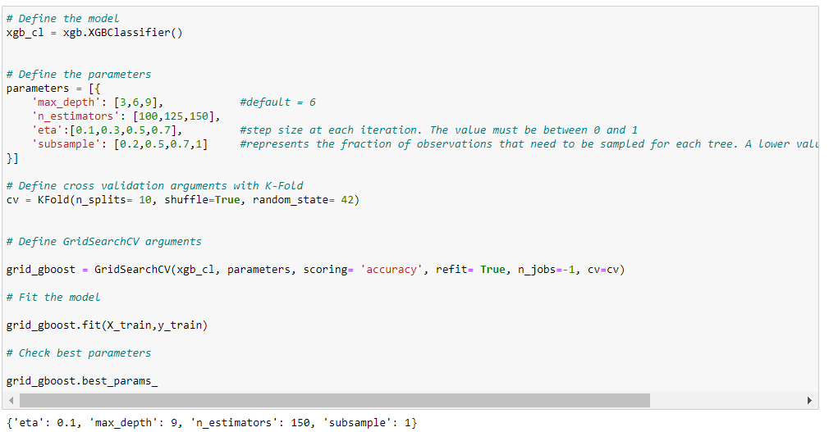
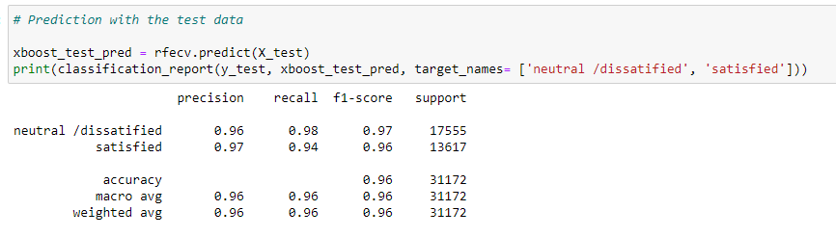
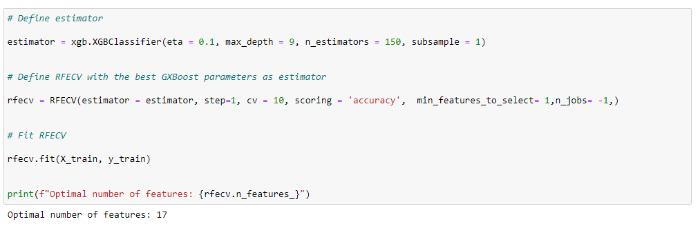
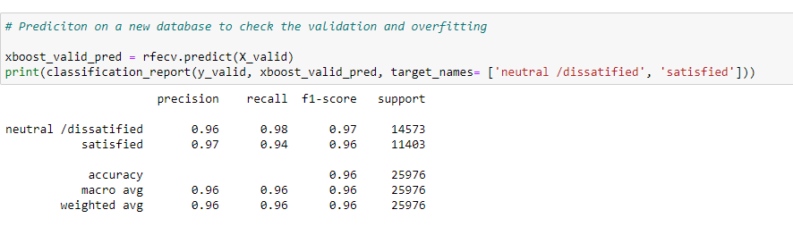
RFECV with XGBoost Classifier Hyperparameter tuned
Evaluation model with test df
Evaluation model with validation df

Slide 11
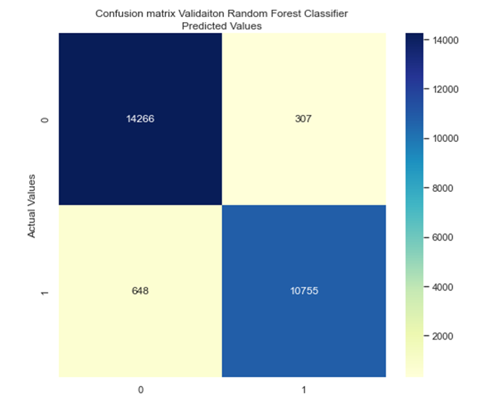
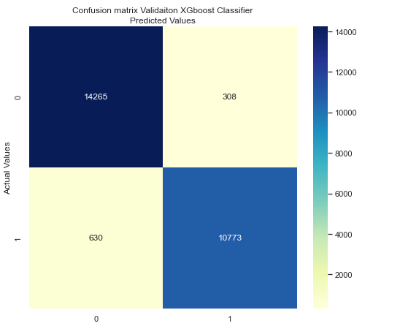
Confusion matrix of the validation dataframe
Random Forest Classifier
XGBoost Classifier
In this study-case XGBoost is better able to classify True Negative and both gave a very good classification, also can be seen that classifiers are better able to predict negative classes, this is because even if the target variable is well balanced, the greater number of negative values allows classifiers to detect them more easily.

Slide 12
Conclusion
The use of machine learning models to assess the degree to which customers of different airlines are satisfied or not could bring additional benefits from a publicity, improvement and customer increase point of view by going to reinforce key points and define, improve or eliminate points that promote an increase in dissatisfied customers in addition to improvement from an economic management point of view of the companies' services and assets.

Slide 13
Thanks for your attention

