Slide 1

Kiana Hashemi
Implementation of DRM in 2D version of SPEED
Thursday 08th October 2015

Slide 2
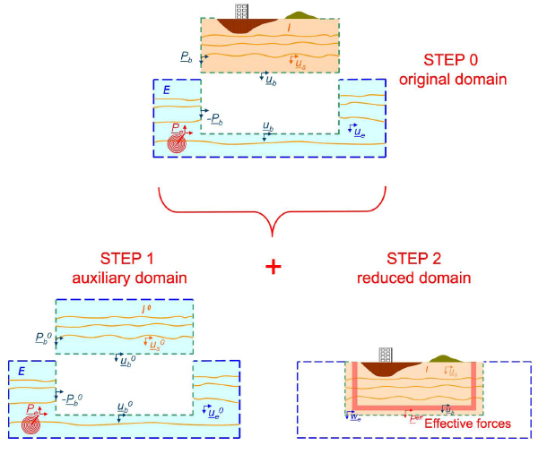
Implementation of a Sub-structuring Technique for Plane Wave Propagation
Construction of large scale computational grids, including an extended seismic source, the propagation path and the localized structure, is still very demanding from a computational viewpoint.
3D numerical simulations of strong ground motion are rarely used in engineering practice due to:
Computational cost
High level of required detail
Passing from the scale of a large seismogenic source (few tens kilometers) to that of a man-made structures (tens of meters)
Engineering applications mostly aim to study the seismic response of civil and geotechnical engineering structures
Application of a sub-structuring method named Domain Reduction Method (DRM) in SPEED
Kiana Hashemi
Notes:
As a matter of fact, construction of large scale computational grids, including in the same numerical model an extended seismic source, the propagation path and the localized structure, is still very demanding from a computational viewpoint and inevitably implies a certain amount of approximations, concerning the maximum frequency of propagation and the lowest propagation velocity.
Passing from the scale of a large seismogenic source (few tens kilometers) to that of a man-made structures (tens of meters) implies a jump of about three orders of magnitude, that is hardly accommodated within a single computational model.
For many engineering applications the scope is to study the seismic response of civil and geotechnical engineering structures, such as buildings or foundation structures
The DRM essentially consists in subdividing the original problem in two subsequential models. Starting from the original problem, in a first step (auxiliary problem) one considers a background geological model, where the geological feature of interest has been removed and replaced by the same materials of the surrounding soil, and computes the corresponding free-field ground motion in the halfspace due to the prescribed seismic source. The numerical grid used at this stage is generally fairly coarse.
In a second step (reduced problem), one focuses on a reduced numerical model, discretized to the desired accuracy, which contains the geological feature (e.g. basin or topographic irregularity) and excludes the seismic source and most of the propagation path from source to site. Note that the reduced model is only slightly larger than the geological feature itself so that the computational grid can be easily optimized with respect to the original problem. The size of the elements of the reduced model may vary from a few kilometers down to a few meters/centimeters, depending on the feature of interest. Seismic excitation is introduced in the reduced problem in the form of localized effective forces computed from the free-field displacement and applied within a single-element fictitious interface that separates the exterior domain from the interior one, as highlighted in Figure

Slide 3
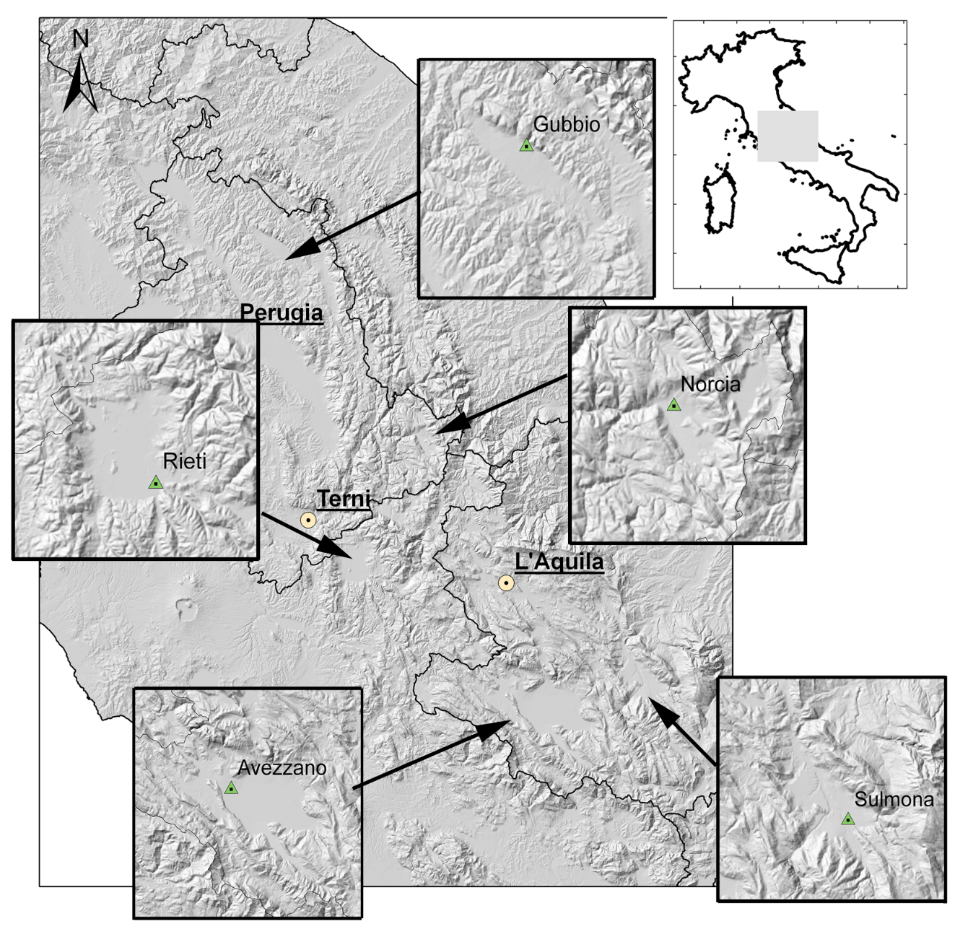
Seismic Response of Gubbio Basin (Central Italy)
Kiana Hashemi

Slide 4
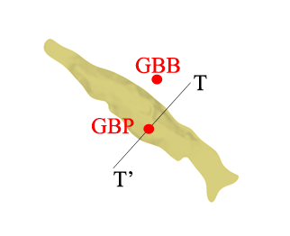
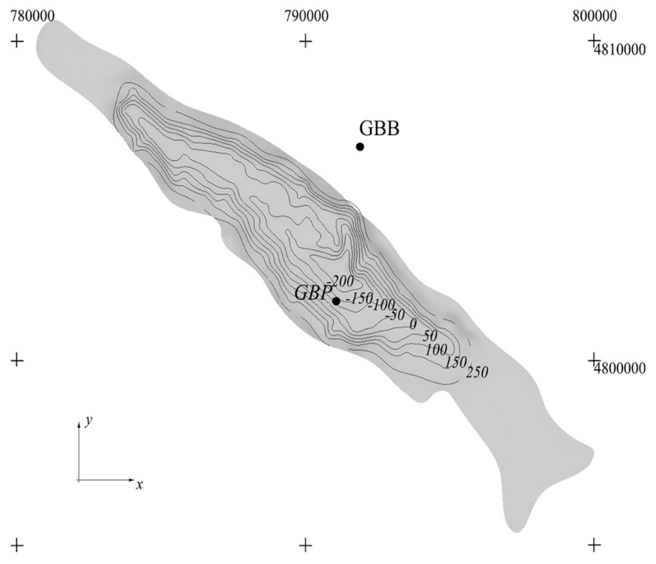
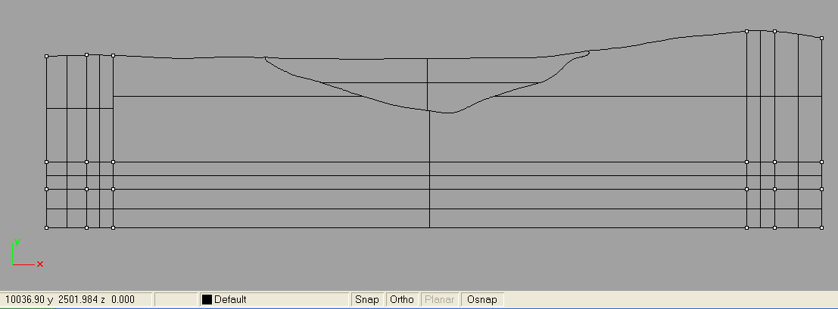
Seismic Response of Gubbio Basin (Central Italy)
3D model of soft alluvial sediments
Contour lines of bedrock topography
TT’: representative transverse cross-section of the Gubbio plain
~ 22 km
T’
T
Kiana Hashemi

Slide 5
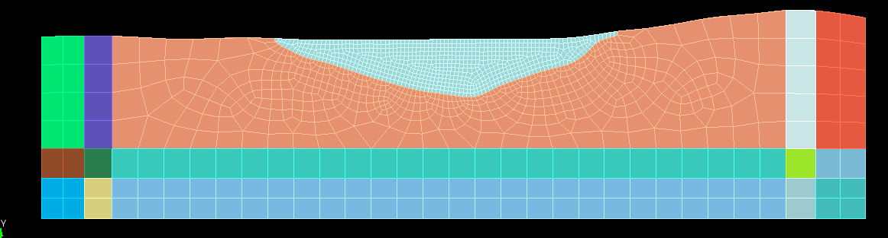
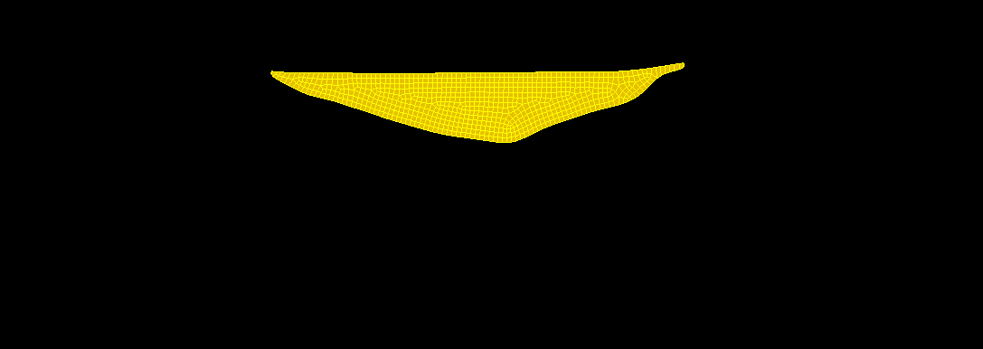
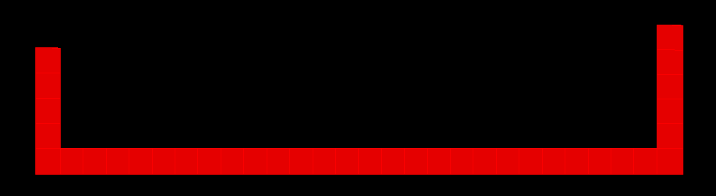
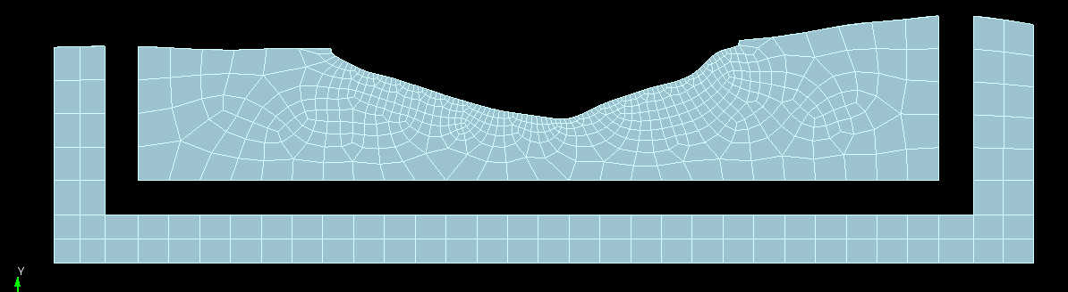

Numerical Modelling of Gubbio Basin
Generation of the mesh by SEs (CUBIT)
Spectral Degree of N = 4
Creation of blocks → Each block identifies an homogeneous set of entities
Kiana Hashemi

Slide 6
Numerical Modelling of Gubbio Basin
-------------------Reading Grid File-------------------
Grid File : gubbio_2d_trasv.mesh
Nodes : 1476
Elements : 1399
Edges : 82
Read.
-------------Making Spectral connectivities------------
Nodes : 22689
-----------Setting calculation parameters--------------
Time step = 0.1000E-03
Stability for time advancing algorithm
Min. element length : 0.3017E+02
Min. pressure wave velocity : 0.3500E+04
*******************************************************
OK!!! deltat CFL = 0.1488E-02
You are using 6.72% of critical time step.
*******************************************************
Number of points per wave length
Max. element length : 0.5594E+03
Max. shear wave velocity : 0.1800E+04
Number of points per wave length : 0.3277E+01
Number of time-steps = 250000
Final time = 0.2500E+02
Kiana Hashemi

Slide 7
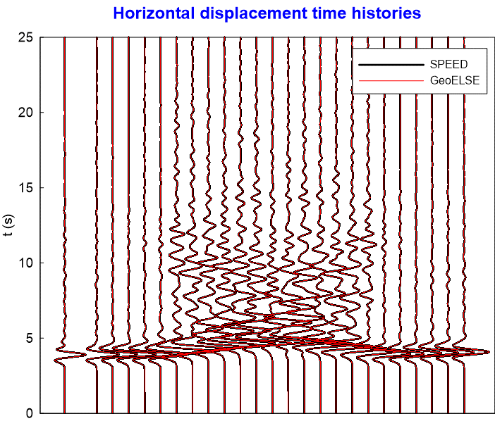
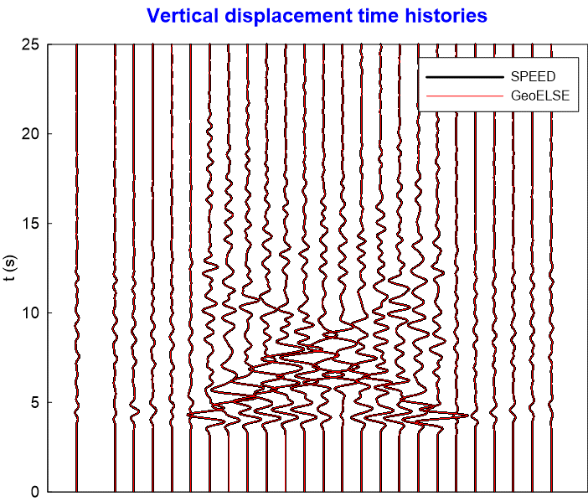
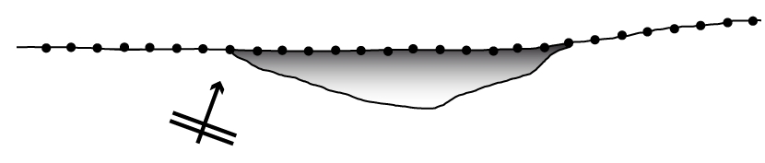
Comparison between SPEED and GeoELSE
Monitor00001
GBP
Monitor00019
Monitor00025
Monitor00001
GBP
Monitor00019
Monitor00025
Kiana Hashemi

Slide 8
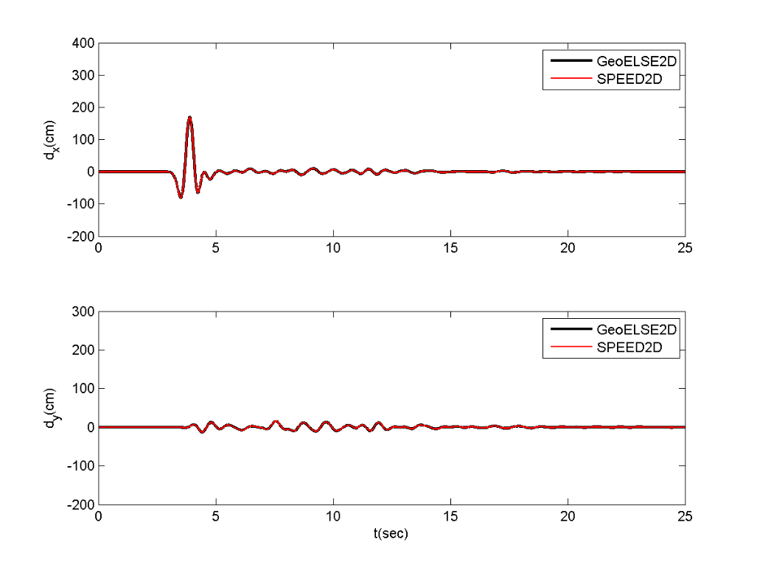
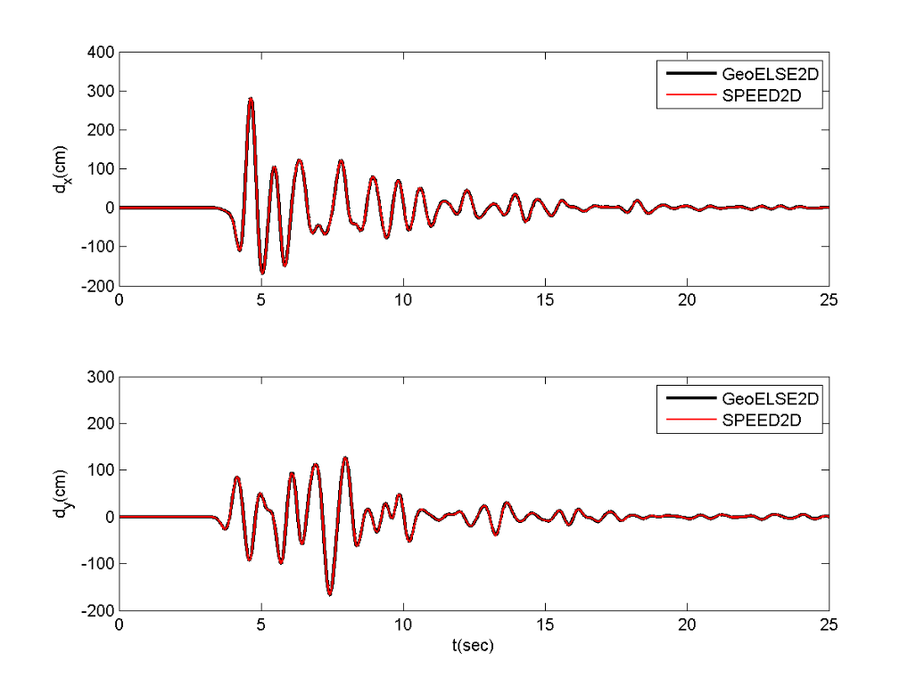
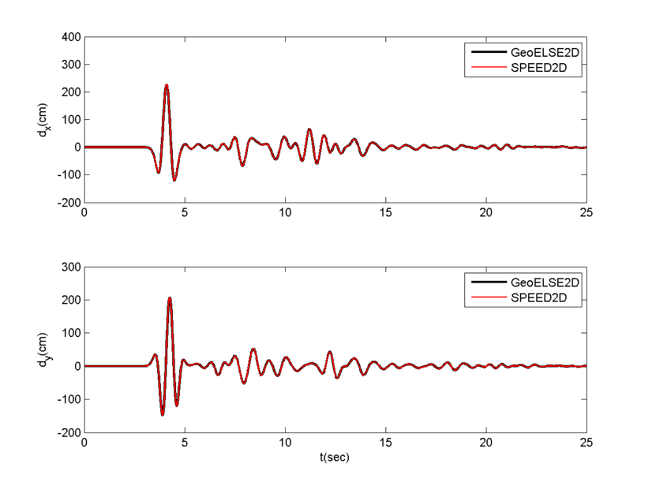
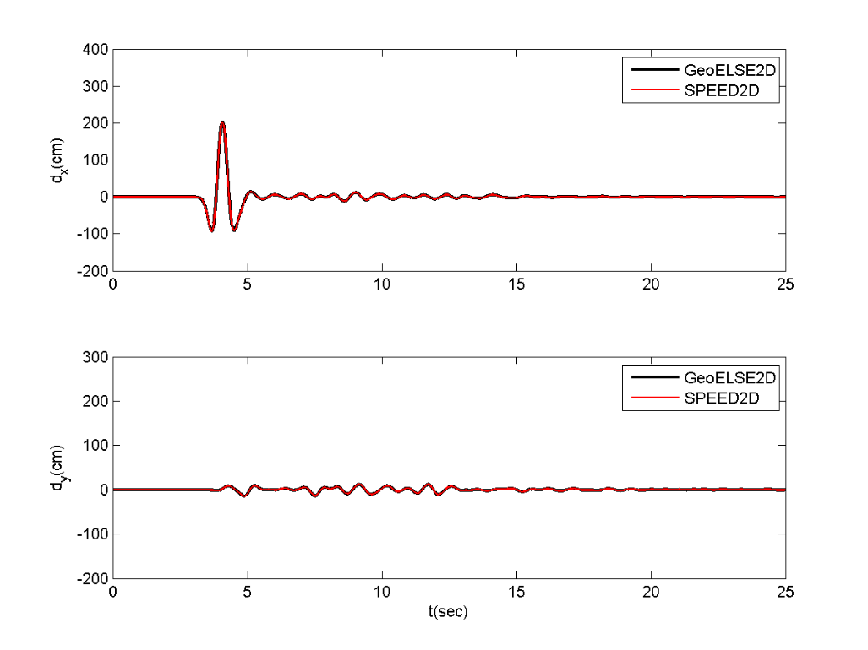
Comparison of Output from SPEED and GeoELSE
Displacement Time Histories
Monitor 00001
Gubbio Basin (GBP)
Monitor 00019
Monitor 00025
Kiana Hashemi

Slide 9
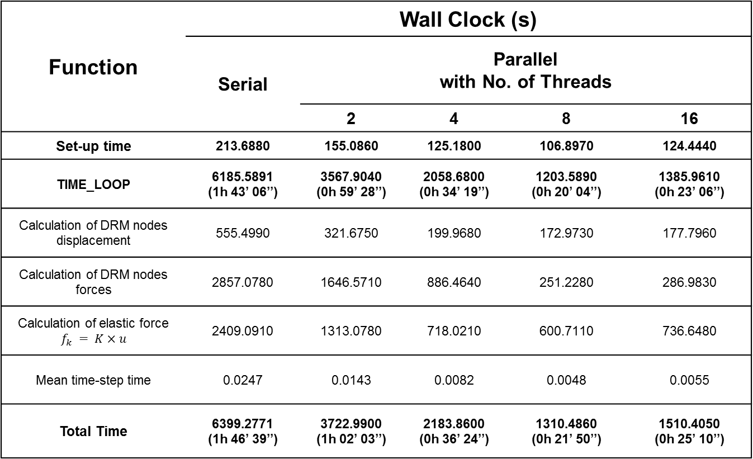
Optimization Results in term of Wall Clock
Function | Wall Clock (s)
 | Serial | Parallel with No. of Threads
 |  | 2 | 4 | 8 | 16
Set-up time | 213.6880 | 155.0860 | 125.1800 | 106.8970 | 124.4440
TIME_LOOP | 6185.5891 (1h 43’ 06’’) | 3567.9040 (0h 59’ 28’’) | 2058.6800 (0h 34’ 19’’) | 1203.5890 (0h 20’ 04’’) | 1385.9610 (0h 23’ 06’’)
Calculation of DRM nodes displacement | 555.4990 | 321.6750 | 199.9680 | 172.9730 | 177.7960
Calculation of DRM nodes forces | 2857.0780 | 1646.5710 | 886.4640 | 251.2280 | 286.9830
Calculation of elastic force $f_{k} = K×u$ | 2409.0910 | 1313.0780 | 718.0210 | 600.7110 | 736.6480
Mean time-step time | 0.0247 | 0.0143 | 0.0082 | 0.0048 | 0.0055
Total Time | 6399.2771 (1h 46’ 39’’) | 3722.9900 (1h 02’ 03’’) | 2183.8600 (0h 36’ 24’’) | 1310.4860 (0h 21’ 50’’) | 1510.4050 (0h 25’ 10’’)
Kiana Hashemi

Slide 10
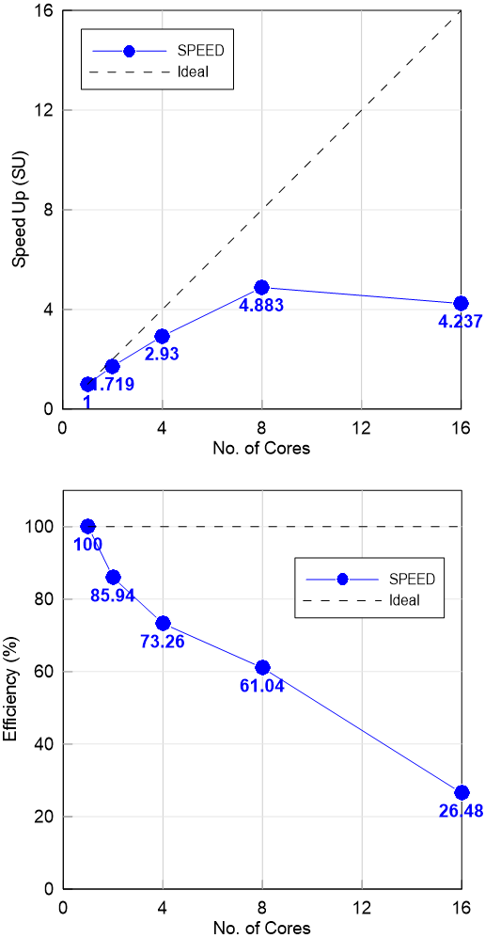
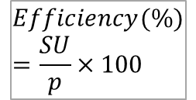

Speed Up & Efficiency
Cluster used for parallel computation: IDRA Cluster of MOX (The Laboratory for Modeling and Scientific Computing) of the Department of Mathematics at Politecnico di Milano.
IDRA Cluster: 16 nodes, 32 Intel Xeon X5560 @2.80GHz, 128 cores, 432GB RAM, O.S. RHES 6.2
Cluster for parallel applications, both MPI and openMP (the latter up to 8 cores), one node has RAM increased to 64GB for suited tasks.
$$SU=\frac{T_{serial}}{T_{parallel}}$$
$$Efficiency(\%)=\frac{SU}{p}×100$$
Kiana Hashemi
Notes:
As we can see in these figures, it is better to use less no. of threads. Because our model dimension is not so big less time is spent for computation and more time for communication so in this case it is better to use less no. of processors.

Slide 11
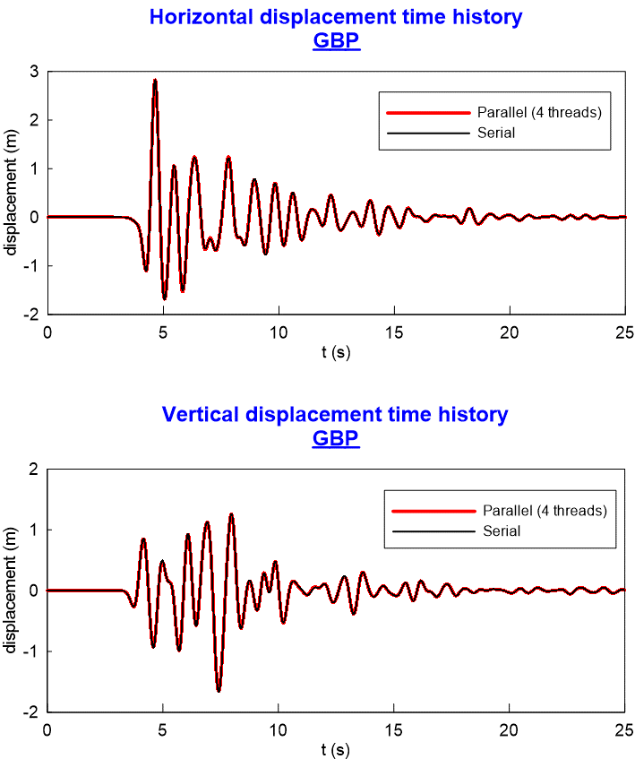
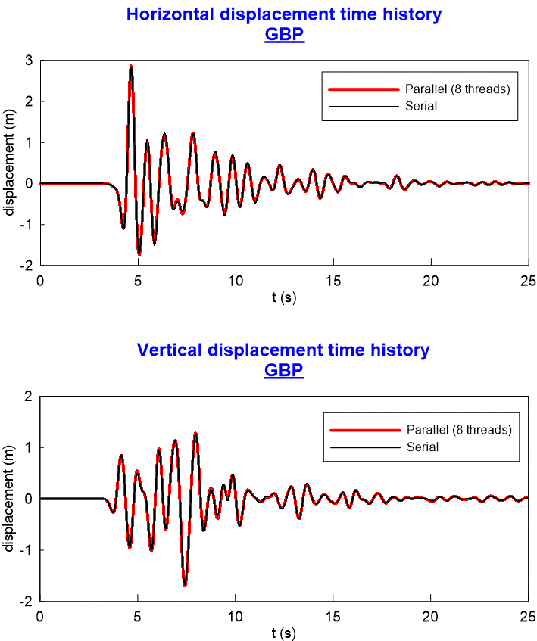
Comparison of Numerical Results after Parallelization
Kiana Hashemi

