Slide 1


NCO based CDR implementation in FPGA
Team number: xohw20_203
Team Participant: Filippo Marini
Team Supervisor: Dr. Ing. Marco Bellato

Slide 2
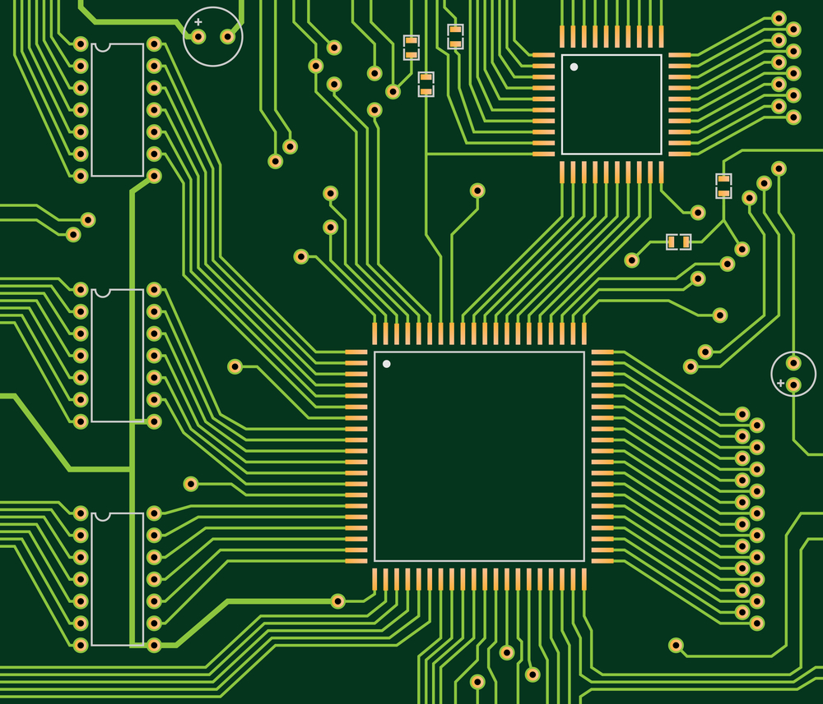
What is a Clock and Data Recovery (CDR)?
Digital data streams are usually sent without any accompanying clock signal.
How to decode them without any timing information?
Physical medium (cable, fiber …)
Sender Board
Receiver Board

Slide 3
What is a Clock and Data Recovery?
Receiver Board
0
1
1
0
0
0

Slide 4
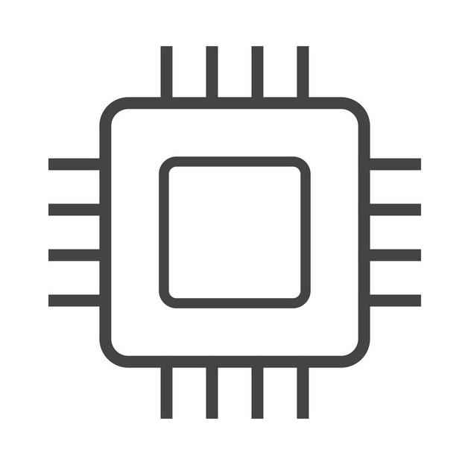
What is a Clock and Data Recovery?
A Clock and Data Recovery (CDR) provide timing information from the serial data stream to correctly decode the message
CDR
0
1
1
0
1
0
0
1

Slide 5
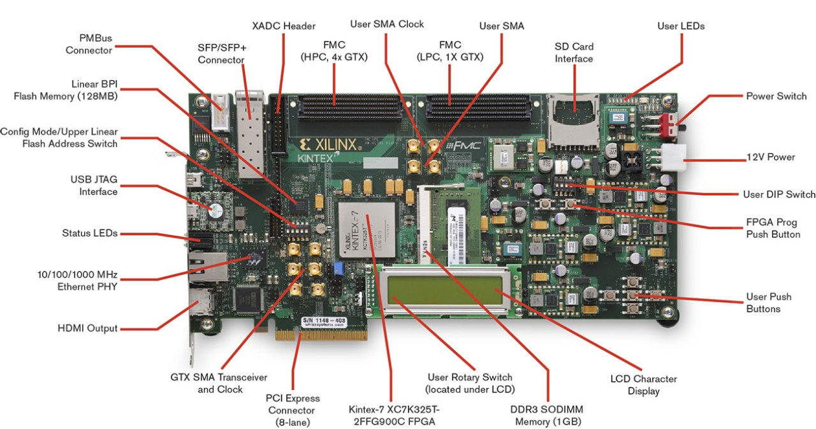
Proposed Core: FPGA implementation of a CDR
The submitted core is an FPGA implementation of a CDR
The core uses High Range (HR) Input/Output (I/O) general purpose pin over dedicated transceivers. This grants a reduced power consumption and a more straightforward design
The data rate tested ranges from 62,5 Mbps to 250 Mbps
Data decoded with no errors after 100 meters of CAT. 5e cable
Core consists of custom VHDL code. Advanced clock management tiles (i.e., with phase shifting capability) and an output SerDes tile are mandatory resources
Core implemented in Xilinx KC705 Evaluation Board

Slide 6
CDR (Simplified) Architecture Overview
CDR core
Numerically Controlled Oscillator
Phase and Frequency Detector
MMCM
Phase Aligner
CDR Recovered Clock
Non-Return-to-Zero (NRZ) Data

Slide 7
CDR (Simplified) Architecture Overview
CDR core
Numerically Controlled Oscillator
MMCM
The Numerically Controlled Oscillator (NCO):
Generates a clock signal
The generated clock frequency is dynamically controllable
Since fully digital, time domain is discrete and the phase resolution is 500 ps
MMCM helps cleaning the jitter and overcome the discrete time domain effect

Slide 8
CDR (Simplified) Architecture Overview
CDR core
Numerically Controlled Oscillator
Phase and Frequency Detector
MMCM
Non-Return-to-Zero (NRZ) Data
The Phase and Frequency Detector:
Compares the frequency of the NCO clock to the data rate
Controls and adjust the NCO output clock frequency
Controls the ‘CDR locked’ flag, which is asserted high when NCO output clock matches as close as possible the data rate

Slide 9
CDR (Simplified) Architecture Overview
CDR core
Numerically Controlled Oscillator
MMCM
Phase Aligner
Non-Return-to-Zero (NRZ) Data
The Phase Aligner:
Enabled when CDR locked
Compares the phase of the NCO clock to the Data
Interact with the dynamic phase-shifting capability of the 7 Series advanced MMCM (MMCME2_ADV)
Eliminates any residual drifting of the clock respect to the data and provide a deterministic clock-data phase relationship

Slide 10
CDR (Simplified) Architecture Overview
CDR core
Numerically Controlled Oscillator
Phase and Frequency Detector
MMCM
Phase Aligner
CDR Recovered Clock
Non-Return-to-Zero (NRZ) Data
The recovered clock:
Provided by the MMCM
User controllable phase relationship with the data

Slide 11
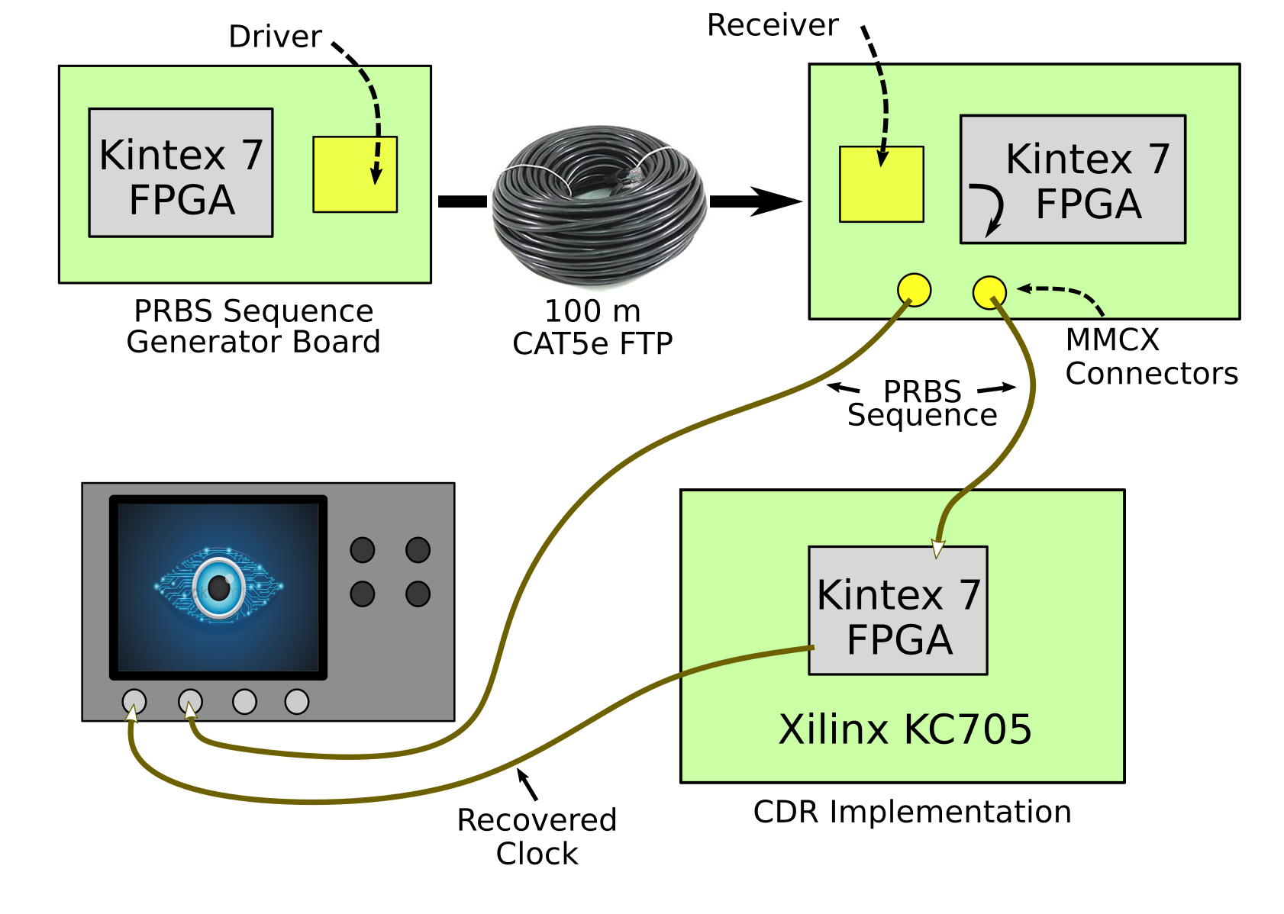
CDR Testing Setup
PRBS Data is generated in FPGA
Data rate: 250 Mbps
Data go through a differential buffer for cable driving applications

Slide 12
CDR Testing Setup
PRBS Data go through a cable equalizer for data reconstruction
FPGA on the Data Receiver Board only needed to forward received data to the connectors. No logic is present
One PRBS sequence go to the oscilloscope, the other to the CDR hosting board for clock recovery

Slide 13
CDR Testing Setup
CDR core implemented in Xilinx KC705 evaluation board
Data enters through the FMC connector
Recovered clock exits through the FMC connector and triggers the oscilloscope
LED indicates when CDR is locked

