Slide 1


What happens when a smart building is trying to be smarter than you?
by
ENCHANTED DUCTAPE

Slide 2
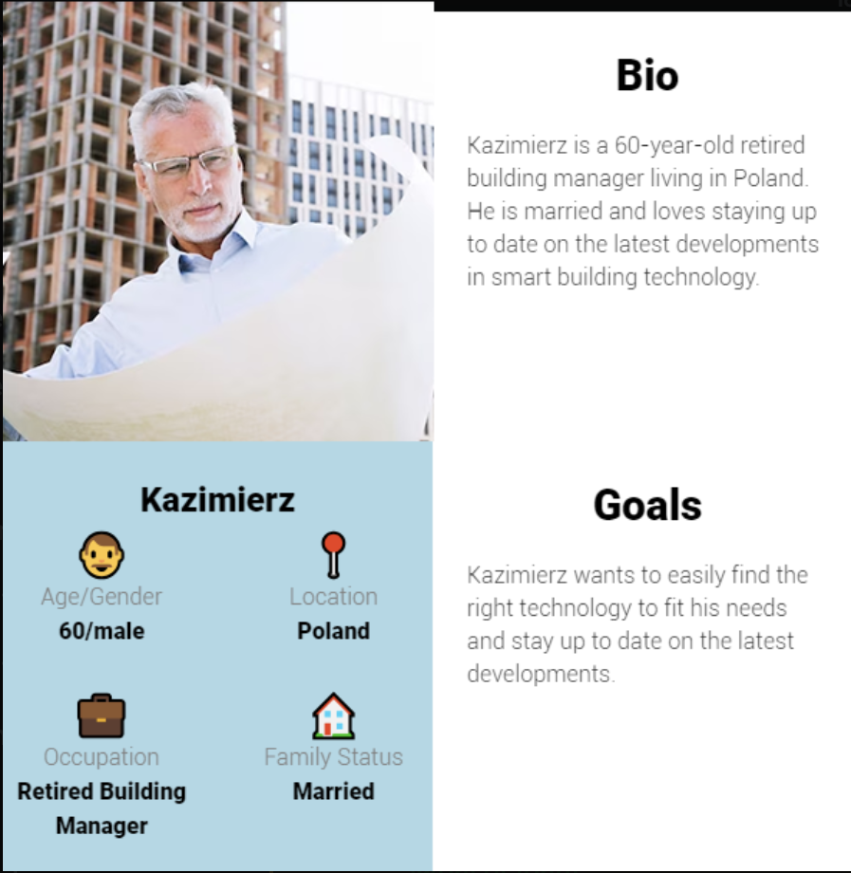
Problem description

Slide 3
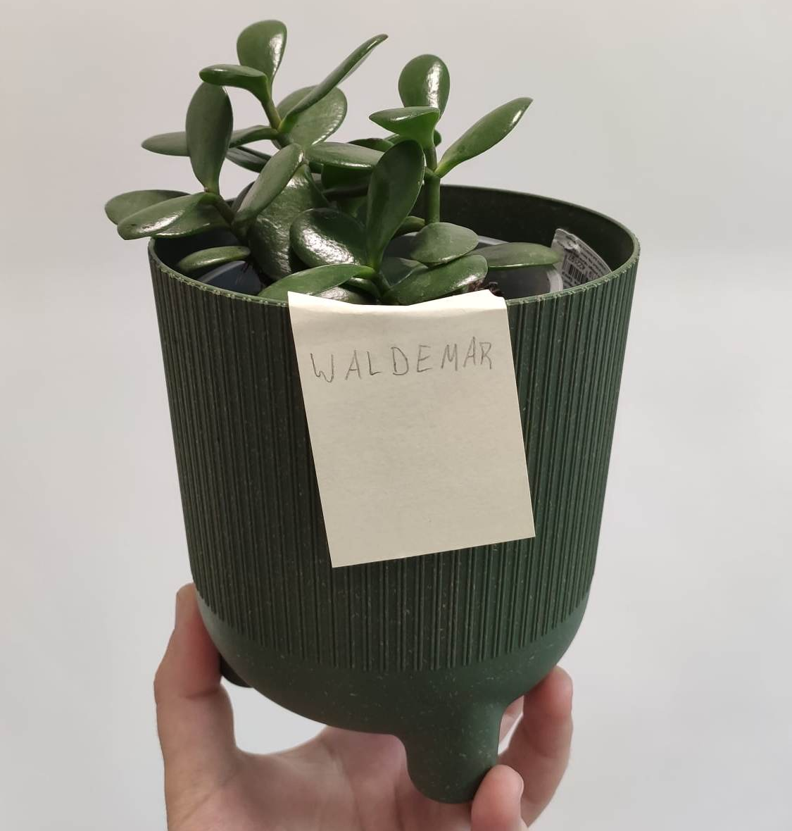
Problem description
Notes:
Mr Kazimierz lives in a big house with his wife. Since he has retired, he finds it difficult to organize his time efficiently. One of us has the similar problem - we want to be more efficient. So we decided to design a system which takes care of one’s habbits.

Slide 4
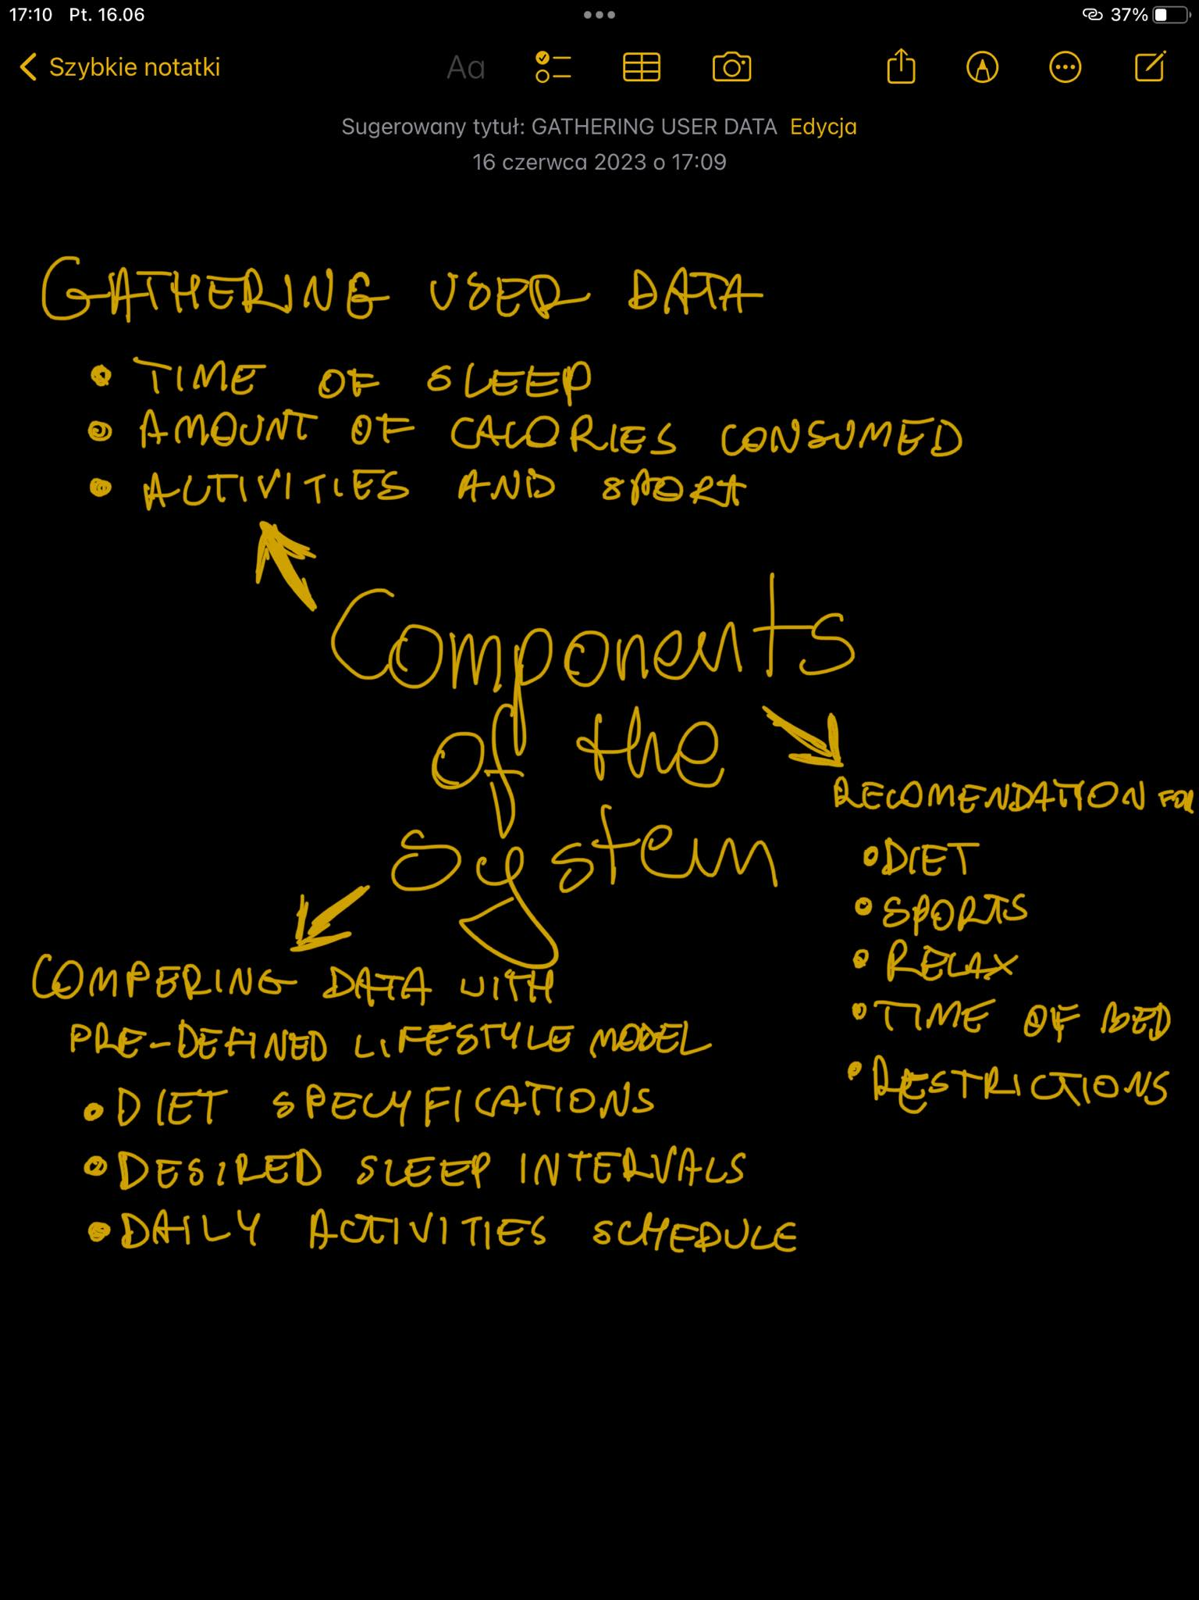

Our Idea
Automatic System for Lifestyle Evident Enhancement and Performance
ASLEEP

Slide 5
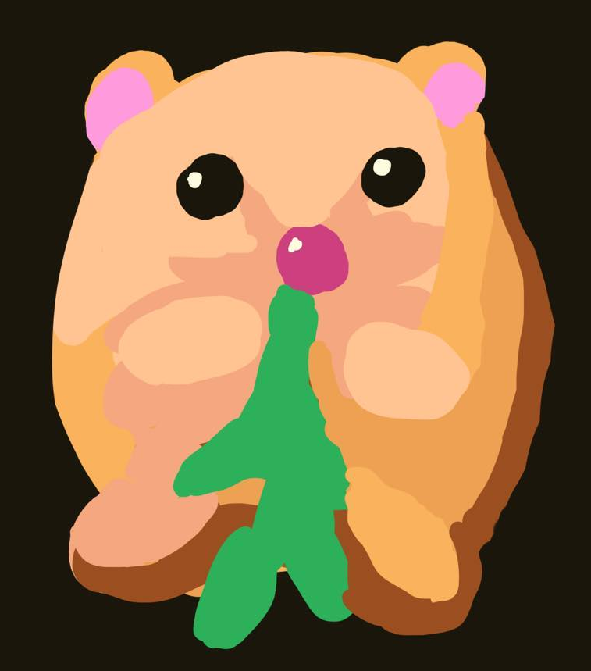
Our Idea
Hamster companion
Its mission is to:
Give positive feedback
Keep track of user’s progres
Inform the user of his strike
Give useful recommendations

Slide 6
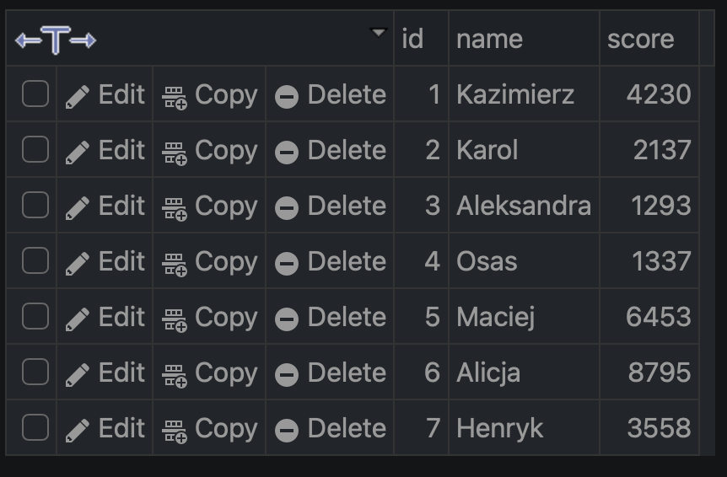
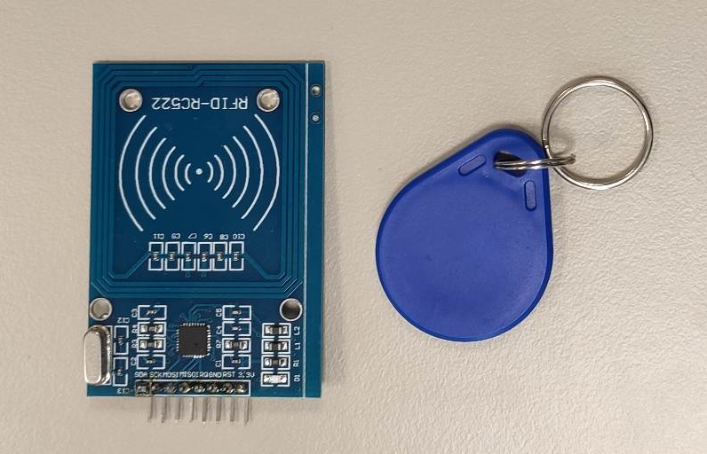
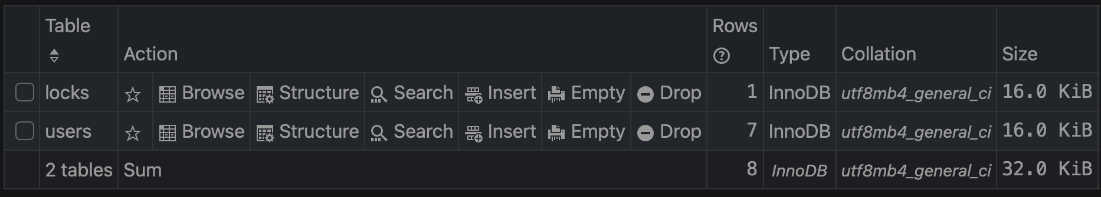
Gathering Data
Personal RFID sensors
Relational database
Statistics from smart home devices
Physical sensors

Slide 7
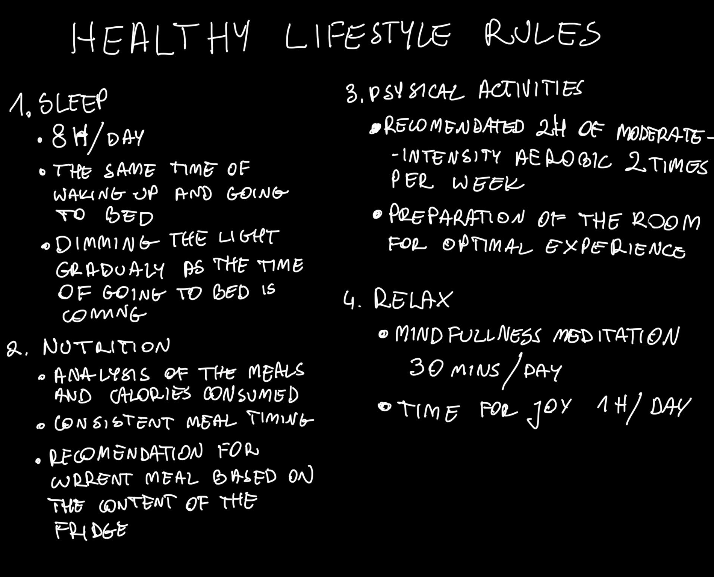

Predefined Lifestyle model

Slide 8
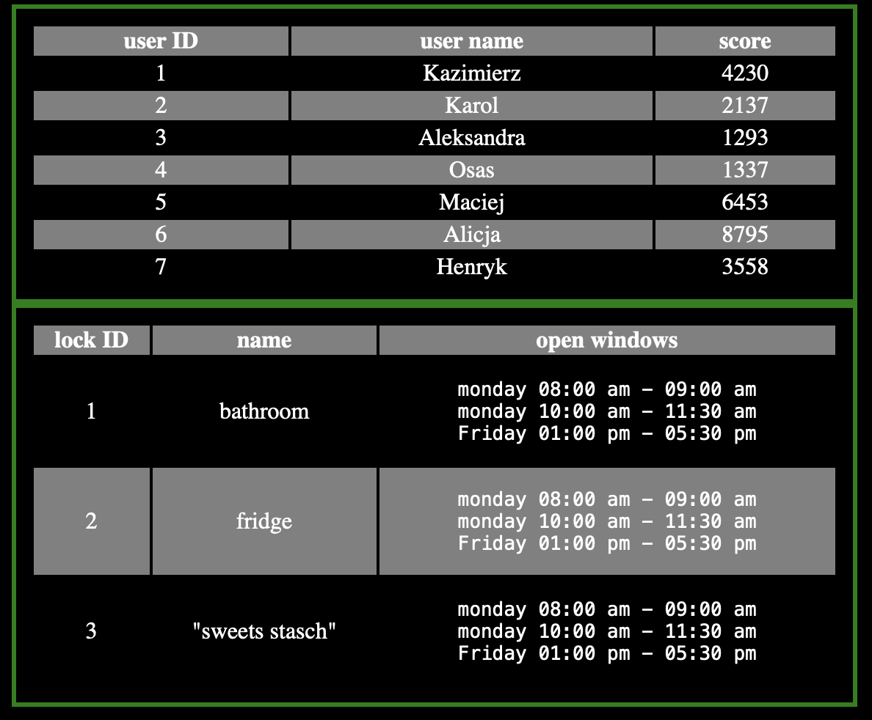
Recomendations
The database keeps all the necessary information of both – desired and actual behaviour.
The data is compared and feedback is provided with assistance of Hamster companion.

Slide 9
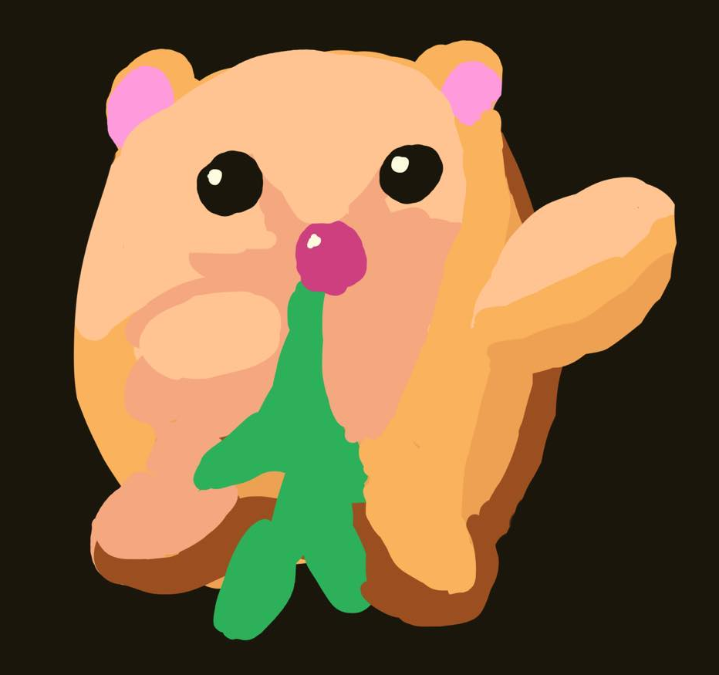
Recomendations
Hello there Kazimierz!
It’s 6.30 pm. right now. I just want to remind you about your schedule, which says, it’s the best time for you to sit back, relax and read a book.
Follow your personal plan to keep your perfect strike!

Slide 10
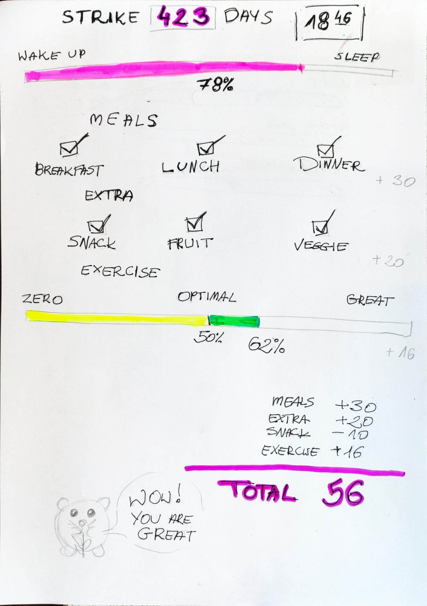
Motivational summary

