Slide 1
Customer Churn Prediction for SyriaTel
Predicting and Reducing Customer Attrition
Name: Filda Kiarie
Email: filda.kiarie@student.moringaschool.com
Date: 23/12/2024

Slide 2
Business Problem
Overview of SyriaTel’s Churn Challenge
High Churn rates affecting revenue, growth, and customer loyalty
Importance of identifying key churn drivers.
Goal: Develop a predictive model for targeted retention strategies

Slide 3
Project objectives
Objective 1: Identify key drivers of customer churn.
Analyze customer data to identify the critical features that contribute to churn behavior. This will help uncover patterns that can be used to predict customer attrition
Objective 2: Build an accurate predictive model for churn.
Develop and test machine learning models to accurately classify customers who are likely to churn. This will enable SyriaTel to proactively target at-risk customers.
Objective 2: Build an accurate predictive model for churn.
Provide actionable insights and retention strategies that SyriaTel can implement to reduce churn rates and improve customer loyalty, ultimately enhancing revenue and business sustainability

Slide 4
Data Preprocessing
Dataset Overview
Feature Engineering: Encoding categorical variables.
Scaling: Normalized features using StandardScaler.
Feature Selection: Dropped irrelevant and highly correlated features
Handling Missing Values: Checked and managed null values.
Dataset: 3333 rows, 21 columns with customer details.
Features: Account information, usage statistics, subscription plans.
Target: Churn (Yes/No).

Slide 5
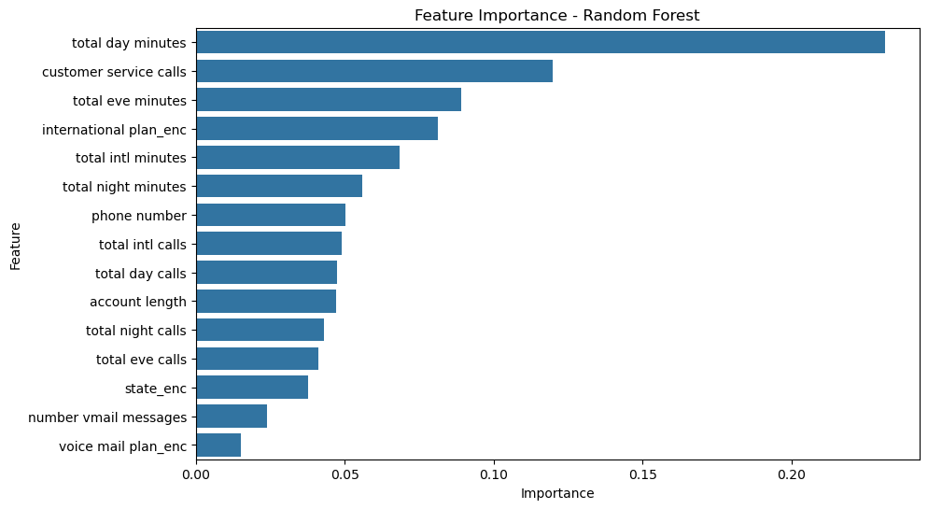
Key Drivers of Churn
Feature Importance: Random Forest analysis to identify key churn drivers.
Top Features:
Total Day Minutes
Customer Service Calls
International Plan

Slide 6
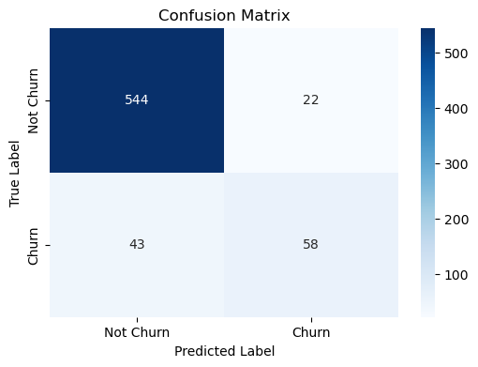
Predictive Model
Model: Random Forest Classifier
Performance:
Accuracy: 90.25%
Cross-Validation Accuracy: 91.26%
Evaluation:
Classification Report (Precision, Recall, F1-Score)
Confusion Matrix

Slide 7
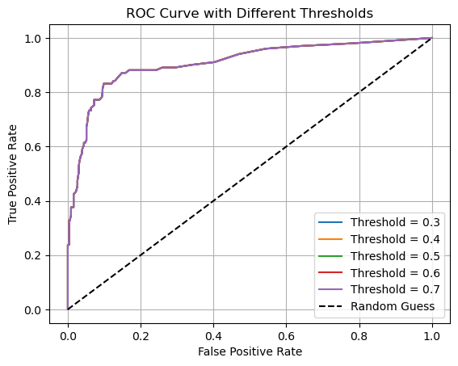
Model Performance with Threshold Adjustments
Threshold Experimentation: Testing various thresholds to balance precision and recall.
Findings: Lower thresholds increase recall (detecting more churn), while higher thresholds improve precision (fewer false positives).

Slide 8
Strategic Recommendations
Target High-Risk Customers: Engage with personalized offers for customers predicted to churn.
Improve Customer Support: Provide better service for customers with frequent service calls.
Boost Engagement: Encourage low-engagement users (e.g., those with low usage) to stay.

Slide 9
Business Insights
Key Insights:
Low Usage & High Service Calls: Indicators of churn.
Actionable Steps:
Focus on high-risk customers.
Use model predictions for targeted campaigns
Prioritize improving customer experience.

Slide 10
Conclusion
Summary:
A predictive model for churn is developed and evaluated with high accuracy.
Key churn drivers have been identified and actionable strategies provided to reduce churn.
Provided actionable strategies to improve customer retention.
Next Steps:
Implement retention strategies based on model predictions.
Monitor the model’s performance post-deployment.

Slide 11
THANK YOU!
Git repository:
https://github.com/FildaKim/Churn-in-Telecoms-Project.git
Feel free to reach out for questions or clarifications!

