Slide 1


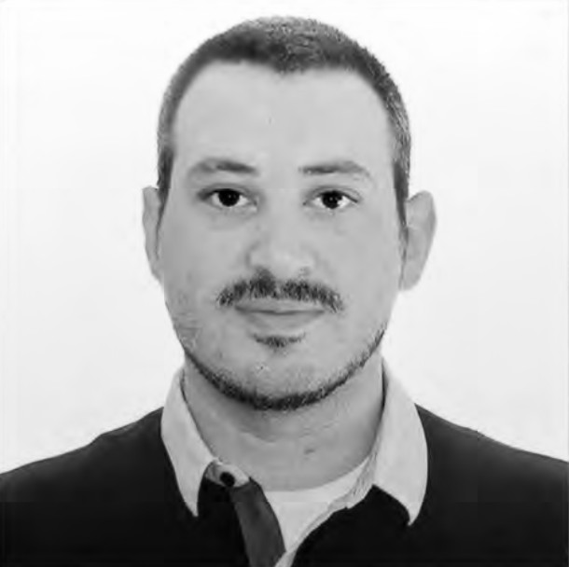


State of Filecoin
Dante Cullari
CEO - Konvergence Inc.
Web3 Architect, Full Stack Developer, UI/UX Designer, Web Researcher
dante@raincloud.earth https://raincloud.earth

Slide 2
Current Hot Topics
High Gas Fees
Baseline Crossing
FVM
FIL Collateral Issues
FIP 0036 - Sector Duration Multiplier - Rejected

Slide 3
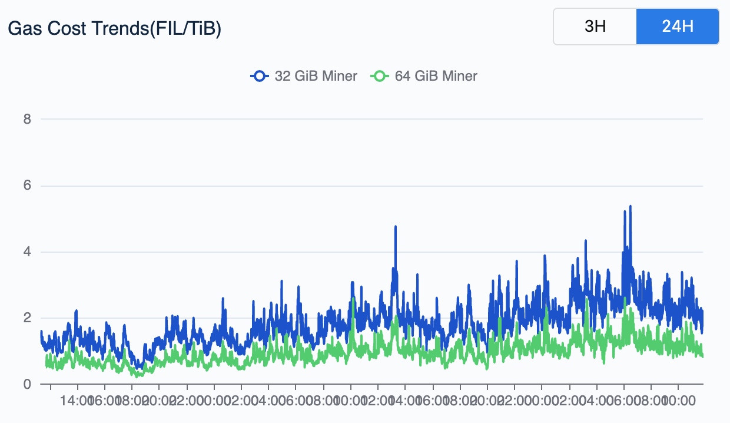
High Gas Fees
https://fgas.io/

Slide 4
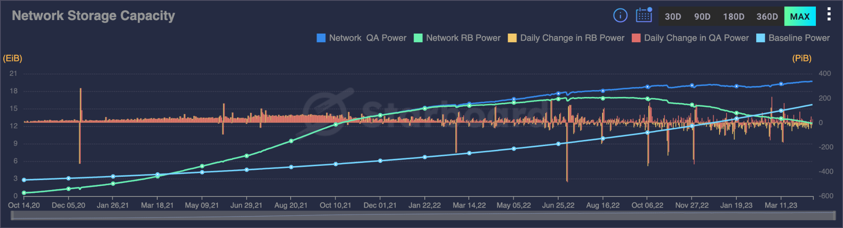
Baseline Crossing
https://dashboard.starboard.ventures/capacity-services

Slide 5
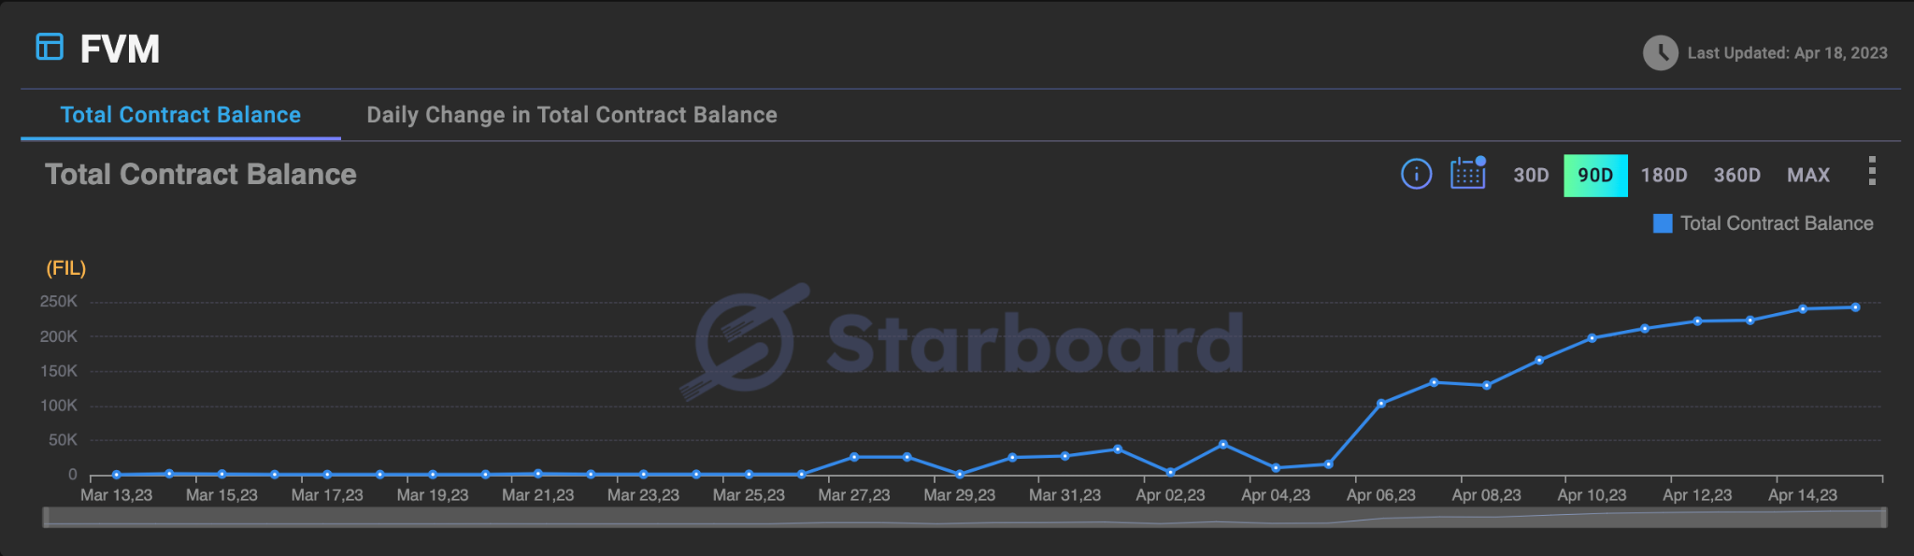
FVM
https://dashboard.starboard.ventures/dashboard

Slide 6
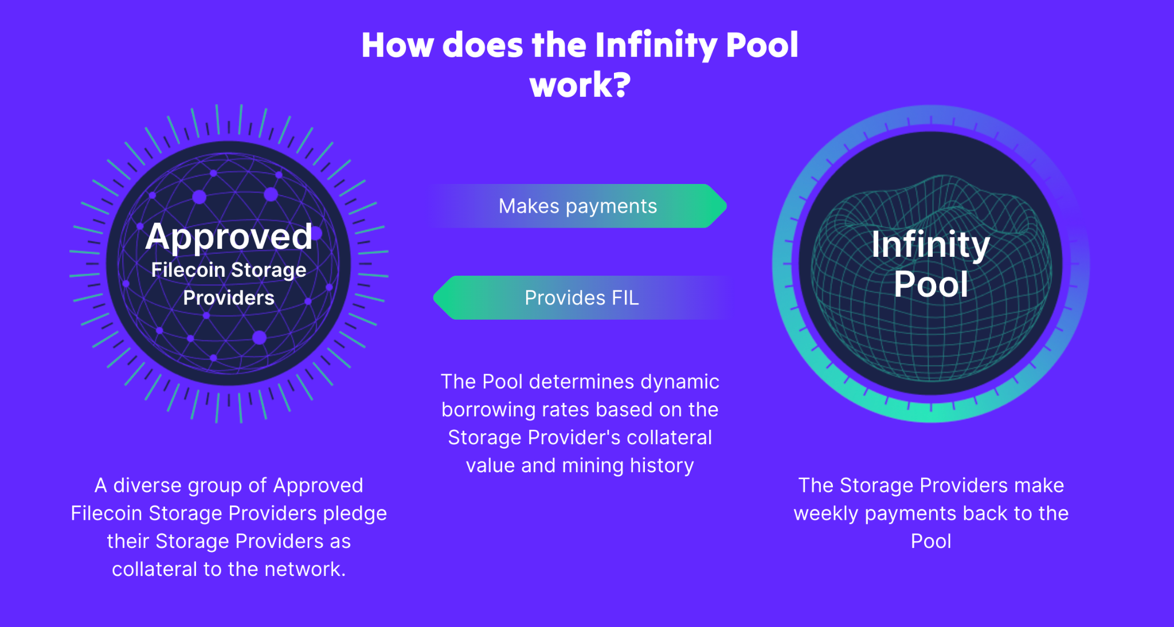
FIL Collateral Issues - FIL+
https://docs.filecoin.io/basics/how-storage-works/filecoin-plus/

Slide 7
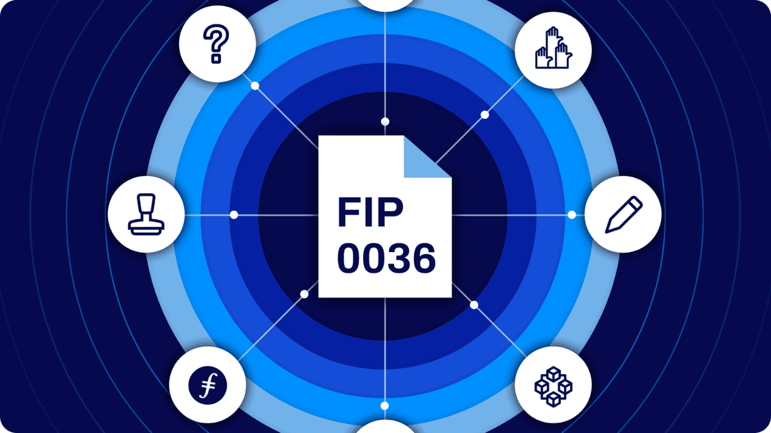
FIP 0036 - Sector Duration Multiplier - Rejected
https://github.com/filecoin-project/FIPs/blob/master/FIPS/fip-0036.md

Slide 8
Hot Projects
InterPlanetary Consensus - IPC
InterPlanetary Network Indexer - IPNI
Delta.Store
Lync - Web3 Gaming
TableLand
HyperMedia
Cloud Forest

Slide 9

Join us on Slack!
Continue Discussions online
Get Event updates
Reach out to Organizers

Slide 10

Survey
Filecoin Orbit Community Program Survey

Slide 11


Thank You
dante@raincloud.earth
https://raincloud.earth
https://twitter.com/KonvergenceInc

