Slide 1
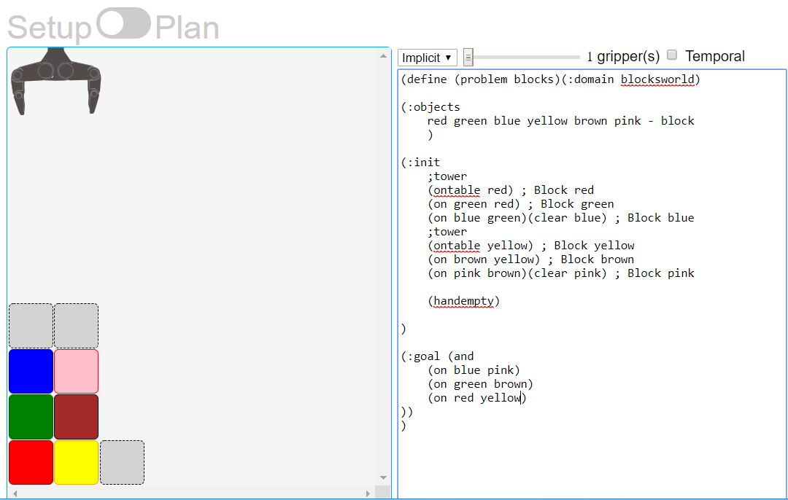
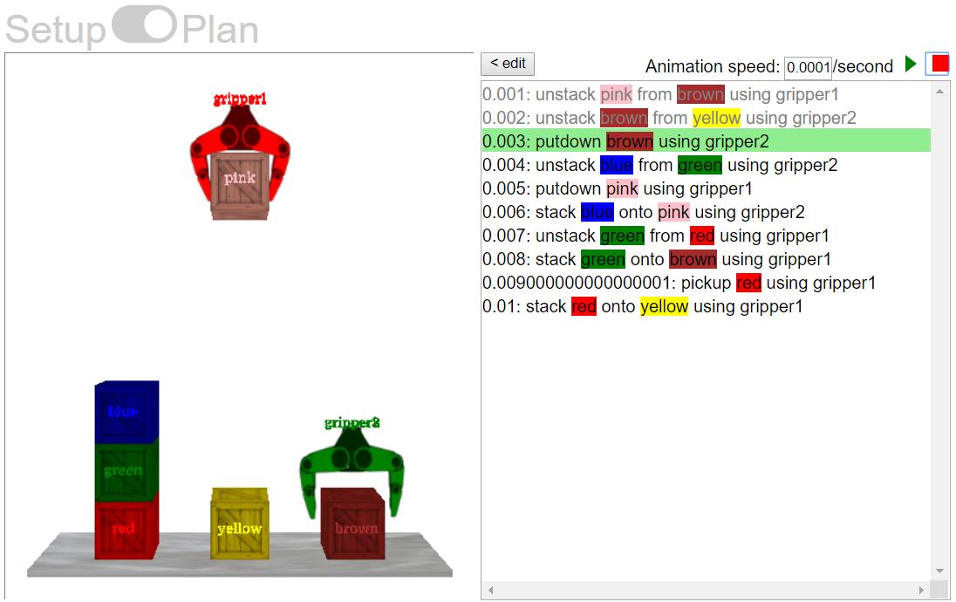
Planning warehouse operations
https://blocks-dot-ai-planning.appspot.com/

Slide 2
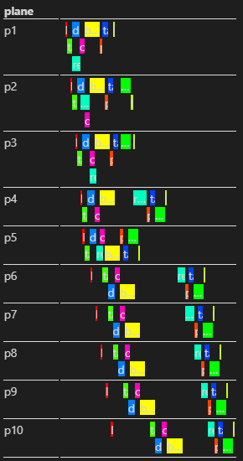
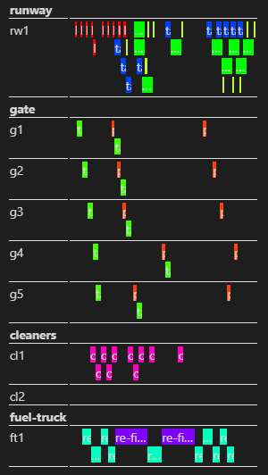
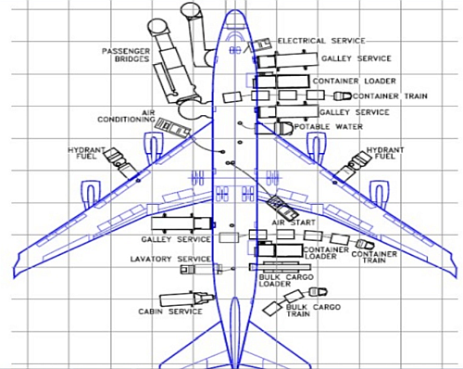
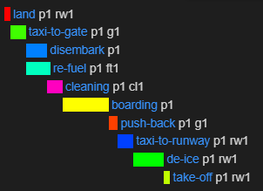
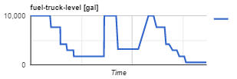
Airport ground operations
10 aircrafts, 1 runway, 1 cleaning crew, 1 fuel truck
1 aircraft
Notes:
https://github.com/jan-dolejsi/vscode-pddl-samples/tree/master/Airport
Solve problem for 1 aircraft, find bug in the domain, make it freeze
Solve problem for 10 aircraft, add a fuel truck, plan for worsening weather forecast

Slide 3


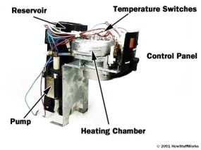
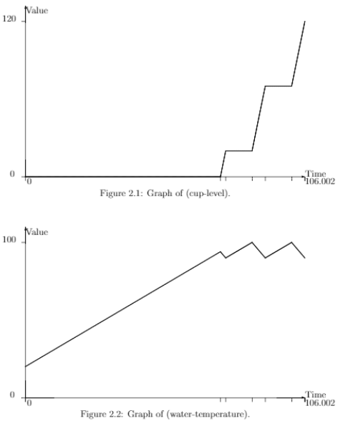
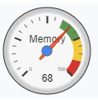
Coffee machine planning – solving opposing LP constraints

