Slide 1
BLACK | BANK
APP
Filip Fojtík, 4. semestr, B - IT
https://github.com/FilipFojtik/Black-Bank

Slide 2
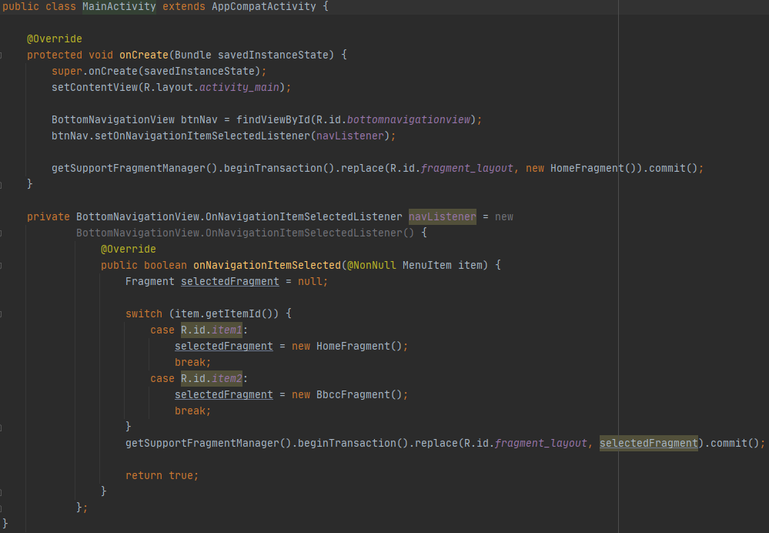
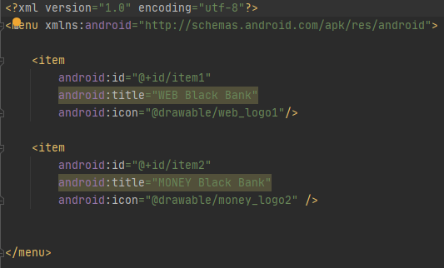
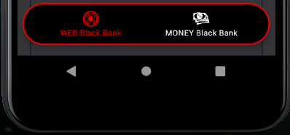
ROZVRŽENÍ | MENU
https://github.com/FilipFojtik/Black-Bank/tree/master/app/src/main/res/menu
https://github.com/FilipFojtik/BlackBank/tree/master/app/src/main/java/com/example/blackbank_semestralni_prace

Slide 3
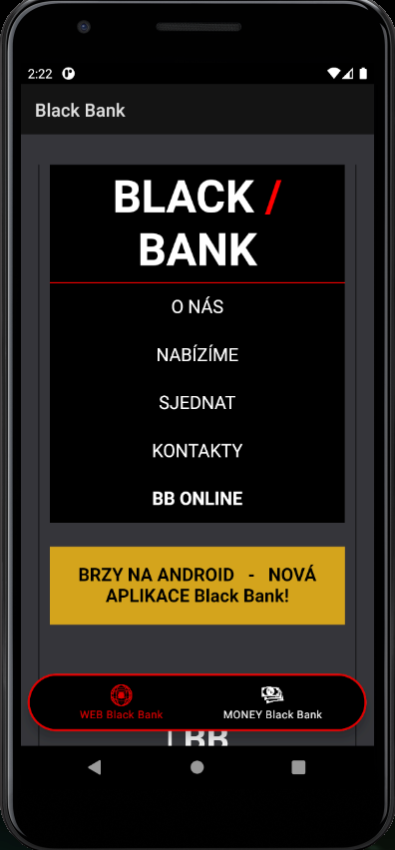
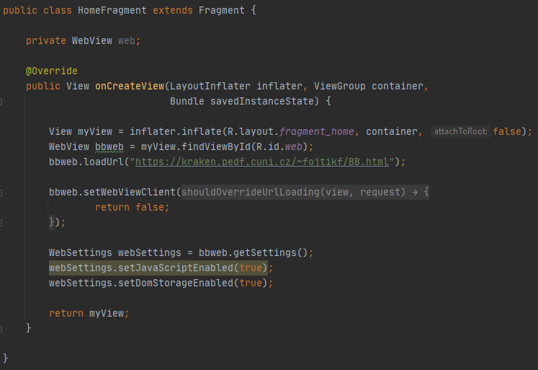
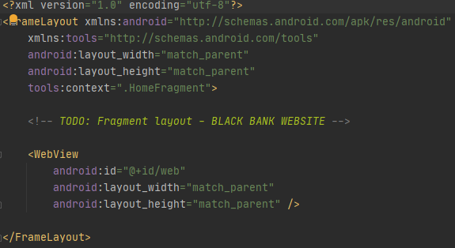
WEB | LAYOUT
https://github.com/FilipFojtik/BlackBank/tree/master/app/src/main/java/com/example/blackbank_semestralni_prace

Slide 4
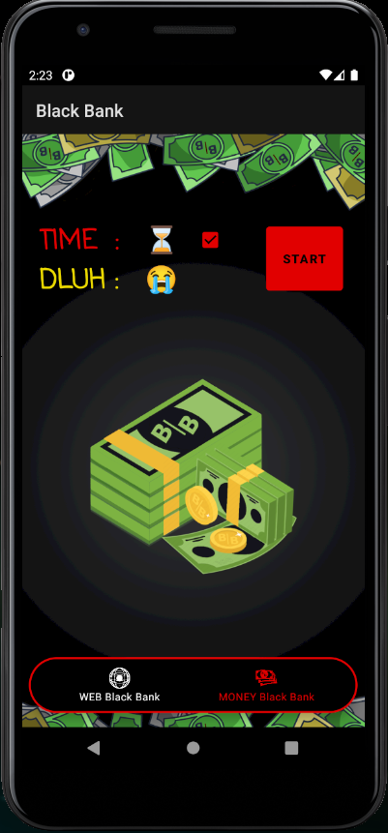
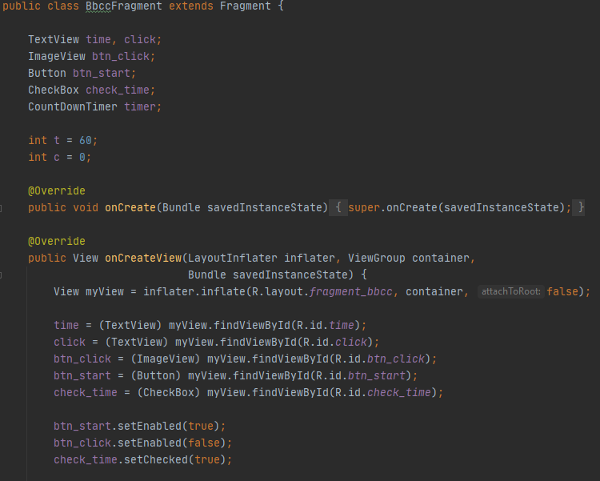
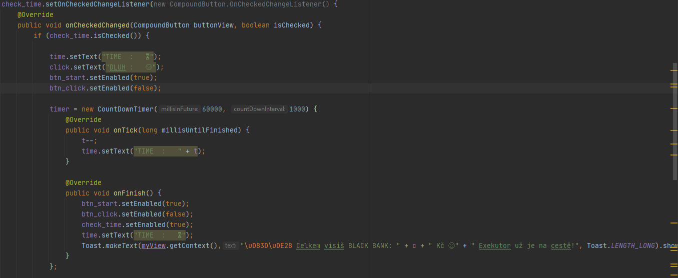
GAME | LAYOUT
https://github.com/FilipFojtik/Black-Bank/tree/master/app/src/main/java/com/example/blackbank_semestralni_prace

Slide 5
https://github.com/FilipFojtik/Black-Bank

