Slide 1
Intelligent tree data management component
Jakub Lečbych

Slide 2

Content
Goal
Introduction to the problem
API research
Technology
Component structure design
Component life cycle (data flow)
Pros and cons
Competitive solutions
Demo

Slide 3
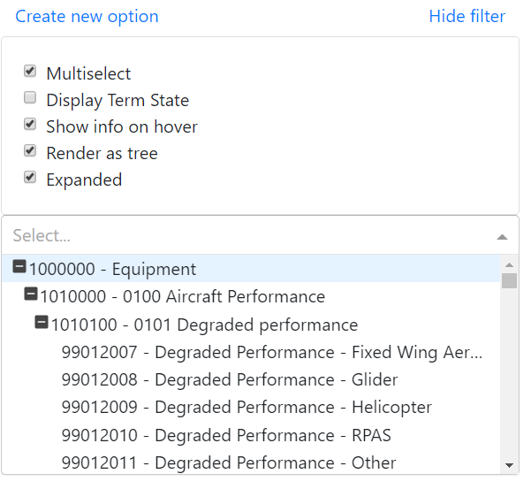
Goal
Create UI component for selecting/ multi-selecting options
UI component will be represented as input field with dropdown menu

Slide 4
No existence of a component supporting following
Multiple option providers
Linked data
Flexible
Maintain same functionality as current solutions
Multi-select, show options as tree, collapsible tree branches, etc.
Additional functionality of the new component
Display some info such as description, status, etc.
Creating new options
Configuration in UI (e.g. selectin type)
Downloading data from different providers simultaneously
Introduction to the problem

Slide 5
API research
Based on several definitions
Type – web, system, software, hardware, ...
Data format – file, JSON, CSV, XML, ...
Returned informations – complete data, data headers (IDs), ...
Returned structure – list, tree, graph, ...
URL structure
Protocol + ´sub domain´ + Domain + ´version´ + endpoint + ´query´
Example:
https://www.api.spotify.com/v1/artist/123456789/albums?location=CZ,SK&limit=25&offset=5

Slide 6


Technology

Slide 7
Component structure
STORE
Inteligent tree management component
Global storage for all data
Settings
Virtualized tree-select component
Form
Ability to edit component behavior
Core module for searching and selecting options
For adding new options
Virtualized select component
3rd party module powered by @bvaughn

Slide 8
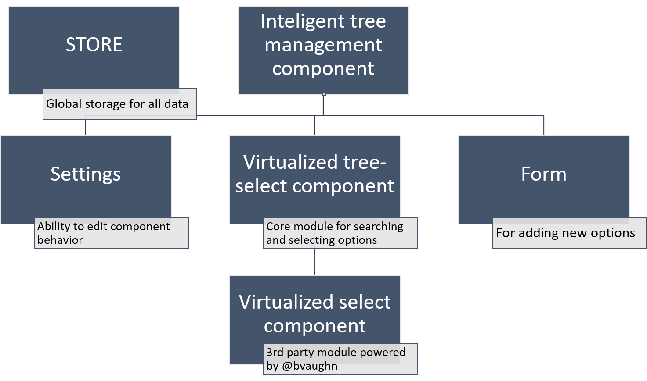
Component structure

Slide 9
Life cycle
Search
Show all options
Asynchronous requests to all providers
Inicialize store
Render components
Preproces local options
Set up component behavior
Create all necesary variables
Create actual html elements
Create tree graph
Remove duplicite options
Filter responses
Filter local options
Preproces responses
Show local results

Slide 10
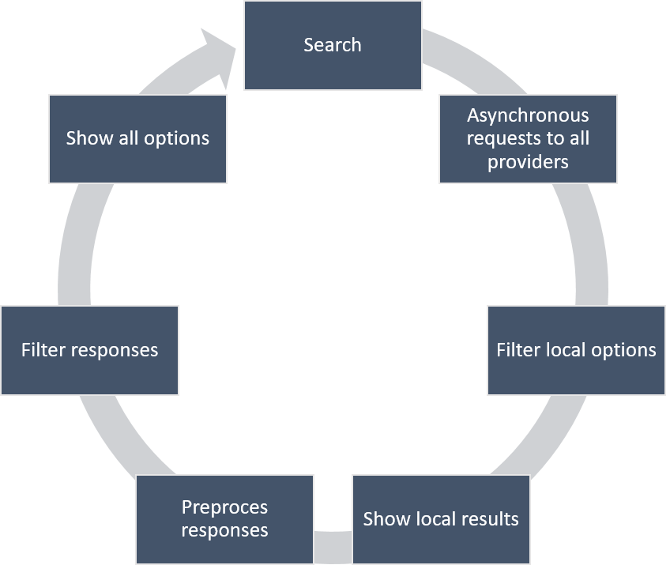
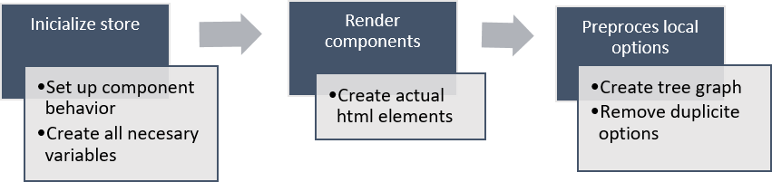
Component flow + life cycle

Slide 11
Pros and Cons
Pros
Support multiple option providers
Work with linked data
Huge customization potencial
Easily integable with other react application
Does not affect UI performance (rendering)
Cons
Processing data may be slow
Merging duplicates and creating tree graph can took some time for large datasets (1000+ items)
By default support only JSON data format (? - CSV, XML)

Slide 12
Competitive solutions

Slide 13
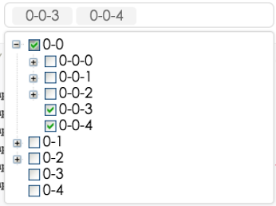
RC-tree
Pros
Draggable options
Cons
Unable to customize render method
Render all options at once
Removing selected only via checkbox
Support only specific option format
{ label: ‘node1’, children: [ { label: ‘node1-0’, children: []}, …]}
http://react-component.github.io/tree/

Slide 14
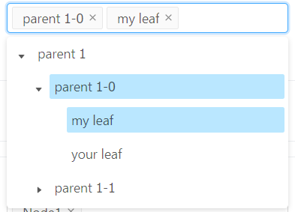
Ant.design tree-select
Pros
Modern design
Cons
Each option take too much space
Unable to customize render method
Render all options at once
https://ant.design/components/tree-select/

Slide 15
Demo

Slide 16
Thanks you for your attention
Questions?

