Slide 1
Intelligent tree data management component
Jakub Lečbych

Slide 2
Content
Introduction to the problematics
API research
Technology
Component structure design
Component life cycle (data flow)
Pros and cons
Demo

Slide 3
Introduction to the problematic
No existence of the component supporting following
Multiple option providers
Linked data
Flexible
Maintain same functionality as current solutions
Multi-select, show options as tree, collapsible tree branches
Additional functionality of the new component
Display some info such as description, status, etc.
Creating new options
Configuration in UI (e.g. selectin type)

Slide 4
API research
Based on several definitions
Type – web api, system api, software api, hardware api, ...
Data format – file, JSON, CSV, XML, ...
Returned informations – complete data, data headers (IDs), ...
Returned structure – list, tree, graph, ...
URL structure
Protocol + ´sub domain´ + Domain + ´version´ + endpoint + ´querry´
Example: https://www.api.spotify.com/v1/artist/123456789/albums?location=CZ,SK&limit=25&offset=5

Slide 5
Technology
React + Redux
NPM
JSON-LD (? - Podporuji, ale není to technologie, na které jsem závislý)
React select component (? - komponenta, kterou používám ve své)

Slide 6
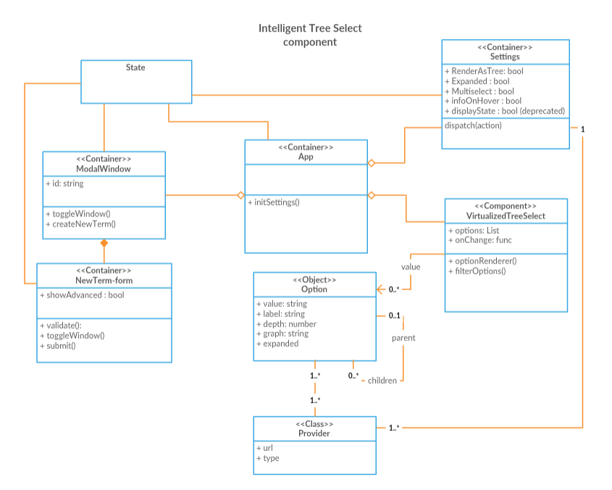
Component structure
TODO nový diagram

Slide 7
Life cycle
TODO

Slide 8
Pros and Cons
Pros
Cons
Support multiple option providers
Work with linked data
Huge customization potencial
Easily integable with other react application
Does not affect UI performance (rendering)
Procesing data may be slow
By default support only JSON data format (? - CSV, XML)

Slide 9
Demo

Slide 10
Thanks you for your attention
Questions?

