Slide 1
Intelligent tree data management component
Jakub Lečbych

Slide 2

Content
Introduction to the problem
API research
Technology
Component structure design
Component life cycle (data flow)
Pros and cons
Demo

Slide 3
No existence of a component supporting following
Multiple option providers
Linked data
Flexible
Maintain same functionality as current solutions
Multi-select, show options as tree, collapsible tree branches, etc.
Additional functionality of the new component
Display some info such as description, status, etc.
Creating new options
Configuration in UI (e.g. selectin type)
Introduction to the problem

Slide 4
API research
Based on several definitions
Type – web, system, software, hardware, ...
Data format – file, JSON, CSV, XML, ...
Returned informations – complete data, data headers (IDs), ...
Returned structure – list, tree, graph, ...
URL structure
Protocol + ´sub domain´ + Domain + ´version´ + endpoint + ´query´
Example:
https://www.api.spotify.com/v1/artist/123456789/albums?location=CZ,SK&limit=25&offset=5

Slide 5


Technology

Slide 6
Component structure
STORE
Inteligent tree management component
Global storage for all data
Settings
Virtualized tree-select component
Form
Ability to edit component behavior
Core module for searching and selecting options
For adding new options
Virtualized select component
3rd party module powered by @bvaughn

Slide 7
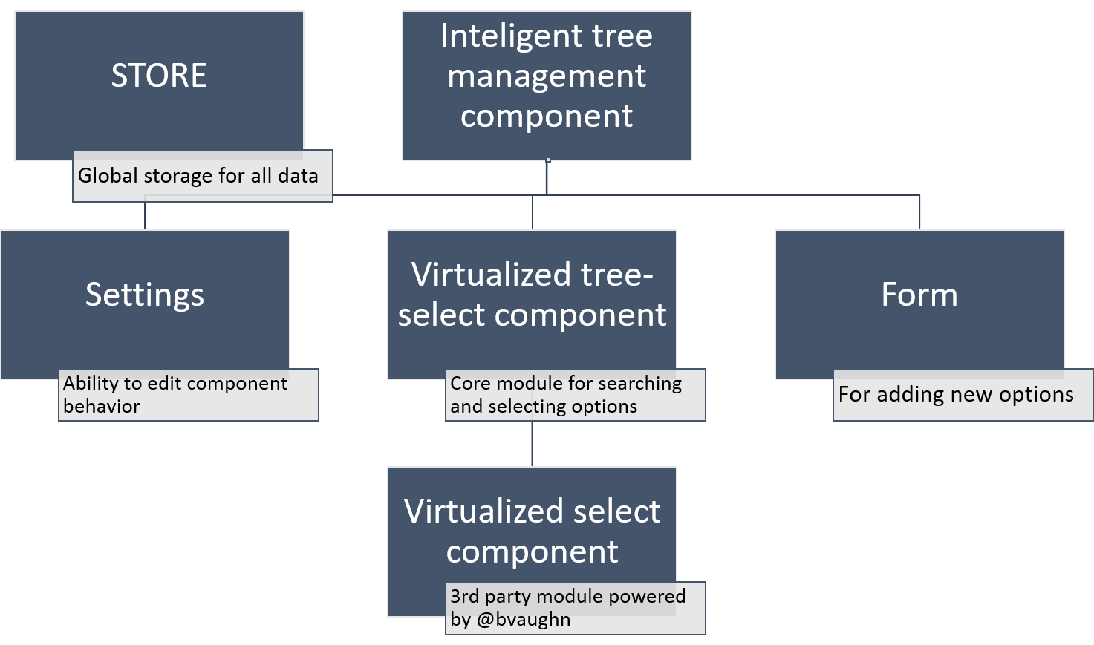
Component structure

Slide 8
Life cycle
Search
Show all options
Asynchronous requests to all providers
Inicialize store
Render components
Preproces local options
Set up component behavior
Create all necesary variables
Create actual html elements
Create tree graph
Remove duplicite options
Filter responses
Filter local options
Preproces responses
Show local results

Slide 9
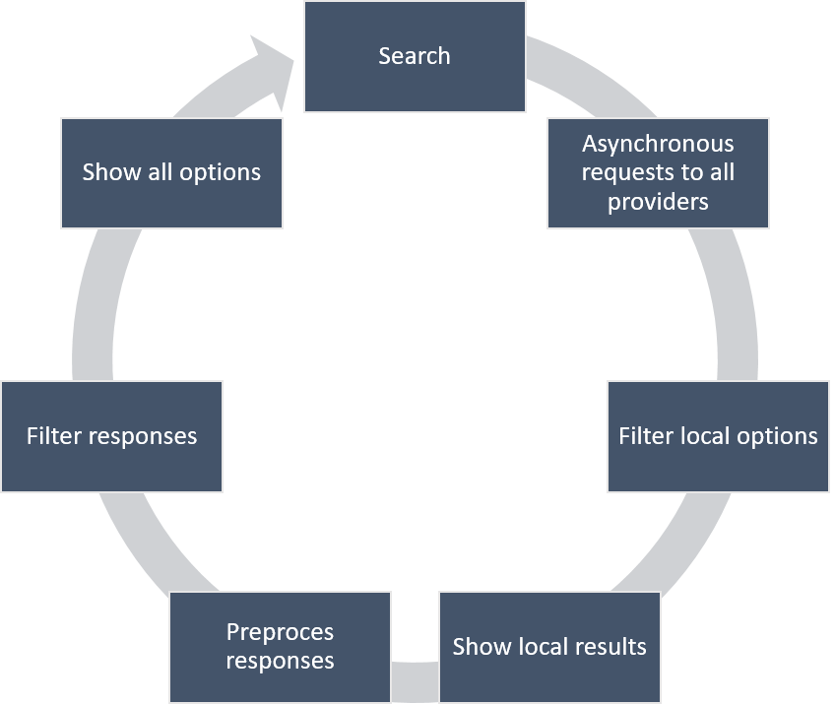
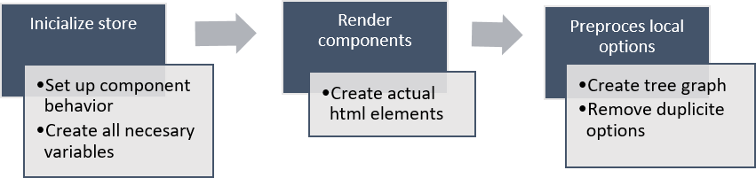
Component flow + life cycle

Slide 10
Pros and Cons
Pros
Support multiple option providers
Work with linked data
Huge customization potencial
Easily integable with other react application
Does not affect UI performance (rendering)
Cons
Processing data may be slow
By default support only JSON data format (? - CSV, XML)

Slide 11
Competitive solutions

Slide 12
Demo

Slide 13
Thanks you for your attention
Questions?

