Slide 1
Progress DO 30.07.2020

Slide 2
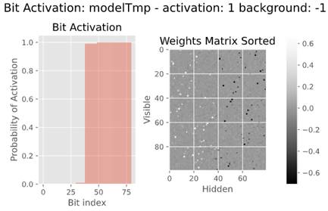
Bit Activation and Weight Matrix
Bit Activatio Procedure:
Activate separetelly only one input node
Binarize encoded represtnations around 0 (x>0: 1 else 0)
Calculate bit activation probability
Sort bits according to their probability (stable sort)
Weights Matrix Sorted procedure:
Sort matrix columns in the same way
as we sorter bits distributon
Plot’s conclusions:
Negative weights transfer bit contribution further
Positive weights exclude bit contribution
Cons:
Binarization of the encoded representation is heuristic.

Slide 3
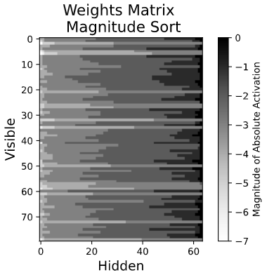
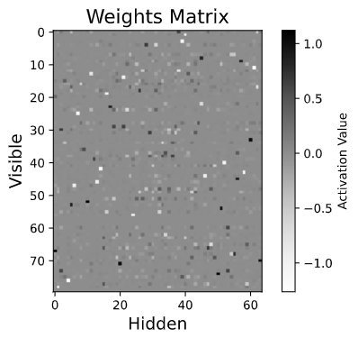
Weight Matrix Magnitude ”Unit” Sort
Procedures for every row:
1. Take absolute value for every weight in a row
2. Calculate rounded Log10 value for every weight in a row
3. Sort such modyfied row

Slide 4
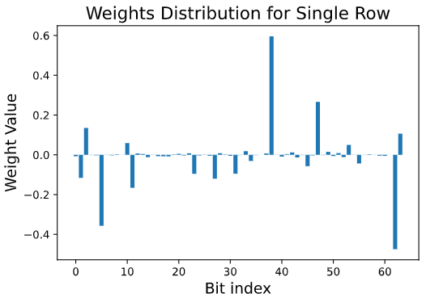
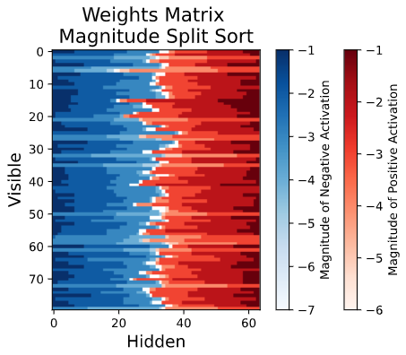
Weight Matrix Magnitude ”Split” Sort
Positive Split
Negative Split
Procedures for every row:
Split the row into two (positive and negative weights)
Add zeros to splits to fill the whole dimension
Descending sort of the positive split
Ascending sort of the negative split
Calculate rounded Log10 value for every weight in a positive split
Calculate rounded Log10 -value for every weight in a negative split
Create two mask and stack them

Slide 5
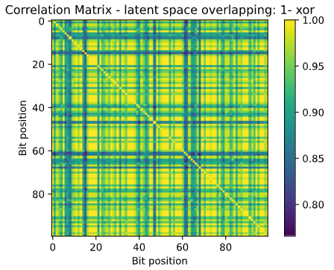
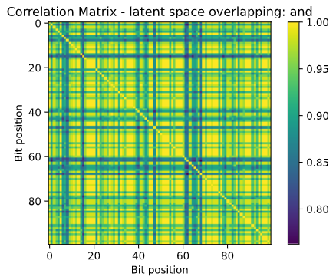
Correlation Matrix - latent space overlapping
Procedures:
Activate every single input node deactivat all the rest
Check bits correlation based on the encoded representaion similarities
(encoded representation is binarized around 0)
* 1-xor: calculate fraction of overlapping bits
* and: calculate fraction of overlapping active bits
* RMSE: root mean square error
Cons: Binarization of latent space seems to be heuristic and not very accurate
Further measures: Discretize arround magnitude of activation

Slide 6
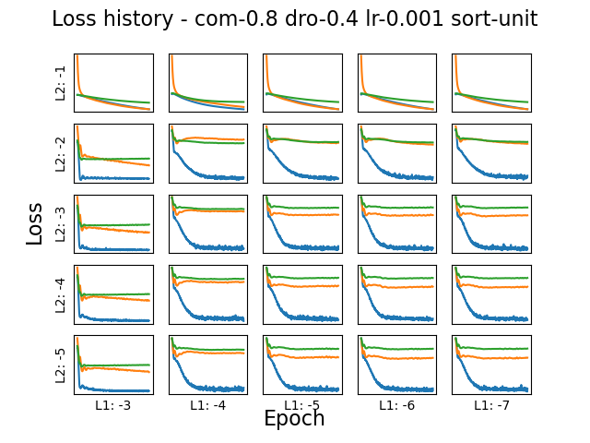
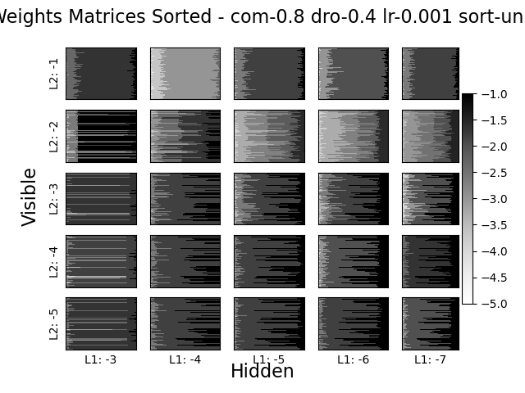
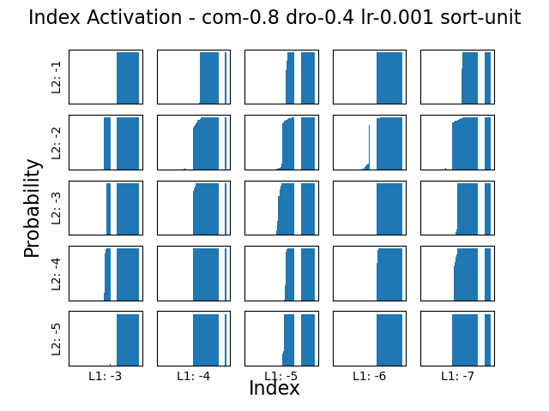
Hyperparamters Tuning: L1 and L2
L1 and L2 values are rounded log10

Slide 7
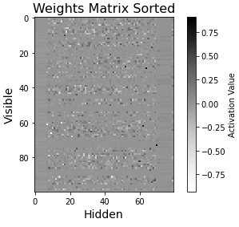
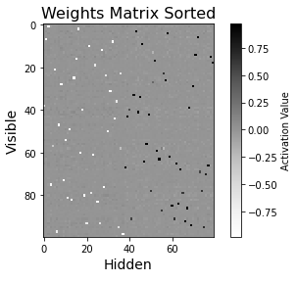
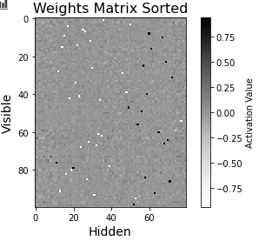
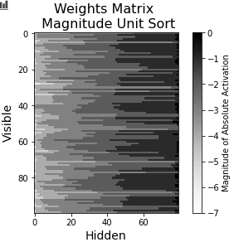
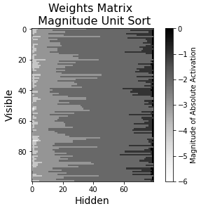
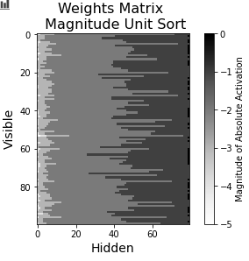
Shallow DO Weights: compression = 0.8, batch_size = 20, reg_cof = [0.0001, 0.001], dropout = 0.3
lr = 0.0002
lr = 0.002
lr = 0.02

Slide 8
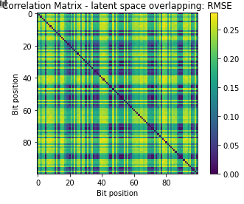
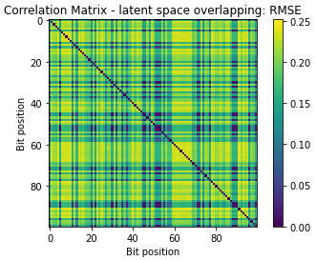
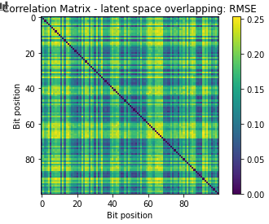
Shallow DO Correlations: compression = 0.8, batch_size = 20, reg_cof = [0.0001, 0.001], dropout = 0.3
lr = 0.0002
lr = 0.002
lr = 0.02

Slide 9
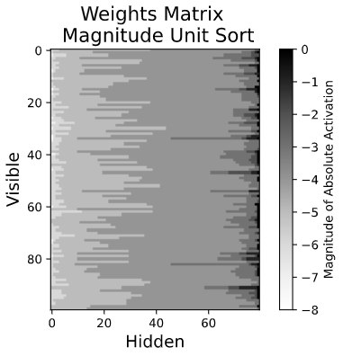
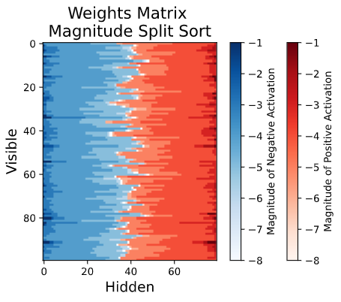
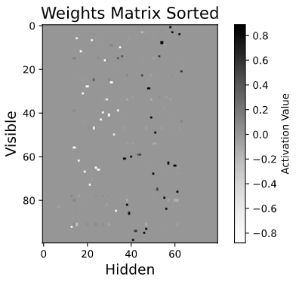
Shallow DO: compression = 0.8, batch_size = 20, reg_cof = [0.001, 0.001], dropout = 0.4, lr = 0.0001,

Slide 10
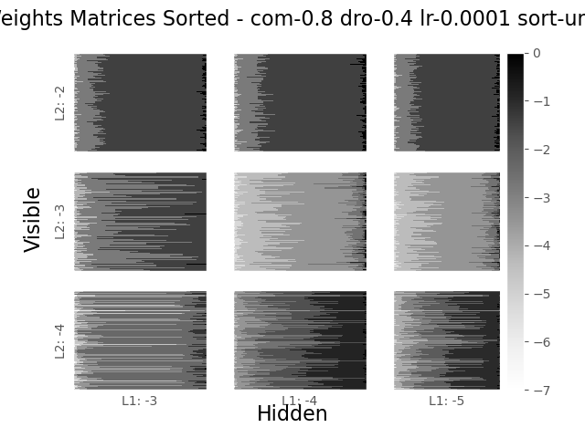
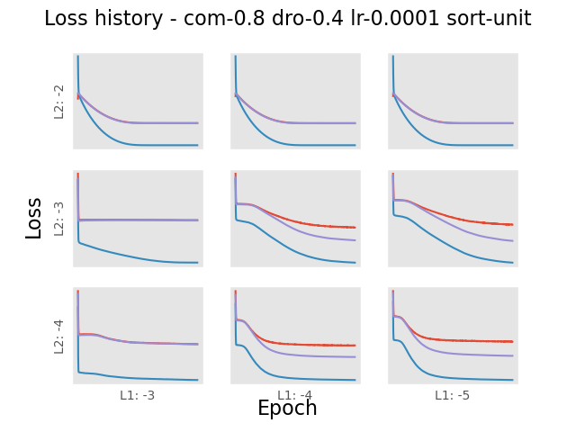

Slide 11
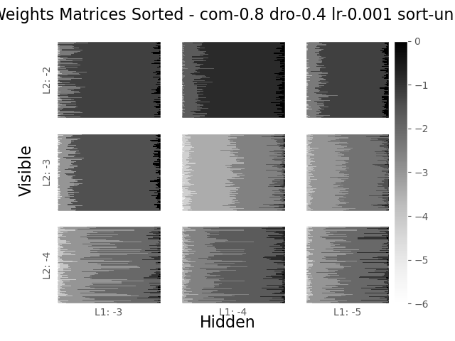
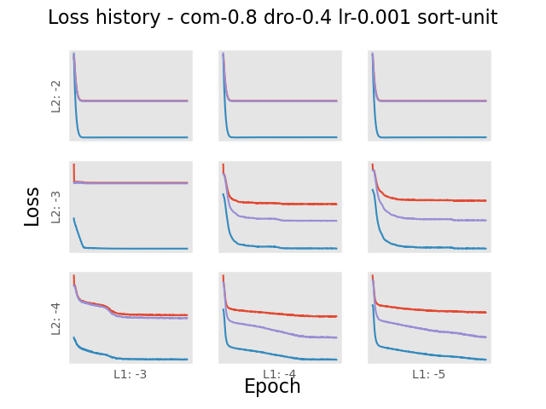

Slide 12
