Slide 1
Master Thesis Algorythm

Slide 2
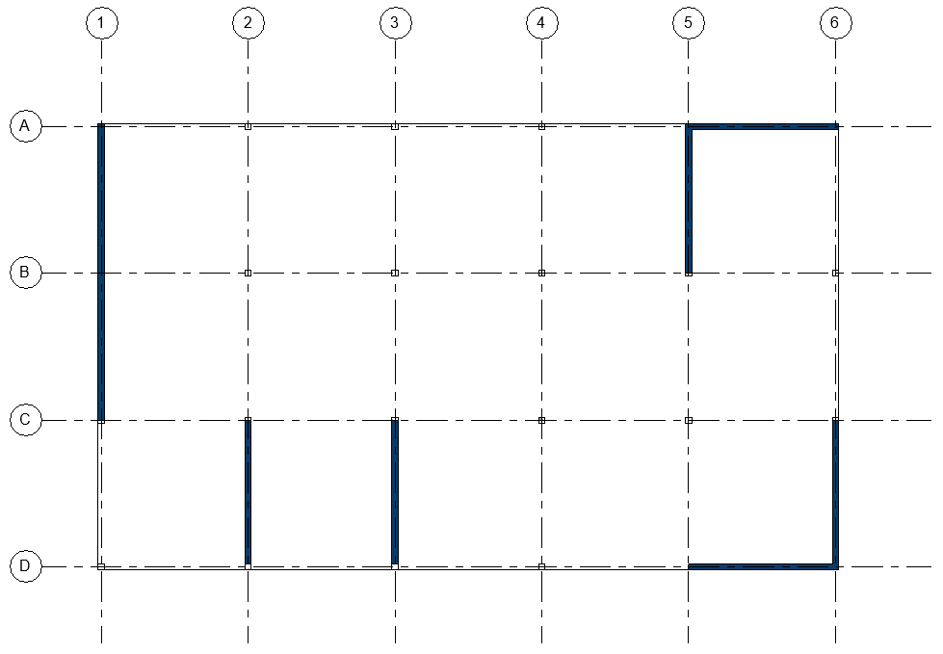

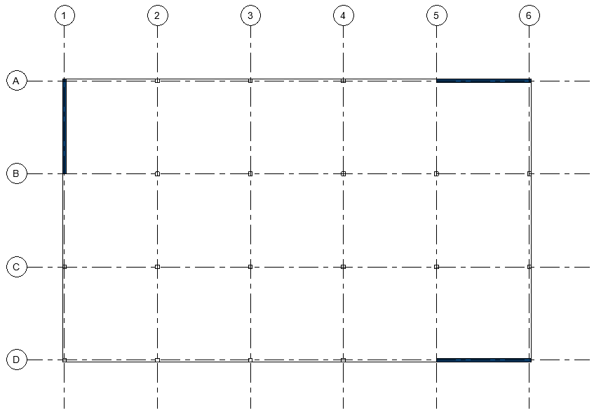
Struktur der Arbeit
Step 1:
Check module
Step 2:
Layout searching module
Ausnutzug:

Slide 3
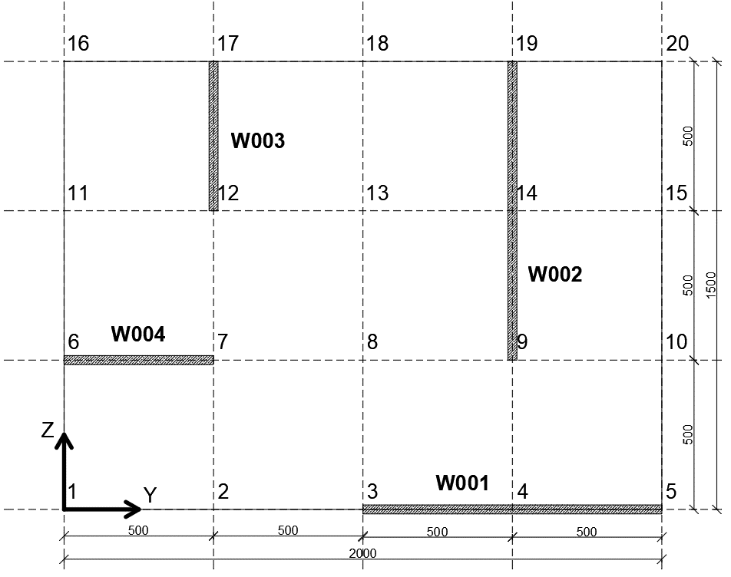
Calculational example

Slide 4
Classes
Vertical Load
Fields: vertical load value
Methods: calling vertical load value
Wall
Fields: -position coordinates, orientation, physical parameters
Methods: - calculation and calling each of physical parameters of a wall
Grid
Fields: - numer of horizontal and vertical axes, spacing between the axes
Methods: - returning list of Points based on the axes dimensions
Point
Fields: - coordinates of the grid cross-sections
Methods: - returning of points coordinates
Building
Fields: - combined values of walls’ physical parameters
Methods: - Combining parameters of all walls

Slide 5
Step 1: Main Program
Input data
New Building()
New Grid()
Grid > List of Points > Walls definition
Parameters for each wall (moments, stiffnesses)
Walls’ parameters > Shear Center of the system
Rotation criteria
Building()
Validation of translation and rotation criteria
Global buckling loads:
FvBB, FvBS…
Global parameters (warpingAreaMoment, sums of stiffnesses…)
Vertical load

Slide 6
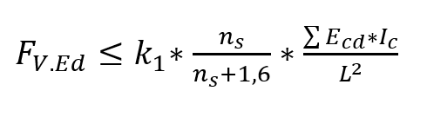
Analysis of design conditions - Translation
k1– constant parameters
L , ns – height of the building (permanent)
E – Young’s Modulus (permanent)
Ic – second moment of inertia – affects the result

Slide 7
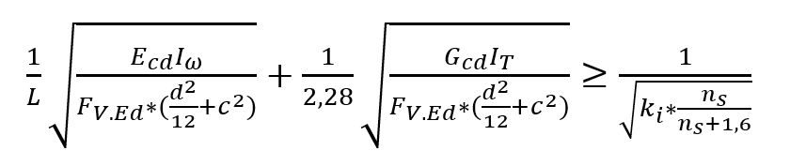
Analysis of design conditions - Rotation
K1 – constant parameters
L, ns, d – building’s parameters(permanent)
E, G – material’s parameters(permanent)
Iω – warping area moment - affects the result
IT – torsion area moment - affects the result
c – distance between geometrical centre and shear centre of a building - affects the result

Slide 8
Decisive parameters
I_{c} – second moment of inertia (b*h³/12): few long walls > many short walls
I_{ω} – warping moment of inertia – increases with the distance from shear center of the building to the center of a wall : walls distributed along perimeter, external walls
I_{T} – torsional moment of inertia – for a wall-like element can be taken as : 0,323*b³*h – but increasing the thickness is not reasonable
c - distance between geometrical centre and shear centre of a building: symmetrical layout of walls

Slide 9
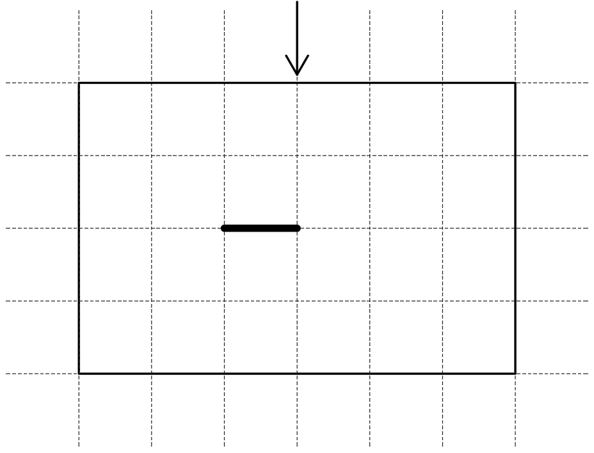
Search for the solution
1 wall
Failure due to translation in perpendicular direction

Slide 10
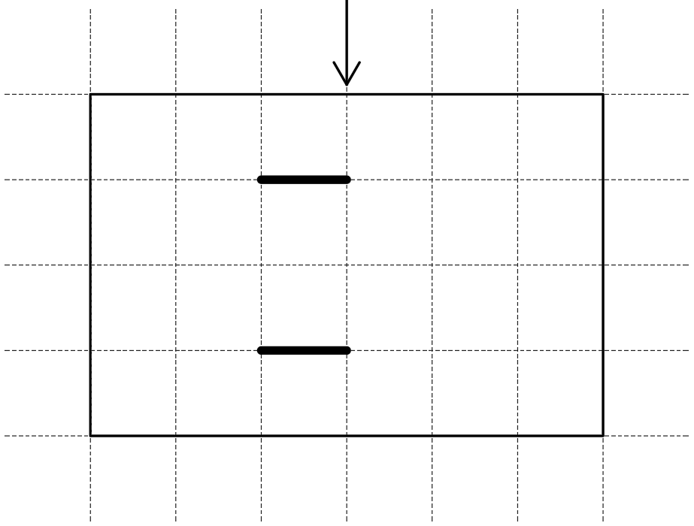
Search for the solution
2 walls -parallel
Failure due to translation in perpendicular direction

Slide 11
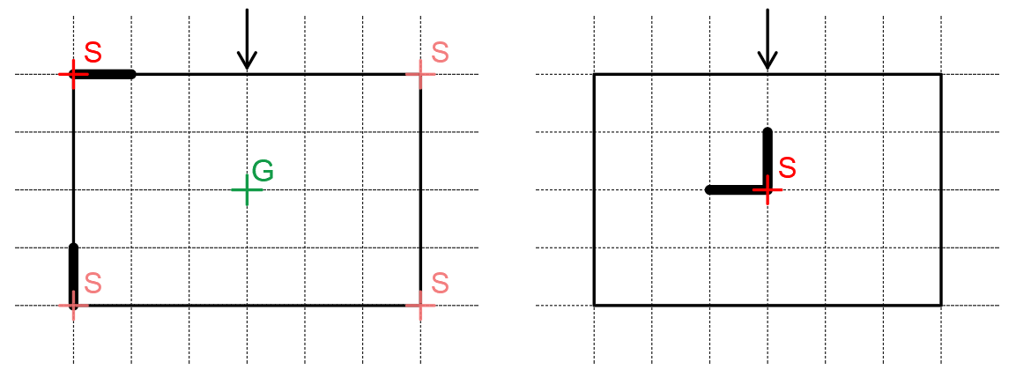
Search for the solution
2 walls -perpendicular
Solution 1: Walls distributed along perimeter, I_{ω} c
Solution 2: Walls located close to the buildings centre I_{ω} c

Slide 12
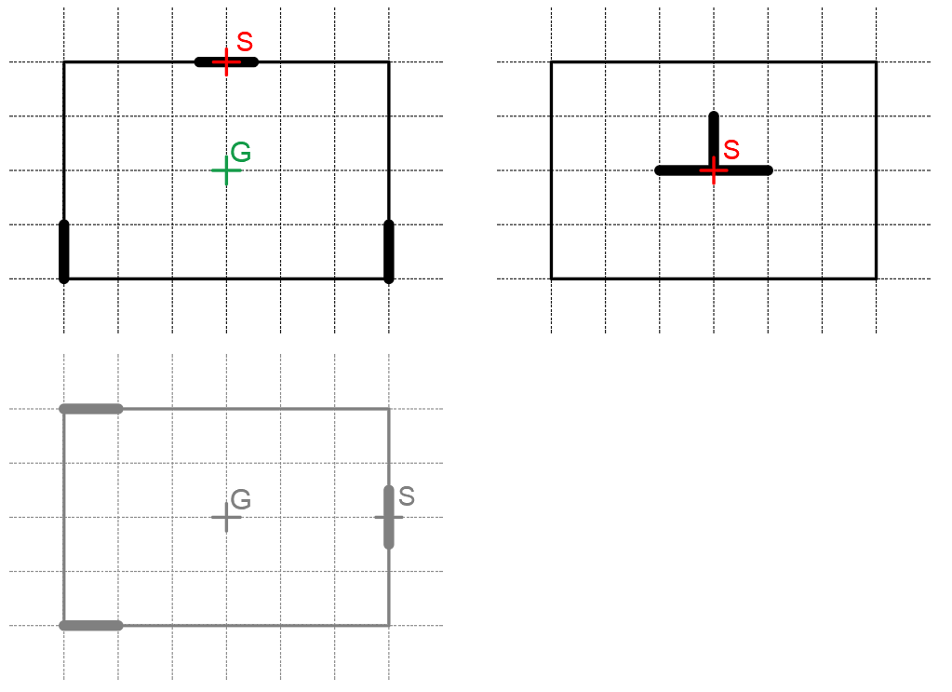
Search for the solution
3 walls
Solution 1: Walls distributed along perimeter, I_{ω} c
Solution 2: Walls located close to the buildings centre I_{ω} c

Slide 13
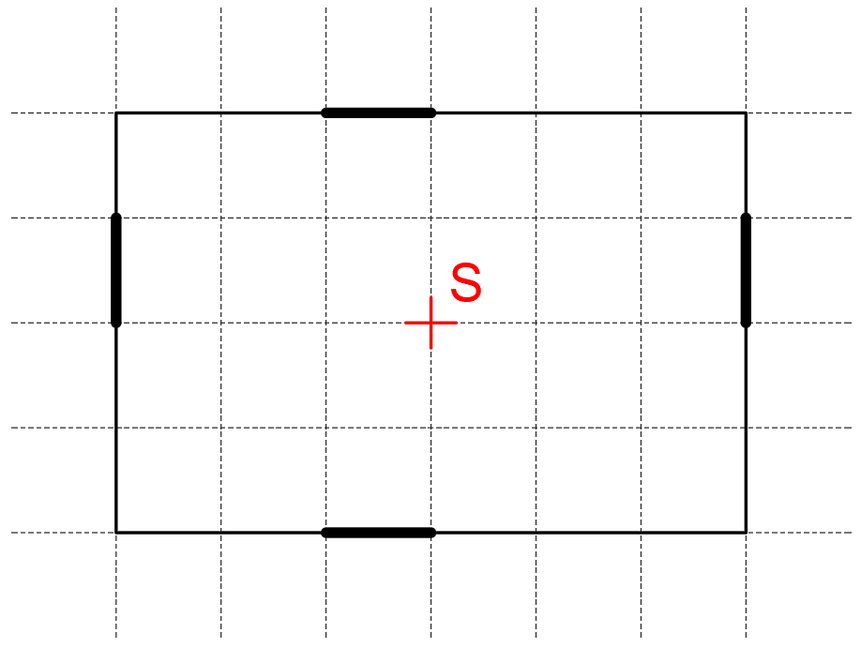
Search for the solution
4 walls
One Solution: Walls distributed along perimeter, symmetrical distribution of walls I_{ω} c

Slide 14
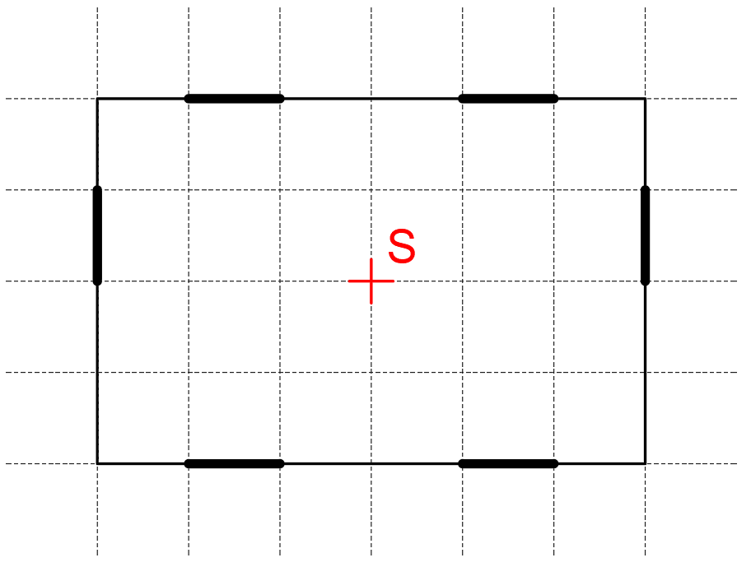
Search for the solution
5 walls and more…
Increasing the numer of walls = increasing the length of 4 walls I_{ω} c

