Slide 1
Apriori
EDAMI Project 2022
Student team: Dora Doljanin & Filip Pavičić

Slide 2
Project topic
Topic 2: Implementation of an Apriori algorithm for discovering association rules with items occurrence constraints.

Slide 3
Project goals
Create our own implementation of a data mining Apriori algorithm and test its properties (scaling, influence of parameters values on results, etc.)

Slide 4
Tools and dataset
Programming language: Java
IDE: Eclipse
Dataset: Mushroom dataset
Test: Unit tests, we obtain expected test results using R library arules

Slide 5
Supported arguments
support
lift
confidence
minlen
maxlen
right side items
left side items

Slide 6
Classes
Main
Utils
Rule:
double support;
double confidence;
double lift;
ItemSet leftSide;
ItemSet rightSide;
ItemSet:
Set<String> items;
double support;

Slide 7
Classes (2)
Apriori:
Set<String> items;
double support;
double confidence;
Predicate<Double> lift;
int minlen;
int maxlen;
Set<String> rightSide;
Set<String> leftSide;
Set<Rule> rules;
Set<ItemSet> frequentItemSets;
double frequentItemSetsSupport = 0.0;
int frequentItemSetsMaxLen = 0;
Set<String> frequentItemSetsItems = new HashSet<>();
boolean rulesLiftChanged = false;
double rulesConfidence = 0.0;
boolean frequentItemSetsChanged = false;
int rulesMinLen = 0;
Set<String> rulesLeftSide = new HashSet<String>();
Set<String> rulesRightSide = new HashSet<String>();
Comparator<ItemSet> frequentItemSetsComparator = (a, b) -> Double.compare(b.getSupport(), a.getSupport());
Comparator<Rule> rulesComparator = (a, b) -> Double.compare(b.getConfidence(), a.getConfidence());

Slide 8

Discovering frequent item sets
We use: support, maxlen
We do not start the process of discovering frequent item sets every time, but only when:
there are no frequent item sets yet
a required support is lower than the support of frequent item sets we already have
a required maxlen value is bigger than the maxlen value of frequent item sets we already have

Slide 9
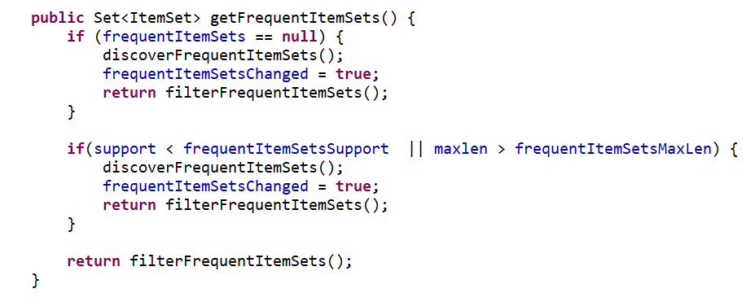
Code implementation

Slide 10
Discovering association rules
We use: support, lift, confidence, minlen, maxlen
We do not start the process of discovering association rules every time, but only when:
there are no association rules yet
frequent item sets changed
a required confidence value is lower than the confidence value of association rules we already have
rules lift changed
if the left or the right side changed
a required minlen value is smaller than the minlen value of frequent item sets we already have

Slide 11
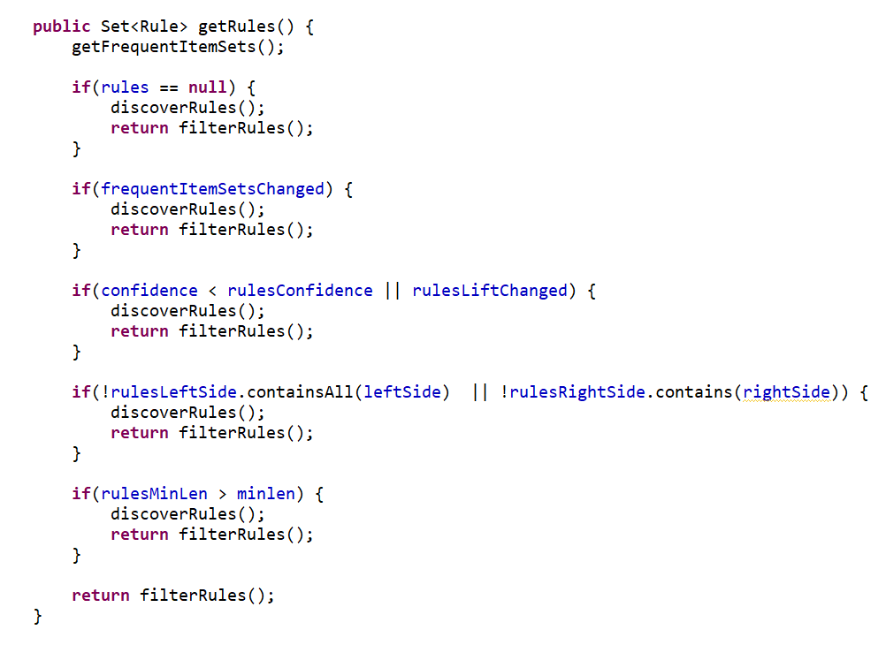
Code implementation

Slide 12
Items occurrence constraints
We provide items occurrence constraints separate for the left and the right side
User can define an array of items and one of the available properties
all – all elements from array must occur
any – at least one element from array must occur
none – none of the elements from array should occur

Slide 13
Testing plan
We will test application performance on Mushroom dataset
For test purpose we will multiply mushroom dataset 1x, 2x, 5x, and 10x times
We will use different supported arguments for testing performance
We will provide graph results

