Slide 1
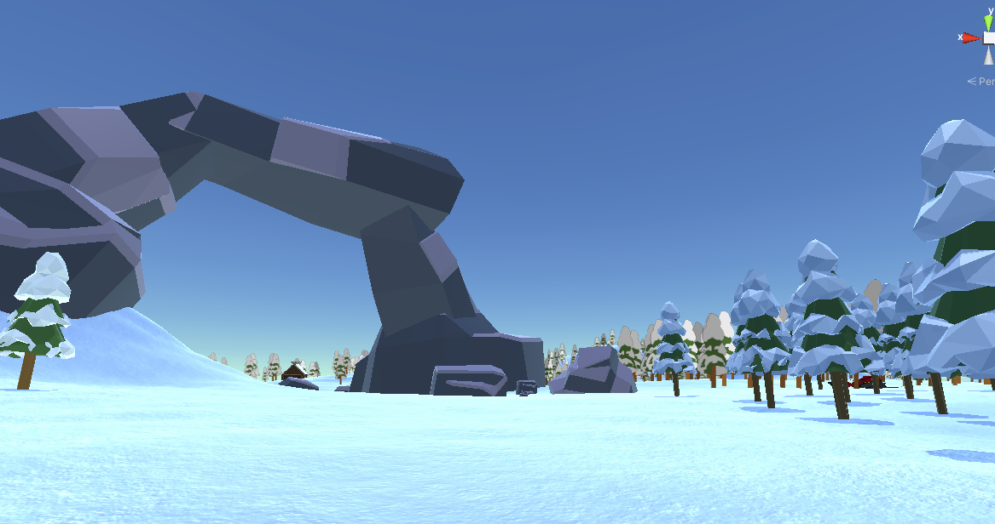




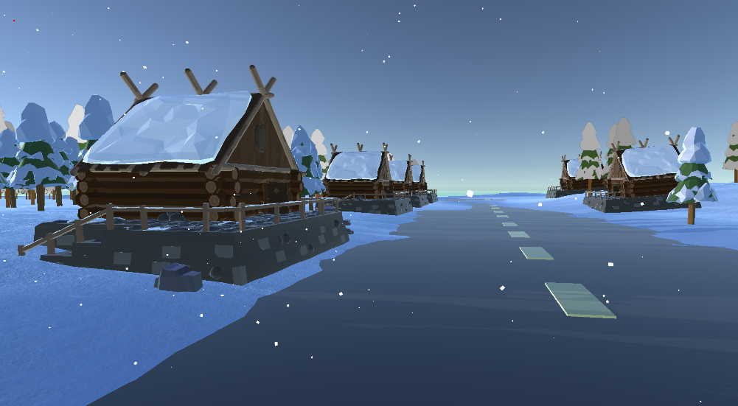
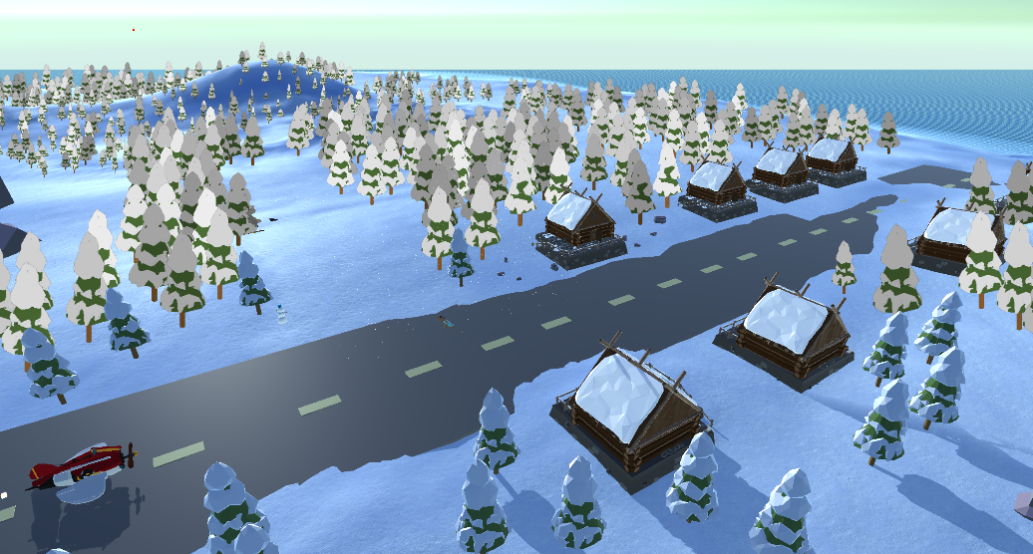
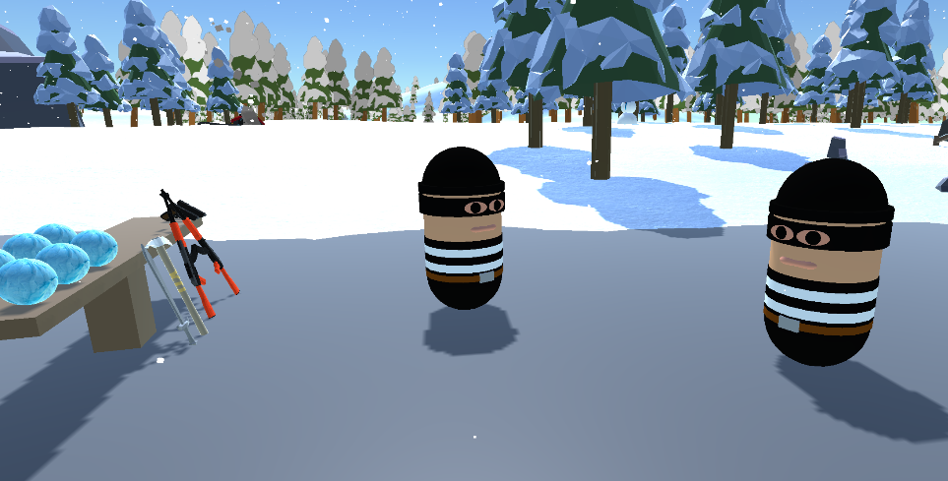
Winter Wonder – VR Multiplayer Project
Filip Rusiecki – Student number: C00250721
(All images and background captured in game)
Portfolio:
LinkedIn:
A Muliplayer survival-based game in VR. Players goal would be to survive and fight other players as well as surviving the cold weather in a large scale environment which has different locations. While players scavenge the land they will encounter parts for a buildable plane that they can make and then fly with it. While progressing through the game players would face challenges such as monsters, cold extreme weathers and also other players, the game also has a day and night cycle Players would have to find shelter (set up a base to be safe from the creatures).

