Slide 1
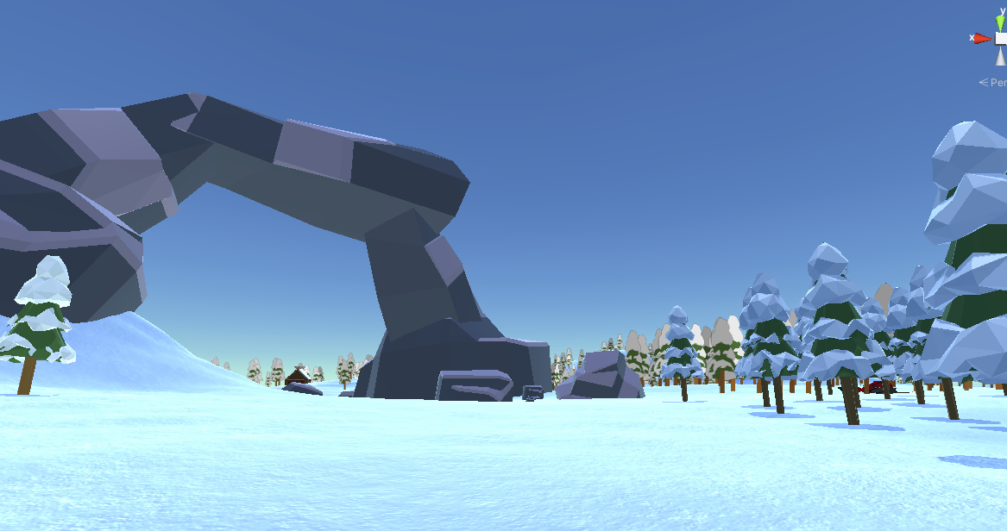
Winter Wonder – VR Multiplayer Project
Filip Rusiecki

