Slide 1
Introduction into C++ Template Meta Programming

Slide 2
Motivating Example
Create a string for logging of content of any value …
template <typename T>
std::string printValue(T const& v);
Any Type may has an operator <<
Any Type may be derived from Formattable
Any Type may have an implementation of PrintTo function

Slide 3
Let’s specialize
template <typename T>
std::string printValue(T const& v);
template <>
std::string printValue(std::string const& v) {
return v;
}
template <>
std::string printValue(MString const& v) {
return v.toStdString();
}

Slide 4
Implement for all types …
This is rather boring!
Error prone!
New types need special care!

Slide 5
Next try – let’s delegate the work
template <typename T>
struct Printer;
template <typename T>
std::string printValue(const T& v){
std::ostringstream os;
Printer<T>::print(v, os);
return os.str();
}

Slide 6
Let’s do it for std::string
template <>
struct Printer<std::string>
{
static void print(std::string const& v,
std::ostream& os) {
os << v;
}
};

Slide 7
Nothing gained so far…
But let’s change the struct Printer a bit:
template <typename T, typename Enabled = void>
struct Printer;

Slide 8
What is “typename Enabled = void” ?
template <typename T,
typename Enabled = void>
struct Printer;
Is only taken into account during specialization if the type “Enabled” is a real type
So use it as a switch within a switching construct
C++11’s switch std::enable_if<U>::type
boost’s switch boost::enable_if<U>::type
U must be true- or false-type

Slide 9
Let‘s make a switch
template<bool B, class T = void>
struct enable_if {};
Partially specialization for true:
template<class T>
struct enable_if<true, T>
{
typedef T type;
};

Slide 10
What‘s a true or false type?
struct true_type
{
static const bool value = true;
};
struct false_type
{
static const bool value = false;
};

Slide 11
Let’s use a partial specialization for all types that have a string stream operator
template <typename T>
struct Printer<T,
typename std::enable_if<
has_string_stream_operator<T>::value,
T>::type
>
{
static void print(T const& v, std::ostream& os) {
os << v;
}
};

Slide 12
Who needs PrintTo()?
Preferred interface in GoogleTest to print values
Used by GoogleTest to print values in case an assertion failed
void PrintTo(int v, std::ostream* s);

Slide 13
More specialization …
template <typename T>
struct Printer<T,
typename std::enable_if<
has_PrintTo<T>::value,
T
>::type
> {
static void print(T const& v, std::ostream& os){
PrintTo(v, &os);
}
};

Slide 14
Classic SFINAE (Specialization failure is not an error)
typedef char Yes;
typedef int No;
This may not work, because standard does not require sizeof(int) != sizeof(char)
template <typename T>
class has_PrintTo
{
typedef char Yes;
typedef struct No { char dummy[2]; };
template<typename U>
static Yes test(U* p);
template<typename>
static No test(...);
public:
static const bool value =
sizeof(test<T>(nullptr)) == sizeof(Yes);
};
The general form is not enough!

Slide 15
Get a little help from decltype
template <typename T>
class has_PrintTo
{
typedef char Yes;
typedef struct No { char dummy[2]; };
static std::ostream os;
template<typename U>
static decltype(PrintTo(*p, &os), Yes(0)) test(U* p);
template<typename>
static No test(...);
public:
static const bool value =
sizeof(test<T>(nullptr)) == sizeof(Yes);
};
Comma Operator
Unfortunately does not compile!

Slide 16
Final has_PrintTo
template <typename T>
class has_PrintTo
{
typedef char Yes;
typedef struct No { char dummy[2]; };
static std::ostream os;
template<typename U>
static auto test(U* p) -> decltype(PrintTo(*p, &os), Yes(0));
template<typename>
static No test(...);
public:
static const bool
value = sizeof(test<T>(nullptr)) == sizeof(Yes);
};

Slide 17
has_string_stream_operator
template <typename T>
class has_string_stream_operator {
typedef char Yes;
typedef struct No { char dummy[2]; };
static std::ostream os;
template<typename U>
static auto test(U* p) -> decltype(os << *p, Yes(0));
template<typename>
static No test(...);
public:
static const bool
value = sizeof(test<T>(nullptr)) == sizeof(Yes);
};

Slide 18
With a little help of std::is_base_of for Formattable types
template <typename T>
struct Printer<T,
typename std::enable_if<
std::is_base_of<Formattable,
T>::value
>::type> {
static void print(T const& v, std::ostream& os){
Formatter f;
v.formatTo(f);
os << f.getString().toStdString();
}
};

Slide 19
printValue now can take any value of a type that
has a string stream operator<<
or has a PrintTo(T const&, std::ostream*) function
or is Formattable

Slide 20
Let’s write a UnitTest!
Test
PrintTo
stream operator
and for other traits
Done!

Slide 21
Used it in real code…
Does not compile for std::string
???????
But std::string has operator<<!!!
std::string is a typedef :
typedef basic_string<
char,
char_traits<char>,
allocator<char>> string;

Slide 22
So we still need the specialization for std::string
template <>
struct Printer<std::string>
{
static void print(std::string const& v,
std::ostream& os) {
os << v;
}
};

Slide 23
Examples
log(printValue(1));
log(printValue(string(“Foo“));
log(printValue(Bar(42,4711));

Slide 24
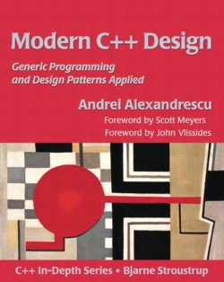
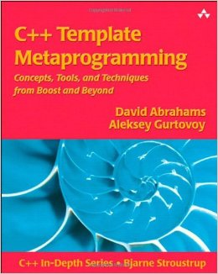
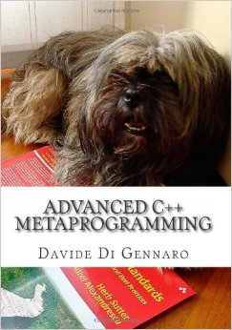
Reference
Introduction into modern C++ Techniques
Presentation by Michael Caisse at C++ Now 2012
Introduction into auto and declspec
Blog by Thomas Becker
Great source of knowledge
www.stackoverflow.com

Slide 25
Thank’s for your attention
Feedback is as always welcome!
felix@petriconi.net

