Slide 1
The PGDB::ResultProcessor
Prepared for C++ UG Bremen
A kind of more magic …

Slide 2
… we have a problem

Slide 3
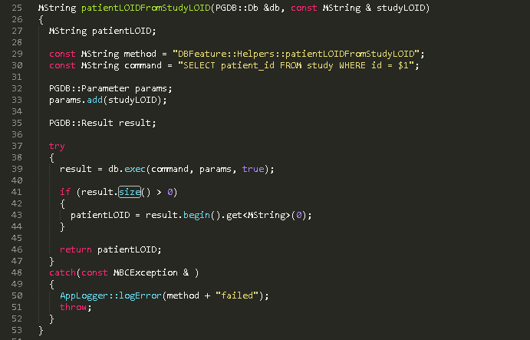
Examples from our code

Slide 4
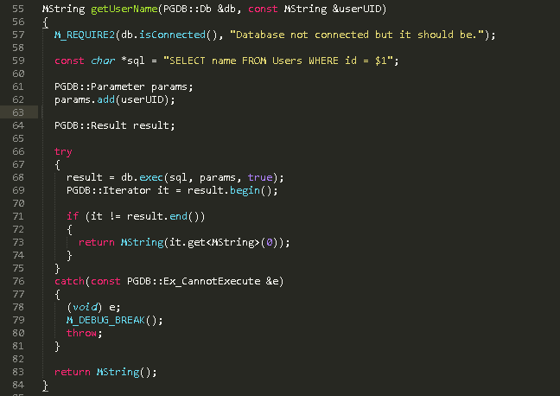

Slide 5
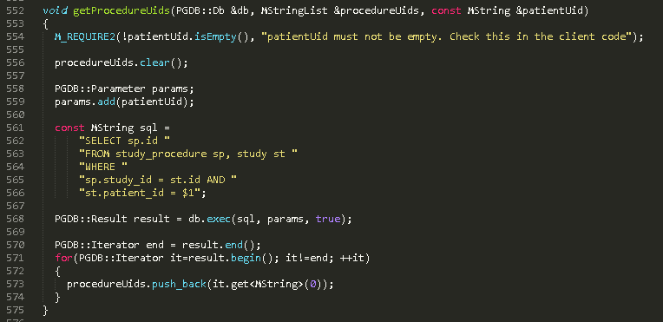
example with collection

Slide 6
Our Problem
Code Duplication
Not character wise
But semantically

Slide 7

Goal
No code duplication for simple cases
Advanced goal
Use the power of fusion

Slide 8
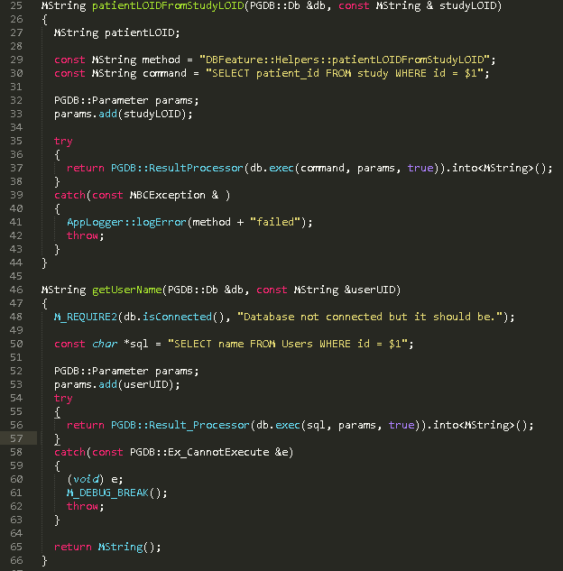
It should look like this …

Slide 9
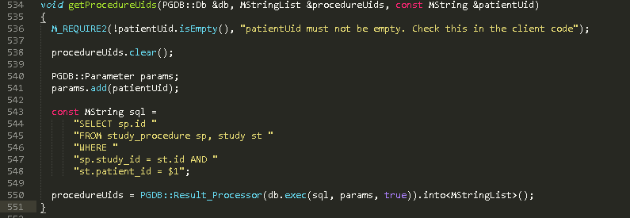
and it should look like that.

Slide 10
Let’s rumble
Start with the easiest case

Slide 11
DB Result with one Row, one Column
auto receivedValue = ResultProcessor(emptyResult).into<MString>();
EXPECT_EQ(MString(), receivedValue);
auto receivedValue = ResultProcessor(filledResult).into<MString>();
EXPECT_EQ(MString(“Don’t panic!”), receivedValue);
class ResultProcessor
{
const Result& _result;
public:
ResultProcessor(const Result& result): _result(result) {}
template <typename T>
T into()
{
if (_result.empty()) return T();
return *_result.begin().get<T>(0);
}
}

Slide 12
Let’s try it with an int
auto receivedValue = ResultProcessor(emptyResult).into<int>();
EXPECT_EQ(0, receivedValue);
auto receivedValue = ResultProcessor(filledResult).into<int>();
EXPECT_EQ(42, receivedValue);
class ResultProcessor
{
const Result& _result;
Public:
ResultProcessor(const Result& result): _result(result) {}
template <typename T>
T into()
{
if (_result.empty()) return T();
return *_result.begin().get<T>(0);
}
}
No stable test results
Here is the problem

Slide 13
So we must forbid to use an int!
Are there other types with the same problem?
All integral, floating point and pointer types
OK, let’s put a M_DEBUG_BREAK or M_REQUIRE
But these just evaluate during runtime and it does not work with types
It would be great, if we could check during compile time!
We can do it with static_assert()

Slide 14
Let’s use static_assert
auto receivedValue = ResultProcessor(emptyResult).into<int>();
EXPECT_EQ(0, receivedValue);
auto receivedValue = ResultProcessor(filledResult).into<int>();
EXPECT_EQ(42, receivedValue);
class ResultProcessor
{
const Result& _result;
Public:
ResultProcessor(const Result& result): _result(result) {}
template <typename T>
T into()
{
static_assert(!(std::is_integral<T>::value || std::is_floating_point<T>::value),
“Default types does not have a default c’tor!");
if (_result.empty()) return T();
return *_result.begin().get<T>(0);
}
}

Slide 15
But we have integer in the DB!!!
auto receivedValue = ResultProcessor(emptyResult).intoOrDefault<int>(0);
EXPECT_EQ(0, receivedValue);
auto receivedValue = ResultProcessor(filledResult).intoOrDefault<int>(0);
EXPECT_EQ(42, receivedValue);
class ResultProcessor
{
const Result& _result;
Public:
ResultProcessor(const Result& result): _result(result) {}
template <typename T>
T into()
{
static_assert(!(std::is_integral<T>::value || std::is_floating_point<T>::value),
"Simple types does not have a default c’tor!");
if (_result.empty()) return T();
return *_result.begin().get<T>(0);
}
template <typename T>
T intoOrDefault(const T& default)
{
if (_result.empty()) return default;
return *_result.begin().get<T>(0);
}
}

Slide 16
We want to handle result collections!
auto receivedValue = ResultProcessor(emptyResult).into<MStringList>();
EXPECT_EQ(MStringList(), receivedValue);
auto receivedValue = ResultProcessor(filledResult).into<MStringList>();
ASSERT_EQ(2, receivedValue.size());
EXPECT_EQ(Mstring(“Arthur Dent”), receivedResult[0]);
EXPECT_EQ(Mstring(“Ford Prefect”), receivedResult[1]);
class ResultProcessor
{
const Result& _result;
public:
ResultProcessor(const Result& result): _result(result) {}
template <typename T>
T into()
{
???
}
}
Partial function specialization is not supported by C++

Slide 17
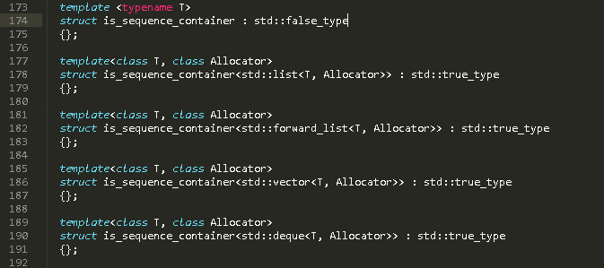
Excurs into type traits: std::true_type / std::false_type

Slide 18
Let’s delegate the work
class ResultProcessor
{
const Result& _result;
public:
ResultProcessor(const Result& result): _result(result) {}
template <typename T>
T into()
{
Executor<T> executor(_result);
return executor.evaluateRows();
}
template <typename T>
T intoOrDefault(const T& defaultValue)
{
Executor<T> executor(_result);
return executor.evaluateRows(defaultValue);
}
};

Slide 19
And the work is done by …
template <typename R>
class Executor
{
const Result& _result;
public:
Executor(const Result& result)
: _result(result) {}
R evaluateRows() const
{
return ExecutorImpl<R>::doIt(*this);
}
R evaluateRows(const T& defaultValue) const
{
return ExecutorImpl<R>::doIt(*this, defaultValue);
}
};
template <typename T, typename Enabled = void>
class ExecutorImpl
{};
Here happens now the separation if R
is a container or not

Slide 20
Non Container Case
template <typename T>
class ExecutorImpl<T, typename std::enable_if<
!SCR::is_sequence_container<T>::value>::type>
{
static T doIt(const Executor& executor)
{
if (executor._result.empty()) return T();
return *executor._result.begin().get<T>(0);
}
};

Slide 21
Adding single default return value
template <typename T>
class ExecutorImpl<T, typename std::enable_if<
!SCR::is_sequence_container<T>::value>::type>
{
static T doIt(const Executor& executor)
{
if (executor._result.empty()) return T();
return *executor._result.begin().get<T>(0);
}
static T doIt(const Executor& executor, const T& defaultValue)
{
if (executor._result.empty()) return defaultValue;
return *executor._result.begin().get<T>(0);
}
};

Slide 22
Container Case
template <typename T>
class ExecutorImpl<T, typename std::enable_if<SCR::is_sequence_container<T>::value>::type>
{
typedef typename T::value_type value_type;
public:
static T doIt(const Executor& executor)
{
if (executor._result.empty()) return T();
T returnValue(executor._result.size());
auto returnIt = resultValue.begin();
for (auto dbIt = executor._result.begin();
dbIt != executor._result.end(); ++ dbIt, ++resultIt)
{
*returnIt = dbIt.get<value_type>(0);
}
return returnValue;
}
};
Create container with size equal to number of rows

Slide 23
Adding container default return value
template <typename T>
class ExecutorImpl<T, typename std::enable_if<SCR::is_sequence_container<T>::value>::type>
{
typedef typename T::value_type value_type;
public:
static T doIt(const Executor& executor)
{
if (executor._result.empty()) return T();
T returnValue(_result.size());
auto returnIt = resultValue.begin();
for (auto dbIt = executor._result.begin();
dbIt != executor .result.end(); ++ dbIt, ++resultIt) { *returnIt = dbIt.get<value_type>(0); }
return returnValue;
}
static T doIt(const Executor& executor, const T& defaultValue)
{
if (executor._result.empty()) return defaultValue;
T returnValue(executor._result.size());
auto returnIt = resultValue.begin();
for (auto dbIt = executor._result.begin(); dbIt != executor.result.end(); ++dbIt, ++resultIt)
{
*returnIt = dbIt.get<value_type>(0);
}
return returnValue;
}
};

Slide 24
Do you see the problem?
Code duplication!
We have to refactor!
Runtime polymorphism does not work here, we are handling with templates!

Slide 25
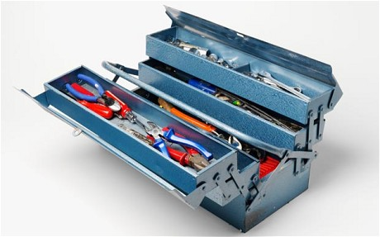
We are engineers. So we need a better toolbox

Slide 26
‘Grab the most powerful tools of C++
Template Meta Programming (TMP)
Policy Based Design

Slide 27


Slide 28
What is policy based design?
Has anybody used it before?
You use it every day
std::vector<T> is really
std::vector<T, Allocator>
This a policy.
It handles how memory shall be allocated.

Slide 29
We need policies that handles cases when the DB Result is empty
When no default value is provided
Then the default c’tor shall be returned
When a default value is provided
Then the default value shall be returned
(Later when an exception is specified
Then an exception shall be thrown)
It is important that all policies have the same interface!

Slide 30
Policy for returning the default c’tor
template <typename T>
class EmptyRowsNoDefaultValuePolicy
{
public:
T handleEmptyRows() const { return T(); }
};

Slide 31
Policy for returning a default value
template <typename T>
class EmptyRowsDefaultValuePolicy
{
T _defaultValue;
public:
EmptyRowsDefaultValuePolicy(const T& defaultValue)
: _defaultValue(defaultValue) {}
T handleEmptyRows() const { return defaultValue; }
};

Slide 32
Adding the policy to the Executor
template <typename R, typename EmptyRowPolicy>
class Executor
{
const Result& _result;
EmptyRowPolicy _emptyRowPolicy;
public:
Executor(const Result& result, const EmptyRowPolicy& emptyRowPolicy)
: _result(result)
, _emptyRowPolicy(emptyRowPolicy)
{}
R evaluateRows() const
{
return ExecutorImpl<R>::doIt(*this);
}
};

Slide 33
User of the policy: non container specialization
template <typename T>
struct ExecutorImpl<T,
typename std::enable_if<
!SCR::is_sequence_container<T>::value>::type>
{
static T doIt(const Executor& executor)
{
if (executor._result.empty() )
{
return executor._emptyRowPolicy.handleEmptyRows();
}
return *executor._result.begin().get<T>(0);
}
};
The function overload for doIt with the defaultValue is gone!

Slide 34
User of the policy: container specialization
template <typename T>
struct ExecutorImpl<T, typename std::enable_if<SCR::is_sequence_container<T>::value>::type>
{
typedef typename T::value_type value_type;
static T doIt(const Executor& executor)
{
if (executor._result.empty())
{
return executor._emptyRowPolicy.handleEmptyRows();
}
T returnValue(executor._result.size());
auto returnIt = returnValue.begin();
for(auto it = executor._result.begin(); it != executor._result.end();
++it, ++returnIt)
{
returnValue[index] = *it.get<value_type>(0);
}
return returnValue;
}
};

Slide 35
Now the interface for the user
class ResultProcessor
{
const Result& _result;
template <typename T>
T into()
{
Executor<T, EmptyRowsNoDefaultValuePolicy<T>>
executor(_result, EmptyRowsNoDefaultValuePolicy<T>());
return executor.evaluateRows();
}
template <typename T>
T intoOrDefault(const T& defaultValue)
{
Executor<T, EmptyRowsDefaultValuePolicy<T>>
executor(_result, EmptyRowsDefaultValuePolicy<T>(defaultValue));
return executor.evaluateRows();
}
};

Slide 36
A little cleanup …
class ResultProcessor
{
const Result& _result;
...
template <typename T, typename EmptyRowPolicy>
auto makeExecutor(const Result& result, const EmptyRowPolicy& policy)
{
return Executor<T, EmptyRowPolicy>(result, policy);
}
template <typename T>
T into()
{
return makeExecutor(_result, EmptyRowsNoDefaultValuePolicy<T>()).evaluateRows();
}
template <typename T>
T intoOrDefault(const T& defaultValue)
{
return makeExecutor(_result, EmptyRowsDefaultValuePolicy<T>(defaultValue)).evaluateRows();
}
};

Slide 37

We reached our refueling stop
Time for a break

Slide 38
These are the missing parts
ResultProcessor::intoOrThrow<>()
Handling of CondVar<T>
They need *it.getC<0>
Giving the option to pass a Lambda that manipulates the results before returning
Automatic filling of all member of a fusion struct

Slide 39
Let’s add a throw option
class ResultProcessor
{
const Result& _result;
...
template <typename T, typename EmptyRowPolicy
Executor<T, EmptyRowPolicy> makeExecutor(const Result& result, const EmptyRowPolicy& policy)
{
return Executor<T, EmptyRowPolicy>(result, policy);
}
template <typename T>
T into()
{
makeExecutor(_result, EmptyRowsNoDefaultValuePolicy<T>()).evaluateRows();
}
template <typename T>
T intoOrDefault(const T& defaultValue)
{
makeExecutor(_result, EmptyRowsDefaultValuePolicy<T>(defaultValue)).evaluateRows();
}
template <typename T, typename Ex>
T intoOrThrow()
{
return makeExecutor(_result, EmptyRowsThrowPolicy<T, Ex>()).evaluateRows();
}
};
We need just this new policy

Slide 40
Policy for throwing
template <typename T, typename Ex>
class EmptyRowsThrowPolicy
{
public:
T handleEmptyRows() const
{
throw Ex();
}
};

Slide 41
Follow up on static_assert
template <typename T>
class EmptyRowsNoDefaultValuePolicy<T>
{
static_assert(
!(std::is_integral<T>::value ||
std::is_pointer<T>::value ||
std::is_floating_point<T>::value),
“Default types does not have a default c’tor!");
public:
T handleEmptyRows() const { return T(); }
};

Slide 42
What’s the problem?
static_assert works
But how to ensure that the assertion survives a refactoring?
First attempt:
Place failing test into commented code inside *Test.cpp
André complained rightly that nobody would know about them
Not an actual UnitTest
So let’s combine compilation failure and UnitTest

Slide 43
The 1st trick: Forbid instantiation
That’s needed for the 2nd trick
template <typename T>
class disable_usage
{
typedef T disable_marker_type;
private:
disable_usage() {}
};
class Foo : public disable_usage<Foo>
{
};
Make the c’tor private
No way to instantiate
class Foo

Slide 44
The 2nd part of the trick: Check existence of forbidden class with SFINAE
template <typename T>
class is_disabled_from_usage
{
typedef char Yes;
typedef struct No { char dummy[2]; };
template<typename U>
static Yes test(typename U::disable_marker_type* p);
template<typename>
static No test(...);
public:
static const bool value = sizeof(test<T>(nullptr)) == sizeof(Yes);
};
EXPECT_TRUE(is_disabled_from_usage<Foo>::value);
Disabled class is not instantiated.
Just the existence of a typedef is checked.

Slide 45
Handling of nullable column results
template <typename T>
struct ExecutorImpl<T,
typename std::enable_if<
!SCR::is_sequence_container<T>::value>::type>
{
static T doIt(const Executor& executor)
{
if (executor._result.empty() )
{
return executor._emptyRowPolicy.handleEmptyRows();
}
return *executor._result.begin().get<T>(0);
}
};
If column zero can be NULL, T must be a CondVar
We have to distinguish between T is CondVar or not

Slide 46
Specialize the access to the columns
template <typename T, typename Enabled = void>
struct IteratorColumnAccessor {};
template <typename T>
struct IteratorColumnAccessor<T, typename std::enable_if<!SCR::is_condvar<T>::value>
{
static T getColumn(const PGDB::Iterator& it)
{
return it.get<T>(0);
}
};
template <typename T>
struct IteratorColumnAccessor<T, typename std::enable_if<SCR::is_condvar<T>::value>::type>
{
using value_type = typename T::value_type;
static T getColumn(const PGDB::Iterator& it)
{
return it.getC<value_type>(0);
}
};

Slide 47
Usage of the IteratorColumnAccessor Non Container T
template <typename T>
struct ExecutorImpl<T,
typename std::enable_if<
!SCR::is_sequence_container<T>::value>::type>
{
static T doIt(const Executor& executor)
{
if (executor._result.empty() )
{
return executor._emptyRowPolicy.handleEmptyRows();
}
return
IteratorColumnAccessor<T>::getColumn(*executor._result.begin());
}
};

Slide 48
Usage of the IteratorColumnAccessor Container T
template <typename T>
struct ExecutorImpl<T, typename std::enable_if<SCR::is_sequence_container<T>::value>::type>
{
using value_type = typename T::value_type;
static T doIt(const Executor& executor)
{
if (executor._result.empty())
{
return executor._emptyRowPolicy.handleEmptyRows();
}
T returnValue(executor._result.size());
auto returnIt = returnValue.begin();
for(auto it = executor._result.begin(); it != executor._result.end();
++it, ++returnIt)
{
*returnIt = IteratorColumnAccessor<value_type>::getColumn(*it);
}
return returnValue;
}
};

Slide 49
Adding Lambda support
EXPECT_TRUE( ResultProcessor(filledResult).intoOrDefault<bool>(false, [this](const PGDB::Iterator& it)
{ return it.get<MString>(0) == Test_UID;})
);
Problem
Code of existing functions should be re-used
So no new handling of T Container and T non-Container cases
Solution
Adding a 2nd policy to handle all cases up to now (non-Lambda) and Lambda cases

Slide 50
Simplest case
template <typename T>
T into()
{
return makeExecutor(_result,
EmptyRowsNoDefaultValuePolicy<T>()).evaluateRows();
}
becomes
template <typename T>
T into()
{
return makeExecutor<T>(_result,
EmptyRowsNoDefaultValuePolicy<T>(),
FieldTransformDefaultPolicy<T>()).evaluateRows();
}

Slide 51
FieldTransformDefaultPolicy
template <typename T>
class FieldTransformDefaultPolicy
{
public:
T fromDBIterator(const PGDB::Iterator& it) const
{
return IteratorColumnAccessor<T>::getColumn(it);
}
};

Slide 52
Which then builds the Executor
template <typename R, typename EmptyRowPolicy, typename FieldTransformPolicy>
class Executor
{
const Result& _result;
const EmptyRowPolicy _emptyRowPolicy;
const FieldTransformPolicy _fieldTransformer;
public:
Executor(const Result& result,
EmptyRowPolicy policy,
FieldTransformPolicy transformPolicy)
: _result(result)
, _emptyRowPolicy(std::move(policy))
, _fieldTransformer(std::move(transformPolicy))
{}
R evaluateRows() const
{
return ExecutorImpl<R>::doIt(*this);
}
};

Slide 53
and it is used by ExecutorImpl
template <typename T>
struct ExecutorImpl<T,
typename std::enable_if<!SCR::is_sequence_container<T>::value>::type>
{
static T doIt(const Executor& executor)
{
if (executor._result.empty() )
{
return executor._emptyRowPolicy.handleEmptyRows();
}
return executor
._fieldTransformer.fromDBIterator(*executor._result.begin());
}
};

Slide 54
The Lambda way now becomes
template <typename T, typename F>
T into(F f)
{
return makeExecutor<T>(
_result,
EmptyRowsNoDefaultValuePolicy<T>(),
FieldTransformLambdaPolicy<T,F>(std::move(f))).evaluateRows();
}

Slide 55
FieldTransformLambdaPolicy
template <typename T, typename F>
class FieldTransformLambdaPolicy
{
F _f;
public:
FieldTransformLambdaPolicy(F f)
: _f(std::move(f))
{}
T fromDBIterator(const PGDB::Iterator& it) const
{
return _f(it);
}
};

Slide 56
Similar the other Lambda cases
template <typename T, typename F>
T intoOrDefault(const T& defaultValue, F f)
template <typename T, typename Ex, typename F>
T intoOrThrow(F f)

Slide 57
Finally catch a row into a Fusion
The 1st result column shall get into the 1st Fusion struct parameter
The 2nd result column shall get into the 2nd Fusion struct parameter
…
Let’s use the power of Fusion

Slide 58
How did we access columns?
template <typename T, typename Enabled = void>
struct IteratorColumnAccessor {};

Slide 59
So we need a Fusion specialization
template <typename T>
class IteratorColumnAccessor<T,
typename std::enable_if<
boost::fusion::traits::is_sequence<T>::value>::type>
{
public:
static T getColumn(const PGDB::Iterator& it)
{
T resultValue;
boost::fusion::for_each(resultValue,
IteratorColumnFusionWorker<T>(it));
return resultValue;
}
};

Slide 60
IteratorColumnFusionWorker
template <typename T>
class IteratorColumnFusionWorker
{
const PGDB::Iterator& _it;
mutable int _columnIndex;
public:
IteratorColumnFusionWorker(const PGDB::Iterator& it)
: _it(it)
, _columnIndex(0)
{}
template<typename U>
void operator()(U& t) const
{
t = IteratorColumnAccessor<U>::getColumn(_it, _columnIndex);
_columnIndex++;
}
};

Slide 61
That’s all
All requirements fulfilled
Maximum code re-usage
No code duplication added
Now we have the possibility to simplify the extraction of PGDB::Result

Slide 62
Thank’s for your attention
Feedback is as always welcome!

