Slide 1
ADSAD2 and ADREL2 Introduction
Shelby Huang, Aiyu Li
02/08/2017

Slide 2
CAMMS Studies
CAMMS223: Phase II randomized, open-Label, three-arm study, duration 3 years.
  Arms 1: Alemtuzumab 12 mg/day (N=113); Arm 2: Alemtuzumab 24 mg/day (N=110); Arm 3: SC IFNB-1a (N = 111)
CAMMS323: Phase III study for treatment-naïve patients with relapsing-remitting multiple sclerosis
  Arm 1: Alemtuzumab 12 mg/day (N=386); Arm 2: SC IFNB-1a (N = 195)
CAMMS324: Phase III study for relapsing-remitting multiple sclerosis who have relapsed on therapy
  Arm 1: Alemtuzumab 12 mg/day (N=436); Arm 2: Alemtuzumab 24 mg/day (N=173); Arm 3: SC IFNB-1a (N = 231)
CAMMS03409: extension study for patients who participated in CAMMS223, CAMMS323, or CAMMS324.
  Patients randomized to and treated with alemtuzumab in prior studies will receive safety monitoring. Retreatments of alemtuzumab are as needed.
  Patients randomized to and treated with SC IFNB-1a who desired to be treated with alemtuzumab will be enrolled and receive 2 annual cycles of alemtuzumab. Additional courses may be provided as needed.
Full Analysis population for efficacy: all patients randomized to treatment in the initial studies and who have received at least 1 dose of study drug in 223/323/324/03409

Slide 3
Purpose
SAD, SRD and relapse related analysis will be carried out using these two data sets
ADSAD2 and ADREL2 data sets will be needed to replace the ADSAD and ADREL datasets we created for EU label extension filing to support label extension filing with FDA
FDA require all endpoints be derived within the same dataset and is readable in a straight forward way.

Slide 4
ADSAD2

Slide 5
Definition of SAD and SRD
Sustained Accumulation of Disability (6 months) – SAD6: EDSS assessments are performed every 3 months (±2 weeks) and at the time of a suspected relapse. A patient will be considered to have reached SAD, sustained over a 6-month period, when the following conditions have been met:
  For patients with a baseline EDSS score of 0, their EDSS score must increase by >= 1.5 points and remain at least 1.5 points above baseline during the next 2 scheduled assessments (ie, 6 consecutive months).
  For patients with a baseline EDSS score >= 1, their EDSS score must increase by >=1 point and remain at least 1 point above baseline during the next 2 scheduled assessments (ie, 6 consecutive months).
Sustained reduction in disability (SRD) is defined as a ≥1 point decrease in EDSS score lasting ≥6 months for patients with baseline EDSS scores ≥2.0.
The endpoints, time to SAD and time to SRD are both time to event endpoints.

Slide 6
Definition of SAD and SRD
Sustained Accumulation of Disability (6 months) – SAD6: EDSS assessments are performed every 3 months (±2 weeks) and at the time of a suspected relapse. A patient will be considered to have reached SAD, sustained over a 6-month period, when the following conditions have been met:
  For patients with a baseline EDSS score of 0, their EDSS score must increase by >= 1.5 points and remain at least 1.5 points above baseline during the next 2 scheduled assessments (ie, 6 consecutive months).
  For patients with a baseline EDSS score >= 1, their EDSS score must increase by >=1 point and remain at least 1 point above baseline during the next 2 scheduled assessments (ie, 6 consecutive months).
Sustained reduction in disability (SRD) is defined as a ≥1 point decrease in EDSS score lasting ≥6 months for patients with baseline EDSS scores ≥2.0.
The endpoints, time to SAD and time to SRD are both time to event endpoints.

Slide 7
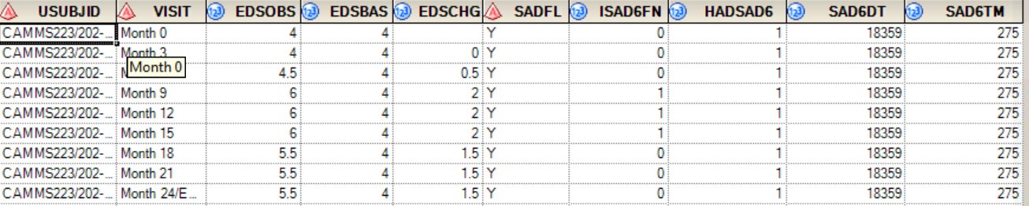
Core Structure of ADSAD
The example dataset is from CAMMS324 ADSAD
The dataset included EDSS score (EDSOBS) from all visits
EDSCHG calculated the EDSS change from baseline
ISAD6FN find EDSS observations that contributed to a SAD (6-month) event – the algorithm will be sent.
HADSAD6 flags whether the subject has SAD6
SAD6DT is the onset of SAD6 event or the censoring time
SAD6TM is the time to SAD6, = SAD6DT – beginning of analysis interval.
The SRD algorithm will be similar
Due to multiple analysis type of SAD/SRD, the time intervals of different analysis type vary, thus multiple sets of the above variables (with different variable names) will be needed to derive multiple SAD variables.

Slide 8
Analysis Type/Interval of CAMMS03409 ADSAD2
SAD
  323/324 - 03409 SAD year 0-4 after first dose [323/324 TRTSTDT, I(patients entered 03409) * min(03409 EDEOSDT, 365*4+14 days after interval started) + I(patients didn't enter03409)*(323/324 EDEOSDT)]
  323/324 - 03409 SAD year 0-6 after first dose [323/324 TRTSTDT, I(patients entered 03409) * min(03409 EDEOSDT, 365*6+14 days after interval started) + I(patients didn't enter03409)*(323/324 EDEOSDT)]
  323/324 SAD during 2-year after 1st dose [323/324 TRTSTDT, 323/324 EDEOSDT] - this can be carried over from 323/324 ADSAD
  03409 SAD (323/324 Xover subjects) during 1st 2-year of extension study (if POOLC ='Y' and XOVRFL='Y' and FA223FL~='Y') [03409 TRTSTDT, , min(03409 EDEOSDT, 744 days after interval started)]
SRD
  323/324 - 03409 SRD year 0-4 after first dose [323/324 TRTSTDT, I(patients entered 03409)*min(03409 EDEOSDT, 365*4+14 days after interval started) + I(patients didn't enter03409)*(323/324 EDEOSDT)]
  323/324 - 03409 SRD year 0-6 after first dose [323/324 TRTSTDT, I(patients entered 03409)*min(03409 EDEOSDT, 365*4+14 days after interval started) + I(patients didn't enter03409)*(323/324 EDEOSDT)]
  323/324 SRD during 2-year after 1st dose [323/324 TRTSTDT, 323/324 EDEOSDT]
  03409 SRD during 1st 2-year of extension study for Xover patients in 323/324 (if POOLC ='Y' and XOVRFL='Y' and FA223FL~='Y')[use 03409 TRTSTDT, min(03409 EDEOSDT, 744 days after interval started )]

Slide 9
ADREL2

Slide 10
Relapses Related Endpoints
Annualized relapse rate (ARR): number of relapses/total follow-up time
Time to first on-study relapse: time to event analysis
Proportion of patients relapse free
In 223/323/324, relapses need to be confirmed by the relapse adjudication panel (RAP). In 03409, relapses are confirmed by the investigators.

Slide 11
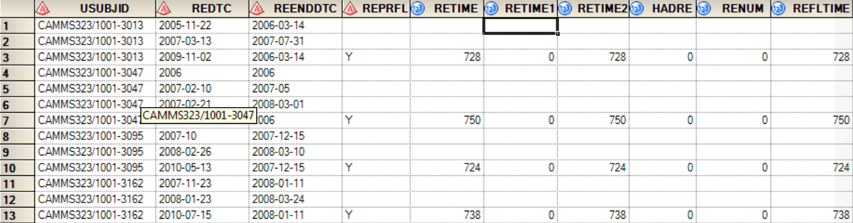
Core Structure of ADREL
The example dataset is from CAMMS324 ADREL
REPRFL: flags records used in primary variable derivation
RETIME is time to relapse,= relapse time (REDT) –beginning of analysis interval
RETIME1: This is the start of the interval for the counting process
RETIME2: the end of the interval for the counting process, = RETIME
HADRE: indicator of relapse
RENUM: This is the cumulative number of relapses for each subject
REFLTIME: duration of follow-up for each subject
Due to multiple analysis interval of relapse, the time intervals of different analysis type vary, thus multiple sets of the above variables will be needed for different analysis.

Slide 12
Analysis Type/Interval of CAMMS03409 ADREL2
323/324 - 03409 relapses during initial and extension studies period after first dose [323/324 TRTSTDT, max(323/324 EDEOSDT, 03409 EDEOSDT)]
323/324 relapses during 2-year after 1st dose [323/324 TRTSTDT, 323/324 EDEOSDT] – can be carried from 323/324 ADREL
03409 relapses during extension study period (all 223,323 and 324 patients enrolled in 03409) [RELFSDT , 03409 EDEOSDT)]
03409 relapses (323/324 Xover subjects, if PoolC ='Y' and XOVRFL='Y) during 1st 2-year of extension study [RELFSDT, min(03409 RELENDDT, 744 days after 03409 TRTSTDT)]
Relapses associated with 1st retreatment - 1 year pre 1st retreatment to 2nd retreatment or 03409 EOS: [ADSL.TRTSDTC3-365 days, min(ADSL.TRTSDTC4, 03409 EDEOSDT)]
Relapses associated with 2nd retreatment - 1 year pre 2nd retreatment to 3rd retreatment or 03409 EOS: [ADSL.TRTSDTC4-365 days, min(ADSL.TRTSDTC5, 03409 EDEOSDT)]
Relapses associated with 3rd retreatment - 1 year pre 3rd retreatment to 4th retreatment or 03409 EOS: [ADSL.TRTSDTC5-365 days, min(ADSL.TRTSDTC6, 03409 EDEOSDT)]
Relapses after course 2 - first dose of course 2 to 03409 EOS: [ADSL.TRTSDTC2, 03409 EDEOSDT]
Relapses after course 3 - first dose of course 3 to 03409 EOS: [ADSL.TRTSDTC3, 03409 EDEOSDT]
Relapses after course 4 - first dose of course 4 to 03409 EOS: [ADSL.TRTSDTC4, 03409 EDEOSDT]

Slide 13
Derivation of REPRFL
Relapse included
  For 323/324, we use RAP confirmed relapse RAPCNF^=‘N’.
  For 03409 records, need to select records with all YCSYMPYN, YCACUTYN, YCSTABYN, YCCHGYN, YCRELTYP =’Y’:
    RELPPFL = ‘Y’ if YCSYMPYN, YCACUTYN, YCSTABYN, YCCHGYN all = ‘Y’.
    RELINFL = ‘Y’ if YCRELTYP = 'PER PROTOCOL MS RELAPSE'
    RELTTLF = ‘Y’ if both RELPPFL and RELINFL =’Y’
REUSEF – for 323/324 records, flag which record to use if there are >1 relapses with the same start date.
RECNTFL – flag the records used in creating the variables required for the primary efficacy analysis such as HADRE, RETIME1, etc.
RE30FL – flag records that occurred within 30 days of a previous record, derived using records with RECNTFL=‘Y’
REPRFL - flags which records were used in the primary efficacy analysis
  For 223, =‘Y’ if RECAT in ('CLINICAL EPISODE' , ‘END’, ’CLINICAL EPISODE HISTORY’) and RECNTFL = 'Y‘ and RE30FL ^= 'Y‘;
  For 323/324/03409, =‘Y’ if RECAT in ('CLINICAL EPISODE' , ‘END’) and RECNTFL = 'Y‘ and RE30FL ^= 'Y‘;
  For all, event time REDT happens within specified time interval.
223/323/324 flag variables can be carried from 223/323/324 ADREL
There should be multiple REPRFL variable (can take different variable names) to flag records used in each analysis interval (described in the previous slide).
Multiple sets of RETIME, RETIME1, RETIME2, HADRE, RENUM, REFLTIME variables (can take different variable names) will be derived based on records flagged by corresponding REPRFL.

Slide 14
Common variables
USTUDYID,STUDYID,USUBJID,SUBJID,AGE,SEX,SEXN,RACE,RACEN,ETHNIC,ETHNICN, COUNTRY,COUNTRYC,COUNTRYN,REGION,REGIONN,SAFFL,FAFL,FA223FL,XTFL,POOLC,G1,XOVRFL,XOVERG,F32424FL,DATFLN,DRFL,RTFL,TRTP,TRTPN,TRTA,TRTAN,TRTSTDT,ALTMSDT,ALTMSFL,TRTPREV,TRTPREVN,RANDDT,RFSTDT,RFENDT,EDEOSDT

Slide 15
List of Documents Included to Support ADSAD2 and ADREL2
CAMMS03409 ADSL, ADSLE, ADNS data (adsl, adsle, adns) and specs (adam_CAMMS03409_icsr_adsl, adam_CAMMS03409_icsr_adsle, adam_CAMMS03409_icsr_adns), 03409 ADAB data
223/323/324 ADREL and ADSAD specs: adam_adam_camms_adrel, adam_adam_camms_adsad
223/323/324 ADREL and ADSAD data sets: adrel_223, adsad_223, adrel_323, adrel_324, adsad_323, adsad_324
324 ADSAD and ADREL program (adrel_324.sas, adsad.sas)
03409 partial ADREL spec, you can use it as a reference for all flag variables: adam_CAMMS03409_icsr_adrel_partial
03409 SAP (camms03409-16-1-9-sap.pdf), 03409 CSR body (camms03409-1-15-body.pdf), 03409 CSR appendix 16-2-6 contains all efficacy tables and figures (camms03409_16_2_6_efficacy_data.pdf)

Slide 16
Other Documents Included
Previous submission Reviewer Guide for SDTM and Adam datasets
Previous submission efficacy SDTMs and ADaMs and specifications relevant to the new work
Previous submission table programs that were submitted to FDA
Annotated CRFs for all studies
CAMMS03409 study SDTMs

Slide 17
Timelines
Cytel provides the specifications (ADSAD2, ADREL2) to Sanofi in two weeks (ADCOM will provide later based on the requirement from Sanofi).
Sanofi will review the specifications in two days.
Cytel then provides the draft datasets in two weeks after specifications are approved by Sanofi.
Cytel will validate datasets in one week and provide both production and QC programs to Sanofi.
Sanofi will provide the TOC and TLFS to Cytel
Cytel will provide the TLFS in three weeks (it can be provided by batches) (datasets may need to be modified through the TLFs production process).
Cytel will provide the ADRG

Slide 18
Appendix

Slide 19
Algorithm of Deriving SAD6
The SAD algorithm uses the EDSS observations from the start of the interval through the end. Unscheduled visits are not used in the SAD algorithm so only use EDSS observations where ADNS.ANLFL = 'Y'. To identify the EDSS observations contributing to SAD, loop over the post-baseline EDSS scores. If BASE = 0 and CHG >= 1.5 or if BASE > 0 and CHG >= 1 (Condition 1), then a potential SAD event has begun. If the analysis type starts from extension study, then use BASEEXT and CHGEXT. Check to see if the potential SAD continues by identifying whether the next EDSS also satisfies Condition 1. If it does, then go to Step 1. If it does not, then go to Step 3.
Step 1: Calculate the number of days between the start of the potential SAD event and the next EDSS (refer to this difference as LWIN) and proceed to Step 2a if the current EDSS is not the last EDSS or Step 2b if the current EDSS is the last EDSS.
Step 2a: If LWIN < 154, then continue checking EDSS scores for Condition 1, recalculating LWIN and checking if LWIN is >= 154. The first time a string of EDSS scores all satisfy Condition 1 and LWIN >= 154 then EDSSFN = 1 for that string and 0 for all other EDSS observations and the algorithm is complete. If Condition 1 is not satisfied, then go to Step 3. If the last EDSS is reached and LWIN < 154 then EDSSFN = 0 for all EDSS observations and the algorithm is complete.
Step 2b: If LWIN >= 63 and the current EDSS is the last EDSS visit then EDSSFN = 1 for that string and 0 for all other EDSS observations and the algorithm is complete. If the current EDSS is the last EDSS visit and LWIN < 63 then EDSSFN = 0 for all EDSS observations and the algorithm is complete.
Step 3: Continue loop over EDSS scores to see if a potential SAD event begins (Condition 1), if one does then go to Step 1. If one does not then EDSSFN = 0 for all EDSS scores and the algorithm is complete.
After EDSSFN is defined, for each analysis type, identify first EDSSFN=1. If identified then an event has occurred and set HADSAD6 = 1, SAD6DT = ADNS.ADNSDTC (associated with the first EDSSFN = 1) and SAD6TM = SAD6DT - Interval start time. If there is no event identified, then the patient is censored: HADSAD6 = 0, SAD6DT is set equal to the interval end date.and EVTTIME = SAD6DT - Interval Start Time.

Slide 20
Algorithm of Deriving SRD6
For SRD, follow the similar algorithm listed in HADSAD6. Use ADNS dataset. For each analysis type, create an intermediate variable EDSSFN (=1 or 0). For each analysis type, use corresponding start and end of the interval. The SRD algorithm uses the EDSS observations from the start of the interval through the end. Unscheduled visits are not used in the SRD algorithm so only use EDSS observations where ADNS.ANLFL = 'Y'. To identify the EDSS observations contributing to SRD, loop over the post-baseline EDSS scores. If BASE >= 2 and CHG <= -1 then a potential SRD event has begun. If the analysis type starts from extension study, then use BASEEXT and CHGEXT Check to see if the potential SRD continues by identifying whether the next EDSS also satisfies Condition 1. If it does, then go to Step 1. If it does not, then go to Step 3.
Step 1: Calculate the number of days between the start of the potential SRD event and the next EDSS (refer to this difference as LWIN) and proceed to Step 2a if the current EDSS is not the last EDSS or Step 2b if the current EDSS is the last EDSS.
Step 2a: If LWIN < 154, then continue checking EDSS scores for Condition 1, recalculating LWIN and checking if LWIN is >= 154. The first time a string of EDSS scores all satisfy Condition 1 and LWIN >= 154 then EDSSFN = 1 for that string and 0 for all other EDSS observations and the algorithm is complete. If the last EDSS is reached and LWIN < 154 then EDSSFN = 0 for all EDSS observations and the algorithm is complete.
Step 2b: If LWIN >= 63 and the current EDSS is the last EDSS visit then EDSSFN = 1 for that string and 0 for all other EDSS observations and the algorithm is complete. If the current EDSS is the last EDSS visit and LWIN < 63 then EDSSFN = 0 for all EDSS observations and the algorithm is complete.
Step 3: Continue loop over EDSS scores to see if a potential SAD event begins (Condition 1), if one does then go to Step 1. If one does not then EDSSFN = 0 for all EDSS scores and the algorithm is complete.
After EDSSFN is defined, for each analysis type, identify first EDSSFN=1. If identified then an event has occurred and set HADSRD6 = 1, SRD6DT = ADNS.ADNSDTC (associated with the first EDSSFN = 1) and SRD6TM = SRD6DT - Interval start time. If there is no event identified, then the patient is censored: HADSRD6 = 0, SRD6DT is set equal to the interval end date.and EVTTIME = SRD6DT - Interval Start Time.

Slide 21
Programming Notes

Slide 22
1. Programming and Convention
Must follow the Good Programming Practice: RDWIN-000023
Lower case for all codes, program names and output names.
Datasets program name: use dataset name: eg: adsad2.sas; adrel2.sas; adcom.sas
TLF program name (will be specified by stats)
e.g. te_mmrm_pr_edss.sas; te_rr_cmsrelappr24fe.sas
All qc program name: adding prefix “qc_” before the production program; eg. qc_adsad2.sas; qc_adrel2.sas; qc_te_rr_cmsrelappr24fe.sas
If necessary for any adhoc program name: use prefix “zz _” eg: zz_ adsad2_check:
No error, warning, invalid, initial in the log files from program execution. Try to limit using word “error”, “warning” in program codes. Please also check word “Note” in the logs for any potential issue.
Use SAS version 9.4 with codes compatible with SAS version 9.2
Deliver dataset, program(production & QC), log and output files together in the zip file.

Slide 23
2. Input Raw Data
SDTM datasets (all SDTM datasets)
ADaM datasets (selected datasets)
If there is any other external data, please specified it in the ADaM specification.

Slide 24

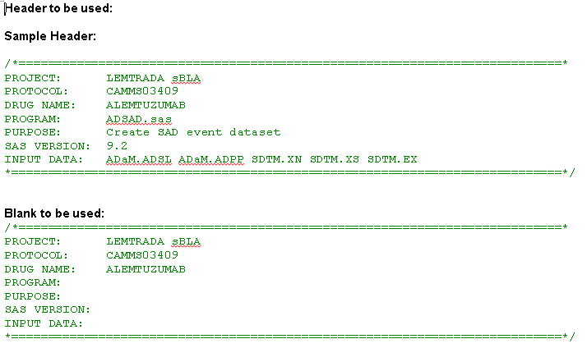
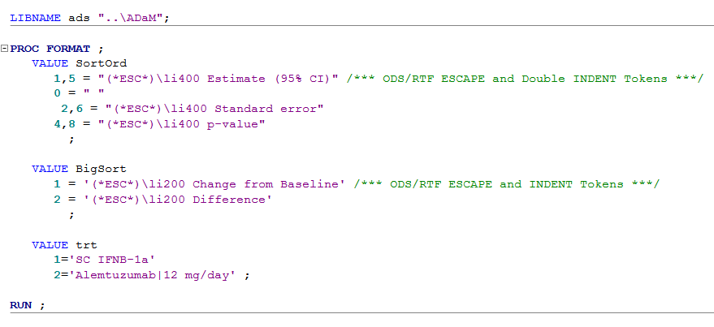
3. Program Header, Libname, formats and execution
Program Header: please see attachment: program_header_example.docx
Libname in the program: Follow attachment programs from CAMMS324 submission
Program format should be included in the each individual programs: See sample programs in the attachment.
Make sure that each program can be re-run individually without calling any sub-programs and external formats.

Slide 25
4. SDTM Metadata & ADaM excel specification sample
Dataset Metadata: see attached excel file: metadata_dds_camms03409.xls
Control Terminology: See attached excel file: metadata_cntrterm_camms.xls
Value Leval Metadata: see attache excel file: metadata_valmeta_camms.xls
Use attached “adam_CAMMS03409_fda_adsl_sample.xls” to write the specification for ADREL2, ADSAD2 and ADCOM. The max comments length is 900 characters. Try to keep in 900 characters in length.

