Slide 1
Trabalho: Maquete SIEM
José Pedro Vieira Gomes - MIEEC
up201307839@fe.up.pt
01-10-2017

Slide 2
Trabalho: Maquete SIEM: Definições
Neste trabalho escolhi como ideia para a maquete um site de partilha e leitura de livros.
Estão descritas algumas das páginas que em geral permitem tomar uma grande parte da arquitetura do site como decidida em termos de:
Fonte: Segoe UI, Segoi UI Light
Cores: diferentes cores para caixas de titulos e assunto correspondente mas na mesma gama, cores consistentes com assuntos: preto para site geral e capitulos integrais, roxo para indicações dos noveis, azul para indicações capitulos, verde para synopsis.
Tamanhos e formatação das páginas também está, em geral, decidido.

Slide 3
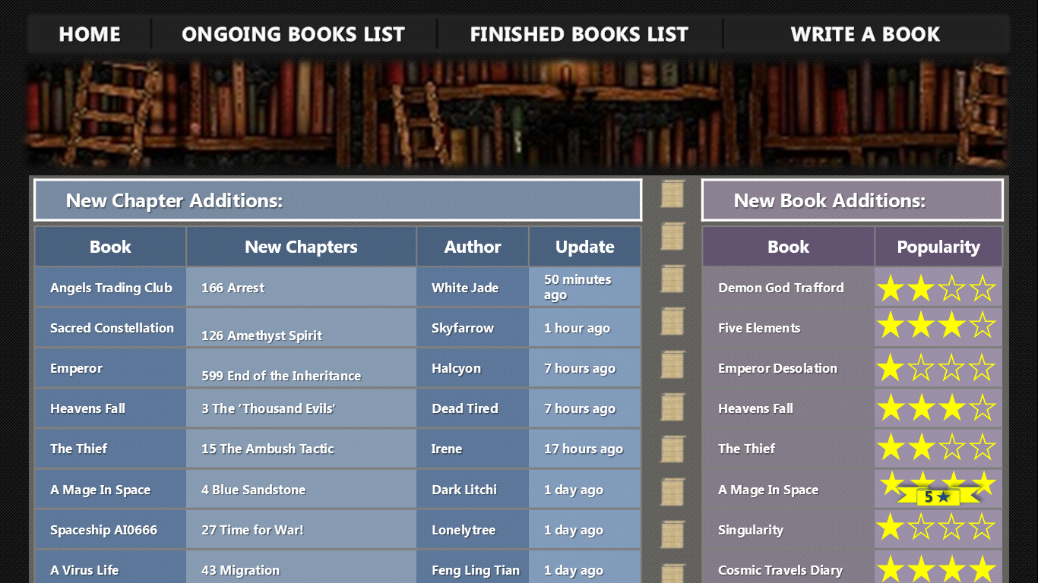
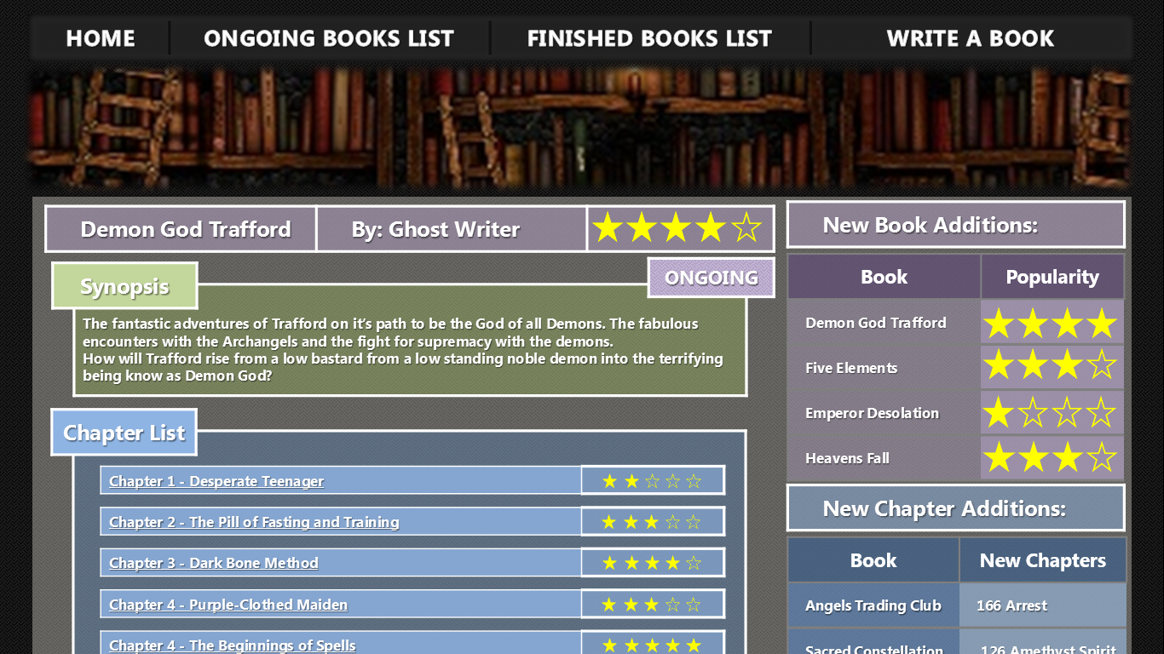
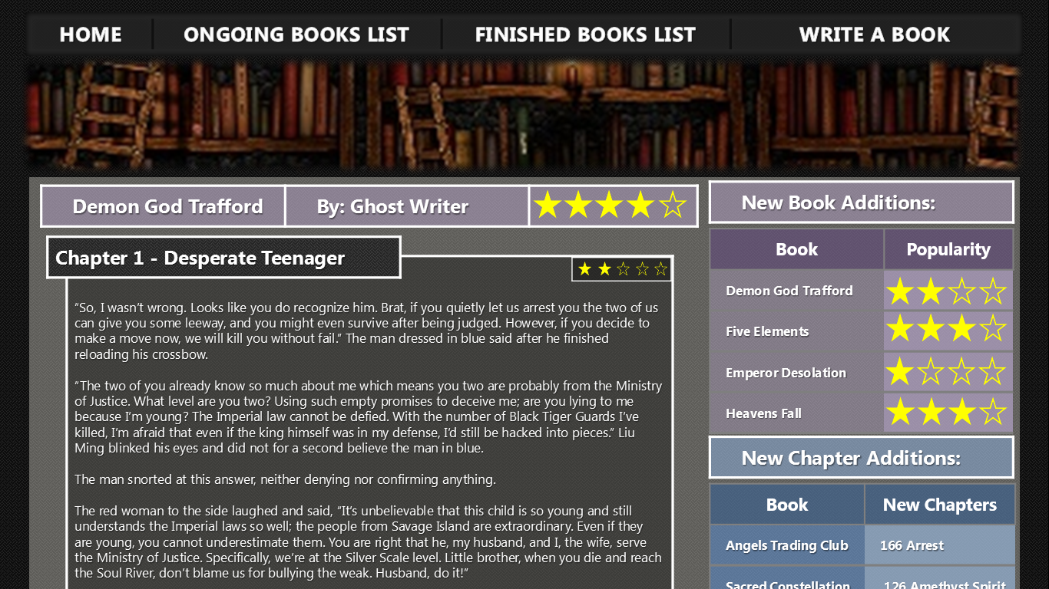
Trabalho: Maquete SIEM: Exemplo Navegação
Página Inicial
Página sobre Livro
Página Com Capítulo

Slide 4

New Chapter Additions:
New Book Additions:
Book | New Chapters | Author | Update
Angels Trading Club | 166 Arrest | White Jade | 50 minutes ago
Sacred Constellation | 126 Amethyst Spirit | Skyfarrow | 1 hour ago
Emperor | 599 End of the Inheritance | Halcyon | 7 hours ago
Heavens Fall | 3 The ‘Thousand Evils’ | Dead Tired | 7 hours ago
The Thief | 15 The Ambush Tactic | Irene | 17 hours ago
A Mage In Space | 4 Blue Sandstone | Dark Litchi | 1 day ago
Spaceship AI0666 | 27 Time for War! | Lonelytree | 1 day ago
A Virus Life | 43 Migration | Feng Ling Tian | 1 day ago
Book | Popularity
Demon God Trafford
Five Elements
Emperor Desolation
Heavens Fall
The Thief
A Mage In Space
Singularity
Cosmic Travels Diary
5

Slide 5
Demon God Trafford | By: Ghost Writer
New Book Additions:
Synopsis
ONGOING
Book | Popularity
Demon God Trafford
Five Elements
Emperor Desolation
Heavens Fall
The fantastic adventures of Trafford on it’s path to be the God of all Demons. The fabulous encounters with the Archangels and the fight for supremacy with the demons. How will Trafford rise from a low bastard from a low standing noble demon into the terrifying being know as Demon God?
Chapter List
Chapter 1 - Desperate Teenager
New Chapter Additions:
Chapter 2 - The Pill of Fasting and Training
Chapter 3 - Dark Bone Method
Book | New Chapters
Angels Trading Club | 166 Arrest
Sacred Constellation | 126 Amethyst Spirit
Emperor | 599 End of the Inheritance
Heavens Fall | 3 The ‘Thousand Evils’
The Thief | 15 The Ambush Tactic
A Mage In Space | 4 Blue Sandstone
Spaceship AI0666 | 27 Time for War!
A Virus Life | 43 Migration
Chapter 4 - Purple-Clothed Maiden
Chapter 4 - The Beginnings of Spells
Chapter 5 - Spirit Farms

Slide 6
Demon God Trafford | By: Ghost Writer
New Book Additions:
Chapter 1 - Desperate Teenager
Book | Popularity
Demon God Trafford
Five Elements
Emperor Desolation
Heavens Fall
“So, I wasn’t wrong. Looks like you do recognize him. Brat, if you quietly let us arrest you the two of us can give you some leeway, and you might even survive after being judged. However, if you decide to make a move now, we will kill you without fail.” The man dressed in blue said after he finished reloading his crossbow. “The two of you already know so much about me which means you two are probably from the Ministry of Justice. What level are you two? Using such empty promises to deceive me; are you lying to me because I’m young? The Imperial law cannot be defied. With the number of Black Tiger Guards I’ve killed, I’m afraid that even if the king himself was in my defense, I’d still be hacked into pieces.” Liu Ming blinked his eyes and did not for a second believe the man in blue. The man snorted at this answer, neither denying nor confirming anything. The red woman to the side laughed and said, “It’s unbelievable that this child is so young and still understands the Imperial laws so well; the people from Savage Island are extraordinary. Even if they are young, you cannot underestimate them. You are right that he, my husband, and I, the wife, serve the Ministry of Justice. Specifically, we’re at the Silver Scale level. Little brother, when you die and reach the Soul River, don’t blame us for bullying the weak. Husband, do it!”
New Chapter Additions:
Book | New Chapters
Angels Trading Club | 166 Arrest
Sacred Constellation | 126 Amethyst Spirit
Emperor | 599 End of the Inheritance
Heavens Fall | 3 The ‘Thousand Evils’
The Thief | 15 The Ambush Tactic
A Mage In Space | 4 Blue Sandstone
Spaceship AI0666 | 27 Time for War!
A Virus Life | 43 Migration

