Slide 1
Laboratory Project in Health Data Science
Convenience Absenteeism in the Portuguese NHS
Analysing Self-Declared Disease Notifications from the SNS Transparency Portal
Ana Correia · André Vicente · Filipa Carneiro
Faculty of Medicine - University of Porto | 2026

Slide 2
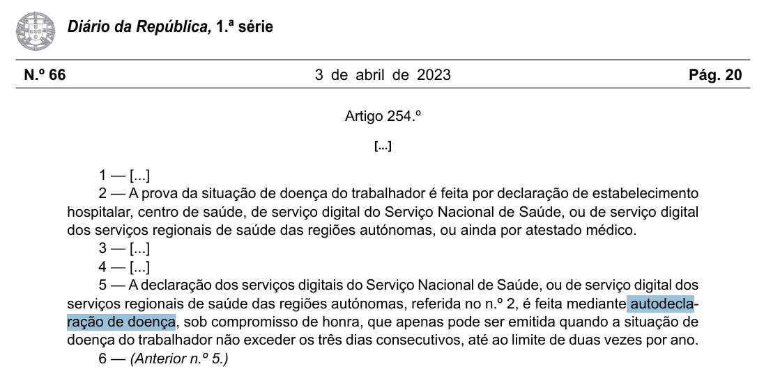
Context
❓ Are workers using Self-Declared Disease Notifications (ADD) strategically - to extend weekends and bridge holidays - rather than for genuine illness?
📋 What are ADDs?
Since May 2023, SNS 24 app/portal allows workers to self-declare up to 3 consecutive sick days without a doctor, up to 2x/year.
⚠️ Why it matters?
Convenience use creates a hidden cost for employers and distorts health surveillance signals.
🔬 Our approach
SARIMAX model with calendar dummies isolates convenience behaviour from genuine flu-driven absences.
Source: Lei n.º 13/2023, de 3 de abril - Altera o Código do Trabalho e legislação conexa, no âmbito da agenda do trabalho digno. Diário da República, 1.ª Série, n.º 67, de 3 de abril de 2023. Disponível em: https://diariodarepublica.pt/dr/detalhe/lei/13-2023-211340863

Slide 3

Data sources
📊 Self-Declared Notifications (ADD)
🏥 Flu Consultations at Primary Care (CSP)
Source
Source
File
autodeclaracoes-de-doenca-dos-utentes.csv
File
atendimentos-nos-csp-gripe.csv
Period
2023 - 2026
Period
2016 - 2026
Key variable
Nº ADD Emitidas (daily total)
Key variable
Nº Consultas Gripe nos CSP
Granularity
Daily, national
Granularity
Daily, by region
Access
Open data, automated download
Role in model
Exogenous regressor (XREG)

Slide 4

Interactive dashboard - Power BI
Gender & Age filters
Time drill-down (Y / Q / M)
ADD origin (App / Portal / Line)
Regional flu rate by NUTS II

Slide 5
Methods
ADDₜ = ARIMA(p,d,q)(P,D,Q) + β₁·Gripeₜ + β₂·Feriadoₜ + β₃·Tolerânciaₜ + β₄·Ponteₜ + β₅·Segundaₜ + β₆·Quartaₜ + Σ Fourier(k) + εₜ
01
02
03
04
05
Data cleaning
Calendar dummies
SARIMAX + Fourier
Outlier pass (v3)
Inference and impact
Daily aggregation · inner_join ADD & flu · NA audit · encoding validation
Public holidays (algorithm) · tolerance days · bridge days · Mon & Wed effects
Fourier terms K=5 (f=365.25) capture annual seasonality; auto.arima selects ARMA orders
1st pass: identify |residual| > 3σ days; 2nd pass: include outlier dummies → cleaner errors
β coefficients + asymptotic p-values; economic cost at €150/day assumption
Language: R · Packages: forecast, tidyverse, lubridate, tseries, openxlsx · seed = 42

Slide 6
Calendar variables
Public Holiday
(Feriado)
Tolerance Day
(Tolerância)
Bridge Day
(Ponte)
10 fixed + 3 movable (Easter-based algorithm).
Official government tolerance days (e.g. Carnival, Holy Thursday, 26 Dec).
Working day directly adjacent to a holiday/tolerance with weekend on the other side.
↓ ADD: workers are off
↓ ADD: bridge before/after holiday
↑ ADD: strategic absence
Monday
(Segunda_Comum)
Wednesday
(Quarta_Comum)
Regular Mondays (not holiday, tolerance or bridge). Tests post-weekend extension hypothesis.
Regular Wednesdays. Tests mid-week absence to create two short weeks.
↑↑ ADD: extending weekend
↑ ADD: splitting the week

Slide 7
Model results
SARIMAX v3
Variable
β (ADD/day)
Std. Error
p-value
Signif.
Interpretation
Flu Consultations (Gripe)
1.00
0.0470
<0.001
***
Clinical signal — genuine illness driver
Public Holiday (Feriado)
−316
35.6
<0.001
***
Day off → fewer ADDs submitted
Tolerance Day (Tolerância)
−584
68.5
<0.001
***
Bridge around govt. tolerance days
Bridge Day (Ponte)
+458
57.2
<0.001
***
Strategic absence to create long weekend
Monday (Segunda_Comum)
+1379
69.1
<0.001
***
Post-weekend extension — strongest effect
Wednesday (Quarta_Comum)
+697
89.9
<0.001
***
Mid-week split — two short working weeks
Model fit
p-value 0.3293
Significance codes: *** p<0.001 ** p<0.01 * p<0.05 · p-values via asymptotic normal approximation (n>500)
Residuals tested for white noise via Ljung-Box

Slide 8
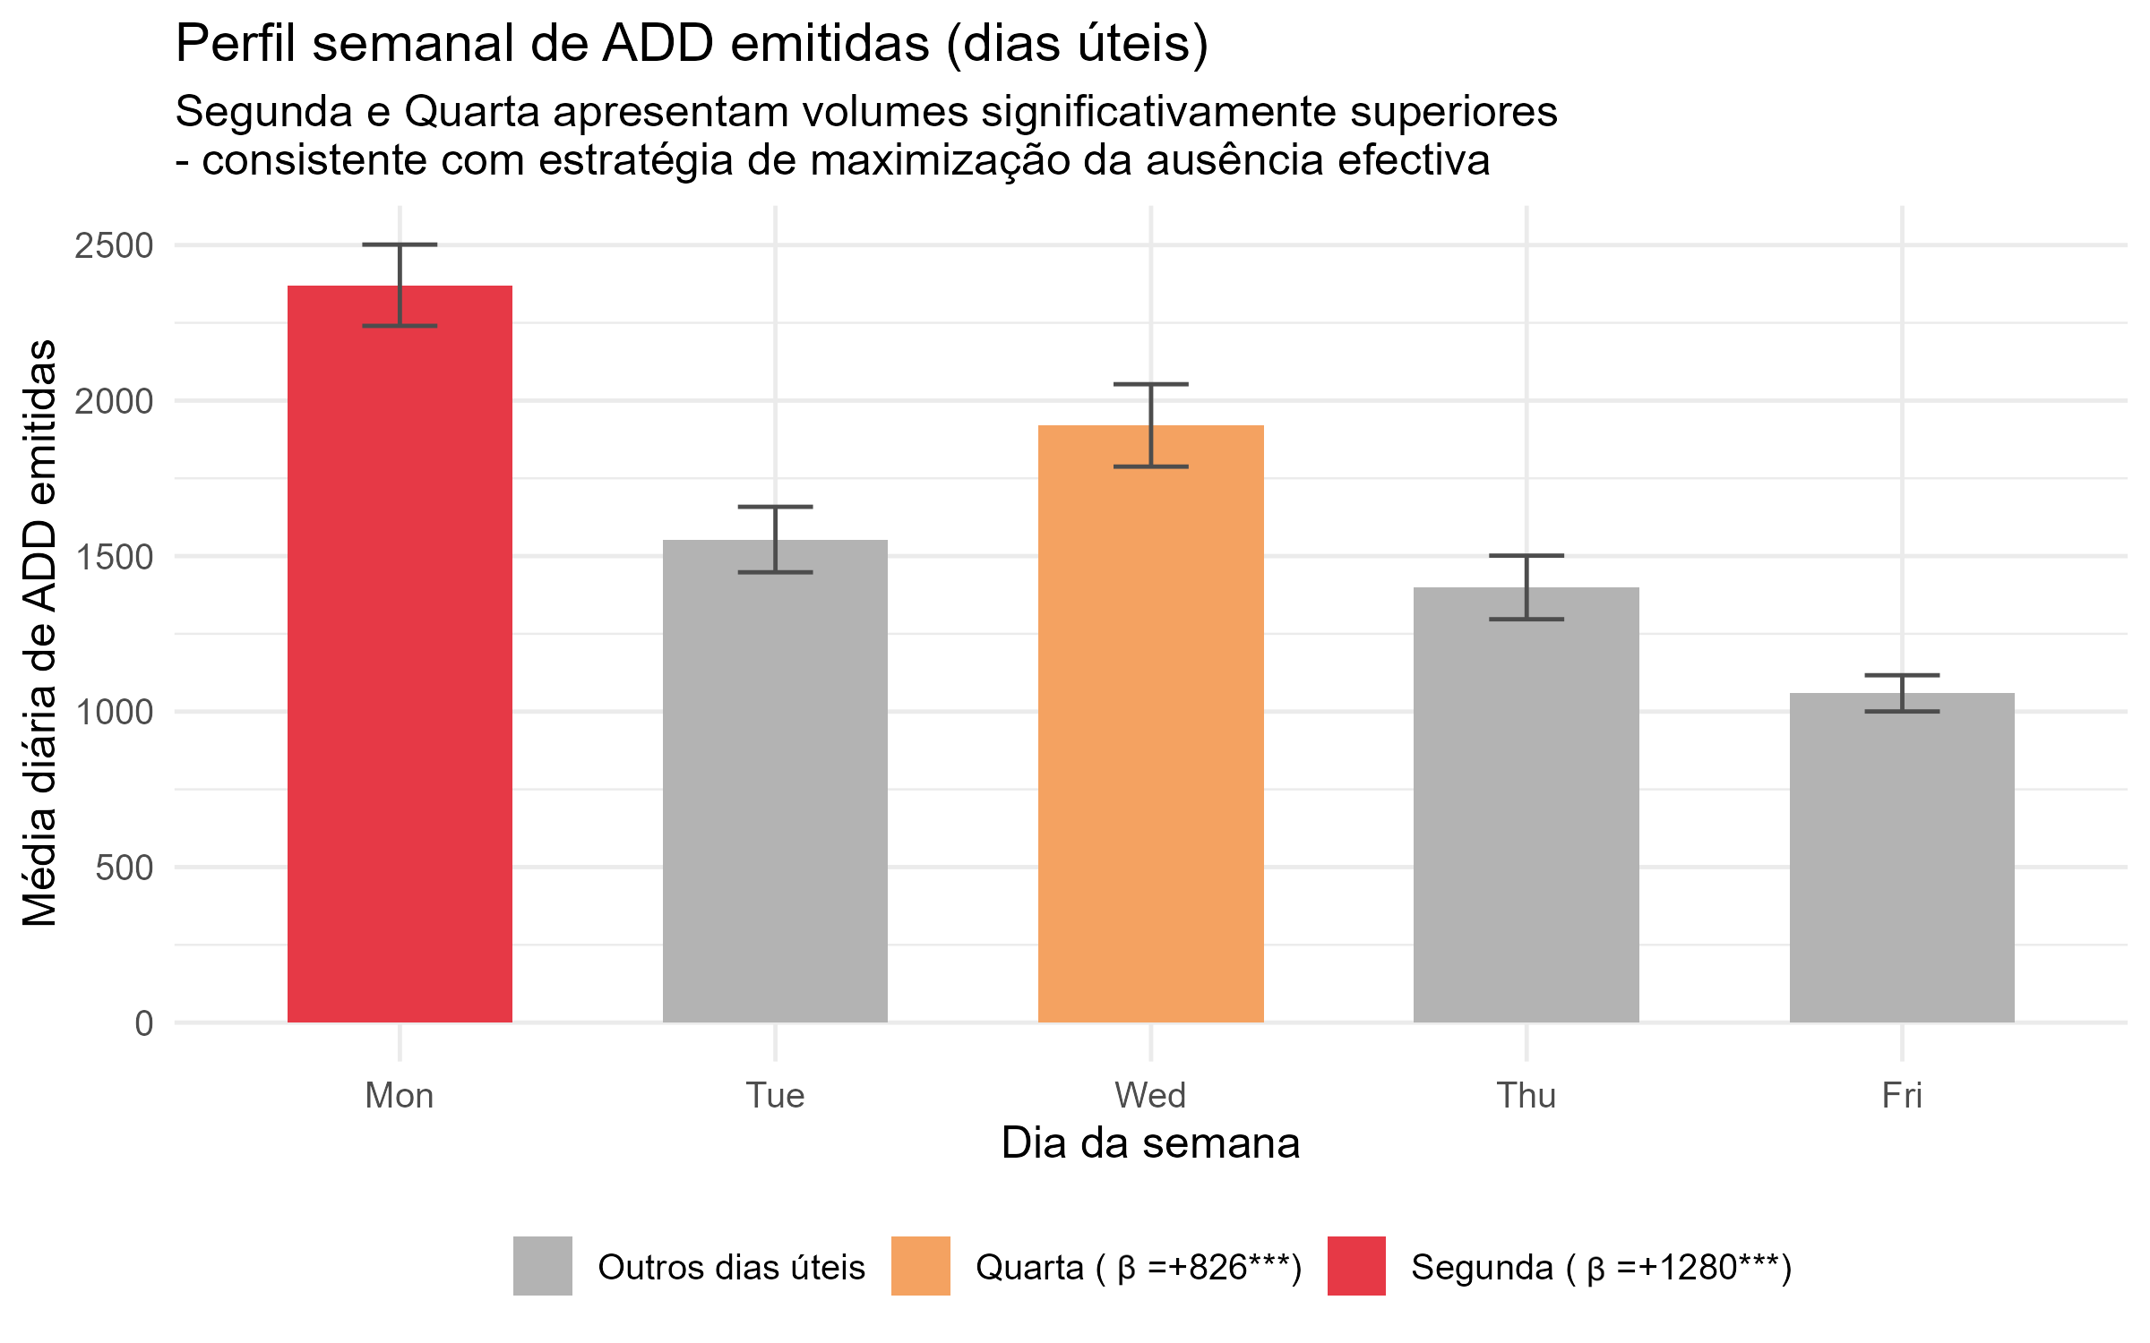
Weekly Pattern - evidence of convenience use
Key Insights
Monday spike
β = +1379***
Post-weekend extension: workers sick on Monday at significantly higher rates
Wednesday peak
β = +697***
Mid-week strategy: splitting 5-day week into two shorter periods

Slide 9
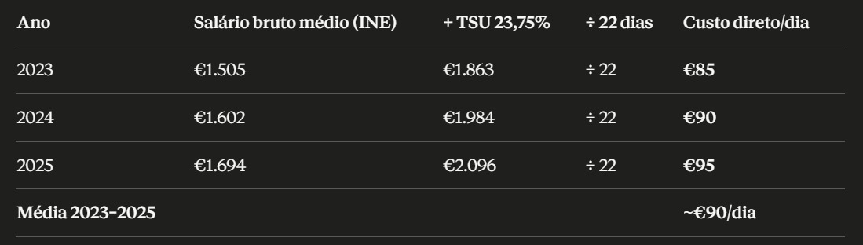
Economic Impact Estimation
⚠️ Assumption: €150 average daily cost per absent worker · 1 ADD = 1 absence day
193 042
101 807
14.5M€
Excess ADDs — Monday
Excess ADDs — Wednesday
Est. Annual Cost (significant vars)
β = +1379 per Monday
β = +697 per Wednesday
How it's calculated
Excess ADDs = β × N_days_in_period Economic cost = Excess ADDs × €150/day
x 1.7
Sources: Nicholson, S., Pauly, M. V., Polsky, D., Sharda, C., Szrek, H., & Berger, M. L. (2006). Measuring the effects of work loss on productivity with team production. Health economics, 15(2), 111–123. https://doi.org/10.1002/hec.1052; Strömberg, C., Aboagye, E., Hagberg, J., Bergström, G., & Lohela-Karlsson, M. (2017). Estimating the Effect and Economic Impact of Absenteeism, Presenteeism, and Work Environment-Related Problems on Reductions in Productivity from a Managerial Perspective. Value in health : the journal of the International Society for Pharmacoeconomics and Outcomes Research, 20(8), 1058–1064. https://doi.org/10.1016/j.jval.2017.05.008

Slide 10

Validation out-of-sample
Walk-forward out-of-sample with 12-month holdout
Training
Test ( 12 months)
①
Model estimated on training data only (no lookahead)
③
Test Fourier terms as continuation of training time axis
②
Test outliers set to 0 (unknown at forecast date)
④
Benchmark: Seasonal Naïve (lag-7) computed on the same training period
< RMSE Naïve s7
MASE < 1
Benchmark vs Naïve s7

Slide 11
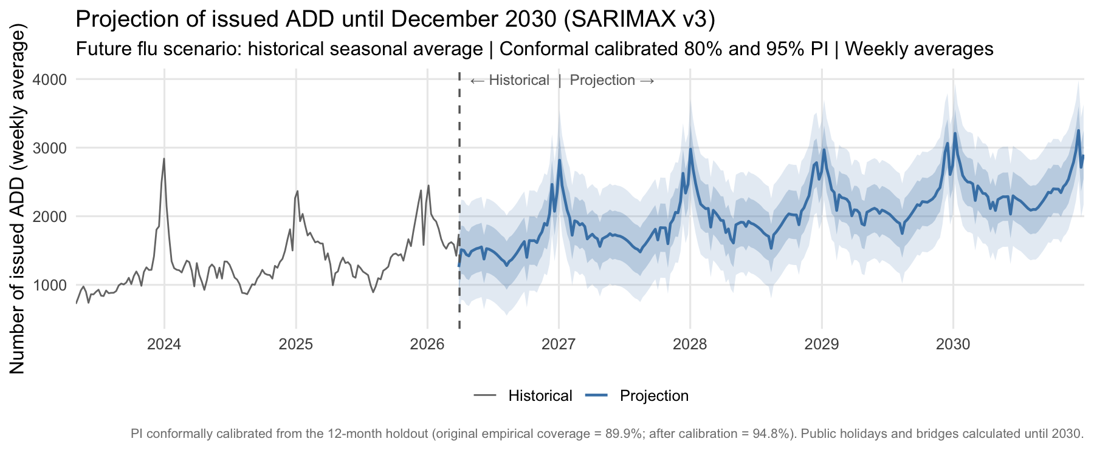
Projection (2027-2030)
Split Conformal Prediction · Papadopoulos et al. (2002) · Angelopoulos & Bates (2023)

Slide 12
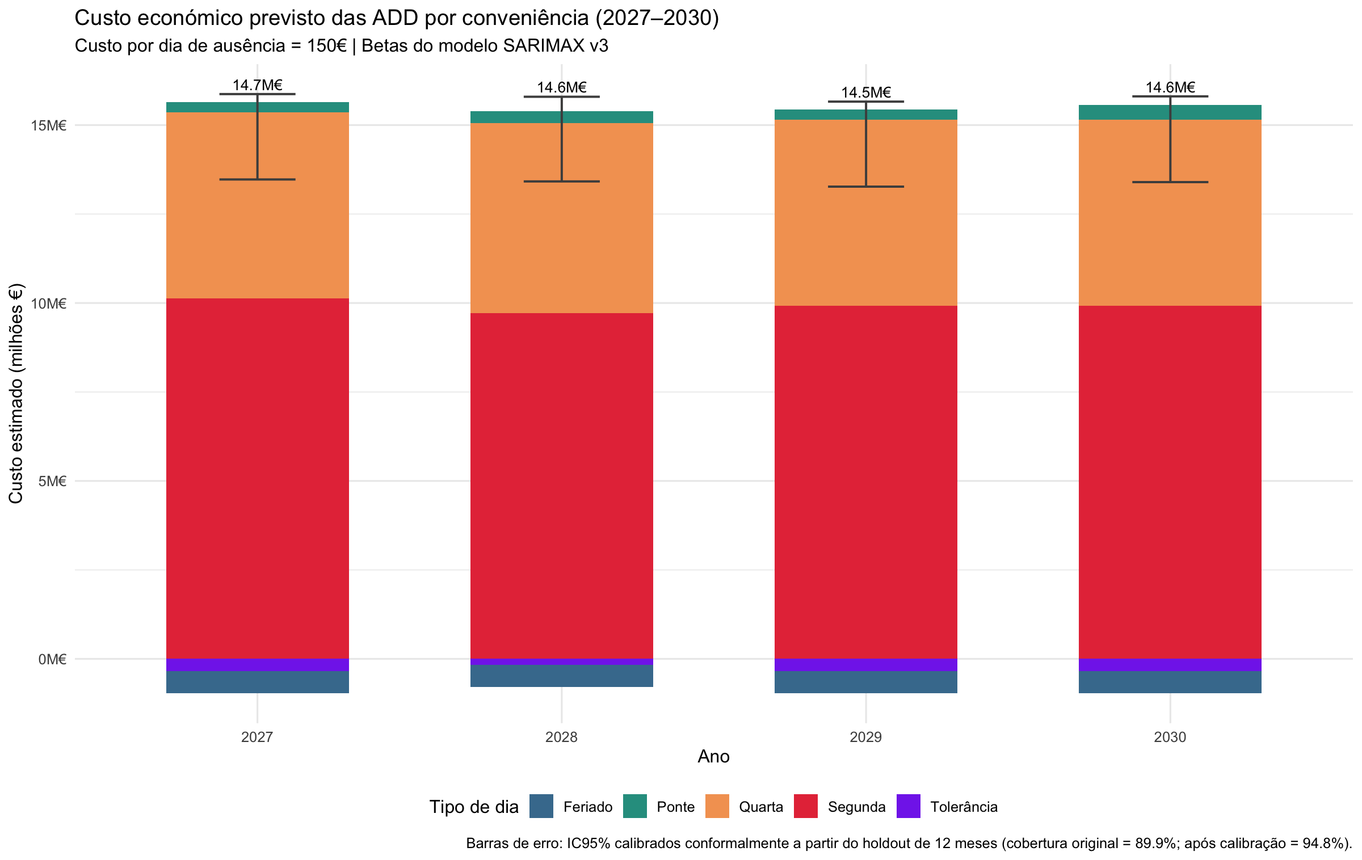
Projected Economic Impact (2026-2030)

Slide 13





Scenarios & Risk Analysis
10 000
2 years
33 M€
150€/day
No. of simulations
Horizon
Risk threshold
Cost/day
Base Scenario
Stress test + 10%
Stress test + 10%
Mean Cost
Mean Cost
33M€
33M€
P(> 33M€)
P(> 33M€)
22.7%
73.1%

Slide 14
Limitations
No individual-level data
Cost assumption
Aggregated daily counts only - we cannot distinguish workers using convenience ADD from genuinely ill ones. Association ≠ individual behaviour.
€150/day is a literature-based placeholder. Results should be re-run with sector-specific labour cost data.
📏
🧮
National aggregation
Short time series
Regional heterogeneity (evident in the dashboard) is not captured in the national model - future work could use region-stratified models.
ADD system started in May 2023. Only ~3-4 flu seasons are available, limiting the stability of annual Fourier terms and long-horizon forecasts.
🗺️
⏳
Confounding
Forecast uncertainty (v3)
Other drivers (remote work policy, sector, age) are unmeasured. Calendar dummies may absorb unrelated behavioural changes.
4-year cost projections assume constant ADD growth and β stability.
🔗
📡

Slide 15
Conclusions
01
Convenience use is real and statistically significant - Mondays and Wednesdays show excess ADD volumes not explained by flu.
Key takeaway
The ADD mechanism - designed to reduce pressure on primary care - is being used strategically. Our model quantifies this effect for the first time using national open data.
02
The SARIMAX + Fourier model cleanly separates clinical from behavioural demand, providing robust β estimates.
03
Economic impact is estimable but depends on labour cost assumptions - transparency on inputs is essential.
📁 GitHub Repository
04
The ADD system needs policy attention: exploit-prevention rules or co-payment mechanisms could reduce abuse.
github.com/FilipaTC/lab_work
README.md · prompts.md · R pipeline · Power BI .pbix · Data CSVs

Slide 16

Projection
📅
Time Horizon
🩺
Future Gripe
📆
Calendar Dummies
4 full years from the last historical date
Daily dates: início_prev to fim_prev
Historical mean seasonal profile by day-of-year
Fallback: day 60 (1 Mar) for 29 Feb in non-leap years
Public holidays + Tolerance days + Bridge days
Computed for 2026-2030 with the same hierarchy
〰️
Fourier Terms
📊
Confidence Interval
⚠️
Outliers
Conformally calibrated CI80 and CI95
Fixed half-width: q₈₀ and q̂ ADD/day
Historical outlier dummies → 0 in the future
(uncertainty incorporated via conformal CI)
K=5 pares, freq=365.25
Continuation of the historical series (unbroken)

