Slide 1
A Survey of Rural and Urban Road Identification
via Satellite Imagery
2/12/2025
DEEC\FCT\UNL - TAPDI
Filipe Cavalheiro, Nº70119
Diogo Novais, Nº70118

Slide 2
Data Gathering
Satellite and Aerial Imagery Sources:
IKONOS
QuickBird
Pleiades-1A/1B
GeoEye
Benchmark Datasets:
Massachusetts Roads
UAV-based Road
TerraSAR-X Road
Abu Dhabi
Conghua
European Road
Mação
Freely Accessible Annotation Sources:
OpenStreetMap (OSM)
Google Earth
2/12/2025
DEEC\FCT\UNL - TAPDI

Slide 3
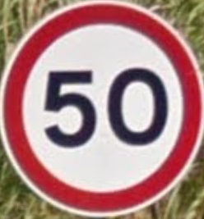
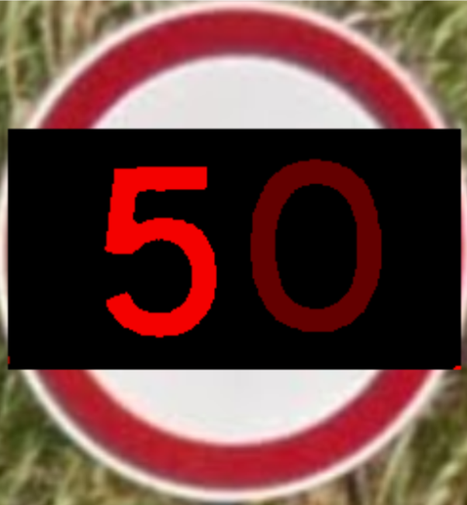
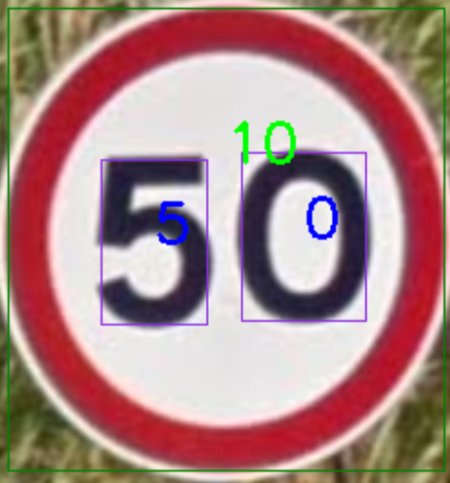
HEURISTIC METHODS
Red Filter
Connected-components
filter by size
component location
Otsu
Connected-components on the numbers
Image comparison
2/12/2025
DEEC\FCT\UNL - TAPDI

Slide 4
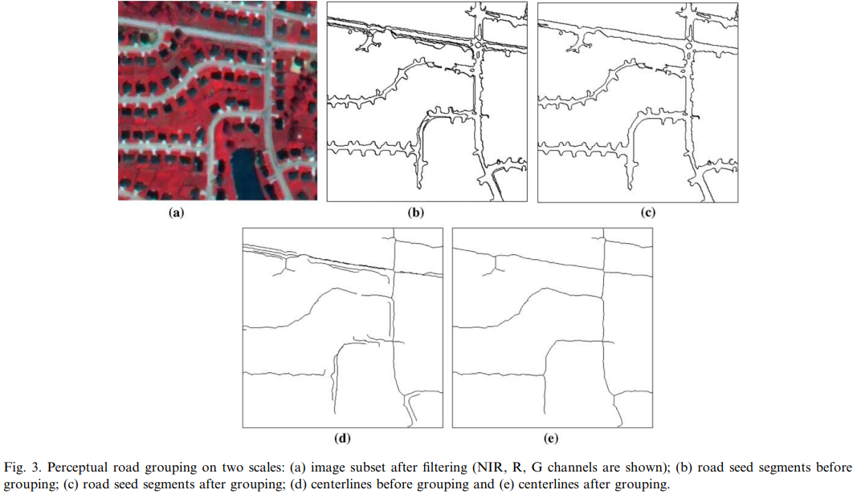
HEURISTIC METHODS
2/12/2025
DEEC\FCT\UNL - TAPDI
An integrated system for automatic road mapping from high-resolution multi-spectral satellite imagery by information fusion [2]

Slide 5
DATA-DRIVEN METHODS
Convolution Neural Networks (CNN)
Fully Convolutional Networks (FCN)
Deep Convolutional Encoder-Decoder (DCED)
Generative Adversary Network (GAN)
2/12/2025
DEEC\FCT\UNL - TAPDI

Slide 6
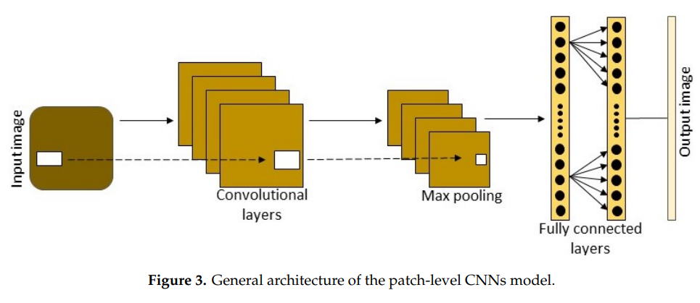
CNN Models
2/12/2025
DEEC\FCT\UNL - TAPDI
Deep Learning Approaches Applied to Remote Sensing Datasets for Road Extraction: A State-Of-The-Art Review [10]

Slide 7


CNN Models
Image of Class (Sunset)
Image of Class (Beach)
2/12/2025
DEEC\FCT\UNL - TAPDI

Slide 8
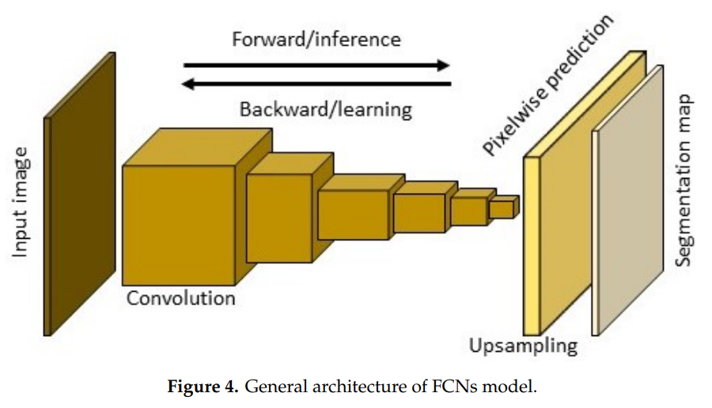
FCN Models
2/12/2025
DEEC\FCT\UNL - TAPDI
Deep Learning Approaches Applied to Remote Sensing Datasets for Road Extraction: A State-Of-The-Art Review [10]

Slide 9

FCN Models
2/12/2025
DEEC\FCT\UNL - TAPDI
FCN-8s pretrained on Pascal-Context, used in farming environment. (1/2)
https://www.youtube.com/watch?v=KMFNNfGLIGg

Slide 10
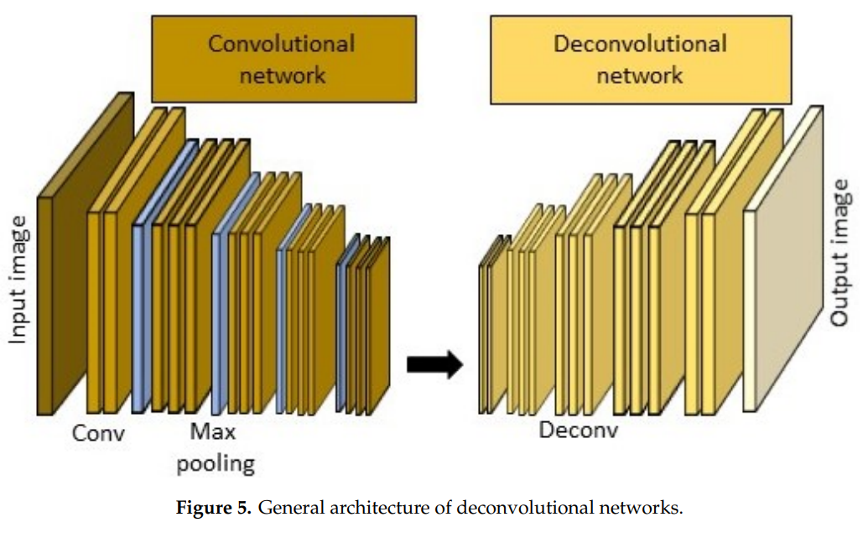
DCED Models
2/12/2025
DEEC\FCT\UNL - TAPDI
Deep Learning Approaches Applied to Remote Sensing Datasets for Road Extraction: A State-Of-The-Art Review [10]

Slide 11
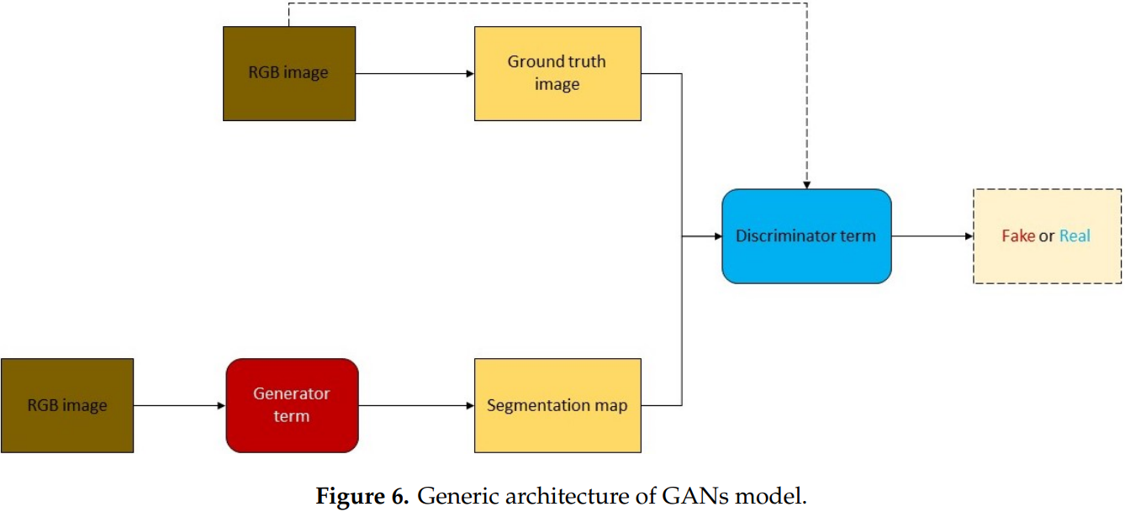
GAN-Based Models
2/12/2025
DEEC\FCT\UNL - TAPDI
Deep Learning Approaches Applied to Remote Sensing Datasets for Road Extraction: A State-Of-The-Art Review [10]

Slide 12
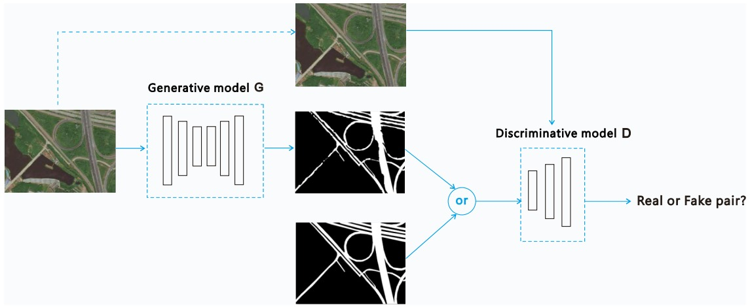
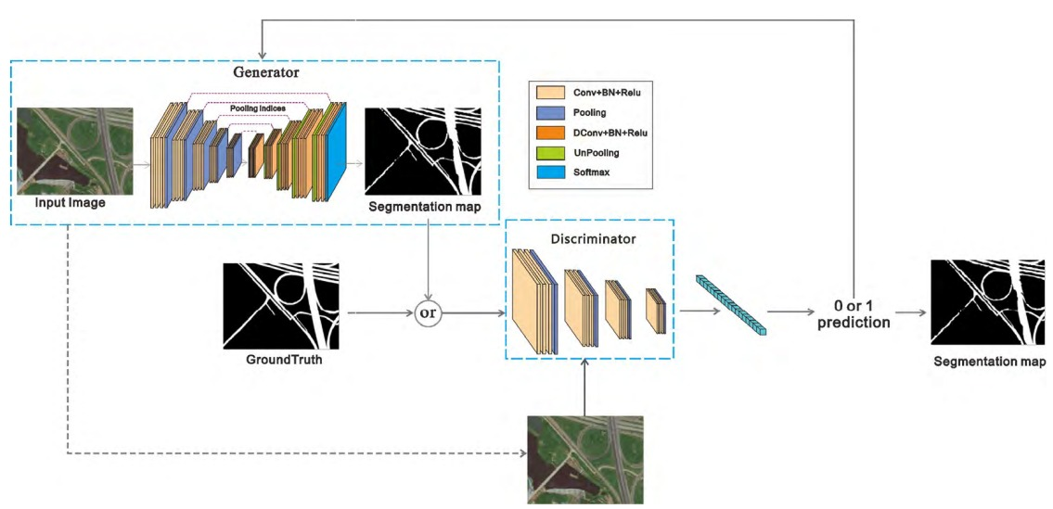
GAN-Based Models
2/12/2025
DEEC\FCT\UNL - TAPDI

Slide 13
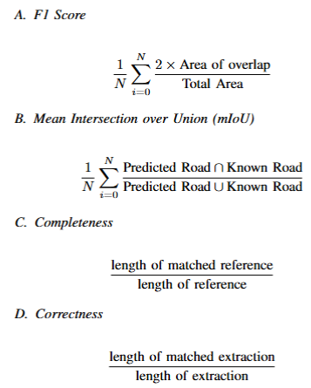
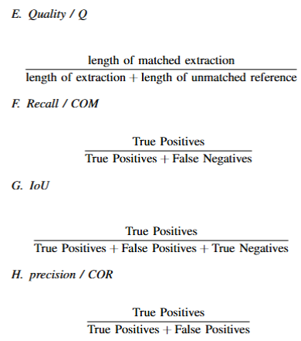

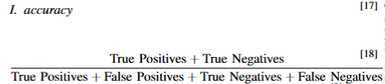
Error Measurement Methods

Slide 14
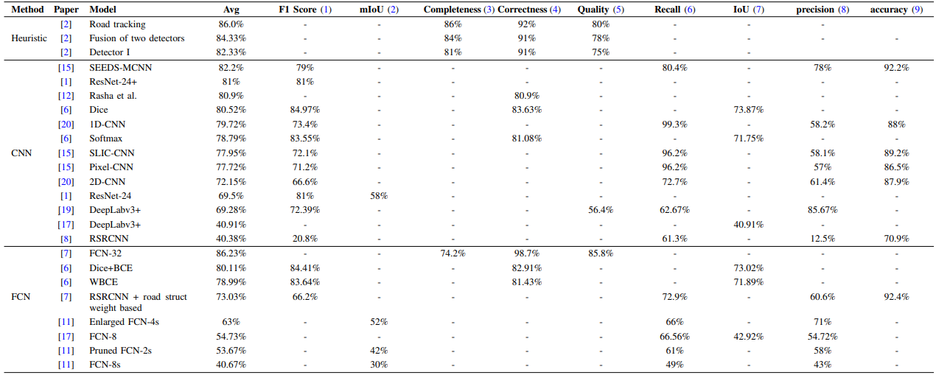
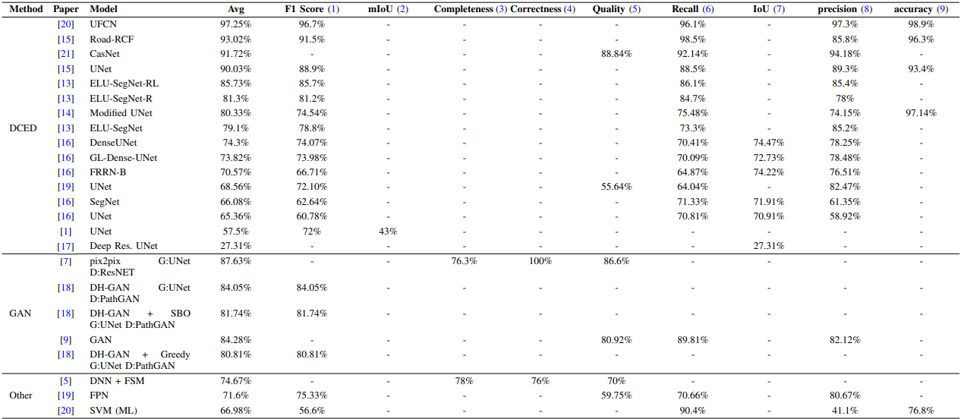
Results

Slide 15
Results

Slide 16
Results

