Slide 1


Ansible Presentation Filipe

Slide 2

Contents
Project Diagram
Controller Setup
Playbook – ec2 instance
Playbook – Install nginx, reverse proxy and node
Playbook – Configure MongoDB
Ansible Vault
Hosts File

Slide 3
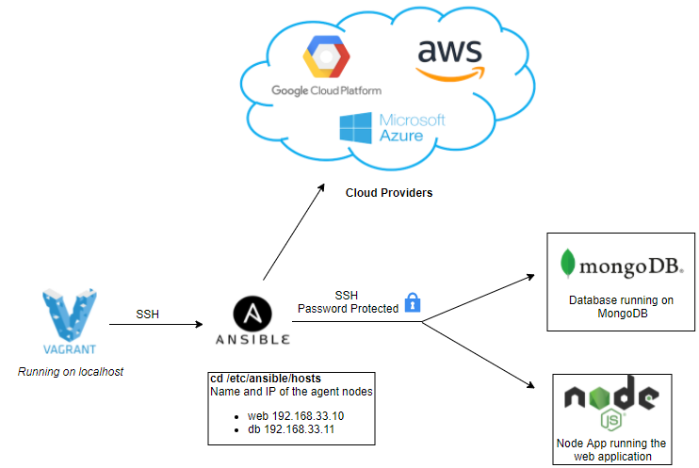
Project Infrastructure Diagram

Slide 4
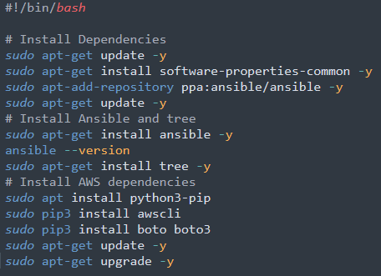
Ansible Controller Setup
This is the provision file to setup the controller
We install all dependencies, like python and AWS
Controller provision script

Slide 5
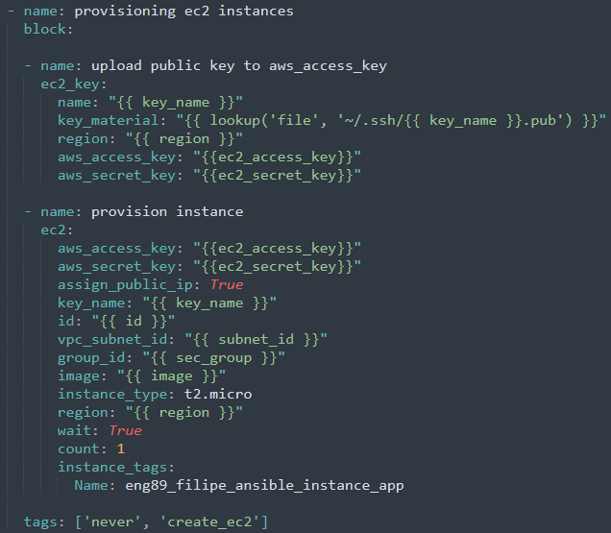
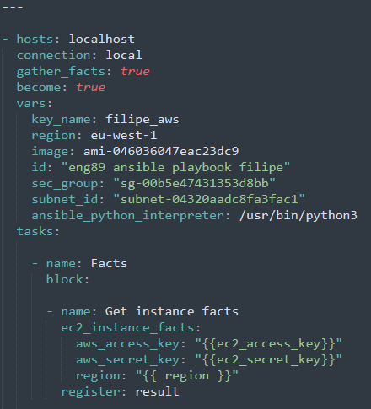
Playbook – Launch ec2
Part 1
Part 2

Slide 6
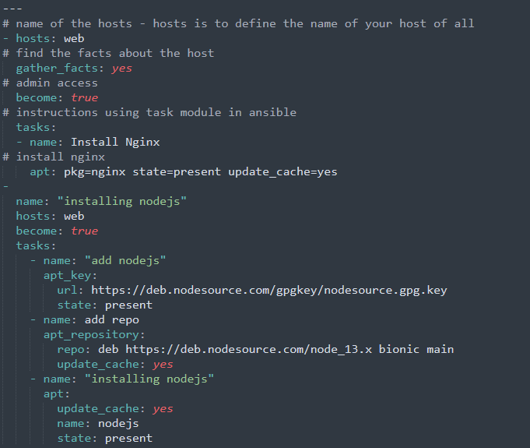
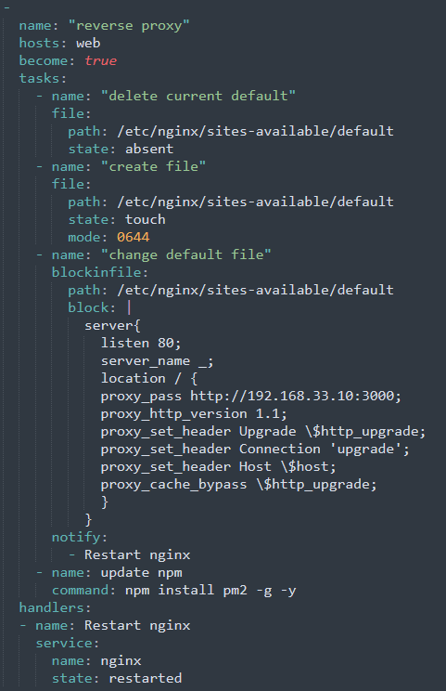
Playbook – Install nginx and reverse proxy and node
Part 1
Part 2

Slide 7
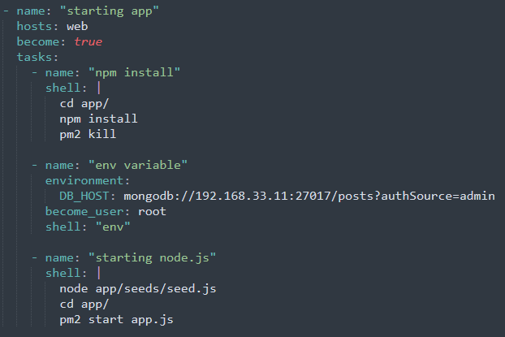
Playbook – Install nginx, reverse proxy and node
We use this playbook to automatically install nginx and setup the reverse proxy, as well as setting up the environment variable and seeding the database
Part 3

Slide 8
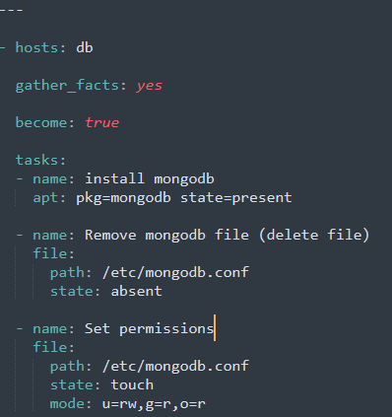
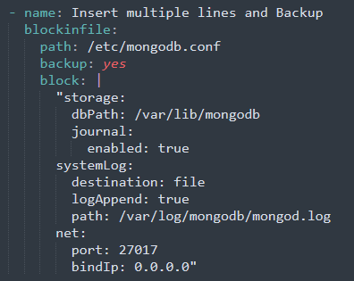
Playbook – Configure MongoDB
Part 1
Part 2

Slide 9
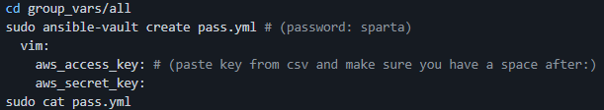
Ansible Vault
We have two directories group_vars > all.
We then run a command to create a password file and add in our access key and secret keys sudo ansible-vault create pass.yml
When we check the password file, we see that the passwords have been hashed.

Slide 10
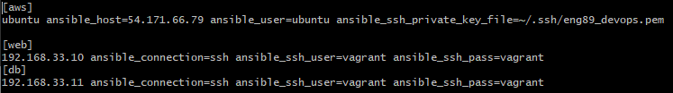
Hosts file
Where we specify the hosts and their IP addresses so we can connect to them
In the case of AWS, because it is not local we have to specify the public IP address

Slide 11
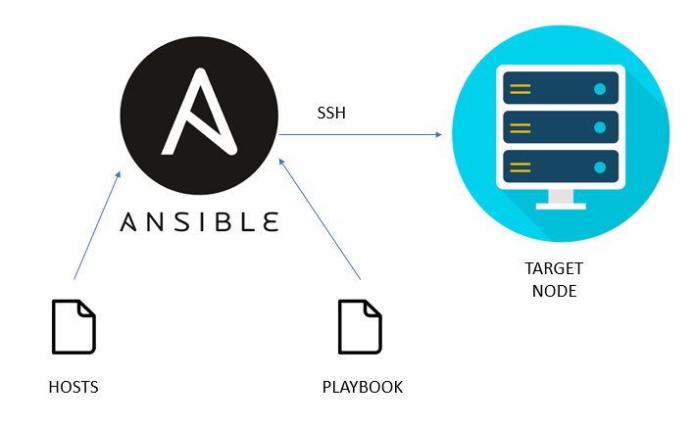
Summary
Ansible is a powerful tool which lets us automate and manage the configuration of systems, which can be located locally or on cloud.
Writing the ansible playbooks can be tricky, so we need to pay attention to indentation and syntax.
Ansible vault is a very useful way to store private data and maximize security within our ansible controller.

Slide 12
spartaglobal.com

