Slide 1

Optical Communications: 64-QAM Classification with Neural Networks
TAA, LEI, 2018/19
Authors:
Filipe Pires (85122)
João Alegria (85048)
Notes:
Organização da Apresentação
Contextualização
Desafio
Pesquisa
Análise
Conclusões e Trabalho Futuro

Slide 2

Contextualization
Quadrature Amplitude Modulation
A modulation scheme conveys data by changing some aspect of a carrier signal, or carrier wave, (usually a sinusoid) in response to a data signal
In the case of QAM, the carrier wave is the sum of two sinusoidal waves of the same frequency, 90 degrees out of phase with each other (“I” and “Q” components)
Each component wave is amplitude modulated
Notes:
QAM - família de métodos de modulação digital muito usada nas telecomunicações modernas para transmitir info
- de 4QAM a +4096QAM
- transporta dados alternando aspetos da onda portadora (soma de 2 sinusoides, desfazeadas em quadratura (90 graus))
- símbolos mapeados n1 diagrama, cada um a uma dist específica da origem (infos inseridas nos param de amplitude e quadratura da onda portadora)

Slide 3
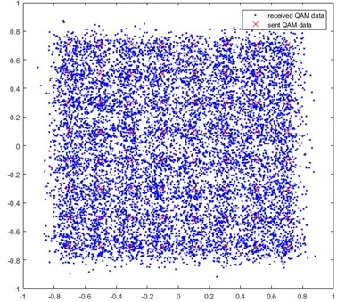
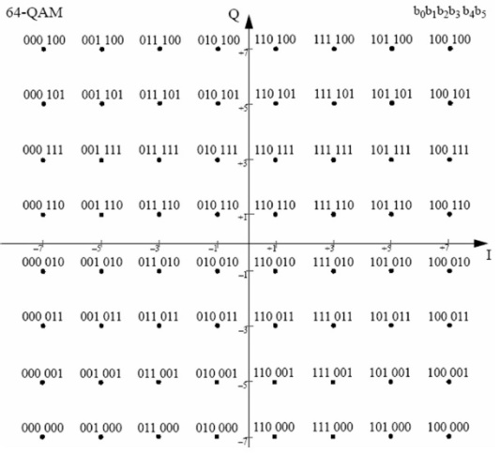
Contextualization
Constellation Diagram
64 points
separately encode all 64 combinations of 6 bits
can transmit 6 bits per sample
Notes:
CD - display 2D num plano complexo
- num de pts = tamanho do alfabeto de símbolos transmissíveis

Slide 4
Contextualization
Inter-Symbol Interference
The transmitted signal is decoded by a demodulator. His function is to classify each sample as a symbol
The performance of the fiber optic communication channels is limited by a phenomenon known as dispersion, giving rise to inter-symbol interference (ISI)
The demodulator may misidentify a sample as other symbol, resulting in a symbol error
Dispersion compensation is an increasingly important issue
Notes:
ISI - descodificação consiste na classificação de cada sample como 1 símbolo
- o fenómeno de dispersão ocorre no transporte dos dados, causando o alargamento dos pulsos ópticos
- procura de soluções

Slide 5
Challenge Addressed
Research teams are now looking for a viable answer to the demands of proper symbol identification by the demodulator
Our goal for this project was to apply ML methods to compensate the inter-symbol interference and correctly decode the symbols transmitted
We focused on the approach of considering the channel equalization as a classification problem with 64 classes and building a reliable classifier – Artificial Neural Network Classifier
Notes:
Objetivo - aplicar ML para compensar o ISI e descodificar os símbolos corretamente
- classification problem com 64 classes
- Rede Neuronal

Slide 6
Research
How can an ANN consider 64 classes in a feasible and efficient manner?
What can the best input parameters be?
How can the best values for the ANN's hyperparameters be found in the minimum amount of time?

Slide 7
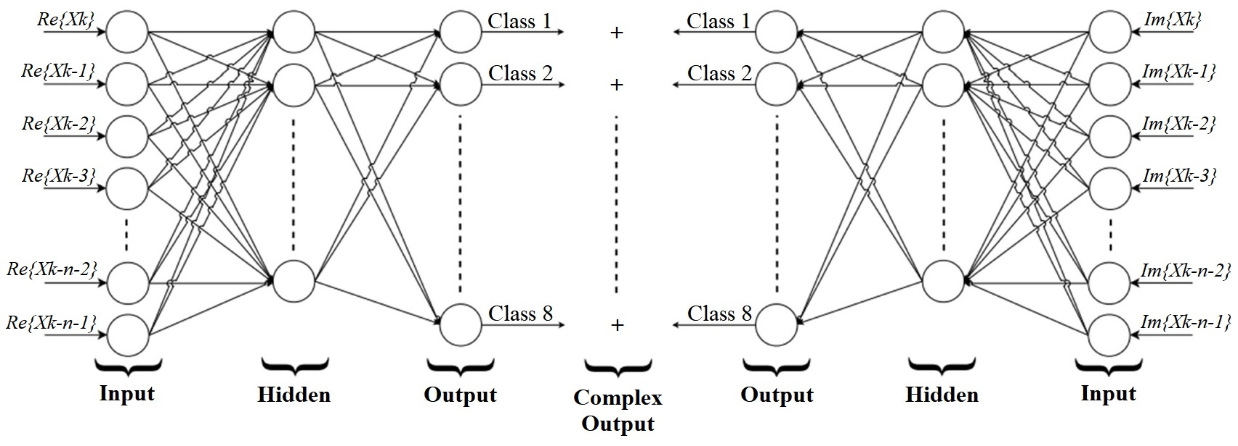
Research
Neural Networks Architecture
dividing the problem in two Neural Networks
Notes:
+ Performance
ANN + focadas
Apropriado para o problema

Slide 8
Research
Data Nature
Taking in consideration that the data consisted in a stream of symbols where the current symbol is somehow related with the previous ones
Purposes: search for good way to predict the symbols' classes;
find out if the symbols of the stream close to the current
one had any effect on its class;

Slide 9
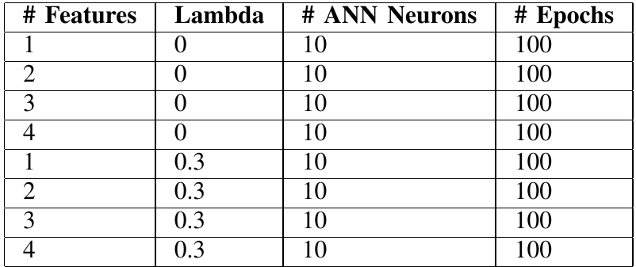
Research
Hyperparameter Weights
Hyperparameters involved:
number of features of each ANN
learning rate (Lambda)
number of hidden layer neurons
number of Epochs
Compromise the variations of values of each (due to shortage of time)

Slide 10
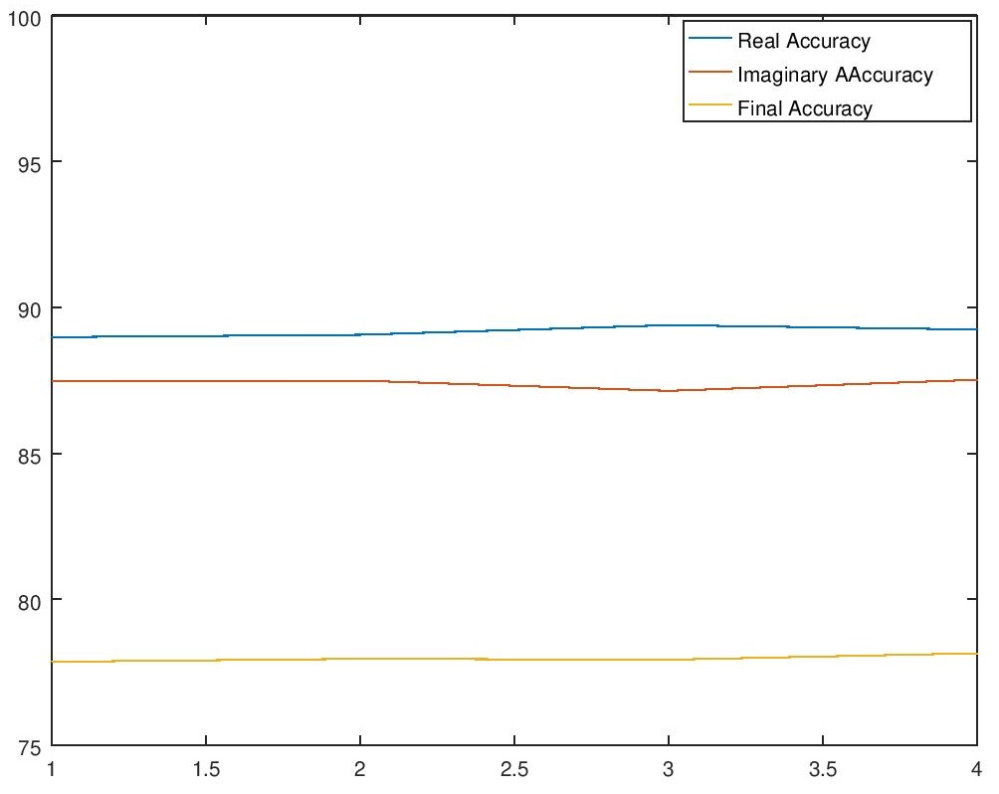
Analysis
Lambda = 0.0

Slide 11
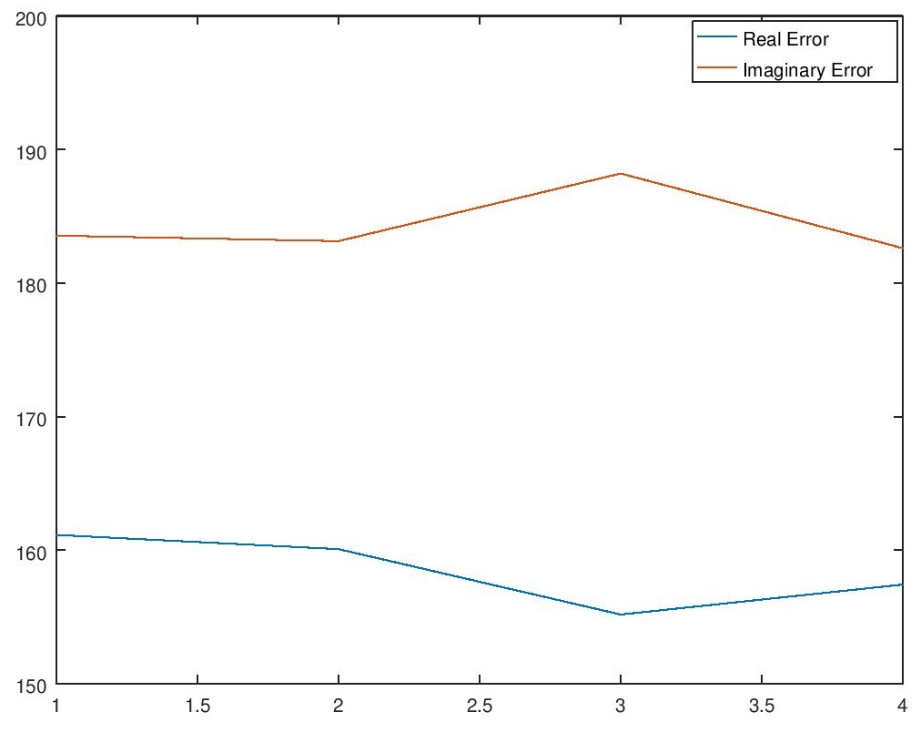
Analysis
Lambda = 0.0

Slide 12
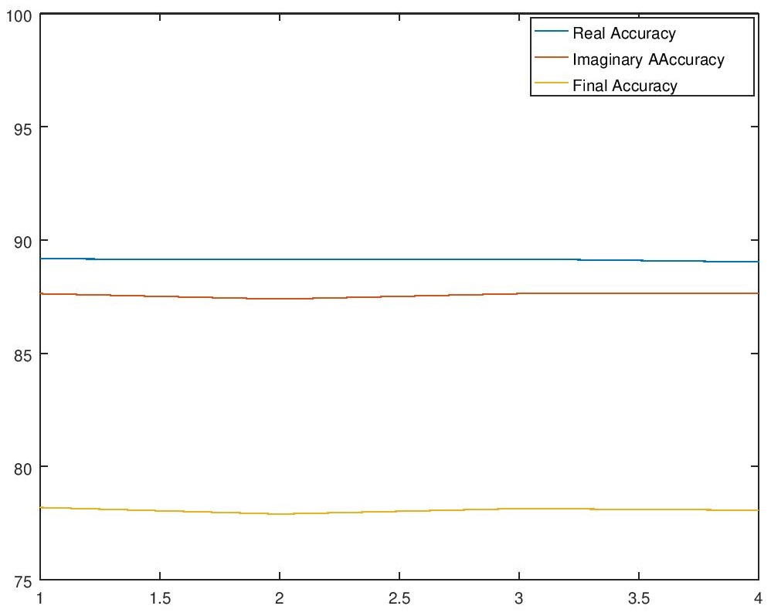
Analysis
Lambda = 0.3

Slide 13
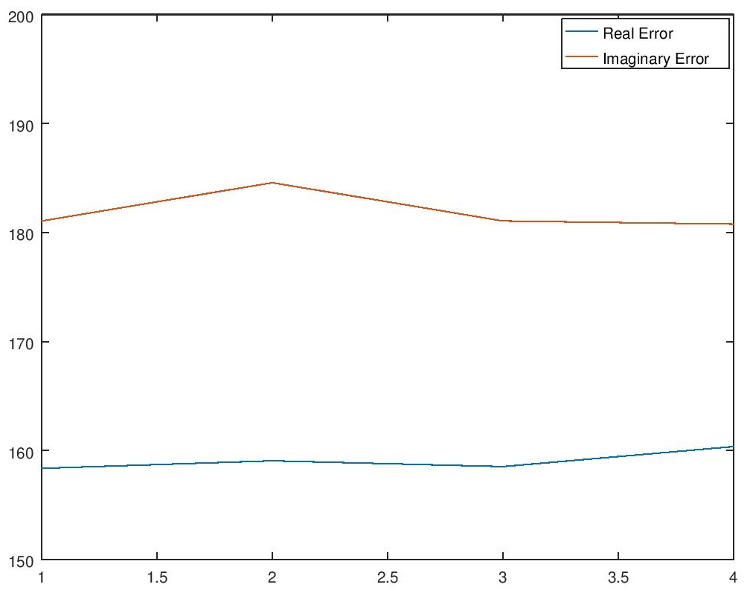
Analysis
Lambda = 0.3

Slide 14
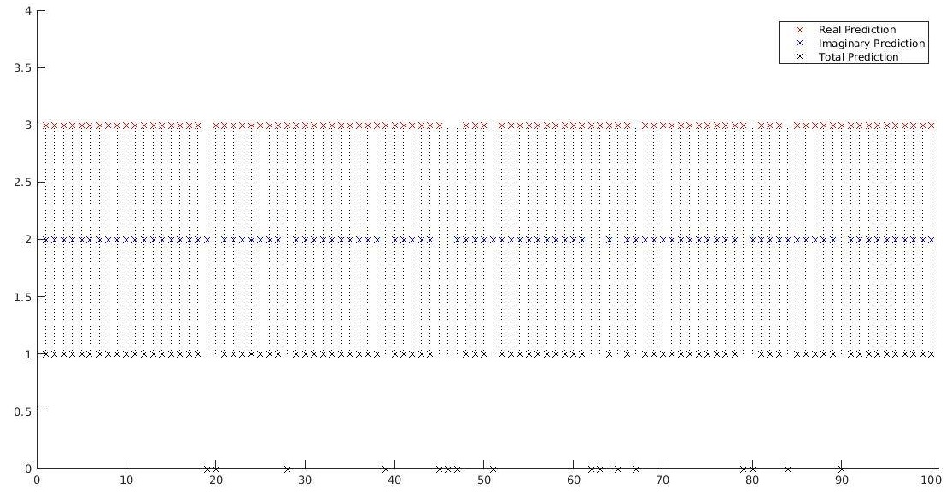
Analysis
Mismatch Visualization

Slide 15
Best Solution
Improving the capabilities of the system using the best found values for the ANNs
Validating the final stage of the system using the testin data and calculating the predictions based on the new and improved theta values
Real Error | Imag. Error | Real Accuracy | Imag. Accuracy | Total Accuracy
158.0394 | 172.6481 | 89.1958 | 88.2049 | 78.7817

Slide 16
Conclusions & Future Work
The overall results of our research were bellow the expectations
The assumption that other symbols on the signal stream could influence the class of the symbol being classified might be partially incorrect, or at least their weights may be of little effect
The next step could be to adopt a new strategy for the ANNs' features
Considering a class as isolated and calculating the distances between the received signal (with ISI) and all the real classes

Slide 17
The collected knowledge made it clear that Neural Networks can be one future solution for this big challenge and are today one step closer to finding it.

