Slide 1


Ccvrpt
A collaborative cinematic Virtual reality production tool
Filipe Pires & Isaac dos anjos
Msc. Informatics engineering | Virtual & augmented reality

Slide 2


Introduction
A Tool for Collaborative CVR Production
Idea: to develop a tool that can be used by VR artists for the creation of scenarios and capture of virtual 360 videos.
Purpose: provide means to study whether artists should create in traditional 2D environments or benefit from creating inside 3D space.
Goal (for this Project): to implement fundamental features that prove the concept.

Slide 3
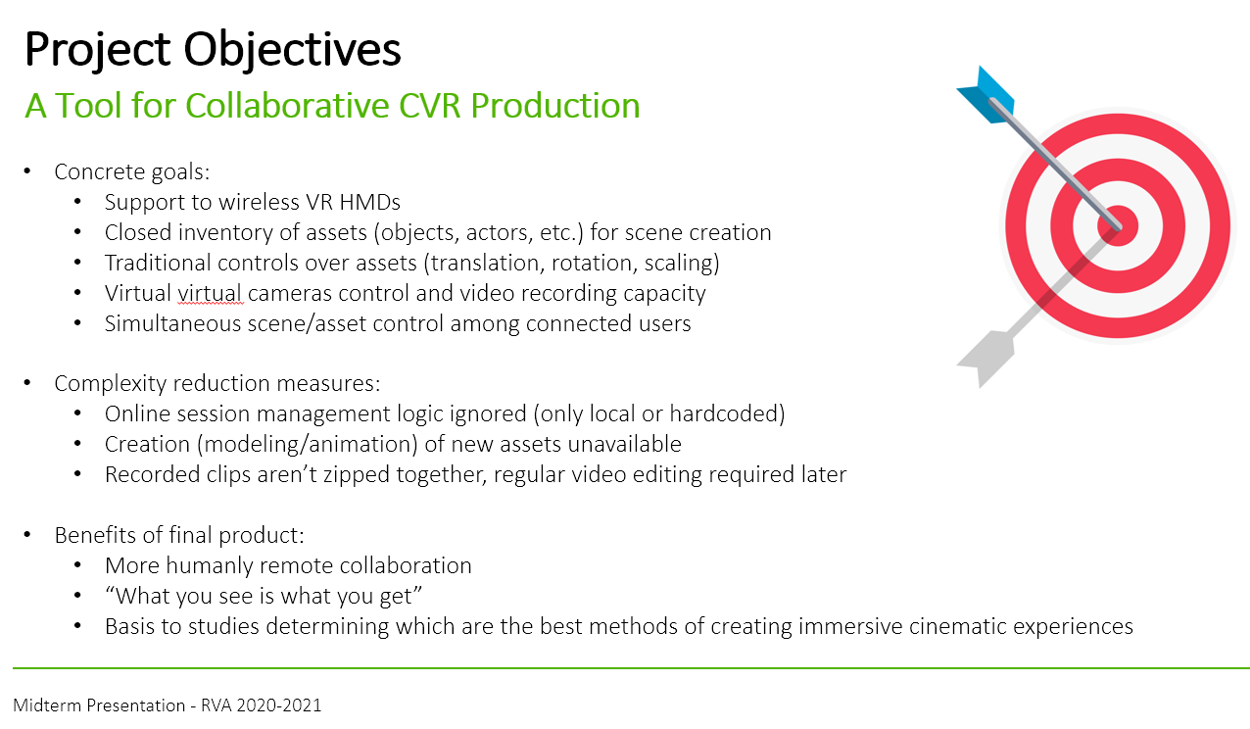
ASSIGNMENT 1
Initially Defined Project Goals

Slide 4

Demo video

Slide 5
Implemented Features
A Tool for Collaborative CVR Production
Locomotion: walking + teleportation
Interaction: point, select/grab (near + far), translate, rotate, scale
UI: “hand-palette” style, follows hand, only appears when desired
Inventory: static objects, virtual virtual cameras, viewpoints
Recording: 360 panorama image sequences
Collaboration: save + load scene files

Slide 6
Non-Implemented Features
A Tool for Collaborative CVR Production
Inventory: animated objects, sounds, import feature
Recording: sound
Collaboration: connect online and create simultaneously
Settings: image quality, etc.

Slide 7
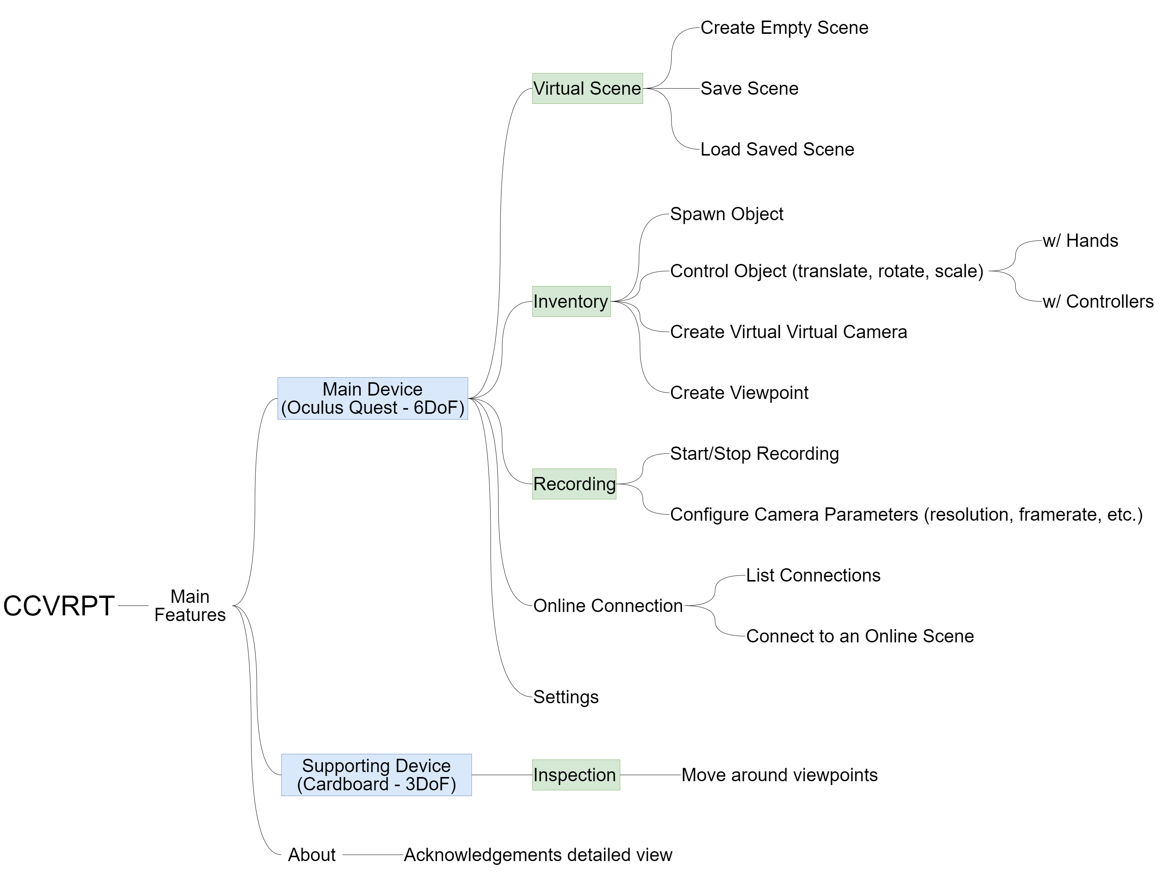
Project structure
A Tool for Collaborative CVR Production

Slide 8
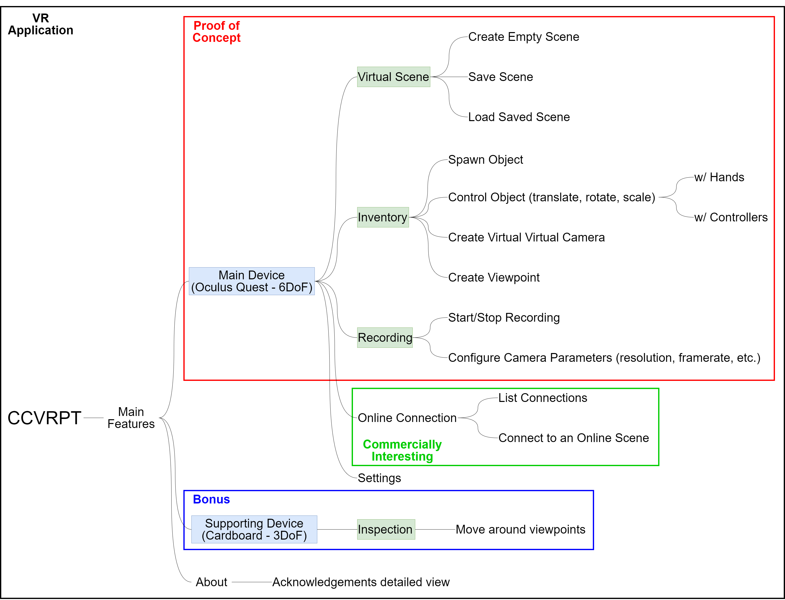
Project structure
A Tool for Collaborative CVR Production

Slide 9

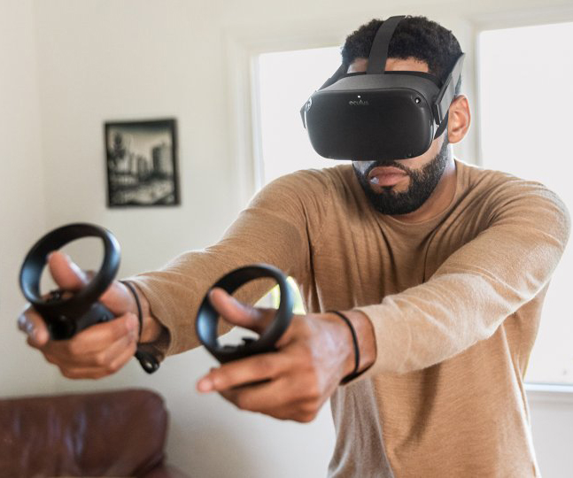
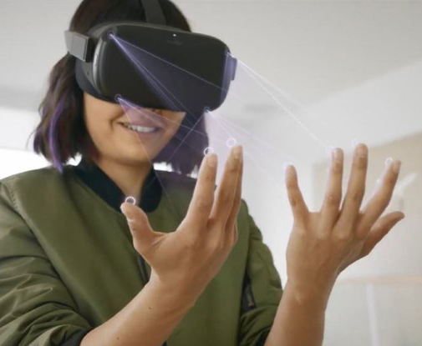
TOOLS USED
A Tool for Collaborative CVR Production
Unity Engine
Oculus Quest Integration
Android Debug Bridge
Mixed Reality Tool Kit
VR Cinema Package
TextMesh Pro
…
…

Slide 10
User evaluation
A Tool for Collaborative CVR Production
Method:
… goal … what was evaluated
… persona(s) addressed
… tasks used
… participants (number, etc.)
… questionnaires used
Results:
Quantitative Analysis: …
Qualitative Analysis: …

Slide 11
Expectations vs reality
A Tool for CVR Production
Collaborative
As development progressed, we realized the need for many more features useful for content creation
It would not make sense to provide real-time collaborative features if offline collaboration wasn’t even possible (saving/loading scenes)
Despite all difficulties (mentioned next), creating scenes proved to be more fun than expected

Slide 12
Main difficulties
A Tool for Collaborative CVR Production
Development Tools:
Continuous Development and Debugging not trivial
Updating GitHub repositories with Unity projects is a nightmare
Virtua Virtual Cameras:
Existing solutions are meant for recording game trailers inside Unity Editor
Over 5 different Unity assets and open-source coding projects were tried
No tool allowed to record a perspective different from the user’s
…

Slide 13
Future work
A Tool for Collaborative CVR Production
…

Slide 14

Thank You!
ANY QUESTIONS?

