Slide 1

Continuous care,
your Personal Monitoring System
Supervisor Teacher: Carlos Costa
Developers Team: André Pedrosa (85098)
Filipe Pires (85122)
João Alegria (85048)

Slide 2
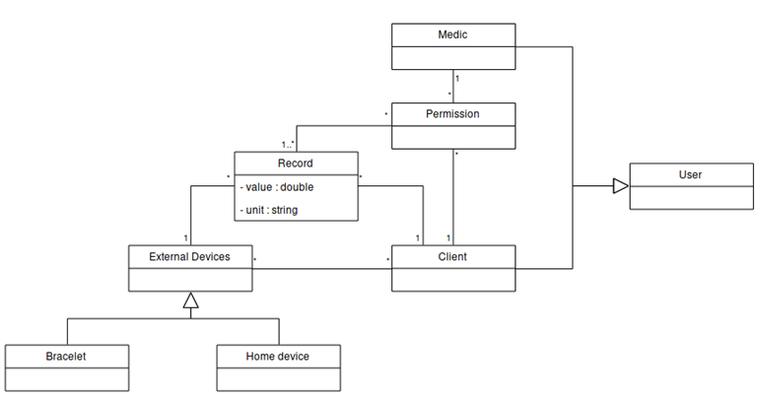
André Pedrosa, Filipe Pires and João Alegria
Requirements Elicitation
17 functional and 12 nonfunctional
2 actors, with 7 main use cases
Figure 1: Domain Model
Notes:
6 Functional
The home device must send data to the server whenever an actor is indoors.
The personal device (bracelet) must send data to the server whenever an actor uses it.
The system must still collect data even when the devices are not being currently used (worn).
The system must be prepared to allow access to the information to other actors (e.g. medical personnel) with the owner’s permission.
2 Non-Functional
PRICACY - All actors’ personal data must be confidential to the owners alone.
RESPONSE TIME - All requests must be responded within a timespace no longer than 1 second.
--------
The domain model is used in this phase of the project to help us developers keep an abstraction of the system model, describing in an intuitive way the entities, roles and relationships
2

Slide 3
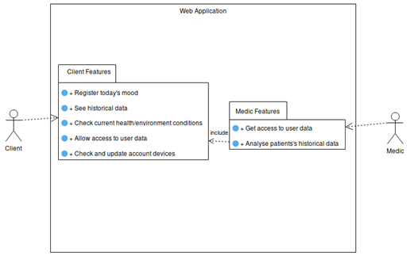
André Pedrosa, Filipe Pires and João Alegria
Requirements Elicitation
Figure 2: Use Case Diagram
Notes:
• Client: Has access to all features of the web interface;
• Doctor: Only has features available when a permission is given by a client;
The levels of experience with technology needed for both these actors to be confortable with the system are relatively low. An actor only needs to be used to work with the basic tools of a computer and a web browser in order to properly use our tools.
Regarding the set up of the external devices and their maintenance, these are tasks that may make actors encounter difficulties that require some more experience.
However, it is a matter taken in consideration and we intend to make available everything necessary for any kind of person to be able to use the system without much entropy.
3

Slide 4
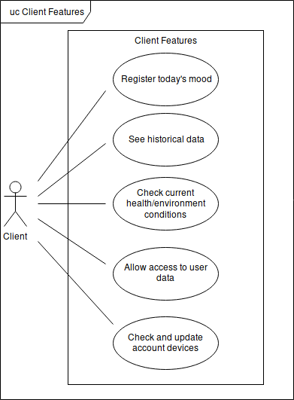
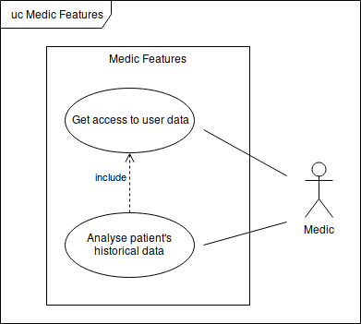
André Pedrosa, Filipe Pires and João Alegria
Requirements Elicitation
Figures 3 and 4: Client and Doctor Features
Notes:
Grant and ask access
This is needed so the doctor can analise the data
---
Register todaus mod so we have labbled data for machine learning algorithms
4

Slide 5
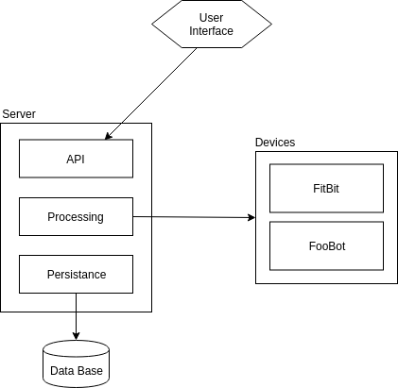
André Pedrosa, Filipe Pires and João Alegria
System Architecture
Deployment Plan
Modular Architecture
Public REST API
Mockup Developed
Figures 5: Architecture Diagram

Slide 6
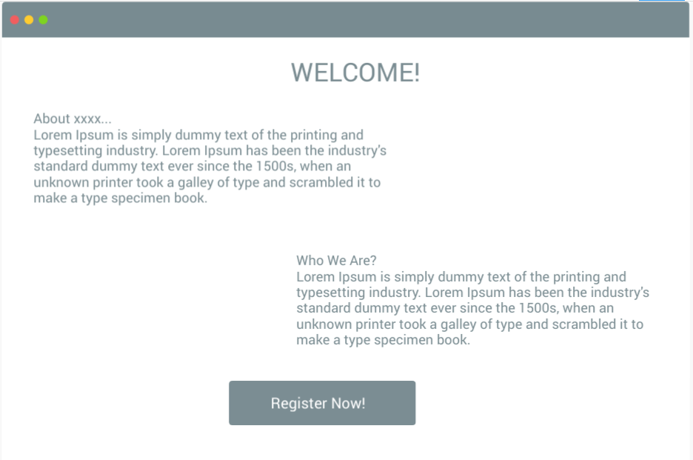
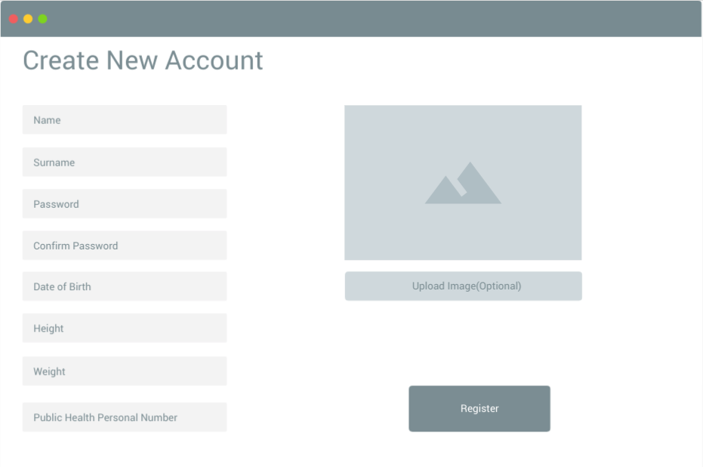
André Pedrosa, Filipe Pires and João Alegria
System Architecture

Slide 7
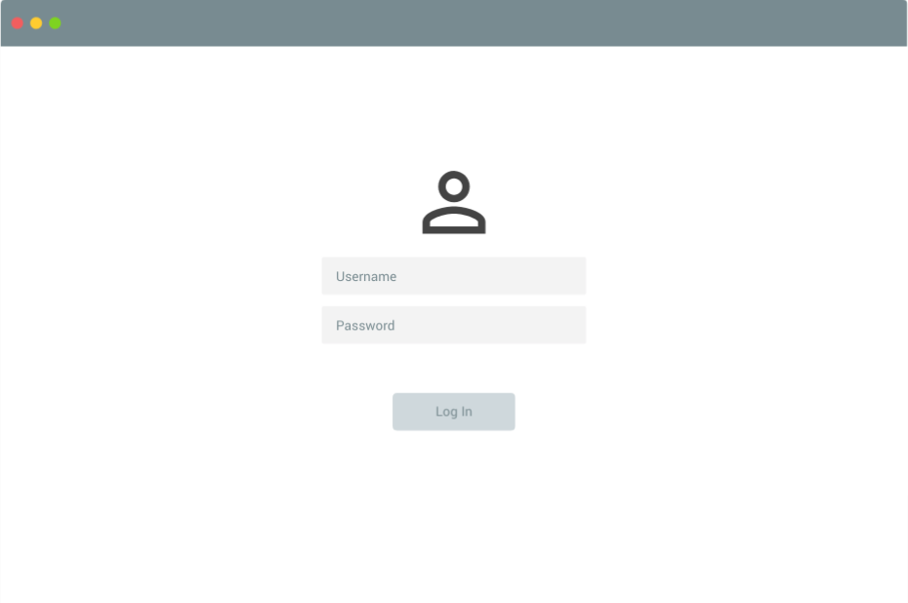
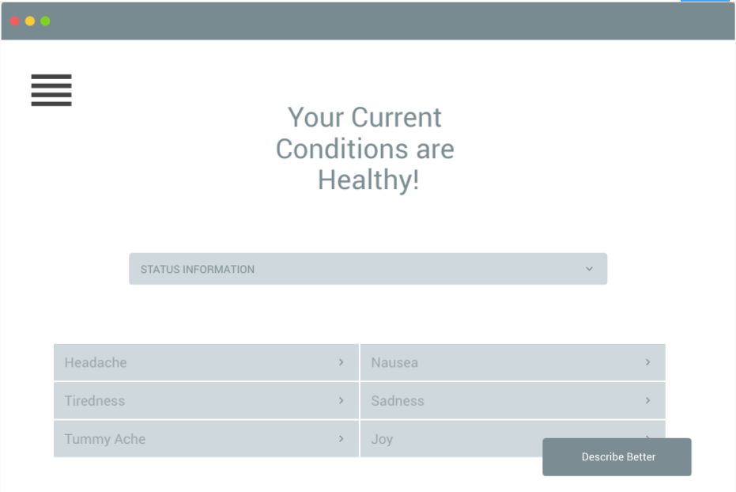
André Pedrosa, Filipe Pires and João Alegria
System Architecture

Slide 8
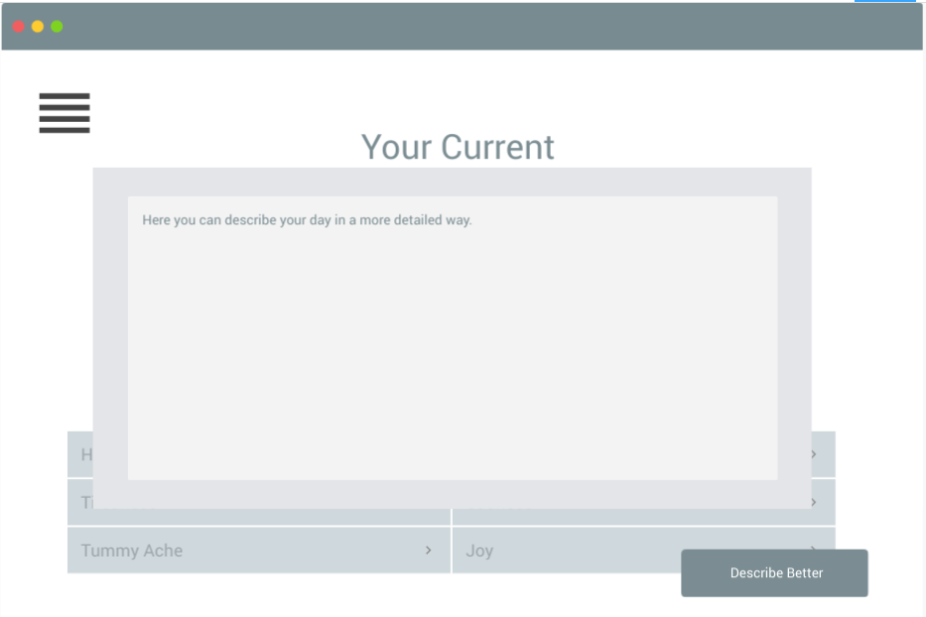
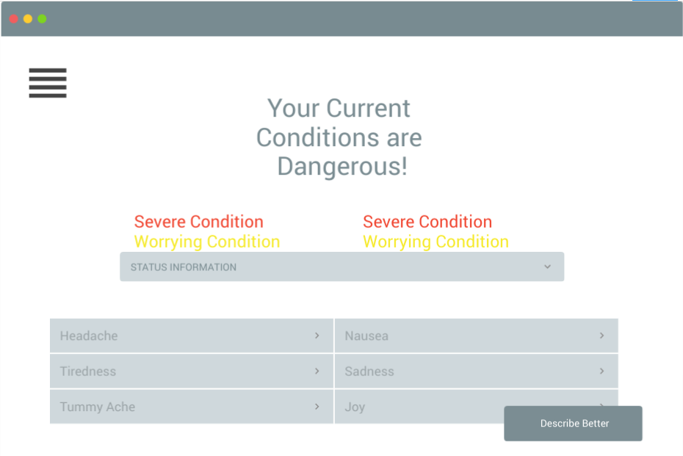
André Pedrosa, Filipe Pires and João Alegria
System Architecture

Slide 9
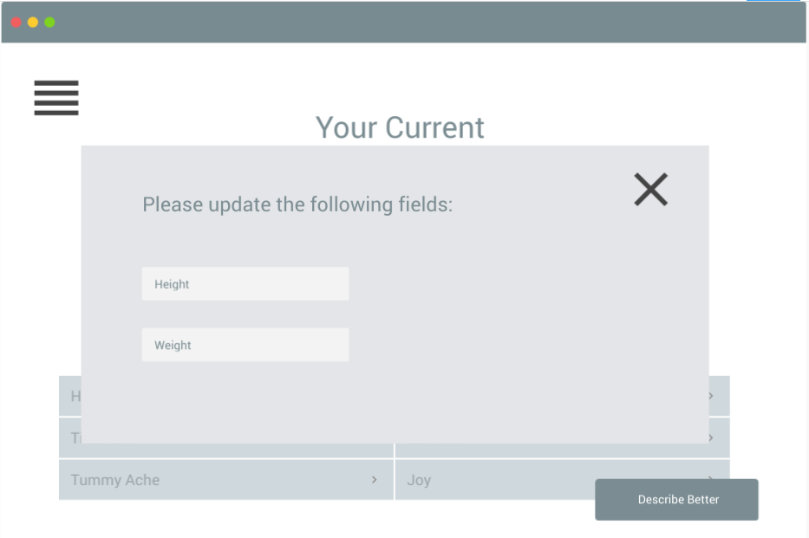
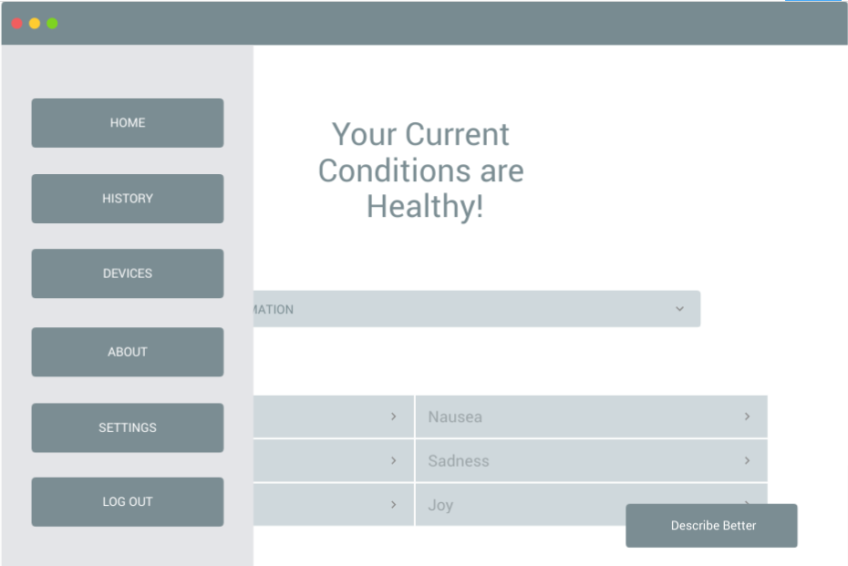
André Pedrosa, Filipe Pires and João Alegria
System Architecture

Slide 10
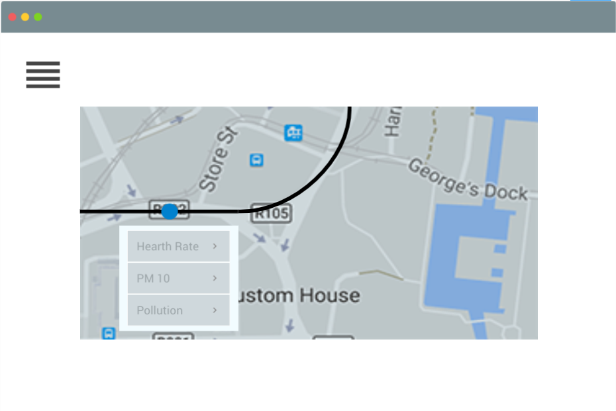
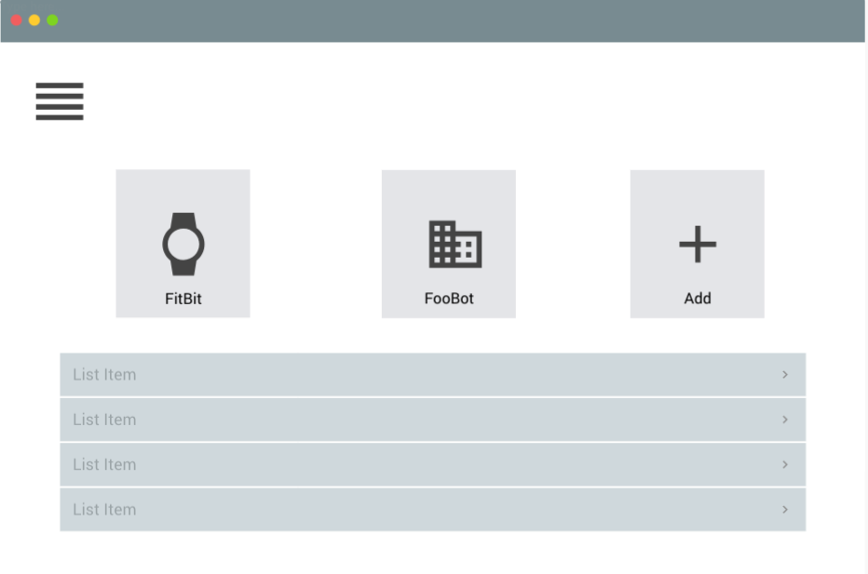
André Pedrosa, Filipe Pires and João Alegria
System Architecture

Slide 11
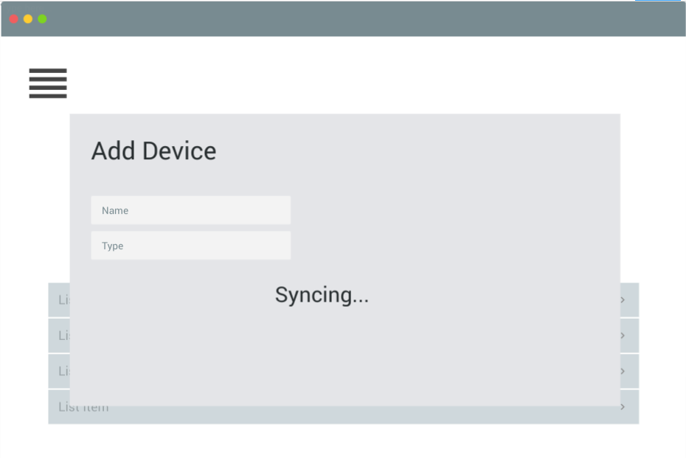
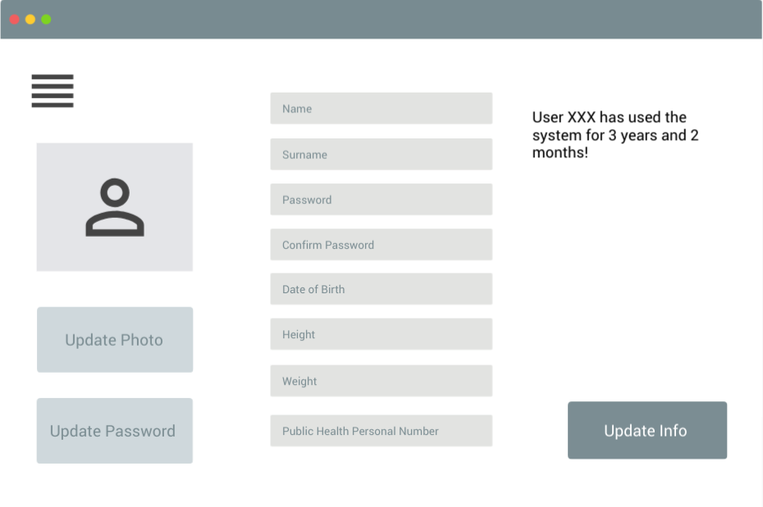
André Pedrosa, Filipe Pires and João Alegria
System Architecture
Initial Tests:
http://localhost:3000/

Slide 12
André Pedrosa, Filipe Pires and João Alegria
Questions?
For more information, please check our CodeUA Project:
http://code.ua.pt/projects/personal_monitoring_system/wiki

