Slide 1

Personal Monitoring System of
clinical & Environmental Conditions
ContinuousCare
Supervisor Teacher: Carlos Costa
Developers Team: André Pedrosa (85098)
Filipe Pires (85122)
João Alegria (85048)

Slide 2
André Pedrosa, Filipe Pires and João Alegria
Contextualization
Increased proliferation of mobile devices for monitoring vital signals and physical activity
Use of geolocation to keep track of the environment the patient was exposed to
Need for quality labelled quotidian data in the medical field
→ A new paradigm of medical monitorization

Slide 3
André Pedrosa, Filipe Pires and João Alegria
Goals
DATA
Transparent & continuous collecting
Simplified visualization
Limited processing
Labelling and storage
API development for daily clinical
information about a subject

Slide 4
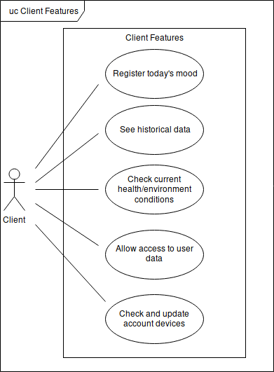
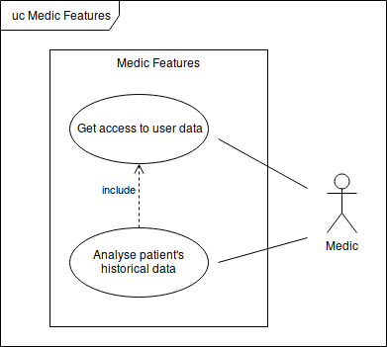
André Pedrosa, Filipe Pires and João Alegria
Requirements Elicitation
Figure 1: Use Cases - Client and Doctor Features
Notes:
Grant and ask access
This is needed so the doctor can analise the data
---
Register todaus mod so we have labbled data for machine learning algorithms
4

Slide 5
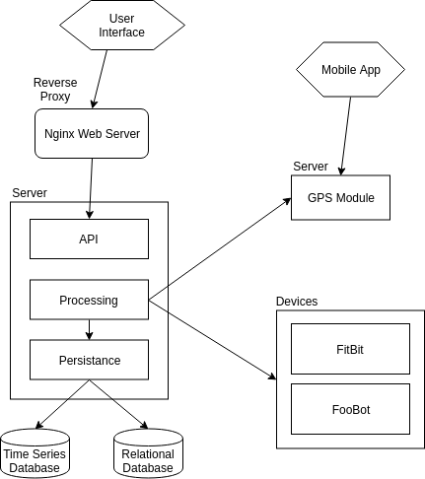
André Pedrosa, Filipe Pires and João Alegria
System Architecture
Strategy:
Deployment Plan
Modular Architecture
Public REST API
Changes Done:
Separate Geolocation
Mobile App Integration
Future Changes:
API Gateway
Figure 2: Architecture Diagram

Slide 6
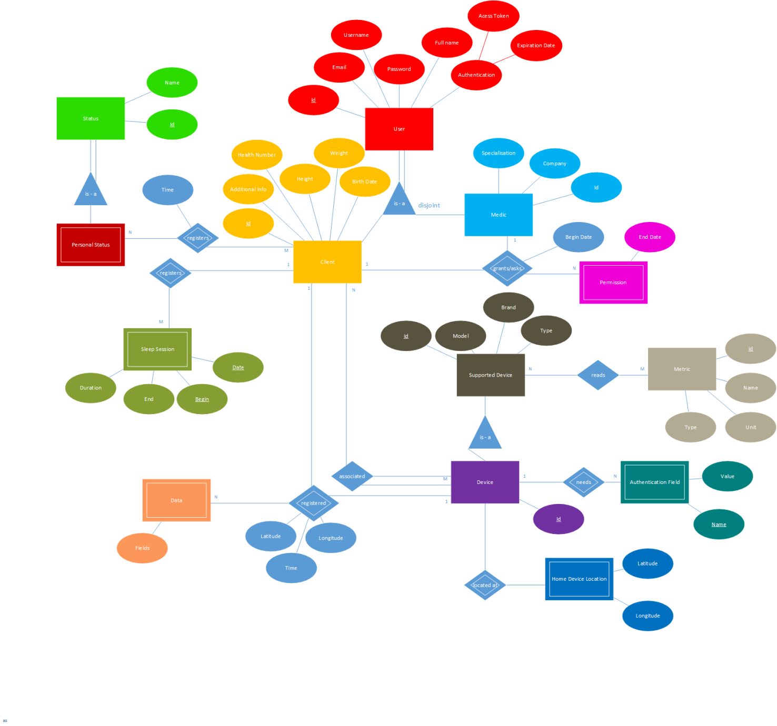
André Pedrosa, Filipe Pires and João Alegria
Persistence
Figure 3: Entity-Relation Diagram

Slide 7
André Pedrosa, Filipe Pires and João Alegria
Following Steps
Client Daily-Mood Registration
Doctor-Account Integration
Client-Doctor Interaction
Mobile and Web Apps Refinement
Improved Data Treatment for External APIs

Slide 8
André Pedrosa, Filipe Pires and João Alegria
DEMO

Slide 9
André Pedrosa, Filipe Pires and João Alegria
Questions?
For more information, please check our CodeUA Project:
http://code.ua.pt/projects/personal_monitoring_system/wiki

