Slide 1
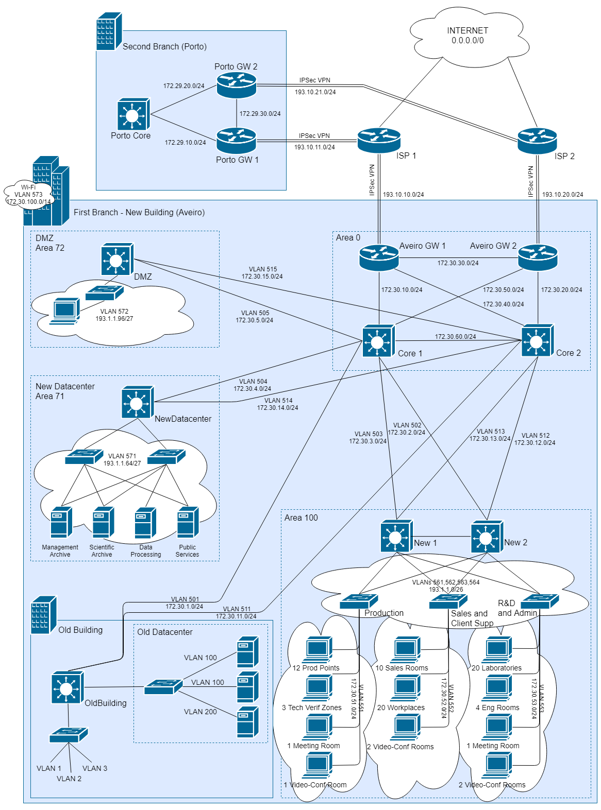


XPTO’s
Networks
Architecture
& Management
First Project
Network
Plan
NEWS
Company site in Porto
3 floor building in Aveiro
Datacenter escalation
Inter-site comm. tunnel
Arquitecture
Tree + Mesh Topology
IPv4 & IPv6 support
OSPF & RIP support
VLAN based
SNAT configured
Qos & security
Demilitarized Zone included
Secure comm. Tunnel
DiffServ implemented
References
AUTHORS • Filipe Pires (85122) • João Alegria (85048)
• Prof. António Nogueira, “AGR: First Project”
• John Kerns, “Network Diagrams Documentation”

