Slide 1



Project ARC
Department of Electronic, Telecommunications and Informatics
PEI 2019/2020
André Marques
Daniela Lopes
Filipe Vale
Gustavo Inácio
Ricardo Azevedo
Tomás Freitas

Slide 2
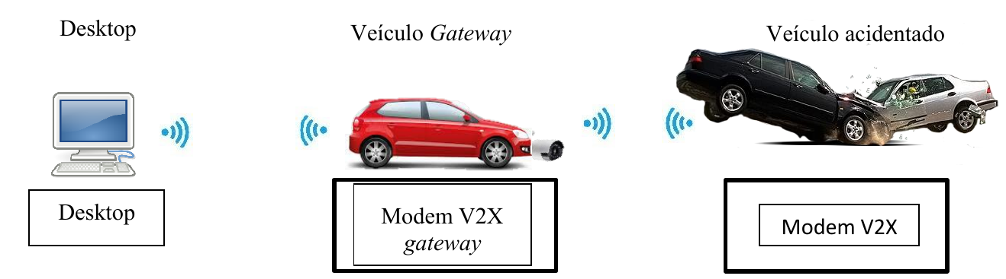
Context – What is Project ARC?
Project ARC (Autonomous Rescue Communications) is a system designed to alert emergency services using cellular communications in the case of a car accident so it can minimize response time and keep the emergency professionals updated via a photo or video stream on a dedicated dashboard.

Slide 3
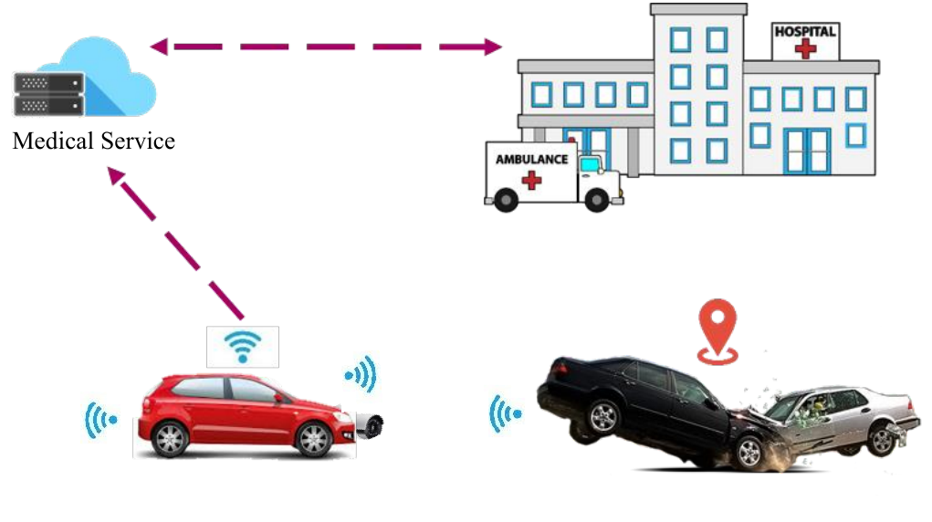
Problem
Human intervention needed to notify emergency services about the accident
No safe way to report status with pictures
Notes:
When there is an accident the medical and emergency team needs someone to contact them so they can mobilize their resources. However, they have no way to decide if their intervention is needed without going to the affected place or trusting who calls them

Slide 4
Goals
Develop a system that can optimize the way that emergency resources can be assigned to a specific occasion.
Reduce the time spent in communications between emergency resources (police, medical care...) and automate it as well.
Help emergency teams understand the severity of the accident using live feed information(video/photos).

Slide 5
Tasks
Hardware selection
Web app for information display and processing
Communication System
Video processing

Slide 6
Expected results
A fully autonomous system that can help save lives by contacting emergency services when needed.

Slide 7
Related Work
5GCar - A European funded project to develop several use cases of V2X communications in driving.
When Backscatter Communication Meets Vehicular Networks: Boosting Crosswalk Awareness – Made in IT, it uses V2X communications to disseminate information, namely, the presence of pedestrians in a nearby crosswalk

Slide 8
Questions?

