Slide 1
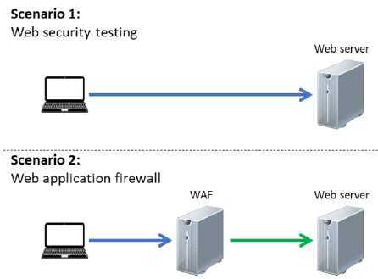
Kali Linux
Juice Shop
Debian Linux
Nat Network
Juice Shop
Debian Linux
Kali Linux
CentOS
Nat Network

