Slide 1
RMarkdown And what you can do with it...

Slide 2
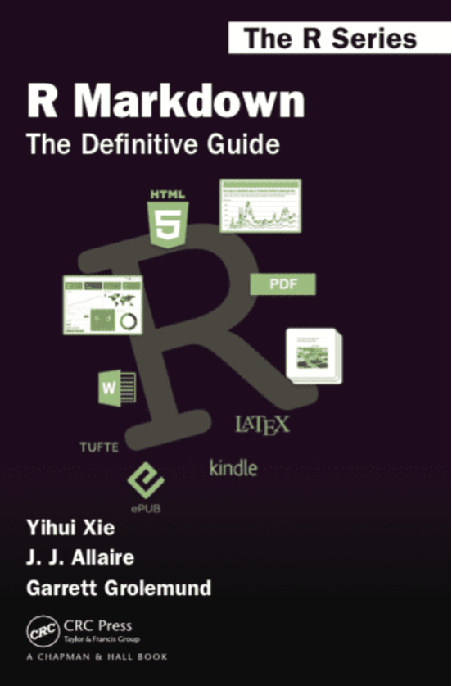
Introduction

Slide 3
Introduction
R Markdown is designed for easier reproducibility
Both computing code and narratives are in the same document
Results are automatically generated from the source code – perfect for sharing reports
Both static and dynamic output formats (incl. “knitting” to word, pdf, html, shiny, etc.)

Slide 4
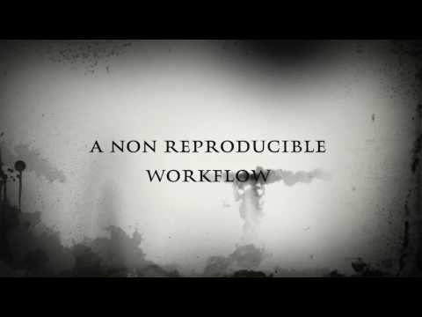
Introduction

Slide 5
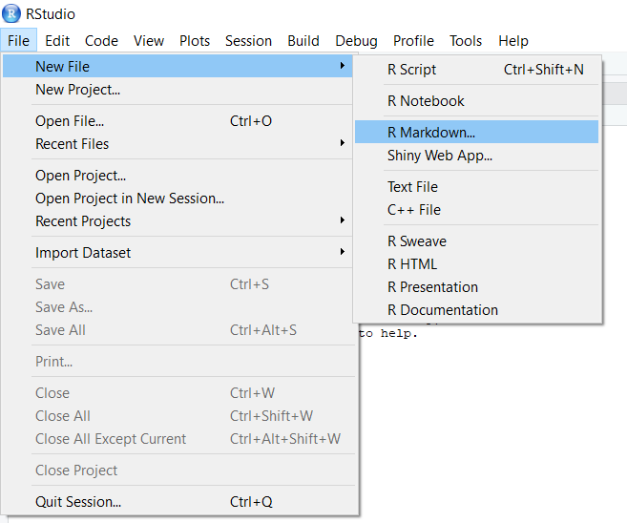
How to?

Slide 6
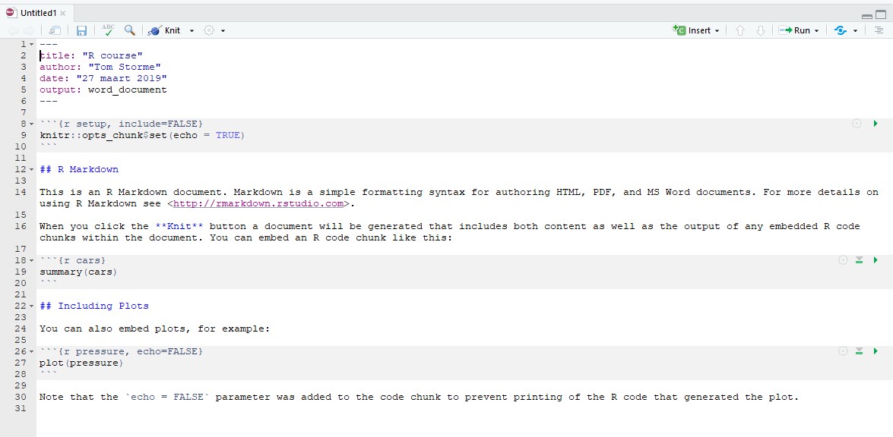
How to?

Slide 7
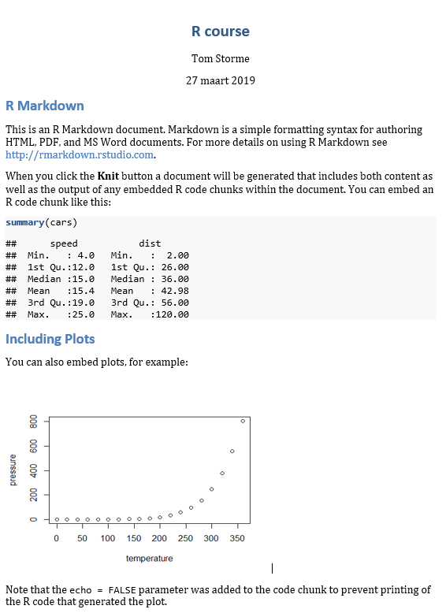
How to?

Slide 8
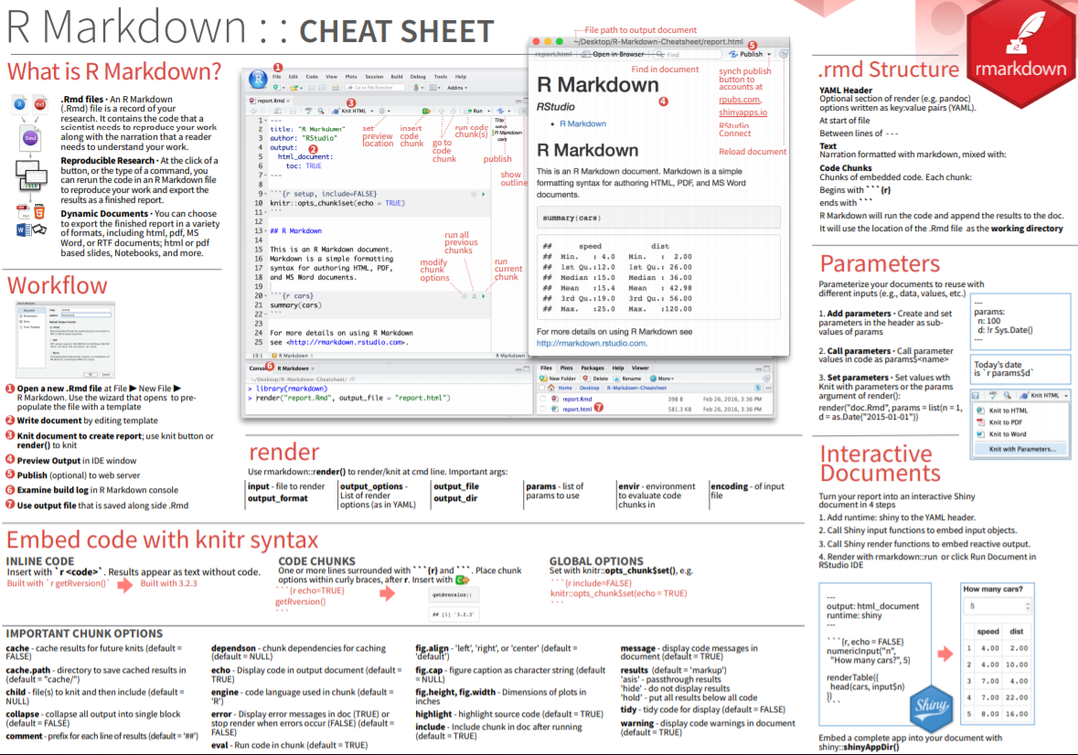
How to?

Slide 9
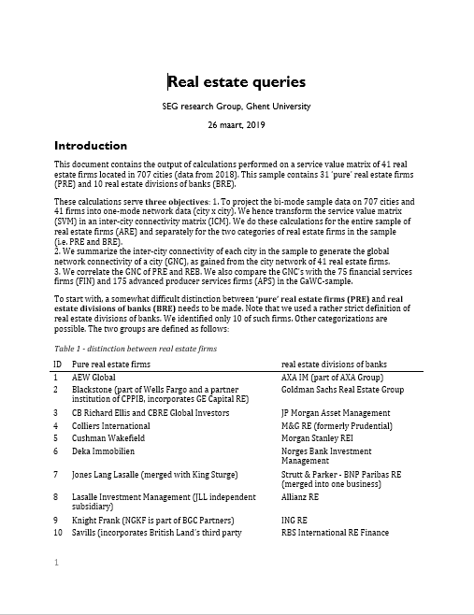
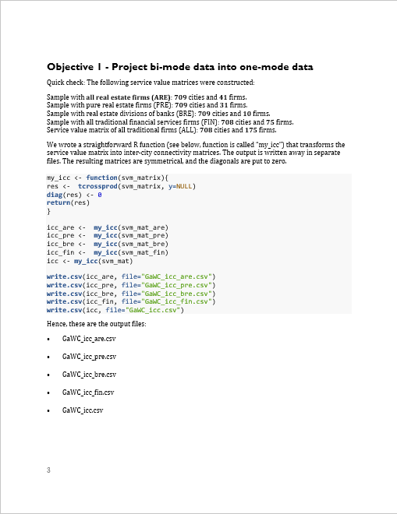
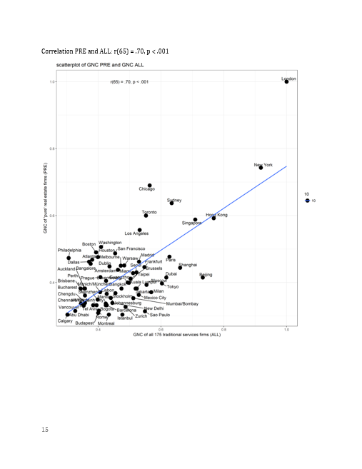
How I use it
Other categorization?
New cut-off value?

Slide 10
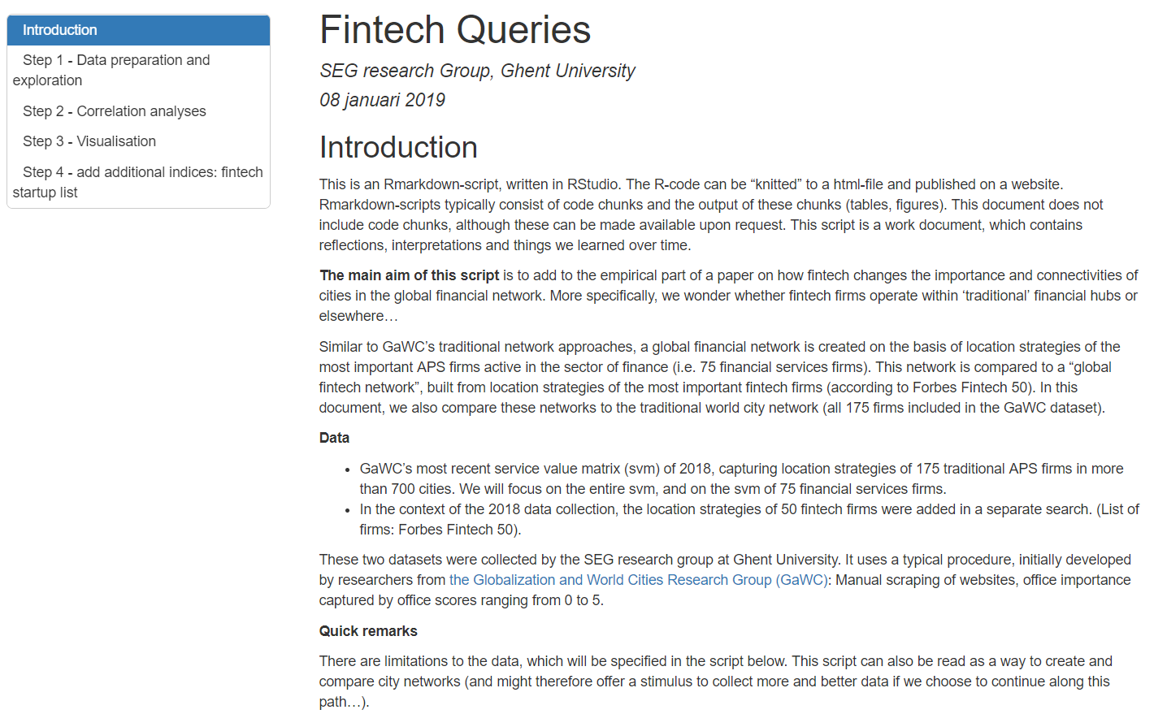
How I use it
https://users.ugent.be/~tbstorme/

Slide 11
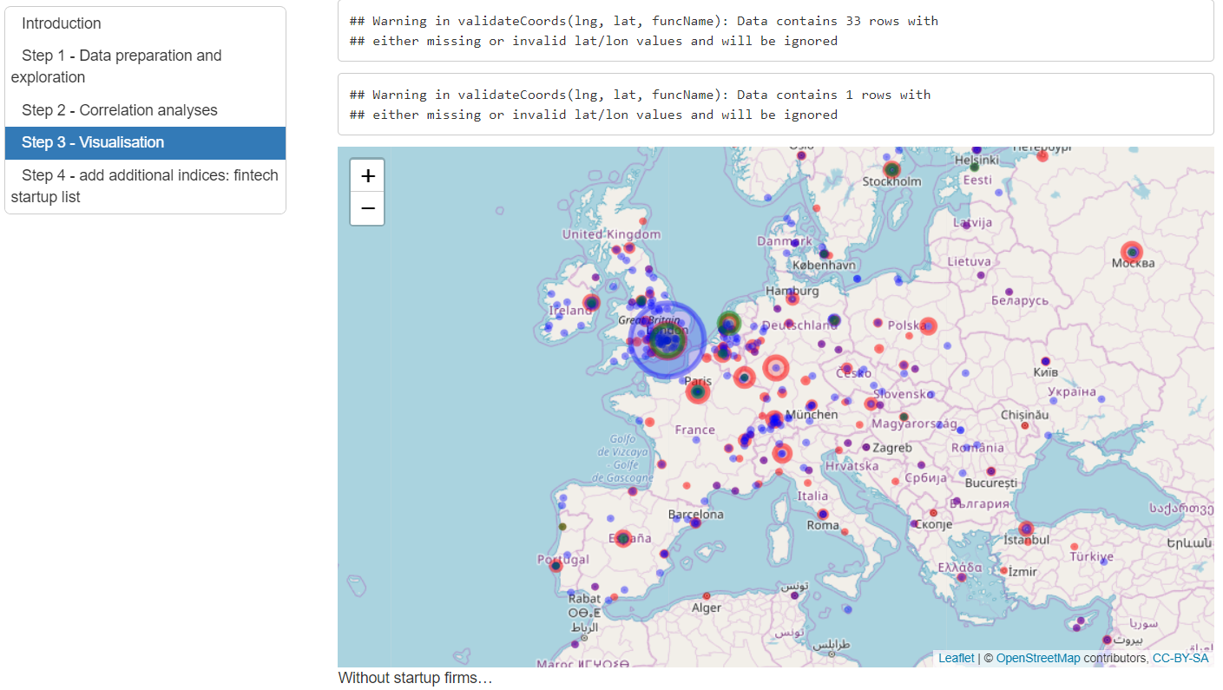
How I use it
https://users.ugent.be/~tbstorme/

Slide 12
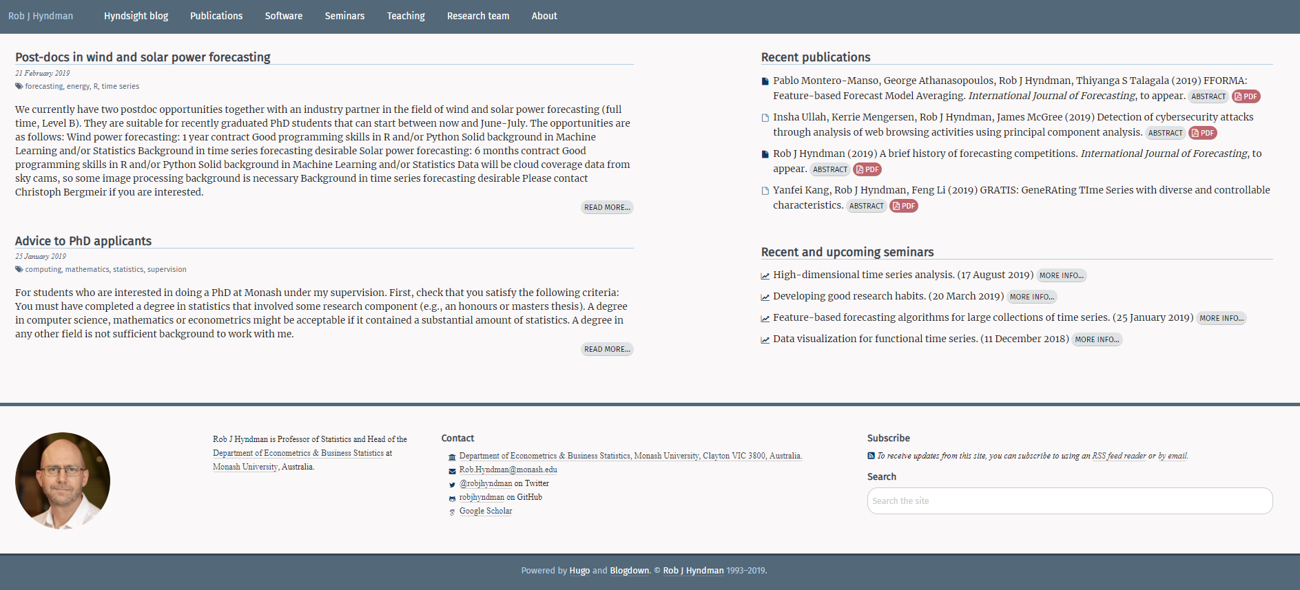
How others use it

Slide 13
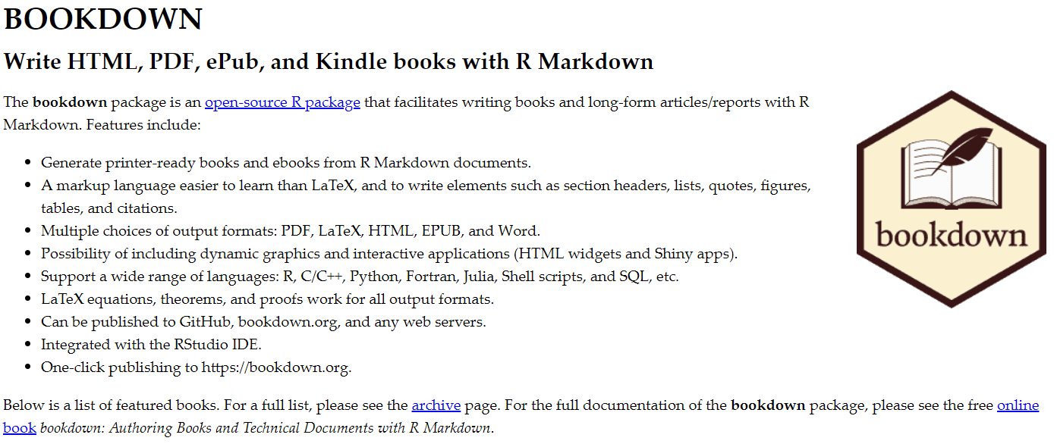
How others use it

Slide 14
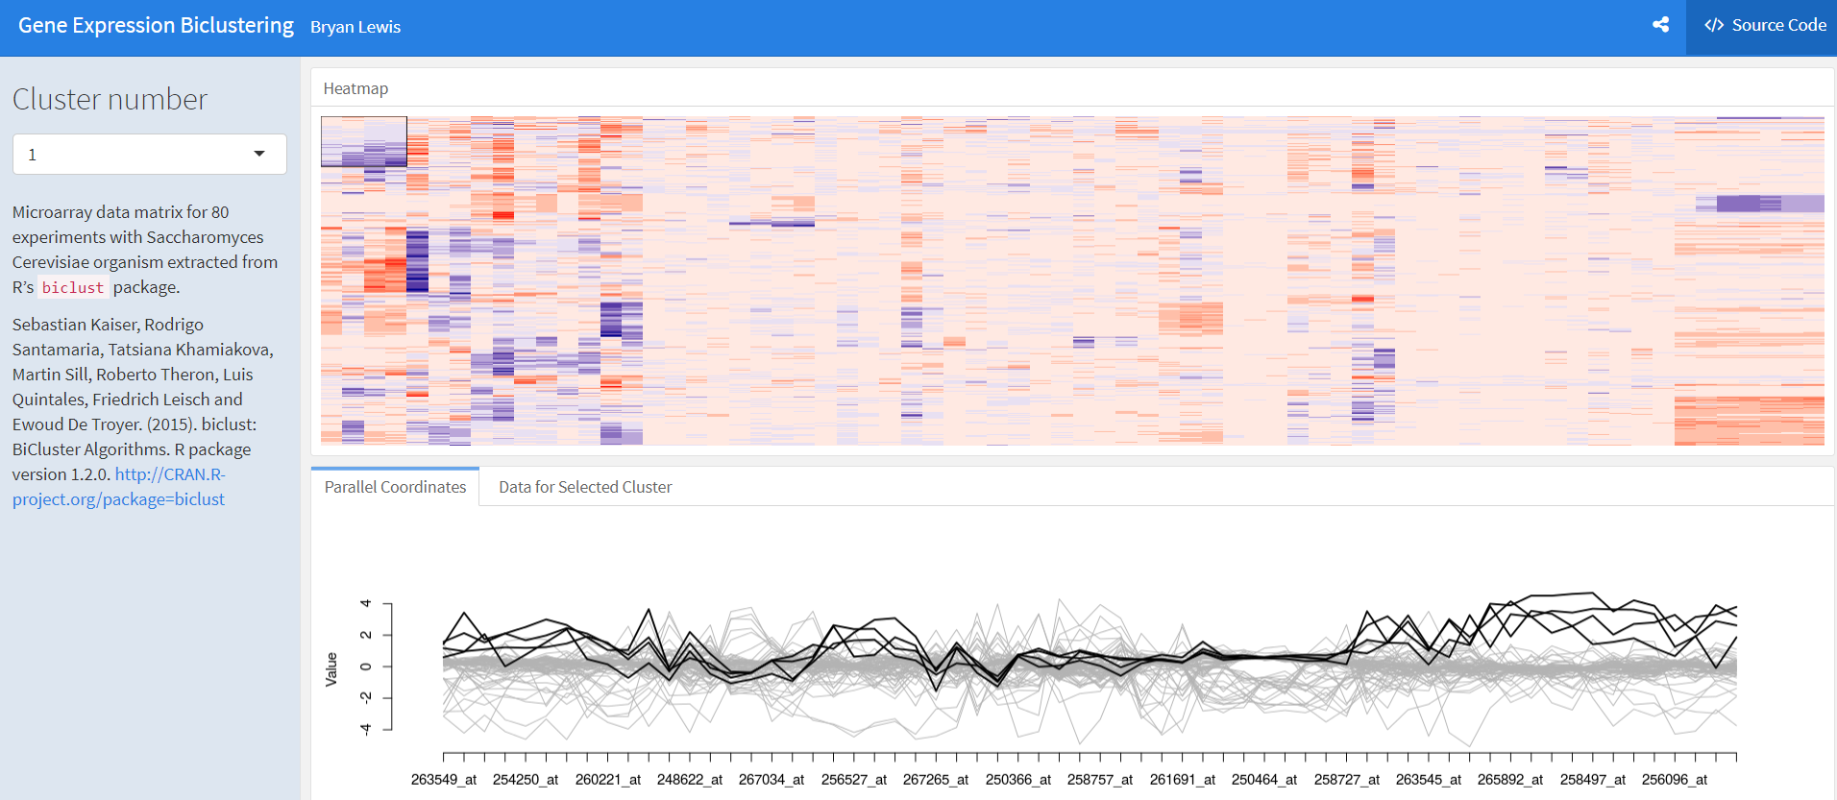
How others use it

