Slide 1
DayBook
Today presenting …
Made by: Gut Ioan Filip
Coordinator: Velciov Darian

Slide 2
An application designed for young generation
But not only for them, everyone can use it:
It will be easy to achieve it
Easy to use
Secured
Dynamic

Slide 3
What is achieved?
Login with firebase
A main page view
A flipper view in order to see the last posts
Post creation
Account management
Search
Real time database connection

Slide 4
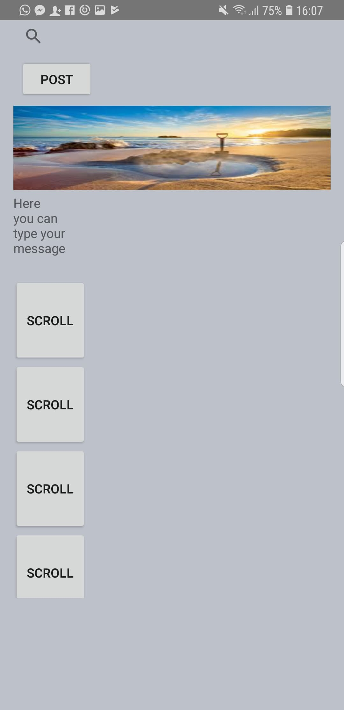
Main Page

Slide 5
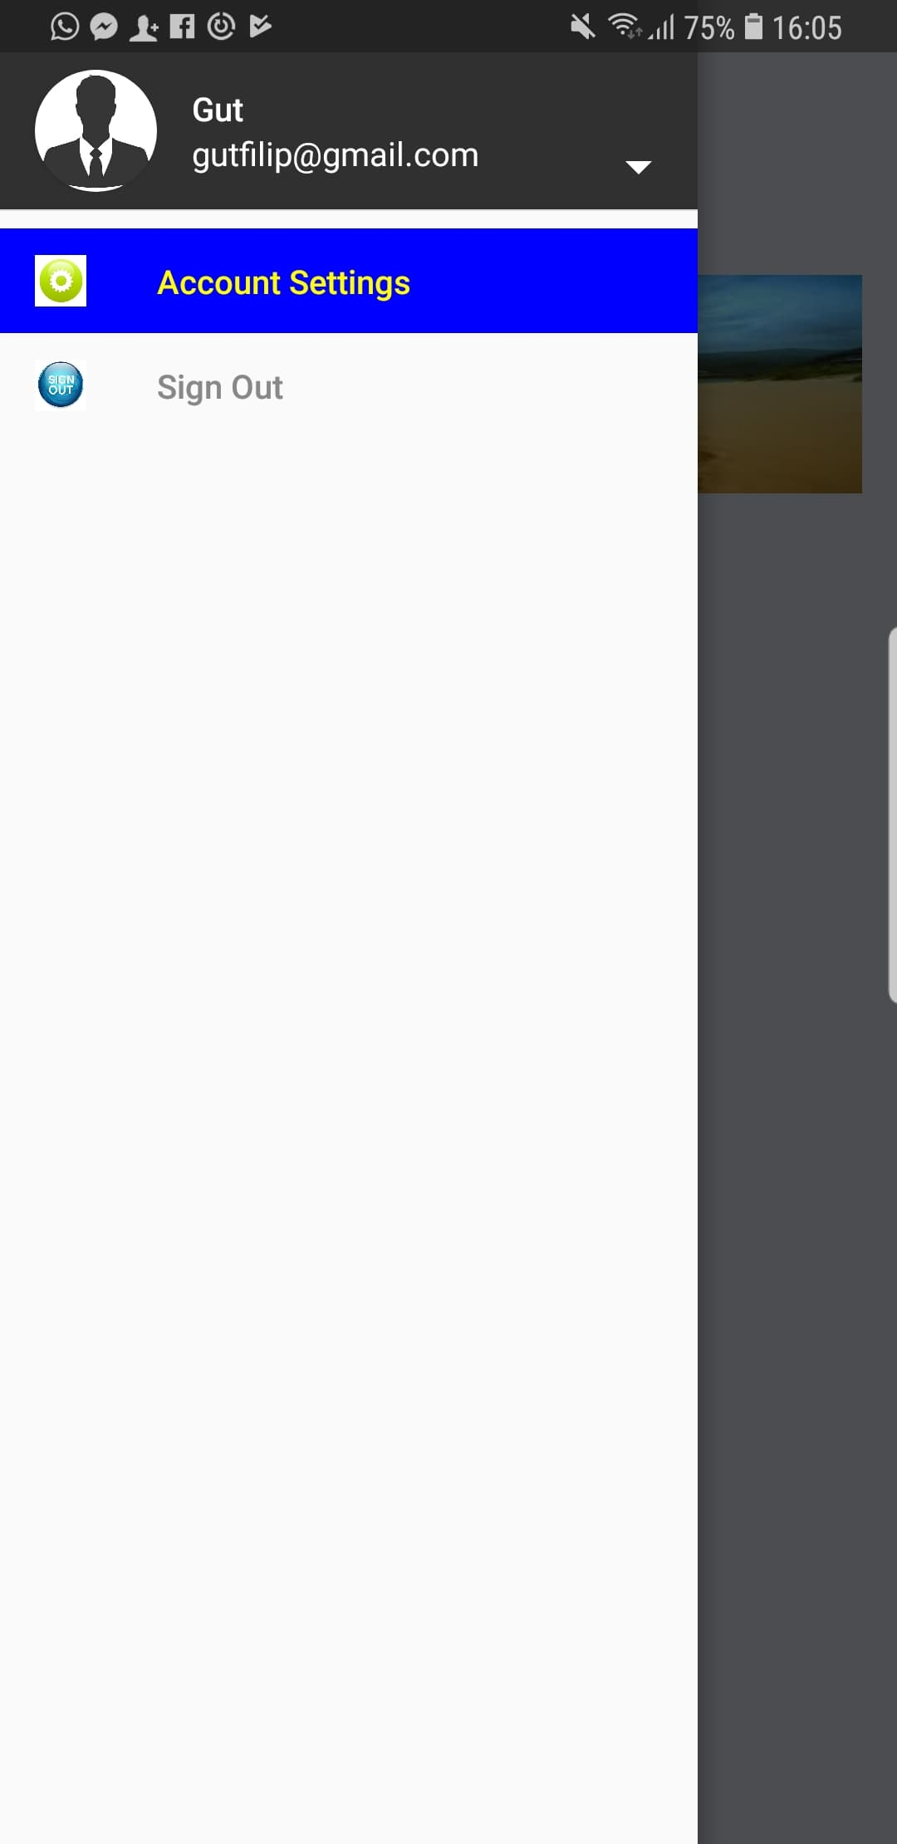
Sliding options

Slide 6
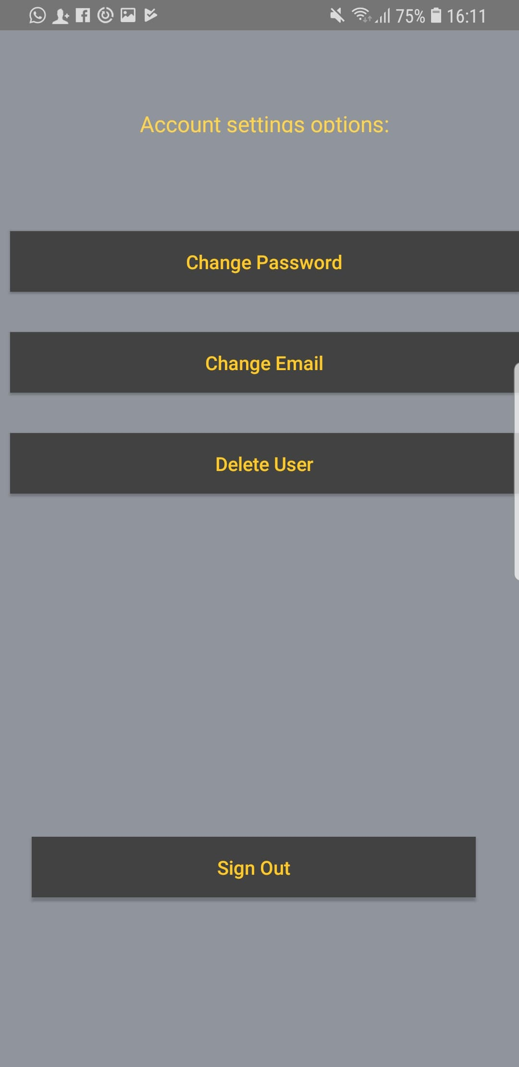
Account Settings

Slide 7
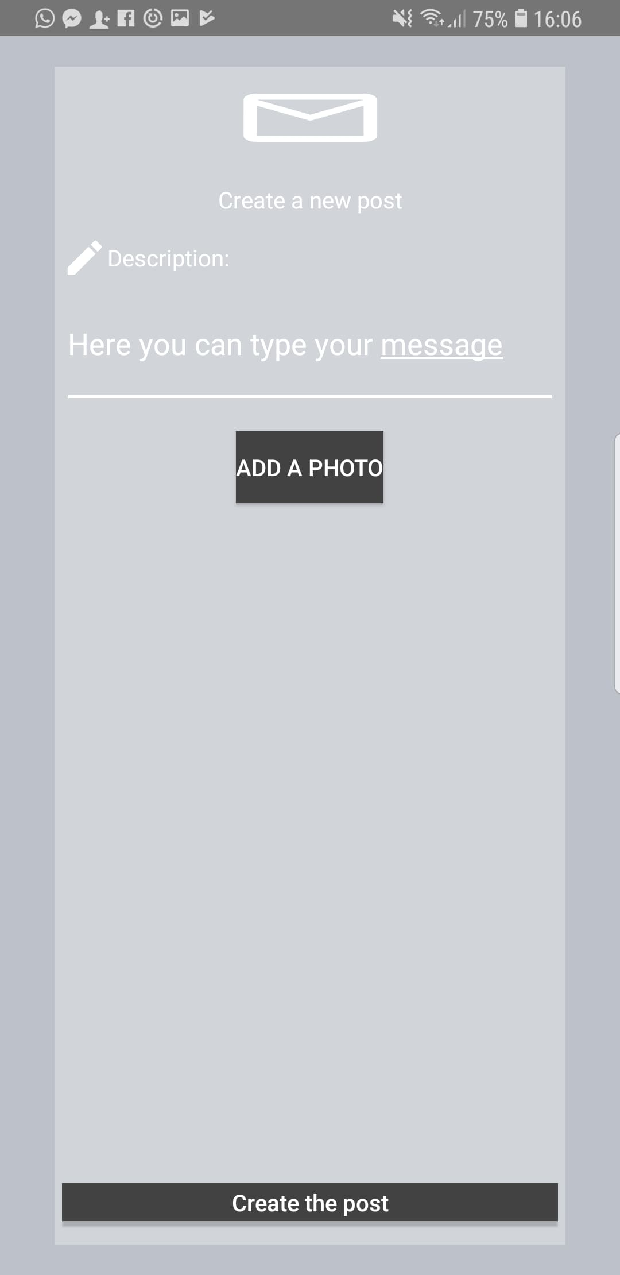
Create post

Slide 8
Future plans
Wipe the posts after one day
Messenger
Friends list
Search and Navigation
Localization (nearby users)
Groups

Slide 9
Thank you for your attention!
Github link:
https://github.com/Filipgut/BookDay

