Slide 1
A* pathfinding algorithm
Basic naming:
node - single cell in grid
starting node - where we start looking for path
target/end node - where we want to “go”
G cost - distance from node to starting node
H cost - distance from node to target node
F cost - sum of G and H cost

Slide 2
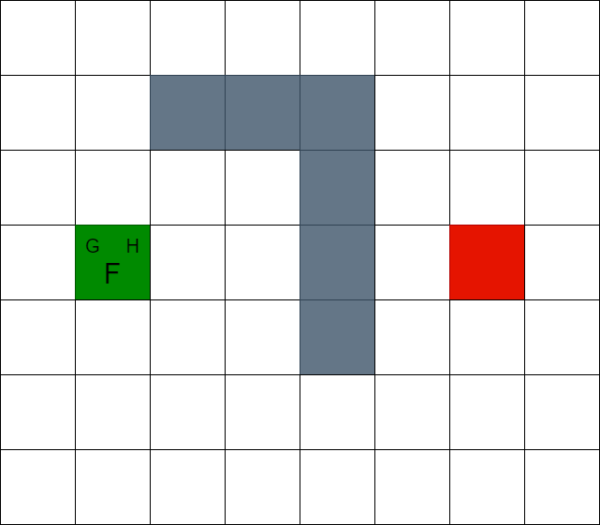

Slide 3
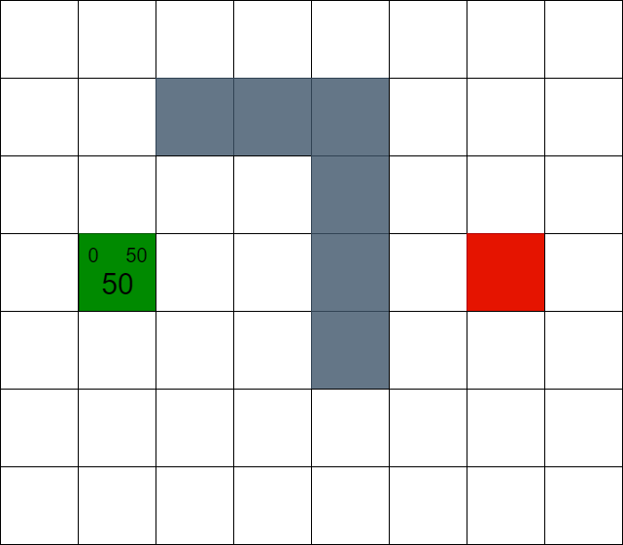

Slide 4
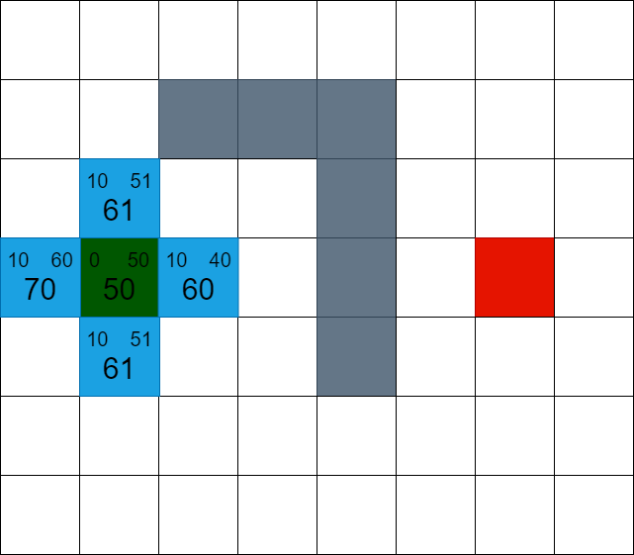

Slide 5
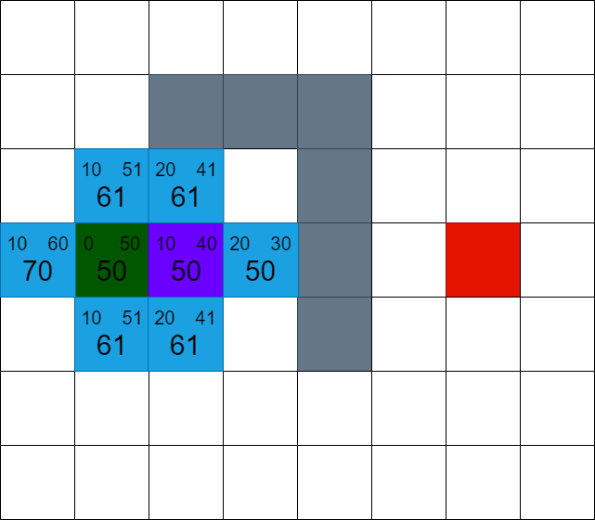

Slide 6
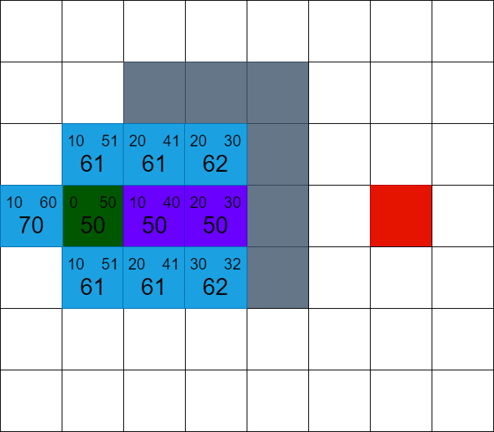

Slide 7
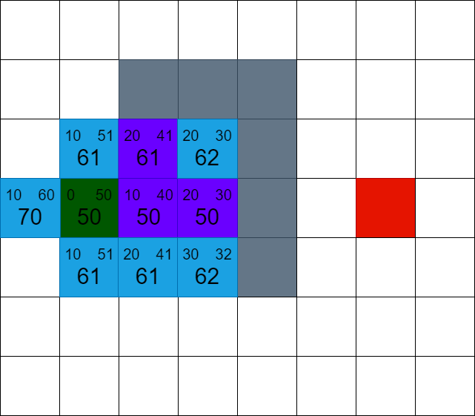

Slide 8
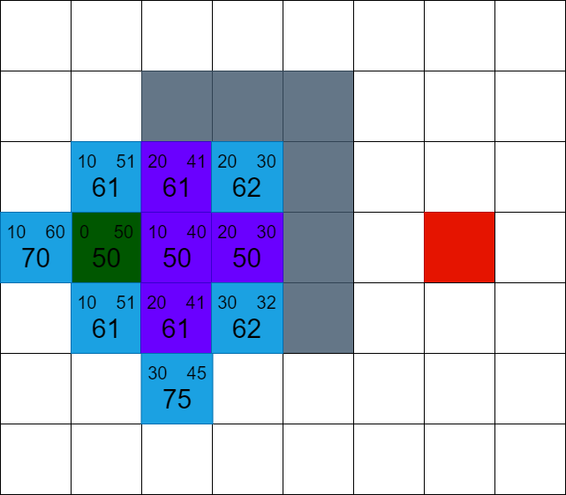

Slide 9
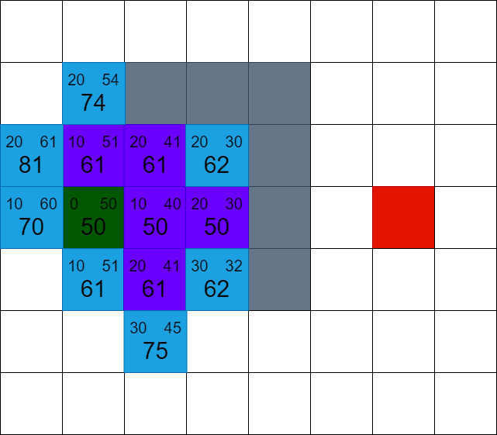

Slide 10
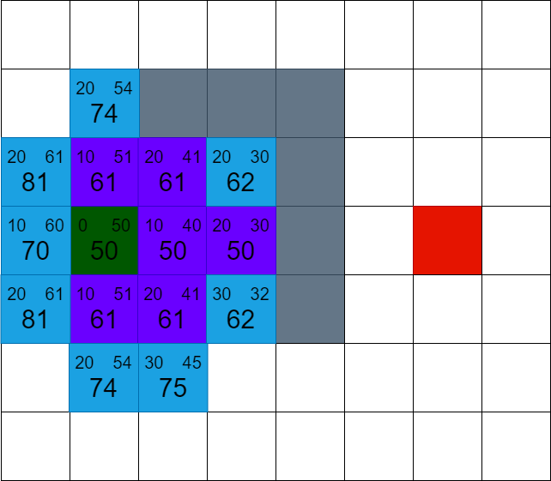

Slide 11
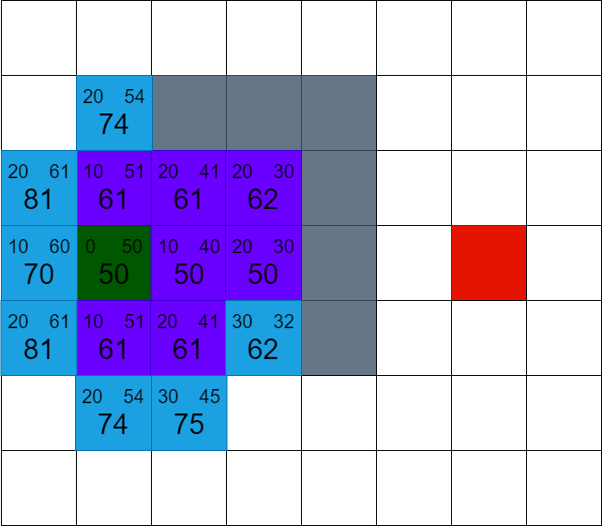

Slide 12
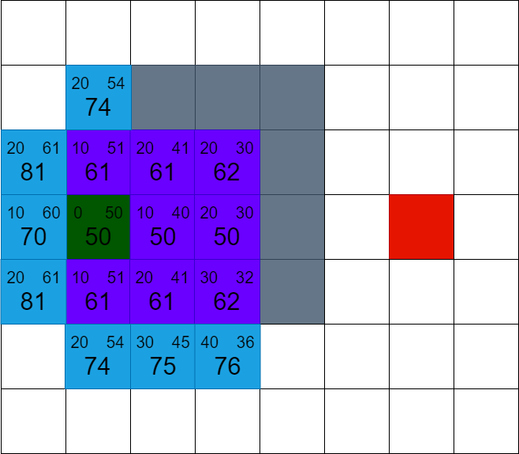

Slide 13
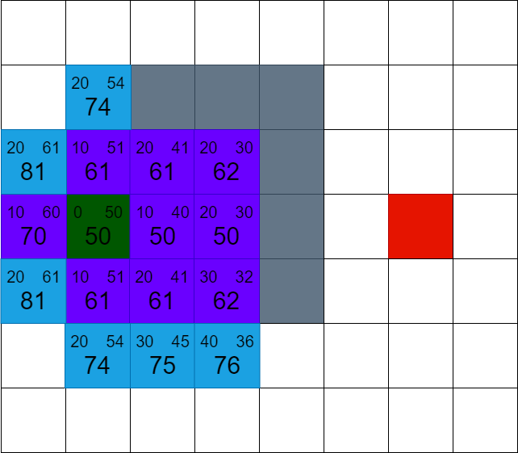

Slide 14
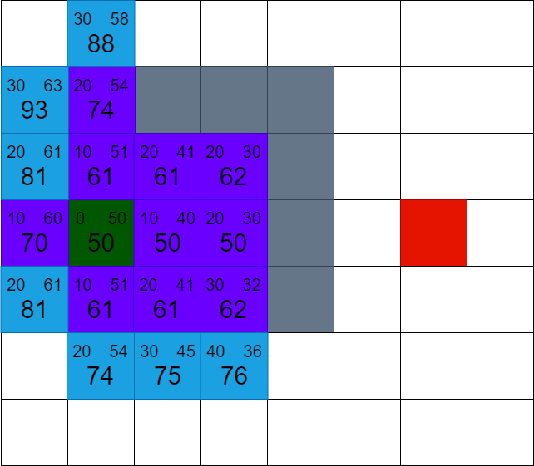

Slide 15
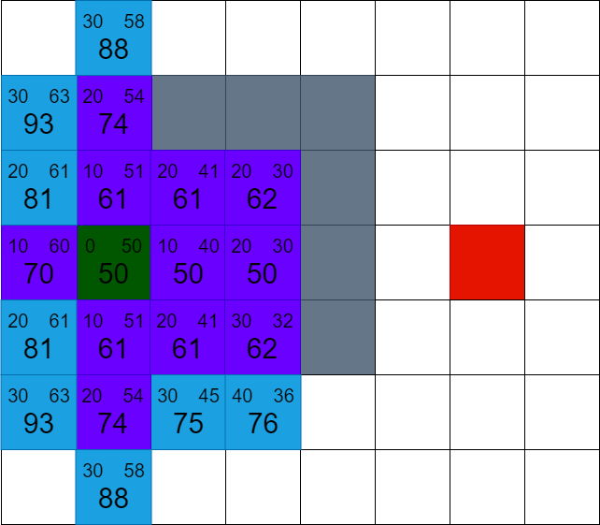

Slide 16
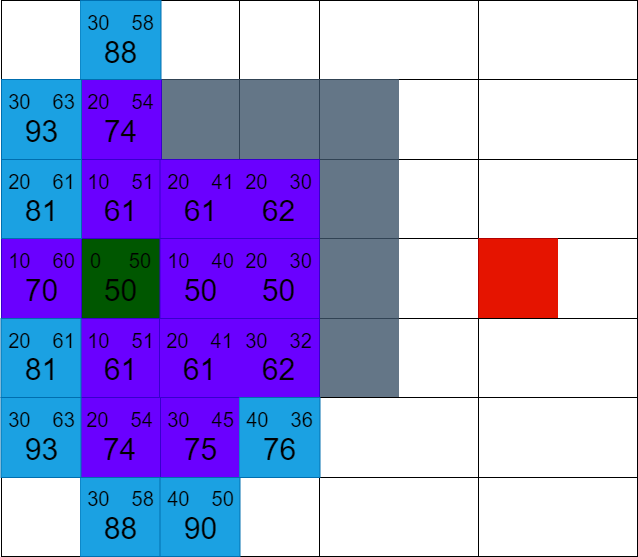

Slide 17
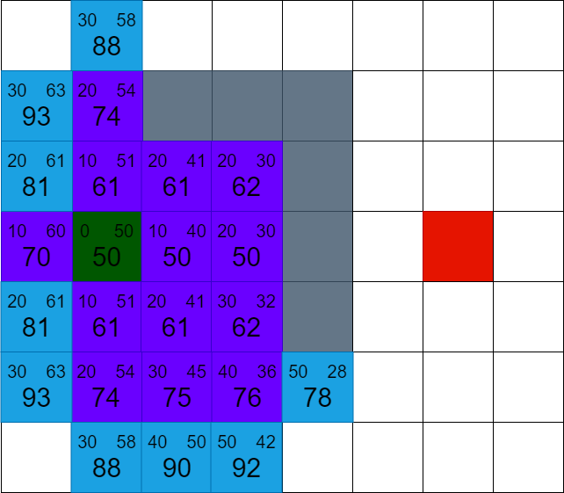

Slide 18
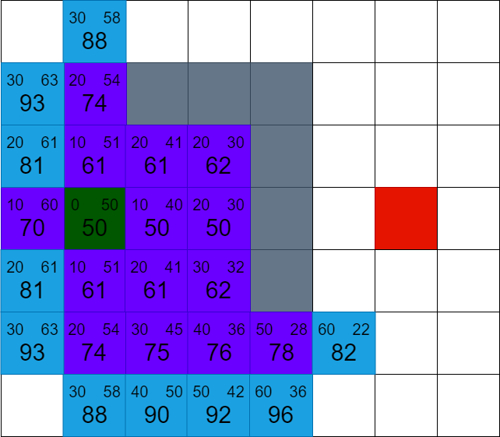

Slide 19
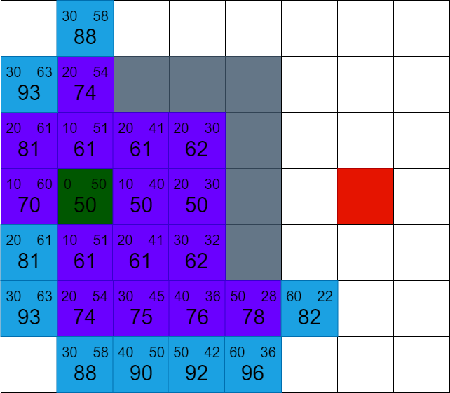

Slide 20
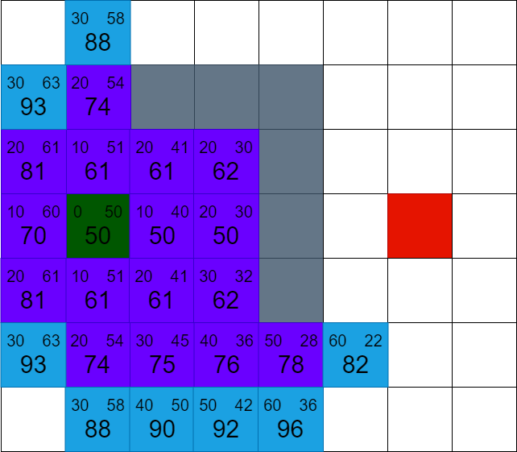

Slide 21
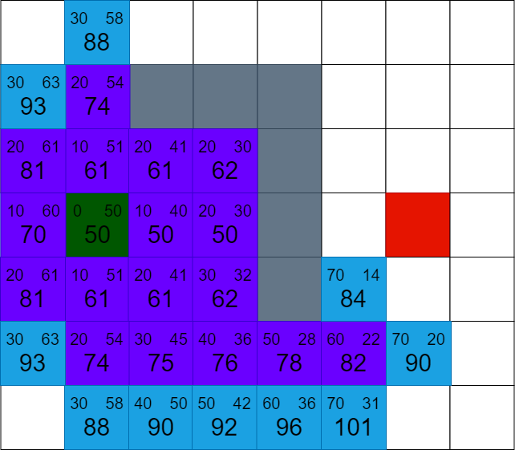

Slide 22
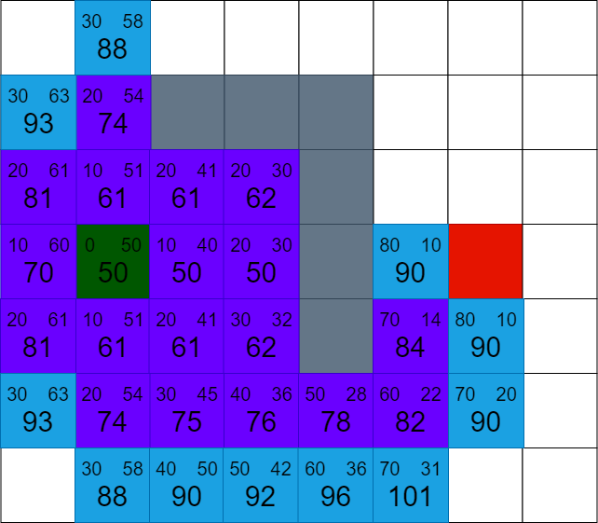

Slide 23
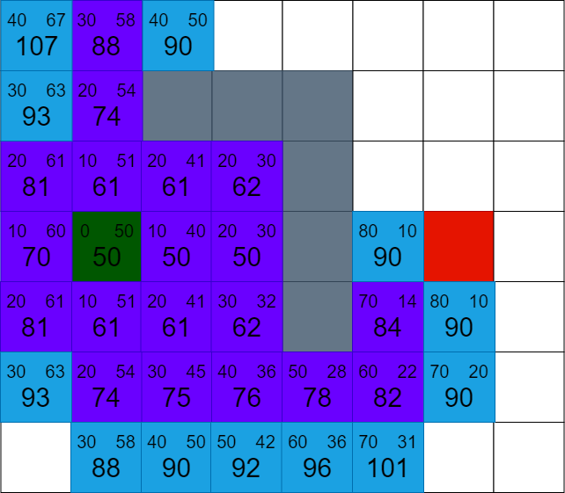

Slide 24
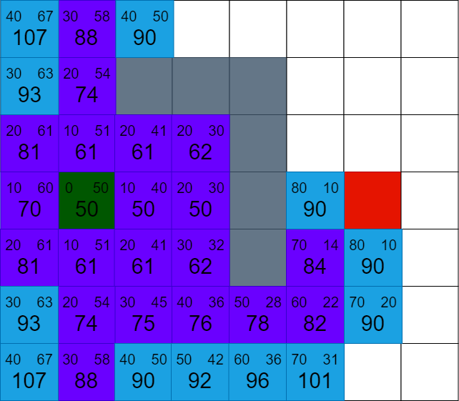

Slide 25
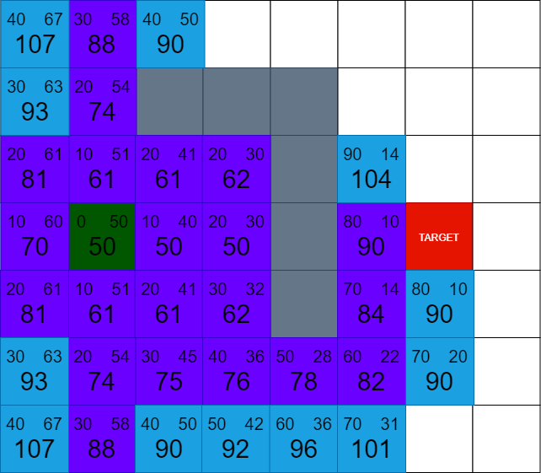

Slide 26
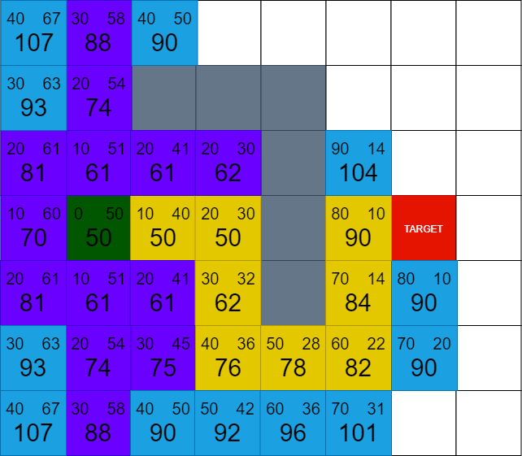

Slide 27
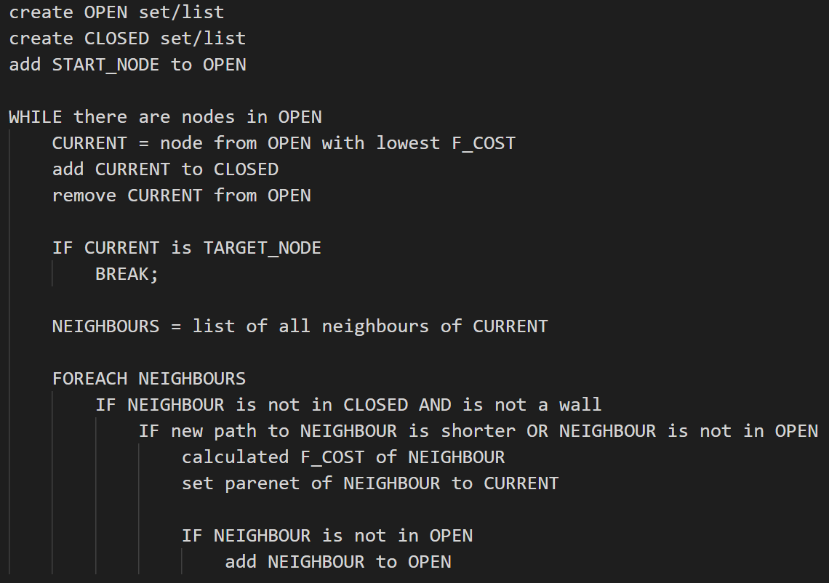
Pseudo code

Slide 28
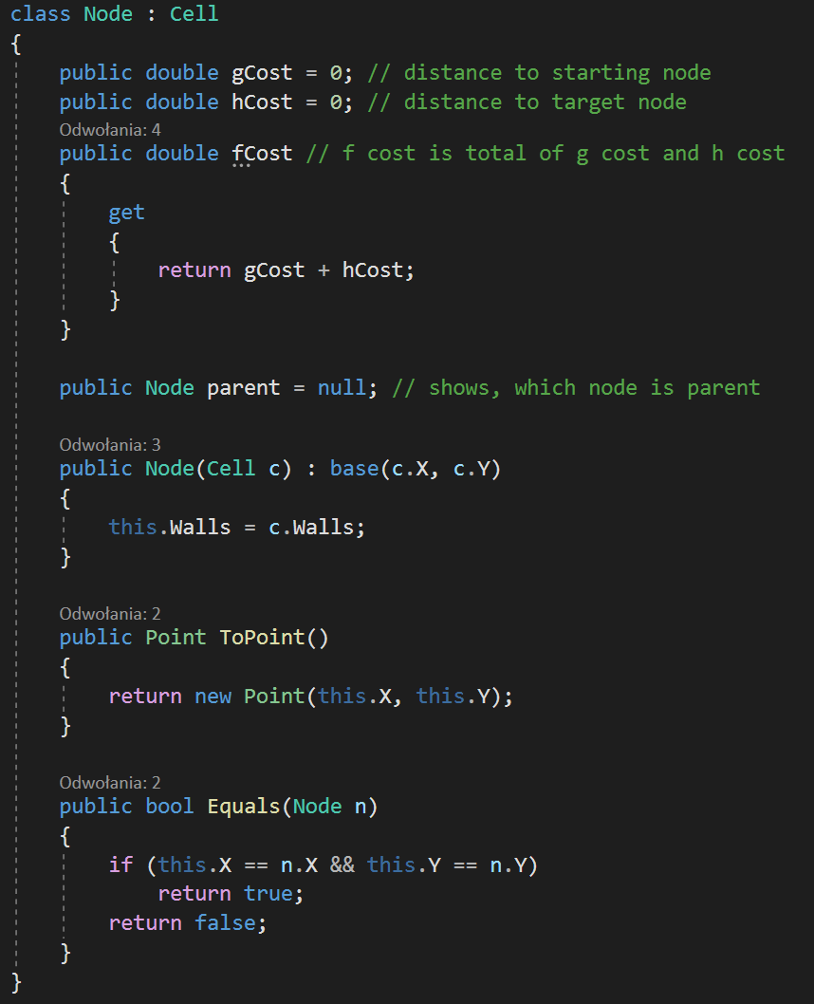
Node class implemented in C#

Slide 29
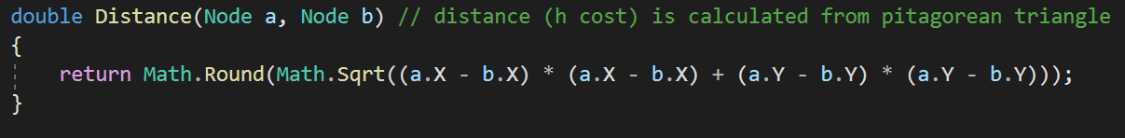
Distance function

Slide 30
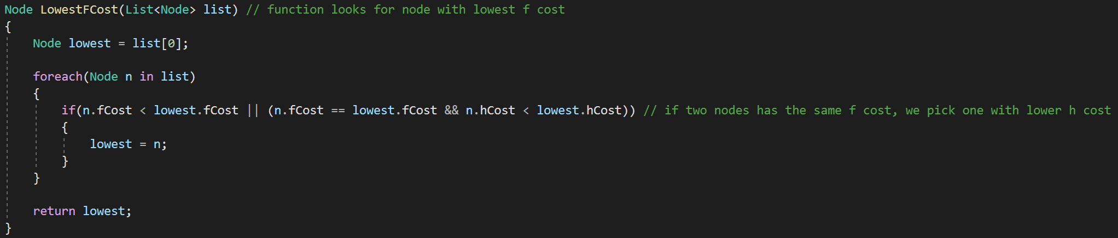
Looking for lowest f cost node

Slide 31
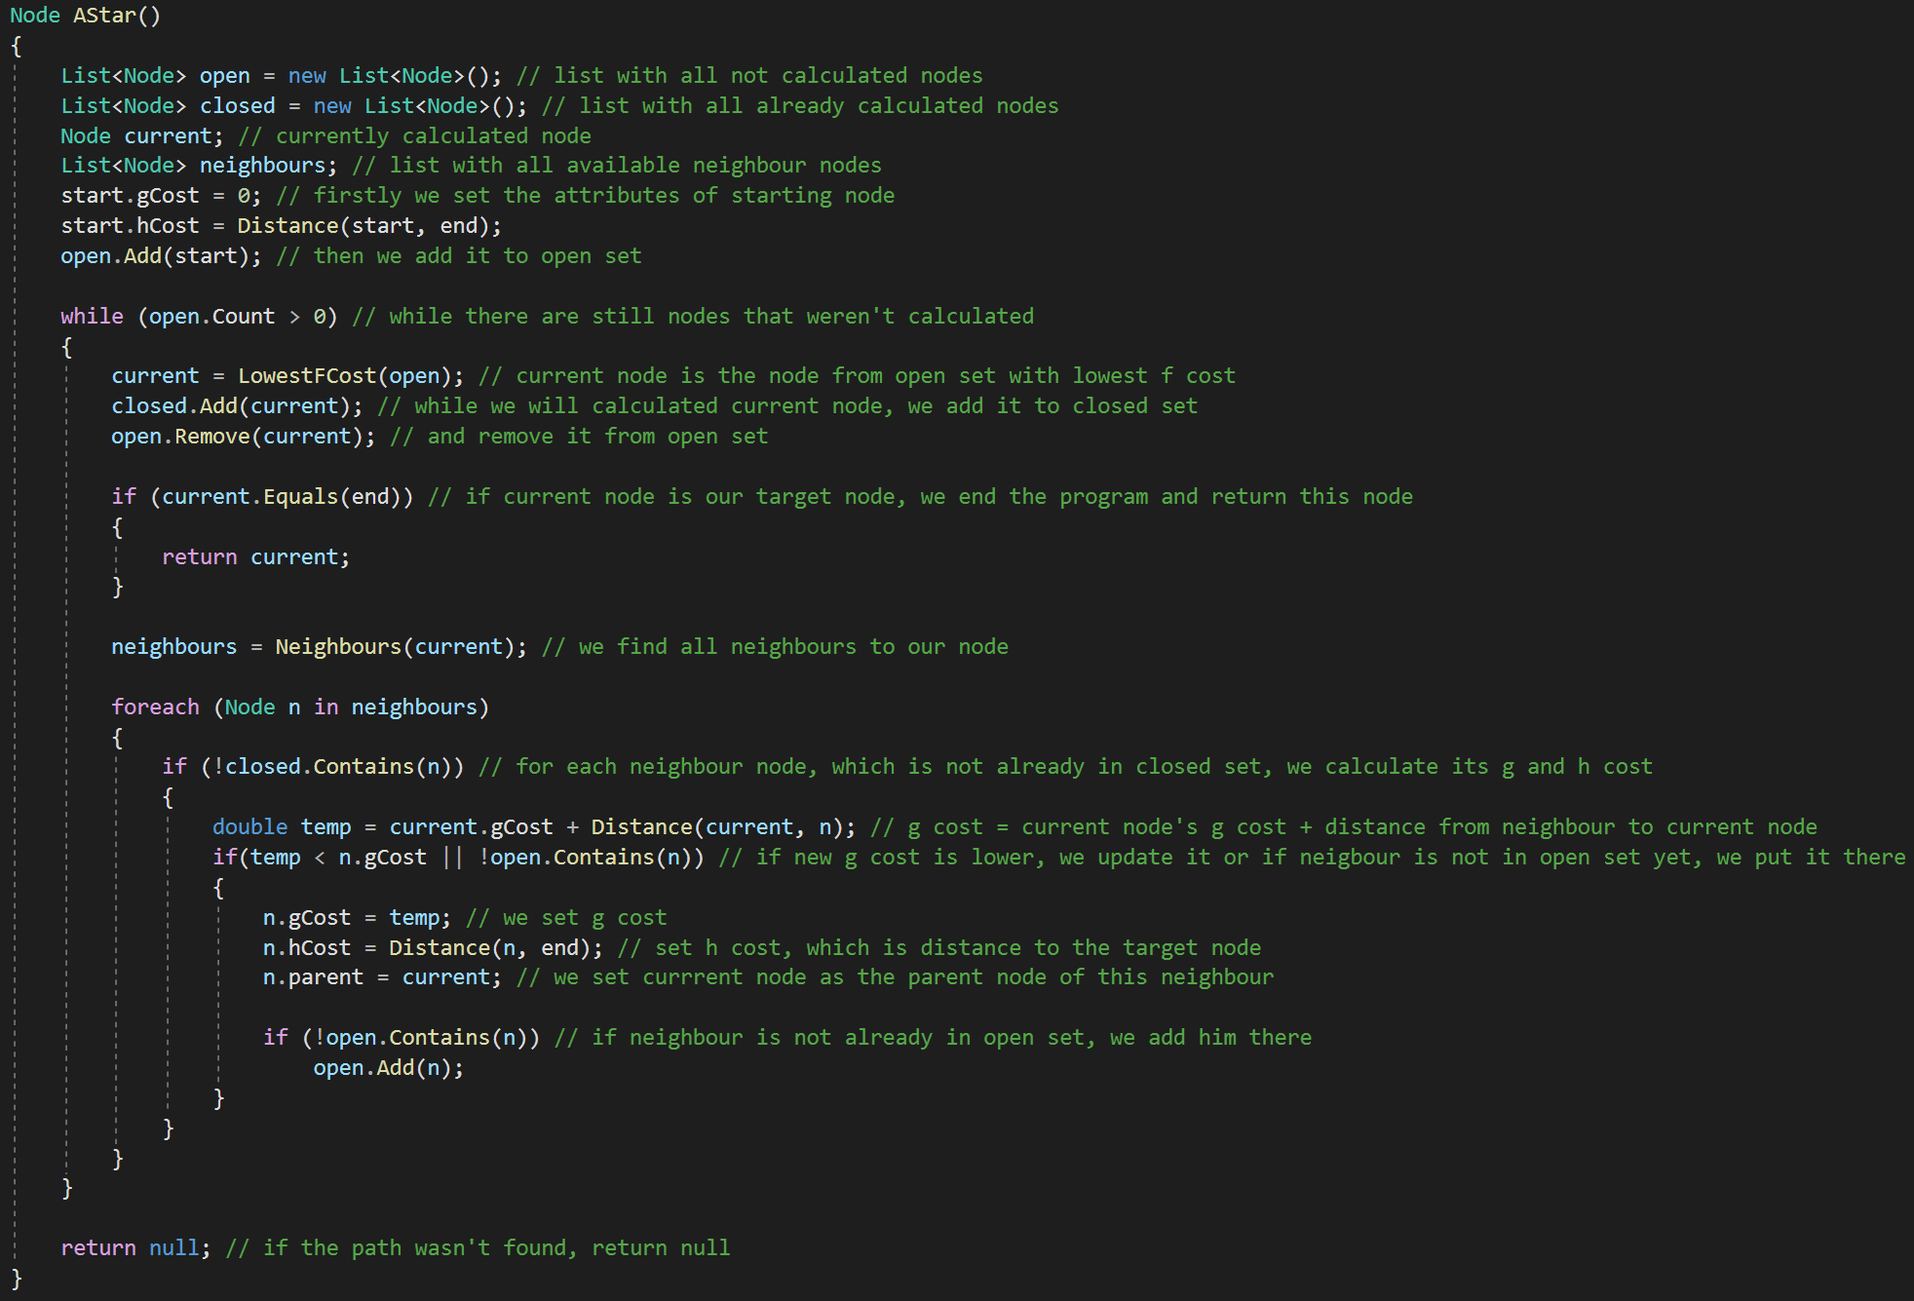
A* algorithm

Slide 32
Modification
The slowest part of A* algorithm is looking for node with lowest f cost.
It takes a lot of time, because we need to loop through whole “open” set.
Solution to this problem is using “Heap” instead of array / list / set.
Heap is normal array, but build as a binary tree with lowest f cost on top.

Slide 33
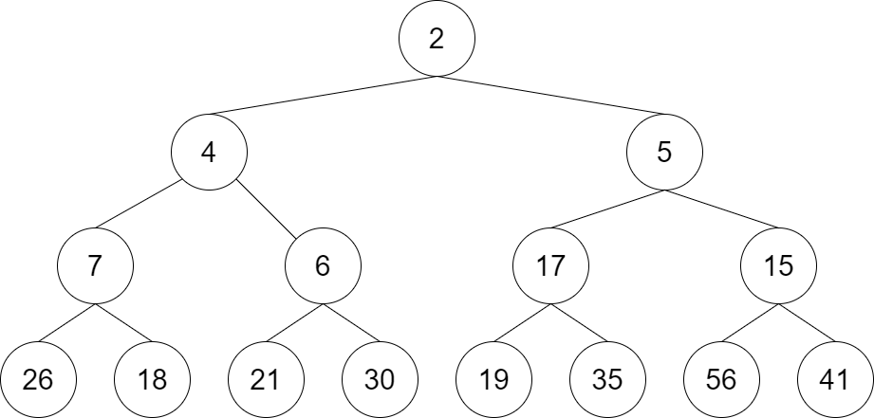
Heap optimization

Slide 34
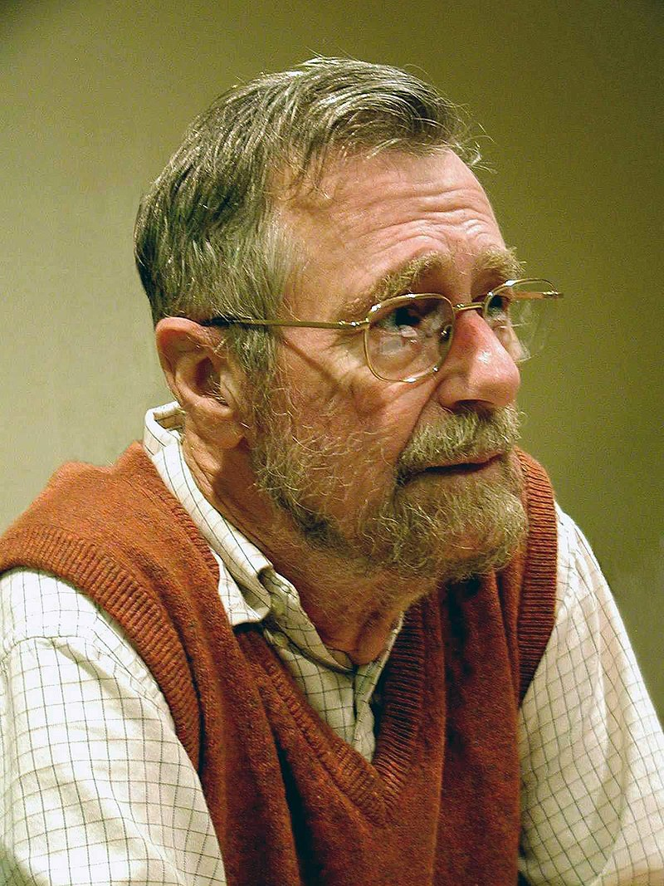
Algorytm Dijsktra
ur. 11 maja 1930 w Rotterdamie
zm. 6 sierpnia 2002 w Nuenen
Notes:
opracowany przez holenderskiego informatyka Edsgera Dijkstrę, służy do znajdowania najkrótszej ścieżki z pojedynczego źródła w grafie o nieujemnych wagach krawędzi.

Slide 35
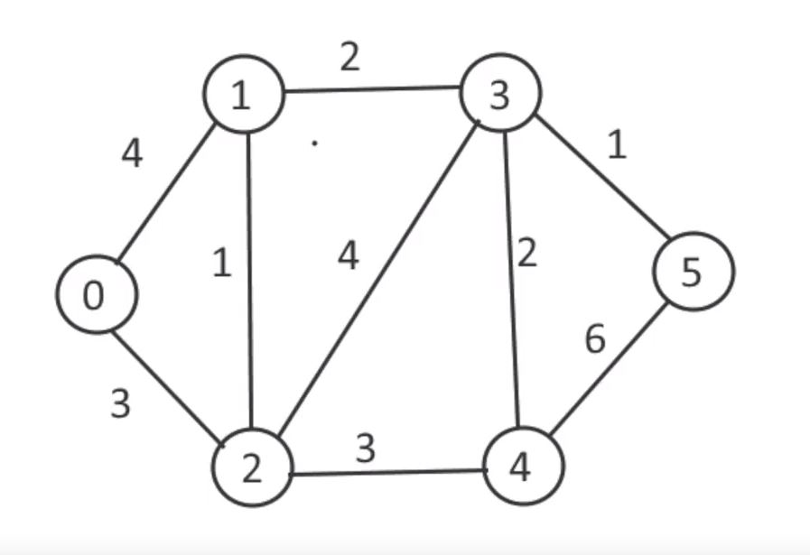
Pseudokod
1 function Dijkstra(Graph, source):
2
3 create vertex set Q
4
5 for each vertex v in Graph:
6 dist[v] ← INFINITY
7 prev[v] ← UNDEFINED
8 add v to Q
10 dist[source] ← 0
11
12 while Q is not empty:
13 u ← vertex in Q with min dist[u]
14
15 remove u from Q
16 // only v that are still in Q
17 for each neighbor v of u:
18 alt ← dist[u] + length(u, v)
19 if alt < dist[v]:
20 dist[v] ← alt
21 prev[v] ← u
22
23 return dist[], prev[]
Notes:
Q to lista kolejkowa, której priorytetem jest dystans.

Slide 36
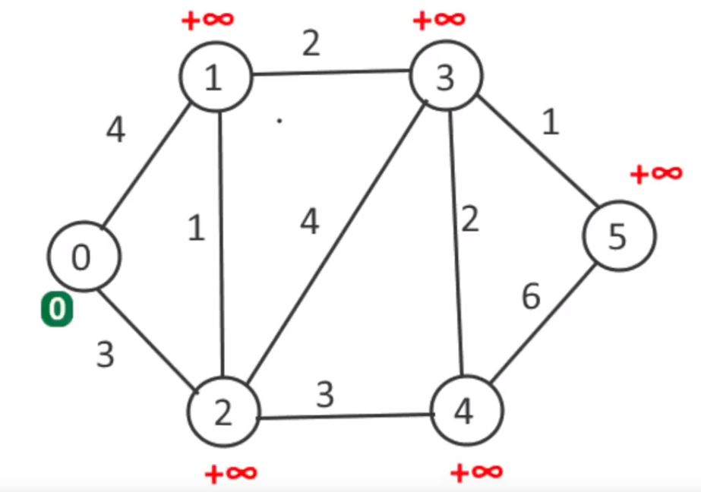
Pseudokod
1 function Dijkstra(Graph, source):
2
3 create vertex set Q
4
5 for each vertex v in Graph:
6 dist[v] ← INFINITY
7 prev[v] ← UNDEFINED
8 add v to Q
10 dist[source] ← 0
11
12 while Q is not empty:
13 u ← vertex in Q with min dist[u]
14
15 remove u from Q
16 // only v that are still in Q
17 for each neighbor v of u:
18 alt ← dist[u] + length(u, v)
19 if alt < dist[v]:
20 dist[v] ← alt
21 prev[v] ← u
22
23 return dist[], prev[]

Slide 37
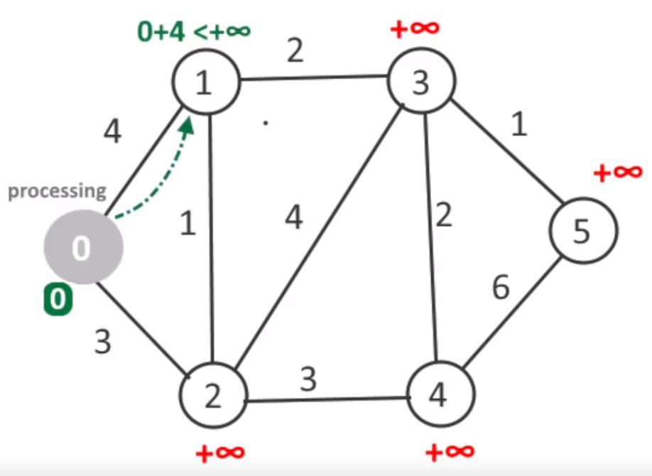
Pseudokod
1 function Dijkstra(Graph, source):
2
3 create vertex set Q
4
5 for each vertex v in Graph:
6 dist[v] ← INFINITY
7 prev[v] ← UNDEFINED
8 add v to Q
10 dist[source] ← 0
11
12 while Q is not empty:
13 u ← vertex in Q with min dist[u]
14
15 remove u from Q
16 // only v that are still in Q
17 for each neighbor v of u:
18 alt ← dist[u] + length(u, v)
19 if alt < dist[v]:
20 dist[v] ← alt
21 prev[v] ← u
22
23 return dist[], prev[]

Slide 38
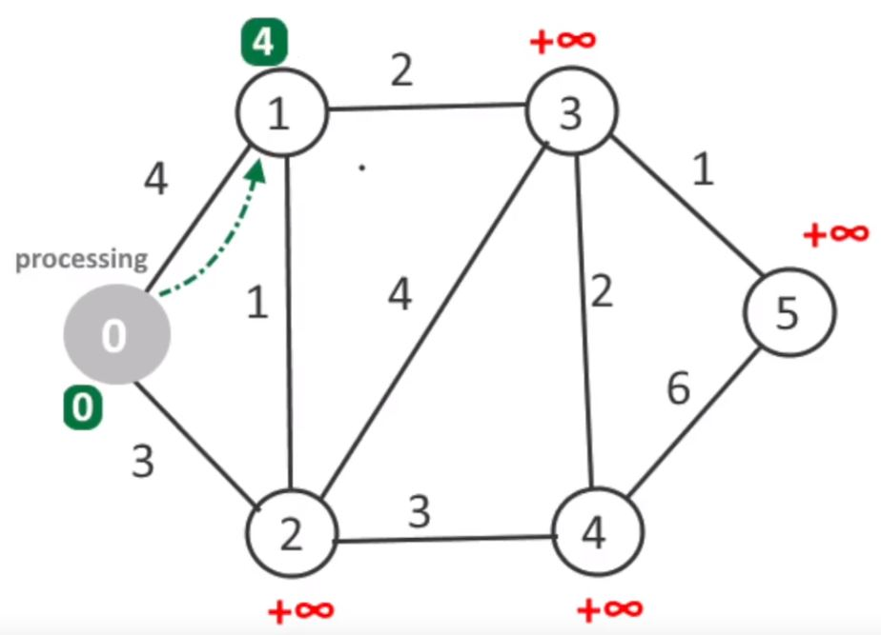
Pseudokod
1 function Dijkstra(Graph, source):
2
3 create vertex set Q
4
5 for each vertex v in Graph:
6 dist[v] ← INFINITY
7 prev[v] ← UNDEFINED
8 add v to Q
10 dist[source] ← 0
11
12 while Q is not empty:
13 u ← vertex in Q with min dist[u]
14
15 remove u from Q
16 // only v that are still in Q
17 for each neighbor v of u:
18 alt ← dist[u] + length(u, v)
19 if alt < dist[v]:
20 dist[v] ← alt
21 prev[v] ← u
22
23 return dist[], prev[]

Slide 39
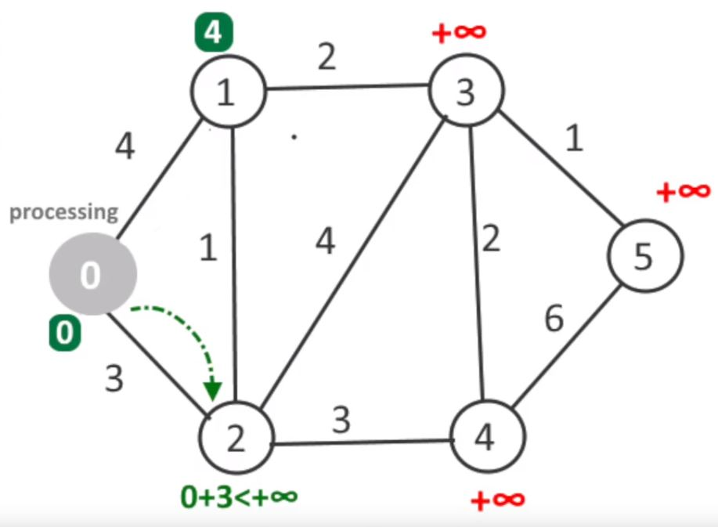
Pseudokod
1 function Dijkstra(Graph, source):
2
3 create vertex set Q
4
5 for each vertex v in Graph:
6 dist[v] ← INFINITY
7 prev[v] ← UNDEFINED
8 add v to Q
10 dist[source] ← 0
11
12 while Q is not empty:
13 u ← vertex in Q with min dist[u]
14
15 remove u from Q
16 // only v that are still in Q
17 for each neighbor v of u:
18 alt ← dist[u] + length(u, v)
19 if alt < dist[v]:
20 dist[v] ← alt
21 prev[v] ← u
22
23 return dist[], prev[]

Slide 40
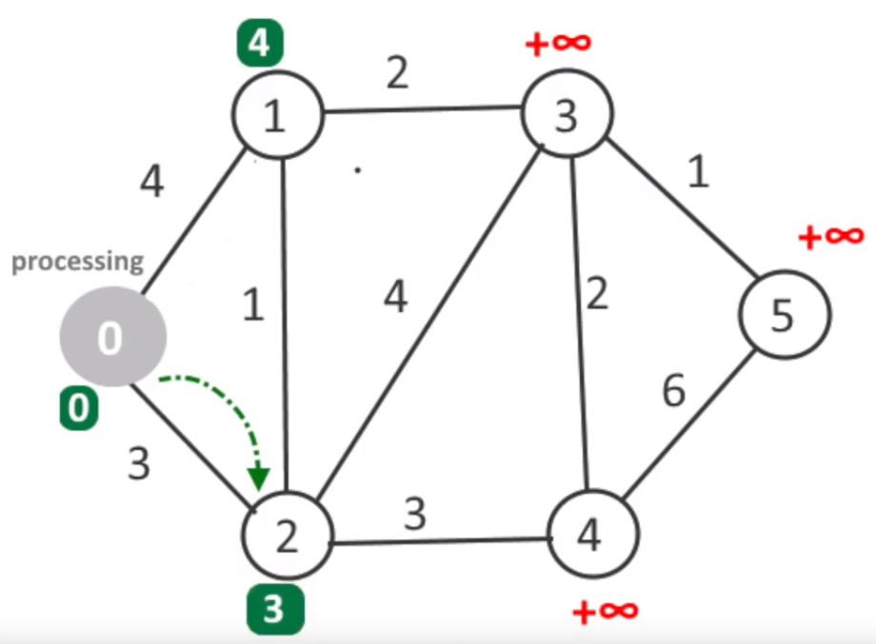
Pseudokod
1 function Dijkstra(Graph, source):
2
3 create vertex set Q
4
5 for each vertex v in Graph:
6 dist[v] ← INFINITY
7 prev[v] ← UNDEFINED
8 add v to Q
10 dist[source] ← 0
11
12 while Q is not empty:
13 u ← vertex in Q with min dist[u]
14
15 remove u from Q
16 // only v that are still in Q
17 for each neighbor v of u:
18 alt ← dist[u] + length(u, v)
19 if alt < dist[v]:
20 dist[v] ← alt
21 prev[v] ← u
22
23 return dist[], prev[]

Slide 41
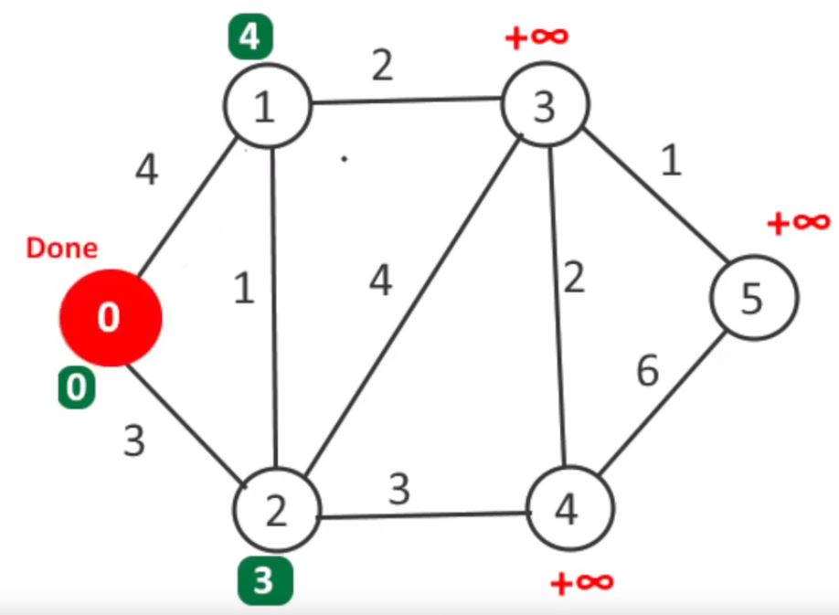
Pseudokod
1 function Dijkstra(Graph, source):
2
3 create vertex set Q
4
5 for each vertex v in Graph:
6 dist[v] ← INFINITY
7 prev[v] ← UNDEFINED
8 add v to Q
10 dist[source] ← 0
11
12 while Q is not empty:
13 u ← vertex in Q with min dist[u]
14
15 remove u from Q
16 // only v that are still in Q
17 for each neighbor v of u:
18 alt ← dist[u] + length(u, v)
19 if alt < dist[v]:
20 dist[v] ← alt
21 prev[v] ← u
22
23 return dist[], prev[]

Slide 42
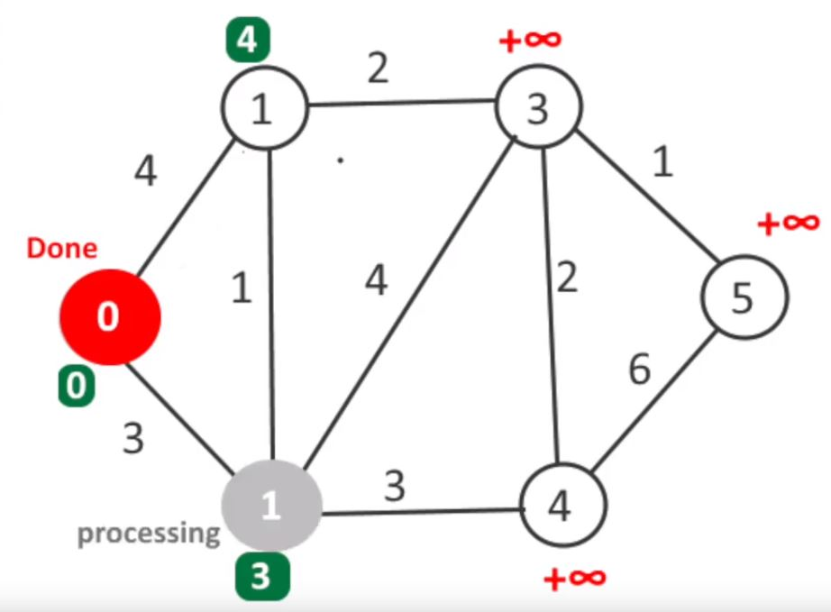
Pseudokod
1 function Dijkstra(Graph, source):
2
3 create vertex set Q
4
5 for each vertex v in Graph:
6 dist[v] ← INFINITY
7 prev[v] ← UNDEFINED
8 add v to Q
10 dist[source] ← 0
11
12 while Q is not empty:
13 u ← vertex in Q with min dist[u]
14
15 remove u from Q
16 // only v that are still in Q
17 for each neighbor v of u:
18 alt ← dist[u] + length(u, v)
19 if alt < dist[v]:
20 dist[v] ← alt
21 prev[v] ← u
22
23 return dist[], prev[]

Slide 43
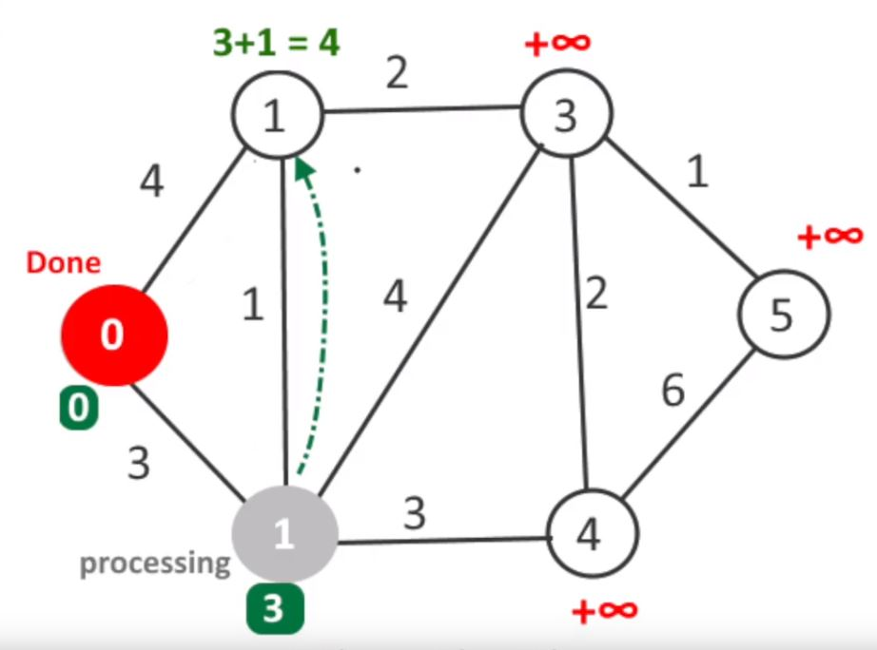
Pseudokod
1 function Dijkstra(Graph, source):
2
3 create vertex set Q
4
5 for each vertex v in Graph:
6 dist[v] ← INFINITY
7 prev[v] ← UNDEFINED
8 add v to Q
10 dist[source] ← 0
11
12 while Q is not empty:
13 u ← vertex in Q with min dist[u]
14
15 remove u from Q
16 // only v that are still in Q
17 for each neighbor v of u:
18 alt ← dist[u] + length(u, v)
19 if alt < dist[v]:
20 dist[v] ← alt
21 prev[v] ← u
22
23 return dist[], prev[]

Slide 44

Pseudokod
1 function Dijkstra(Graph, source):
2
3 create vertex set Q
4
5 for each vertex v in Graph:
6 dist[v] ← INFINITY
7 prev[v] ← UNDEFINED
8 add v to Q
10 dist[source] ← 0
11
12 while Q is not empty:
13 u ← vertex in Q with min dist[u]
14
15 remove u from Q
16 // only v that are still in Q
17 for each neighbor v of u:
18 alt ← dist[u] + length(u, v)
19 if alt < dist[v]:
20 dist[v] ← alt
21 prev[v] ← u
22
23 return dist[], prev[]

Slide 45
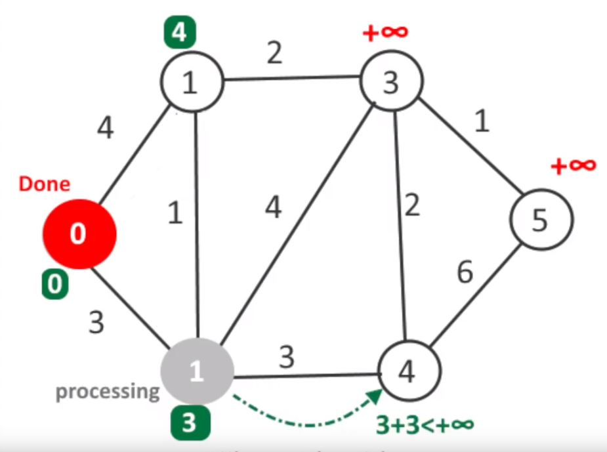
Pseudokod
1 function Dijkstra(Graph, source):
2
3 create vertex set Q
4
5 for each vertex v in Graph:
6 dist[v] ← INFINITY
7 prev[v] ← UNDEFINED
8 add v to Q
10 dist[source] ← 0
11
12 while Q is not empty:
13 u ← vertex in Q with min dist[u]
14
15 remove u from Q
16 // only v that are still in Q
17 for each neighbor v of u:
18 alt ← dist[u] + length(u, v)
19 if alt < dist[v]:
20 dist[v] ← alt
21 prev[v] ← u
22
23 return dist[], prev[]

Slide 46
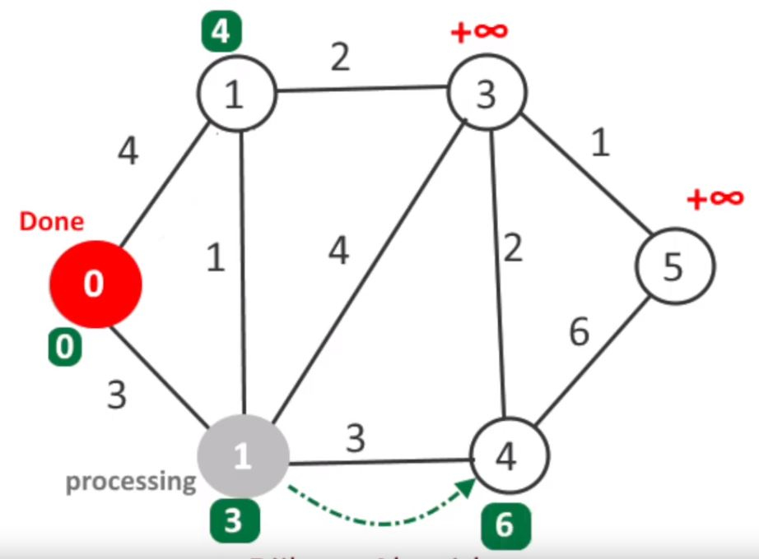
Pseudokod
1 function Dijkstra(Graph, source):
2
3 create vertex set Q
4
5 for each vertex v in Graph:
6 dist[v] ← INFINITY
7 prev[v] ← UNDEFINED
8 add v to Q
10 dist[source] ← 0
11
12 while Q is not empty:
13 u ← vertex in Q with min dist[u]
14
15 remove u from Q
16 // only v that are still in Q
17 for each neighbor v of u:
18 alt ← dist[u] + length(u, v)
19 if alt < dist[v]:
20 dist[v] ← alt
21 prev[v] ← u
22
23 return dist[], prev[]

Slide 47
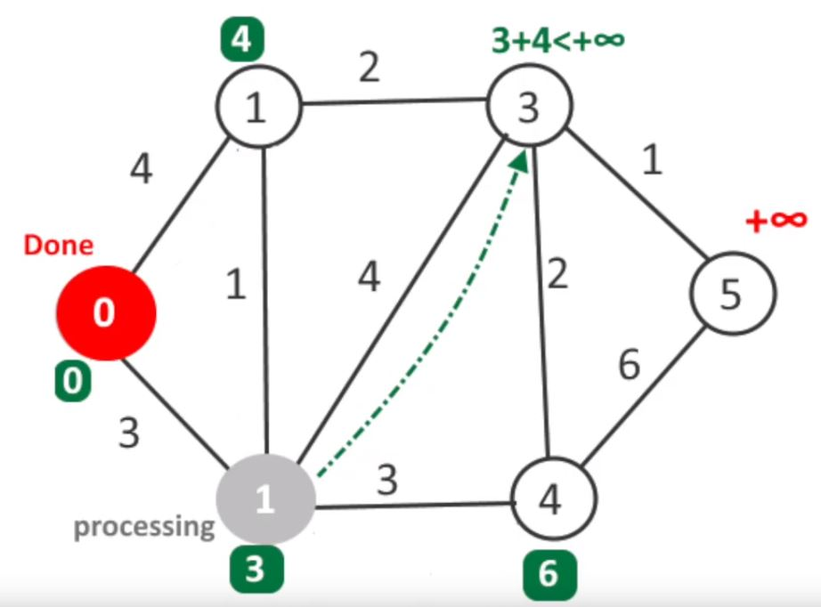
Pseudokod
1 function Dijkstra(Graph, source):
2
3 create vertex set Q
4
5 for each vertex v in Graph:
6 dist[v] ← INFINITY
7 prev[v] ← UNDEFINED
8 add v to Q
10 dist[source] ← 0
11
12 while Q is not empty:
13 u ← vertex in Q with min dist[u]
14
15 remove u from Q
16 // only v that are still in Q
17 for each neighbor v of u:
18 alt ← dist[u] + length(u, v)
19 if alt < dist[v]:
20 dist[v] ← alt
21 prev[v] ← u
22
23 return dist[], prev[]

Slide 48
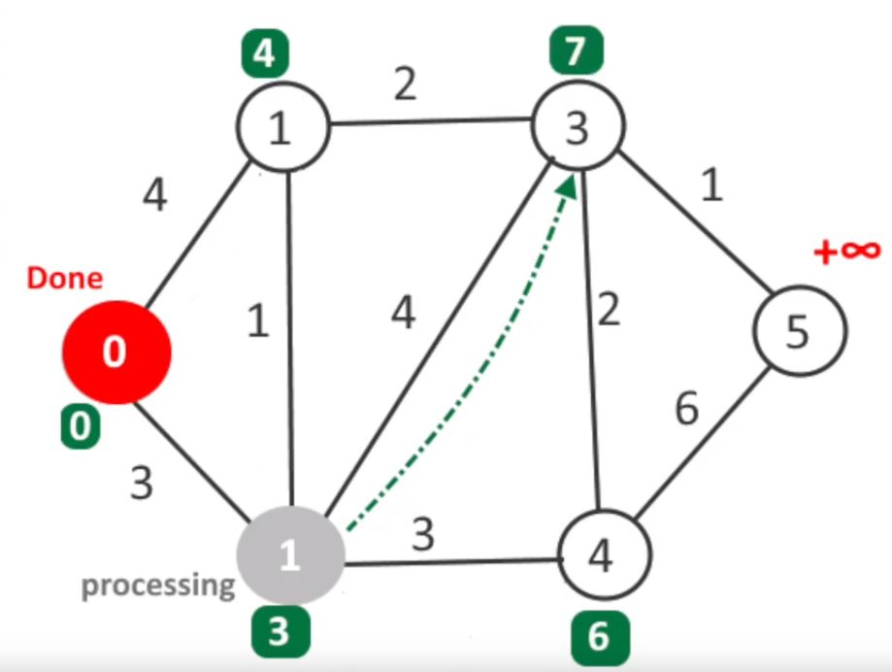
Pseudokod
1 function Dijkstra(Graph, source):
2
3 create vertex set Q
4
5 for each vertex v in Graph:
6 dist[v] ← INFINITY
7 prev[v] ← UNDEFINED
8 add v to Q
10 dist[source] ← 0
11
12 while Q is not empty:
13 u ← vertex in Q with min dist[u]
14
15 remove u from Q
16 // only v that are still in Q
17 for each neighbor v of u:
18 alt ← dist[u] + length(u, v)
19 if alt < dist[v]:
20 dist[v] ← alt
21 prev[v] ← u
22
23 return dist[], prev[]

Slide 49
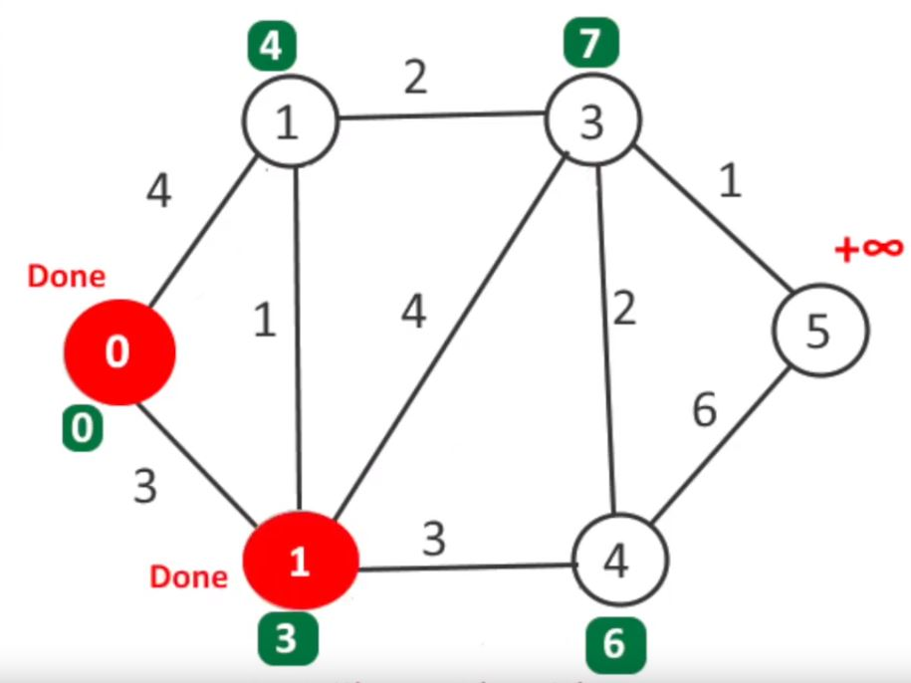
Pseudokod
1 function Dijkstra(Graph, source):
2
3 create vertex set Q
4
5 for each vertex v in Graph:
6 dist[v] ← INFINITY
7 prev[v] ← UNDEFINED
8 add v to Q
10 dist[source] ← 0
11
12 while Q is not empty:
13 u ← vertex in Q with min dist[u]
14
15 remove u from Q
16 // only v that are still in Q
17 for each neighbor v of u:
18 alt ← dist[u] + length(u, v)
19 if alt < dist[v]:
20 dist[v] ← alt
21 prev[v] ← u
22
23 return dist[], prev[]

Slide 50
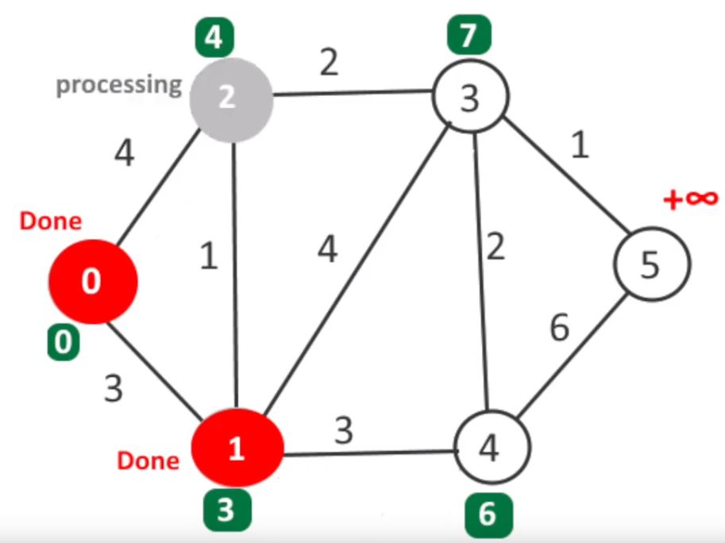
Pseudokod
1 function Dijkstra(Graph, source):
2
3 create vertex set Q
4
5 for each vertex v in Graph:
6 dist[v] ← INFINITY
7 prev[v] ← UNDEFINED
8 add v to Q
10 dist[source] ← 0
11
12 while Q is not empty:
13 u ← vertex in Q with min dist[u]
14
15 remove u from Q
16 // only v that are still in Q
17 for each neighbor v of u:
18 alt ← dist[u] + length(u, v)
19 if alt < dist[v]:
20 dist[v] ← alt
21 prev[v] ← u
22
23 return dist[], prev[]

Slide 51
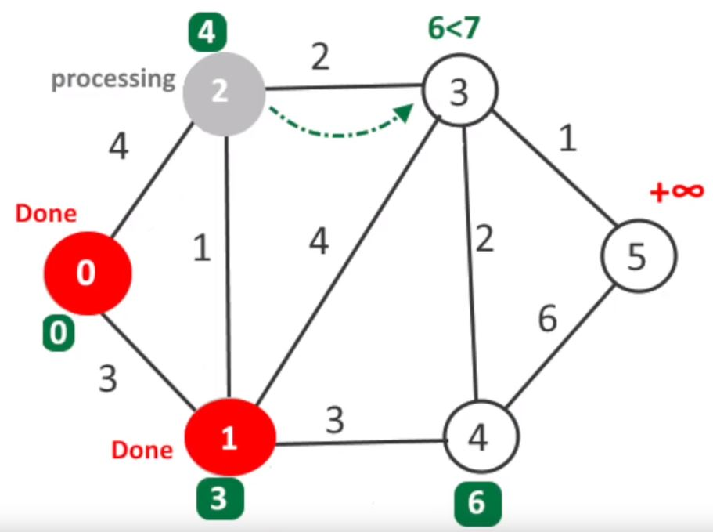
Pseudokod
1 function Dijkstra(Graph, source):
2
3 create vertex set Q
4
5 for each vertex v in Graph:
6 dist[v] ← INFINITY
7 prev[v] ← UNDEFINED
8 add v to Q
10 dist[source] ← 0
11
12 while Q is not empty:
13 u ← vertex in Q with min dist[u]
14
15 remove u from Q
16 // only v that are still in Q
17 for each neighbor v of u:
18 alt ← dist[u] + length(u, v)
19 if alt < dist[v]:
20 dist[v] ← alt
21 prev[v] ← u
22
23 return dist[], prev[]

Slide 52
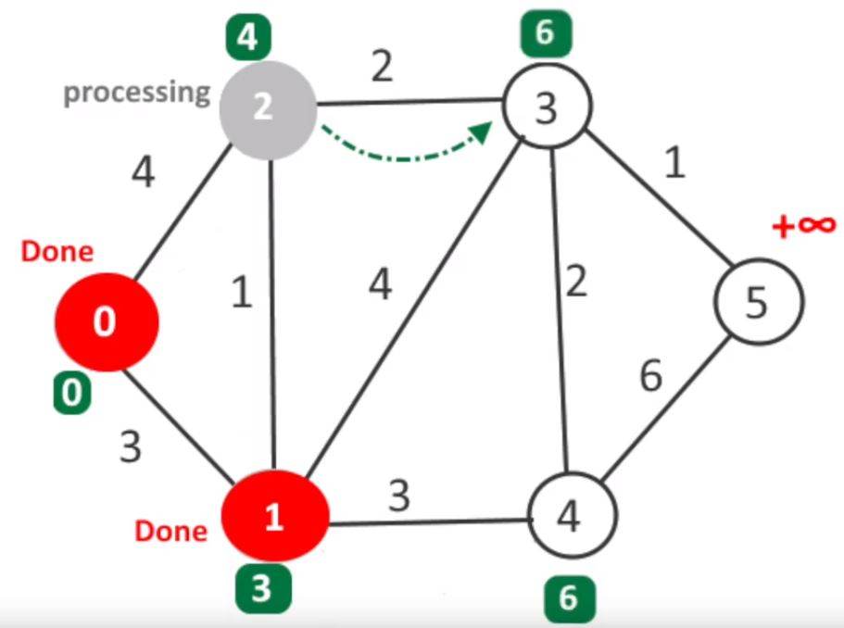
Pseudokod
1 function Dijkstra(Graph, source):
2
3 create vertex set Q
4
5 for each vertex v in Graph:
6 dist[v] ← INFINITY
7 prev[v] ← UNDEFINED
8 add v to Q
10 dist[source] ← 0
11
12 while Q is not empty:
13 u ← vertex in Q with min dist[u]
14
15 remove u from Q
16 // only v that are still in Q
17 for each neighbor v of u:
18 alt ← dist[u] + length(u, v)
19 if alt < dist[v]:
20 dist[v] ← alt
21 prev[v] ← u
22
23 return dist[], prev[]

Slide 53
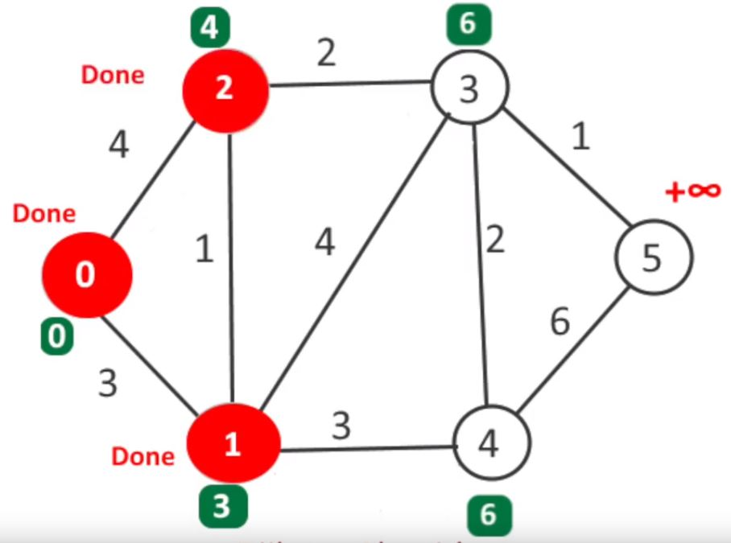
Pseudokod
1 function Dijkstra(Graph, source):
2
3 create vertex set Q
4
5 for each vertex v in Graph:
6 dist[v] ← INFINITY
7 prev[v] ← UNDEFINED
8 add v to Q
10 dist[source] ← 0
11
12 while Q is not empty:
13 u ← vertex in Q with min dist[u]
14
15 remove u from Q
16 // only v that are still in Q
17 for each neighbor v of u:
18 alt ← dist[u] + length(u, v)
19 if alt < dist[v]:
20 dist[v] ← alt
21 prev[v] ← u
22
23 return dist[], prev[]

Slide 54

Pseudokod
1 function Dijkstra(Graph, source):
2
3 create vertex set Q
4
5 for each vertex v in Graph:
6 dist[v] ← INFINITY
7 prev[v] ← UNDEFINED
8 add v to Q
10 dist[source] ← 0
11
12 while Q is not empty:
13 u ← vertex in Q with min dist[u]
14
15 remove u from Q
16 // only v that are still in Q
17 for each neighbor v of u:
18 alt ← dist[u] + length(u, v)
19 if alt < dist[v]:
20 dist[v] ← alt
21 prev[v] ← u
22
23 return dist[], prev[]

Slide 55

Pseudokod
1 function Dijkstra(Graph, source):
2
3 create vertex set Q
4
5 for each vertex v in Graph:
6 dist[v] ← INFINITY
7 prev[v] ← UNDEFINED
8 add v to Q
10 dist[source] ← 0
11
12 while Q is not empty:
13 u ← vertex in Q with min dist[u]
14
15 remove u from Q
16 // only v that are still in Q
17 for each neighbor v of u:
18 alt ← dist[u] + length(u, v)
19 if alt < dist[v]:
20 dist[v] ← alt
21 prev[v] ← u
22
23 return dist[], prev[]

Slide 56

Pseudokod
1 function Dijkstra(Graph, source):
2
3 create vertex set Q
4
5 for each vertex v in Graph:
6 dist[v] ← INFINITY
7 prev[v] ← UNDEFINED
8 add v to Q
10 dist[source] ← 0
11
12 while Q is not empty:
13 u ← vertex in Q with min dist[u]
14
15 remove u from Q
16 // only v that are still in Q
17 for each neighbor v of u:
18 alt ← dist[u] + length(u, v)
19 if alt < dist[v]:
20 dist[v] ← alt
21 prev[v] ← u
22
23 return dist[], prev[]

Slide 57

Pseudokod
1 function Dijkstra(Graph, source):
2
3 create vertex set Q
4
5 for each vertex v in Graph:
6 dist[v] ← INFINITY
7 prev[v] ← UNDEFINED
8 add v to Q
10 dist[source] ← 0
11
12 while Q is not empty:
13 u ← vertex in Q with min dist[u]
14
15 remove u from Q
16 // only v that are still in Q
17 for each neighbor v of u:
18 alt ← dist[u] + length(u, v)
19 if alt < dist[v]:
20 dist[v] ← alt
21 prev[v] ← u
22
23 return dist[], prev[]

Slide 58

Pseudokod
1 function Dijkstra(Graph, source):
2
3 create vertex set Q
4
5 for each vertex v in Graph:
6 dist[v] ← INFINITY
7 prev[v] ← UNDEFINED
8 add v to Q
10 dist[source] ← 0
11
12 while Q is not empty:
13 u ← vertex in Q with min dist[u]
14
15 remove u from Q
16 // only v that are still in Q
17 for each neighbor v of u:
18 alt ← dist[u] + length(u, v)
19 if alt < dist[v]:
20 dist[v] ← alt
21 prev[v] ← u
22
23 return dist[], prev[]

Slide 59

Pseudokod
1 function Dijkstra(Graph, source):
2
3 create vertex set Q
4
5 for each vertex v in Graph:
6 dist[v] ← INFINITY
7 prev[v] ← UNDEFINED
8 add v to Q
10 dist[source] ← 0
11
12 while Q is not empty:
13 u ← vertex in Q with min dist[u]
14
15 remove u from Q
16 // only v that are still in Q
17 for each neighbor v of u:
18 alt ← dist[u] + length(u, v)
19 if alt < dist[v]:
20 dist[v] ← alt
21 prev[v] ← u
22
23 return dist[], prev[]

Slide 60

Pseudokod
1 function Dijkstra(Graph, source):
2
3 create vertex set Q
4
5 for each vertex v in Graph:
6 dist[v] ← INFINITY
7 prev[v] ← UNDEFINED
8 add v to Q
10 dist[source] ← 0
11
12 while Q is not empty:
13 u ← vertex in Q with min dist[u]
14
15 remove u from Q
16 // only v that are still in Q
17 for each neighbor v of u:
18 alt ← dist[u] + length(u, v)
19 if alt < dist[v]:
20 dist[v] ← alt
21 prev[v] ← u
22
23 return dist[], prev[]

Slide 61

Pseudokod
1 function Dijkstra(Graph, source):
2
3 create vertex set Q
4
5 for each vertex v in Graph:
6 dist[v] ← INFINITY
7 prev[v] ← UNDEFINED
8 add v to Q
10 dist[source] ← 0
11
12 while Q is not empty:
13 u ← vertex in Q with min dist[u]
14
15 remove u from Q
16 // only v that are still in Q
17 for each neighbor v of u:
18 alt ← dist[u] + length(u, v)
19 if alt < dist[v]:
20 dist[v] ← alt
21 prev[v] ← u
22
23 return dist[], prev[]

Slide 62

Pseudokod
1 function Dijkstra(Graph, source):
2
3 create vertex set Q
4
5 for each vertex v in Graph:
6 dist[v] ← INFINITY
7 prev[v] ← UNDEFINED
8 add v to Q
10 dist[source] ← 0
11
12 while Q is not empty:
13 u ← vertex in Q with min dist[u]
14
15 remove u from Q
16 // only v that are still in Q
17 for each neighbor v of u:
18 alt ← dist[u] + length(u, v)
19 if alt < dist[v]:
20 dist[v] ← alt
21 prev[v] ← u
22
23 return dist[], prev[]

Slide 63

Pseudokod
1 function Dijkstra(Graph, source):
2
3 create vertex set Q
4
5 for each vertex v in Graph:
6 dist[v] ← INFINITY
7 prev[v] ← UNDEFINED
8 add v to Q
10 dist[source] ← 0
11
12 while Q is not empty:
13 u ← vertex in Q with min dist[u]
14
15 remove u from Q
16 // only v that are still in Q
17 for each neighbor v of u:
18 alt ← dist[u] + length(u, v)
19 if alt < dist[v]:
20 dist[v] ← alt
21 prev[v] ← u
22
23 return dist[], prev[]

Slide 64

Pseudokod
1 function Dijkstra(Graph, source):
2
3 create vertex set Q
4
5 for each vertex v in Graph:
6 dist[v] ← INFINITY
7 prev[v] ← UNDEFINED
8 add v to Q
10 dist[source] ← 0
11
12 while Q is not empty:
13 u ← vertex in Q with min dist[u]
14
15 remove u from Q
16 // only v that are still in Q
17 for each neighbor v of u:
18 alt ← dist[u] + length(u, v)
19 if alt < dist[v]:
20 dist[v] ← alt
21 prev[v] ← u
22
23 return dist[], prev[]

Slide 65

Algorytm w praktyce

Slide 66

Algorytm w praktyce
Notes:
Kwadrat to wierzchołek grafu

Slide 67

Algorytm w praktyce

Slide 68

Algorytm w praktyce

Slide 69

Algorytm w praktyce

Slide 70

Algorytm w praktyce

Slide 71

Kod: class Node

Slide 72

Kod: class PriorityQueue

Slide 73

Kod: class PriorityQueue

Slide 74

Kod: class PriorityQueue

Slide 75


Implementacja algorytmu

Slide 76
Dziękujemy za uwagę.

