Slide 1
Pathfinding-visualizer
Politechnika Śląska, wydział matematyki stosowanej, informatyka sem. V
Heurystyczne metody optymalizacji
Piotr Białas, Filip Gaweł

Slide 2
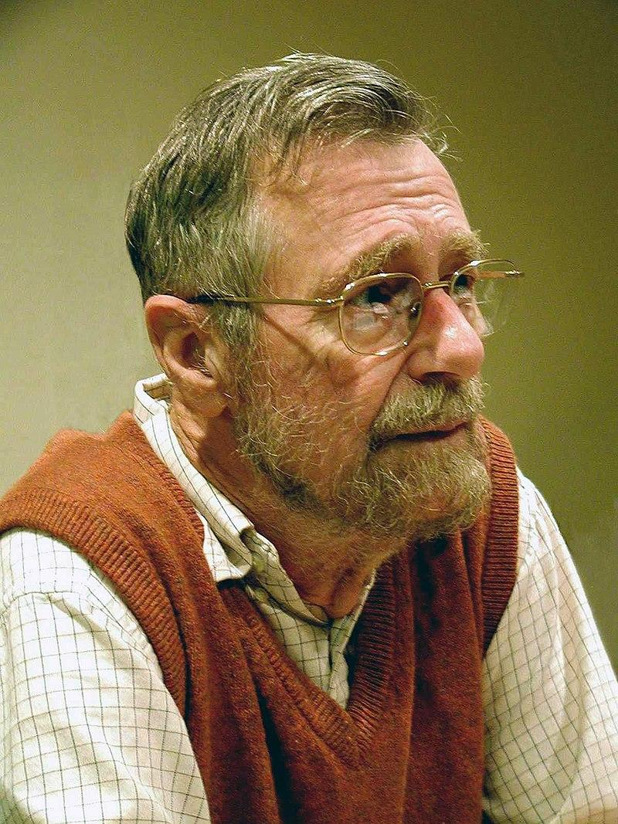
Algorytm Dijsktra
ur. 11 maja 1930 w Rotterdamie
zm. 6 sierpnia 2002 w Nuenen
Notes:
opracowany przez holenderskiego informatyka Edsgera Dijkstrę, służy do znajdowania najkrótszej ścieżki z pojedynczego źródła w grafie o nieujemnych wagach krawędzi.

Slide 3
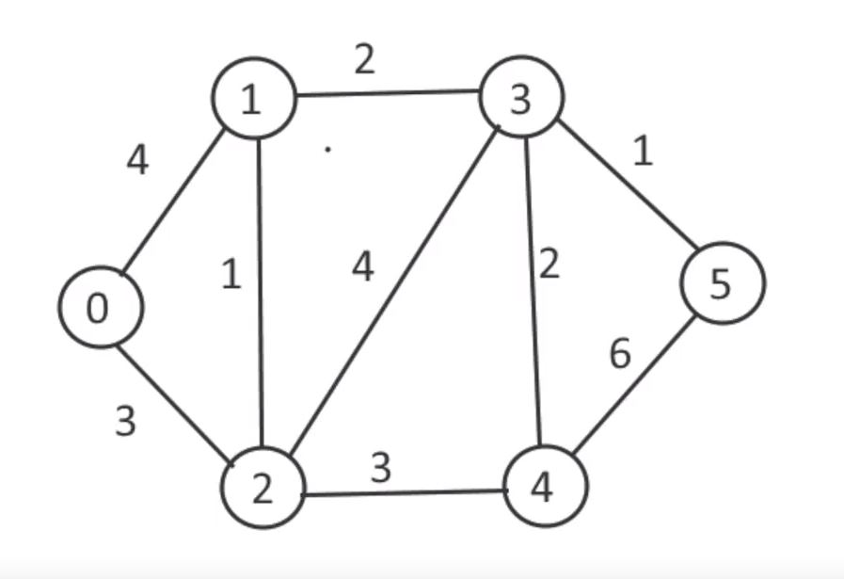
Pseudokod
1 function Dijkstra(Graph, source):
2
3 create vertex set Q
4
5 for each vertex v in Graph:
6 dist[v] ← INFINITY
7 prev[v] ← UNDEFINED
8 add v to Q
10 dist[source] ← 0
11
12 while Q is not empty:
13 u ← vertex in Q with min dist[u]
14
15 remove u from Q
16 // only v that are still in Q
17 for each neighbor v of u:
18 alt ← dist[u] + length(u, v)
19 if alt < dist[v]:
20 dist[v] ← alt
21 prev[v] ← u
22
23 return dist[], prev[]
Notes:
Q to lista kolejkowa, której priorytetem jest dystans.

Slide 4
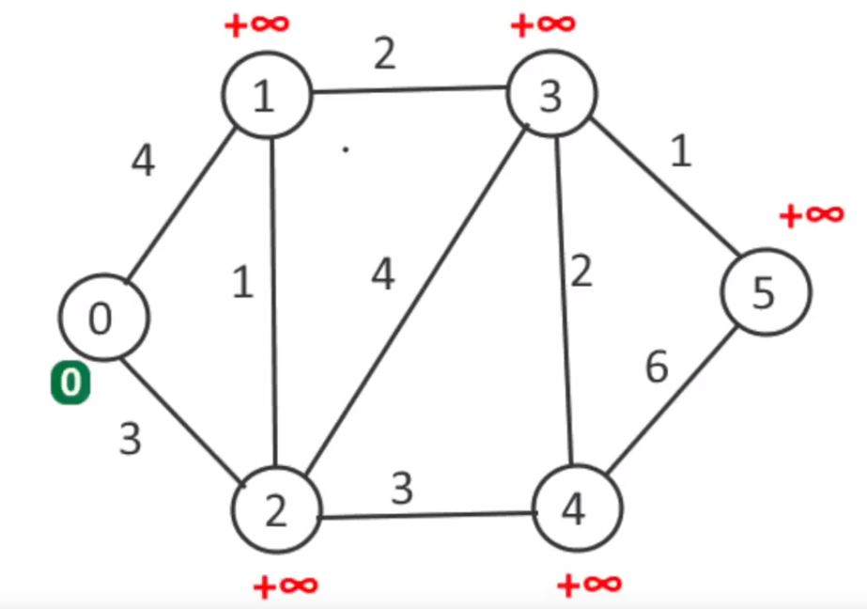
Pseudokod
1 function Dijkstra(Graph, source):
2
3 create vertex set Q
4
5 for each vertex v in Graph:
6 dist[v] ← INFINITY
7 prev[v] ← UNDEFINED
8 add v to Q
10 dist[source] ← 0
11
12 while Q is not empty:
13 u ← vertex in Q with min dist[u]
14
15 remove u from Q
16 // only v that are still in Q
17 for each neighbor v of u:
18 alt ← dist[u] + length(u, v)
19 if alt < dist[v]:
20 dist[v] ← alt
21 prev[v] ← u
22
23 return dist[], prev[]

Slide 5
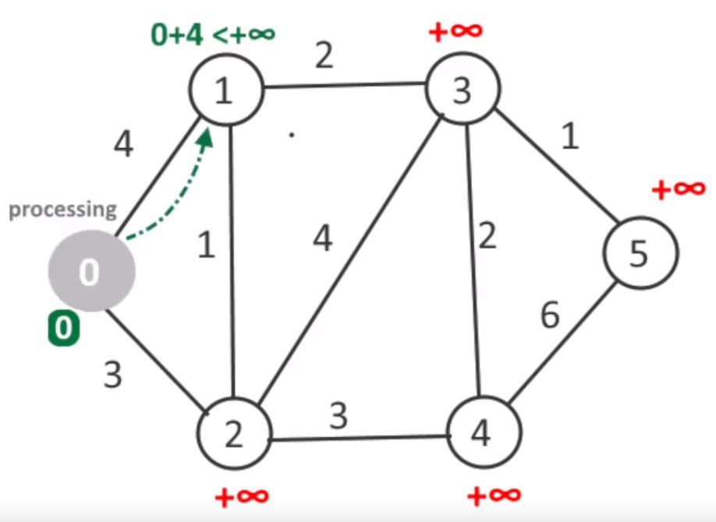
Pseudokod
1 function Dijkstra(Graph, source):
2
3 create vertex set Q
4
5 for each vertex v in Graph:
6 dist[v] ← INFINITY
7 prev[v] ← UNDEFINED
8 add v to Q
10 dist[source] ← 0
11
12 while Q is not empty:
13 u ← vertex in Q with min dist[u]
14
15 remove u from Q
16 // only v that are still in Q
17 for each neighbor v of u:
18 alt ← dist[u] + length(u, v)
19 if alt < dist[v]:
20 dist[v] ← alt
21 prev[v] ← u
22
23 return dist[], prev[]

Slide 6
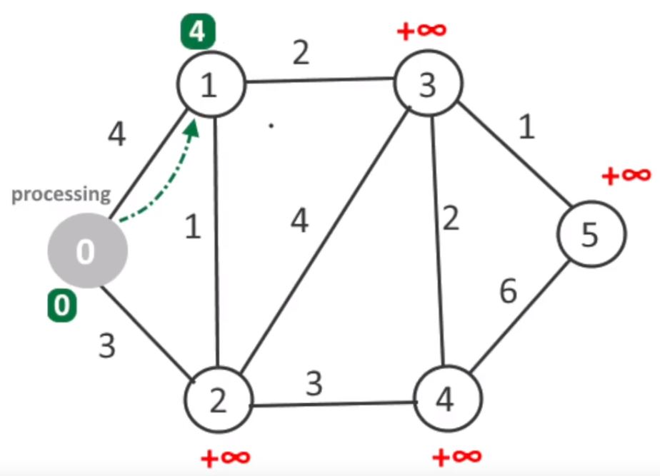
Pseudokod
1 function Dijkstra(Graph, source):
2
3 create vertex set Q
4
5 for each vertex v in Graph:
6 dist[v] ← INFINITY
7 prev[v] ← UNDEFINED
8 add v to Q
10 dist[source] ← 0
11
12 while Q is not empty:
13 u ← vertex in Q with min dist[u]
14
15 remove u from Q
16 // only v that are still in Q
17 for each neighbor v of u:
18 alt ← dist[u] + length(u, v)
19 if alt < dist[v]:
20 dist[v] ← alt
21 prev[v] ← u
22
23 return dist[], prev[]

Slide 7
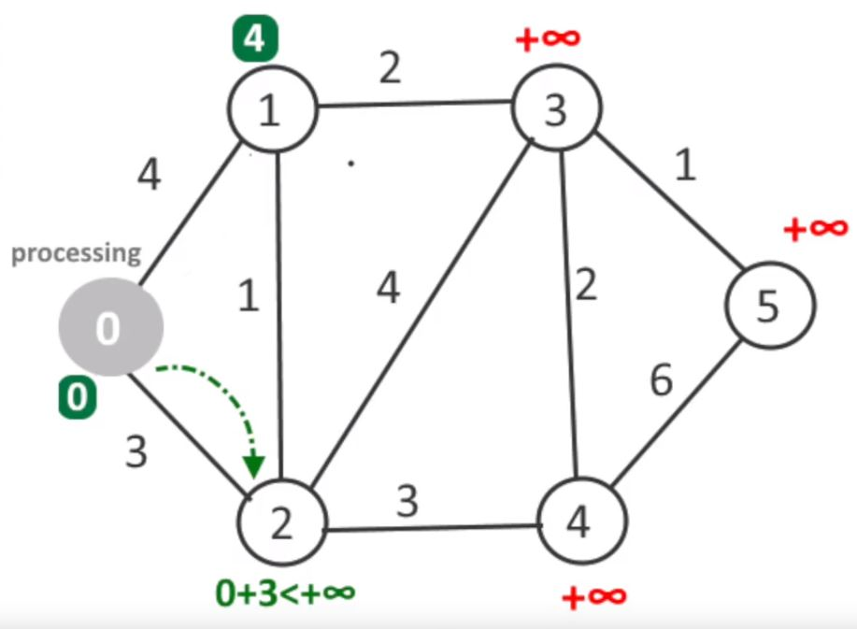
Pseudokod
1 function Dijkstra(Graph, source):
2
3 create vertex set Q
4
5 for each vertex v in Graph:
6 dist[v] ← INFINITY
7 prev[v] ← UNDEFINED
8 add v to Q
10 dist[source] ← 0
11
12 while Q is not empty:
13 u ← vertex in Q with min dist[u]
14
15 remove u from Q
16 // only v that are still in Q
17 for each neighbor v of u:
18 alt ← dist[u] + length(u, v)
19 if alt < dist[v]:
20 dist[v] ← alt
21 prev[v] ← u
22
23 return dist[], prev[]

Slide 8
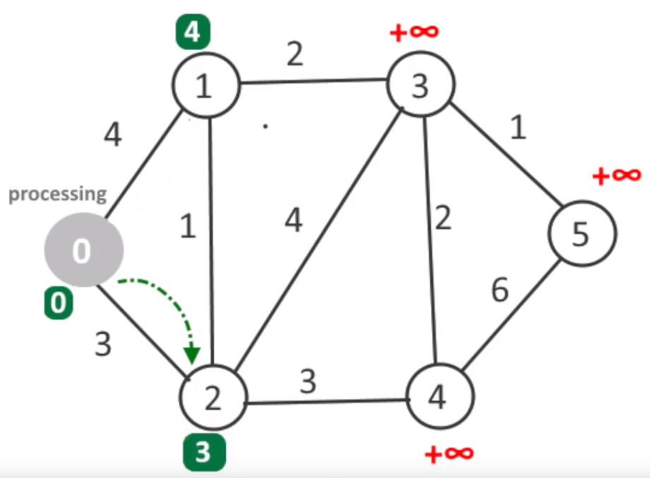
Pseudokod
1 function Dijkstra(Graph, source):
2
3 create vertex set Q
4
5 for each vertex v in Graph:
6 dist[v] ← INFINITY
7 prev[v] ← UNDEFINED
8 add v to Q
10 dist[source] ← 0
11
12 while Q is not empty:
13 u ← vertex in Q with min dist[u]
14
15 remove u from Q
16 // only v that are still in Q
17 for each neighbor v of u:
18 alt ← dist[u] + length(u, v)
19 if alt < dist[v]:
20 dist[v] ← alt
21 prev[v] ← u
22
23 return dist[], prev[]

Slide 9
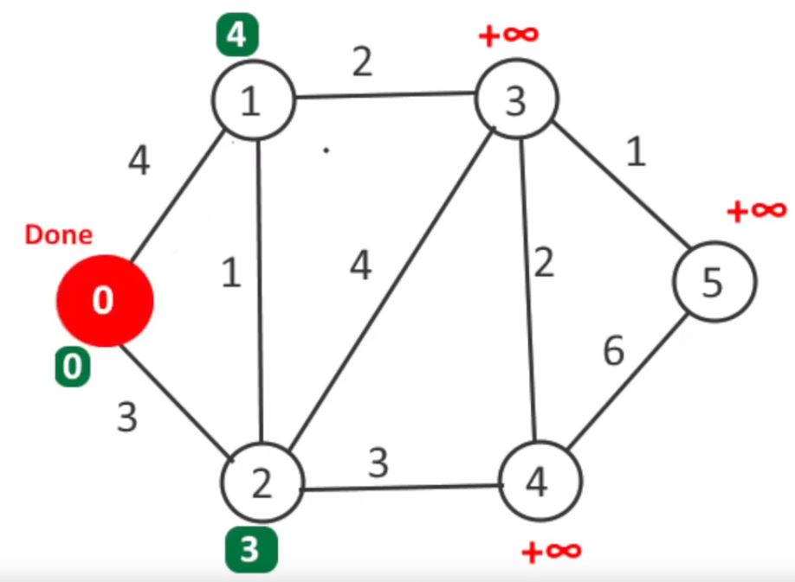
Pseudokod
1 function Dijkstra(Graph, source):
2
3 create vertex set Q
4
5 for each vertex v in Graph:
6 dist[v] ← INFINITY
7 prev[v] ← UNDEFINED
8 add v to Q
10 dist[source] ← 0
11
12 while Q is not empty:
13 u ← vertex in Q with min dist[u]
14
15 remove u from Q
16 // only v that are still in Q
17 for each neighbor v of u:
18 alt ← dist[u] + length(u, v)
19 if alt < dist[v]:
20 dist[v] ← alt
21 prev[v] ← u
22
23 return dist[], prev[]

Slide 10
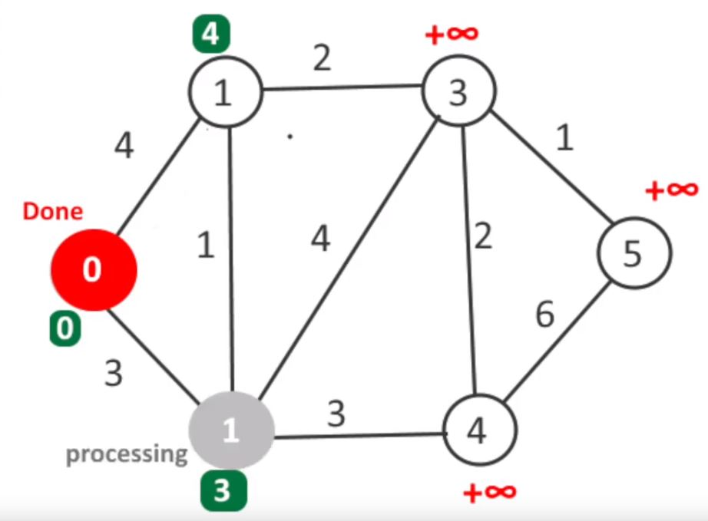
Pseudokod
1 function Dijkstra(Graph, source):
2
3 create vertex set Q
4
5 for each vertex v in Graph:
6 dist[v] ← INFINITY
7 prev[v] ← UNDEFINED
8 add v to Q
10 dist[source] ← 0
11
12 while Q is not empty:
13 u ← vertex in Q with min dist[u]
14
15 remove u from Q
16 // only v that are still in Q
17 for each neighbor v of u:
18 alt ← dist[u] + length(u, v)
19 if alt < dist[v]:
20 dist[v] ← alt
21 prev[v] ← u
22
23 return dist[], prev[]

Slide 11
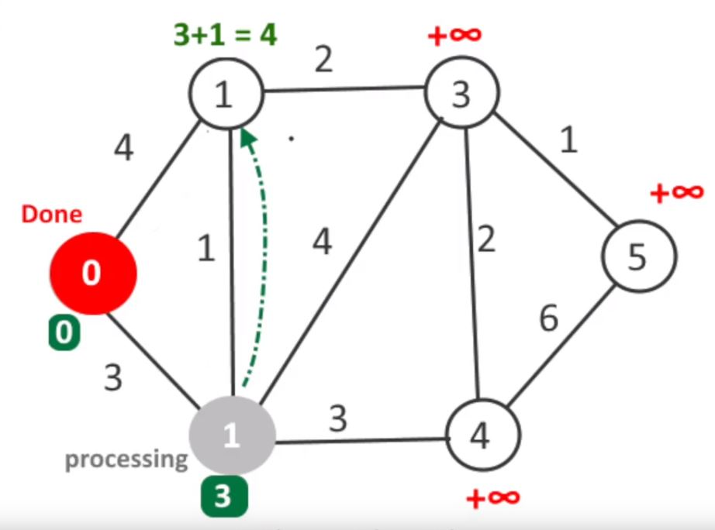
Pseudokod
1 function Dijkstra(Graph, source):
2
3 create vertex set Q
4
5 for each vertex v in Graph:
6 dist[v] ← INFINITY
7 prev[v] ← UNDEFINED
8 add v to Q
10 dist[source] ← 0
11
12 while Q is not empty:
13 u ← vertex in Q with min dist[u]
14
15 remove u from Q
16 // only v that are still in Q
17 for each neighbor v of u:
18 alt ← dist[u] + length(u, v)
19 if alt < dist[v]:
20 dist[v] ← alt
21 prev[v] ← u
22
23 return dist[], prev[]

Slide 12

Pseudokod
1 function Dijkstra(Graph, source):
2
3 create vertex set Q
4
5 for each vertex v in Graph:
6 dist[v] ← INFINITY
7 prev[v] ← UNDEFINED
8 add v to Q
10 dist[source] ← 0
11
12 while Q is not empty:
13 u ← vertex in Q with min dist[u]
14
15 remove u from Q
16 // only v that are still in Q
17 for each neighbor v of u:
18 alt ← dist[u] + length(u, v)
19 if alt < dist[v]:
20 dist[v] ← alt
21 prev[v] ← u
22
23 return dist[], prev[]

Slide 13
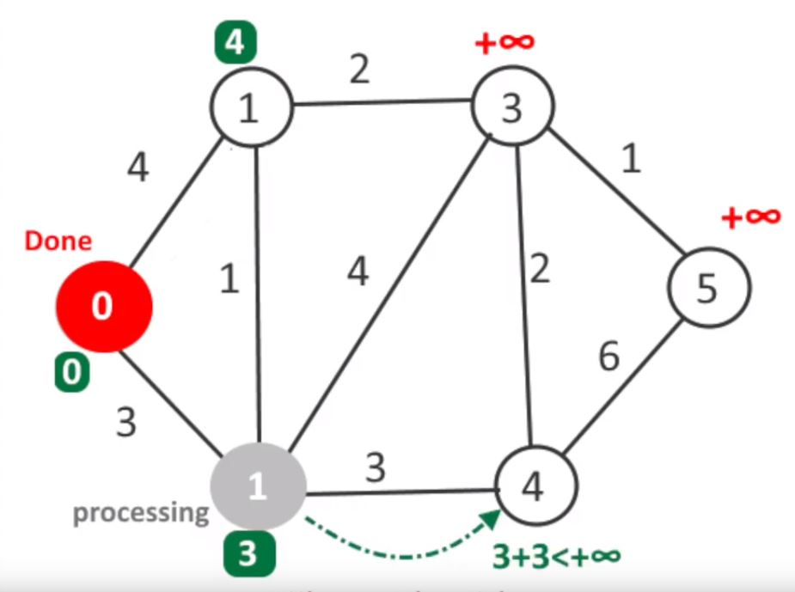
Pseudokod
1 function Dijkstra(Graph, source):
2
3 create vertex set Q
4
5 for each vertex v in Graph:
6 dist[v] ← INFINITY
7 prev[v] ← UNDEFINED
8 add v to Q
10 dist[source] ← 0
11
12 while Q is not empty:
13 u ← vertex in Q with min dist[u]
14
15 remove u from Q
16 // only v that are still in Q
17 for each neighbor v of u:
18 alt ← dist[u] + length(u, v)
19 if alt < dist[v]:
20 dist[v] ← alt
21 prev[v] ← u
22
23 return dist[], prev[]

Slide 14
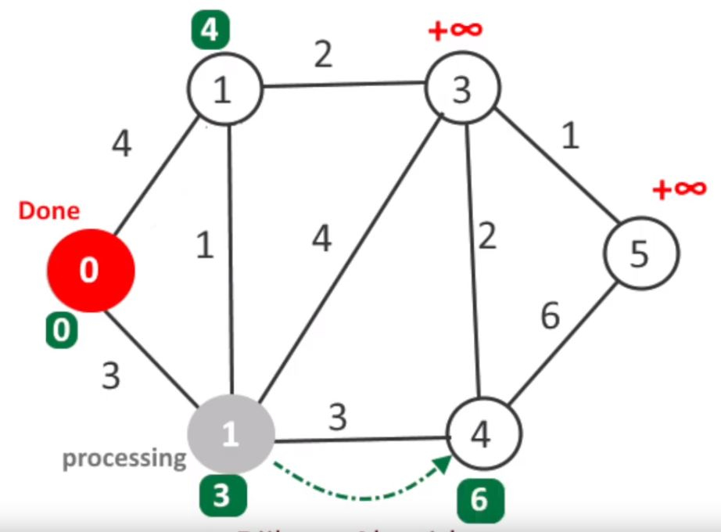
Pseudokod
1 function Dijkstra(Graph, source):
2
3 create vertex set Q
4
5 for each vertex v in Graph:
6 dist[v] ← INFINITY
7 prev[v] ← UNDEFINED
8 add v to Q
10 dist[source] ← 0
11
12 while Q is not empty:
13 u ← vertex in Q with min dist[u]
14
15 remove u from Q
16 // only v that are still in Q
17 for each neighbor v of u:
18 alt ← dist[u] + length(u, v)
19 if alt < dist[v]:
20 dist[v] ← alt
21 prev[v] ← u
22
23 return dist[], prev[]

Slide 15
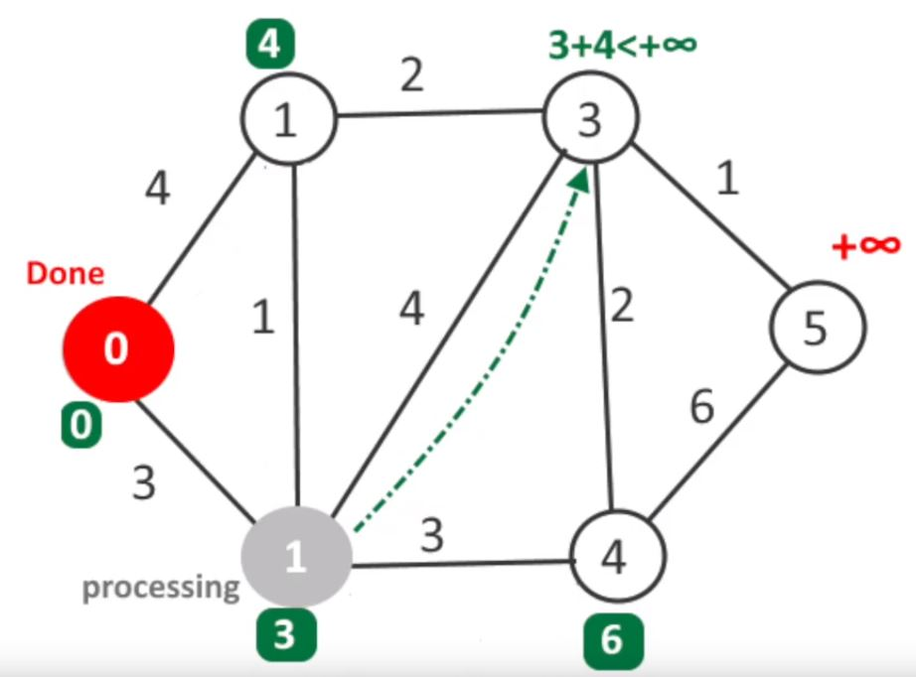
Pseudokod
1 function Dijkstra(Graph, source):
2
3 create vertex set Q
4
5 for each vertex v in Graph:
6 dist[v] ← INFINITY
7 prev[v] ← UNDEFINED
8 add v to Q
10 dist[source] ← 0
11
12 while Q is not empty:
13 u ← vertex in Q with min dist[u]
14
15 remove u from Q
16 // only v that are still in Q
17 for each neighbor v of u:
18 alt ← dist[u] + length(u, v)
19 if alt < dist[v]:
20 dist[v] ← alt
21 prev[v] ← u
22
23 return dist[], prev[]

Slide 16
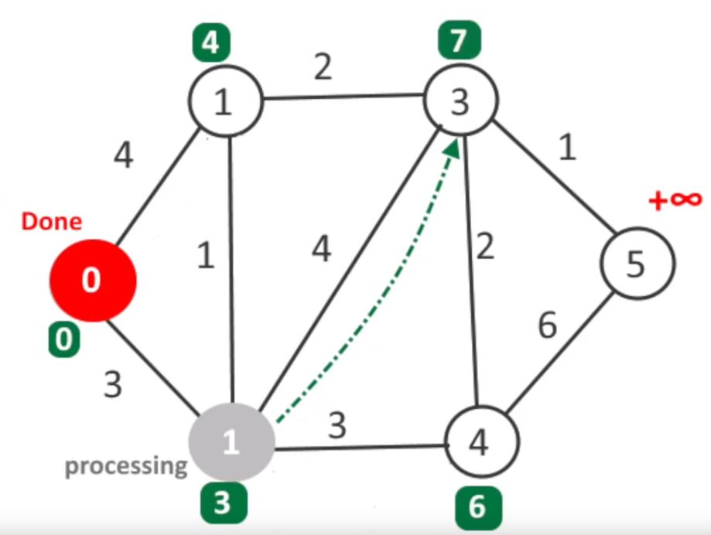
Pseudokod
1 function Dijkstra(Graph, source):
2
3 create vertex set Q
4
5 for each vertex v in Graph:
6 dist[v] ← INFINITY
7 prev[v] ← UNDEFINED
8 add v to Q
10 dist[source] ← 0
11
12 while Q is not empty:
13 u ← vertex in Q with min dist[u]
14
15 remove u from Q
16 // only v that are still in Q
17 for each neighbor v of u:
18 alt ← dist[u] + length(u, v)
19 if alt < dist[v]:
20 dist[v] ← alt
21 prev[v] ← u
22
23 return dist[], prev[]

Slide 17
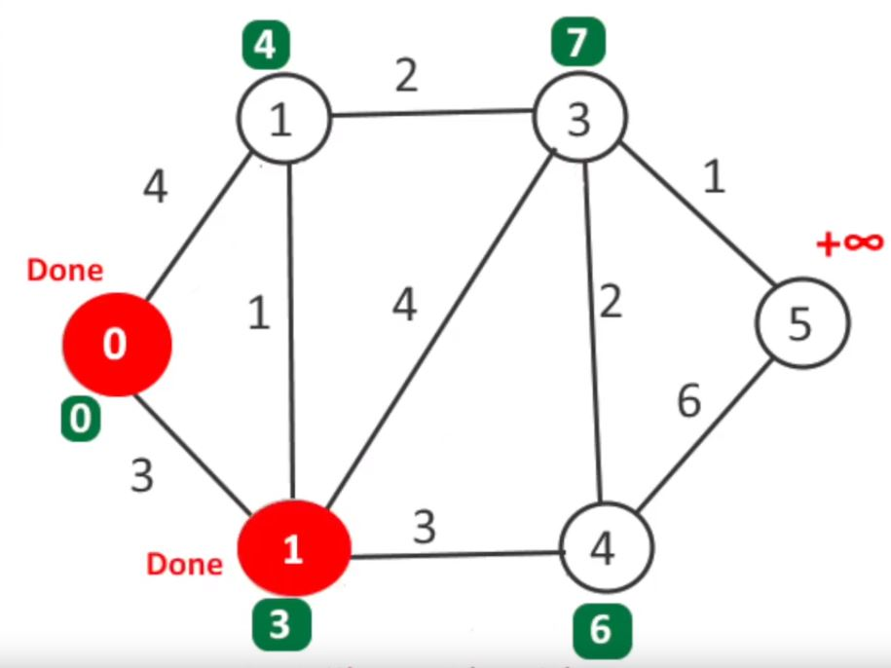
Pseudokod
1 function Dijkstra(Graph, source):
2
3 create vertex set Q
4
5 for each vertex v in Graph:
6 dist[v] ← INFINITY
7 prev[v] ← UNDEFINED
8 add v to Q
10 dist[source] ← 0
11
12 while Q is not empty:
13 u ← vertex in Q with min dist[u]
14
15 remove u from Q
16 // only v that are still in Q
17 for each neighbor v of u:
18 alt ← dist[u] + length(u, v)
19 if alt < dist[v]:
20 dist[v] ← alt
21 prev[v] ← u
22
23 return dist[], prev[]

Slide 18
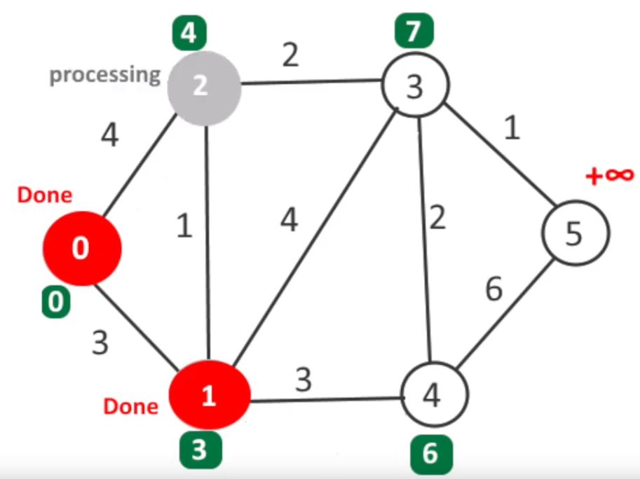
Pseudokod
1 function Dijkstra(Graph, source):
2
3 create vertex set Q
4
5 for each vertex v in Graph:
6 dist[v] ← INFINITY
7 prev[v] ← UNDEFINED
8 add v to Q
10 dist[source] ← 0
11
12 while Q is not empty:
13 u ← vertex in Q with min dist[u]
14
15 remove u from Q
16 // only v that are still in Q
17 for each neighbor v of u:
18 alt ← dist[u] + length(u, v)
19 if alt < dist[v]:
20 dist[v] ← alt
21 prev[v] ← u
22
23 return dist[], prev[]

Slide 19
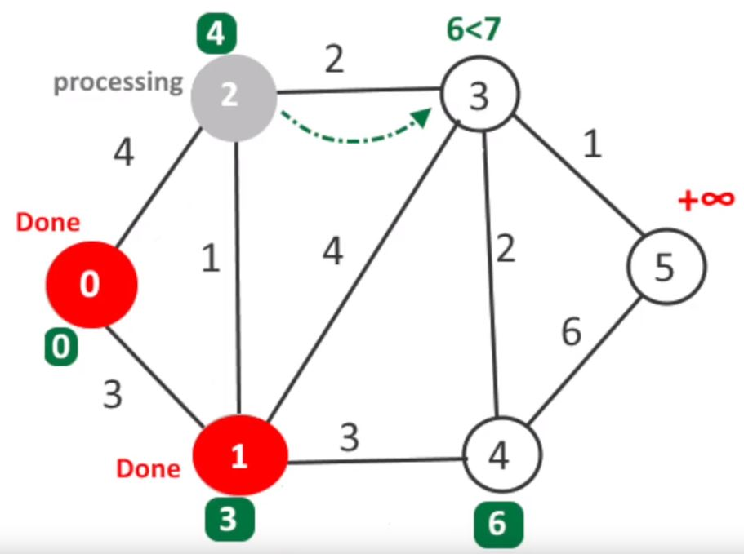
Pseudokod
1 function Dijkstra(Graph, source):
2
3 create vertex set Q
4
5 for each vertex v in Graph:
6 dist[v] ← INFINITY
7 prev[v] ← UNDEFINED
8 add v to Q
10 dist[source] ← 0
11
12 while Q is not empty:
13 u ← vertex in Q with min dist[u]
14
15 remove u from Q
16 // only v that are still in Q
17 for each neighbor v of u:
18 alt ← dist[u] + length(u, v)
19 if alt < dist[v]:
20 dist[v] ← alt
21 prev[v] ← u
22
23 return dist[], prev[]

Slide 20
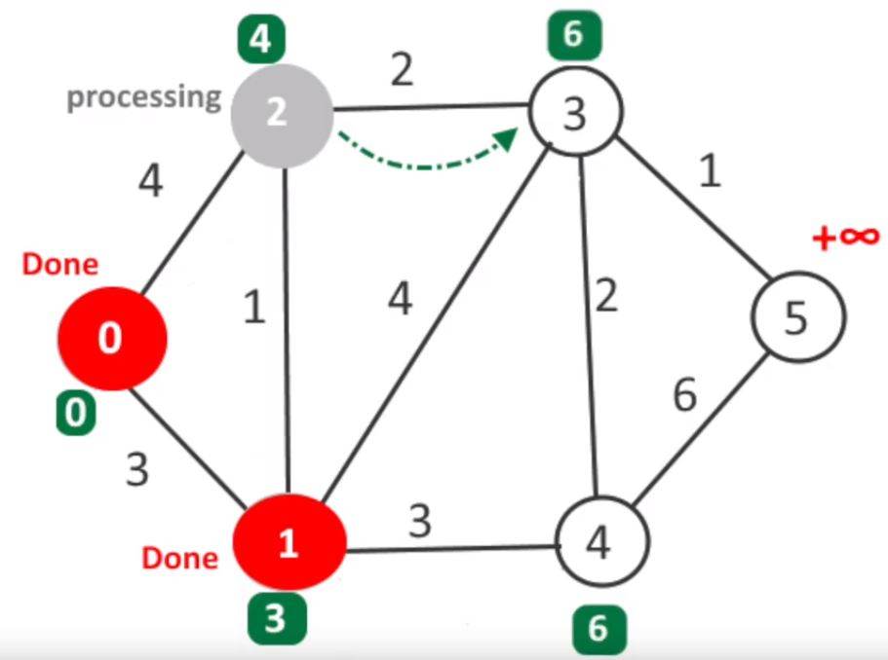
Pseudokod
1 function Dijkstra(Graph, source):
2
3 create vertex set Q
4
5 for each vertex v in Graph:
6 dist[v] ← INFINITY
7 prev[v] ← UNDEFINED
8 add v to Q
10 dist[source] ← 0
11
12 while Q is not empty:
13 u ← vertex in Q with min dist[u]
14
15 remove u from Q
16 // only v that are still in Q
17 for each neighbor v of u:
18 alt ← dist[u] + length(u, v)
19 if alt < dist[v]:
20 dist[v] ← alt
21 prev[v] ← u
22
23 return dist[], prev[]

Slide 21
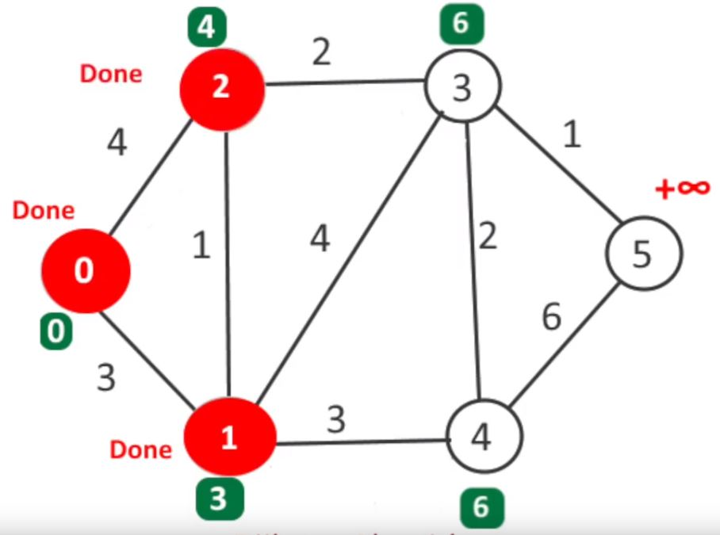
Pseudokod
1 function Dijkstra(Graph, source):
2
3 create vertex set Q
4
5 for each vertex v in Graph:
6 dist[v] ← INFINITY
7 prev[v] ← UNDEFINED
8 add v to Q
10 dist[source] ← 0
11
12 while Q is not empty:
13 u ← vertex in Q with min dist[u]
14
15 remove u from Q
16 // only v that are still in Q
17 for each neighbor v of u:
18 alt ← dist[u] + length(u, v)
19 if alt < dist[v]:
20 dist[v] ← alt
21 prev[v] ← u
22
23 return dist[], prev[]

Slide 22
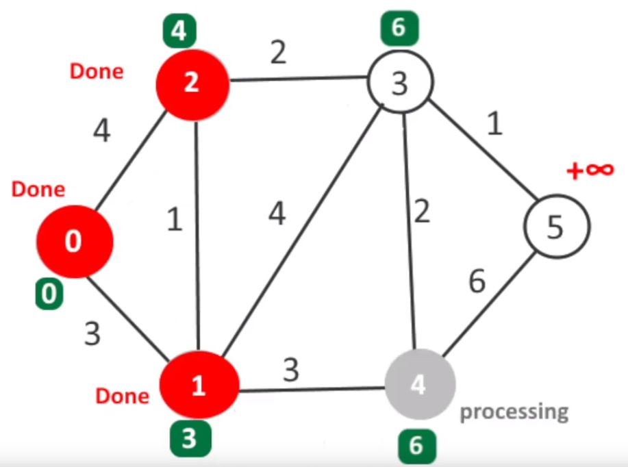
Pseudokod
1 function Dijkstra(Graph, source):
2
3 create vertex set Q
4
5 for each vertex v in Graph:
6 dist[v] ← INFINITY
7 prev[v] ← UNDEFINED
8 add v to Q
10 dist[source] ← 0
11
12 while Q is not empty:
13 u ← vertex in Q with min dist[u]
14
15 remove u from Q
16 // only v that are still in Q
17 for each neighbor v of u:
18 alt ← dist[u] + length(u, v)
19 if alt < dist[v]:
20 dist[v] ← alt
21 prev[v] ← u
22
23 return dist[], prev[]

Slide 23
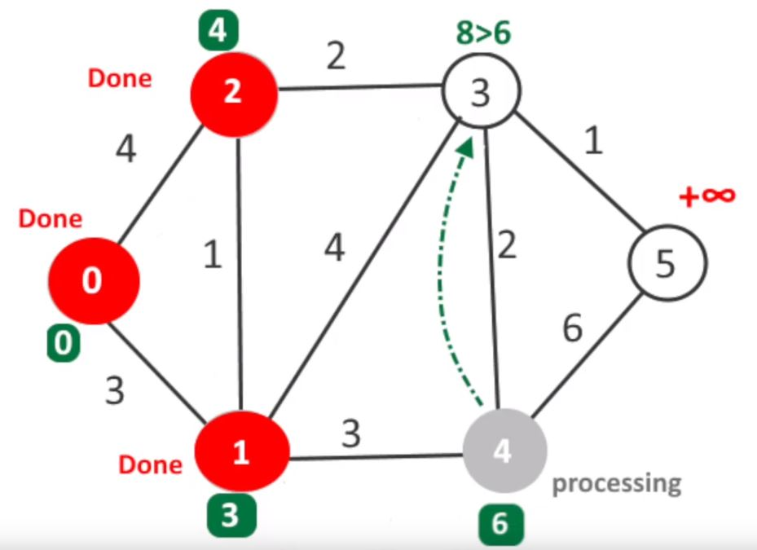
Pseudokod
1 function Dijkstra(Graph, source):
2
3 create vertex set Q
4
5 for each vertex v in Graph:
6 dist[v] ← INFINITY
7 prev[v] ← UNDEFINED
8 add v to Q
10 dist[source] ← 0
11
12 while Q is not empty:
13 u ← vertex in Q with min dist[u]
14
15 remove u from Q
16 // only v that are still in Q
17 for each neighbor v of u:
18 alt ← dist[u] + length(u, v)
19 if alt < dist[v]:
20 dist[v] ← alt
21 prev[v] ← u
22
23 return dist[], prev[]

Slide 24
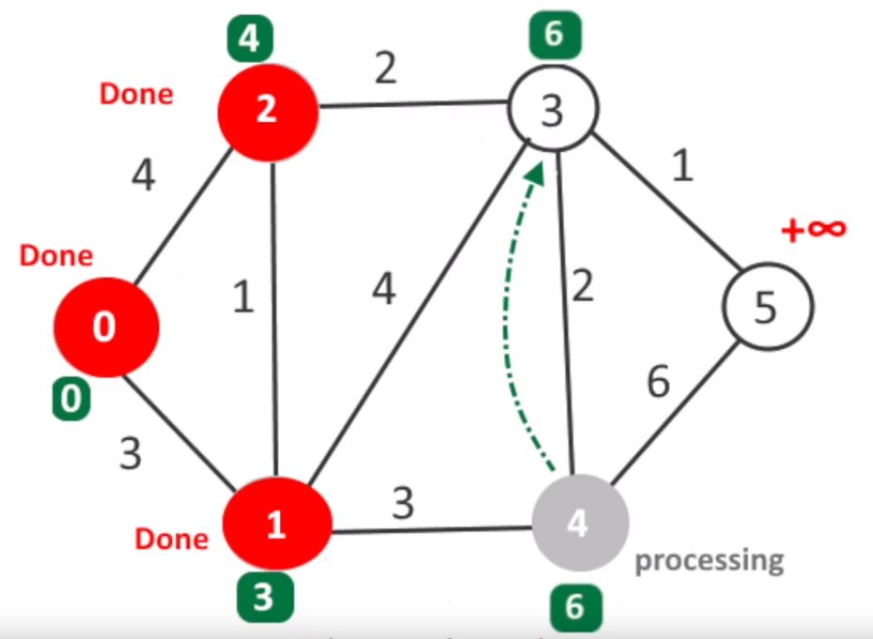
Pseudokod
1 function Dijkstra(Graph, source):
2
3 create vertex set Q
4
5 for each vertex v in Graph:
6 dist[v] ← INFINITY
7 prev[v] ← UNDEFINED
8 add v to Q
10 dist[source] ← 0
11
12 while Q is not empty:
13 u ← vertex in Q with min dist[u]
14
15 remove u from Q
16 // only v that are still in Q
17 for each neighbor v of u:
18 alt ← dist[u] + length(u, v)
19 if alt < dist[v]:
20 dist[v] ← alt
21 prev[v] ← u
22
23 return dist[], prev[]

Slide 25
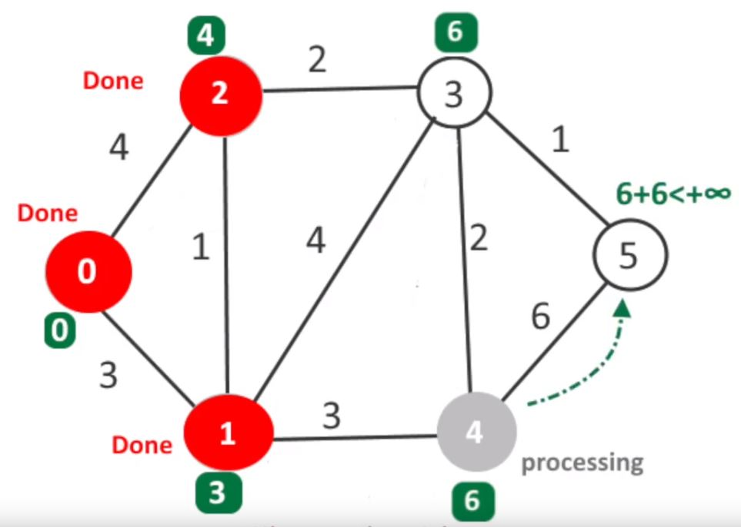
Pseudokod
1 function Dijkstra(Graph, source):
2
3 create vertex set Q
4
5 for each vertex v in Graph:
6 dist[v] ← INFINITY
7 prev[v] ← UNDEFINED
8 add v to Q
10 dist[source] ← 0
11
12 while Q is not empty:
13 u ← vertex in Q with min dist[u]
14
15 remove u from Q
16 // only v that are still in Q
17 for each neighbor v of u:
18 alt ← dist[u] + length(u, v)
19 if alt < dist[v]:
20 dist[v] ← alt
21 prev[v] ← u
22
23 return dist[], prev[]

Slide 26
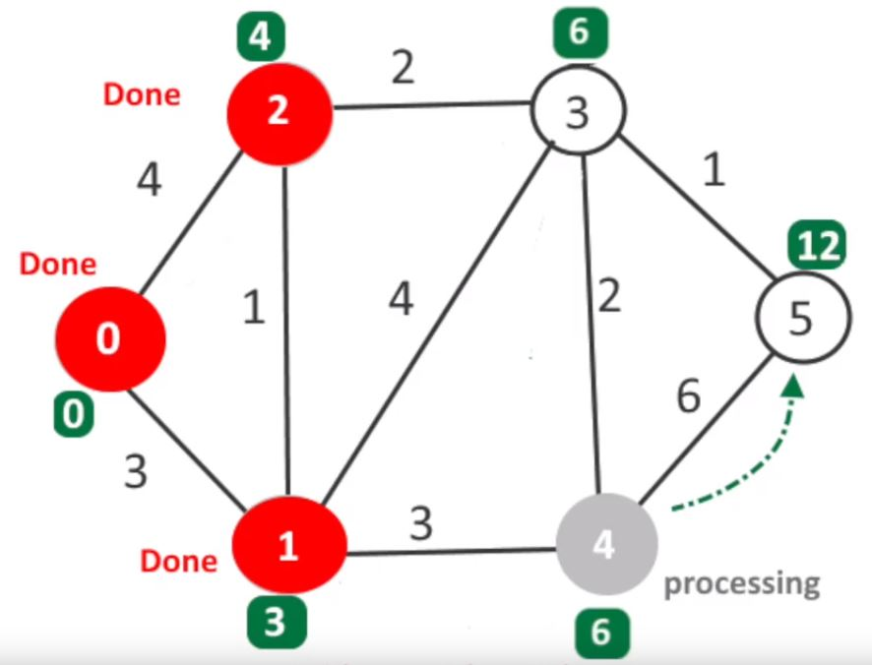
Pseudokod
1 function Dijkstra(Graph, source):
2
3 create vertex set Q
4
5 for each vertex v in Graph:
6 dist[v] ← INFINITY
7 prev[v] ← UNDEFINED
8 add v to Q
10 dist[source] ← 0
11
12 while Q is not empty:
13 u ← vertex in Q with min dist[u]
14
15 remove u from Q
16 // only v that are still in Q
17 for each neighbor v of u:
18 alt ← dist[u] + length(u, v)
19 if alt < dist[v]:
20 dist[v] ← alt
21 prev[v] ← u
22
23 return dist[], prev[]

Slide 27
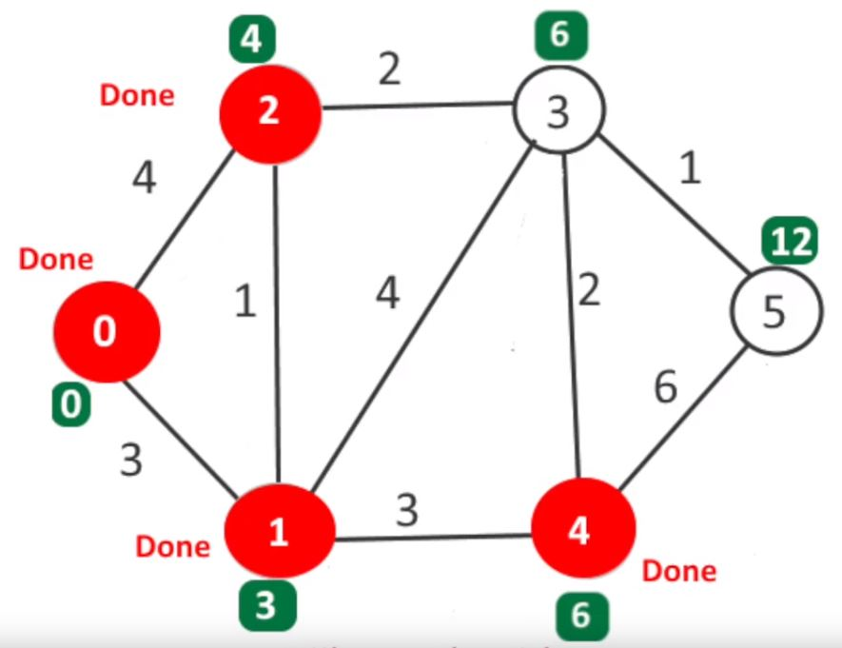
Pseudokod
1 function Dijkstra(Graph, source):
2
3 create vertex set Q
4
5 for each vertex v in Graph:
6 dist[v] ← INFINITY
7 prev[v] ← UNDEFINED
8 add v to Q
10 dist[source] ← 0
11
12 while Q is not empty:
13 u ← vertex in Q with min dist[u]
14
15 remove u from Q
16 // only v that are still in Q
17 for each neighbor v of u:
18 alt ← dist[u] + length(u, v)
19 if alt < dist[v]:
20 dist[v] ← alt
21 prev[v] ← u
22
23 return dist[], prev[]

Slide 28
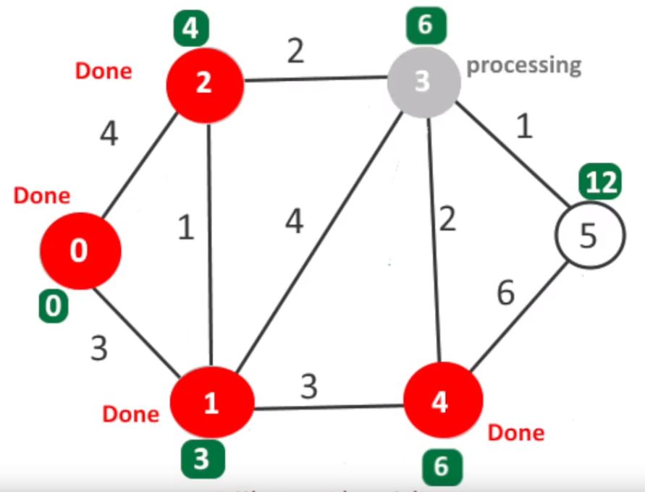
Pseudokod
1 function Dijkstra(Graph, source):
2
3 create vertex set Q
4
5 for each vertex v in Graph:
6 dist[v] ← INFINITY
7 prev[v] ← UNDEFINED
8 add v to Q
10 dist[source] ← 0
11
12 while Q is not empty:
13 u ← vertex in Q with min dist[u]
14
15 remove u from Q
16 // only v that are still in Q
17 for each neighbor v of u:
18 alt ← dist[u] + length(u, v)
19 if alt < dist[v]:
20 dist[v] ← alt
21 prev[v] ← u
22
23 return dist[], prev[]

Slide 29
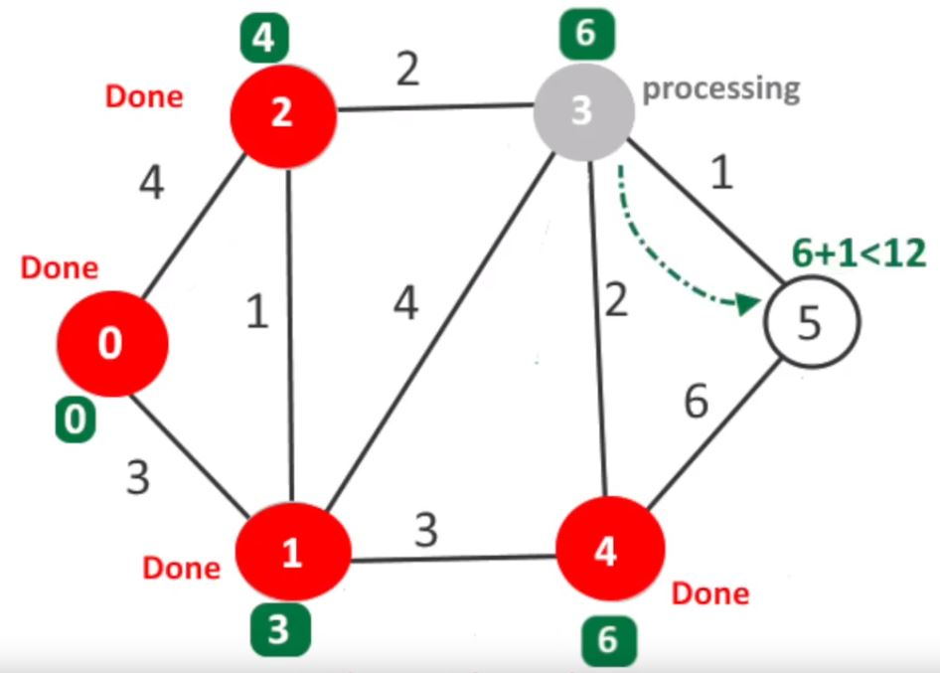
Pseudokod
1 function Dijkstra(Graph, source):
2
3 create vertex set Q
4
5 for each vertex v in Graph:
6 dist[v] ← INFINITY
7 prev[v] ← UNDEFINED
8 add v to Q
10 dist[source] ← 0
11
12 while Q is not empty:
13 u ← vertex in Q with min dist[u]
14
15 remove u from Q
16 // only v that are still in Q
17 for each neighbor v of u:
18 alt ← dist[u] + length(u, v)
19 if alt < dist[v]:
20 dist[v] ← alt
21 prev[v] ← u
22
23 return dist[], prev[]

Slide 30
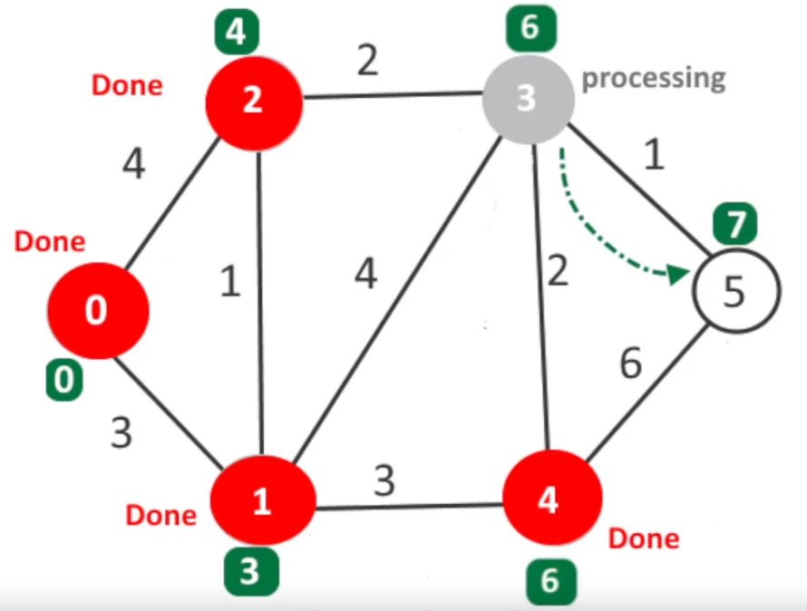
Pseudokod
1 function Dijkstra(Graph, source):
2
3 create vertex set Q
4
5 for each vertex v in Graph:
6 dist[v] ← INFINITY
7 prev[v] ← UNDEFINED
8 add v to Q
10 dist[source] ← 0
11
12 while Q is not empty:
13 u ← vertex in Q with min dist[u]
14
15 remove u from Q
16 // only v that are still in Q
17 for each neighbor v of u:
18 alt ← dist[u] + length(u, v)
19 if alt < dist[v]:
20 dist[v] ← alt
21 prev[v] ← u
22
23 return dist[], prev[]

Slide 31
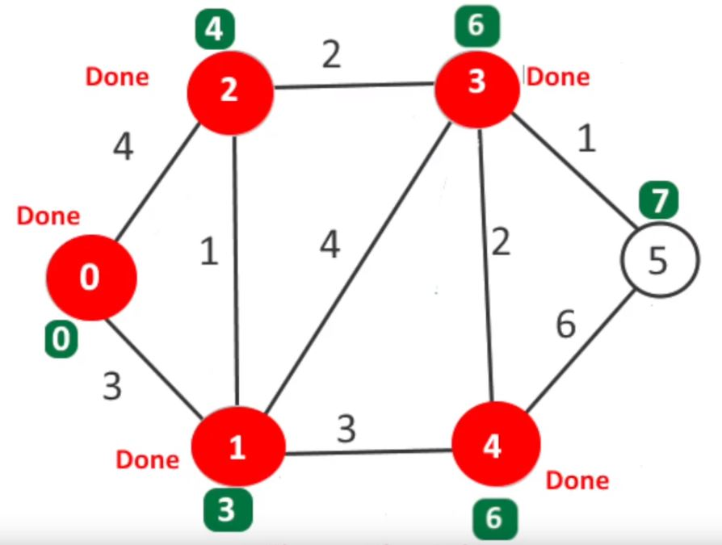
Pseudokod
1 function Dijkstra(Graph, source):
2
3 create vertex set Q
4
5 for each vertex v in Graph:
6 dist[v] ← INFINITY
7 prev[v] ← UNDEFINED
8 add v to Q
10 dist[source] ← 0
11
12 while Q is not empty:
13 u ← vertex in Q with min dist[u]
14
15 remove u from Q
16 // only v that are still in Q
17 for each neighbor v of u:
18 alt ← dist[u] + length(u, v)
19 if alt < dist[v]:
20 dist[v] ← alt
21 prev[v] ← u
22
23 return dist[], prev[]

Slide 32
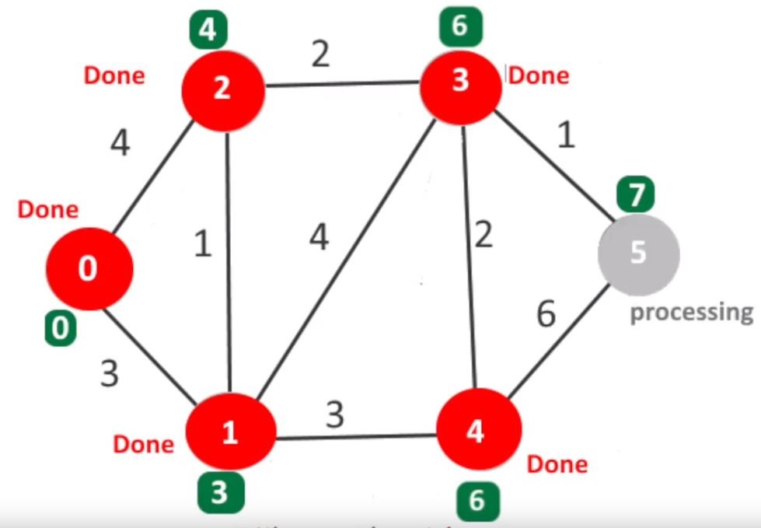
Pseudokod
1 function Dijkstra(Graph, source):
2
3 create vertex set Q
4
5 for each vertex v in Graph:
6 dist[v] ← INFINITY
7 prev[v] ← UNDEFINED
8 add v to Q
10 dist[source] ← 0
11
12 while Q is not empty:
13 u ← vertex in Q with min dist[u]
14
15 remove u from Q
16 // only v that are still in Q
17 for each neighbor v of u:
18 alt ← dist[u] + length(u, v)
19 if alt < dist[v]:
20 dist[v] ← alt
21 prev[v] ← u
22
23 return dist[], prev[]

Slide 33
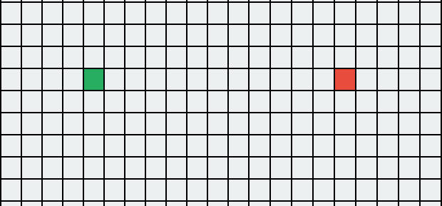
Algorytm w praktyce

Slide 34
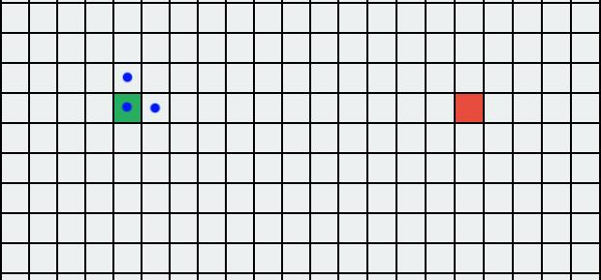
Algorytm w praktyce
Notes:
Kwadrat to wierzchołek grafu

Slide 35
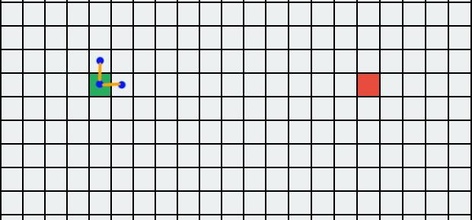
Algorytm w praktyce

Slide 36
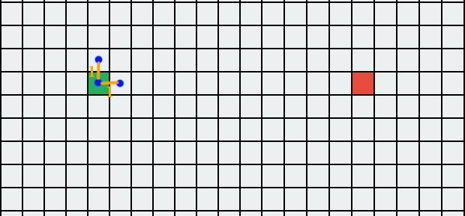
Algorytm w praktyce

Slide 37
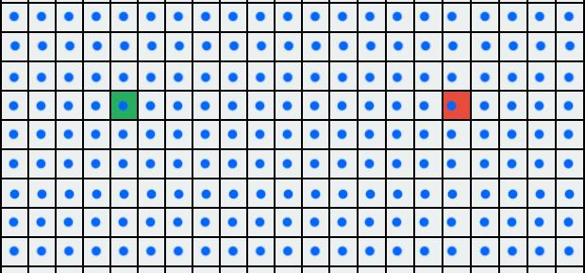
Algorytm w praktyce

Slide 38
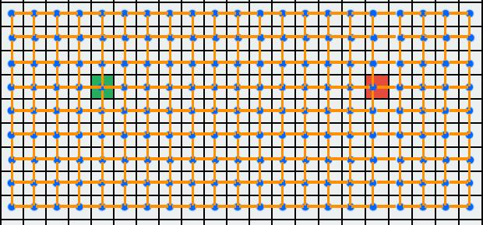
Algorytm w praktyce

Slide 39
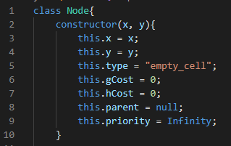
Kod: class Node

Slide 40
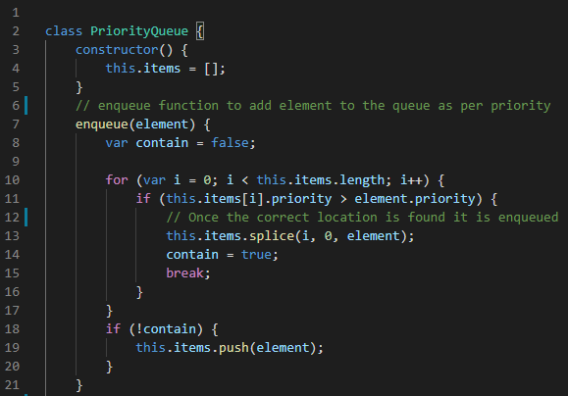
Kod: class PriorityQueue

Slide 41
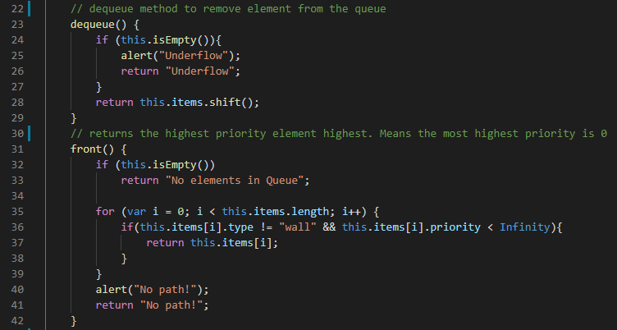
Kod: class PriorityQueue
Notes:
Shift zwraca pierwszy element kolejki i usuwa go

Slide 42
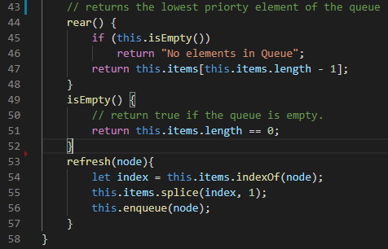
Kod: class PriorityQueue

Slide 43
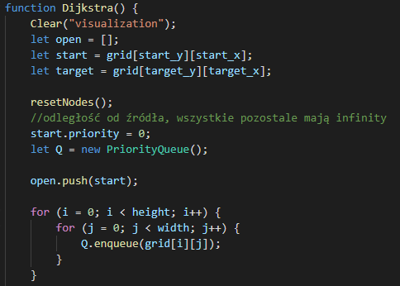
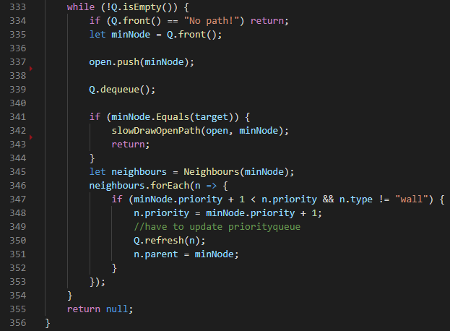
Implementacja algorytmu

Slide 44
A* pathfinding algorithm
Basic naming:
node - single cell in grid
starting node - where we start looking for path
target/end node - where we want to “go”
G cost - distance from node to starting node
H cost - distance from node to target node
F cost - sum of G and H cost

Slide 45
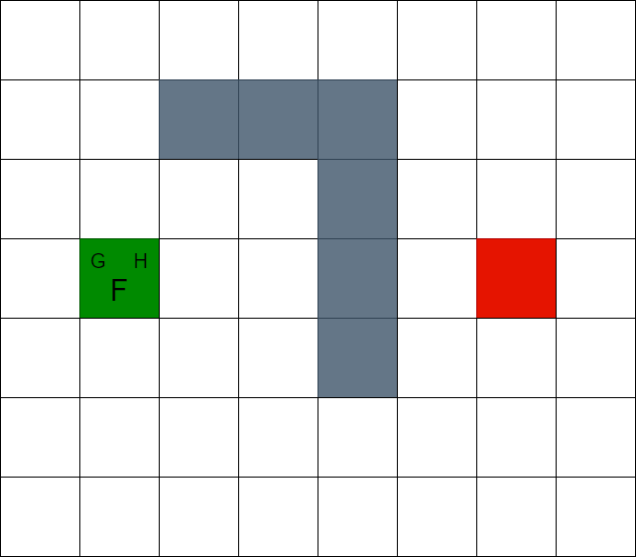

Slide 46
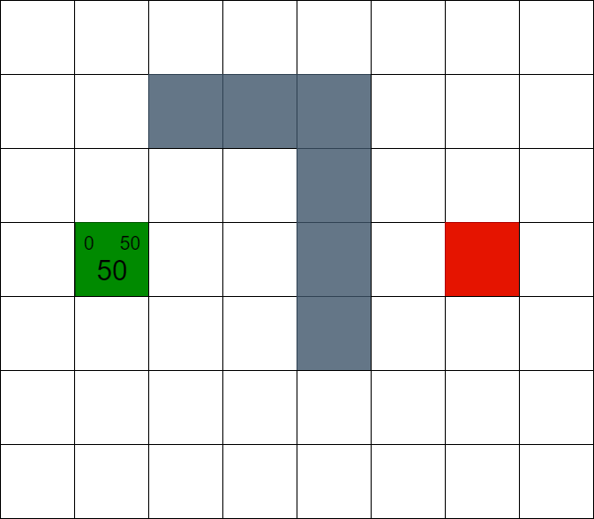

Slide 47
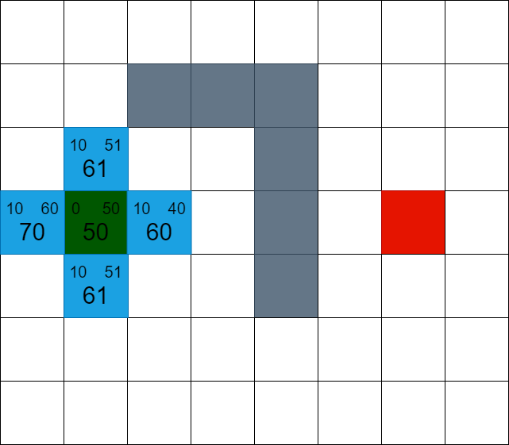

Slide 48
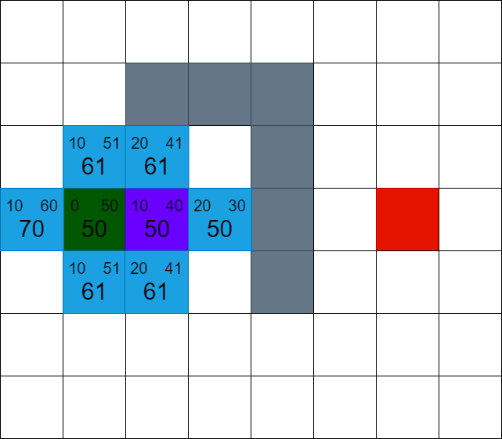

Slide 49
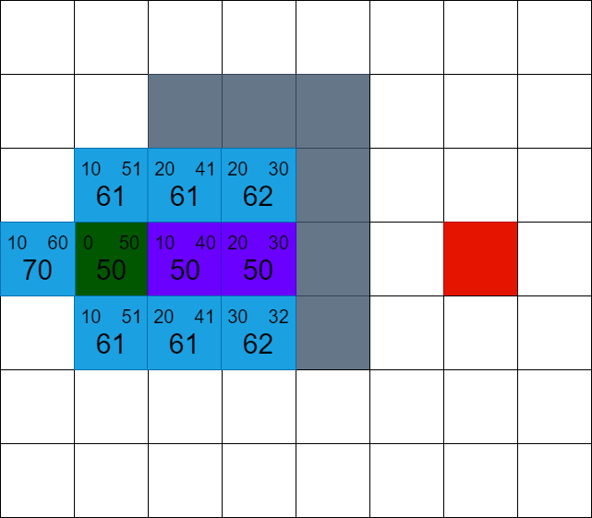

Slide 50
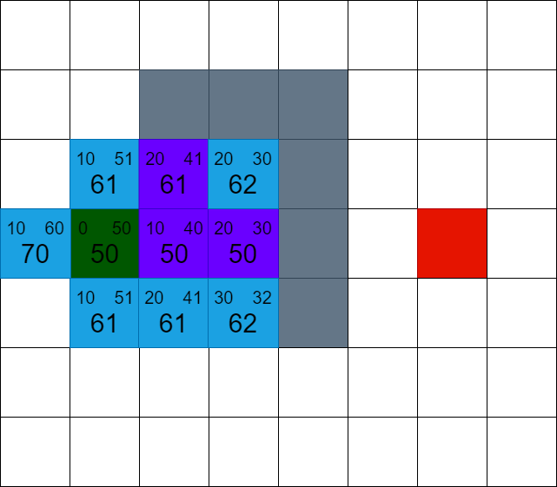

Slide 51
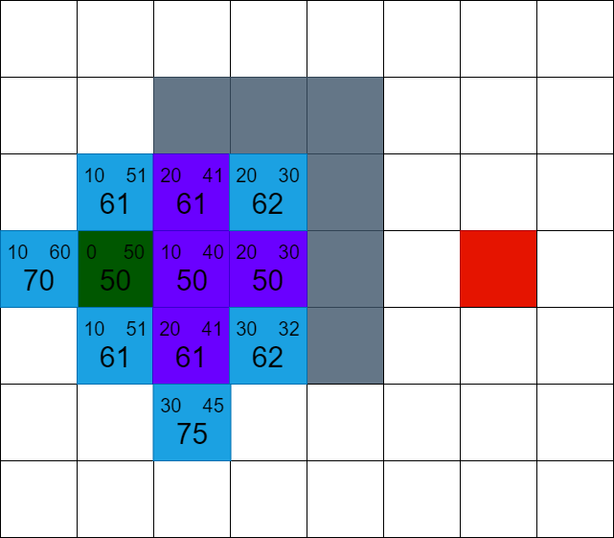

Slide 52
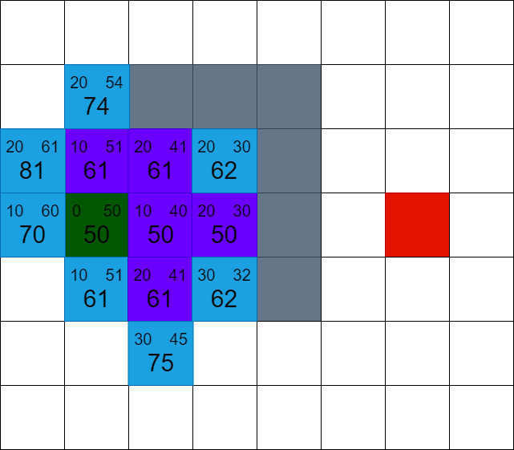

Slide 53


Slide 54


Slide 55


Slide 56


Slide 57


Slide 58


Slide 59


Slide 60


Slide 61


Slide 62


Slide 63


Slide 64


Slide 65


Slide 66


Slide 67


Slide 68


Slide 69


Slide 70

Pseudo code

Slide 71

Node class implemented in C#

Slide 72

Distance function

Slide 73

Looking for lowest f cost node

Slide 74

A* algorithm

Slide 75
Modification
The slowest part of A* algorithm is looking for node with lowest f cost.
It takes a lot of time, because we need to loop through whole “open” set.
Solution to this problem is using “Heap” instead of array / list / set.
Heap is normal array, but build as a binary tree with lowest f cost on top.

Slide 76

Heap optimization

Slide 77
Dziękujemy za uwagę.

