Slide 1

UNIVERSITÀ DEGLI STUDI DI PADOVA Advanced Statistics for Physical Analysis’ project
A bayesian inference of the parameters
of the Lokta-Volterra model

Slide 2

Mathematical premise: dynamic of the system
Lokta-Volterra equations:
Where:
Alpha: Grow rate of prey population
Beta: Rate of shrinkage relative to the product of the populations
Gamma: Shrinkage rate of the predator population
Delta: Grow rate relative to the product of the populations

Slide 3


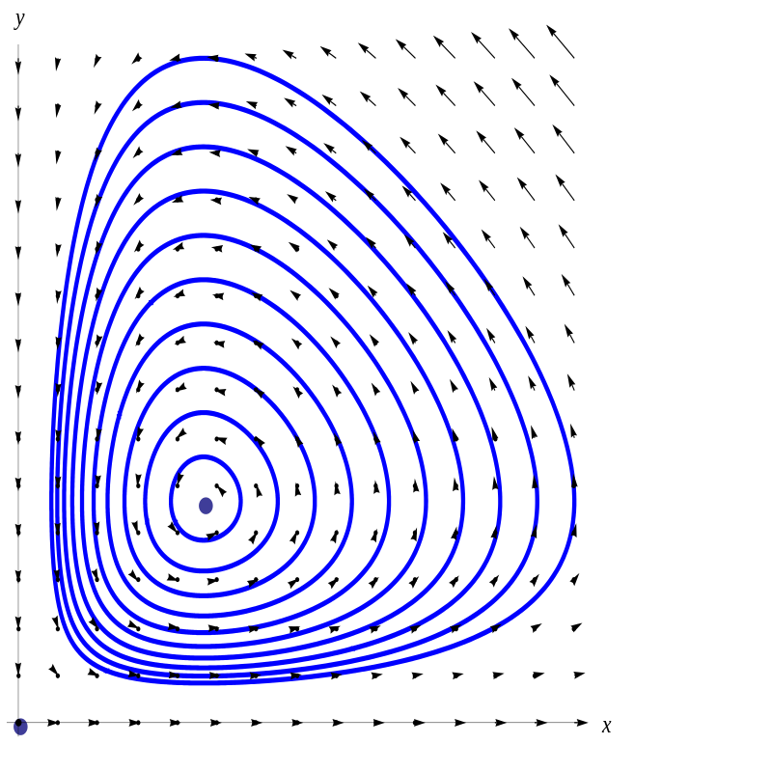


Mathematical premise: dynamic of the system
Condition of stationary:
Stationary solutions:

Slide 4
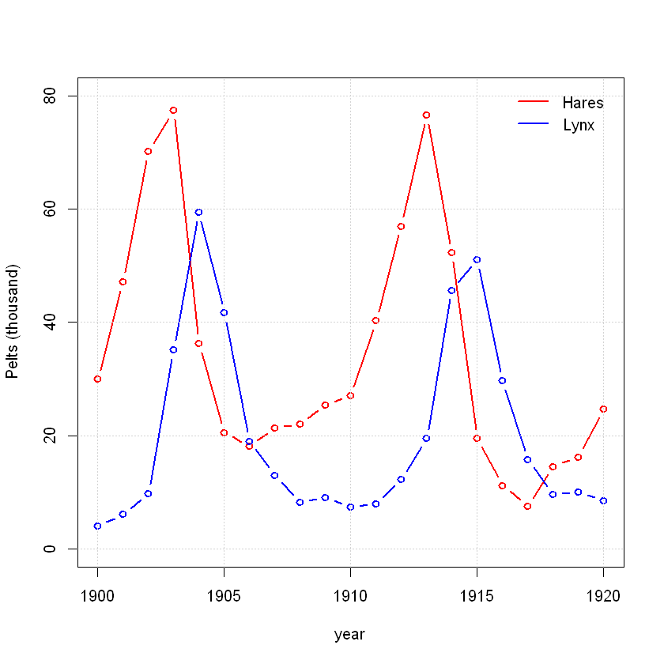
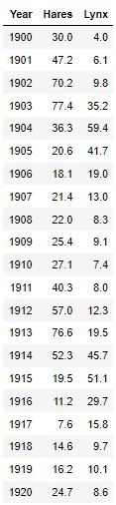
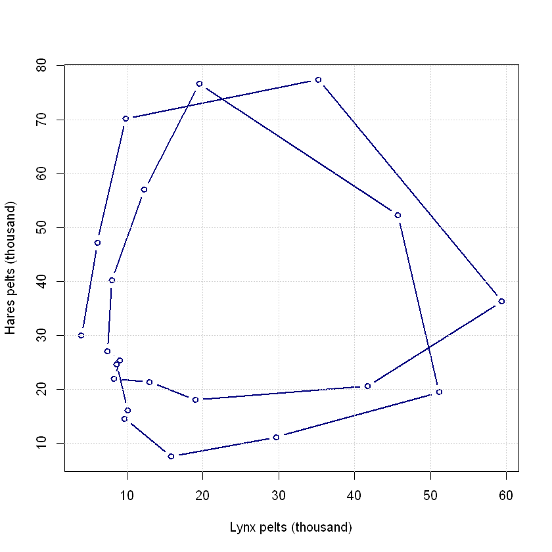
Data

Slide 5
Statistical Model
where
In our case we have:
Observed data of prey and predator at times
True uknown population sizes at time
Solutions of the Lokta-Volterra ODEs at times given the initial condition and the parameters
where

Slide 6
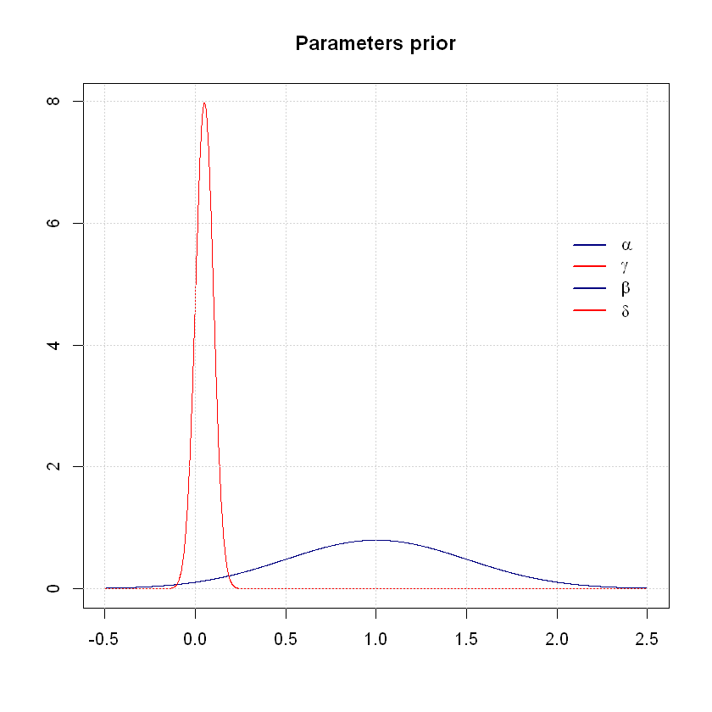
Statistical Model: Weakly Informative Priors

Slide 7
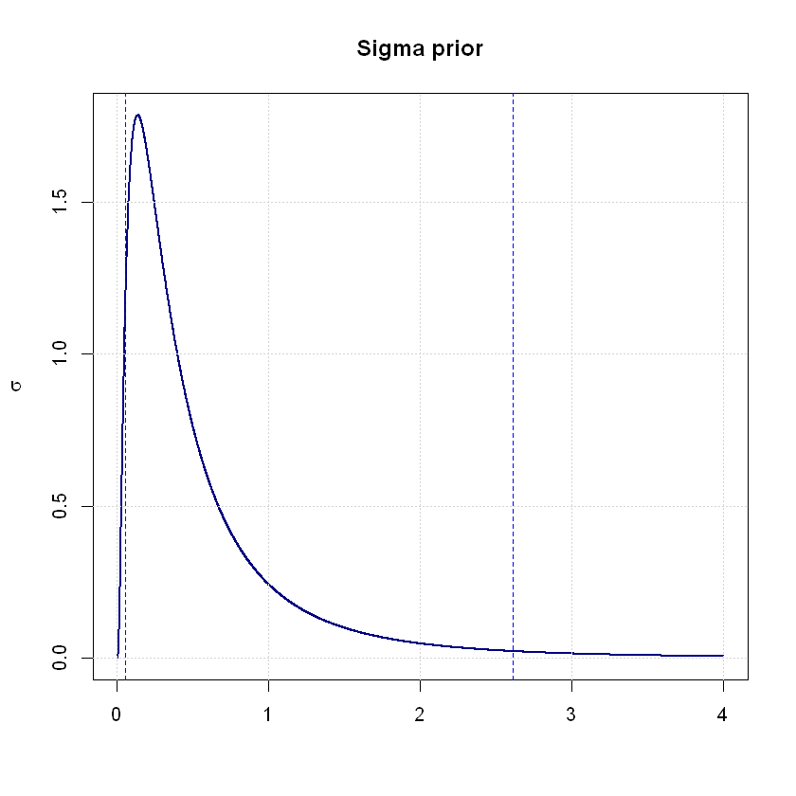
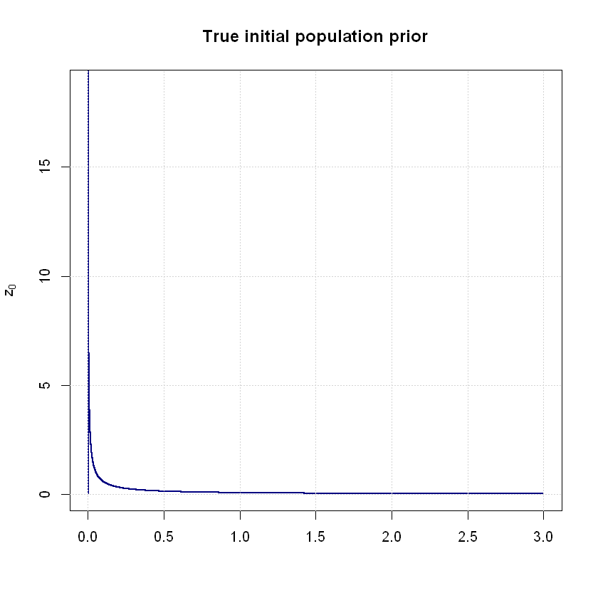
Statistical Model: Weakly Informative Priors

Slide 8
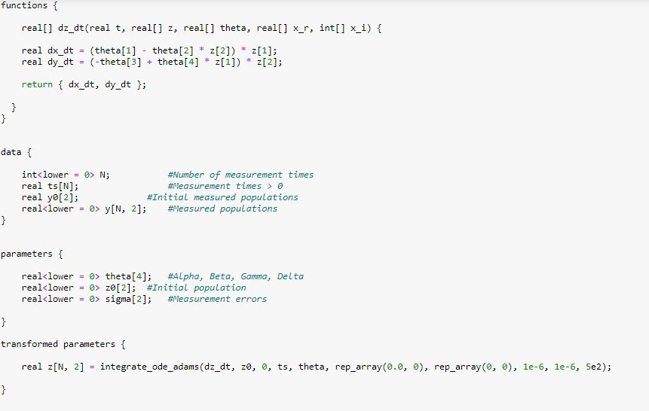
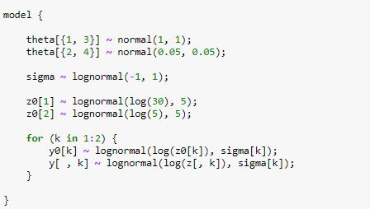
Statistical Model: STAN code

Slide 9
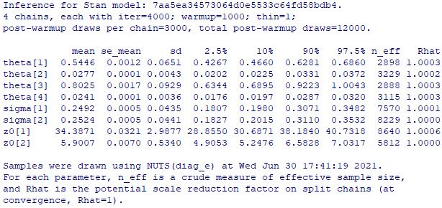
Inference

Slide 10
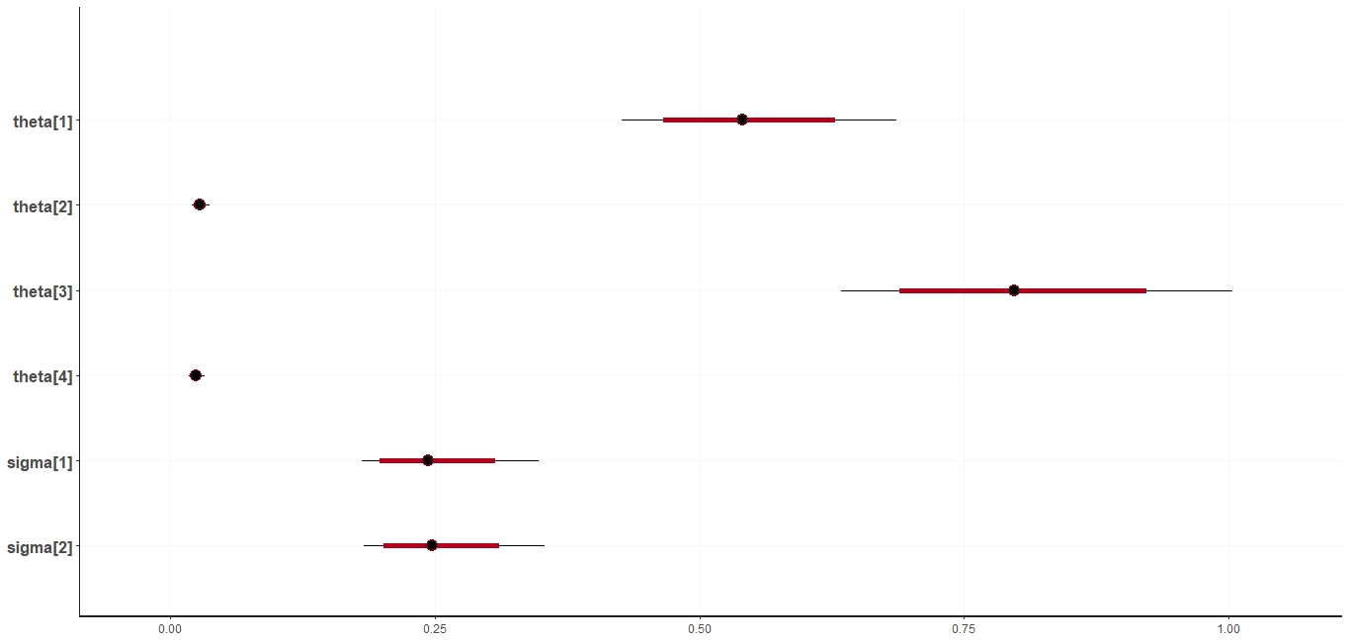
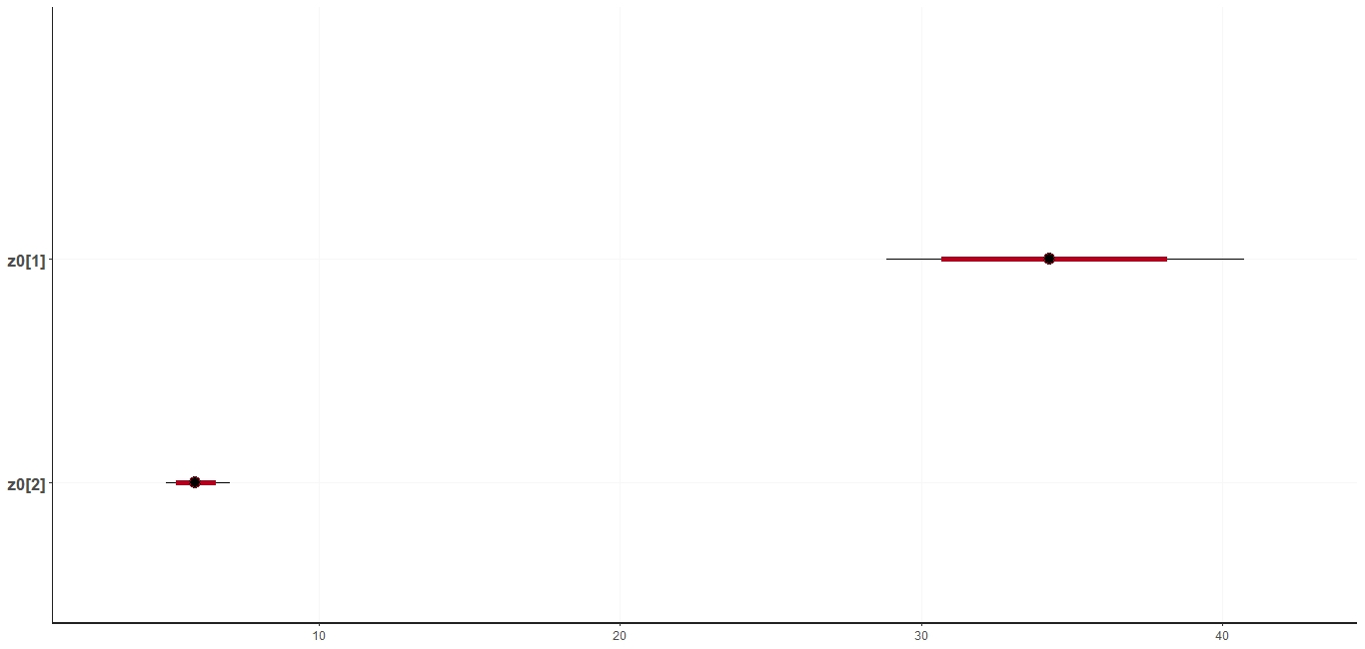

Slide 11
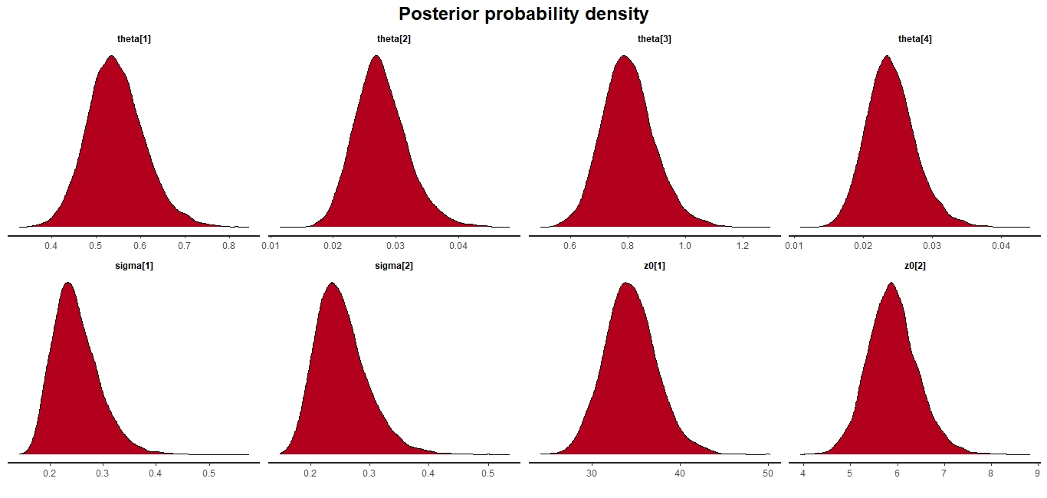
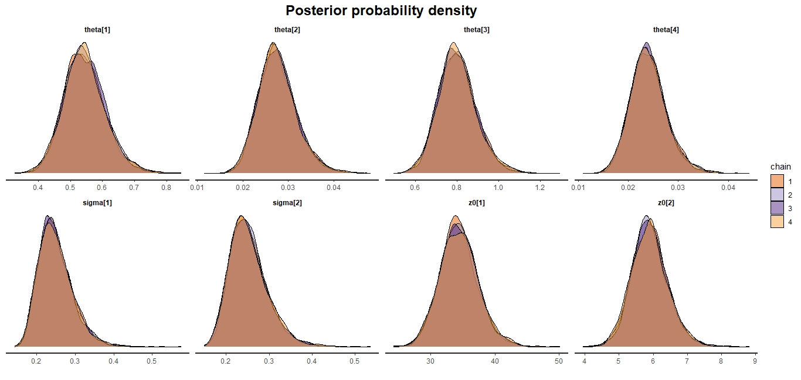

Slide 12
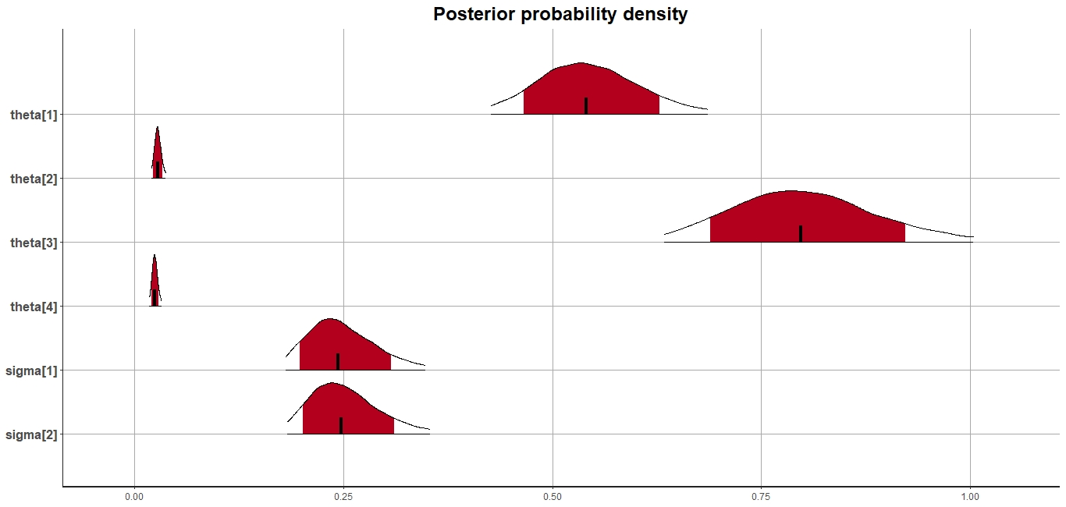
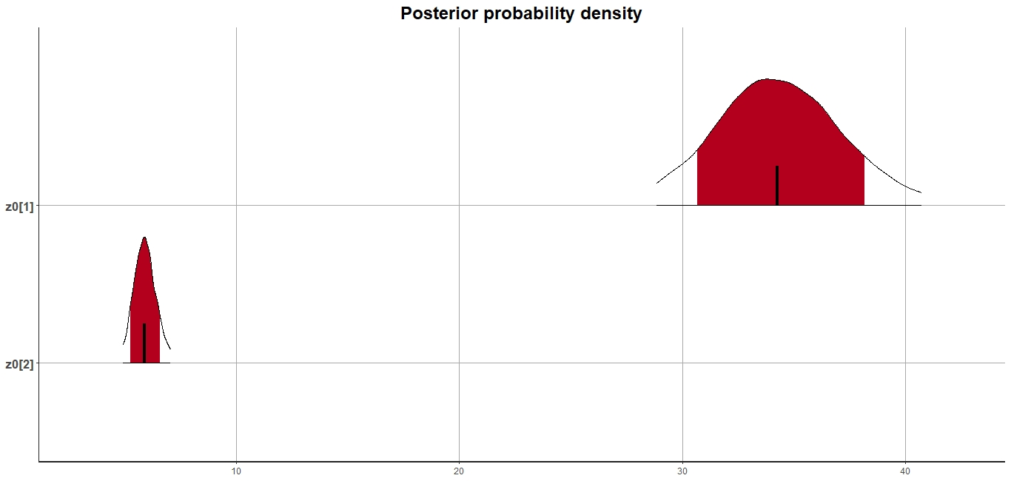

Slide 13
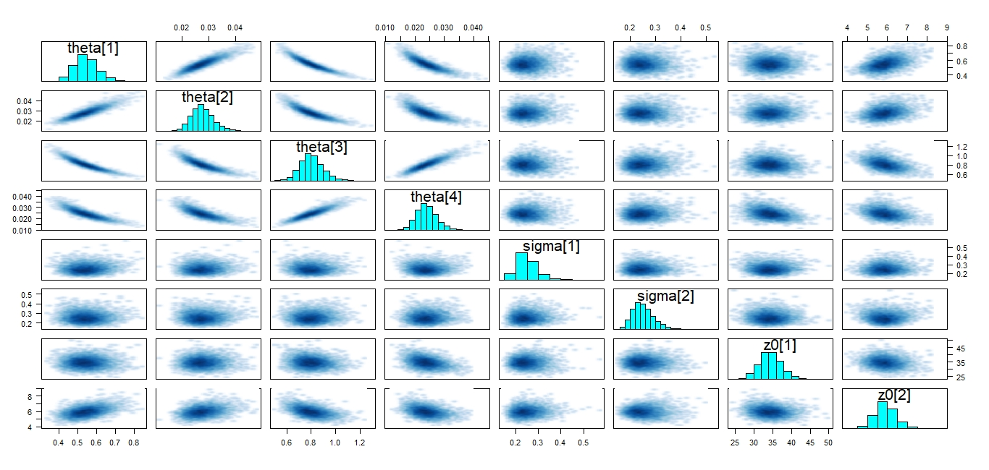

Slide 14
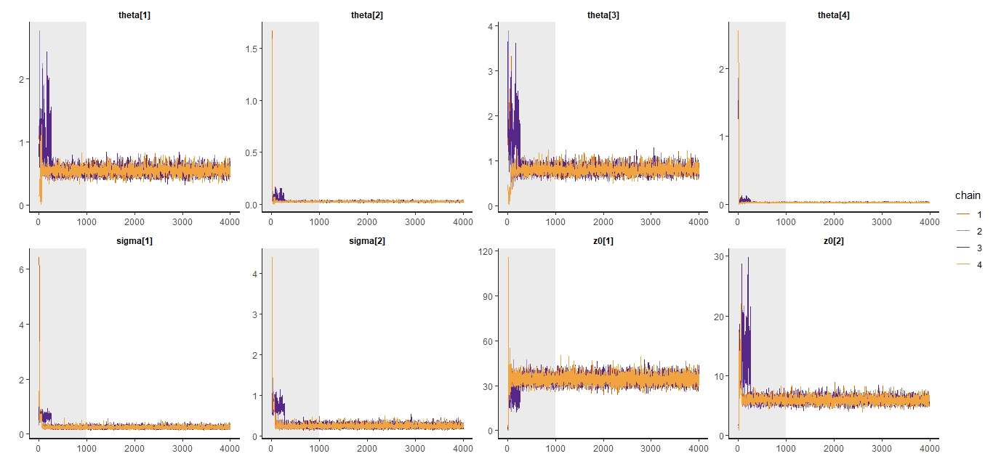
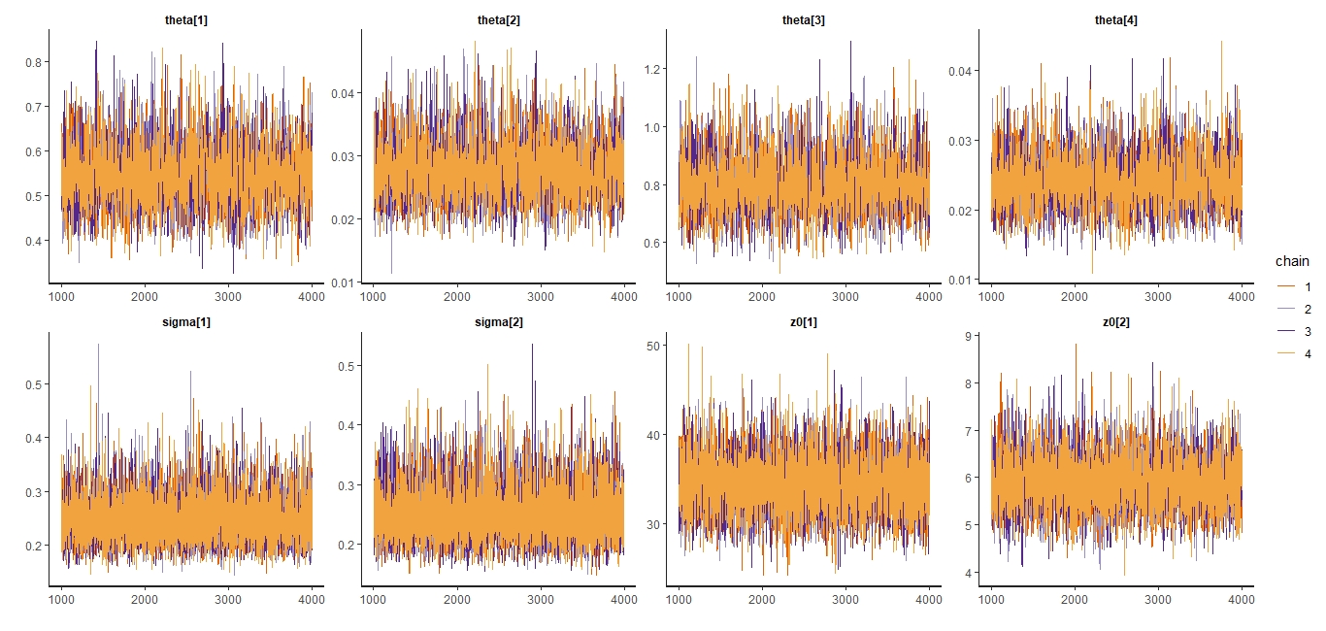

Slide 15
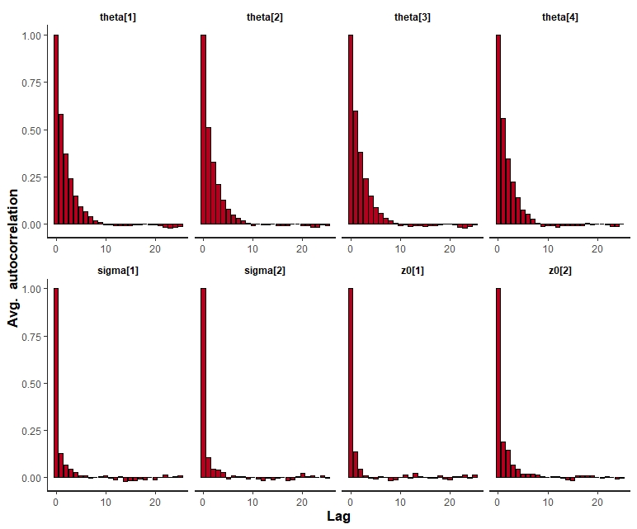

Slide 16
