Slide 1

A new Italian restaurant in London by Filippo M.
image by Free-Photos from Pixabay.com

Slide 2

Aim of the project:
Use the Foursquare location data to predict
the best area of London to open
a new Italian restaurant
image by Free-Photos from Pixabay.com

Slide 3
List of contents:
Introduction to the problem
Data and assumptions
Methodology
Results
Conclusion

Slide 4
1. Introduction to the problem
The popularity of Italian restaurants in London might be an obstacle for entrepreneurs that are interested in opening such type of business.
They are the target audience for this project, since data can help them understanding which area of the city is best suited to welcome a new Italian restaurant, as it can help identifying where the competition is weaker

Slide 5
2. Data and assumptions
The two main sources of data are:
i. [1] Wikipedia. List of London Boroughs. https://en.wikipedia.org/wiki/List_of_London_boroughs.
which contains all the geographical coordinates of the Boroughs of London
ii. Foursquare location data, explore endpoint
which returns a list of popular locations for a given set of latitude and longitude coordinates.

Slide 6
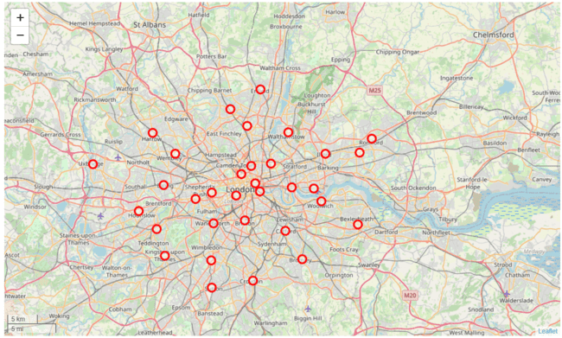
All the Boroughs of London

Slide 7
Some important assumptions and preliminary information include:
i. The presence of Inner London Boroughs and Outer London Borough is mentioned for two reasons. The first is that it helps us displaying the data more clearly, by dividing it in two groups. The second is that the outer areas of the city are larger and with a lower population density, so a larger radius of investigation was used in Foursquare search.
ii. Pizza places have been included into the group of Italian Restaurants. Pizzerias are part of the Italian cuisine tradition, and therefore to the eye of a customer they represent an alternative to an Italian restaurant within the context of Italian cuisine.

Slide 8
3. Methodology
The parameters that are used to assess the feasibility of a new Italian restaurant rely on the idea that it is not easy to start a new business where there is a strong competition. Therefore, a low number of competitors among the 100 most popular venues is to be considered a positive aspect.

Slide 9
The first parameter “Restaurant Frequency” is inclusive of all types of restaurants / competitors:
The second parameter “Italian Restaurant Frequency” is specific for Italian restaurants:

Slide 10
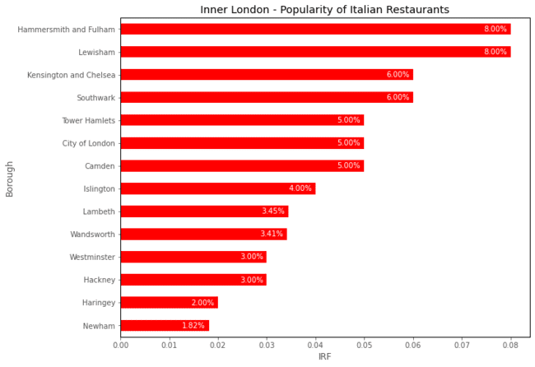
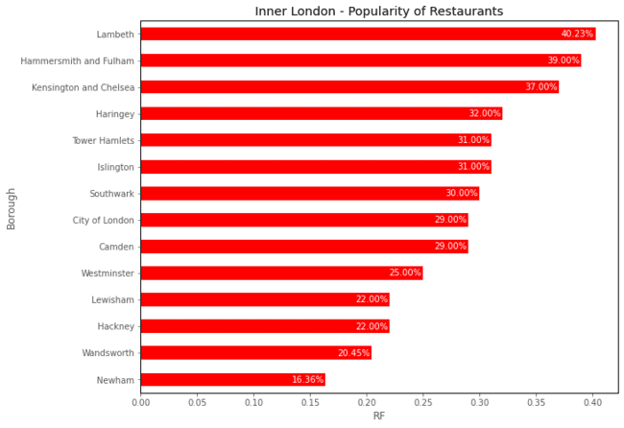
4. Results - Inner London

Slide 11
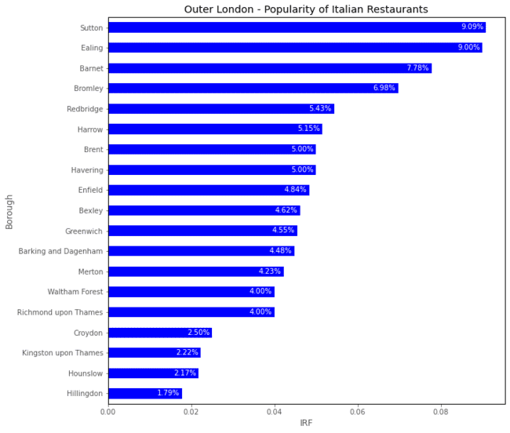
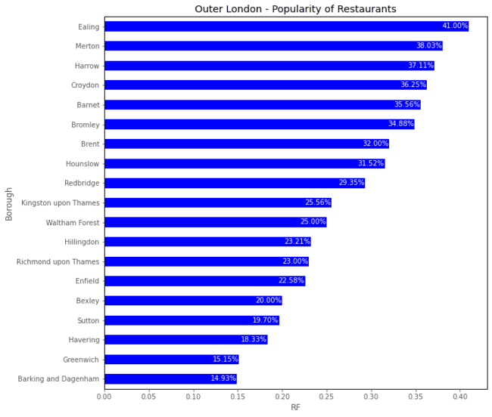
4. Results - Outer London

Slide 12
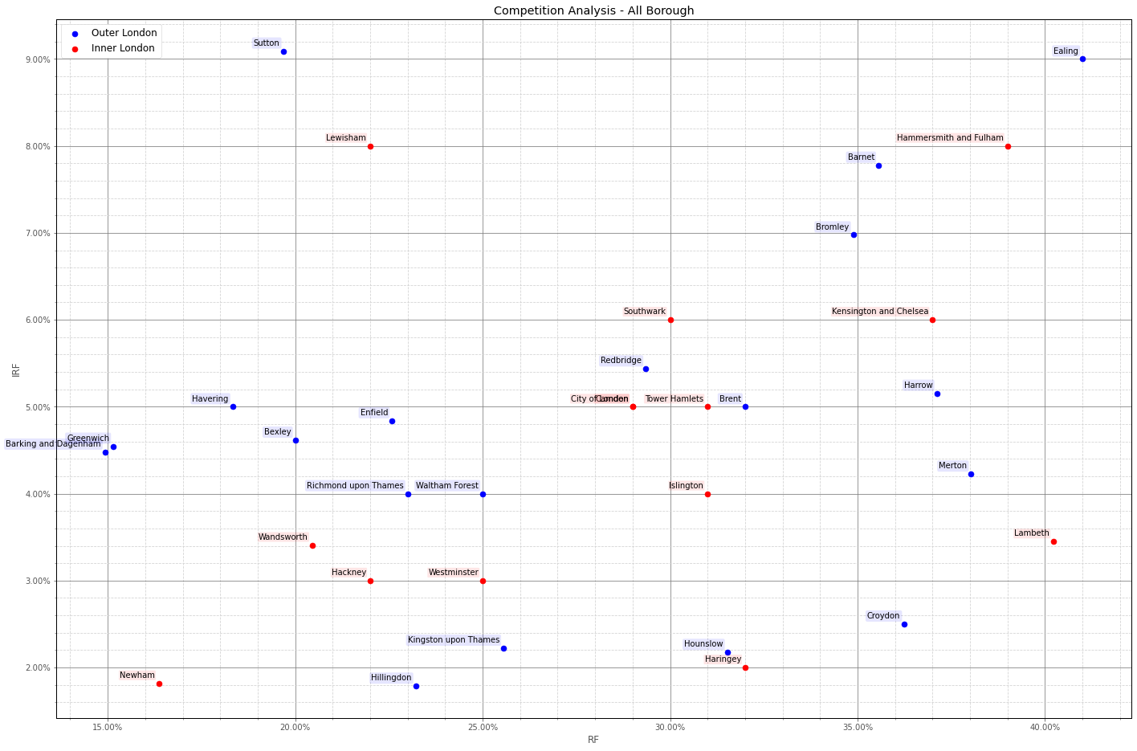
4. Results - Overall Analysis

Slide 13
5. Conclusion
Newham is the best possible Borough to open a new Italian restaurant in London, being the most competitive combination of RF and IRF.
Other notable areas:
Greenwich, and Barking and Dagenham, where the presence of restaurants among the most popular locations is the lowest overall
Hillingdon where the availability of popular Italian restaurant is the lowest

Slide 14
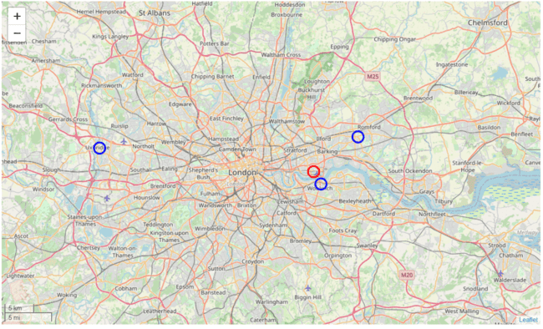
Hillingdon
Barking and Dagenham
Newham
Greenwich

Slide 15
Thank you for your attention

