Slide 1
DATA MANAGEMENT PROJECT — 2026 SEASON
Formula 1 2026
A Multi-Source Data Management Pipeline
Acquisition · Storage · Cleaning · Integration · Quality Assessment · Analysis
Filippo Avon — Matricola 886229
Università degli Studi di Milano-Bicocca | Data Management | September 2026

Slide 2
Presentation
A short abstract of the domain and of the project.
THE DOMAIN
THE PROJECT
Formula 1 in Brief
This Project in One Paragraph
The top tier of open-wheel motorsport: 10 teams, roughly 20 drivers, about 24 Grands Prix per season worldwide
Every session (practice, qualifying, race) generates dense timing, telemetry and strategy data — lap times, pit stops, tyre choices, car sensor readings sampled several times per second
A rich, real-world domain for data management: high volume, multiple independent official and community data sources, and meaningful relationships between drivers, teams, races and circuits
A complete data management pipeline built around the 2026 F1 season, combining a relational dataset (historical results) and a semi-structured dataset (session telemetry) from two independent public sources
Covers the full lifecycle: acquisition, storage (MySQL + MongoDB), cleaning, integration & enrichment, data quality assessment, and analysis through four research questions
Designed to demonstrate not just “getting an answer”, but doing so with measured, documented data quality at every step
F1 2026 — Data Management Project
2

Slide 3
Project at a Glance
A complete, reproducible pipeline combining a relational and a semi-structured data source for the 2026 F1 season.
2
47,771
2
100%
4
data sources
raw files acquired
DBMS (MySQL + MongoDB)
driver & race match rate
research questions answered
Research Questions
1
RQ1 — Fastest pit stop of the 2026 season?
2
RQ2 — Highest peak speed recorded in 2026?
3
RQ3 — Best race pace on MEDIUM tyres at Barcelona?
4
RQ4 — Best qualifying-to-race “comeback”?
F1 2026 — Data Management Project
3

Slide 4
The Pipeline: Six Stages
1
2
3
4
5
6
Acquisition
→
Storage
→
Cleaning
→
Integration &
Enrichment
→
Data Quality
Assessment
→
Analysis
(4 queries)
Every stage is implemented as an independent Python script, orchestrated from a Jupyter notebook, with both databases running as reproducible Docker containers.
Design principle: two DBMS chosen to match the shape of each source — a relational store for Kaggle’s tabular, foreign-key-linked data, and a document store for TracingInsights’ heterogeneous, session-dependent JSON.
F1 2026 — Data Management Project
4

Slide 5
Two Independent Data Sources
RELATIONAL
SEMI-STRUCTURED
Kaggle
TracingInsights
jtrotman/formula-1-race-data
github.com/TracingInsights/2026
Ergast-style CSV files: races, results, qualifying, lap_times, pit_stops, standings, drivers, constructors, circuits
Full history: 1950 – 2026
Downloaded via the official kagglehub Python library
Filtered to the 2026 season during Data Cleaning
Per-session JSON derived from FastF1: telemetry (~3.7 Hz), lap times, tyre compound, weather, race control, circuit corners
47,771 files across the 2026 season
Retrieved via the GitHub REST API (Trees API + Contents API fallback)
Parallel download, then consolidated during Data Cleaning
→ stored in MySQL 8.0
→ stored in MongoDB 7.0
F1 2026 — Data Management Project
5

Slide 6
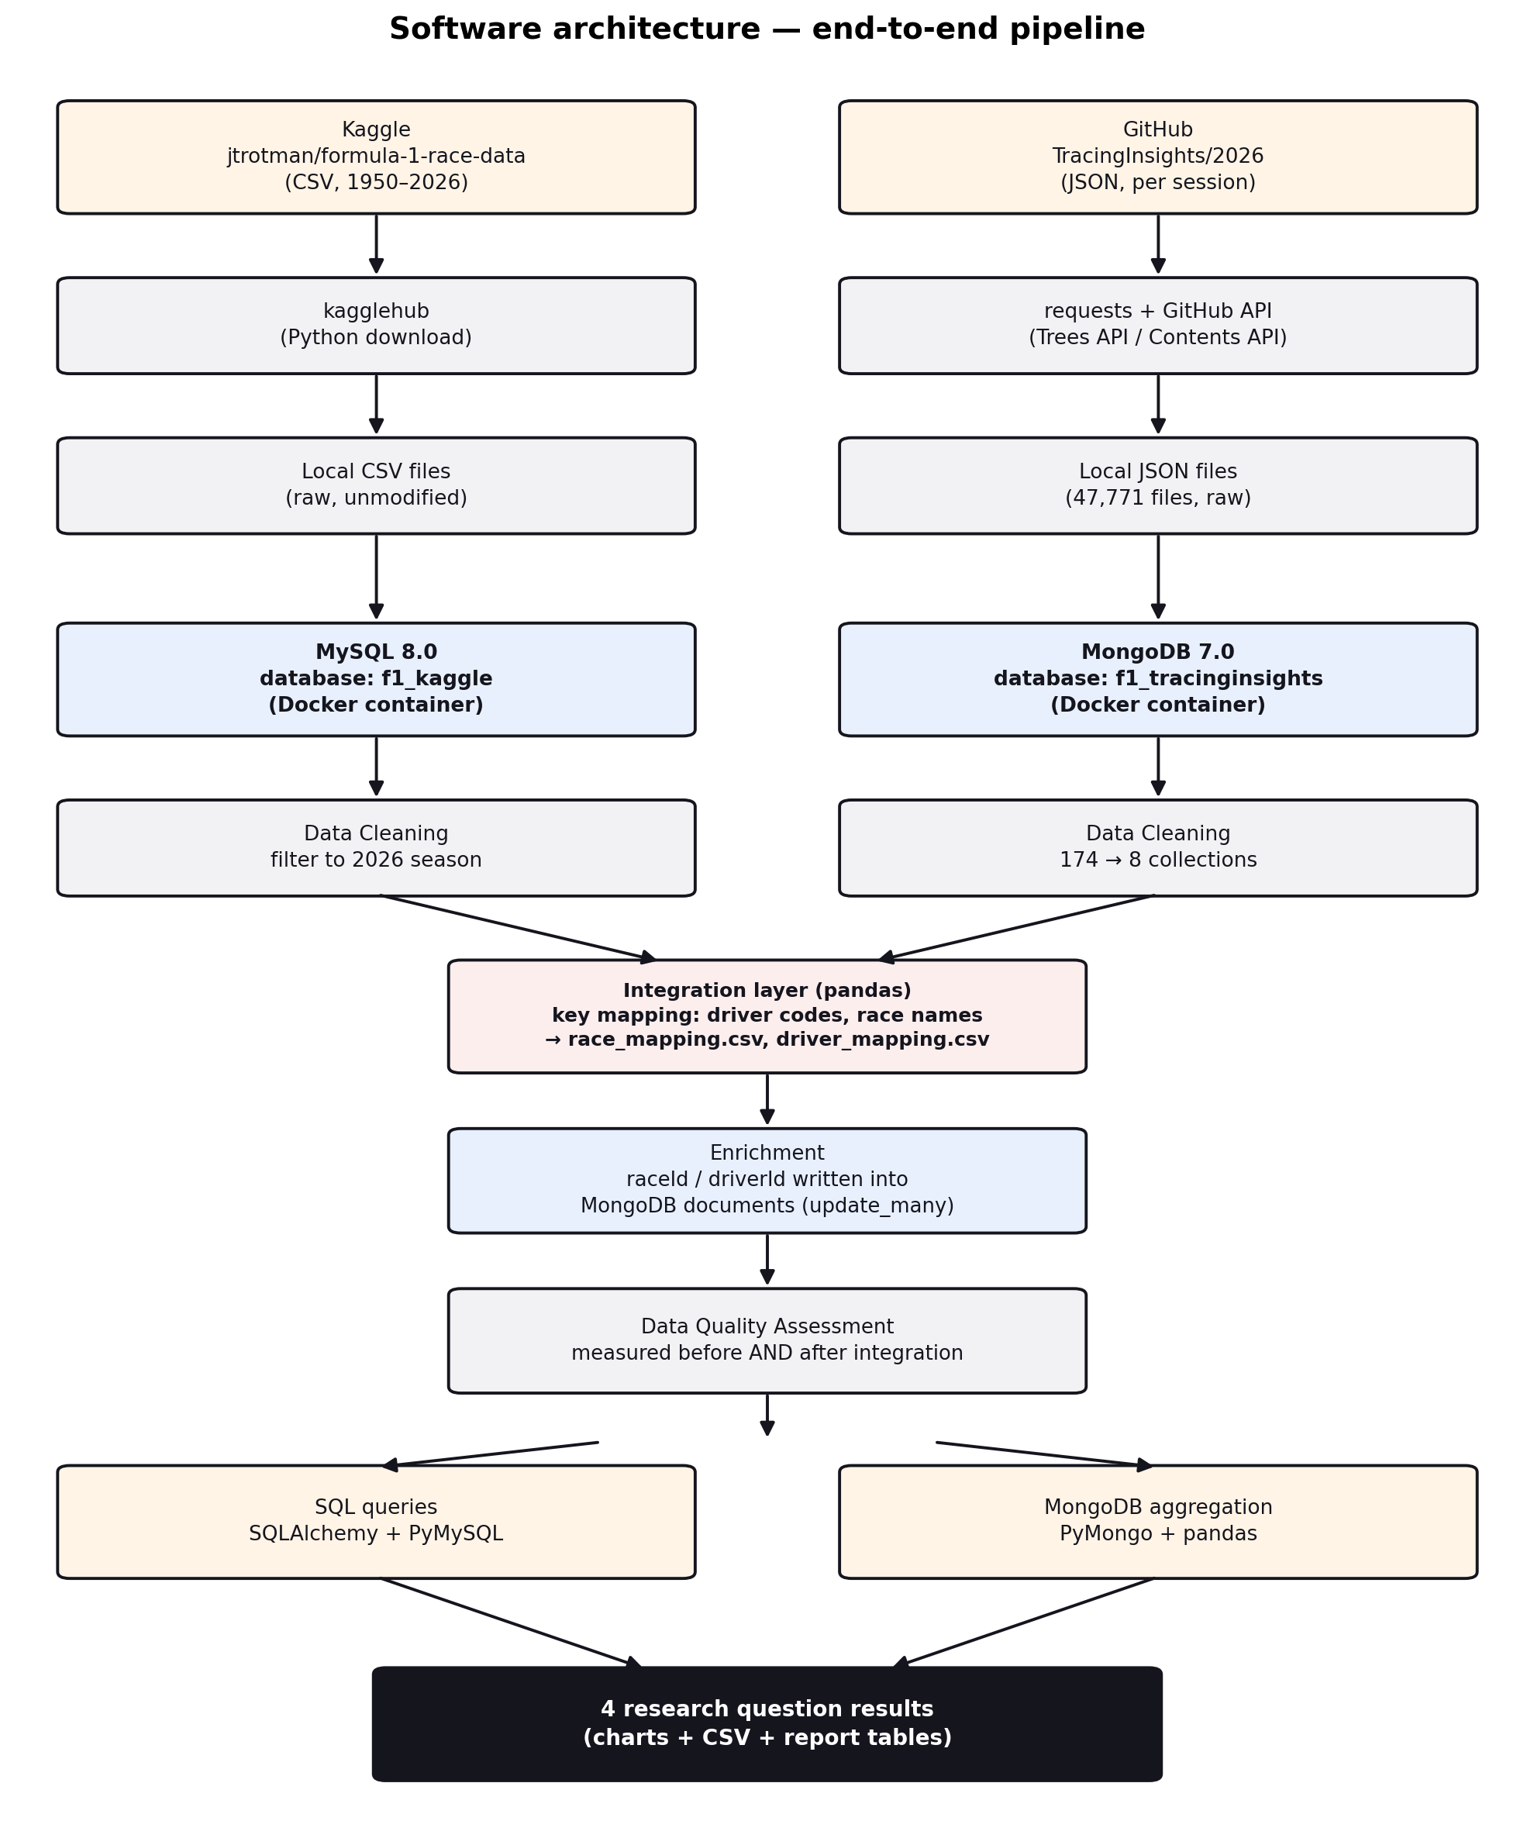
Software Architecture
End-to-end pipeline, from source APIs to the four research-question results.
Two source-specific acquisition scripts (kagglehub / GitHub API)
Two Docker containers: MySQL 8.0 + MongoDB 7.0
pandas-based integration layer building a key-mapping table
Batched update_many() enrichment (no per-document writes)
SQL (SQLAlchemy) and MongoDB aggregation for the 4 queries
Reproducibility: the entire storage layer is defined in a single docker-compose.yml — any evaluator can recreate an identical environment with one command.
F1 2026 — Data Management Project
6

Slide 7
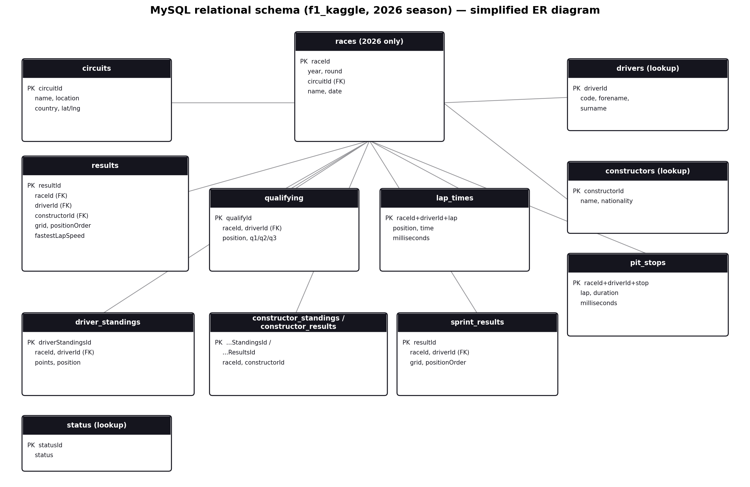
MySQL Relational Schema
f1_kaggle — 13 tables, filtered to the 2026 season (lookup tables kept in full)
F1 2026 — Data Management Project
7

Slide 8
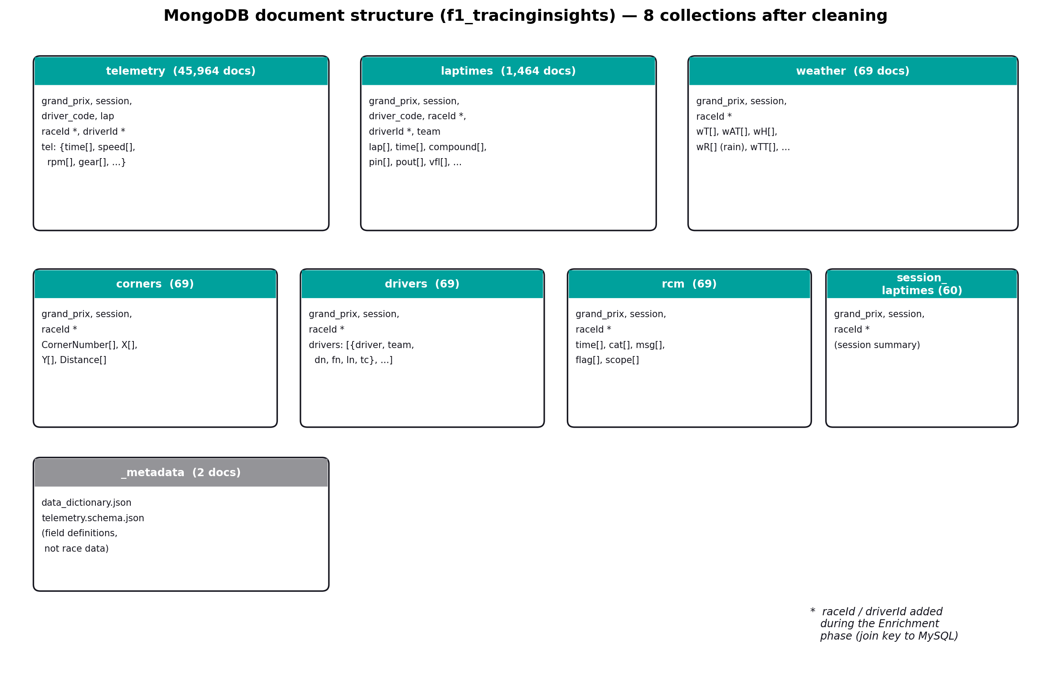
MongoDB Document Structure
f1_tracinginsights — 8 collections after cleaning (down from 174 originally)
F1 2026 — Data Management Project
8

Slide 9
Data Cleaning: Two Issues Found & Fixed
MySQL — season scope
MongoDB — collection fragmentation
1950 – 2026
2026 only
174
8
→
→
full history
23 races
collections (1 per lap file)
clean collections
races.year identifies the relevant raceId values; the filter is propagated to every race-level table. Reference tables (drivers, constructors, circuits, status) are kept in full as join targets.
The original logic used each filename as the collection name, fragmenting telemetry into ~150 collections. Rewritten to route by path depth, consolidating all telemetry into one collection.
F1 2026 — Data Management Project
9

Slide 10
Integration & Enrichment
MySQL uses numeric surrogate keys; MongoDB uses human-readable identifiers. An automated mapping procedure reconciles the two — and its accuracy is explicitly measured.
12/12
23/23
0
races matched
championship drivers matched
duplicate records found
11 direct + 1 manual mapping
(“Barcelona” name variant)
3 testing sessions correctly excluded
100% direct match
9 reserve/test-only codes
correctly left unmatched
MySQL results: 0 duplicates
MongoDB telemetry: 0 duplicates
(uniqueness check)
Key finding: every enrichment gap was traced to a documented, structural cause (pre-season testing sessions, reserve drivers) — not to an unexplained integration error. This distinction is the core deliverable of the quality assessment.
F1 2026 — Data Management Project
10

Slide 11
Data Quality Assessment
BEFORE INTEGRATION
AFTER INTEGRATION
MySQL completeness
raceId coverage (MongoDB)
0% missing cells — all 9 tables
77.1% – 100%, depending on collection
MySQL referential integrity
driverId coverage (MongoDB)
15/15 foreign keys 100% valid, 0 orphaned rows
98.7% – 99.0%
MongoDB key completeness
Race match rate
17/17 checks 100% (grand_prix, session, driver_code, lap)
12/12 (100%) — 3 testing sessions excluded
Uniqueness (both sources)
Driver match rate
0 duplicates — MySQL results, MongoDB telemetry
23/23 championship drivers (100%)
Key insight: both sources are independently complete and consistent, so every post-integration gap reflects differing source coverage — not a pre-existing quality defect.
F1 2026 — Data Management Project
11

Slide 12
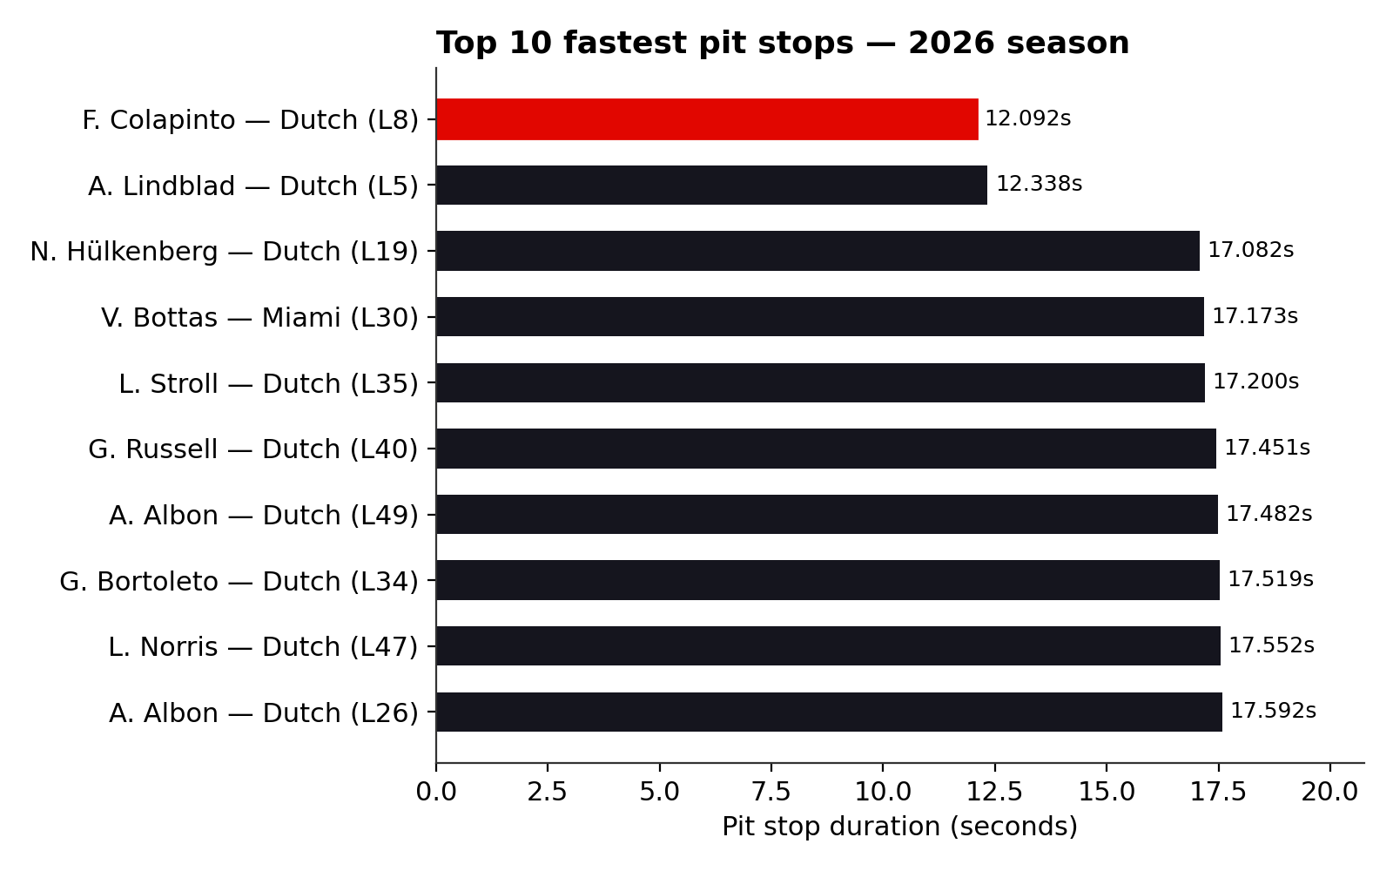
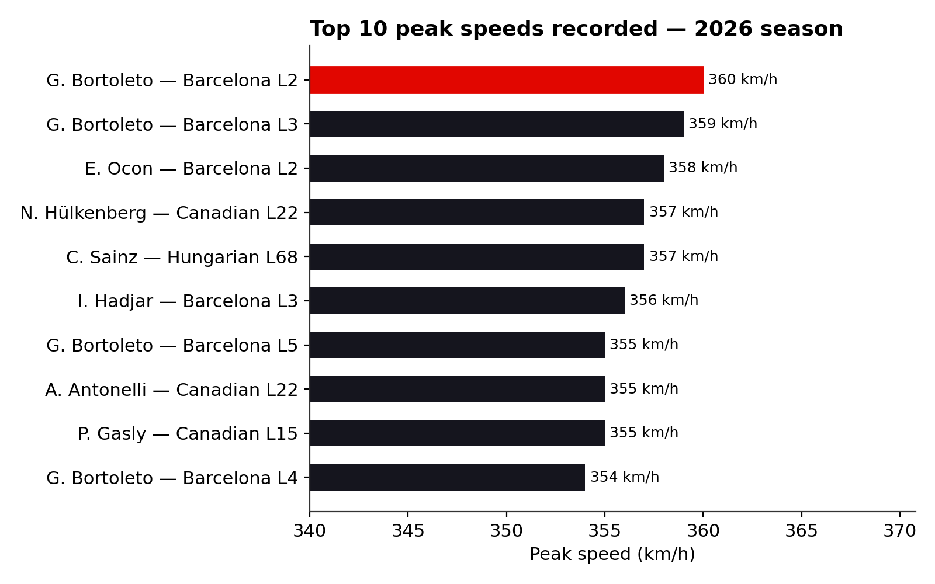
Results (1/2)
1
Fastest Pit Stop
2
Highest Peak Speed
Franco Colapinto (Alpine)
12.092s at lap 8, Dutch Grand Prix
Gabriel Bortoleto (Audi)
360.0 km/h at lap 2, Barcelona-Catalunya GP
F1 2026 — Data Management Project
12

Slide 13
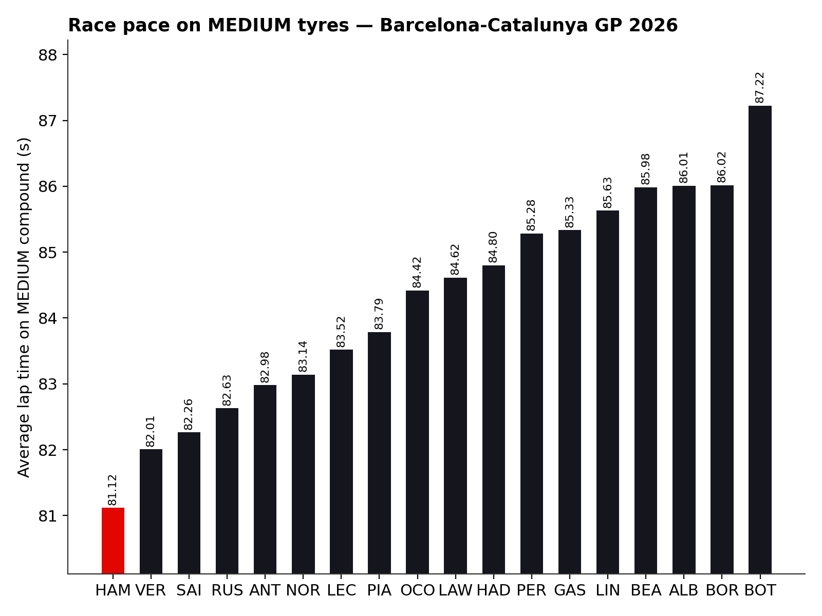
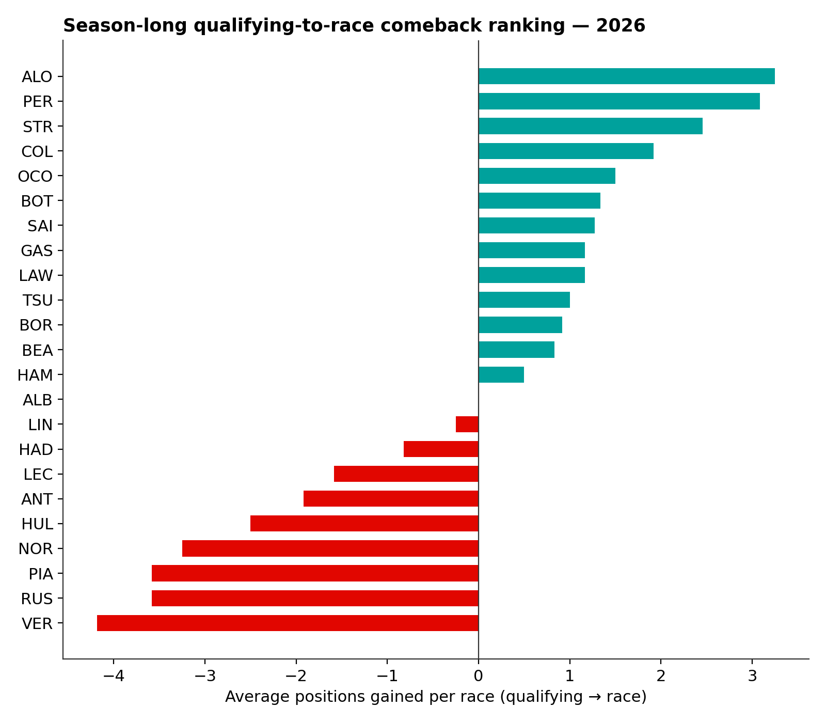
Results (2/2)
3
Best MEDIUM-Tyre Pace — Barcelona
4
Best Qualifying-to-Race Comeback
Lewis Hamilton (Ferrari) — 81.117s avg (12 clean laps)
Fernando Alonso
+11 pos. (Monaco) +3.25/race avg
F1 2026 — Data Management Project
13

Slide 14
Limitations & Future Work
Limitations
Future Work
RQ1 pit stop duration reflects total pit-lane time (entry to exit), not the shorter stationary/tyre-change time alone (2–3s in real F1); not directly comparable to widely cited “fastest stop” records
RQ3 pace comparison mixes drivers with very different clean-lap counts (4 to 37)
Season still in progress at acquisition time — several races present only in MySQL
One race-name discrepancy required a manually curated mapping rule
Re-run once the 2026 season is complete, for a full-season comeback ranking and peak-speed comparison
Extend the spatial dimension: combine TracingInsights corner coordinates with MySQL circuits.lat/lng (e.g. MySQL spatial types or PostGIS)
Automated outlier detection on raw telemetry before analysis
Reusable, cross-season driver/race key-mapping lookup table
F1 2026 — Data Management Project
14

Slide 15
Conclusions
A complete, reproducible pipeline across two DBMS chosen to fit each source's structure
Integration accuracy explicitly measured: 100% of championship drivers and completed races matched
Every quality gap traced to a documented cause, not left as an unexplained defect
4 research questions answered — 2 in pure SQL, 2 requiring MongoDB's telemetry-level detail — demonstrating the value of combining both sources
Thank you
Filippo Avon — 886229 — Data Management, Università degli Studi di Milano-Bicocca

