Slide 1


Augmenting Convolutional Networks with Attention-based Aggregation for Image Classification and Breast Cancer Detection
Course: Neural Networks
Professor: Aurelio Uncini
Authors:
Filippo Betello
1835108
Master’s degree in Artificial Intelligence and Robotics
Federico Carmignani 1845479
Master’s degree in Engineering in Computer Science
Academic Year: 2021-2022

Slide 2

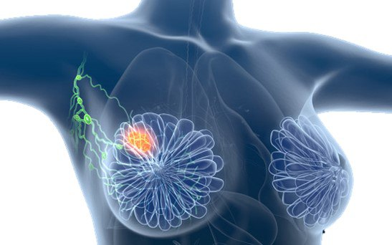
Pipeline followed
Model 1:
ResNet-50
Model 2:
PatchConvNet
Model 1:
ResNet-50
Model 1:
ResNet-50
Dataset
CIFAR-10
Breast cancer
Evaluation
CIFAR-10
Breast cancer
Attention Maps
Pagina 2

Slide 3
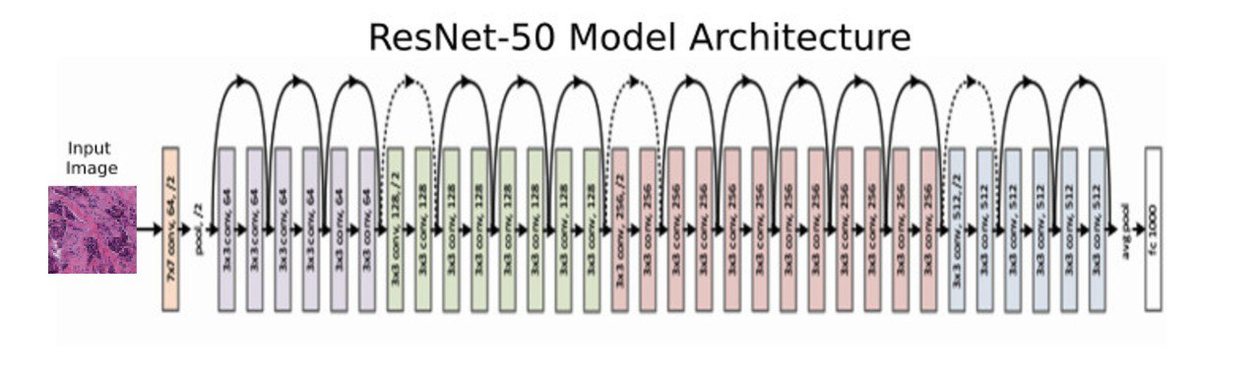
Model 1: ResNet-50
Complete architecture implemented
The basic design goal of CNNs was to create a network where the neurons in the early layer of the network would extract local visual features, and neurons in later layers would combine these features to form high-order features;
Deep networks are hard to train because of the vanishing gradient problem, as the gradient is backpropagated to earlier layer. As the network goes deeper, its performance gets saturated or even starts degrading rapidly;
ResNet-50 is a convolutional neural network that is 50 layers deep (48 Convolution layers along with 1 MaxPool and 1 Average Pool layer).
Model 1
Dataset
Evaluation
Attention Maps
Pagina 3

Slide 4
Model 2: PatchConvNet S60
Complete architecture implemented
PatchConvNet is a deep neural network created merging features of two popular models: Vision Transformers and Convolutional networks:
ViT:
Patch based processing;
aggregation of the image information based on a so called “class token”, used in comparison with the patches more related to the classifcation decision;
a softmax in a self-attention block for producing attention maps: they show relationship between class token and patches;
ConvNets:
a convolutional network;
using patch processing;
producing attention maps with a single class token.
History
The attention based processing has been introduced by ViT: it processes images as a set of non- overlapping patches without convolutions or downsamplings.
Many works are now reintroducing them in ViT and classification decision is obtained through a selfattention mechanism offering a direct access to the location of the information used to make it, inspired to the idea of Vision Transformers.
Model 2
Dataset
Evaluation
Attention Maps
Pagina 4

Slide 5
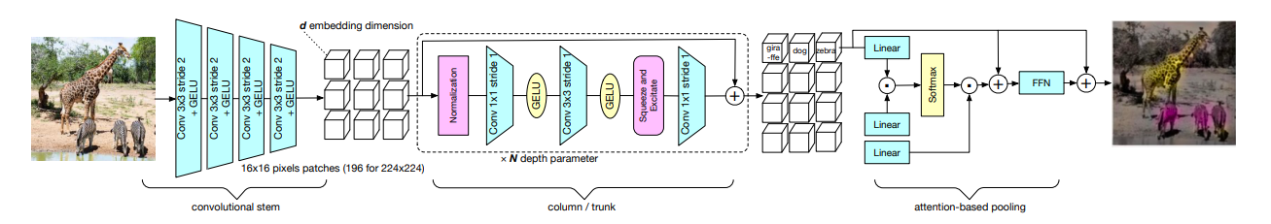
Model 2: PatchConvNet S60
The architecture
The goal of this innovative architecture is to combine a high resolution feature map with the mantainance of the resolution all across the layers
The convolutional stem is the first part of the network where the images are segmented and mapped into a set of vectors: the patches. This is applied to images of size W× H×3 and produces a vector map according to W/16×H/16×d in case of patches whose size is 16×16 or W/4 × H/4×d in case of patches whose size is 4×4.
The column is the core of the network and it consists of N residual convolutional block. The output of this block has the same shape of the input: the number of vectors representing the patches.
Attention-based pooling is at the output of the trunk where the pre-processed vectors are aggregated using a crossattention layer.
Model 2
Dataset
Evaluation
Attention Maps
Pagina 5

Slide 6


Dataset: CIFAR-10
Pre-processing and split steps
The dataset used is the popular CIFAR-10: it consists of 60,000 colour images, whose size is 32x32, divided in 10 classes, with 6,000 images per class.
We use the usual split of this dataset, composed of 50,000 training images and 10,000 test images.
Data-Augmentation:
• We flip the images with respect to the horizontal axis (RandomHorizontalFlip);
• We rotate the images to a specified fixed angle of 10° (RandomRotation);
• We performs actions like zooms, change shear angles (RandomAffine);
• In the end we randomly change the brightness, saturation, and other properties of an image (ColorJitter).
Models
Dataset 1
Dataset
Input
Output
Input
Output
Evaluation
Attention Maps
Pagina 6

Slide 7
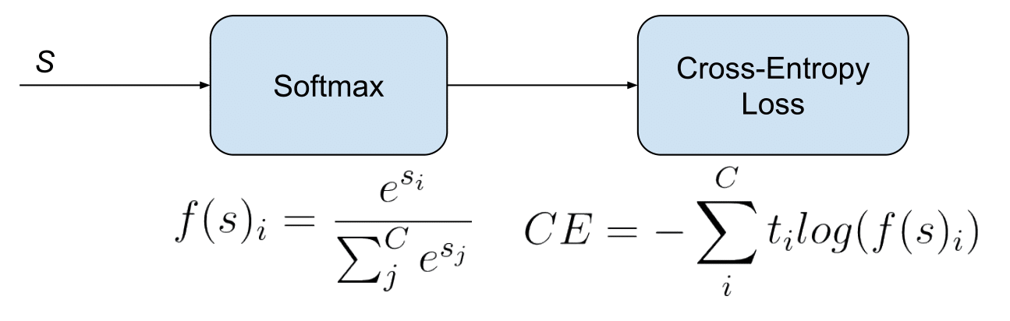
Training receipts
Optimizers:
We adopt the same optimizer of the paper: Lamb: the principle is the layerwise adaptation strategy, used in order to accelerate training of deep neural networks using large mini-batches.
We make also preliminary experiments with other optimizers, in particular SGD and Adam.
For the loss function, we use the CrossEntropyLoss that is useful when training a classification problem with C=10 classes.
Training:
We train our models during 50 epochs using a learning rate (lr) of 3x10−3 or 0.01. For both of this values we fixed the weight decay (wd) to 0.01.
Early Stopping:
It is a form of regularization used to avoid overfitting on the training dataset. If the loss stops decreasing
for 10 epochs in a row the training stops.
Models
Dataset
Evaluation 1
Evaluation
Attention Maps

Slide 8
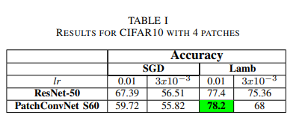
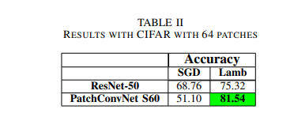
Evaluation
We extract only 4 patches, with the dimension of 16x16, to build the attention maps.
We modify the dimension of the patch, decreasing their dimension to 4x4. Doing that we obtain 64 patches.
Then we perform more training: we changed the batch size to 64 and fixed the lr to 3x10−3. The weight decay is fixed to the value of 0.01 and we train for 10 epochs.
Models
Dataset
Evaluation 1
Evaluation
Attention Maps

Slide 9
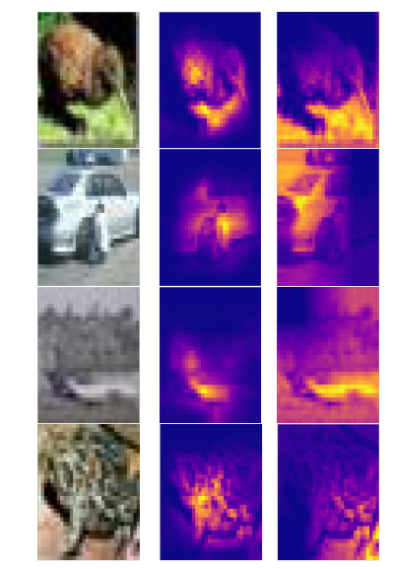
Attention maps
Attention Map on a duck, car, plane and a frog.
In the middle there is the map based on our result, while on the left there is the result based on the paper net.
Models
Dataset
Evaluation
Evaluation
Attention maps 1
Attention Maps

Slide 10
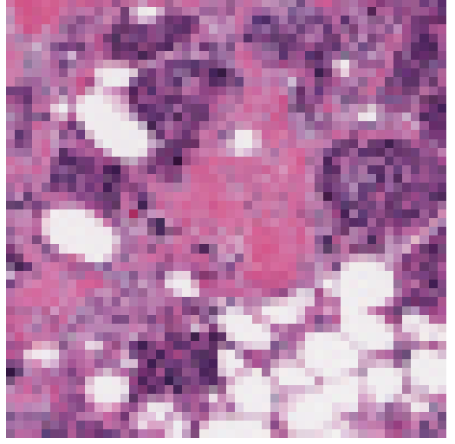
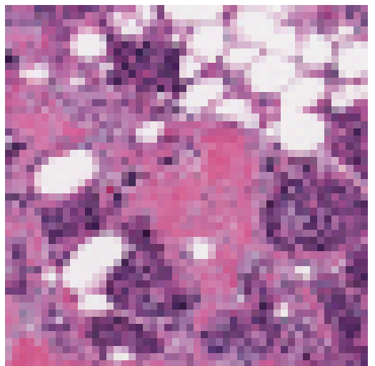
Dataset: Breast cancer
Pre-processing and split steps
Dataset used is taken from Kaggle. Originally there were 277,524 patches of size 50 x 50 were extracted, 198,738 negative and 78,786 IDC positive. We take a subset of this pulling out 52,521 patches, 38,618 IDC negative and 13,903 IDC positive, keeping more or less the same ratio between positive and total patches (28% vs 26%). Then we split the images into training set (80%) and test set (20%).
Data-Augmentation:
• We flip the images with respect to the horizontal axis (RandomHorizontalFlip);
• We flip the images with respect to the vertical axis (RandomVerticalFlip);
• We rotate the images to a specified fixed angle of 10°(RandomRotation).
Models
Dataset 2
Dataset
Input
Output
Input
Output
Evaluation
Attention Maps
Pagina 10

Slide 11
Training receipts
Optimizers:
We used the same parameters as in the CIFAR-10 with 64 patches (lr=3x10−3 and wd=0.01) and the same two different optimizers (SGD and Lamb).
For the loss function, we use the CrossEntropyLoss that is useful when training a classification problem with C=2 classes.
Training:
We train our models during 15 epochs using a learning rate (lr) of 3x10−3. We fixed the weight decay (wd) to 0.01.
Early Stopping:
It is a form of regularization used to avoid overfitting on the training dataset. If the loss stops decreasing
for 10 epochs in a row the training stops.
Models
Dataset
Evaluation 2
Evaluation
Attention Maps

Slide 12
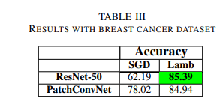
Evaluation
Models
The best result is obtained with the ResNet-50 architecture, but on average the S60 model performs better.
Like in the CIFAR-10, Lamb is better than SGD as optimizers.
We believe that with more epochs and a bigger dataset PatchConvNet will outperform ResNet-50. These results are affected by GPU time limit and RAM memory limitation in Google Colab.
Dataset
Evaluation 2
Evaluation
Attention Maps

Slide 13
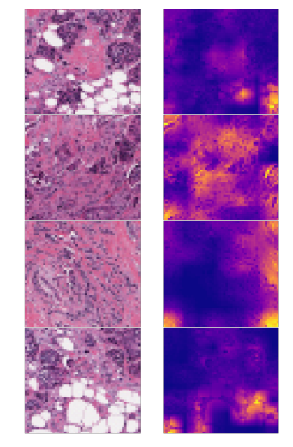
Attention maps
The attention maps produced point out the areas having a greater probability to be affected by Cancer.
In the first column there is the original image, while in the second there is the heat map.
Models
Dataset
Evaluation
Evaluation
Attention maps 2
Attention Maps

Slide 14
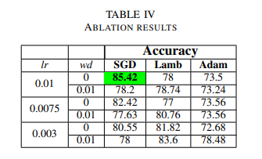
Ablations
We perform more training by changing the learning rate to three different values (0.01, 0.0075 and 3x10−3) and by varying the weight decay from 0.01 to 0, but keeping the batch size to the fixed value of 64.
In addition to that, we also try three different optimizers (SGD, Lamb and Adam).
This exploration phase is being done only for the PatchConvNet S60 model, in order to verify if this model is robust enough in multiple conditions.
Models
Dataset
Evaluation 2
Evaluation
Attention Maps

Slide 15
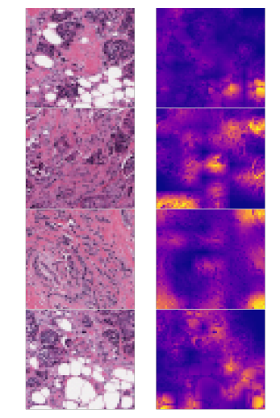
Attention maps
We perform fine tuning: using the
best pretrained S60 model in Table 3, we train for 15 epochs using the same parameters. The accuracy reached is 87.95%.
Models
Dataset
Evaluation
Evaluation
Attention maps 2
Attention Maps

Slide 16
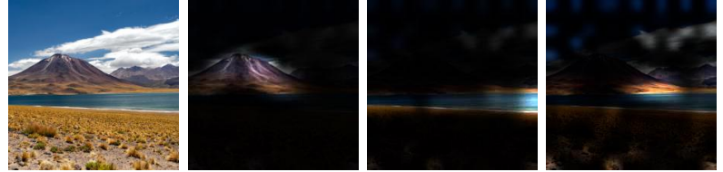
Conclusion Extensions
PatchConvNet can be extended in several aspects and modified in order to be applied to other tasks:
Multiclass PatchConvNet: one token for each class and not one single token, an attention map for each class is produced: more accuracy but even more complexity, so it should be used with a lower learning rate and smaller batch size.
Segmentation with PatchConvNet: it can be applied to semantic segmentation like in the paper is presented.
Detection with PatchConvNet: it can be used for image detection and instance segmentation observing how it is on par with state of the art architectures.
Models
Dataset
Evaluation
Evaluation
Attention Maps

Slide 17
Thanks for the attention!
Filippo Betello
Federico Carmignani

