Slide 1

Optimization Project
Ingegneria Informatica
Students
Bolis Filippo Antonio (matr 1079493)
A.Y. 2024/2025
Mazzoleni Gabriele (matr 1079514)

Slide 2
Dataset presentation
The dataset under analysis contains information related to students' daily habits and personal characteristics, with the objective of investigating potential correlations with academic performance.
It includes 16 variables, of which: 9 are numerical and 7 are categorical

Slide 3
Dataset presentation
The 7 categorial are:
Student_id: Unique alphanumeric identifier for each student.
Gender: Student's gender {Male, Female}.
Part time job: Indicates whether the student has a job alongside studies {Yes, No}.
Diet quality: observed dietary quality {Poor, Fair, Good}.

Slide 4
Dataset presentation
The 7 categorial are:
Parental education level: Highest level of education attained by the student’s parents {High School, Bachelor, Master, PhD}.
Internet quality: Perceived internet connection quality at home {Poor, Average, Good}.
Extracurricular participation: Whether the student participates in extracurricular activities {Yes, No}.

Slide 5
Dataset presentation
The 9 numerical are:
Age [years]: Integer value representing the student's age.
Study hours per day: Average number of hours dedicated to studying each day.
Social media hours: Daily time spent on social media platforms.

Slide 6
Dataset presentation
The 9 numerical are:
Netflix hours: Daily time spent watching Netflix or similar platforms.
Attendance percentage: Percentage of lectures or classes attended.
sleep hours: Average number of hours of sleep per night.

Slide 7
Dataset presentation
The 9 numerical are:
exercise frequency [times/week]: Number of times per week the student engages in physical activity.
mental health rating [scale 1–10]: Self-assessed mental health condition.
exam score [scale 1–10]: Numerical score obtained in a key exam.

Slide 8
Dataset presentation
The 9 numerical are:
exercise frequency [times/week]: Number of times per week the student engages in physical activity.
mental health rating [scale 1–10]: Self-assessed mental health condition.
exam score [scale 1–10]: Numerical score obtained in a key exam.

Slide 9
Data preparation
The dataset contain roughly 1000 rows.
We conducted a missing data analysis, computing the percentage of missing values for each feature.
We set a threshold of 30% missingness to eliminate any variable whose proportion of missing data exceeded this limit.

Slide 10
Data preparation
Only one variable presented missing values, but the proportion of missing entries was well below the exclusion limit.
As a result, we applied a row-wise deletion strategy (dropna) to remove only the affected samples, ensuring a clean dataset without discarding useful variables.

Slide 11
Data preparation
To better understand the data, we visualized the distribution of all numerical features:
Most variables showed distributions compatible with normal.

Slide 12
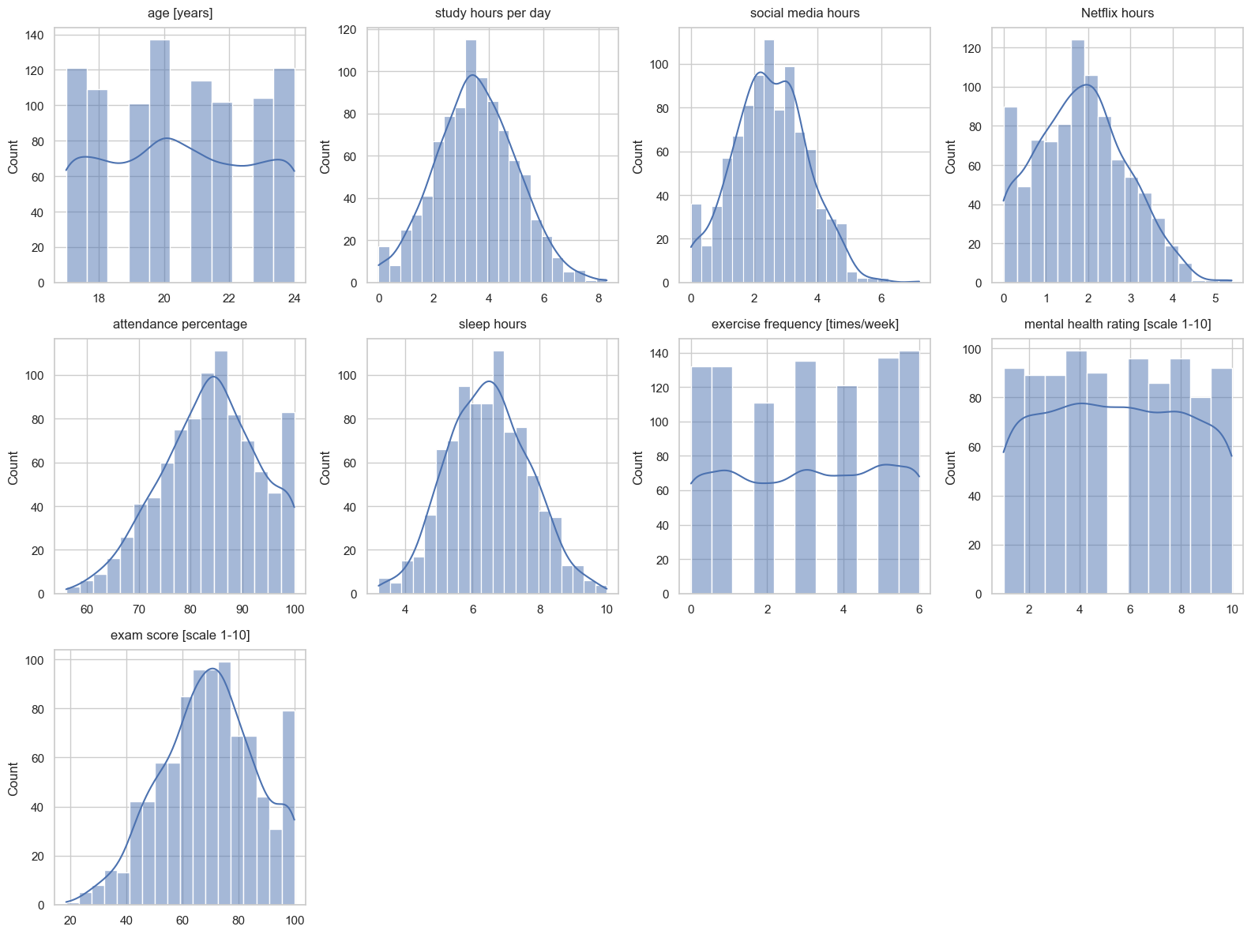
Data preparation

Slide 13
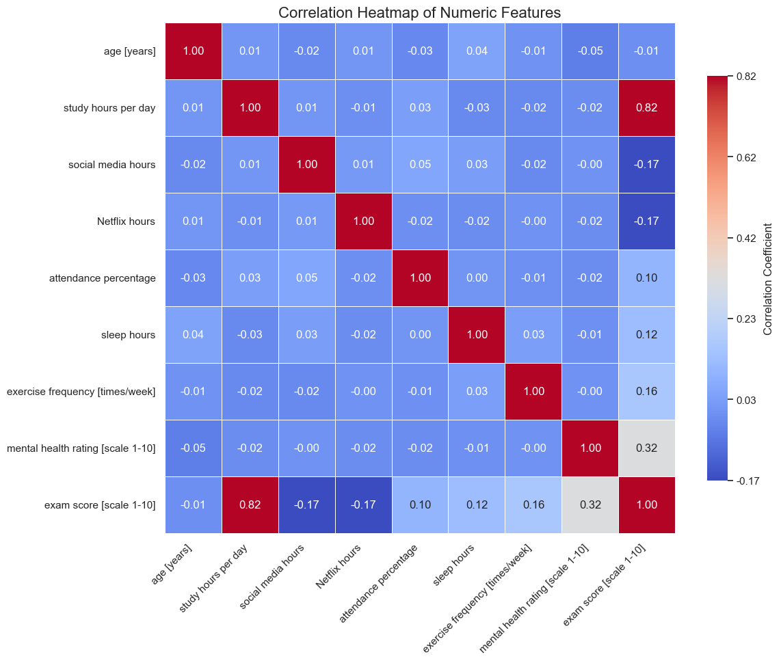
Data preparation
To better understand the correlation between the numerical variables in the dataset, we computed the correlation matrix.

Slide 14
Gradient Descent - Objective
The objective of our work is to demonstrate how theoretical step‑size selection affects speed and stability of optimization.

Slide 15
Gradient Descent - Pipeline
We implemented a multivariate linear regression workflow driven by Gradient Descent.
The pipeline:
standardize every numerical feature.
build a design matrix with an intercept.
run GD variants with different step‑size rules.
compare convergence and fitted lines.

Slide 16

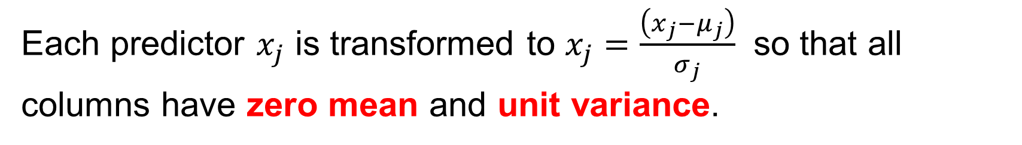
Data Standardization & Design Matrix
Each predictor $x_{j}$ is transformed to $x_{j}=\frac{\left(x_{j}−μ_{j}\right)}{σ_{j}}$​ so that all columns have zero mean and unit variance.
We then create matrix $A=\left[1 | X\right]$ and vector $b=$ standardized exam score.
Standardization removes scale effects, letting us use a single learning rate across all coefficients.

Slide 17
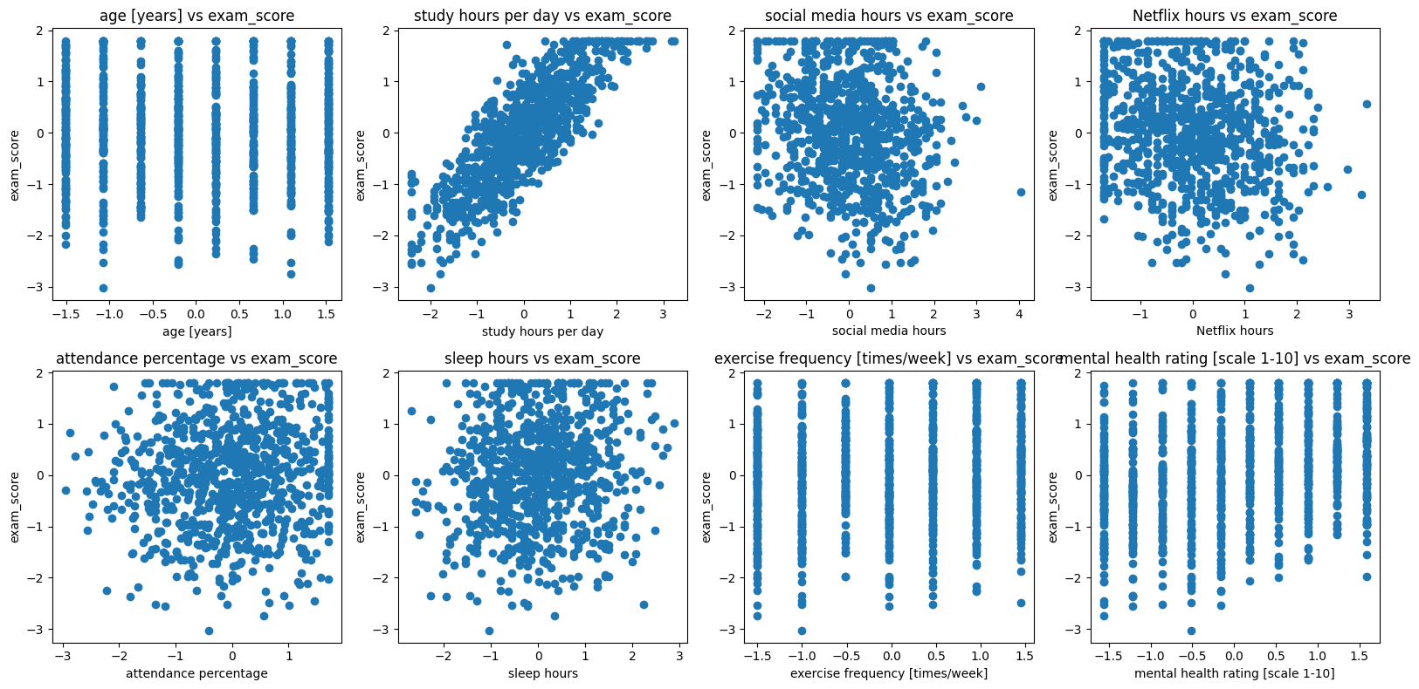
Exploratory Scatter Plots

Slide 18
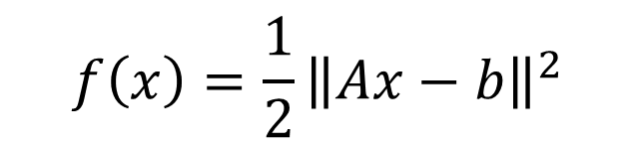
Core GD Implementation
We decided to pick the following loss function as our objective function for this analysis (Ordinary Least Squares):
$$f\left(x\right)=\frac{1}{2}{\left\|Ax−b\right\|}^{2}$$

Slide 19
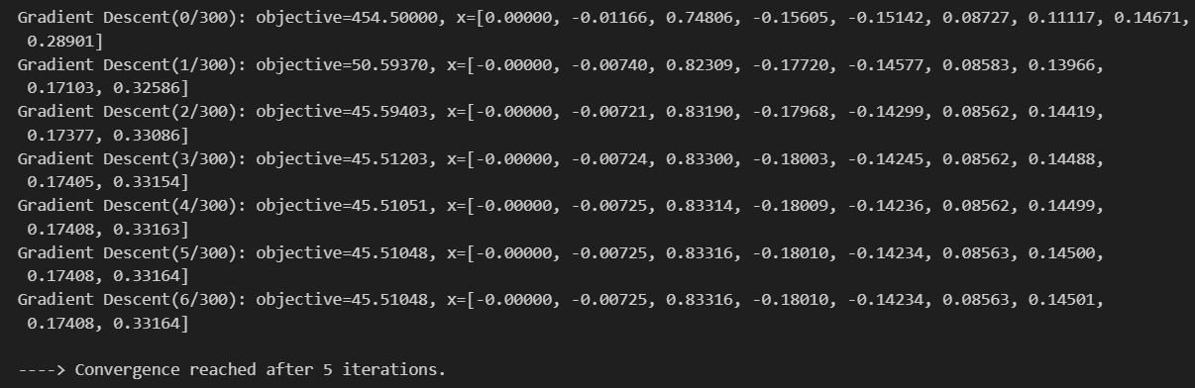
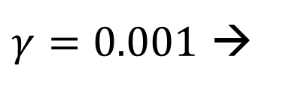
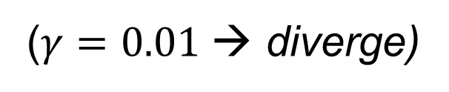
First variant: Naive Test
We set an empirical $γ$
($γ=0.01$→ diverge)
$γ=0.001$ →

Slide 20
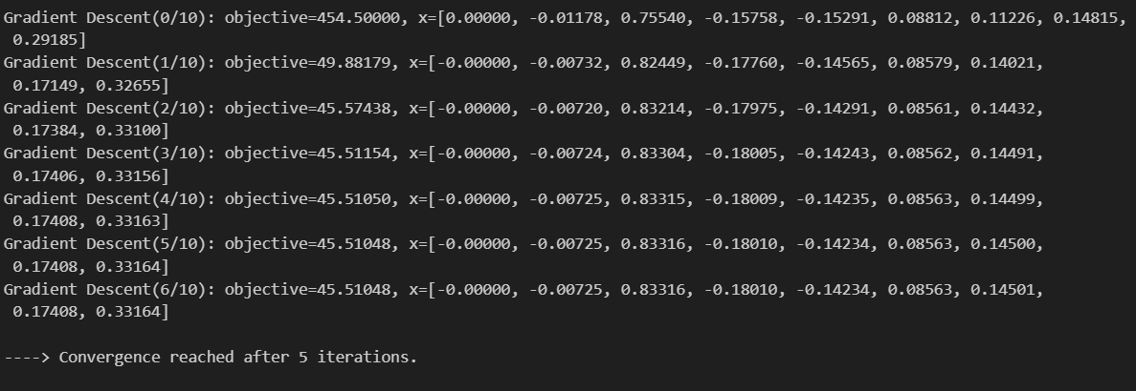

Second variant: Smoothness‑Based Step
We computed the Lipschitz constant $L= \left\|A^{T}A\right\|$
And then we used $γ= \frac{1}{L}$ →

Slide 21
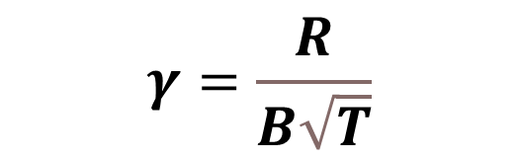
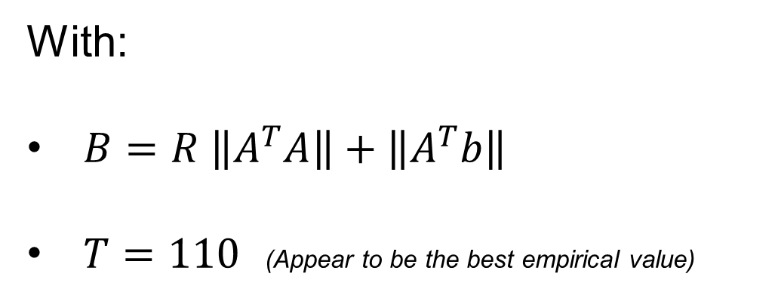
Third variant: Bounded‑Gradient
We empirically assumed parameters lie in a radius $R=25$ ball.
$$γ=\frac{R}{B\sqrt{T}}$$
Then we bound the gradient norm and set:
With:
$B=R \left\|A^{T}A\right\|+\left\|A^{T}b\right\|$
$T=110$ (Appear to be the best empirical value)

Slide 22
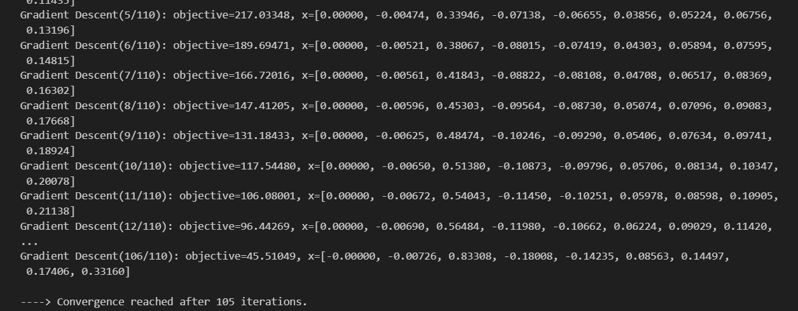
Third variant: Bounded‑Gradient

Slide 23
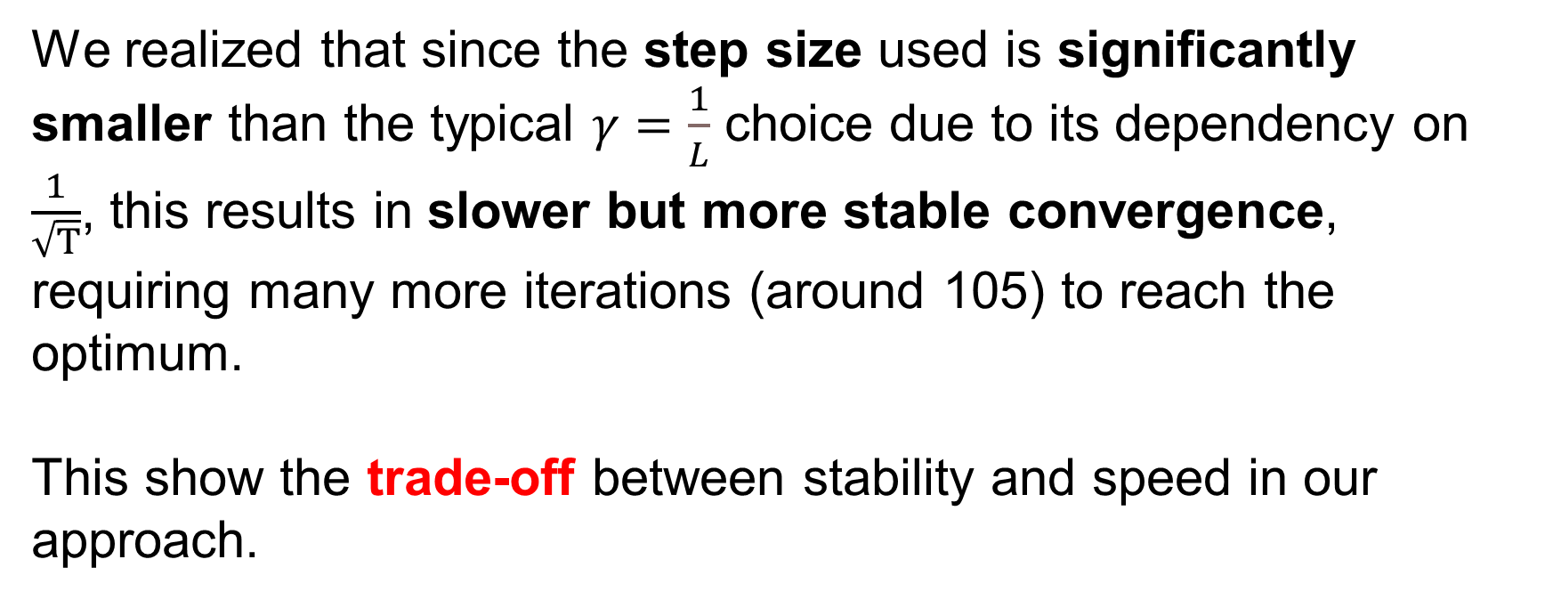
Third variant: Bounded‑Gradient
We realized that since the step size used is significantly smaller than the typical $γ=\frac{1}{L}$ choice due to its dependency on $\frac{1}{\sqrt{T}}$, this results in slower but more stable convergence, requiring many more iterations (around 105) to reach the optimum.
This show the trade-off between stability and speed in our approach.

Slide 24
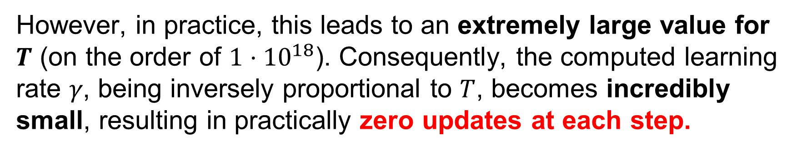
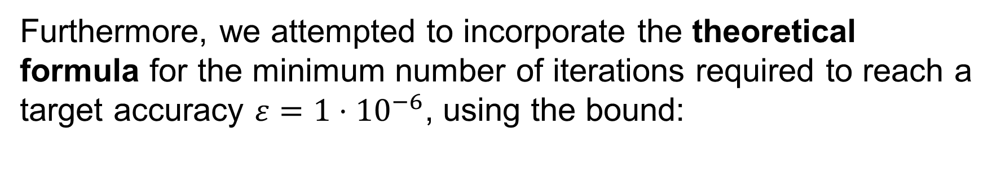
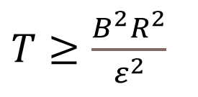
Third variant: Bounded‑Gradient
Furthermore, we attempted to incorporate the theoretical formula for the minimum number of iterations required to reach a target accuracy $ε=1⋅{10}^{−6}$, using the bound:
$T≥\frac{B^{2}R^{2}}{ε^{2}}$​
However, in practice, this leads to an extremely large value for $T$ (on the order of $1⋅{10}^{18}$). Consequently, the computed learning rate 𝛾, being inversely proportional to $T$, becomes incredibly small, resulting in practically zero updates at each step.

Slide 25
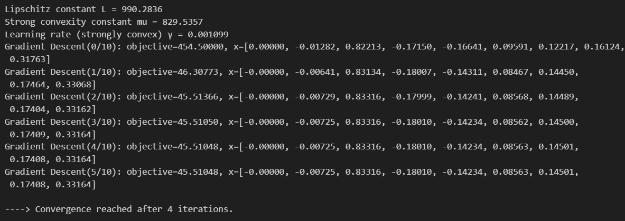
Fourth variant: Strongly‑Convex Step
We calculated $μ=λ_{−min}\left(A^{T}A\right)$ and reused the same $L$ as before.
We calculated $γ= \frac{2}{L+μ}$ (if $μ$ were unknown we would have used $γ= \frac{1}{L}$)

Slide 26
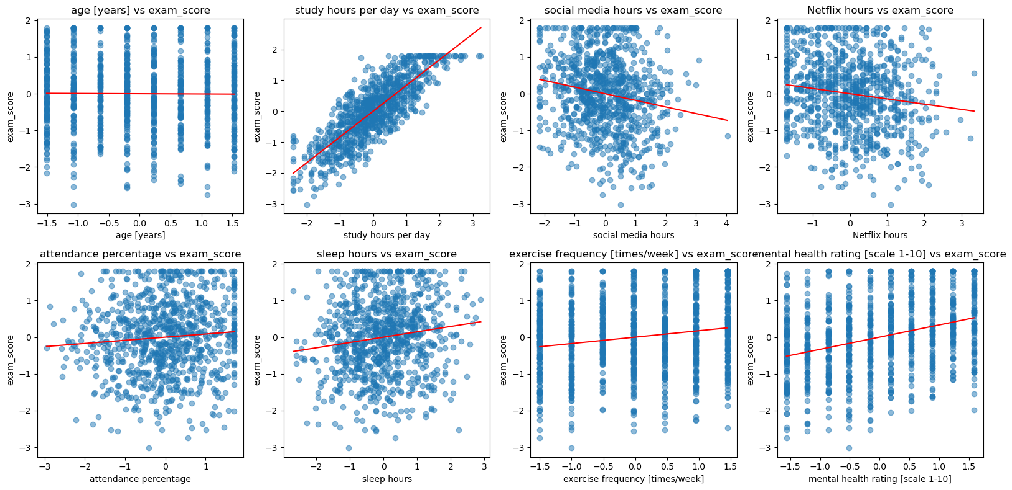
Regression Line Overlays

Slide 27
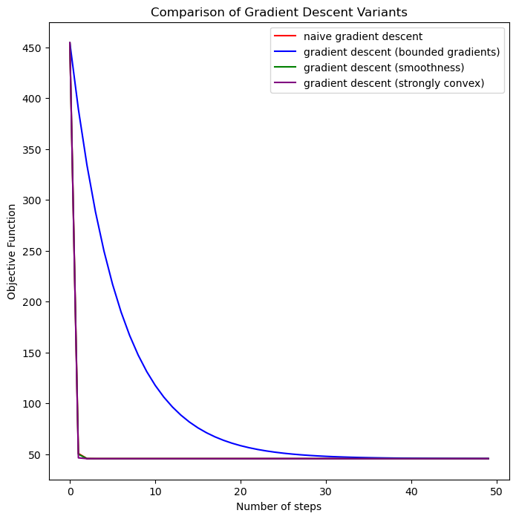
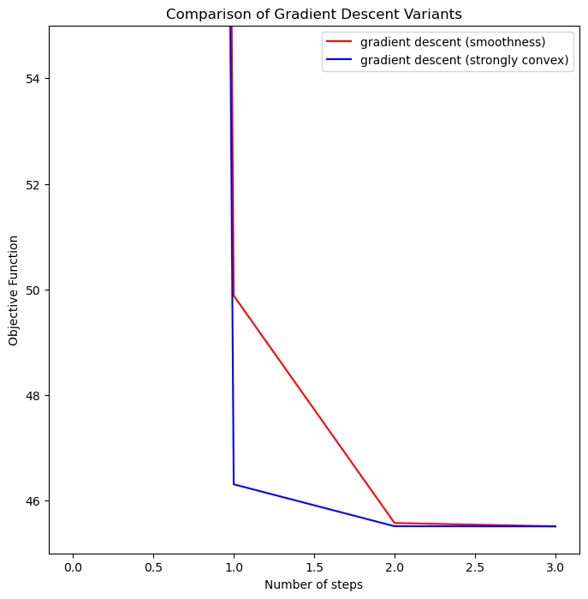
Convergence Comparison

Slide 28
Performance Comparison
Gradient Descent Setting | Time needed
Naive Test | 7ms
Smooth Constant | 5ms
Lipschitz function | 55ms
Strong convexity Test | 4ms

Slide 29
Stochastic GD
We wanted to evaluate how Stochastic Gradient Descent methods compare to GD methods in reaching the optimum convergence.
For the first round of tests, we chose to use a single observation stochastic gradient, meaning the batch size used is equal to 1.

Slide 30
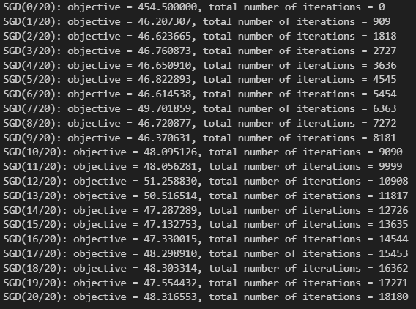
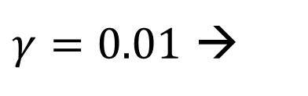
Stochastic GD – Naive test
We set an empirical $γ$ and max number of epochs = 20.
$γ=0.01$ →

Slide 31
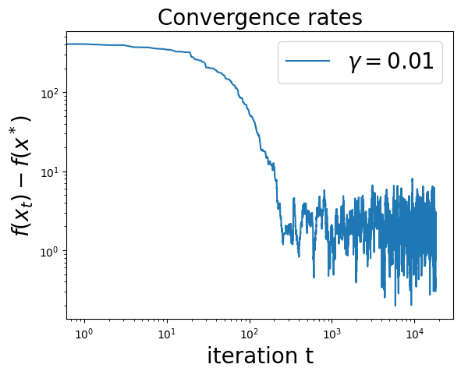
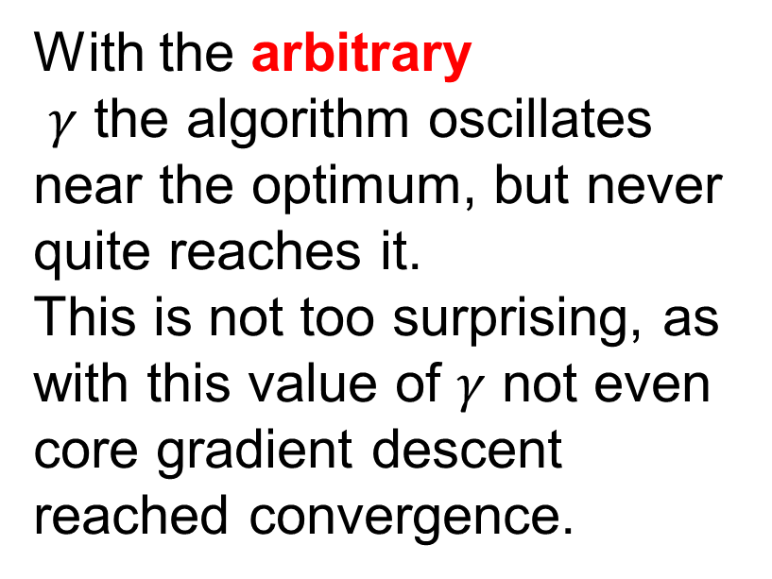
Convergence rate – Naïve vs optimal value
With the arbitrary
$γ$ the algorithm oscillates near the optimum, but never quite reaches it.
This is not too surprising, as with this value of $γ$ not even core gradient descent reached convergence.

Slide 32
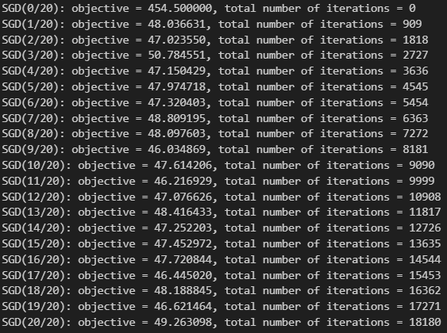
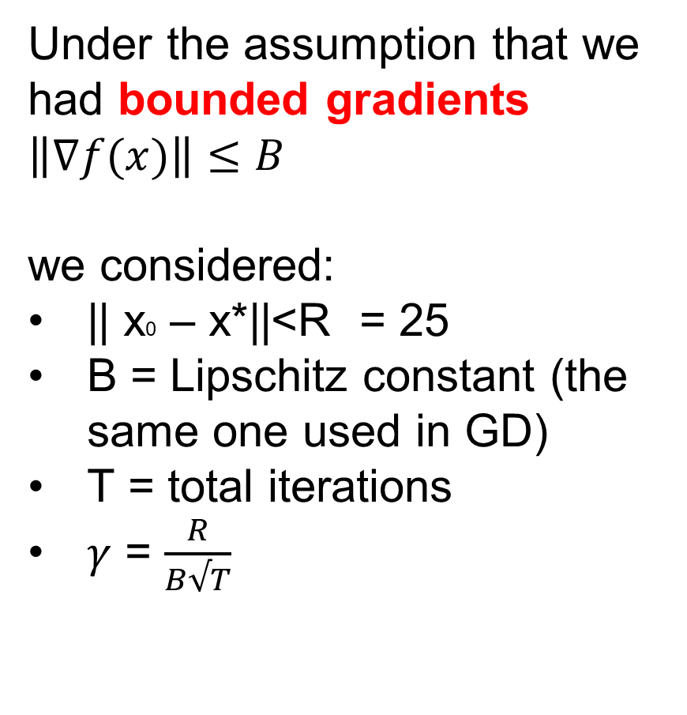
SGD assuming bounded gradients
Under the assumption that we had bounded gradients
$$\left\|∇f(x)\right\|≤B$$
we considered:
|| x0 – x*||<R = 25
B = Lipschitz constant (the same one used in GD)
T = total iterations
$γ$ = $\frac{R}{B√T}$

Slide 33
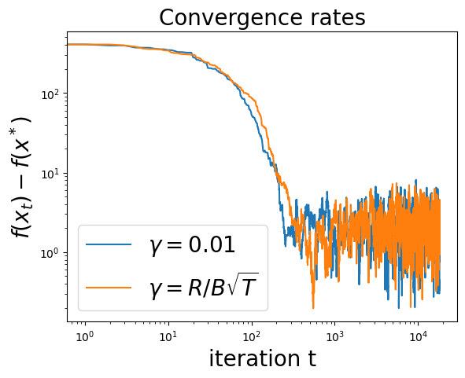
Convergence rate – Naïve vs Bounded
The step size used for bounded stochastic gradient causes the algorithm to get closer to the optimum, but on average it’s still very similar to the previous method.

Slide 34
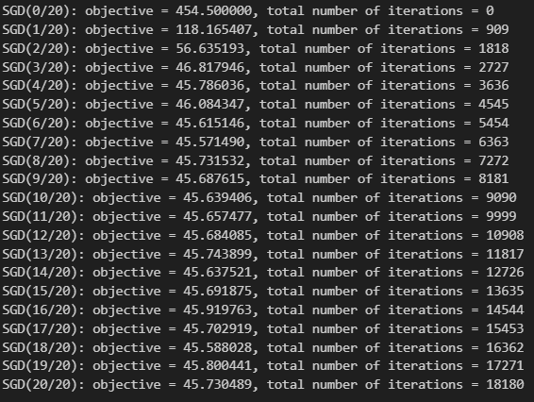
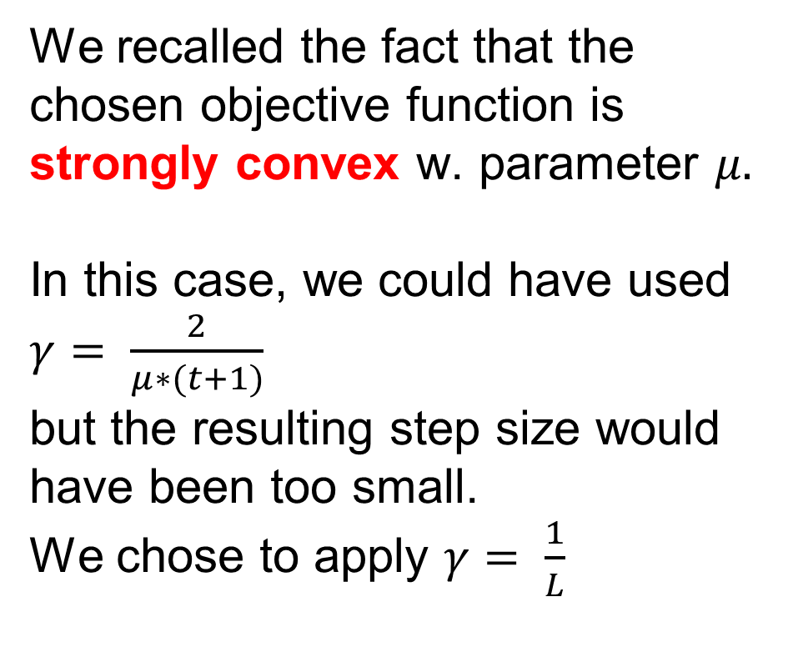
SGD using Strong Convexity
We recalled the fact that the chosen objective function is strongly convex w. parameter $μ.$
In this case, we could have used
$γ= \frac{2}{μ∗(t+1)}$
but the resulting step size would have been too small.
We chose to apply $γ= \frac{1}{L}$

Slide 35
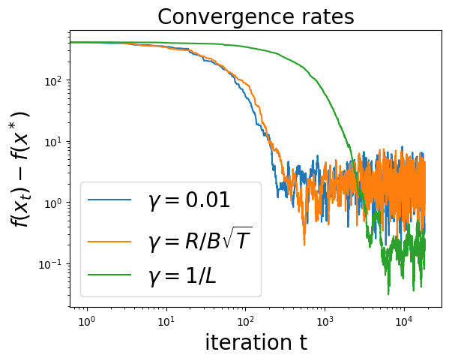
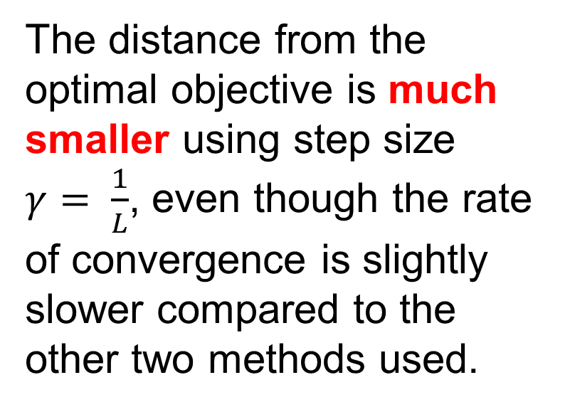
Convergence rate – comparing results
The distance from the optimal objective is much smaller using step size
$γ= \frac{1}{L}$, even though the rate of convergence is slightly slower compared to the other two methods used.

Slide 36
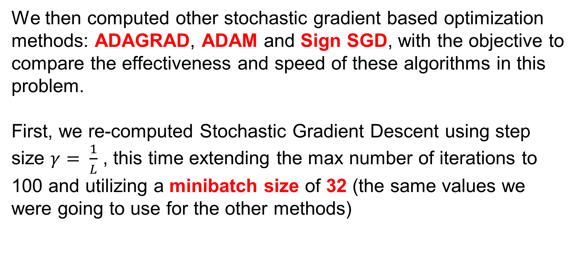
Other stochastic gradient based methods
We then computed other stochastic gradient based optimization methods: ADAGRAD, ADAM and Sign SGD, with the objective to compare the effectiveness and speed of these algorithms in this problem.
First, we re-computed Stochastic Gradient Descent using step size $γ= \frac{1}{L}$ , this time extending the max number of iterations to 100 and utilizing a minibatch size of 32 (the same values we were going to use for the other methods)

Slide 37

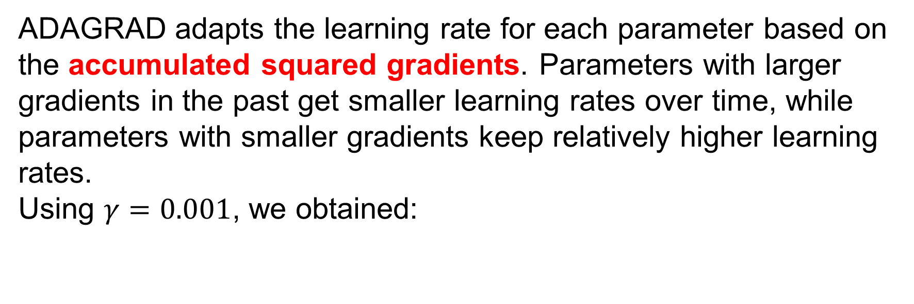
ADAGRAD
ADAGRAD adapts the learning rate for each parameter based on the accumulated squared gradients. Parameters with larger gradients in the past get smaller learning rates over time, while parameters with smaller gradients keep relatively higher learning rates.
Using $γ=0.001$, we obtained:

Slide 38

ADAM
Adam is an adaptive optimization algorithm that maintains exponentially decaying averages of past gradients (first moment) and squared gradients (second moment), which are used to adapt the learning rate for each parameter individually. Using parameters (as commonly used, for example by Keras)
β1 = 0.9 (hyperparameter used for first moment)
β2 = 0.999 (hyperparameter used for second moment)

Slide 39

Sign SGD
Sign SGD operates in a much more similar way to basic SGD but uses the sign of the gradient for each parameter as step direction instead of its value.
As for ADAGRAD and ADAM we used step size 0.001.

Slide 40
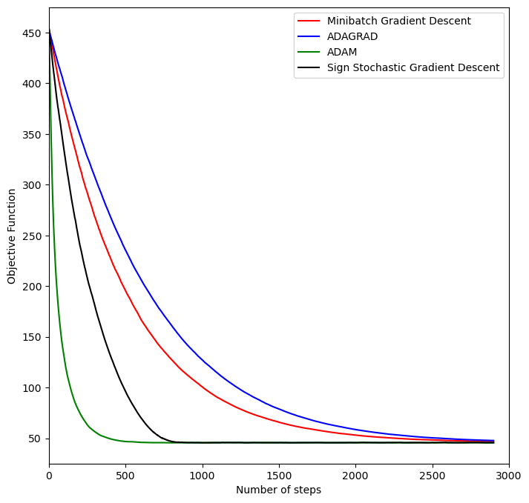
Comparing all Stochastic methods
ADAM is the fastest method out of the four, as it adapts the learning rate of each parameter using momentum, resulting in "smarter" adjustments;
Sign SGD is the second fastest, as it applies simple constant updates always in the same direction;
Minibatch Gradient Descent is relatively slower, as calculating the gradient stochastically may result in less decisive steps, requiring more iterations;
ADAGRAD is the slowest, as the step size is inversely proportional to the gradient values, resulting in small updates that get smaller and smaller.

Slide 41
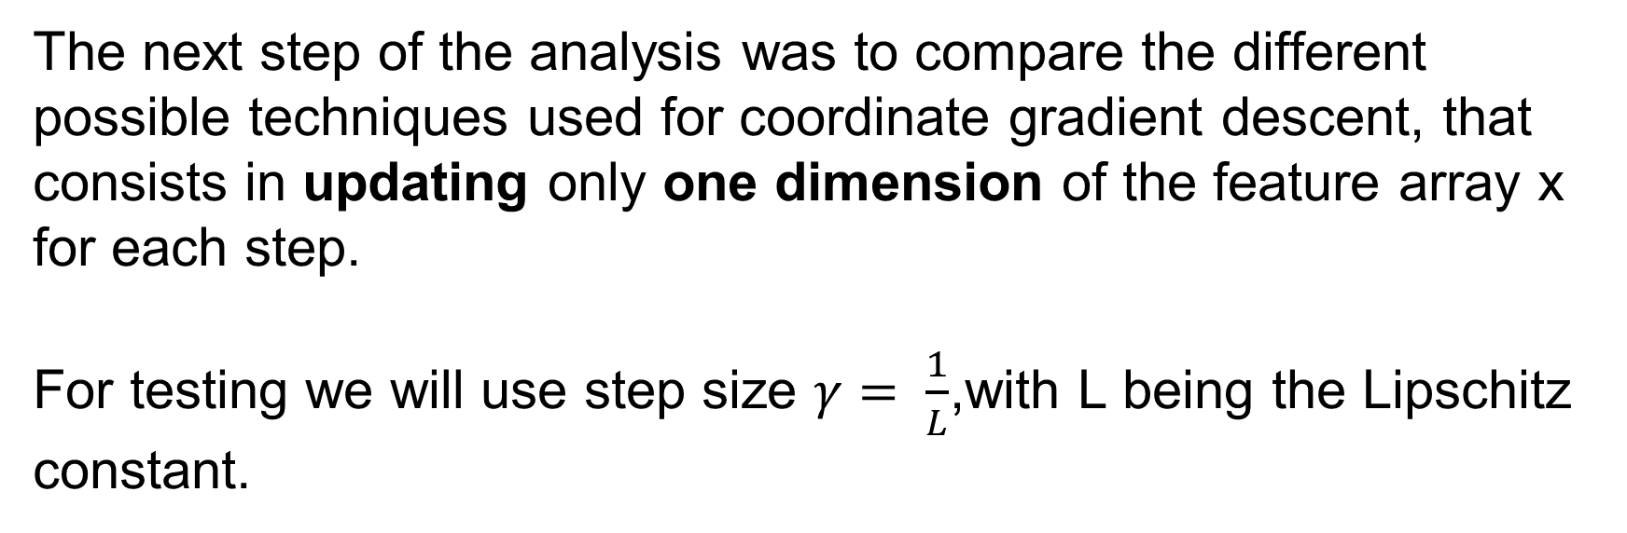
Coordinate descent
The next step of the analysis was to compare the different possible techniques used for coordinate gradient descent, that consists in updating only one dimension of the feature array x for each step.
For testing we will use step size $γ= \frac{1}{L}$,with L being the Lipschitz constant.

Slide 42
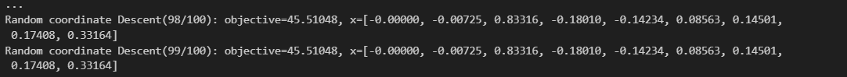
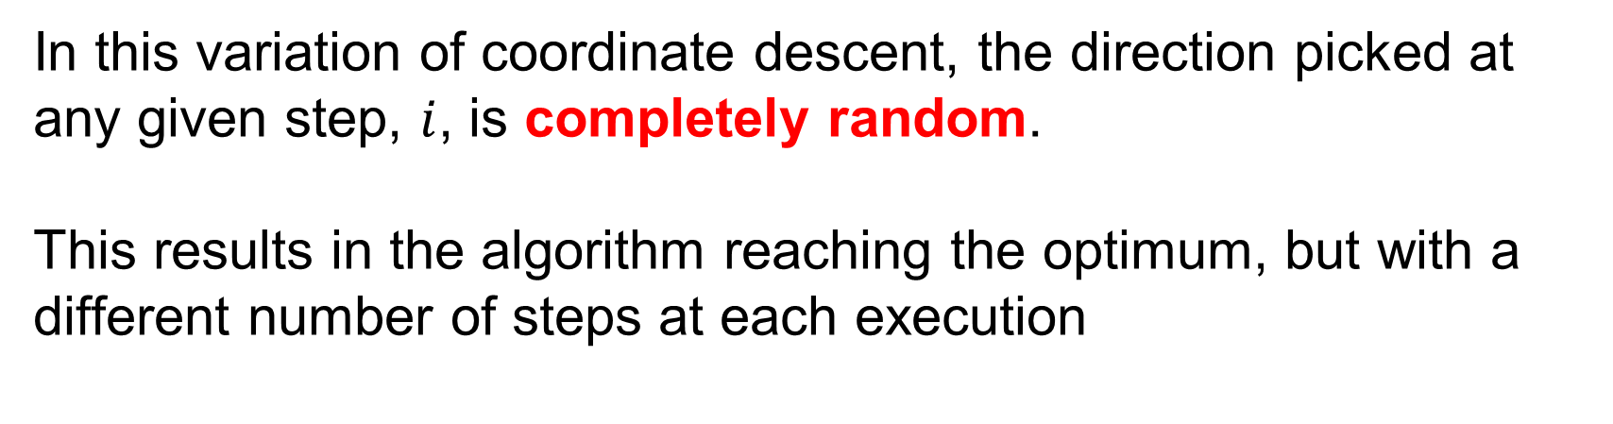
Random coordinate descent
In this variation of coordinate descent, the direction picked at any given step, $i$, is completely random.
This results in the algorithm reaching the optimum, but with a different number of steps at each execution
The final steps are always the same, though, as convergence is eventually reached.

Slide 43
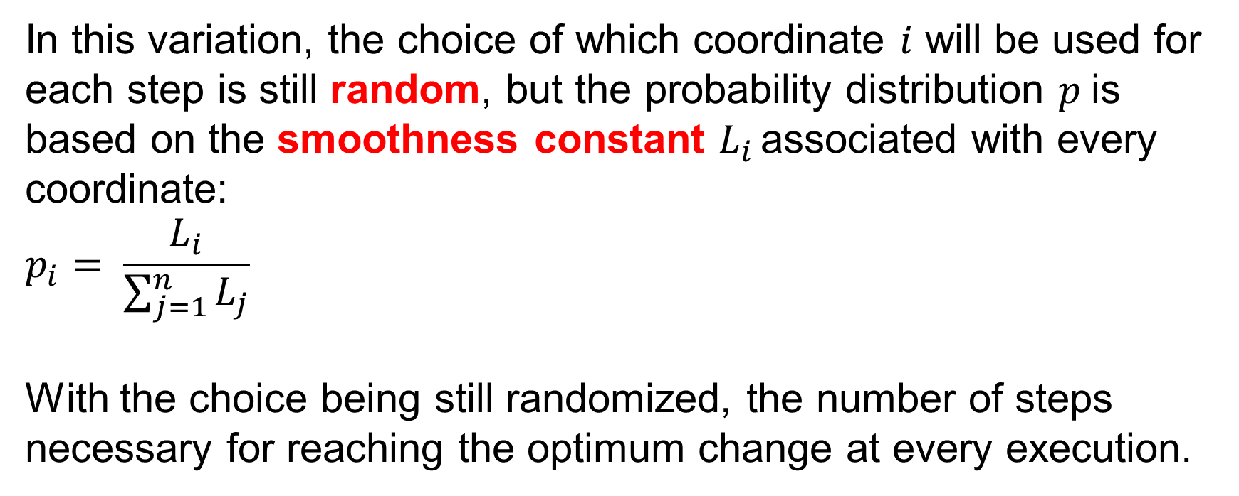
Importance sampling coordinate descent
In this variation, the choice of which coordinate $i$ will be used for each step is still random, but the probability distribution $p$is based on the smoothness constant $L_{i }$associated with every coordinate:
$$p_{i}= \frac{L_{i}}{\sum_{j=1}^{n}{L_{j}}}$$
With the choice being still randomized, the number of steps necessary for reaching the optimum change at every execution.

Slide 44
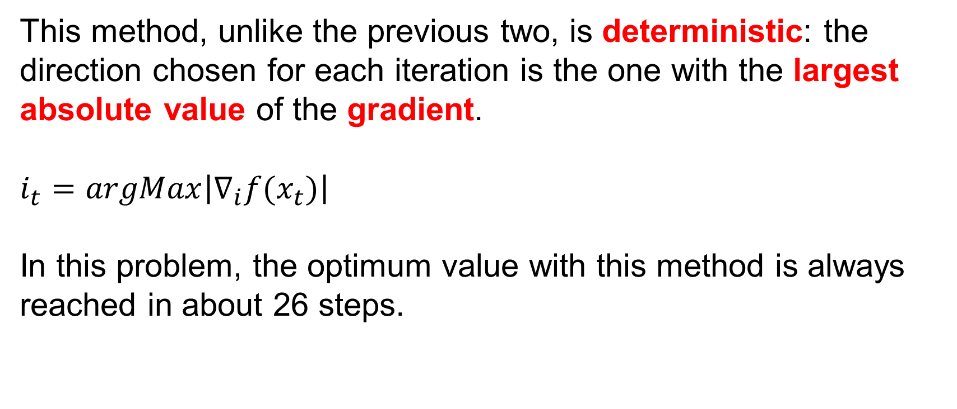
Steepest coordinate descent
This method, unlike the previous two, is deterministic: the direction chosen for each iteration is the one with the largest absolute value of the gradient.
$$i_{t}=argMax\left|∇_{i}f(x_{t})\right|$$
In this problem, the optimum value with this method is always reached in about 26 steps.

Slide 45
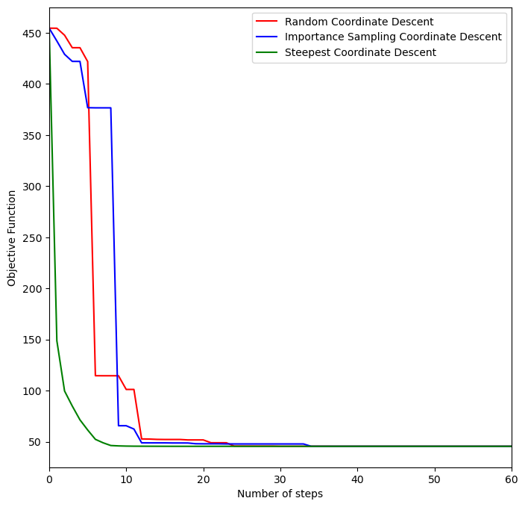
Comparing the coordinate techniques
All three converge in less than 50 steps.
Steepest Coordinate is by far the fastest method;
Importance Sampling is slower;
Random Coordinate has the most variance in its results.

Slide 46
Newton method
Finally we Implemented multivariate linear regression via the Newton method
We first computed the Hessian matrix: $∇^{2}f\left(x\right)=A^{T}A$

Slide 47
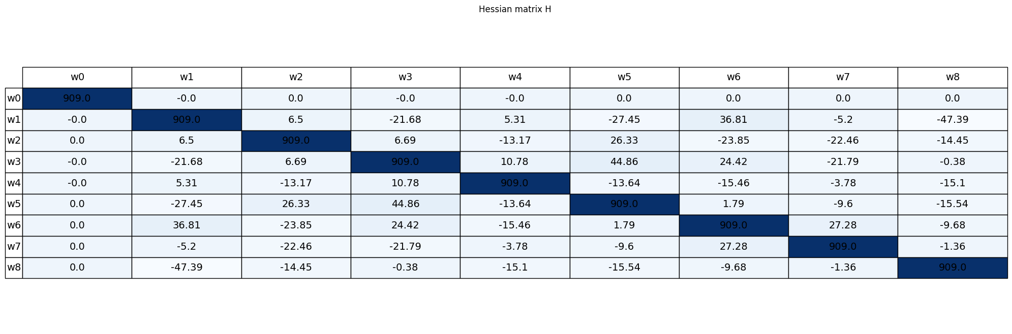
Hessian Diagnostics
Determinant of Hessian: $4,17⋅{10}^{26}$ → Hessian is invertible

Slide 48
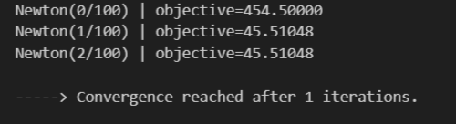
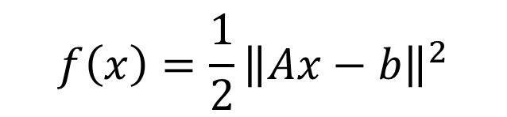
Newton converge in one step
Since our objective function is quadratic:
Newton's method is expected to converge in a single iteration.
$$f\left(x\right)=\frac{1}{2}{\left\|Ax−b\right\|}^{2}$$
And as expected:

Slide 49
Newton performance
In general, computing the inverse of the Hessian can be computationally expensive. However, in our case, the Hessian was computed in approximately 11 ms, and the optimal solution was found in an additional 6 ms.
We are satisfied with this performance, as it is comparable to other methods tested. Therefore, there is no need to explore quasi-Newton approaches, which estimate the inverse Hessian, for further speed-up in this scenario.

Slide 50
All performance compared
Gradient Descent Setting | Time needed | Steps needed
Naive Test | 7ms | 5
Smooth Constant | 5ms | 5
Lipschitz function | 55ms | 105
Strong convexity Test | 4ms | 4
Minibatch Stochastic Gradient | 203ms | /
ADAGRAD | 215ms | /
ADAM | 245ms | /
Sign Stochastic gradient | 180ms | /
Newton | 11+6ms | 1

Slide 51
All performance compared
Coordinate Descent Setting | Time needed | Steps needed
Random coordinate | 8ms | About 50
Importance sampling | 12ms | About 50
Steepest coordinate | 7ms | 20
The optimal objective function value and global minimum of the function are:

Slide 52
Conclusion
Out of all the techniques used for this problem’s analysis, the ones that performed the best were
Gradient Descent with strong convexity assumption, the fastest in terms of computational time;
Newton Method, the fastest in term of number of steps.
The Stochastic gradient methods seem to be the least performative, but this is due to the relatively small size of the dataset, which results in the full gradient to be computable quickly at every iteration.

