Slide 1

Optimization Project
Ingegneria Informatica
Students
Bolis Filippo Antonio (matr 1079493)
2024/2025
Mazzoleni Gabriele (matr 1079514)

Slide 2
Dataset presentation
The dataset under analysis contains information related to students' daily habits and personal characteristics, with the objective of investigating potential correlations with academic performance.
It includes 16 variables, of which: 9 are numerical and 7 are categorical

Slide 3
Dataset presentation
The 7 categorial are:
Student_id: Unique alphanumeric identifier for each student.
Gender: Student's gender {Male, Female}.
Part time job: Indicates whether the student has a job alongside studies {Yes, No}.
Diet quality: observed dietary quality {Poor, Fair, Good}.

Slide 4
Dataset presentation
The 7 categorial are:
Parental education level: Highest level of education attained by the student’s parents {High School, Bachelor, Master, PhD}.
Internet quality: Perceived internet connection quality at home {Poor, Average, Good}.
Extracurricular participation: Whether the student participates in extracurricular activities {Yes, No}.

Slide 5
Dataset presentation
The 9 numerical are:
Age [years]: Integer value representing the student's age.
Study hours per day: Average number of hours dedicated to studying each day.
Social media hours: Daily time spent on social media platforms.

Slide 6
Dataset presentation
The 9 numerical are:
Netflix hours: Daily time spent watching Netflix or similar platforms.
Attendance percentage: Percentage of lectures or classes attended.
sleep hours: Average number of hours of sleep per night.

Slide 7
Dataset presentation
The 9 numerical are:
exercise frequency [times/week]: Number of times per week the student engages in physical activity.
mental health rating [scale 1–10]: Self-assessed mental health condition.
exam score [scale 1–10]: Numerical score obtained in a key exam.

Slide 8
Dataset presentation
The 9 numerical are:
exercise frequency [times/week]: Number of times per week the student engages in physical activity.
mental health rating [scale 1–10]: Self-assessed mental health condition.
exam score [scale 1–10]: Numerical score obtained in a key exam.

Slide 9
Data preparation
The dataset contain roughly 1000 rows.
We conducted a missing data analysis, computing the percentage of missing values for each feature.
We set a threshold of 30% missingness to eliminate any variable whose proportion of missing data exceeded this limit.

Slide 10
Data preparation
Only one variable presented missing values, but the proportion of missing entries was well below the exclusion limit.
As a result, we applied a row-wise deletion strategy (dropna) to remove only the affected samples, ensuring a clean dataset without discarding useful variables.

Slide 11
Data preparation
To better understand the data, we visualized the distribution of all numerical features:
Most variables showed distributions compatible with normal.

Slide 12
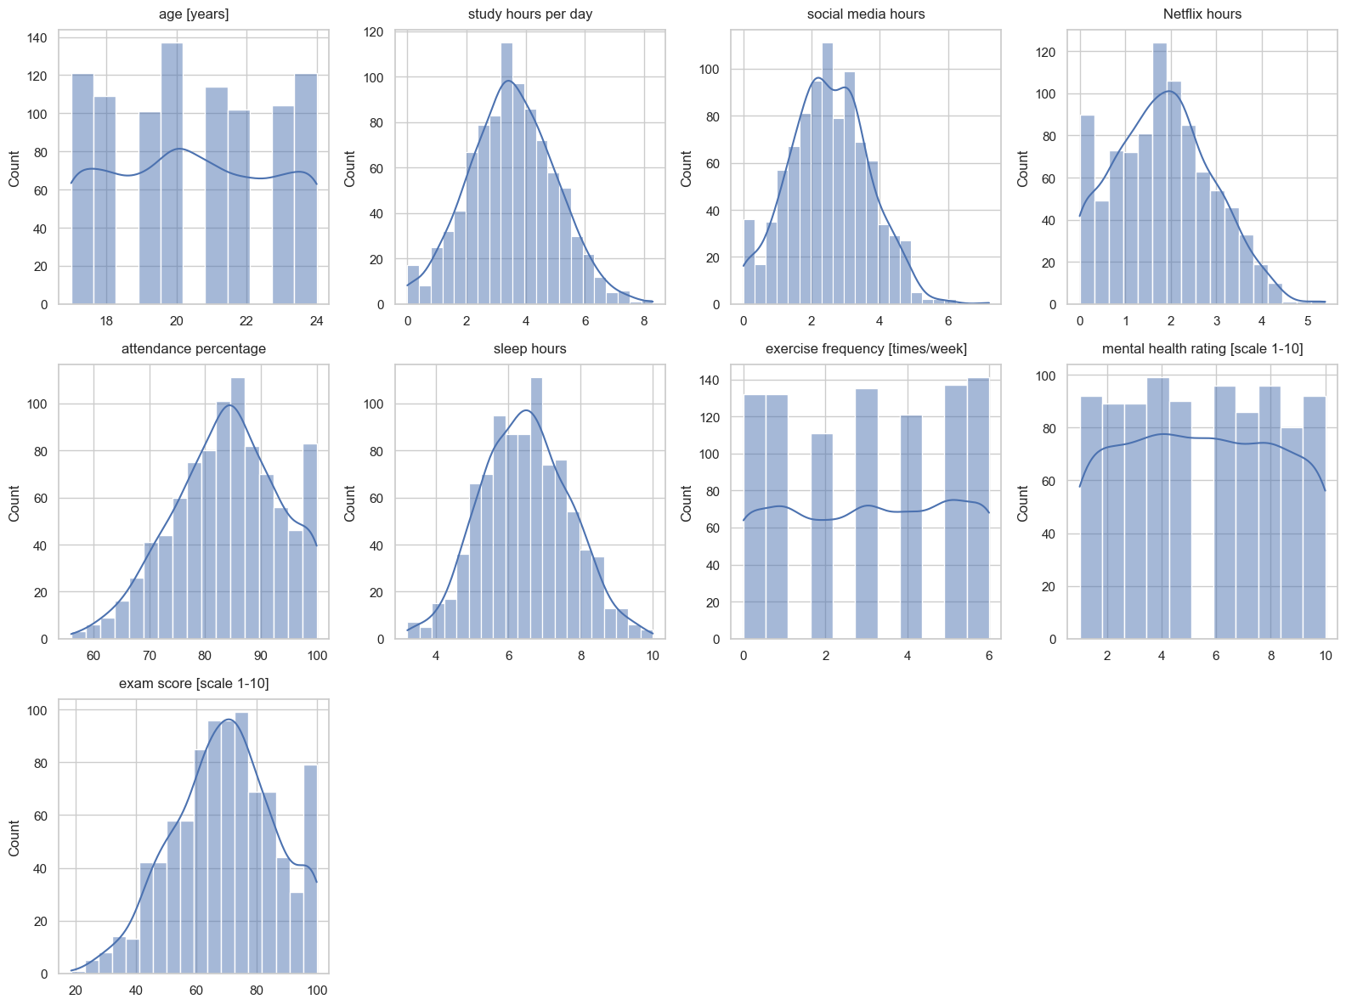
Data preparation

Slide 13
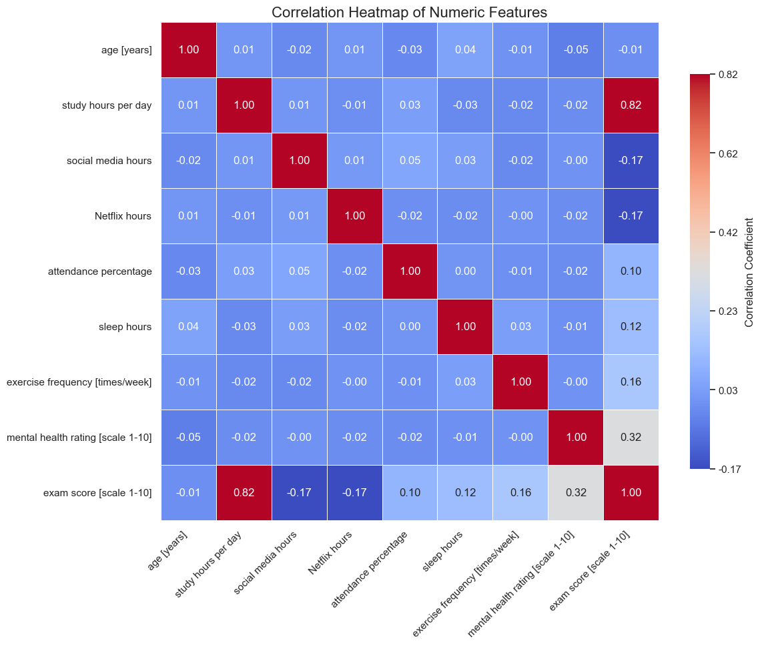
Data preparation
To better understand the correlation between the numerical variables in the dataset, we computed the correlation matrix.

Slide 14
Gradient Descent - Objective
The objective of our work is to demonstrate how theoretical step‑size selection affects speed and stability of optimization.

Slide 15
Gradient Descent - Pipeline
We implemented a multivariate linear regression workflow driven by Gradient Descent.
The pipeline:
standardize every numerical feature.
build a design matrix with an intercept.
run GD variants with different step‑size rules.
compare convergence and fitted lines.

Slide 16

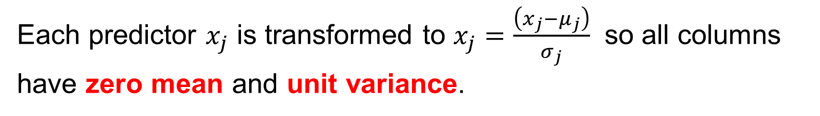
Data Standardization & Design Matrix
Each predictor $x_{j}$ is transformed to $x_{j}=\frac{\left(x_{j}−μ_{j}\right)}{σ_{j}}$​ so all columns have zero mean and unit variance.
We then create matrix $A=\left[1 | X\right]$ and vector $b=$ standardized exam score.
Standardization removes scale effects, letting us use a single learning rate across all coefficients.

Slide 17
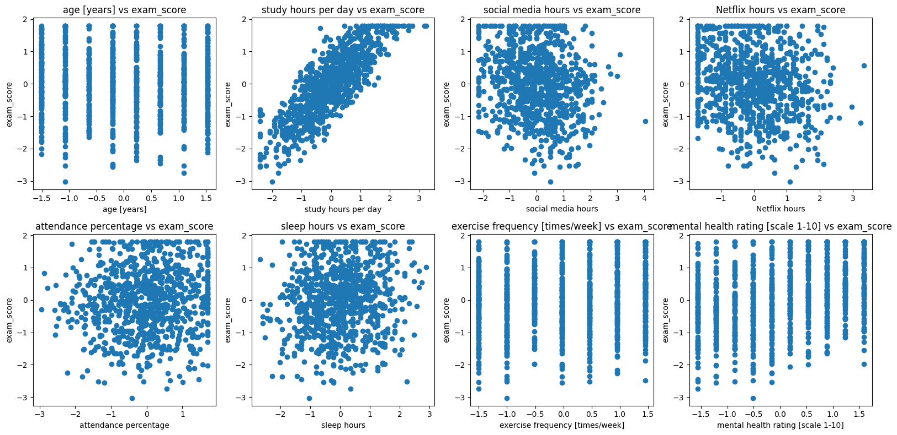
Exploratory Scatter Plots

Slide 18
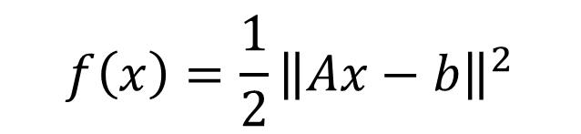
Core GD Implementation
We decided to pick the following loss function as our objective function for this analysis (Ordinary Least Squares):
$$f\left(x\right)=\frac{1}{2}{\left\|Ax−b\right\|}^{2}$$

Slide 19
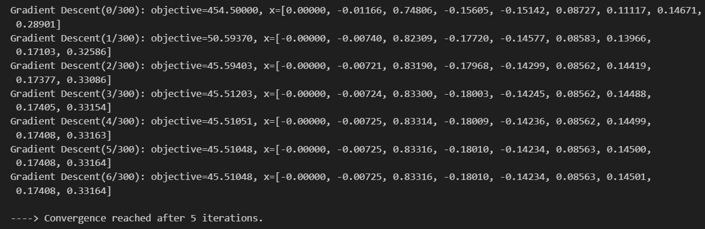
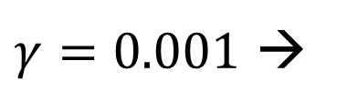
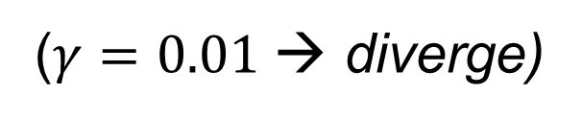
First variant: Naive Step
We set an empirical $γ$
($γ=0.01$→ diverge)
$γ=0.001$ →

