Slide 1
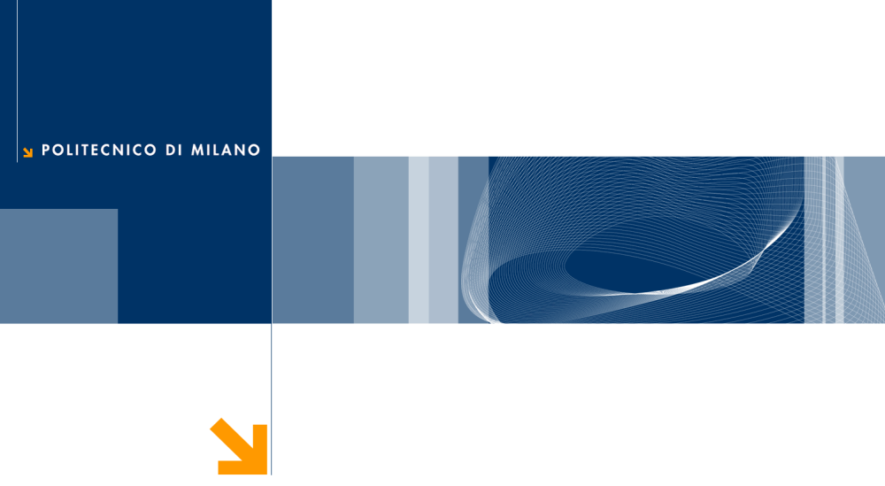
Non-Parametric methods application for Sleep Stages recognition.
Biomedical Signal Processing 2021-2022
Gaia Vettori & Filippo Castellani
POLITECNICO DI MILANO

Slide 2

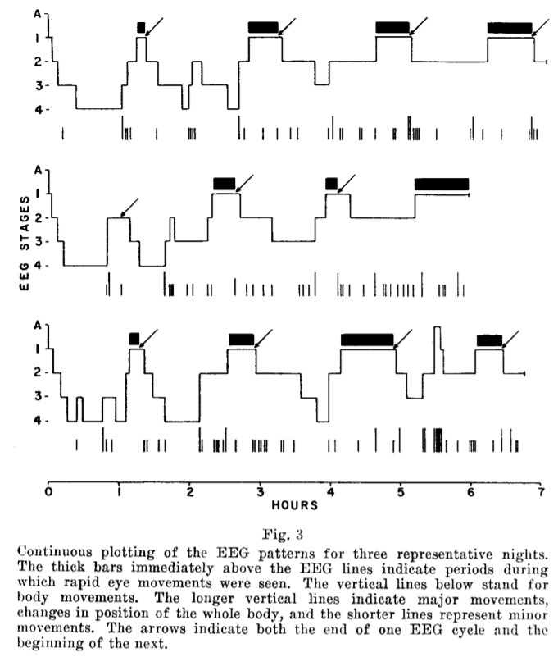
What is an Hypnogram
Descriptions
Hypnograms are Stages of Sleep vs Time plots.
Hypnograms are usually obtained by visually scoring the recordings from polysomnography recordings.
Biomedical Signal Processing 2021-2022
POLITECNICO DI MILANO

Slide 3
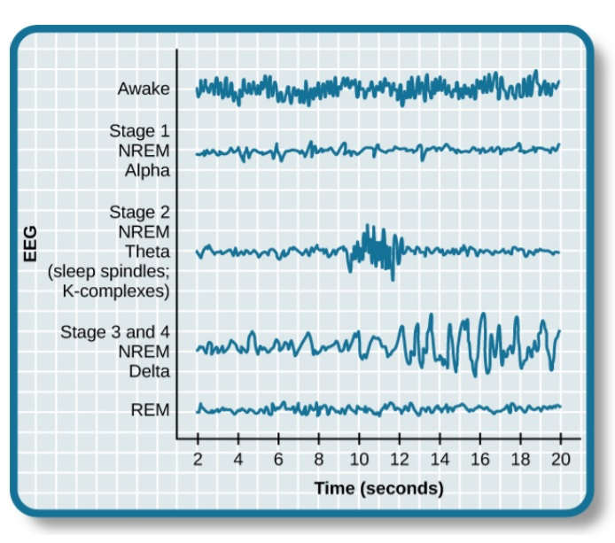
Stages of Sleep
SoS characteristics
Sleep is composed of several different stages.
Stages are differentiated by the patterns of brain wave activity that occur during each stage.
Biomedical Signal Processing 2021-2022
POLITECNICO DI MILANO

Slide 4
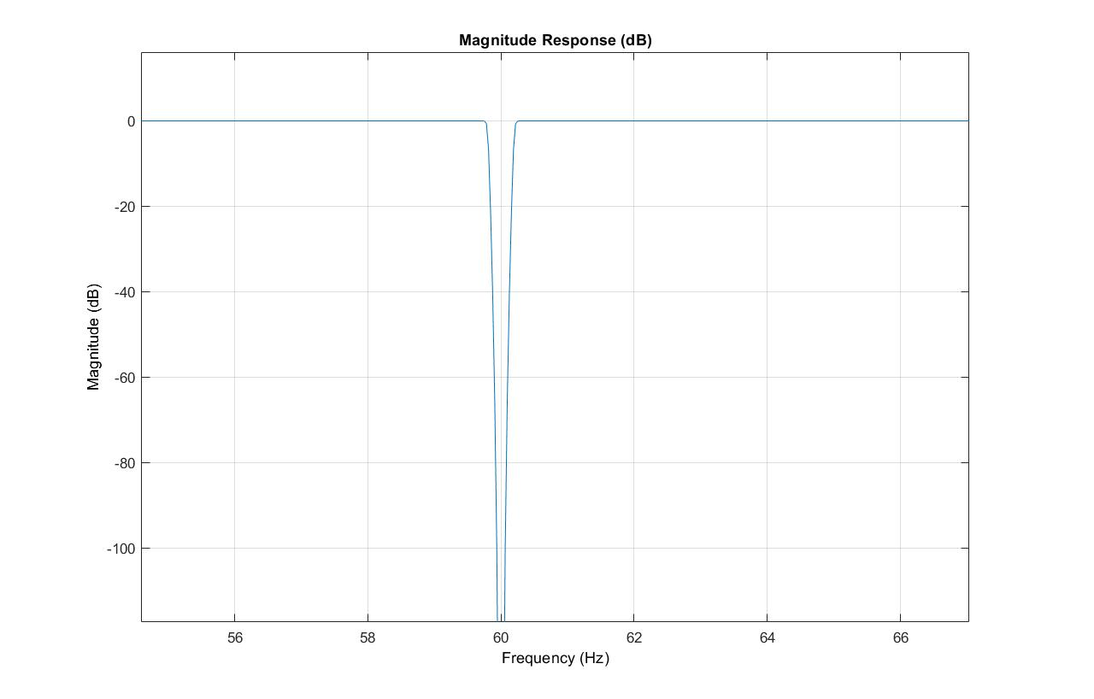
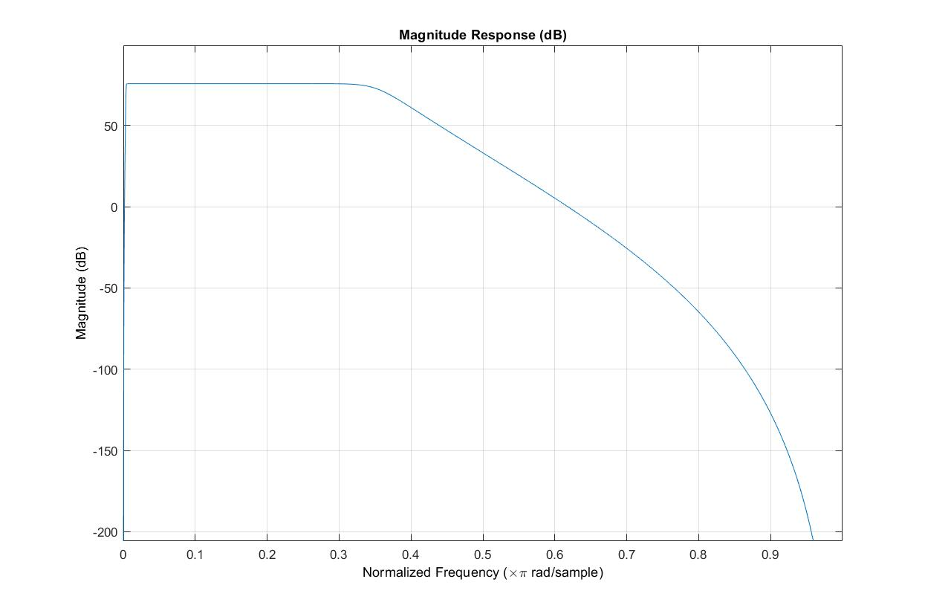
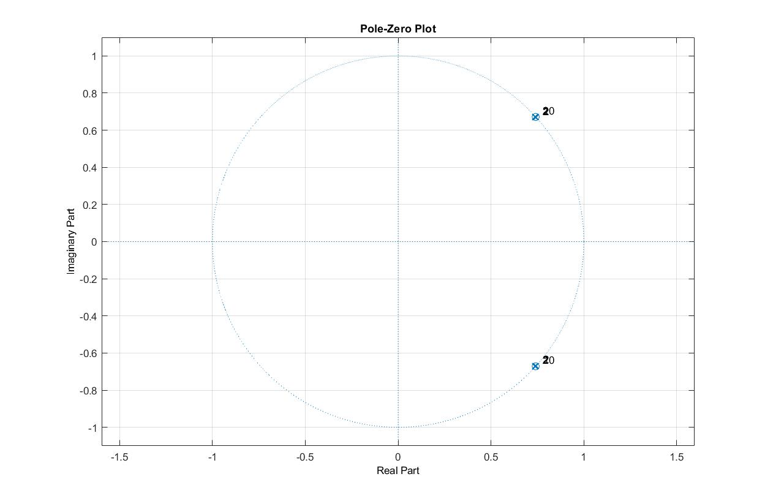
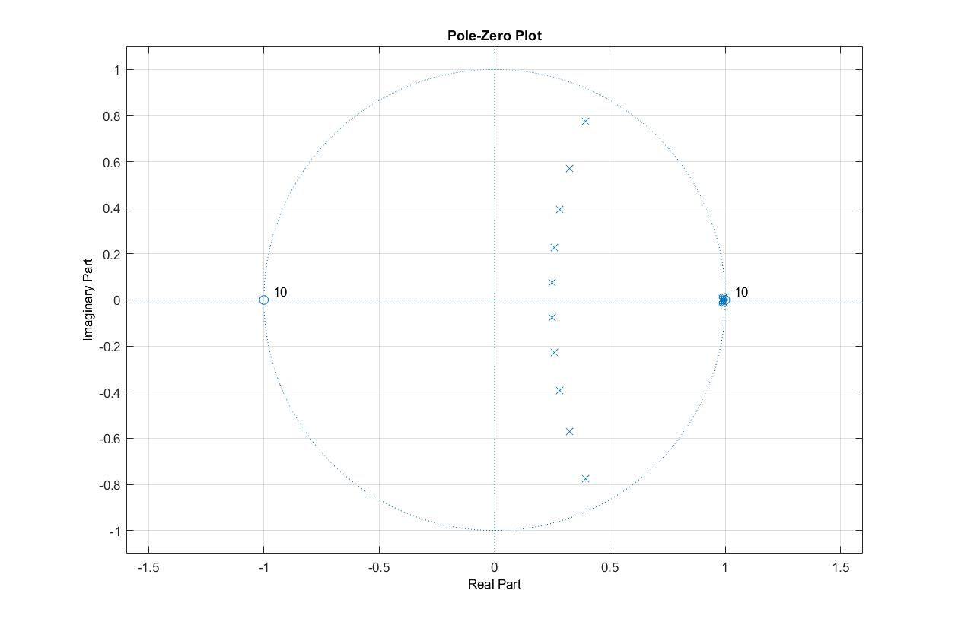
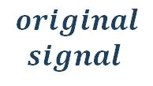
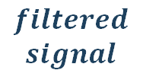
Signal Pre-Processing
De-Noising
Removing high and low frequencies
$$original$$
$$signal$$
$$filtered$$
$$signal$$
Biomedical Signal Processing 2021-2022
POLITECNICO DI MILANO
Notes:
This is the right versione of the slide.
This same slide in the video has wrong pictures on the right side.

Slide 5
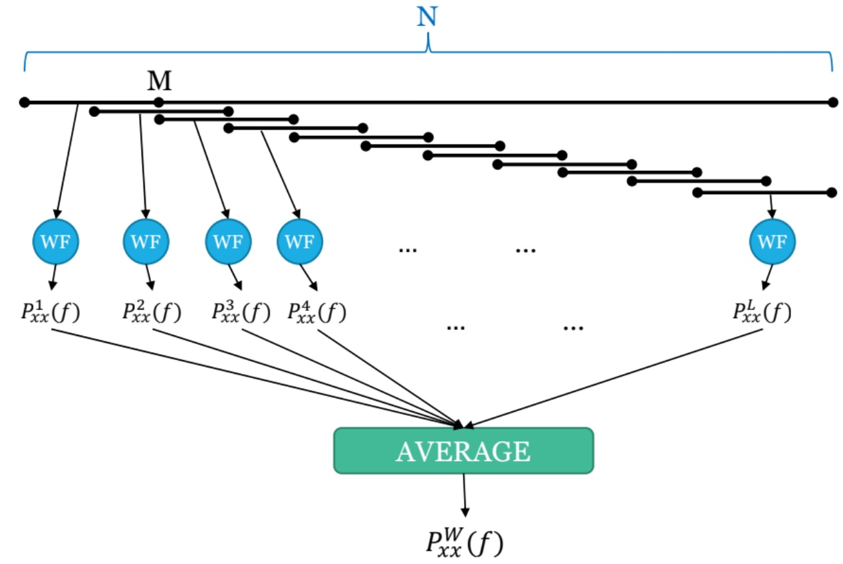
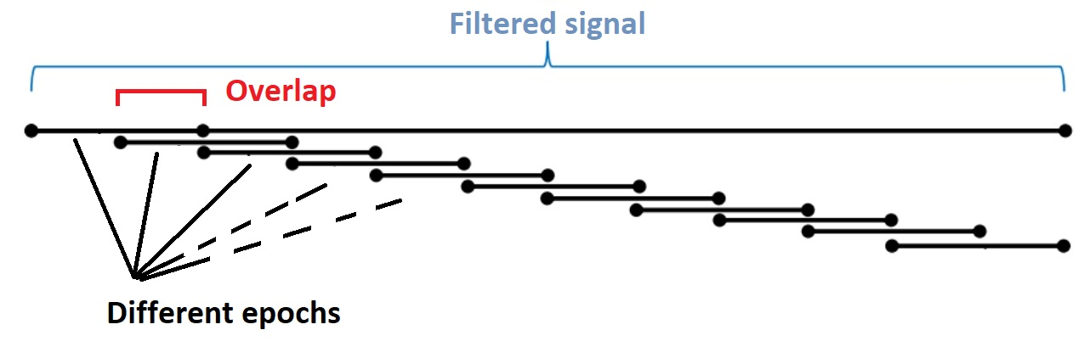

Welch’s modified periodogram (non-parametric frequency analysis)
Epoch: 30 sec (N)
Window: 10 sec (M)
Window type: Hann
OL: 0.5
$$Zero$$
$$padding$$
This procedure has been applied overlapping the epochs as well
Variable Jump = 0.9
(overlapping samples
number is = M*0.9)
Biomedical Signal Processing 2021-2022
POLITECNICO DI MILANO

Slide 6
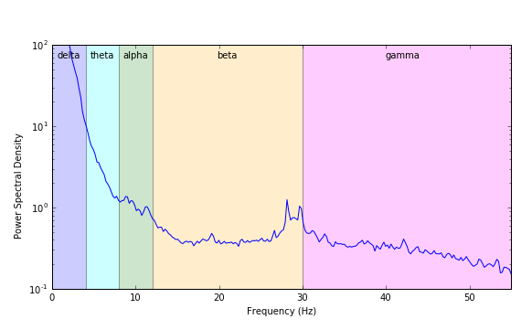
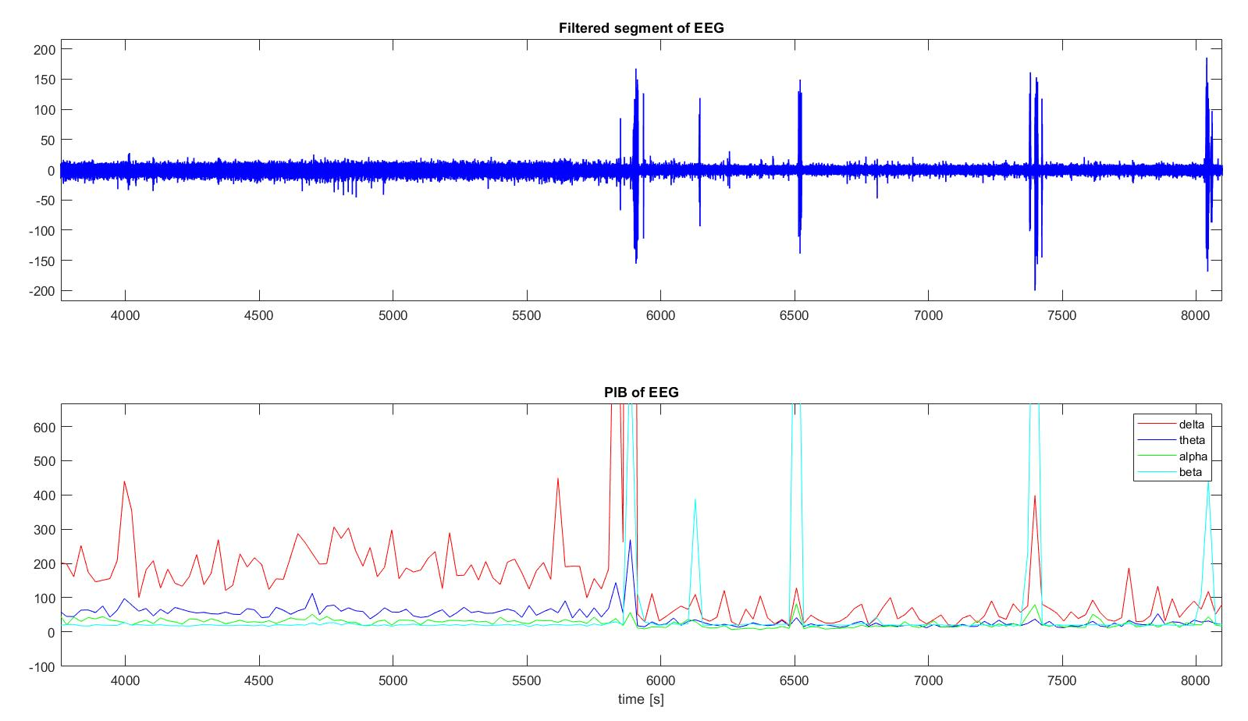
Sleep Stages Classification
Partitioning power in
four classes
Biomedical Signal Processing 2021-2022
POLITECNICO DI MILANO

Slide 7
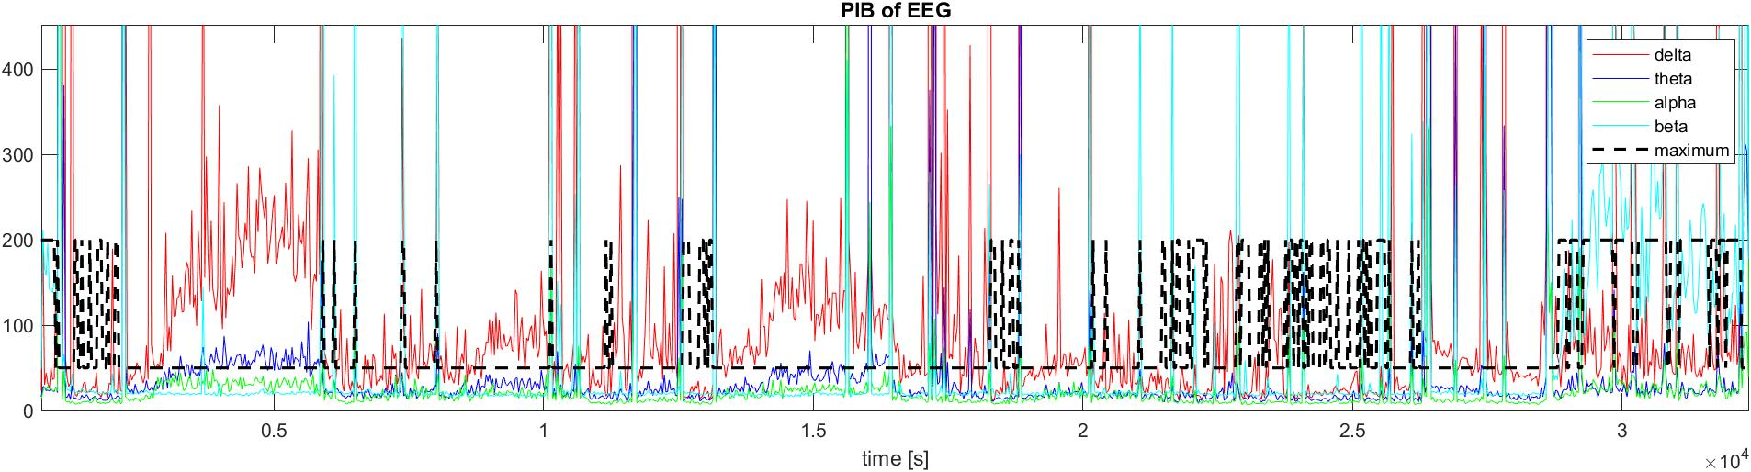
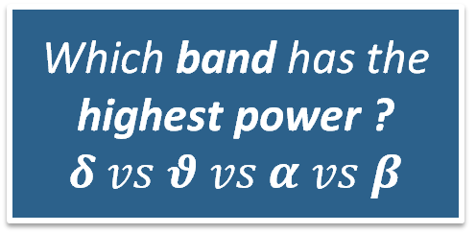
Sleep Stages Classification
Which band has the highest power ?
$$δ vs θ vs α vs β$$
Biomedical Signal Processing 2021-2022
POLITECNICO DI MILANO

Slide 8
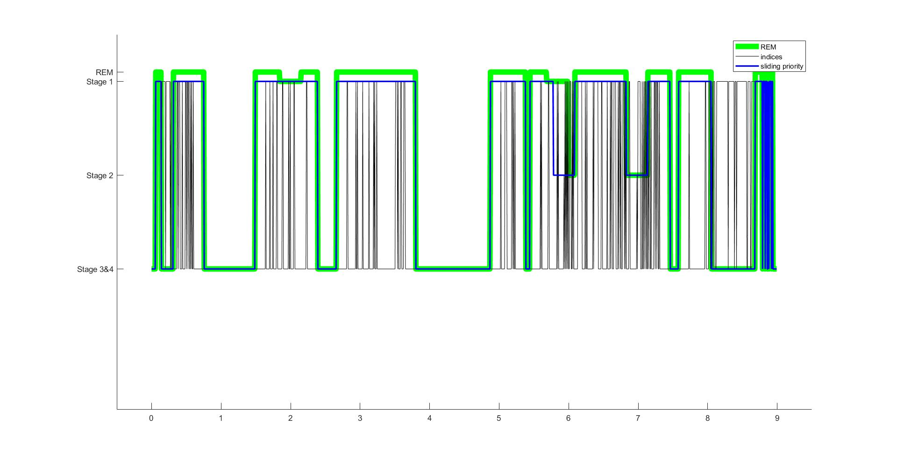
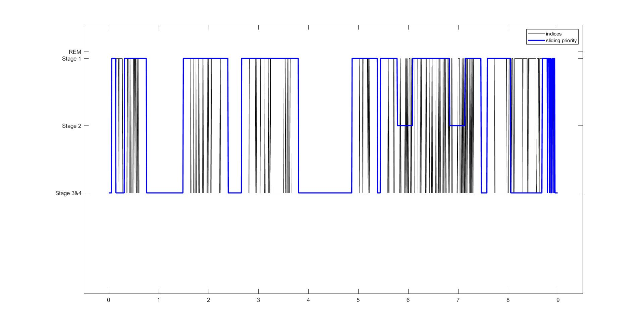
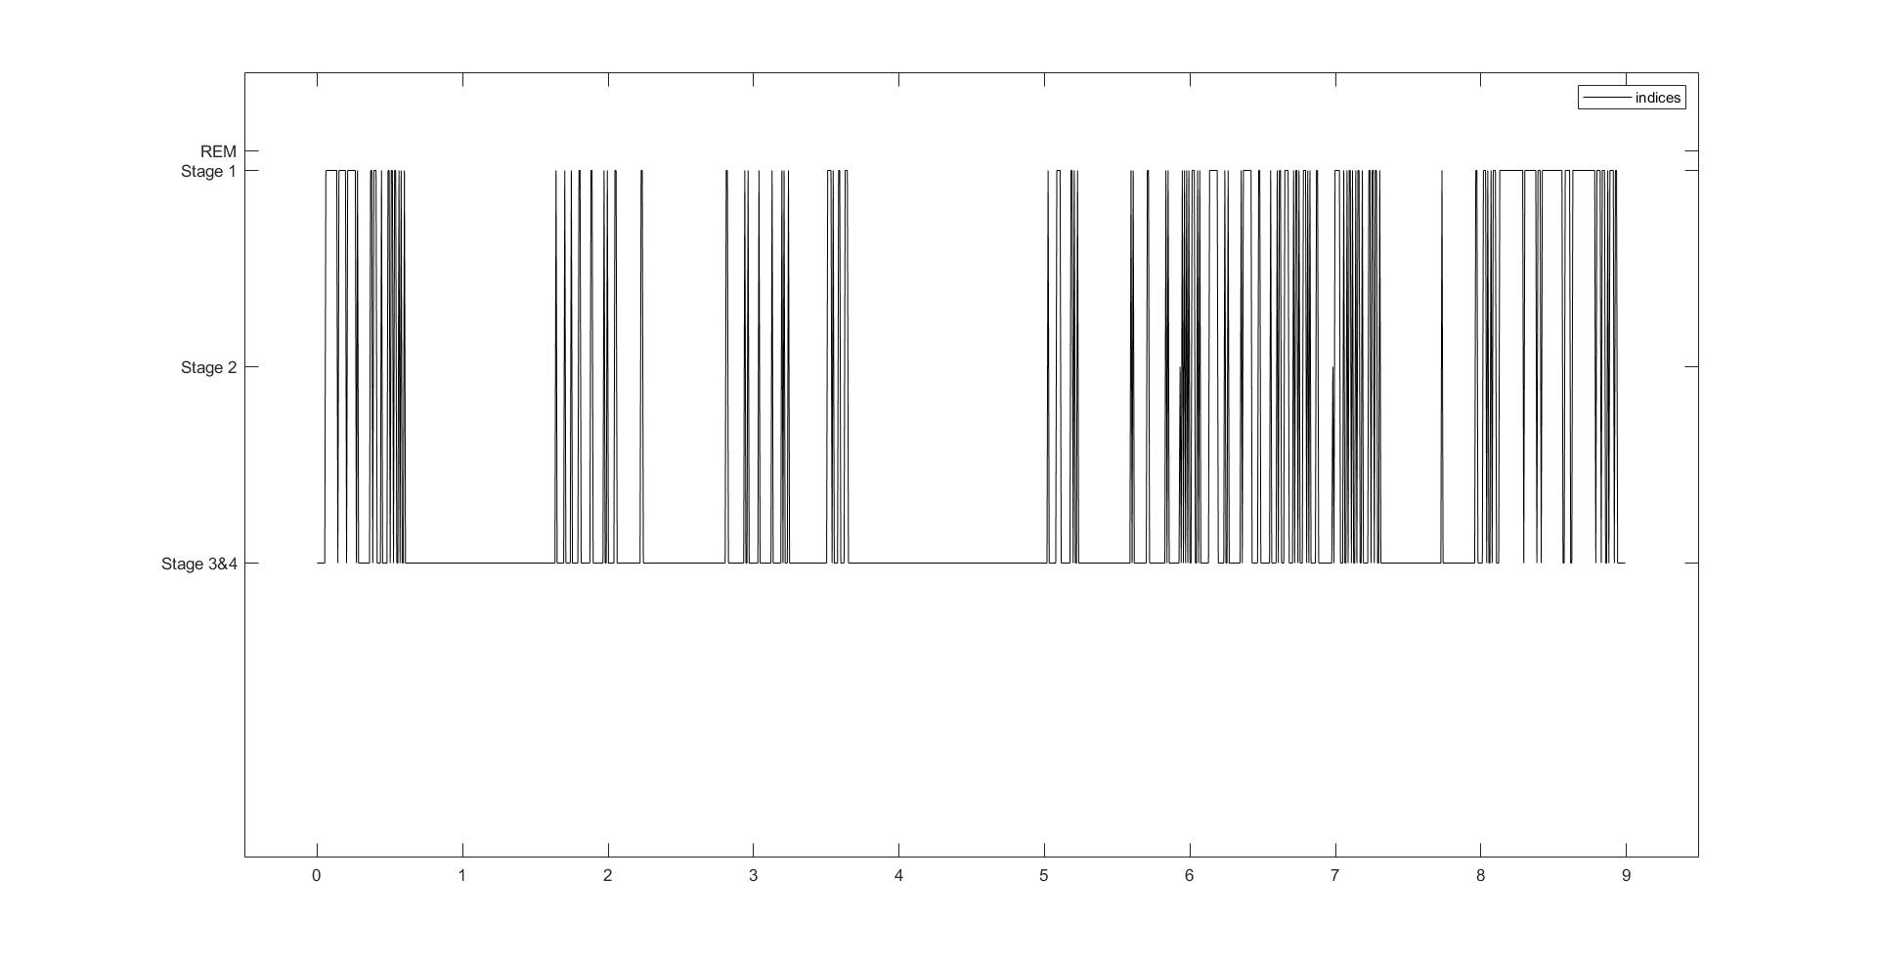
Results & Conclusions
Biomedical Signal Processing 2021-2022
POLITECNICO DI MILANO

Slide 9
Thank you for your attention
Biomedical Signal Processing 2021-2022
Gaia Vettori & Filippo Castellani
POLITECNICO DI MILANO

Slide 10
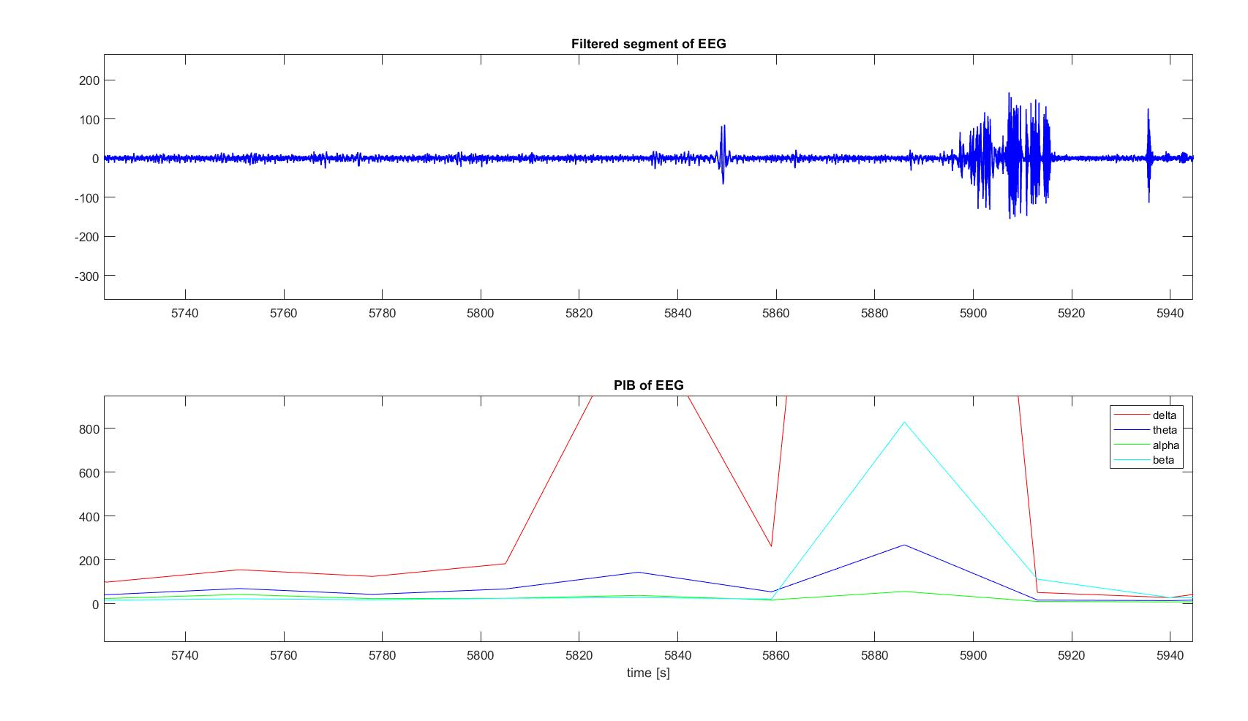
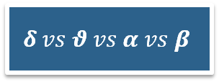
Sleep Stages Classification (Priority Assignment)
$$δ vs θ vs α vs β$$
Priority Assignment stabilizes the winning indices plot.
The function gives priority to weak but crucial events which appear enough times to overcome an “occurrency threshold”.
Biomedical Signal Processing 2021-2022
POLITECNICO DI MILANO
Notes:
EXTRA SLIDE

