Slide 1

Non-Parametric methods application for Sleep Stages recognition.
Biomedical Signal Processing 2021-2022
Gaia Vettori & Filippo Castellani
POLITECNICO DI MILANO

Slide 2

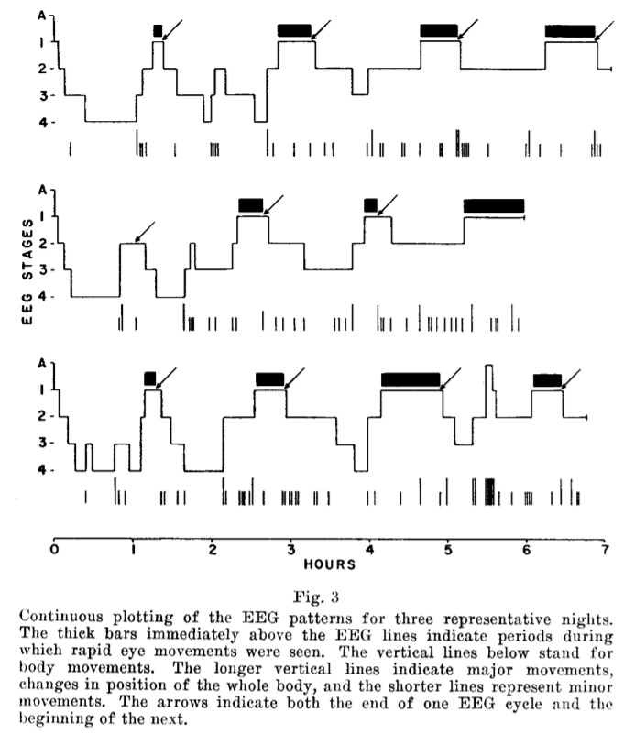
What is an Hypnogram
Descriptions
Hypnograms are Stages of Sleep vs Time plots.
Hypnograms are usually obtained by visually scoring the recordings from polysomnography recordings.
Biomedical Signal Processing 2021-2022
POLITECNICO DI MILANO
Notes:
Hypnograms are Stages of Sleep vs Time plots.
Hypnograms are usually obtained by viually scoring the recordings from polysomnography recordings which means EEG + EOG + EMG.
These are some examples of hypnograms we took from the article «Cyclic variations in EEG …»

Slide 3
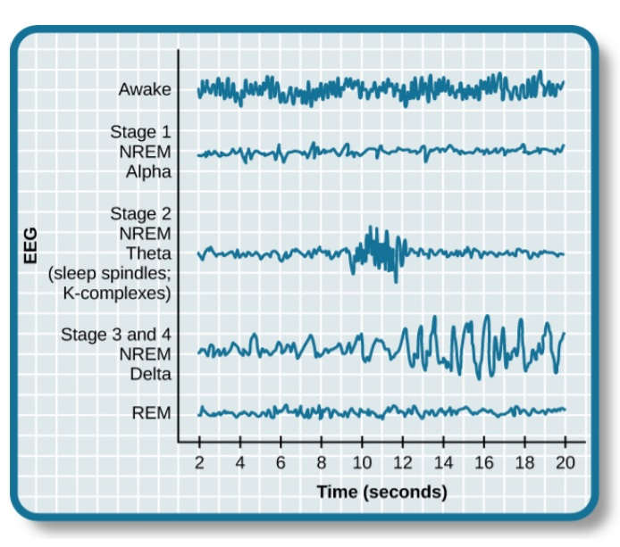
Stages of Sleep
SoS characteristics
Sleep is composed of several different stages.
Stages are differentiated by the patterns of brain wave activity that occur during each stage.
Biomedical Signal Processing 2021-2022
POLITECNICO DI MILANO
Notes:
Sleep is not a uniform state of being. Instead, sleep is composed of several different stages that can be differentiated from one another by the patterns of brain wave activity that occur during each stage.
These changes in brain wave activity can be visualized using EEG and are distinguished from one another by both the frequency and amplitude of brain waves

Slide 4
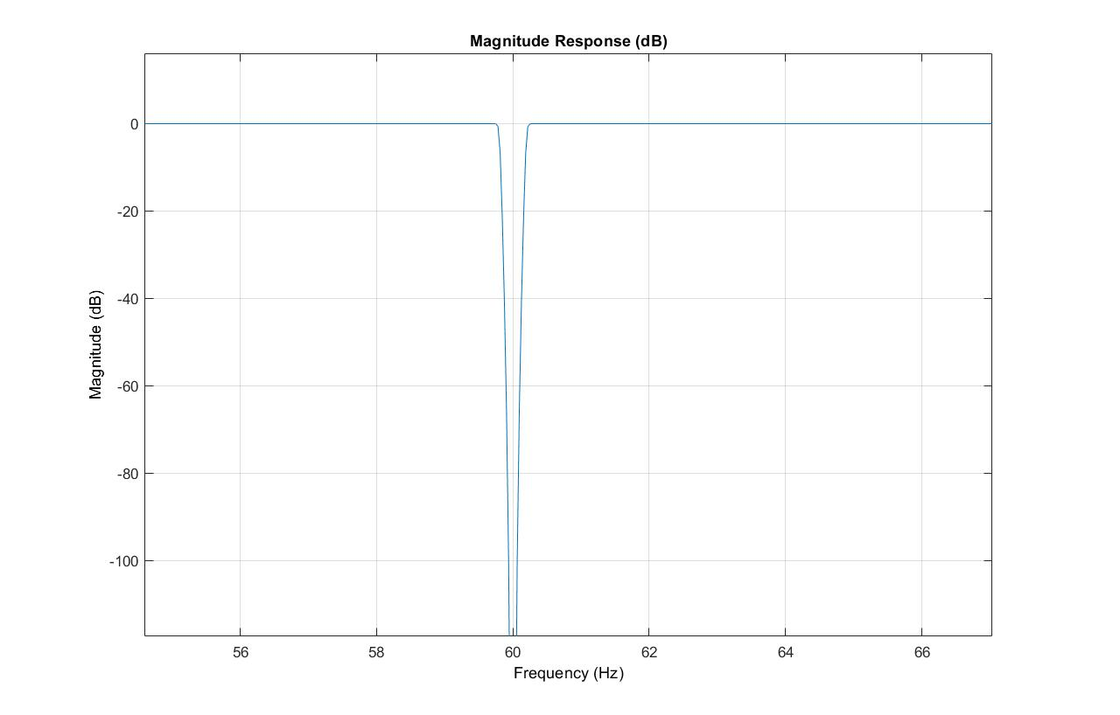
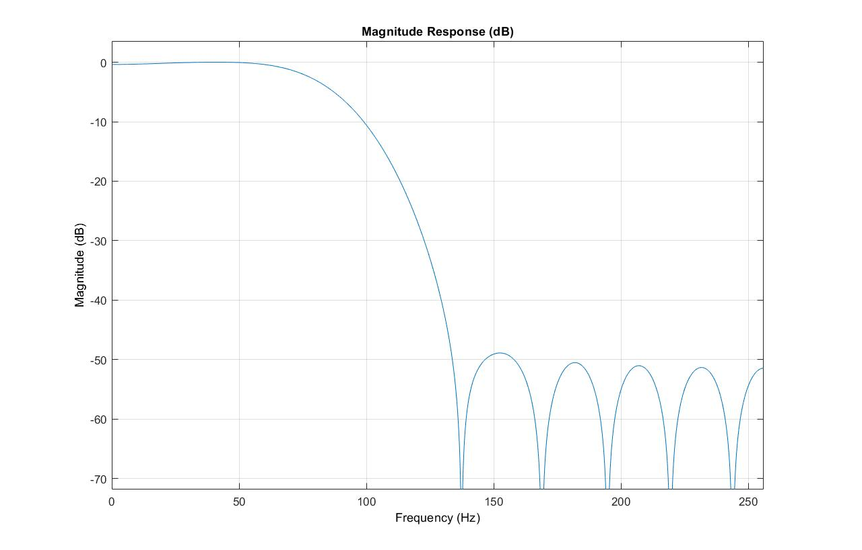
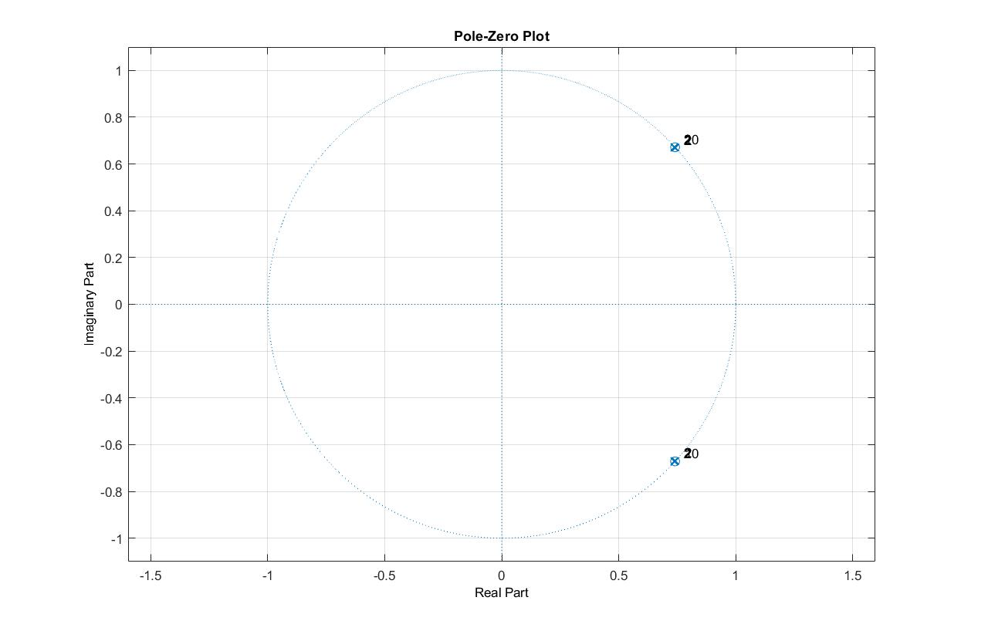
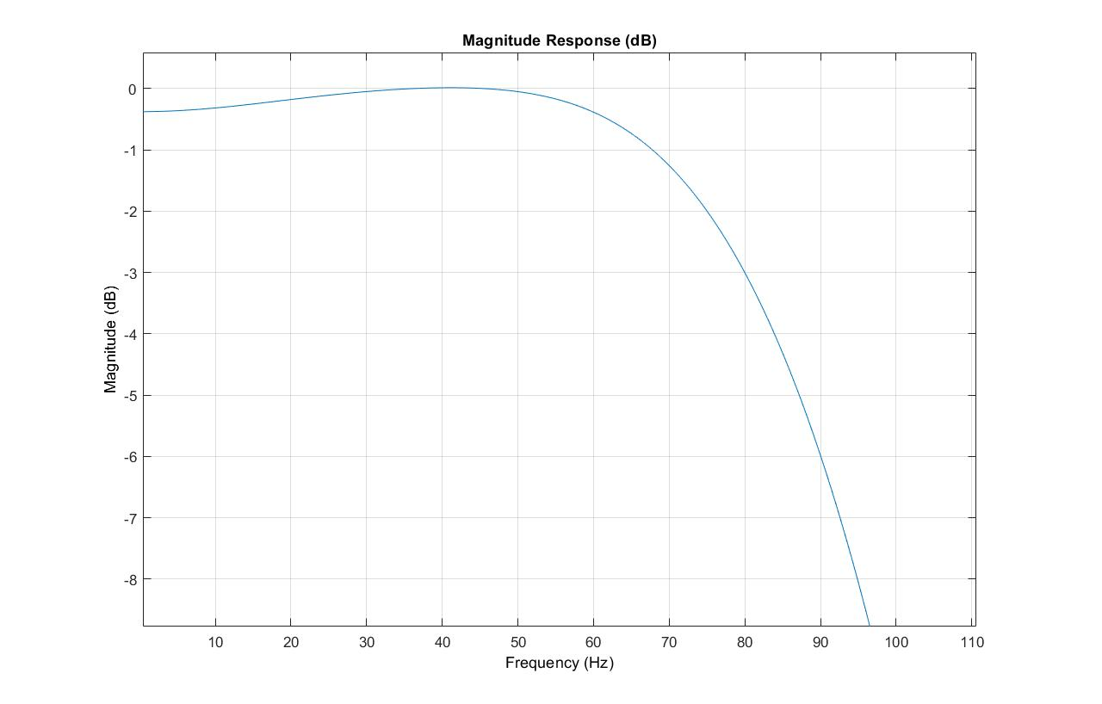
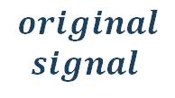
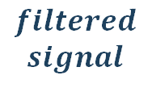
Signal Pre-Processing
De-Noising
Removing high and low frequencies
$$original$$
$$signal$$
$$filtered$$
$$signal$$
Biomedical Signal Processing 2021-2022
POLITECNICO DI MILANO
Notes:
The pre-processig of the signal consisted in eliminated noise and unnecessary frequencies. The 60 Hz noise was canceled using a 20 order butterworth stop band filter and the further cleaning was done with a 20 order passband filter generated by the function filterDesigner

Slide 5
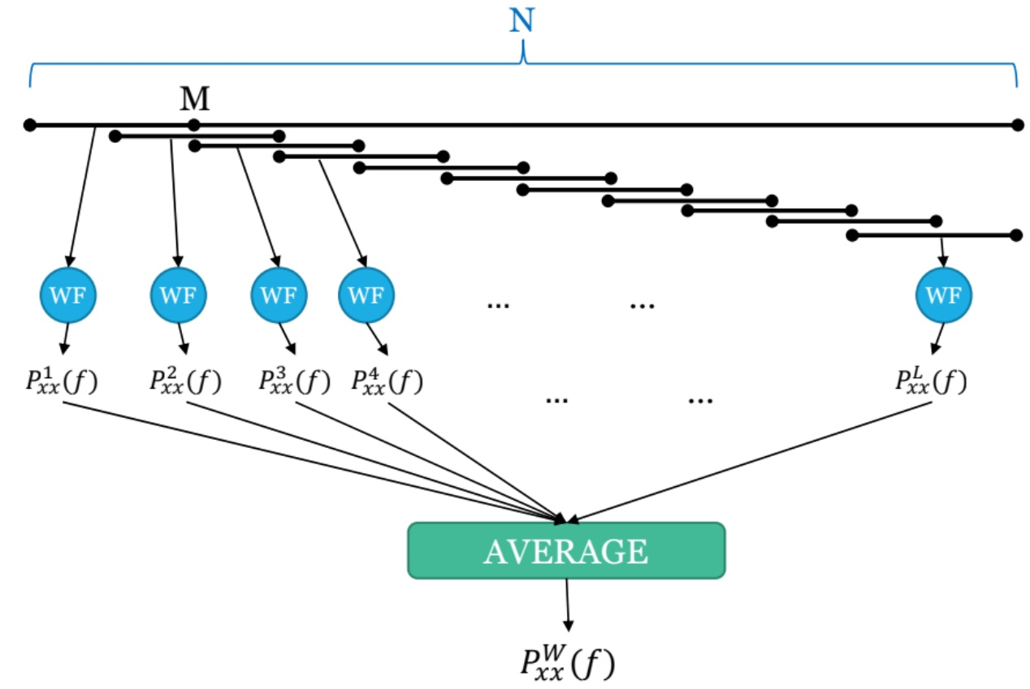
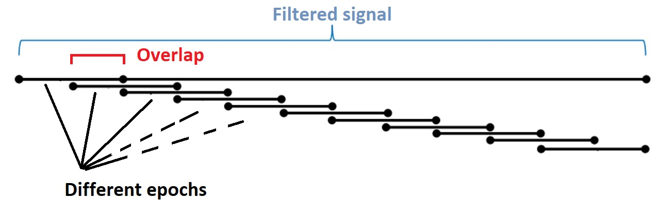

Welch’s modified periodogram (non-parametric frequency analysis)
Epoch: 30 sec (N)
Window: 10 sec (M)
Window type: Hann
OL: 0.5
$$Zero$$
$$padding$$
This procedure has been applied overlapping the epochs as well
Variable Jump = 0.9
(overlapping samples
number is = M*0.9)
Biomedical Signal Processing 2021-2022
POLITECNICO DI MILANO
Notes:
The PS analysis was done using the Welch non-parametric method over 30 second epochs and 10 second windows. The window length of 10 secs and the overlap 50% between windows were given as inputs to the pwelch matlab function. Furthermore an overlap between epoch was also implemented.

Slide 6
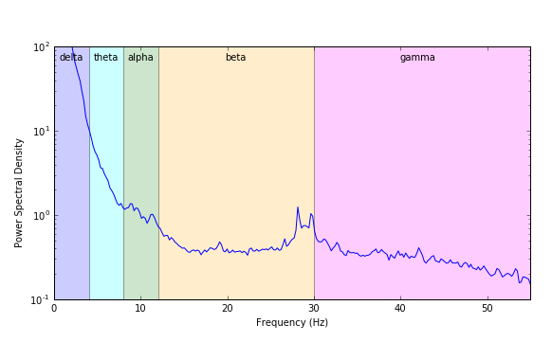
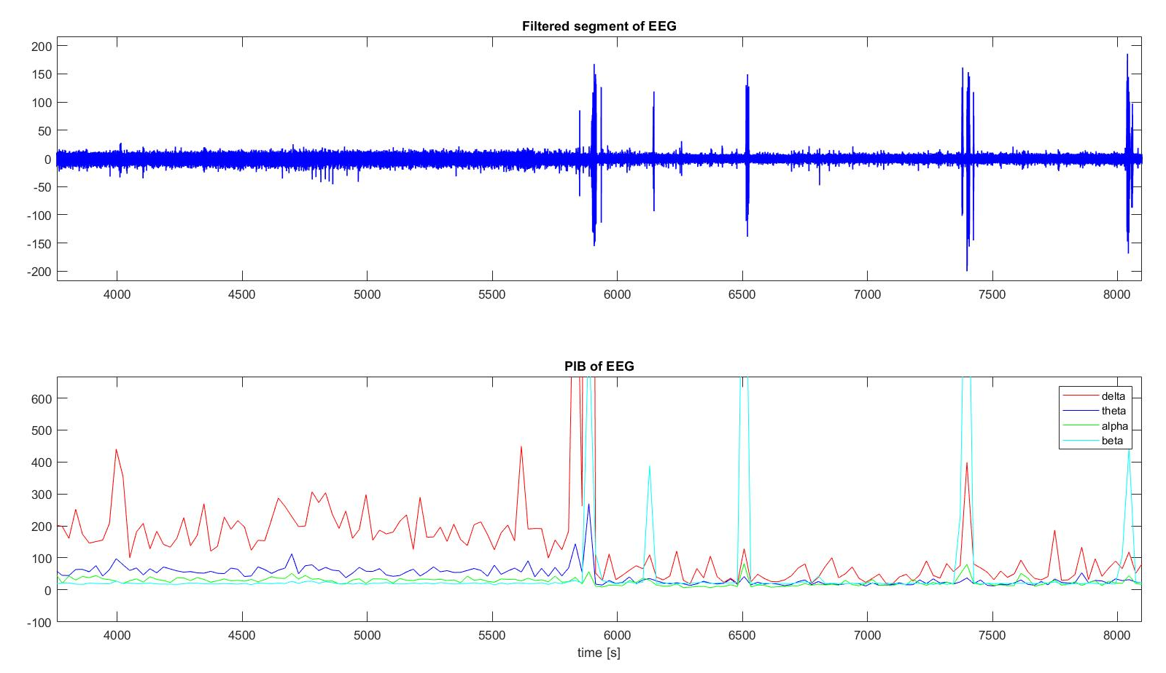
Sleep Stages Classification
Partitioning power in
four classes
Biomedical Signal Processing 2021-2022
POLITECNICO DI MILANO
Notes:
The different frequency components’ power spectra were stored in vectors showed in the graph.

Slide 7
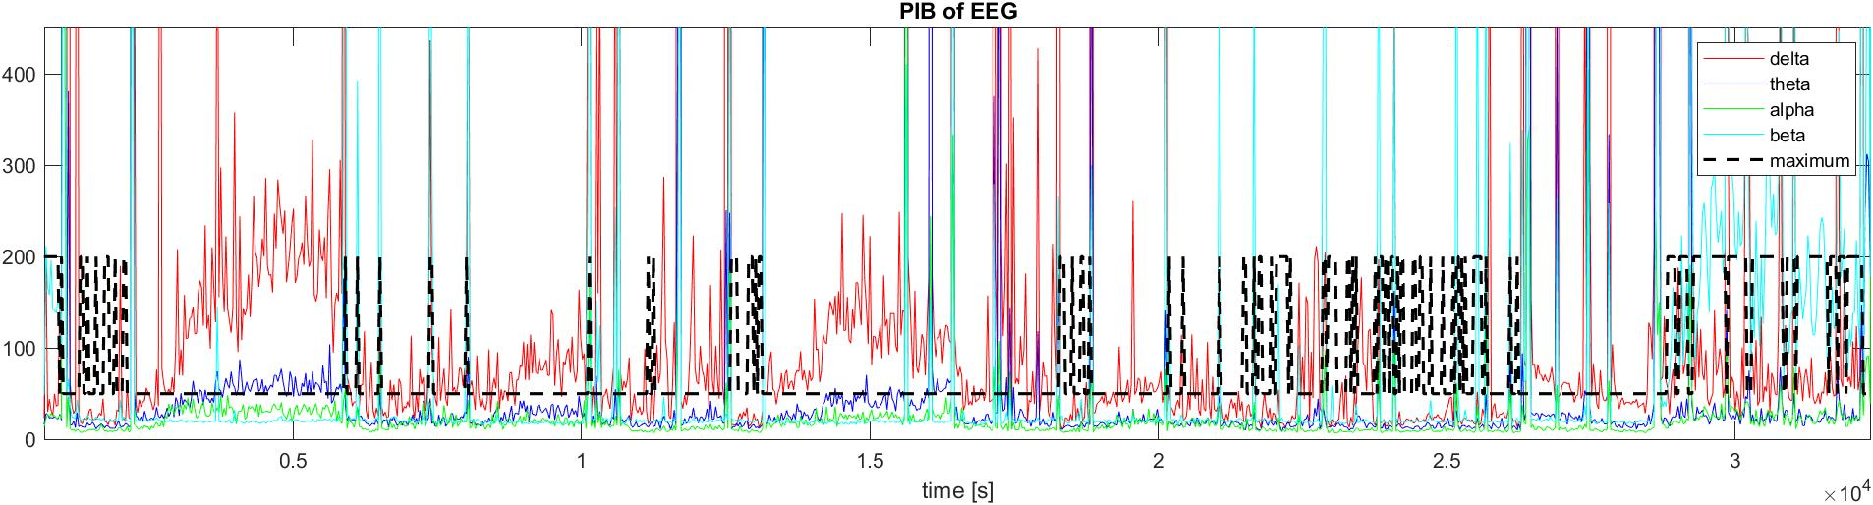
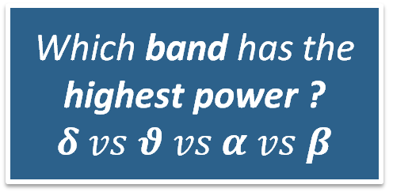
Sleep Stages Classification
Which band has the highest power ?
$$δ vs θ vs α vs β$$
Biomedical Signal Processing 2021-2022
POLITECNICO DI MILANO
Notes:
And the vector I, plotted in black, stored the winning component for each epoch, so the index corresponding to the maximum value

Slide 8
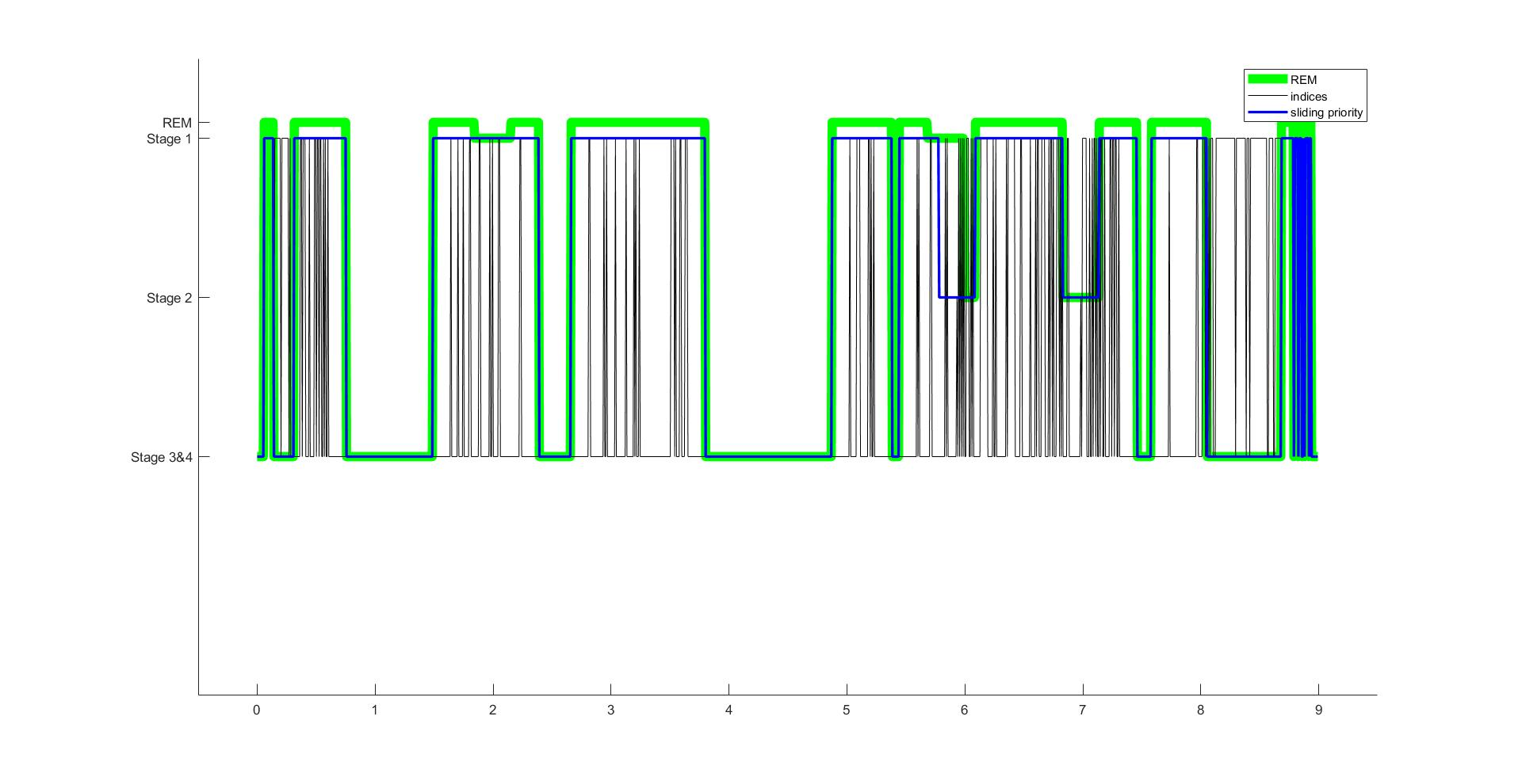
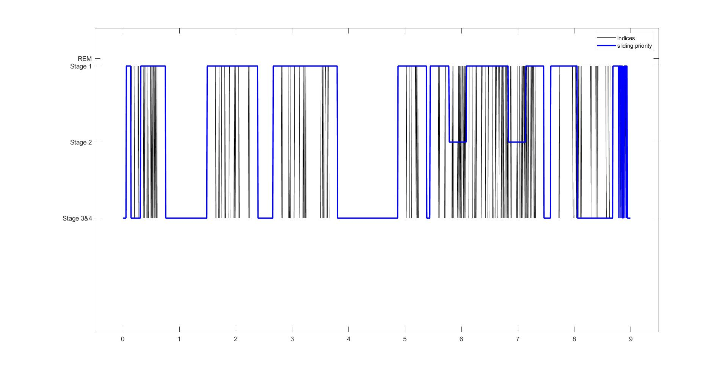
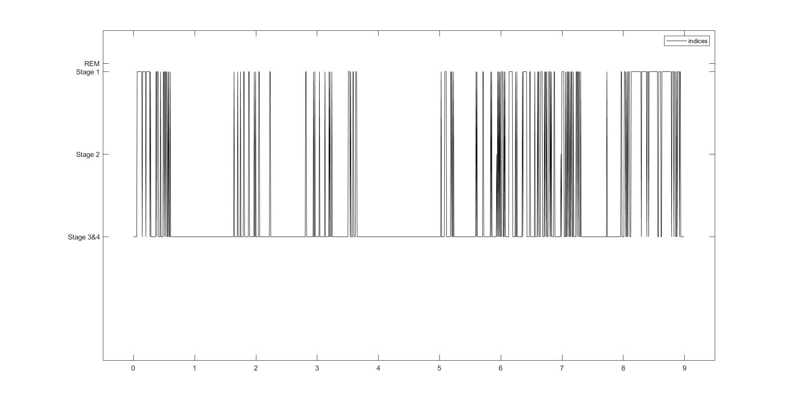
Results & Conclusions
Biomedical Signal Processing 2021-2022
POLITECNICO DI MILANO
Notes:
This graph shows the resulting -R vector in black (the winning component in each epoch) and the “modified winners” obtained with the functions designed for this purpose, which prioritize the losing index if higher than a certain percentage threshold, in order to stabilize the graph.

Slide 9
Bibliography
W. Dement e N. Kleitman, «Cyclic variations in EEG during sleep and their relation to eye movements, body motility, and dreaming», Electroencephalography and Clinical Neurophysiology, vol. 9, n. 4, pagg. 673–690, nov.1957, doi: 10.1016/0013-4694(57)90088-3.
Moser D; Anderer P; Gruber G; Parapatics S; LoretzE; Boeck M; Kloesch G; Heller E; Schmidt A; Danker-Hopfe H; Saletu B; Zeitlhofer J; DorffnerG. Sleep classification according to AASM and rechtschaffen & kales: effects on sleep scoring parameters. SLEEP 2009;32(2):139-149.
https://courses.lumenlearning.com/wsu-sandbox/chapter/stages-of-sleep/
Biomedical Signal Processing 2021-2022
POLITECNICO DI MILANO
Notes:
This graph shows the resulting -R vector in black (the winning component in each epoch) and the “modified winners” obtained with the functions designed for this purpose, which prioritize the losing index if higher than a certain percentage threshold, in order to stabilize the graph.

Slide 10
Thank you for your attention
Biomedical Signal Processing 2021-2022
Gaia Vettori & Filippo Castellani
POLITECNICO DI MILANO

Slide 11
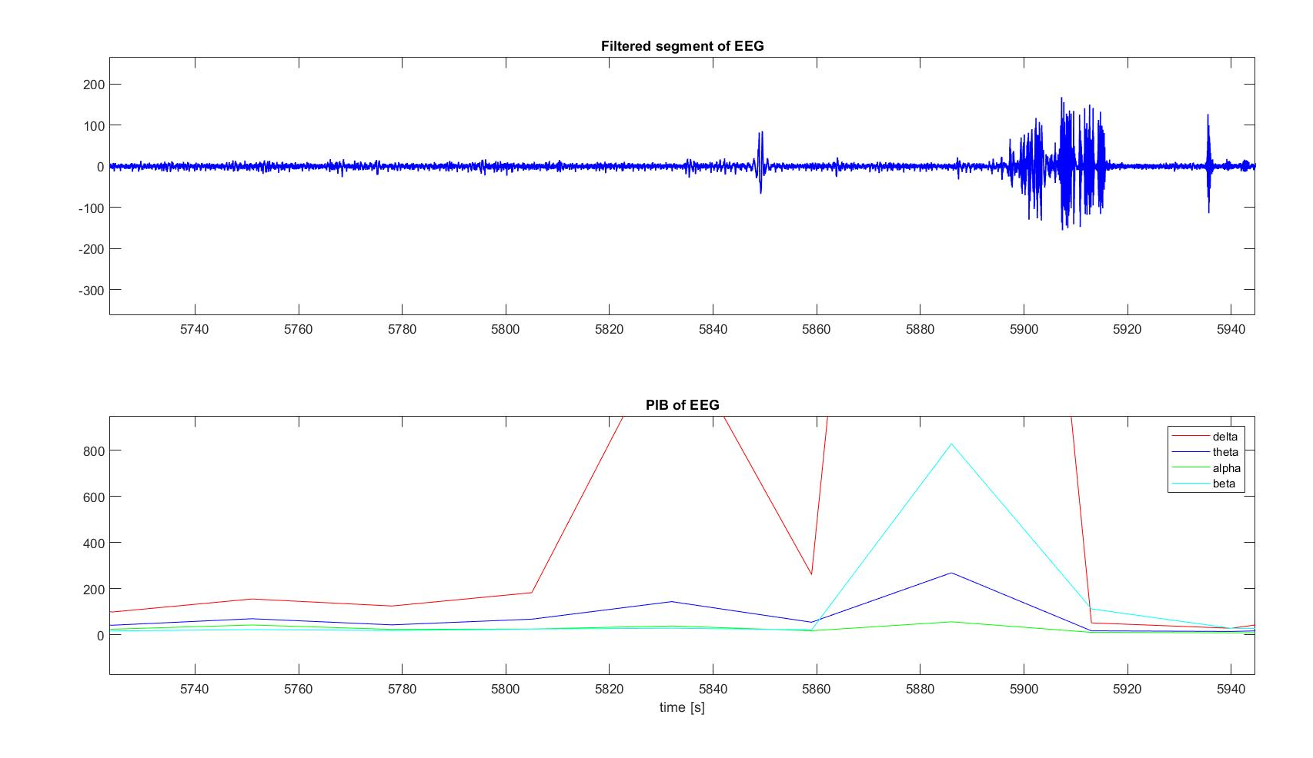
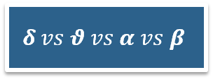
Sleep Stages Classification (Priority Assignment)
$$δ vs θ vs α vs β$$
Priority Assignment stabilizes the winning indices plot.
The function gives priority to weak but crucial events which appear enough times to overcome an “occurrency threshold”.
Biomedical Signal Processing 2021-2022
POLITECNICO DI MILANO

Slide 12
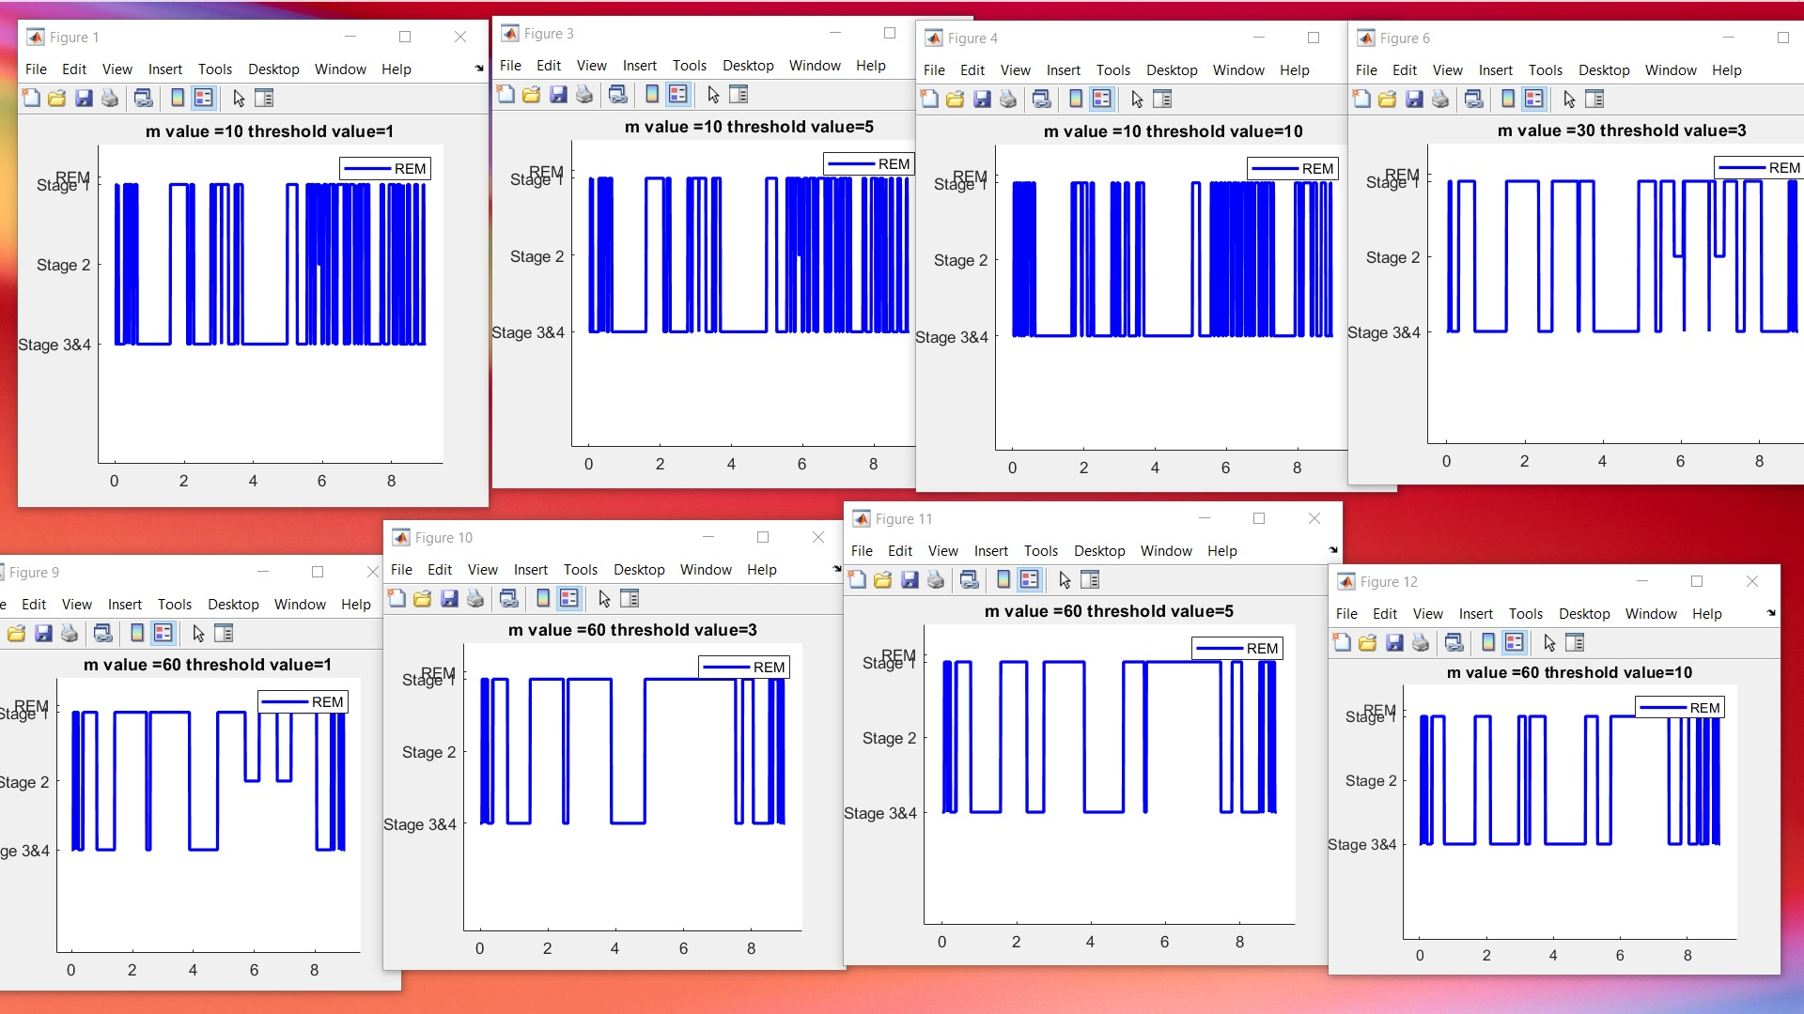
Sleep Stages Classification (Priority Assignment)
Biomedical Signal Processing 2021-2022
POLITECNICO DI MILANO

