Slide 1
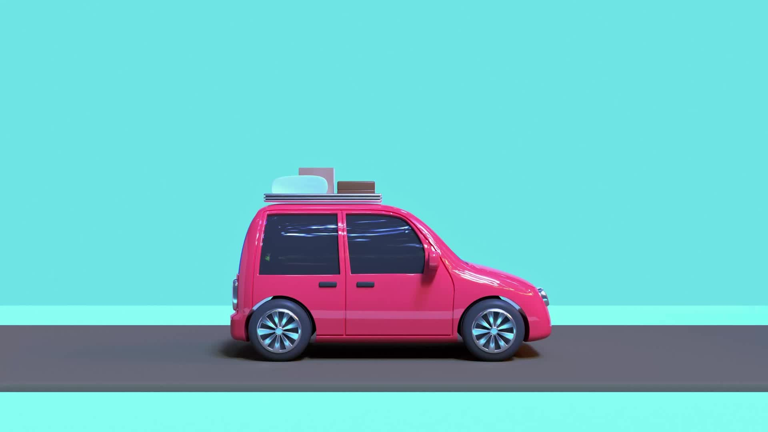
AUTOMATED CAR WASH WITH PDDL & INDIGOLOG
Filippo Croce
Federico Occelli
Jacopo Tamarri

Slide 2
ABOUT THE IDEA
The idea for this project is to develop efficient automated car washing facilities that can handle multiple vehicle types, multiple cleaning program while managing resources effectively.
Different vehicle sizes such as small car, big car, motocycle,.
Various cleaning programs such as fast, basic, premium with different resource requirements and cost.
Resource management including water, soap and wax,
Optimal scheduling to minimize wait times and maximize throughput
The goal is to minimize cleaning time, efficiently allocate resources, and maximize station throughput while ensuring that resource replenishment and scheduling constraints are respected.

Slide 3
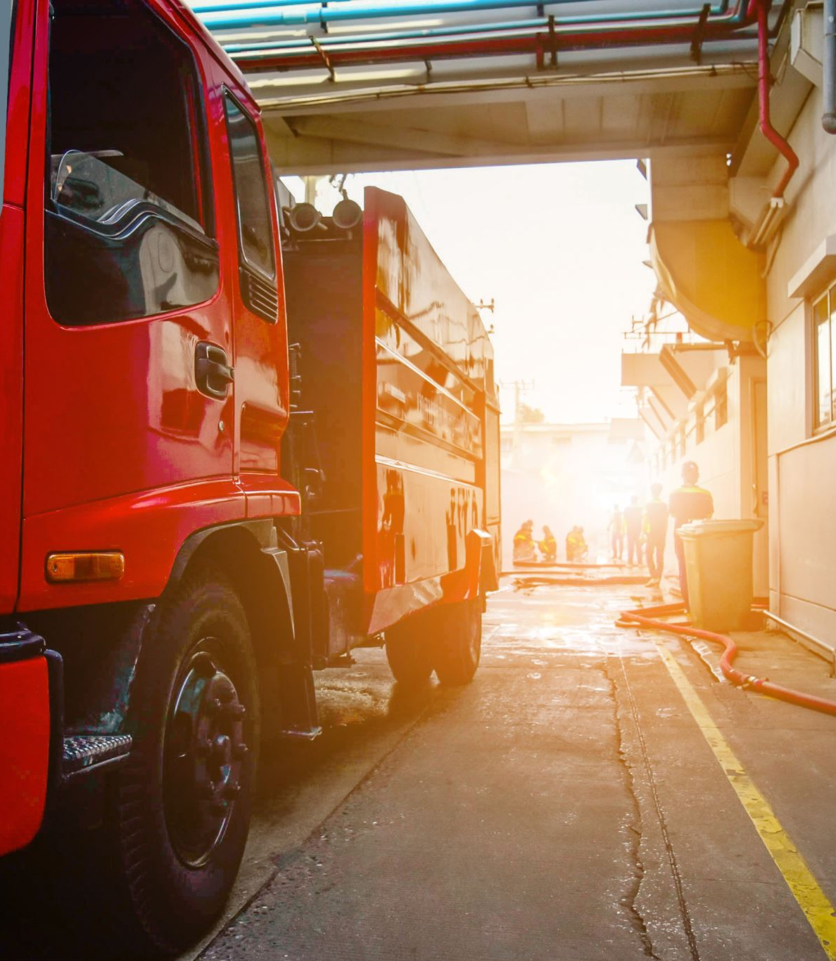
THE DOMAIN
Multiple cleaning stations (fast cleaning station, basic cleaning station, premium cleaning station, interior cleaning station)
Various vehicle types requiring different cleaning resources
Limited resources that need to be managed and replenished
Different cleaning programs with varying cost and resource requirements

Slide 4
THE PREDICATES
(vehicle_at ?v - vehicle ?s - station) TRUE if a vehicle is at a certain station
(free_location ?v – vehicle) TRUE if a location is free
(connected ?l1 - location ?l2 - location) TRUE if locations are connected
(station-compatibility ?p - program ?s - station) TRUE if a station is compatible with the program selected
(has_resources ?s - station ?r - resource) TRUE if a station has that kind of resources (written general for simplicity)
(small-car ?v - small_car) / (big-car ?v - big_car) / (moto ?v - moto) TRUE is the vehicle is the kind specified
(can-be-refilled ?s - station) TRUE if the station support the refill
(vehicle-ready ?v - vehicle ?p - program) TRUE if the vehicle has been cleaned and ready
(interior-clean ?v - vehicle) TRUE if the interior cleaning has be done
(vehicle-ready-int ?v - vehicle ?p - program) TRUE if the vehicle is ready with the interior cleaned
(interior ?s - interior) TRUE if the station is of kind that can clean the interior
V = (small car, big car, motocycle)
S = 1-2-5
R= (water tank, active soap tank, wax tank)
P = (fast, basic, premium, moto)
fast = water –
basic= soap, water
premium = soap, water, wax
premium with interior = soap, water, wax, interior
moto = soap water

Slide 5
THE AVAILABLE ACTION
MOVE
FINISH
FINISH-INTERIOR
INTERIOR-CLEAN
START-PREMIUM-CLEANING
START-BASIC-CLEANING
START-FAST-CLEANING
REFILL-WATER
REFILL-SOAP
REFILL-WAX

Slide 6
THE GENERAL PROBLEM
In the problem file we can make different choices and model whatever we want such as:
Number of cleaning stations
Type of station
Number of vehicles
Type of vehicle
Available resources
Type of resources (water, soap, wax)
Cleaning program types
Fast, Basic, Premium, Interior
Resource consumption rates
Cleaning cost
In the Initial State we set:
Station availability
Resource levels
Vehicle positions
Resource consumption rates
Cleaning cost parameters for the program
The Goal is to clean all vehicles according to their required programs while:
Minimizing total cleaning cost
Optimizing resource usage
Ensuring efficient station utilization

Slide 7
3 INSTANCES OF THE PROBLEM
PROBLEM 1: Basic Setup
1 stations
1 vehicles (1 cars)
Basic resources (water)
Limited resources: 1 unit of water
1 cleaning programs (Fast)
Goal: Clean all vehicles while ensuring no resource depletion.
PROBLEM 2: Multiple Station Types
2 stations
2 vehicles (2 cars, 1 motorcycle)
Extended resources (water, soap, wax)
Resources include water (0 liters), soap (0 liters), and wax (0 liters).
3 cleaning programs (fast, basic, premium)
Goal: Optimize cleaning while managing resource replenishment.
PROBLEM 3: Full System
5 stations
7 vehicles (all types)
Complete resource management
Large but constrained resources: each station has their level of resources
All cleaning programs
Added interior clenaing
Maintenance and scheduling
Goal: Optimize cleaning while managing resource replenishment.

Slide 8
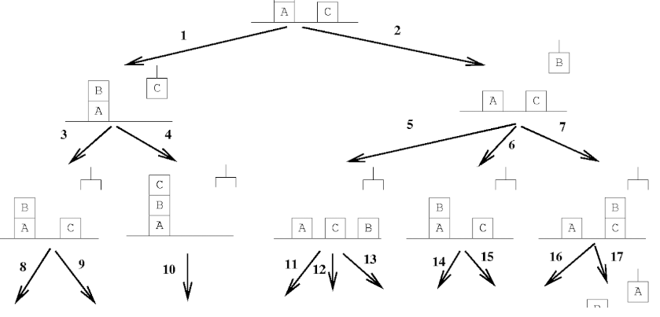
The planner
To solve the numerical planning problem, we have decided to use ENHSP-20 (Expressive Numeric Heuristic Search Planner) which is a PDDL automated planning system that supports both Classical and Numeric Planning (PDDL2.1).
ENHSP transforms the PDDL descriptions into a graph-search problem where nodes represent states visited by the planner. The planner is guided by a heuristic function to explore only those nodes whose associated state is reachable from the init and get the planner closer to the goals.

Slide 9
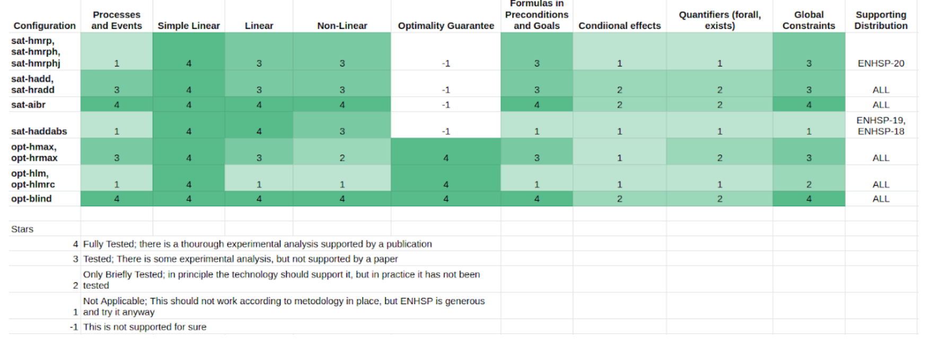
THE HEURISTICS AVAILABLE
Different configurations tested:
sat-hmrp: GBF with MRP heuristic
sat-hadd: GBF with HADD heuristic
opt-hmax: A* with numeric heuristics for optimization scenarios (only some problem available)
The chosen metric to be minimized is a combination of:
Total cleaning cost
Resource refill cost
Number of move
To run the planner with different configuration:

Slide 10
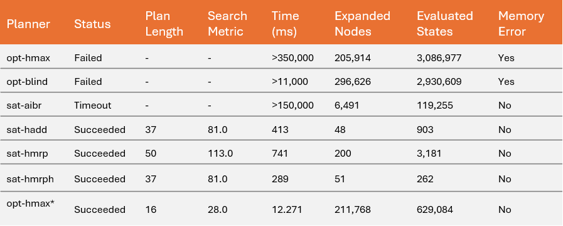
RESULTS
The results demonstrate that for this problem, satisficing planners with sophisticated heuristics (particularly sat-hmrph) performed best.
The results are correlated all to the latest and more complex planning problem.
The optimal planners, while theoretically capable of finding the best possible solution, were impractical due to memory constraints. This suggests that for similar complex planning problems, using satisficing planners with well-designed heuristics might be the most practical approach.
*The last row represent the second problem implementation

Slide 11
REASONING TAKS WITH INDIGOLOG

Slide 12
Scenario
Different Stations
Different cars
Resources
Run with:
swipl config.pl examples/carwash_sim/main.pl

Slide 13
Main differences with PDDL
Boolean resource
Automatic multiple car and station handling
Exogenous action handling:
New car
Station failure

Slide 14
The Avaible Fluents / Predicates
stn(N)
car_waiting(M)
station_free(N)
resources(N)

Slide 15
The Avaible Actions
start_wash(M,N)
finish_wash(M,N)
reload_resources(N)

Slide 16
Reasoning task with indigolog
Three main controllers:
Dumb controllers:
- Fixed
- Not fixed
Smart Controller
Reactive Controller

Slide 17
Reasoning task with indigolog
Checks if is it possible to 2 consecutive washes in the same station
indigolog(test_execution1).
Checks if resources are empty after a 2 consecutive washes in the same station with only 1 reload
indigolog([test_execution2,?(resources(2))]).
Checks if after a cycle of wash, the car is still waiting
indigolog([test_execution3,?(neg(car_waiting(1)))]).

Slide 18
Thanks for the attention

