Slide 1

PREDICTING PEDESTRIAN CROSSING INTENTION
Filippo Croce 2147314
Jacopo Tamarri 1946293

Slide 2
TABLE OF CONTENTS
01
INTRODUCTION
02
OUR MODEL
03
DATASET AND METRICS
04
IMPLEMENTATION
Topic presentation
What model we have used
Dataset usage and evaluation metrics
How we implement it, with all the trials
05
RESULT
Final results in different metrics

Slide 3
INTRODUCTION

Slide 4
Pedestrian crossing intention
What is pedestrian crossing intention?
To understand if the pedestrian is crossing the street or not.
What are the main applications of the topic?
Autonomous driving, ADAS implementation, etc.
Why performing pedestrian crossing intention?
Mostly for safety.
Possible challenges:
Real time computation and response time.

Slide 5
OUR MODEL

Slide 6
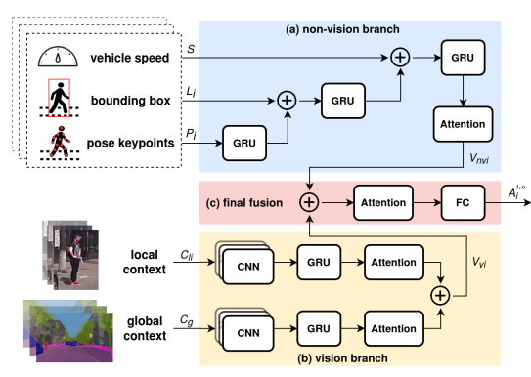
Model structure:
Non-Vision branch.
Vision branch.
Final model.

Slide 7
DATASET AND METRICS

Slide 8
DATASET PREPROCESSING
JAAD DATASET
DATA BALANCING
02
04
SUBSET
346 hd videos
More than 80.000 frames
170 GB
60 hd videos
Around 15.000 frames
36 GB
TRASFORMATION
For Global and local context
VIDEO TO FRAME
01
Creation of the frames from the videos
03
Around 60-40 class division
05

Slide 9
METRICS AND LOSS:
Accuracy | Precision | Recall | F1 Score
TP + TN
TP + TN + FP + FN
TP
TP + FP
TP
TP + FN
PRECISION * RECALL
PRECISION + RECALL
2
Loss function:
Binary cross entropy

Slide 10
IMPLEMENTATION

Slide 11
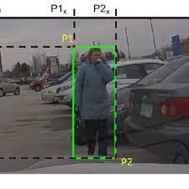
BOUNDING BOX
Taken from the dataset
Expressed (for each pedestrian) as:
$$(x_{leftUp}, y_{leftUp}, x_{rightDown}, y_{rightDown})$$

Slide 12

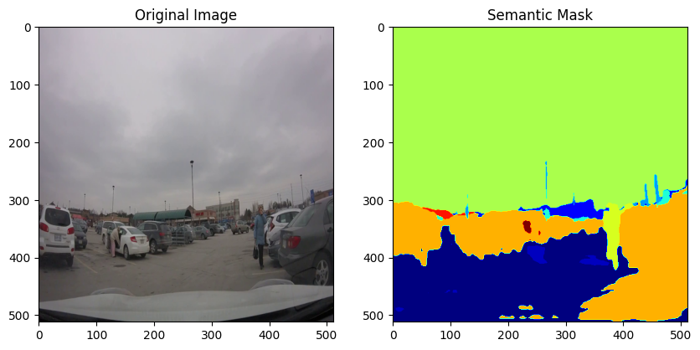
GLOBAL CONTEXT
Steps followed:
Resize the input to 512x512 for fast computation
Apply the DeepLab Model pre-trained on CityScapes dataset
Convert to 224x224 dimension for the Vgg16

Slide 13
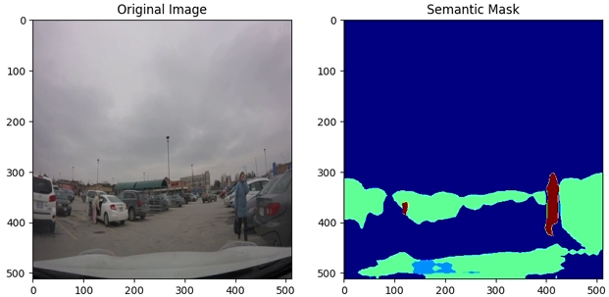
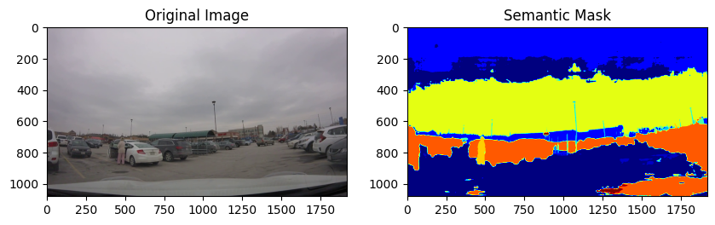
GLOBAL CONTEXT - Experiments
Generic DeepLab Model
Not Resized Input

Slide 14

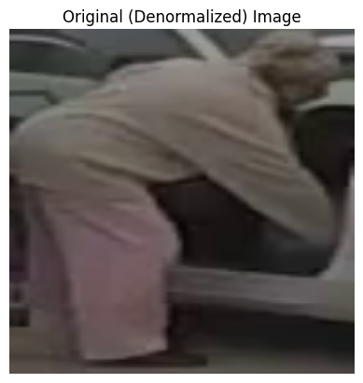
LOCAL CONTEXT
Steps for each video:
Take a single frame
Crop the image on its Bbox
Then resize to 224x224 for the Vgg16 input

Slide 15
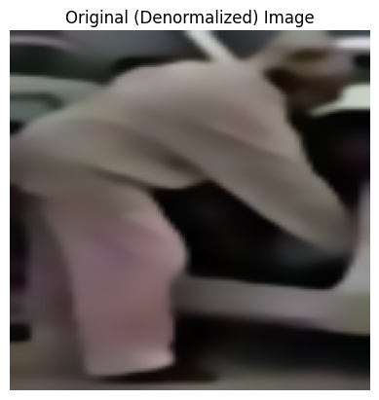
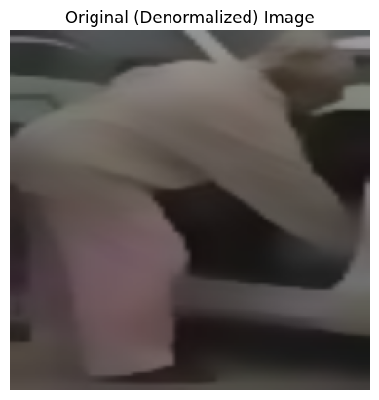
LOCAL CONTEXT – Experiments
Bilateral Filtering
Gaussian Filter

Slide 16
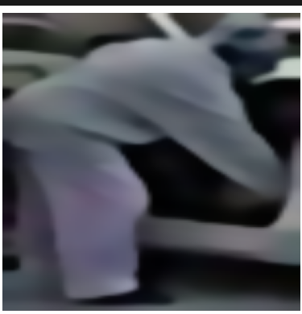
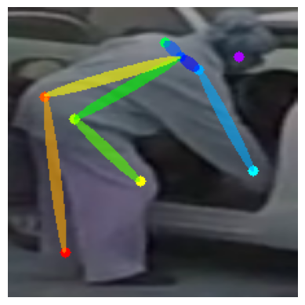
POSE EXTIMATION - Experiments
Bilateral Filtering
No Filters

Slide 17
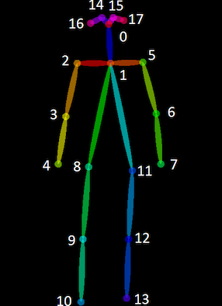
POSE EXTIMATION
Steps for each video:
Take a single frame
Execute OpenPose pre-trained model
Eventually set placeholder for data consistency
Save the obtained pose vector

Slide 18
RESULTS

Slide 19
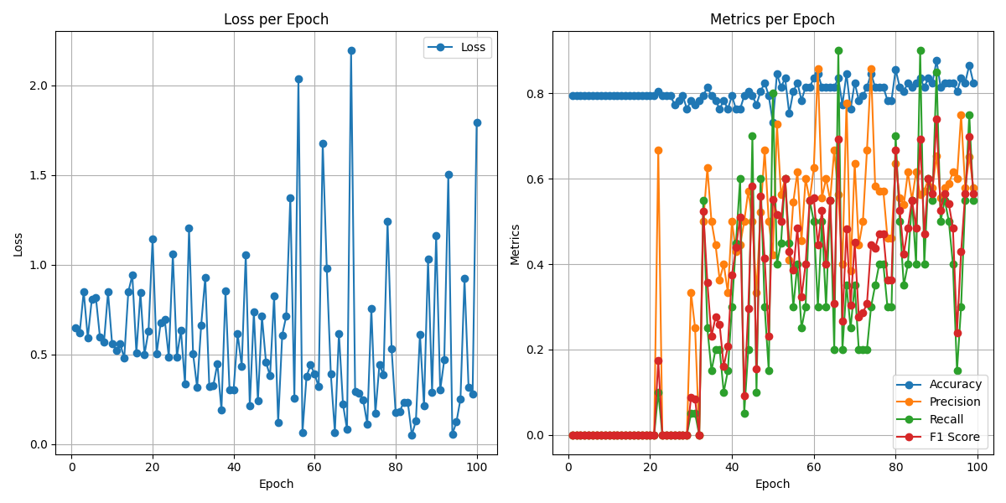
FIRST MODEL
Dummy for the first 30
epochs
Some spikes for loss

Slide 20
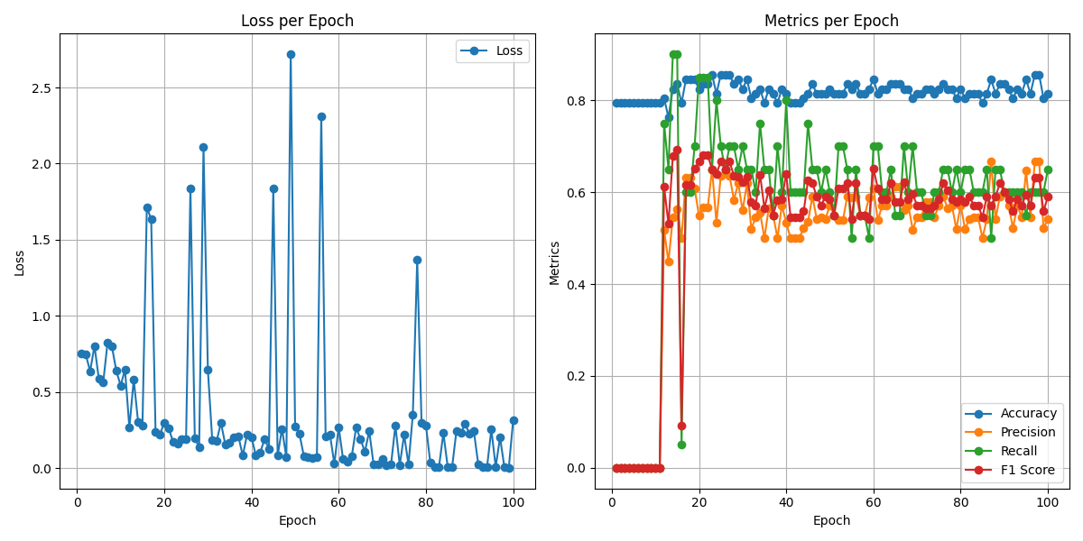
BEST MODEL
Swap order of pose and bbox
Good training earlier
Less spikes for loss

Slide 21
THANKS FOR THE ATTENTION
Filippo Croce 2147314
Jacopo Tamarri 1946293

