Slide 1

PREDICTING PEDESTRIAN CROSSING INTENTION
Filippo Croce 2147314
Jacopo Tamarri 1946293

Slide 2
TABLE OF CONTENTS
01
OUR MODEL
02
DATASET AND METRICS
03
IMPLEMENTATION
04
RESULT
What models we have used
Dataset usage and evaluation metrics
How we implement it, with all the trials
Final results in different metrics
05
CONCLUSION
Final comment and future works

Slide 3
INTRODUCTION

Slide 4
Pedestrian crossing intention
What is pedestrian crossing intention?
To understand if the pedestrian is crossing the street or not.
Why performing pedestrian crossing intention?
Mostly for sefety.
What are the main applicatives of the topic?
Autonomous driving, ADAS implementation, etc.
Possible challenges:
Real time computation and response time.

Slide 5
OUR MODEL

Slide 6
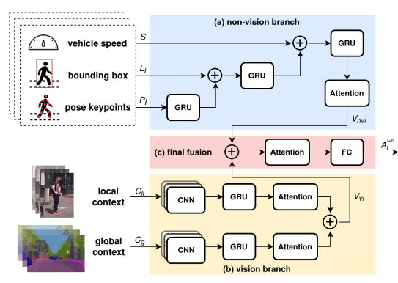
Model structure:
Non-Vision branch.
Vision branch.
Final model.

Slide 7
DATASET AND METRICS

Slide 8
DATASET PREPROCESSING
JAAD DATASET
DATA BALANCING
SUBSET
TRASFORMATION
02
04
346 hd videos
More than 80.000 frames
170 GB
Around 60-40 classi division
01
03
60 hd videos
Around 15.000 frames
36 GB
For Global and local context

Slide 9
Metrics:
Accuracy | Precision | Recall | F1 Score
TP + TN
TP + TN + FP + FN
TP
TP + FP
TP
TP + FN
PRECISION * RECALL
PRECISION + RECALL
2

Slide 10
IMPLEMENTATION

Slide 11
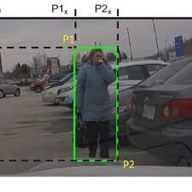
BOUNDING BOX
Taken from the dataset
Expressed (for each pedestrian) as:
$$(x_{leftUp}, y_{leftUp}, x_{rightDown}, y_{rightDown})$$

Slide 12
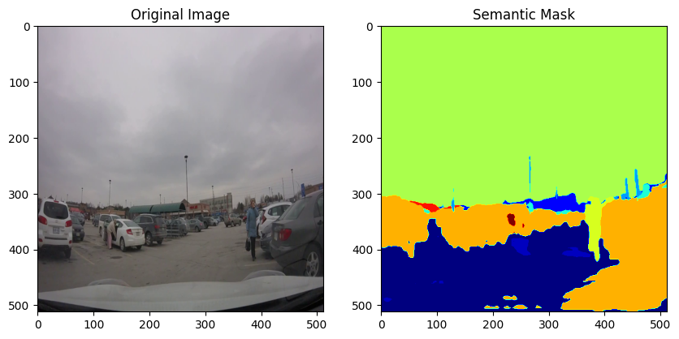
GLOBAL CONTEXT
Steps followed:
Resize input to a lower dimension
Apply DeepLab Model trained on CityScapes
Convert to the accettable input for our Model

Slide 13
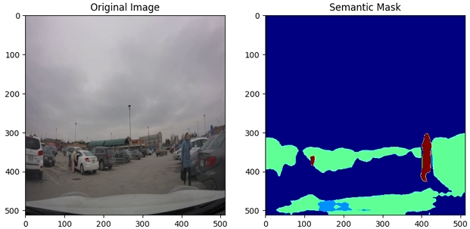
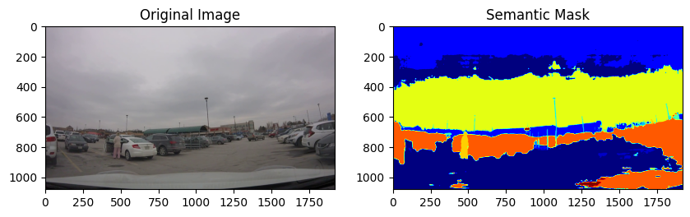
GLOBAL CONTEXT - Experiments
Generic DeepLab Model
Not Resized Input

Slide 14
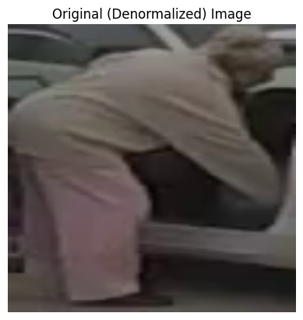
LOCAL CONTEXT
Steps followed(for each video):
Take a frame
Take the corresponding bbox
Crop
Resize

Slide 15
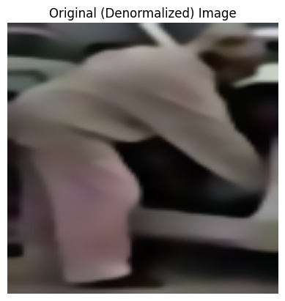
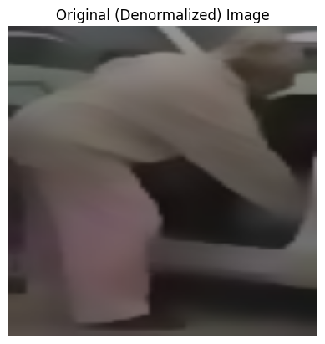
LOCAL CONTEXT – Experiments
Bilateral Filtering
Gaussian Filter

Slide 16
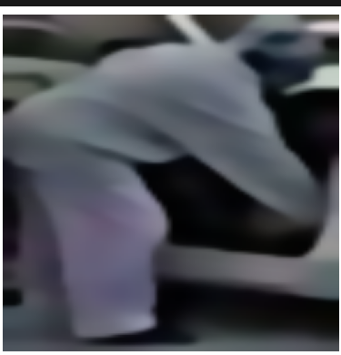
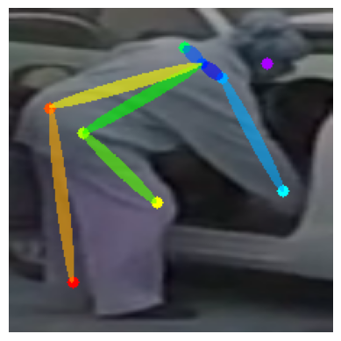
POSE EXTIMATION - Experiments
Bilateral Filtering
No Filters

Slide 17
POSE EXTIMATION
Steps followed(for each video):
Take a frame
Execute OpenPose model
Save the obtained pose

Slide 18
RESULTS

Slide 19
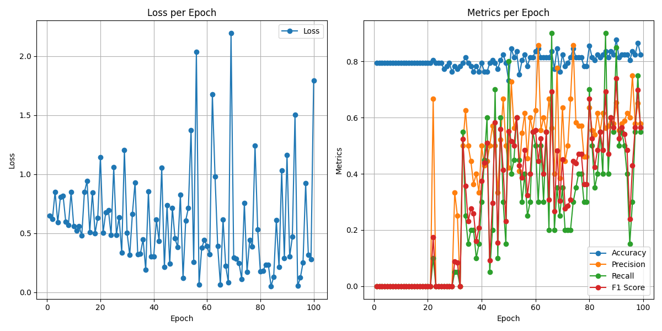
Dummy for the first 30
epochs
Some spikes for loss

Slide 20
CONCLUSIONS:

Slide 21
CONCLUSIONS
Good implementation thanks to the usage of different models fused together:
VGG, GRU, DeepLab, OpenPose
Future works:
Works with all data and without any compression

Slide 22
THANKS FOR THE ATTENTION
Filippo Croce 2147314
Jacopo Tamarri 1946293

