Slide 1



Group 24 Project Presentation
HaclOSsim
Rollo Francesco s328739
Goffredo Filippo s322435
Pizzenti Giovanni s332941
Anna Alexandra Antonini s332218

Slide 2
Tutorial
In order to set up our configuration we followed these steps:
Install QEMU and FreeRTOS on Ubuntu OS;
Set up GDB as debugger;
AN385 platform on the MPS2 board;
Configure CLION as IDE facilitating debugging;

Slide 3
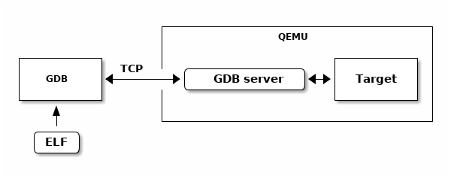
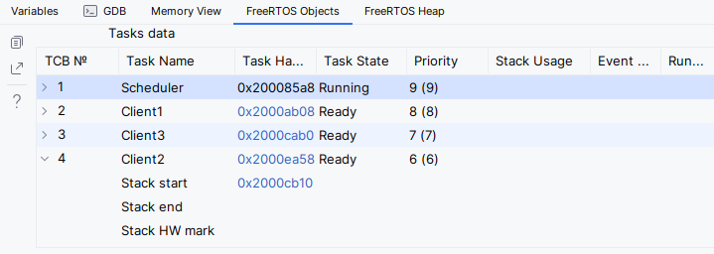

Slide 4
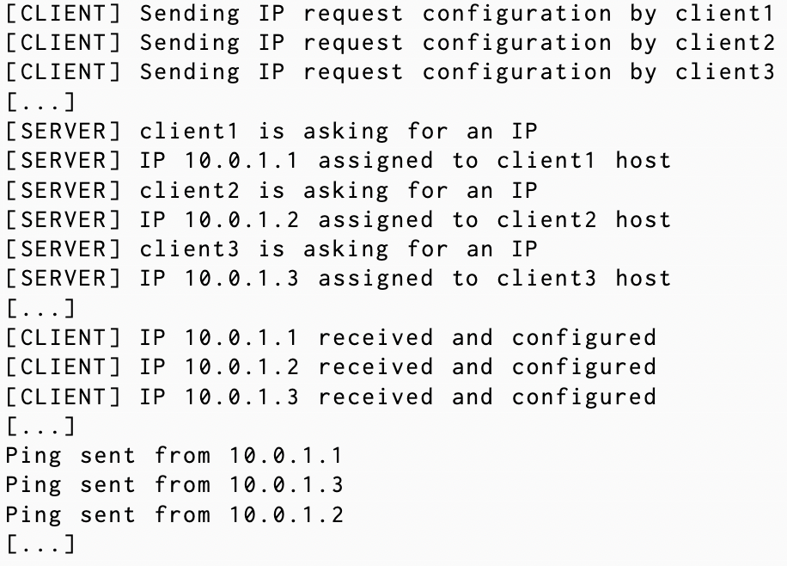
FreeRTOS Demo
FreeRTOS queues and native scheduling showcase:
Client – Server demo
IP assignment using two queues
ICMP ping showing priority functionality

Slide 5
RealTimeScheduler library
RealTimeScheduler enables advanced functionalities for Real-Time scheduling.
Features:
Static and dynamic priority scheduling: RMS & EDF
Periodic and aperiodic tasks
Polling Server
Feasibility Test and WCRT analysis
Execution time statistics

Slide 6
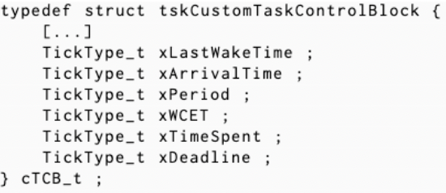
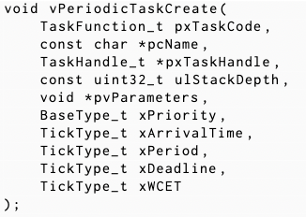
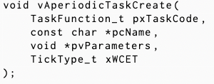
Code Structure
Custom TCB for periodic and aperiodic tasks
Linked list for periodic tasks
FIFO queue (list) for aperiodic tasks

Slide 7
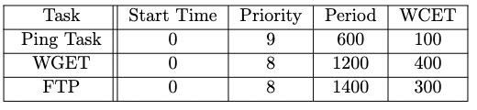
RealTimeScheduler library
FreeRTOS preemptive scheduling showcase:
Ping, FTP, WGET demo
Round Robin algorithm
Time Quantum = 50 ticks

Slide 8
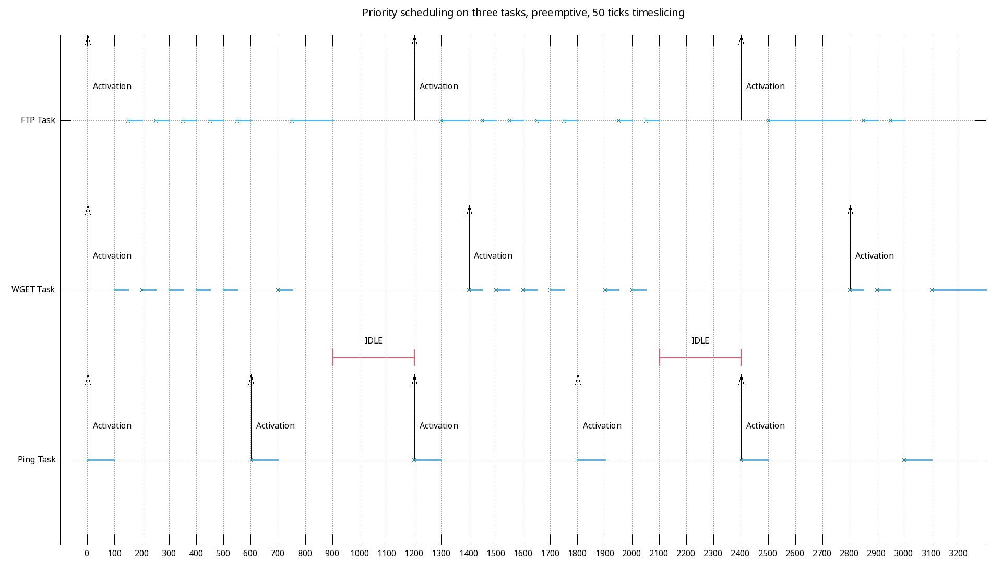
Round Robin algorithm - GANTT

Slide 9
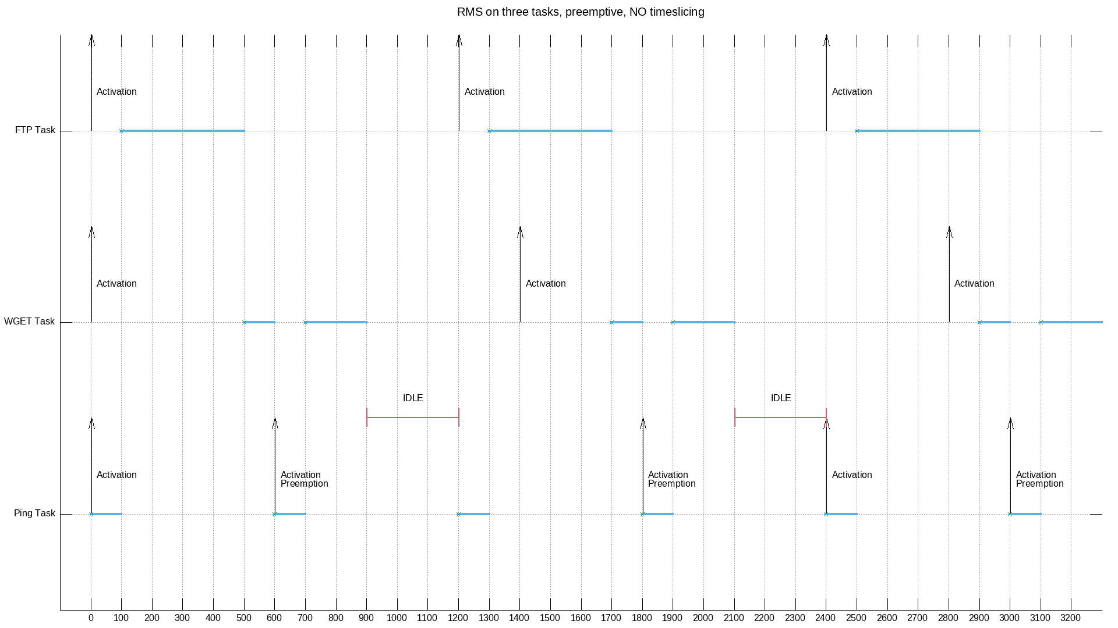
Rate Monotonic Scheduling
RMS implementation:
Task creation
Dynamic sorting list
Priority assignment
Start scheduler

Slide 10
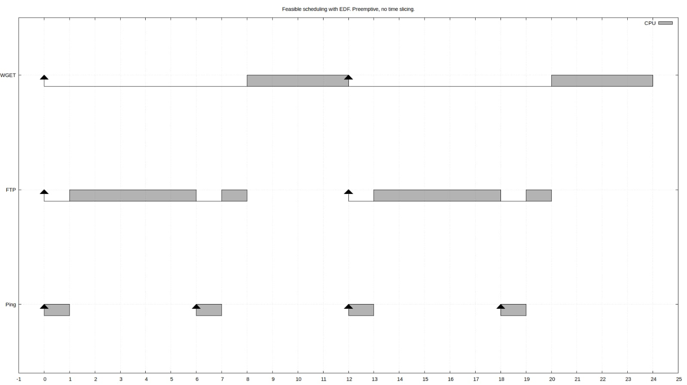
Earliest Deadline First
EDF implementation:
Task creation
Dynamic sorting list
EDF Scheduler init
Dynamic priority assignment

Slide 11
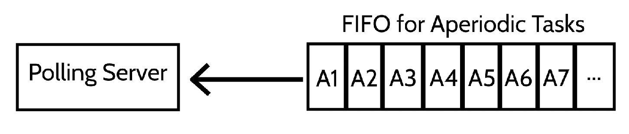
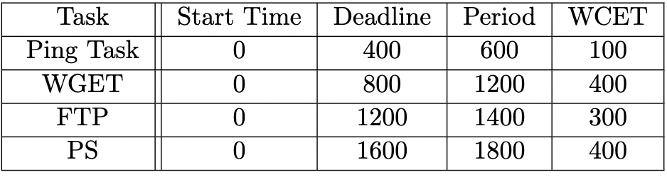
Polling Server
Polling server implementation:
AP & P task creation
RMS for periodic tasks
PS task handles AP tasks
Budget constraint

Slide 12
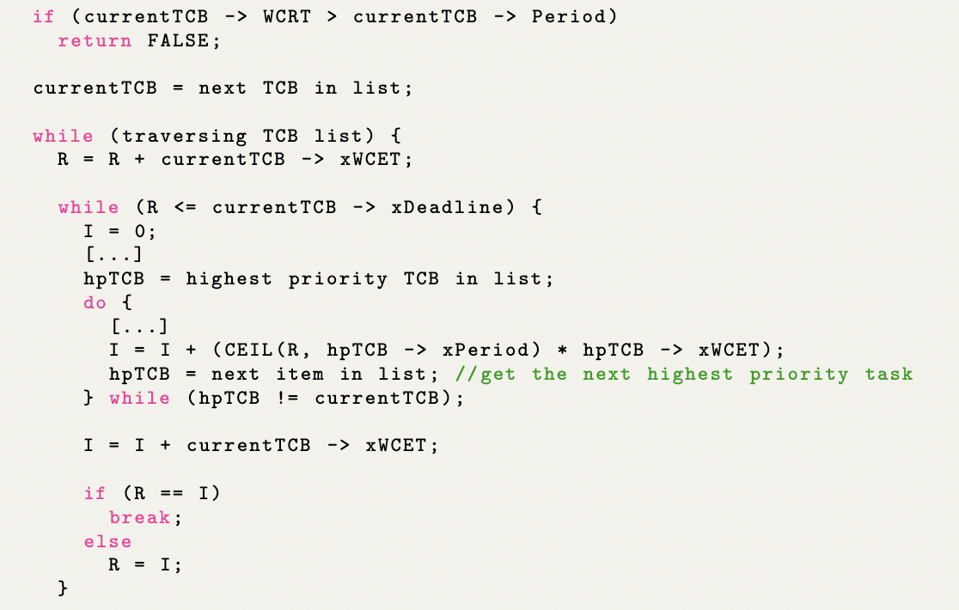
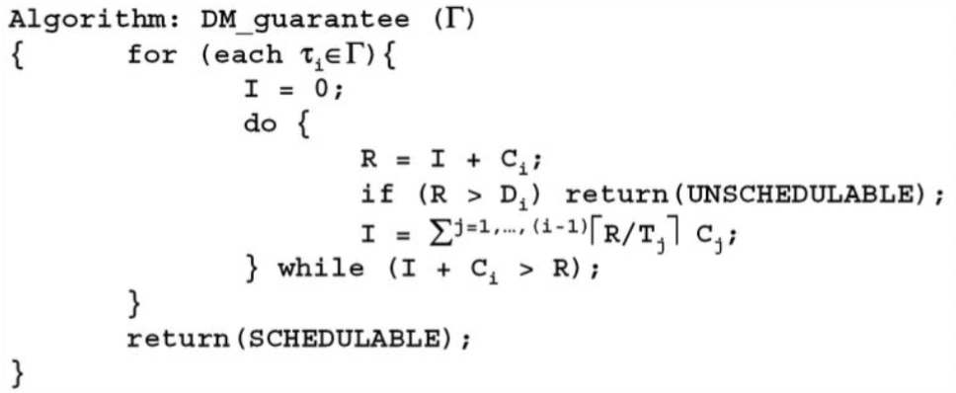
Worst Case Response Time
More accurate Feasibility test
WCRT: length of the longest interval from a task release until its completion.

Slide 13
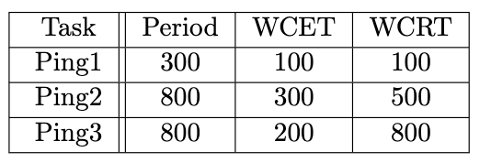
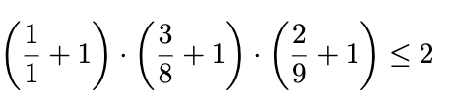
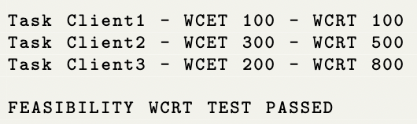
Worst Case Response Time - Example
Output:

Slide 14
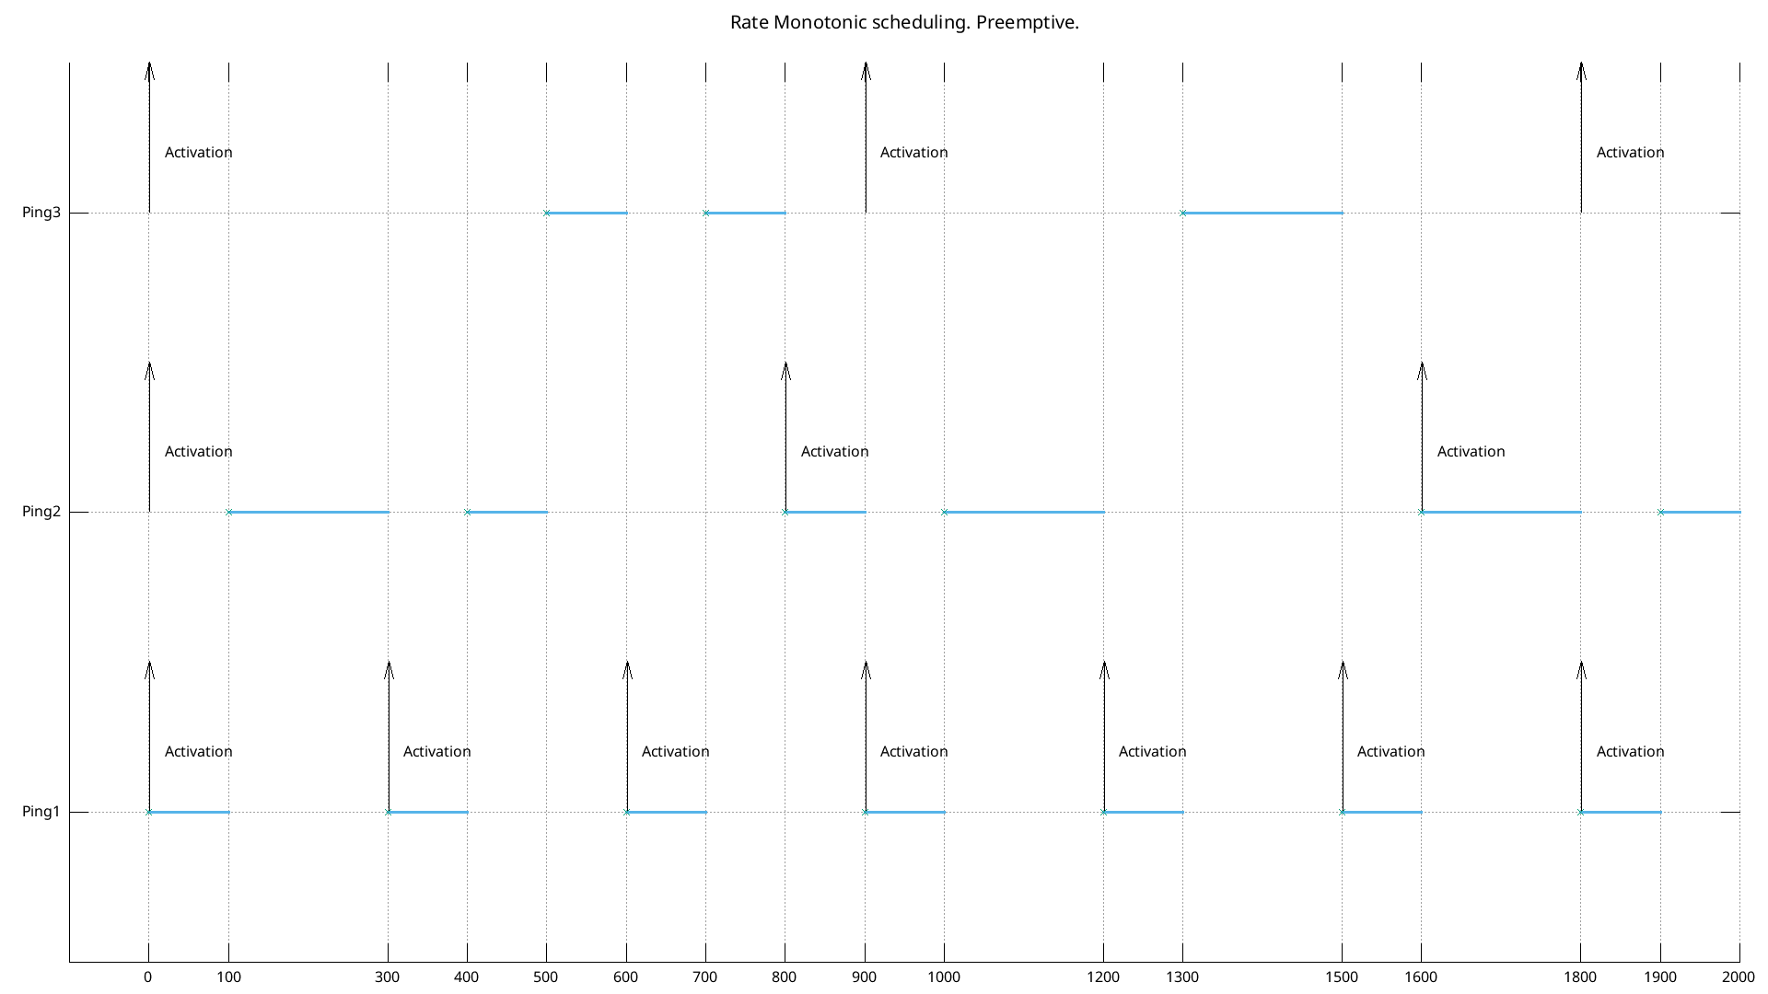
RMS with WCRT - GANTT

Slide 15
Evaluation
All the tests below are related to this set of tasks
Native priority scheduling without preemption
Native priority scheduling with preemption

Slide 16
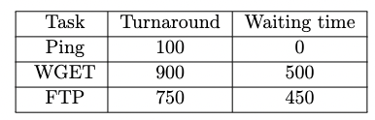

Round Robin

Slide 17
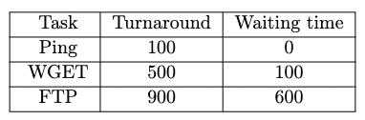
Rate Monotonic Scheduling
RMS improvement:
Automatic priority assignment
14% on average turnaround
27% on average waiting time

Slide 18
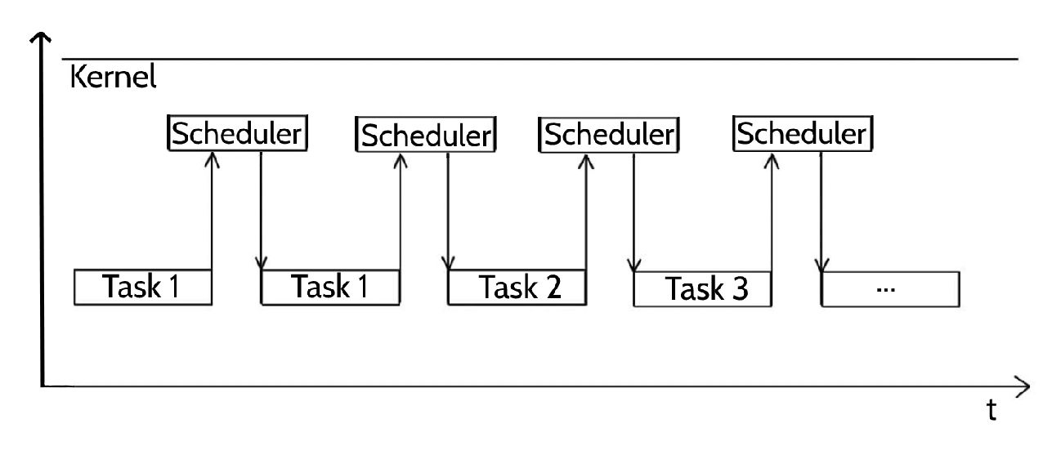
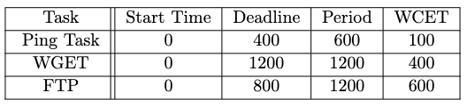
Earliest Deadline First
EDF improvement:
Dynamic priority assignment
RMS not feasible
More Flexibility
Less idle time

Slide 19
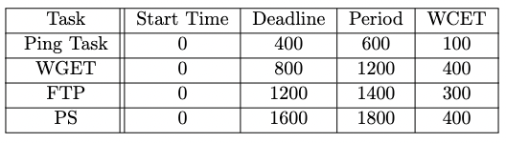
RMS with Polling Server
Polling Server Task is added to handle aperiodic tasks:

Slide 20
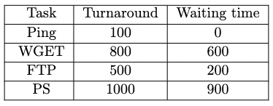

RMS with Polling Server
The introduction of the polling server lowers the performances of:
17% on turnaround time average
46% on waiting time average

Slide 21
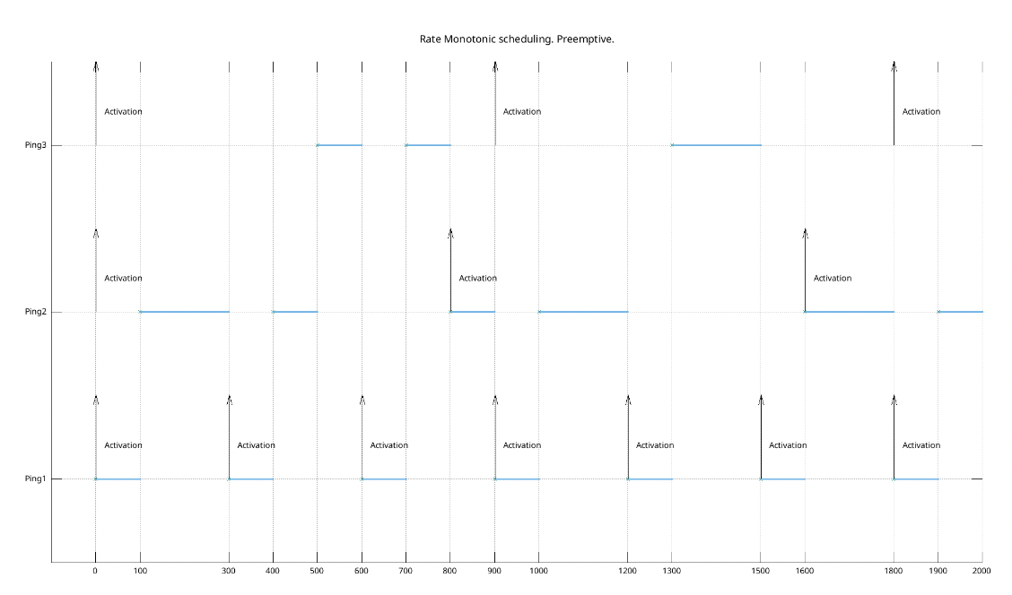
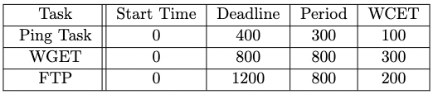
RMS with WCRT
RMS feasbility test fails
WCRT test passed

Slide 22
THANKS FOR YOUR
ATTENTION!

Slide 23
