Slide 1
FINAL PROJECT · DELOITTE × LUISS 2026
DiscoverAI
Semantic Product Search for Health & Personal Care
A review-aware search system on Amazon Reviews 2023, with quality-driven re-ranking, BART summarization, and domain entity extraction.
Team Mean-Squared-Terrors

Slide 2
THE CHALLENGE
Keyword search doesn't understand what shoppers actually mean
WHAT TRADITIONAL SEARCH DOES
Lexical match: looks for exact words only
WHAT THE USER TYPES
Doesn't understand synonyms or intent
Natural-language intent "something to help me sleep at night"
Cannot tell "with" from "without"
Ranks by text relevance or raw popularity
Implicit exclusions "face cream without parabens"
Ignores the customer voice inside reviews
Price intent & trust signals "professional but affordable shampoo"
DiscoverAI · Mean-Squared-Terrors · Deloitte × LUISS 2026
2 / 17

Slide 3
OUR APPROACH
A review-aware system that understands intent and trust
One embedding model, two sources of truth: the product text for what it claims to be, the reviews for how it actually performs, fused into a semantic index with quality-driven re-ranking.
01
02
03
04
05
06
Cleaning
Embedding
Index
Search
NLP
Demo
Balanced sampling, minimum thresholds
Two-tower MPNet, dynamic alpha
FAISS IndexFlatIP, exact search
Parsing, synonyms, re-ranking
BART summary + domain entities
Gradio UI, 3 tabs
Search · Similar Products · System Info
Min 10 reviews per product · drop reviews <25 tokens · 5-star bias: 62% → 46%
all-mpnet-base-v2 · 768 dim · 1B+ pairs · alpha ∈ [0.35, 0.70]
7,593 products · 768-dim normalised vectors · exact inner-product search
4 versions: baseline → negation → synonyms+price → hybrid BM25+semantic
BART-Large-CNN · positive/negative split · extractive fallback <5 reviews
Full pipeline integrated · hybrid_v4 · NDCG@5 = 0.526
Product emb + weighted review emb (70% helpful + 30% rating dev)
spaCy NER + regex: ingredients, certifications, use-case targets
Cap: {5:5, 4:3, 3:2, 2:3, 1:3} per product, prioritising most helpful
No approximate index — exact is instant at this scale, recall = 1.0
Adaptive β_quality: 0.12 → 0.20 when mean sim < 0.65
DiscoverAI · Mean-Squared-Terrors · Deloitte × LUISS 2026
3 / 17

Slide 4
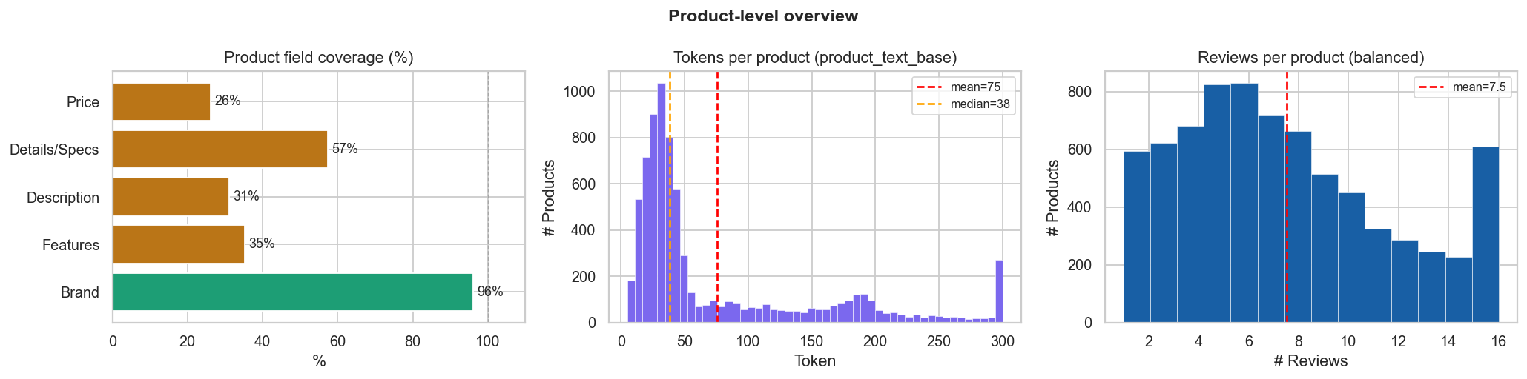
DATASET AT A GLANCE
Amazon Reviews 2023: Health & Personal Care
Field coverage, token distribution and reviews per product (balanced set)
7,647
318k
57k
96%
products
cleaned reviews
balanced reviews
brand coverage
CLEANING DECISIONS
Min 10 reviews per product
Below this threshold the review signal is too weak for a meaningful embedding
Drop reviews shorter than 25 tokens
"Love it!!", "Fast shipping" carry no semantic content
DiscoverAI · Mean-Squared-Terrors · Deloitte × LUISS 2026
4 / 17

Slide 5
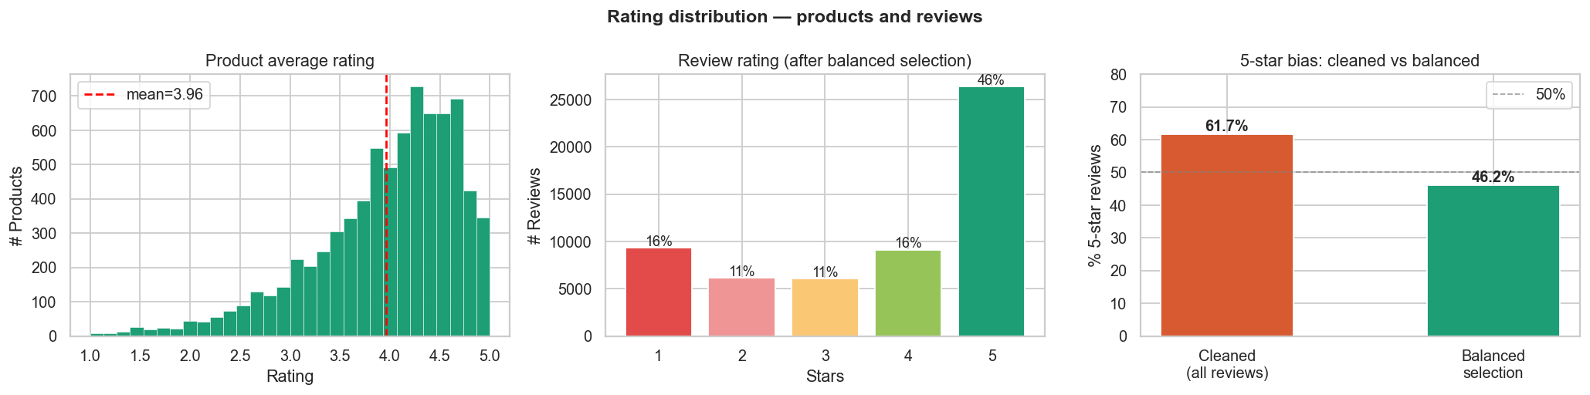
REDUCING THE 5-STAR BIAS
Balanced sampling: from 61.7% to 46.2% five-star reviews
WHY THIS MATTERS
Without balancing, the model sees a corpus where 6 out of 10 reviews say "5 stars, love it" — useful signal drowns in praise. The bias correction is per-product, so even niche items keep a critical voice.
HOW THE CAP WORKS
{5:5, 4:3, 3:2, 2:3, 1:3}
Per product, take at most this many reviews per rating, prioritising the most helpful within each band.
DiscoverAI · Mean-Squared-Terrors · Deloitte × LUISS 2026
5 / 17

Slide 6
ARCHITECTURE · CHOICE #1
Two-tower embedding: product and reviews kept separate
Two sources, two voices
PRODUCT
REVIEWS
Product text says what the brand sells; reviews say how it actually works. Concatenating lets the noisier source dominate.
Title + Brand · Features + Specs
weighted avg (helpful + rating dist.)
↓ ↓
Same encoder, two embeddings
all-mpnet-base-v2 (768 dim, trained on 1B+ pairs): shared semantics, vectors we can weight separately.
COMBINED
768-dim, normalised
combined = α · product_emb + (1 − α) · review_emb
Weighted review aggregation
70% helpful_vote score + 30% deviation from neutral rating: most useful reviews surface first.
α is per-product and dynamic (see next slide)
DiscoverAI · Mean-Squared-Terrors · Deloitte × LUISS 2026
6 / 17

Slide 7
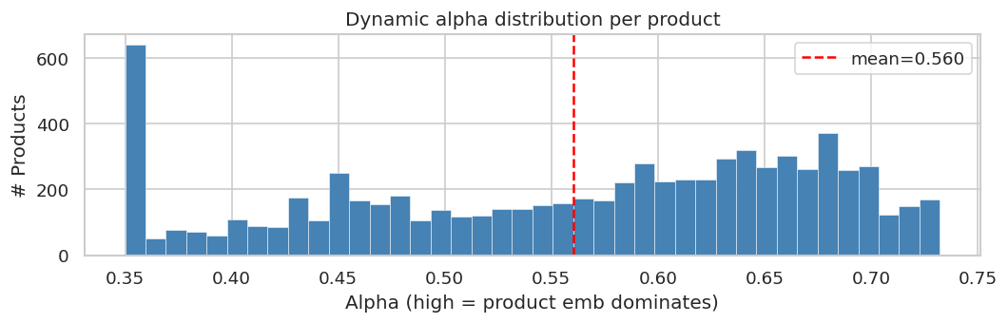
ARCHITECTURE · CHOICE #2
Dynamic alpha: the product decides the weight, not the engineer
WEAK SIGNAL → HIGH Α
Product text dominates
Few reviews, low helpful_vote → product text carries the representation.
α ≈ 0.70
STRONG SIGNAL → LOW Α
Customer voice carries weight
Many helpful reviews, decisive rating → customer voice carries weight.
α ≈ 0.35
Real distribution of α across the 7,593 products (mean 0.560)
DiscoverAI · Mean-Squared-Terrors · Deloitte × LUISS 2026
7 / 17

Slide 8
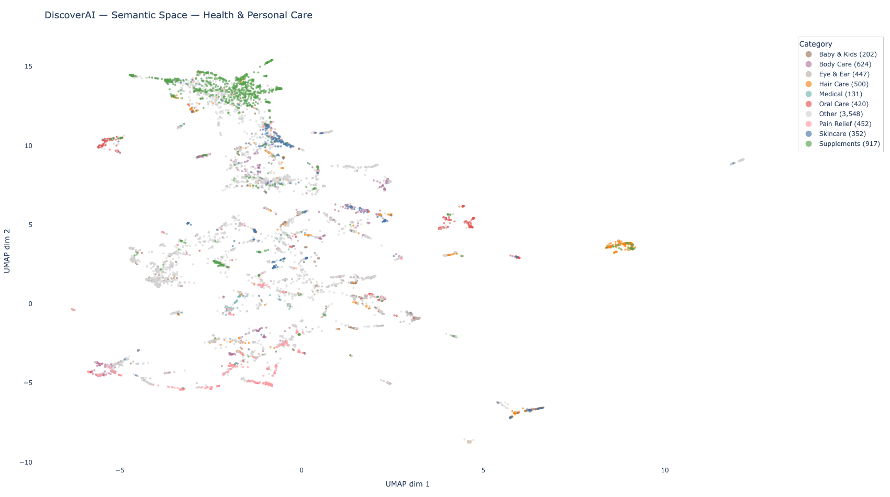
INSIDE THE EMBEDDING SPACE
UMAP projection: semantic clusters emerge by category
7,593 product embeddings · UMAP 2D · coloured by inferred category
WHAT IT TELLS US
Supplements form a tight cluster top-left.
Hair Care separates cleanly from Skin Care.
Pain Relief sits between supplements and topical products — it bridges both.
The model learned the catalogue's structure without ever being trained on it: proof of useful semantic geometry.
DiscoverAI · Mean-Squared-Terrors · Deloitte × LUISS 2026
8 / 17

Slide 9
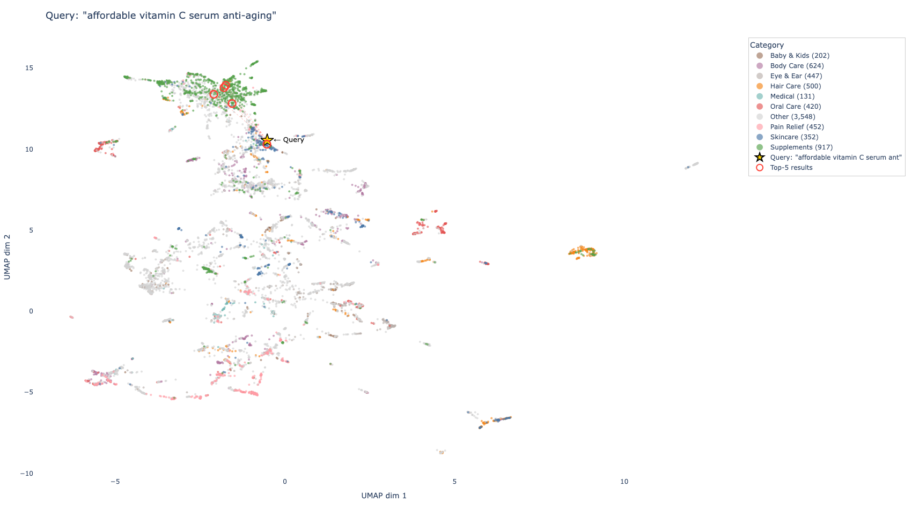
INSIDE THE EMBEDDING SPACE
A query lands exactly where its products live
Query: "affordable vitamin C serum anti-aging" · encoded with same MPNet, projected into same UMAP
WHY THIS WORKS
The query vector falls inside the supplement / skincare neighbourhood, not in a random spot.
The top-5 results (red circles) are pulled from that same neighbourhood.
We gain interpretability for free: "why this result?" → because it's spatially close to your intent.
DiscoverAI · Mean-Squared-Terrors · Deloitte × LUISS 2026
9 / 17

Slide 10
ARCHITECTURE · CHOICE #3
FAISS IndexFlatIP: exact search, no compromises
OPTION
LATENCY @ 7.6K
RECALL
TUNING
IndexFlatIP ✓
negligible
1.0
none
IndexIVF
lower
≈ 0.95
nlist, nprobe to tune
IndexHNSW
lower
≈ 0.97
M, efSearch, slow build
Defense: at 7,593 products exact search is effectively instant. An approximate index trades recall for speed we wouldn't notice. Approximate becomes the right answer once the catalogue grows past tens of millions.
DiscoverAI · Mean-Squared-Terrors · Deloitte × LUISS 2026
10 / 17

Slide 11
SEARCH & RE-RANKING
From query to ranked results
01
02
03
04
05
PARSE
→
ENCODE
→
FAISS
→
FILTER
→
RE-RANK
price intent, exclusions
MPNet on the cleaned query
top-80 candidates
price, rating, exclusions
final score + quality
FINAL SCORE
QUALITY SCORE
score = similarity + β_quality · quality_score
avg_rating + frac_positive + frac_negative + log(helpful_votes)
β_quality
= 0.12 — small enough that a low-quality product cannot overtake a genuinely more relevant one
0.40 · avg_rating + fraction positive reviews + fraction negative reviews + log helpful_votes, min-max normalised to [0,1]
β_pop
evaluated but disabled — degraded MRR by ~1.8% in ablation
adaptive
β rises to 0.20 when mean similarity < 0.65 (generic query)
DiscoverAI · Mean-Squared-Terrors · Deloitte × LUISS 2026
11 / 17

Slide 12
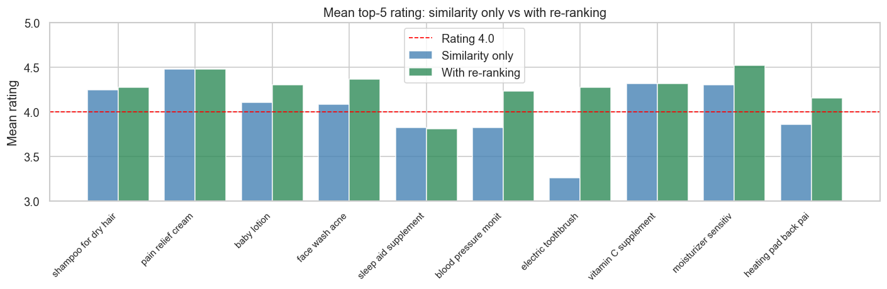
RE-RANKING PAYS OFF
Mean rating of top-5 results: similarity-only vs with re-ranking
10 representative natural-language queries · β_quality=0.12
+0.20
stars average lift in top-5
KEY FINDING
Largest gain on noisy / generic queries such as electric toothbrush and sleep aid.
DiscoverAI · Mean-Squared-Terrors · Deloitte × LUISS 2026
12 / 17

Slide 13
ITERATING THE SEARCH
Iterating through versions: Demo now uses hybrid_v4
V1 · BASELINE
V2 · NEGATION
V3 · PRODUCTION
V4 · PRODUCTION (BEST VERSION)
Similarity + fixed re-ranking
Filter out what users exclude
Synonyms, price, dosages, adaptive β
The foundation
Answers observed failure
Hybrid v4: BM25 + Semantic + RRF
FAISS top-50 + score with fixed β
Patterns: "without X", "no X", "X-free"
Full-featured
Synonym expansion ("SPF" → sunscreen…)
Powers the demo
Works on "catalogue-style" queries
Extracted terms post-filter the product text
Demo powered by hybrid_v4
Price-intent parsing ("affordable" → budget)
BM25 + Semantic + Reciprocal Rank Fusion
Fails on negation and natural language
"cream without parabens" stops returning paraben creams
Dosage extraction (1000mg, SPF 50…)
Evaluation — NDCG@5 = 0.526
Adaptive β_quality: 0.20 when mean sim < 0.65
DiscoverAI · Mean-Squared-Terrors · Deloitte × LUISS 2026
13 / 17

Slide 14
SUMMARIZATION & EXTRACTION
From thousands of reviews to a readable card in seconds
SUMMARIZATION
ENTITY RECOGNITION
BART-Large-CNN
Domain regex + spaCy NER
ACTIVE INGREDIENTS
Split into positive (≥4★) and negative (≤2★)
retinol
niacinamide
hyaluronic acid
SPF
omega-3
Filters: ≥12 words, no "I…", <300 chars, deduped
CERTIFICATIONS
BART produces summary + pros + cons
organic
vegan
cruelty-free
paraben-free
Extractive fallback if < 5 reviews — avoids hallucinations on thin evidence
USE-CASE TARGETS
skin type
hair type
age group
body area
DiscoverAI · Mean-Squared-Terrors · Deloitte × LUISS 2026
14 / 17

Slide 15
DEMO
Gradio interface, 3 tabs, the entire pipeline integrated
01
02
03
Search
Similar Products
System Info
Free-text query with optional filters for price bucket and minimum rating.
Content-based recommendation: from a product name, returns the 5 most similar on the combined embedding.
System transparency for evaluators: index size, model in use, feature coverage.
product image, rating, price
index stats (7,593 products · 768-dim)
BART summary (pros & cons)
no text encoding at runtime
model: all-mpnet-base-v2 + BART-Large-CNN
extracted active ingredients & certifications
operates directly on combined_emb matrix
feature coverage (summaries, entities)
powered by hybrid_v4 (BM25 + semantic + RRF)
instant lookup via FAISS inner-product
evaluation: NDCG@5 = 0.526 (hybrid_v4)
shows image, rating, price, BART summary
negation, synonym expansion, price-intent parsing
DiscoverAI · Mean-Squared-Terrors · Deloitte × LUISS 2026
15 / 17

Slide 16
CHOICES WE DEFEND
The architectural decisions we would make again
Two-tower over concatenation
Dynamic α over fixed α
Exact FAISS over approximate
Mixing product and review text in one 512-token sequence lets the noisier source dominate. Two towers let us weight contributions explicitly.
An average weight punishes products with credible review evidence and inflates those with thin reviews. Per-product α respects both ends.
At 7,593 products, exact is effectively instant and recall = 1. We adopt approximate when the catalogue forces it, not before.
Iteration v1→v2→v3→v4 over big bang
Balanced sampling + 10-review threshold
Extractive fallback for BART
Each version answers an observed failure (negation, synonyms, hybrid fusion). Clear responsibilities and easy regression testing.
Cuts the 5-star bias from 62% to 46% and excludes products whose review signal is too thin to generate a reliable embedding.
On few reviews, abstractive summarization hallucinates. Extractive is less elegant but honest about the evidence.
DiscoverAI · Mean-Squared-Terrors · Deloitte × LUISS 2026
16 / 17

Slide 17
MEAN-SQUARED-TERRORS · DISCOVERAI · DELOITTE × LUISS 2026
Thank You
Questions

