Slide 1
Machine Learning and Artificial Intelligence
Lab 01 – Introduction
09/03/2021

Slide 2
An initial FAQ
What will we learn in this lab? Implementations of various algorithms seen during the lectures in Python.
What can we do if we have doubts regarding the arguments treated during the labs? You can contact me anytime via mail at geri.skenderi@univr.it

Slide 3
Brief introduction to ML
Machine learning: The study of computer algorithms that improve automatically through experience.
Starting from a set of data, we can try to understand underlying tendencies in order to then make predictions or decisions without being explicitly programmed to do so.
Simple example: Given a set of images, we need to try and understand if a new never seen before image contains a cat or not.

Slide 4
Brief introduction to ML
The above tasks are very intuitive and easy for humans: because of mechanisms we don’t fully understand yet.
On a computing level, these tasks are not simple.

Slide 5
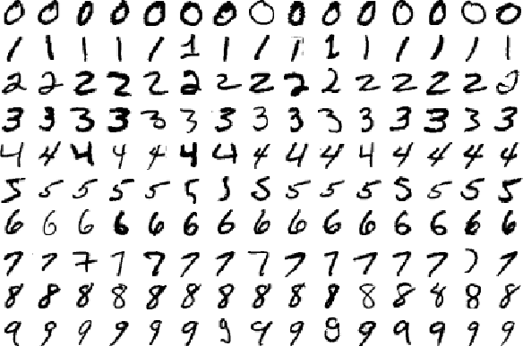
Why is that?
What we see
What the computer sees
Variability

Slide 6
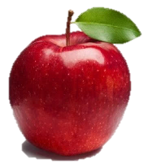

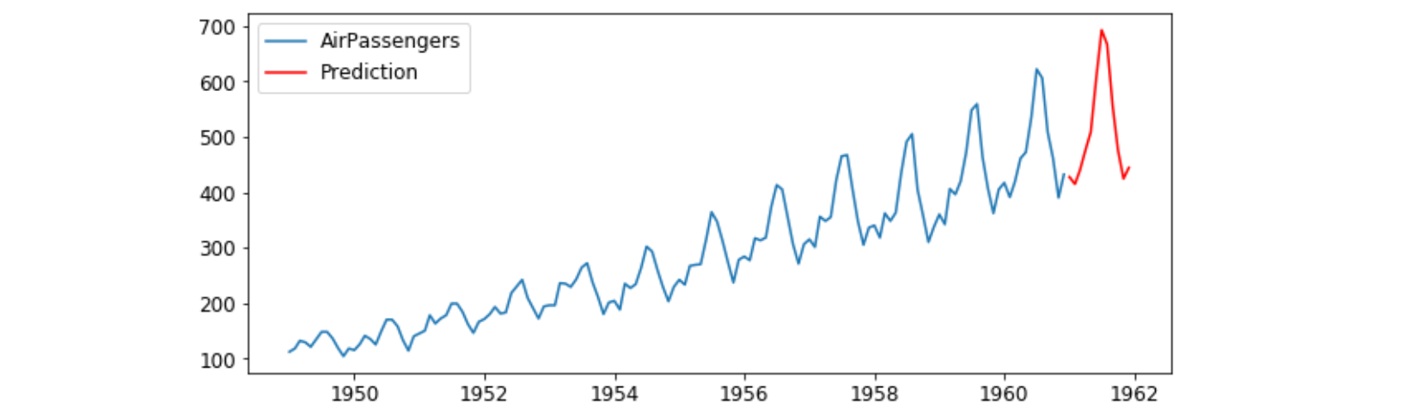
Some more examples
Understand that this is an apple
Distinguish different characters written by hand
Identify the most important object in a scene
Predict the future values of a signal based on the past

Slide 7
Other classic examples:
Scene recognition:
http://places2.csail.mit.edu/demo.html
Image understanding:
https://azure.microsoft.com/it-it/services/cognitive-services/computer-vision/
Image generation from text queries:
https://openai.com/blog/dall-e/

Slide 8
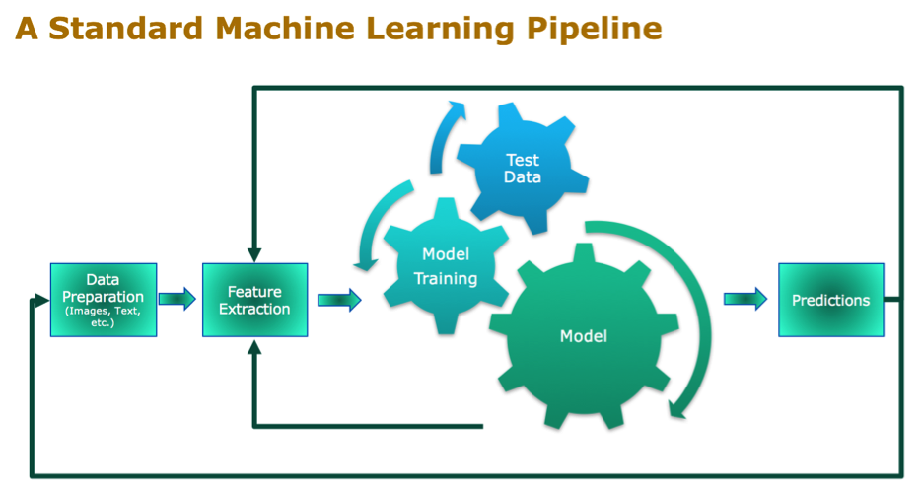
Learning. From. Experience.

Slide 9

In this course: ML in Python
Python is a high-level, object-oriented (often used as a scripting language), multi-purpose, cross-platform programming language.
In recent years, it has been widely used for scientific computing.

Slide 10
Python
Weird stuff:
Dynamic typing
Indentation is very important
Multiple differences between version 2.7 and 3+
IDEs:
PyCharm
VS Code
Bash command python opens an interactive shell
https://docs.python.org/3/tutorial/

Slide 11
Python package manager
Python has an internal system for downloading, storing, and resolving packages. The most common packages (open source, third-party) are available in a repository called the Python Package Index (PyPI).
pip install numpy
pip install scipy==1.2.1
pip install --user Pillow # install only for current user
A requirements.txt file is handy for saving all the packages on which the project depends:
pip install –r requirements.txt
https://docs.python.org/3/tutorial/

Slide 12
Importing packages
Python is so popular because of its packages and libraries. Here’s an import of numpy in the shell:
N.B.: pip installs packages system-wide (globally). It may not always be the best solution (compatibility issues between versions, need to be superuser etc.)
>> import numpy as np
https://www.dabapps.com/blog/introduction-to-pip-and-virtualenv-python/?utm_source=feedly

Slide 13

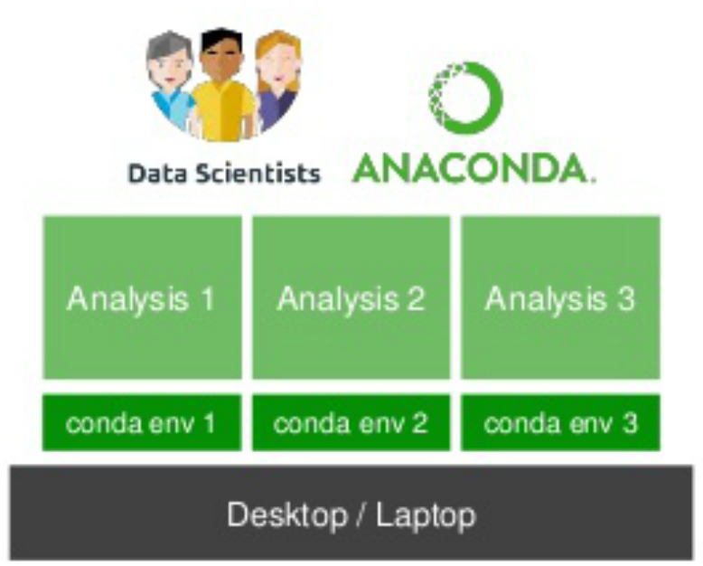
Conda
Create an isolated virtual environment
To install → https://www.anaconda.com/products/individual#Downloads
Legacy → https://repo.anaconda.com/archive/
Creating a virtual env
conda create –n <name> python=3.8
Activating and deactivating the env
conda activate <name>
conda deactivate

Slide 14
Python: Lists, vectors and matrices
>> a = 5 # scalar
>> b = [2, 3] # list, len(b): 2
>> c = [[1,2],[3,4]] # list of lists. len(c): 2
>> import numpy as np
>> d = np.array([0]) # scalar. len(d): 1, d.shape: (1,)
>> e = np.array([2, 3]) # vector (array). len(e): 2, e.shape: (2,)
>> F = np.array([[1,2],[3,4]] # matrix. len(F): 2, F.shape: (2,2)

Slide 15

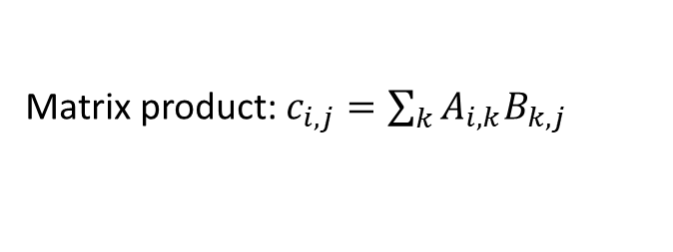
Python: matrix operations
Are of great importance in Machine Learning.
>> B = A + A
>> C = A ** 2 # power of 2
>> C = A * A # element-wise
>> C = np.dot(A,A)
>> D = np.divide(A,A) # element-wise
>> D = np.dot(A, np.linalg.inv(A))
>> np.sum(A)
>> np.sum(A, axis=0) # col wise
>> np.mean(A, axis=1) # row wise
Matrix product: $c_{i,j}=\sum_{k}{A_{i,k}B_{k,j}}$
M$atrix \text{division}: D=AA^{−1}$

Slide 16
Extracting data from matrices
>> a = [10,20,30,40]
>> b = a[0:2] # b = [10,20]
>> A = np.array([[10,20,30],[40,50,60]])
>> B = A[:2,:2]

Slide 17
Python as a scripting language
A script is a set of python commands that are interpreted
Scripts are simple text files with a .py extension
To execute a script: python <name>.py
Debugging: depends on the IDE
A lot of useful information can be found in the python cheatsheet attached to the lesson

Slide 18
Visualization
The most popular libraries for visualization are:
1. Matplotlib: for the visualization and plotting of
https://matplotlib.org/contents.html
2. Pillow: for the visualization of images
https://pillow.readthedocs.io/en/latest/

Slide 19
Jupyter Notebook
Unique set-up for programming: open-source web-based application that allows you to create and share documents that contain live code, equations, visualizations and narrative text. https://jupyter.org/
Very useful for sharing and interactive output functionalities.
Files end with a .ipynb extension.

Slide 20
Google Colab
Free platform for developing Python code on cloud based on Jupyter Notebooks.
PROs:
Most scientific Python libraries already installed
Access to Google GPUs and TPUs
Ability to share code
https://towardsdatascience.com/getting-started-with-google-colab-f2fff97f594c

Slide 21

Excercises
On the course’s Moodle page

