Slide 1
Machine Learning and Artificial Intelligence
Lab 03 – K-Nearest Neighbours & Parzen Windows
23/03/2021

Slide 2
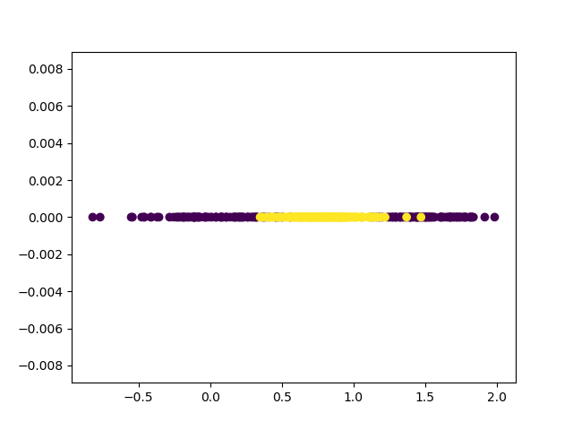
The problem
Starting point:
Train data set (400 objects, 1 feature)
Test data set (100 objects, 1 feature)
Train data labels
Test data labels (will never be considered except in final validation)

Slide 3
Non-parametric methods
Parametric methods make a strong assumption, which is that the shape of the probability densities is known. This assumption cannot be made in many problems.
Idea of non-parametric methods: estimate the probability density function from the samples directly:
K-Nearest Neighbours
Parzen Windows

Slide 4
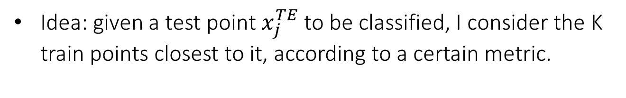

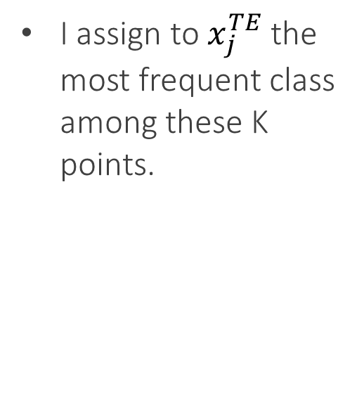
K-Nearest Neighbours
Idea: given a test point $x_{j}^{TE}$to be classified, I consider the K train points closest to it, according to a certain metric.
I assign to $x_{j}^{TE}$the most frequent class among these K points.
$$x_{j}^{TE}$$

Slide 5
K-NN: In practice
Starting point:
Train data set
Train data labels
Test data set
Test data labels (will never be considered until final validation)

Slide 6
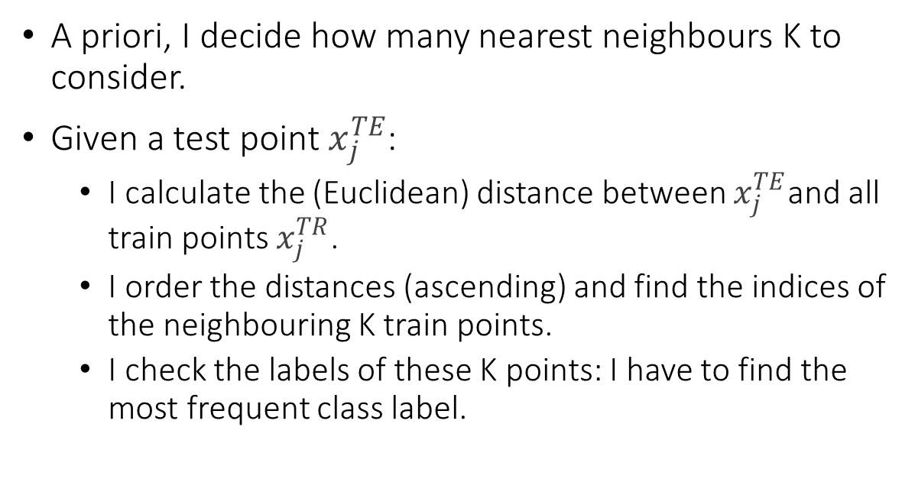
K-NN: In practice
A priori, I decide how many nearest neighbours K to consider.
Given a test point $x_{j}^{TE}$:
I calculate the (Euclidean) distance between $x_{j}^{TE}$and all train points $x_{j}^{TR}$.
I order the distances (ascending) and find the indices of the neighbouring K train points.
I check the labels of these K points: I have to find the most frequent class label.

Slide 7
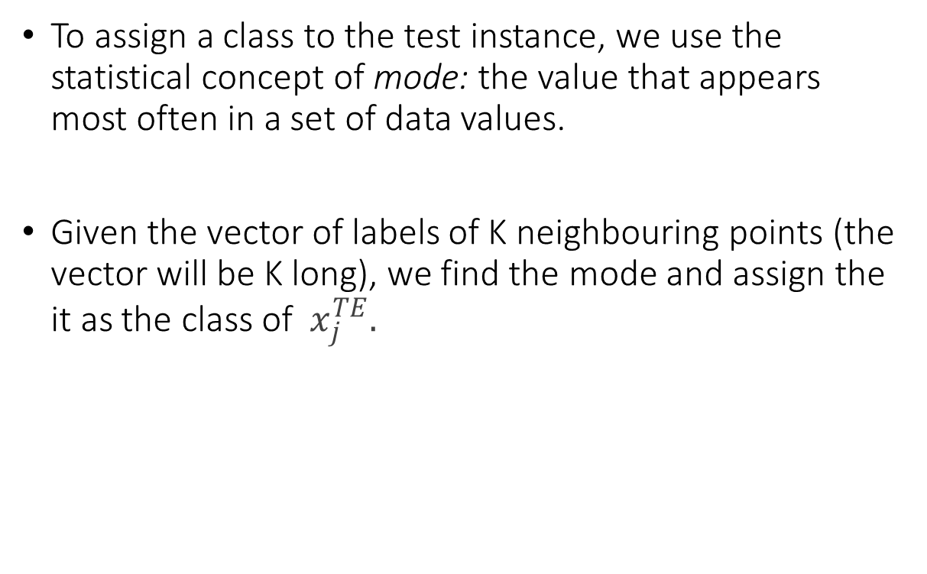
K-NN: In practice
To assign a class to the test instance, we use the statistical concept of mode: the value that appears most often in a set of data values.
Given the vector of labels of K neighbouring points (the vector will be K long), we find the mode and assign the it as the class of $x_{j}^{TE}.$

Slide 8

Exercises

Slide 9
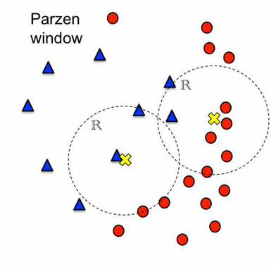
Parzen Windows
Idea: estimate the pdf (underlying probability distribution) by looking at individual regions in space.
If you need to estimate p(x=x0), you look at the region in a window centred on x0 and estimate from that region.
This can be repeated for all the points to be classified.

Slide 10
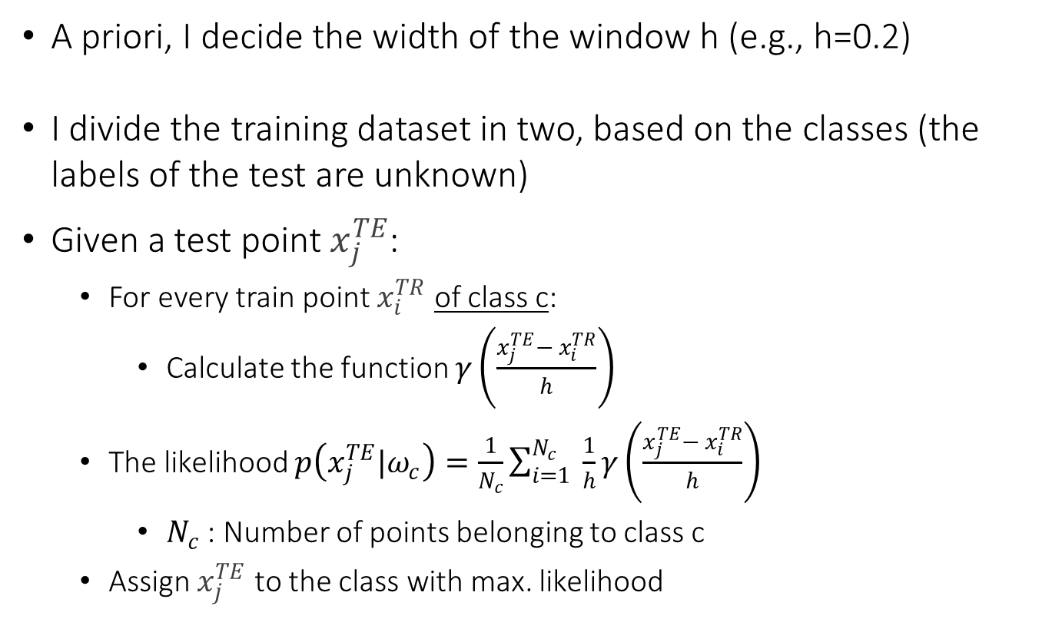
Parzen Windows: In practice
A priori, I decide the width of the window h (e.g., h=0.2)
I divide the training dataset in two, based on the classes (the labels of the test are unknown)
Given a test point $x_{j}^{TE}$:
For every train point $x_{i}^{TR}$ of class c:
Calculate the function $γ\left(\frac{x_{j}^{TE}− x_{i}^{TR}}{h}\right)$
The likelihood $p\left(x_{j}^{TE}|ω_{c}\right)=\frac{1}{N_{c}}\sum_{i=1}^{N_{c}}{ \frac{1}{h}}γ\left(\frac{x_{j}^{TE}− x_{i}^{TR}}{h}\right)$
$N_{c}$ : Number of points belonging to class c
Assign $x_{j}^{TE}$ to the class with max. likelihood

Slide 11
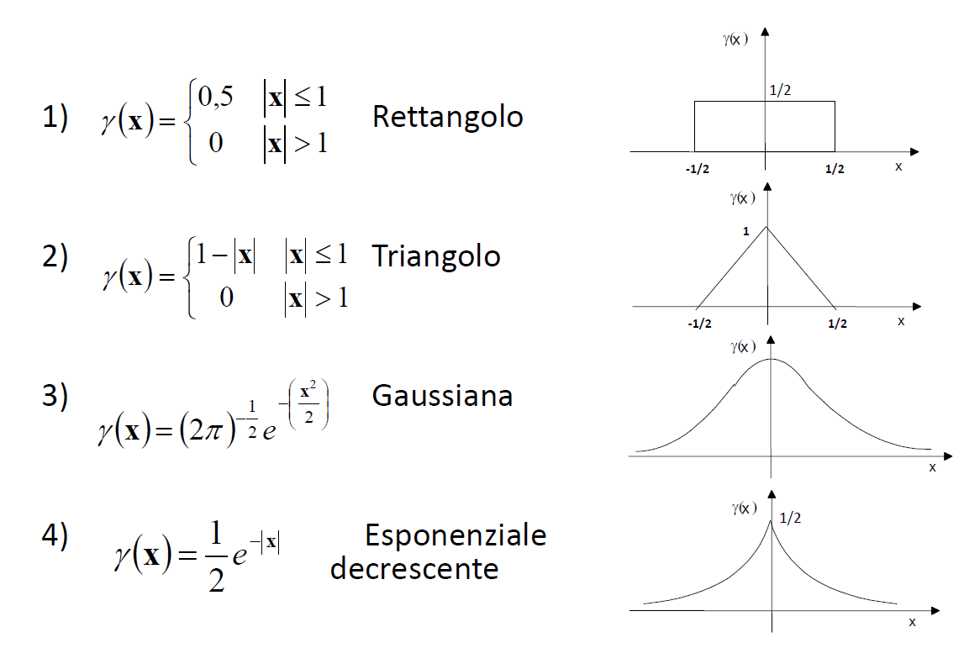

Viable functions for $γ$
Rectangle
Triangle
Gaussian
Exponential (decreasing)

Slide 12
Exercises

